Slide 1
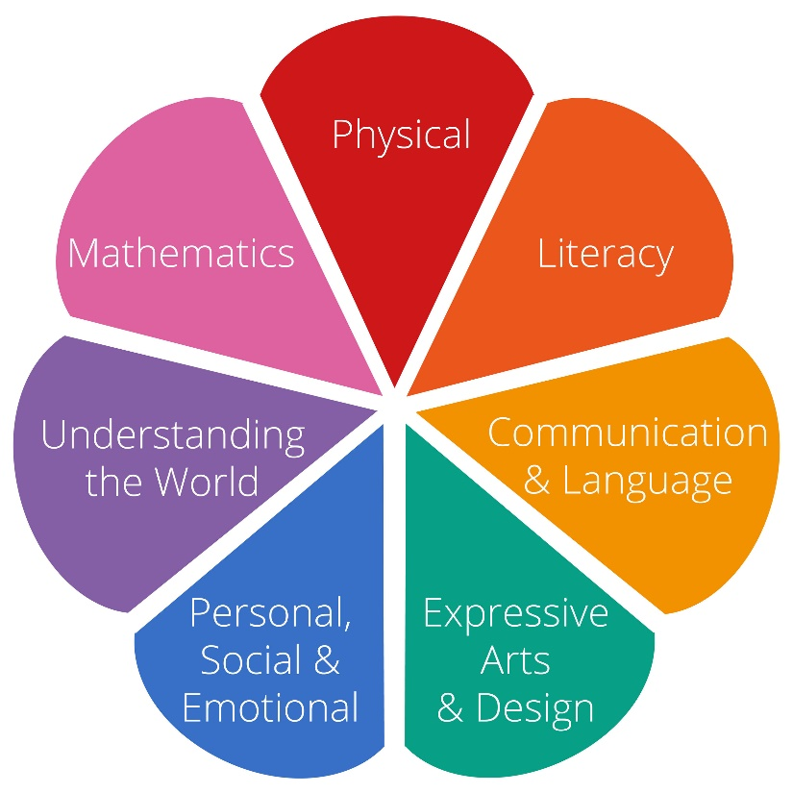
EYFS Curriculum and Reading Meeting
Wednesday 1st October 2025 5.30-6.30pm

Slide 2
Early Years Foundation Stage Curriculum
3 Prime Areas of Learning
1. Communication & Language –
Listening, Attention and Understanding
Speaking
2. Physical Development –
Gross Motor Skills
Fine Motor Skills
3. Personal, Social & Emotional Development Self Regulation
Managing Self
Building Relationships
4 Specific Areas of Learning
1. Literacy –
Comprehension
Word Reading
Writing
2. Mathematics–
Number
Numerical Patterns
3. Understanding the World –
Past and Present
People, Culture and Communities
The Natural World
4. Expressive Arts & Design –
Creating with Materials
Being Imaginative and Expressive
The Specific Areas of Learning cannot be developed alone, and rely on the skills gained in the Prime Areas of Learning
Notes:
The EYFS curriculum is split into Prime and Specific areas. There's 3 prime areas (C&L, PD, PSE) and 4 specific areas (L, M, UTW, EAD) - so 7 areas of learning all together. The prime areas are important because they lay the foundations for children’s progress in all other areas of learning/
A large proportion of the meeting will be on “Word Reading.” However, all the areas are important!

Slide 3
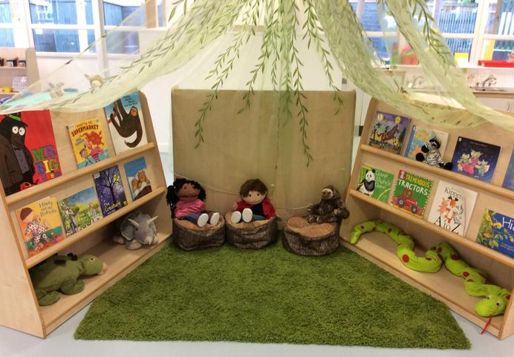
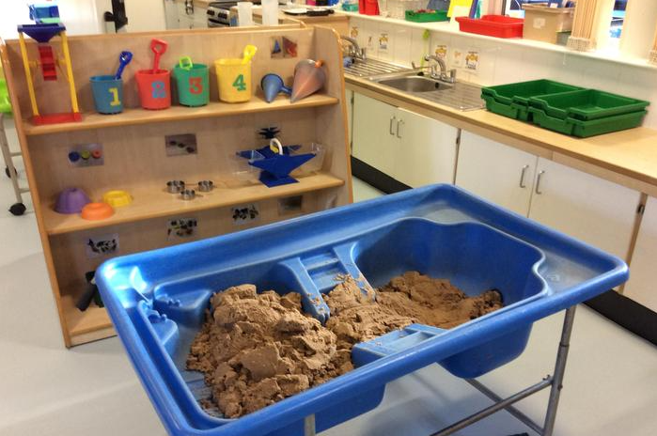
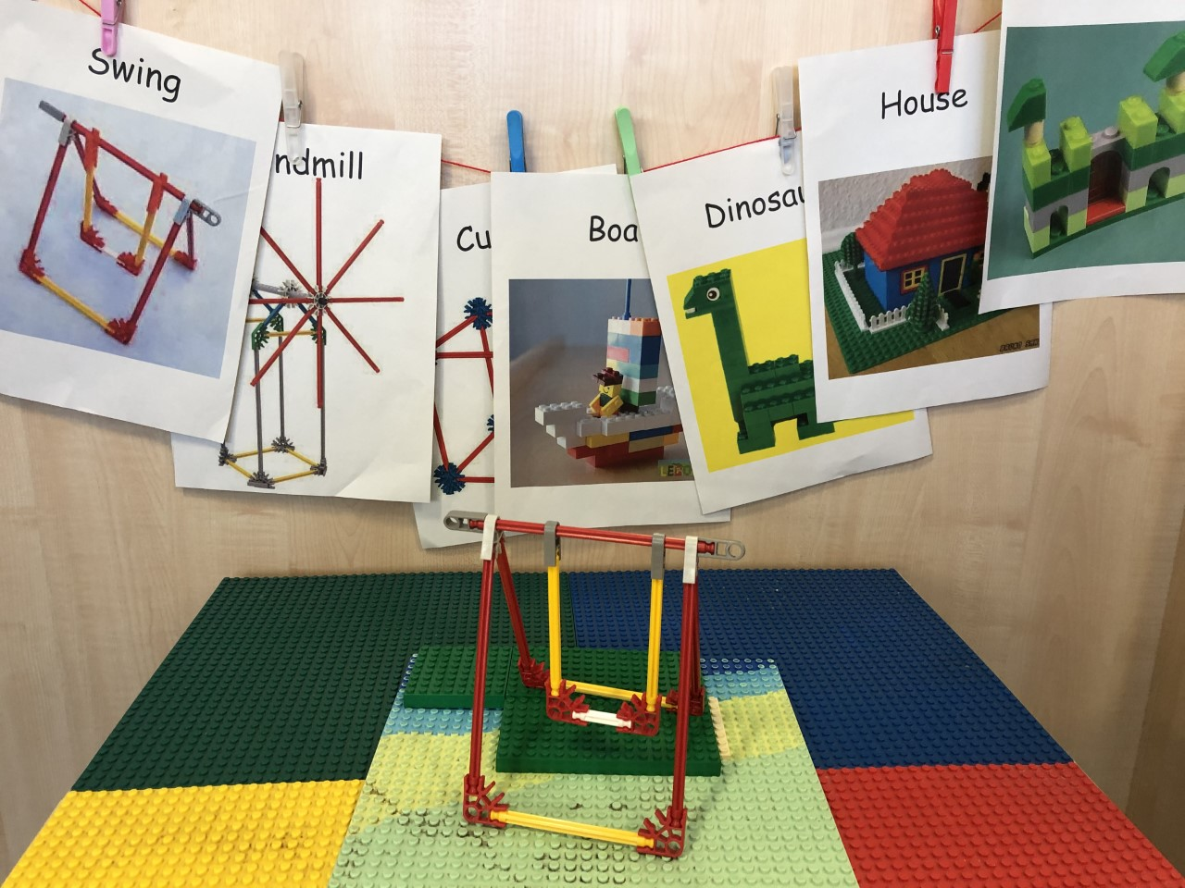
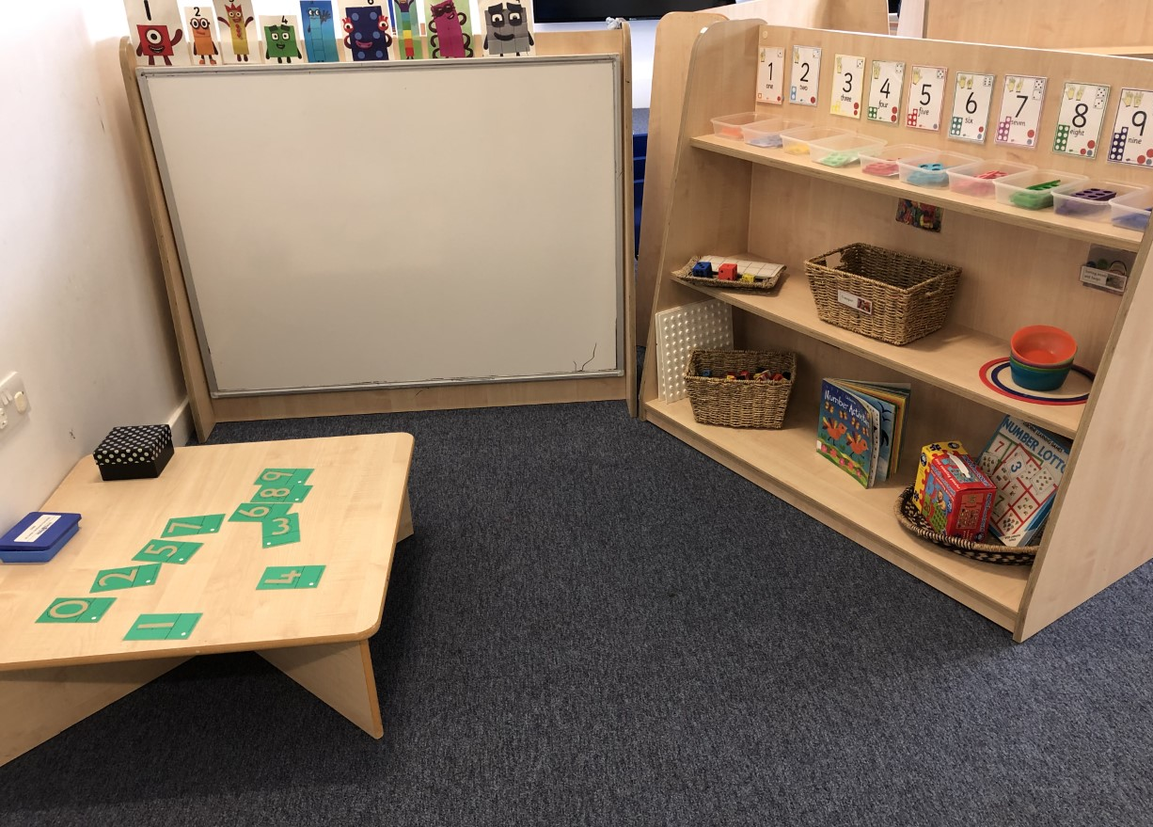
Notes:
In Reception, learning takes place through play and through a mix of whole class teaching, small group work and one-to-one work.
Our indoor and outdoor environment is set up in a way to promote child-led learning through all of the seven areas of learning.
So for example, collaboration and communication skills are needed to lift and work with the large wooden blocks outside thus supporting the areas communication and language, personal, social emotional, as well as physical skills and mathematical skills (how many / which length).

Slide 4
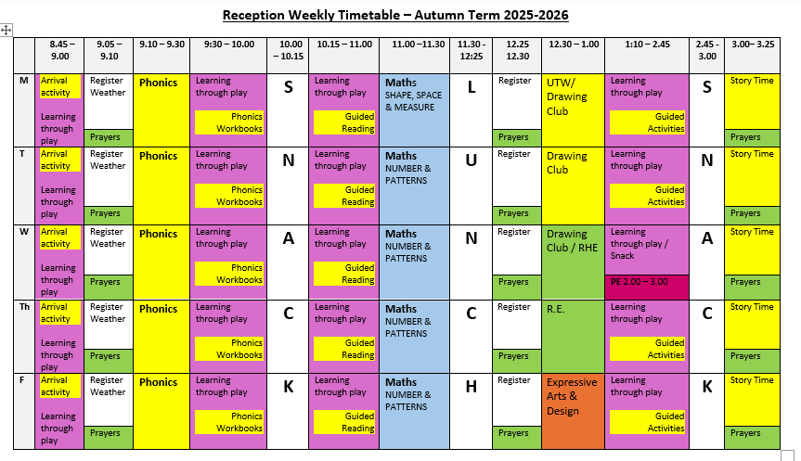
Notes:
This is our timetable (also on our website). We have designed our daily routine so that every moment is used as a learning opportunity from developing social skills at snack time to working on gross-motor skills during outdoor play.

Slide 5
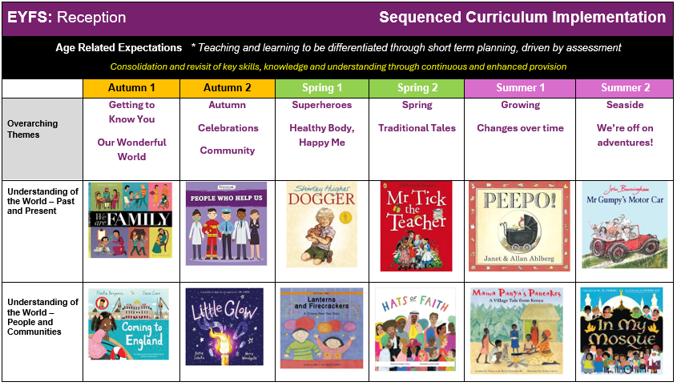
Notes:
We also plan out our curriculum across the year and use the 7 areas of learning and development to guide the knowledge and skills that children will develop over the year.
This is a SNIPPET of a larger curriculum document (again, available on our class page). A key feature of our curriculum is that it is book-led. We use high quality texts as vehicles for learning about new concepts and about the world around us. E.g. one of the strands of learning is ‘past and present’ and we use books as a key method to explore the past. We start with our familiar history with our families, we expand outwards and learn about key roles in the community and then we explore what life was like in the past, toys / school / homelife and vehicles.

Slide 6

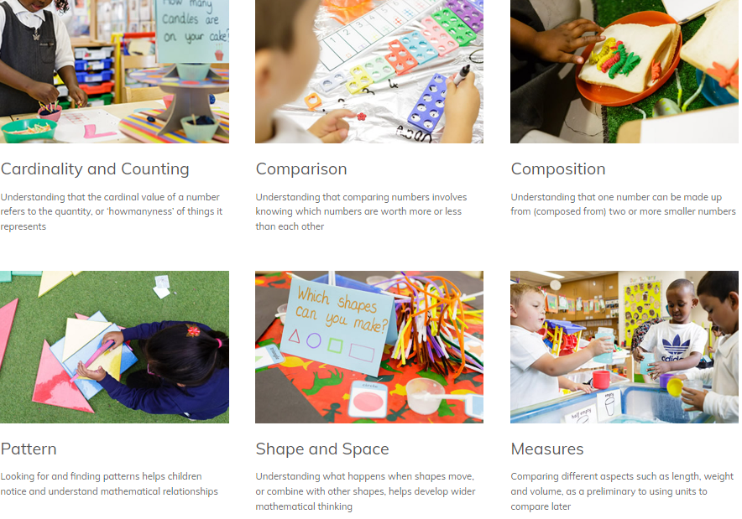
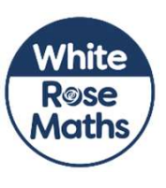
Notes:
How we teach maths
NCETM for number (4 lessons a week)
White Rose for shape, space, measure (one lesson a week)
=> Activities within the learning environment

Slide 7
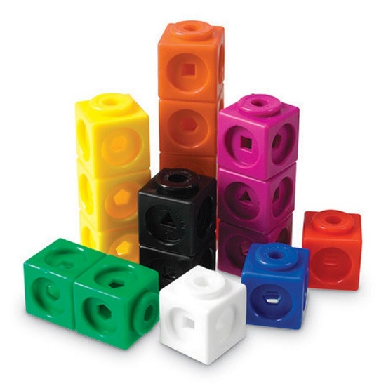
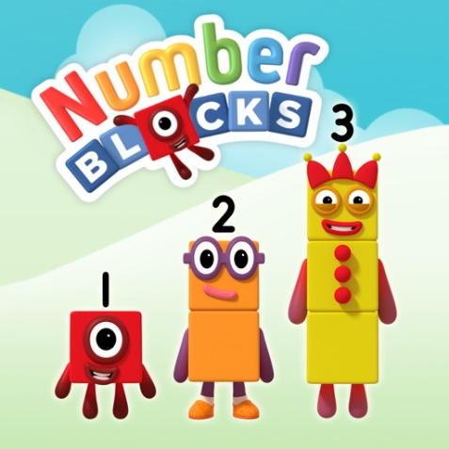
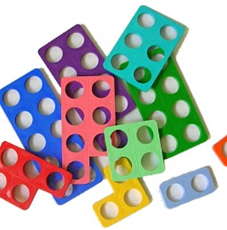

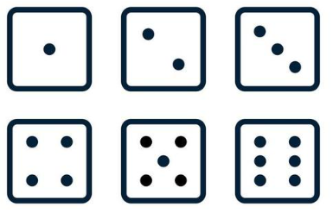
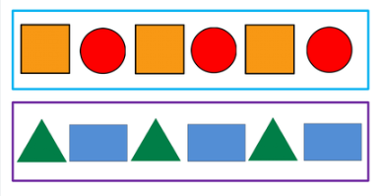

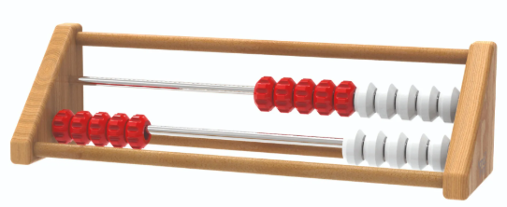
Notes:
Key resources we use to support learning and understanding
Multilink
Numberblocks (cbeebies)
Numicon
5 frames and 10s frames
Dice games
Rekenreks
Resources for pattern making / comparison / sorting
Key words and definitions
Subitising (don’t count, say the amount)
Number bonds to 5 and 10
Systematic counting using 1 to 1 correspondence

Slide 8
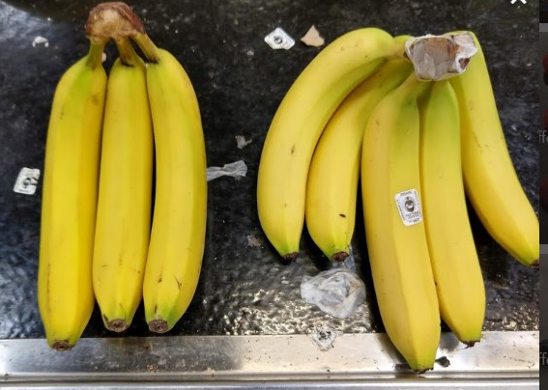
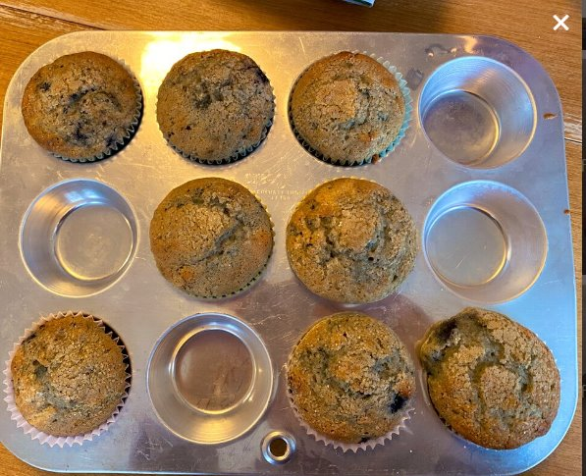
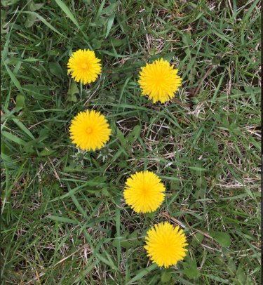
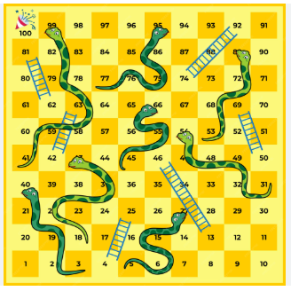
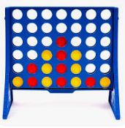


Maths is all around us!
Notes:
Dice games
When baking / playing in the garden / playing with toys you have at home – spot patterns, describe arrangements (e.g. 3 bananas and 5 bananas – that’s 8 altogether), use all opportunities for counting

Slide 9




Getting all children to
read well, quickly.
Notes:
Our phonics scheme is called Essential Letters and Sounds. It’s been fully approved by the Department for Education, and it has been designed to support children in making quick progress to become fluent and confident readers.

Slide 10



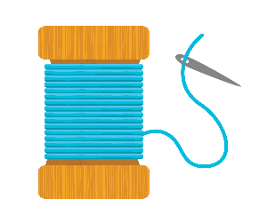
What is Phonics?
Phonics is a way of teaching children to read quickly and skilfully.
Children are taught how to recognise the sounds that each individual letter makes.
Children will learn the 44 sounds of the English language
A key focus is on the application of this phonic knowledge to ‘de-code’ new words that the children see or hear.
© Oxford University Press 2021
Notes:
Phonics gives children the knowledge and skills to read well, quickly. Phonics teaches the link between the spoken sounds of our language (44) and the written version of that sound. In effect, they learn the code of our language.
Our daily phonics lessons breaks this down into tiny steps which enables them to become decoders to read and encoders to spell. Phonics will enable the children, once they have learnt the code, to apply this to any word to be able to read it.

Slide 11
Terminology used in Phonics
Phoneme: a single sound
For example, in the word ‘rock' there are three phonemes r/o/ck.
Grapheme: the written representation of a sound.
For example, in the word ‘rock’ there are three graphemes r , o, ck
Digraph: two letters making one sound.
For example, /sh/ in the word 'shop'.
Trigraph: three letters making one sound.
For example, /igh/ in the word 'night'.
© Oxford University Press 2021
Notes:
We use phonemes and graphemes to teach children the code of our language.
Use flashcards to put this into context (c, k, ck). Same sound, different spelling

Slide 12
How do we teach phonics?
We use a simple, consistent approach to teaching phonics.
We have flashcards and rhymes to support learning and recall
We teach phonics every single day as a class, and we all go at the same pace.
Reinforced and supported in smaller groups as needed
Regular review and revise sessions
© Oxford University Press 2021
Notes:
We use a simple, consistent approach to teaching phonics. For example, we use the same flashcards, friezes and workbooks each day.
We teach phonics every day and we all go at the same pace.
We use the same routine in each lesson which reduces cognitive load.
All children are supported to apply their new phonic knowledge.

Slide 13
Pronouncing pure sounds
We must use pure sounds when we are pronouncing the sounds and supporting children in reading words.
c a t not cuh a tuh
If we mispronounce these sounds we will make reading harder for our children.
Youtube Video: Phonics: How to pronounce pure sounds | Oxford Owl where you can hear the correct pronunciation of the sounds https://www.youtube.com/watch?v=UCI2
mu7URBc
© Oxford University Press 2021
Notes:
If we use the ‘uh’ sound after the pure sound we are teaching the schwa.
For example instead of /c/ /a/ /t/ we teach /cuh/ /a/ /tuh/ - cuhatuh – not a word! IT makes blending harder if you teach or use a schwa after the initial sound.
Model orally blending words. Say: Me, then you. I am going to sound-talk some words. Can you repeat the sounds, blend them together and say the word? Robot arms and blending hands.
Ch-i-n
B-o-x
Sh-ee-p

Slide 14
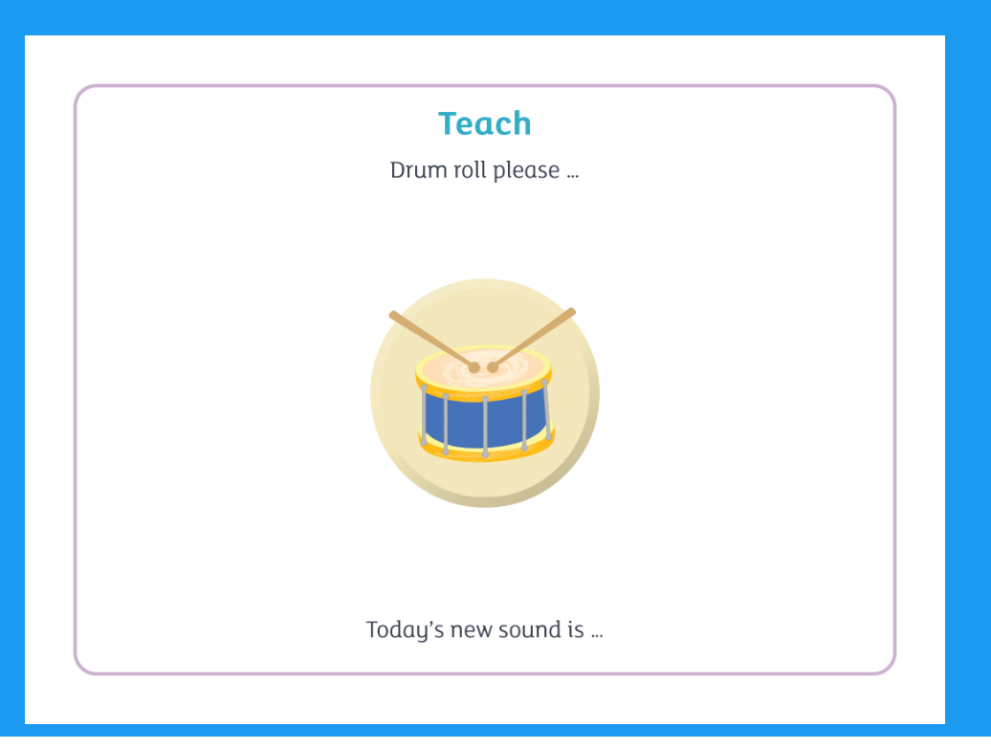
Notes:
We learn 4 new sounds a week.

Slide 15
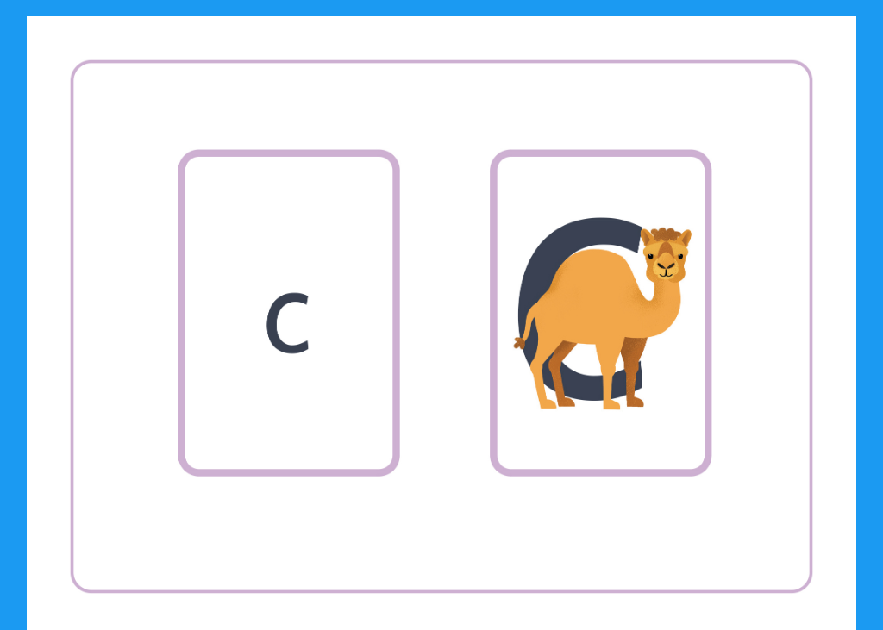
Notes:
This is where we introduce the grapheme to match the phoneme. This is the grapheme. Using ‘Me, then you’, repeat the sound multiple times. Show the picture – for example, ‘c for camel’. Use ‘Me, then you’ and repeat three times: c camel, camel c, c camel.

Slide 16
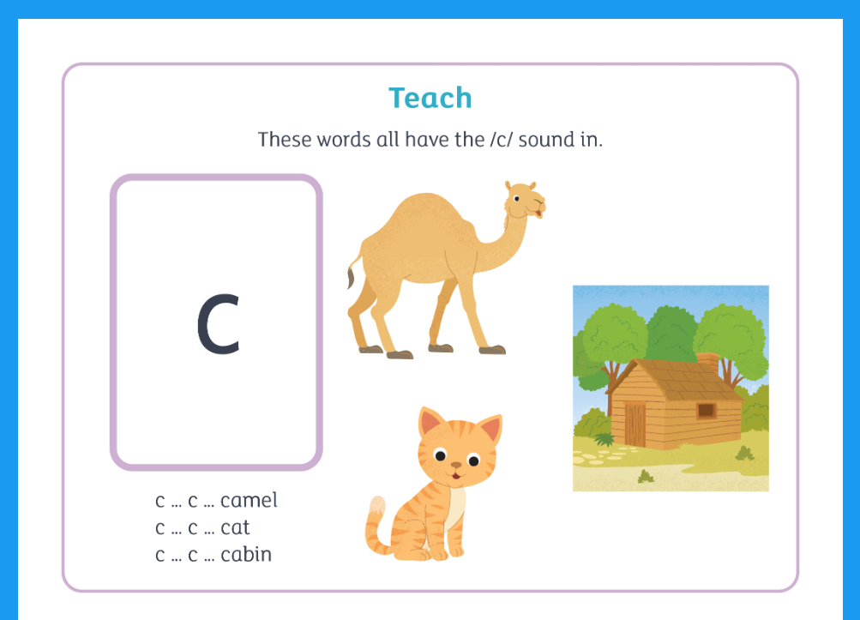

Slide 17
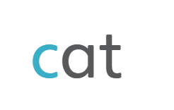
Notes:
Now we know the letters (grapheme recognition) and the sound they make, and have developed our auditory skills to help us to orally blend words, we can now apply these skills to read words on the page. Using ‘Me, then you’, model the word:
sound out, blend and say the whole word; use the new word in context within a sentence

Slide 18
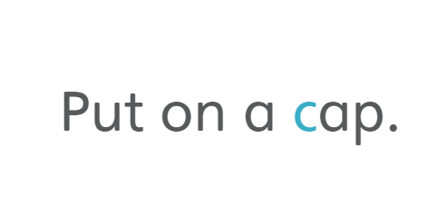
Notes:
1 – decode
2 – more fluently
3 – with expression ‘make it sound like talking’

Slide 19
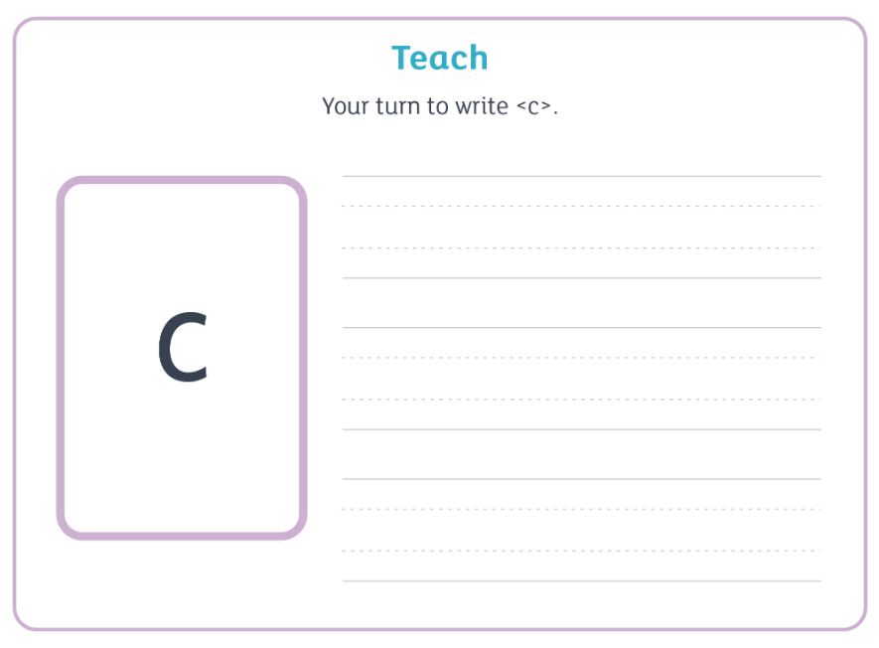
Notes:
Letter formation - anti clockwise movement (the basis for many letters incl. d, g, s, o)

Slide 20
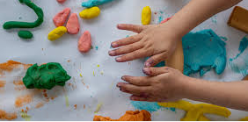
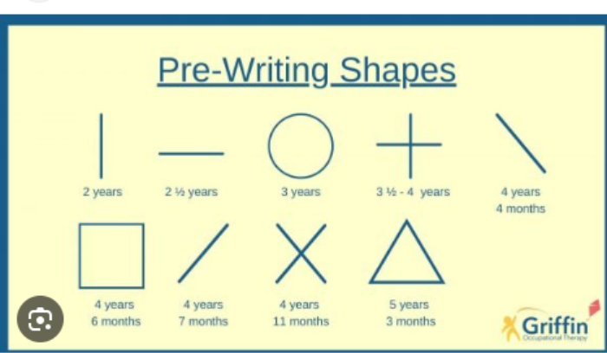
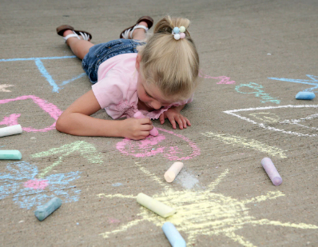
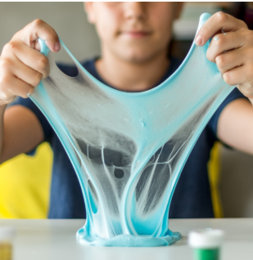
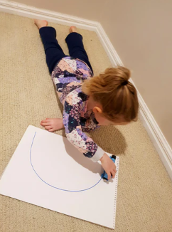

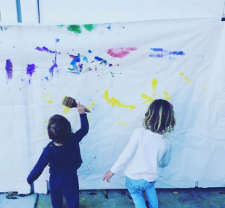
Supporting writing at school and home
Notes:
Developing gross motor skills in preparation for the writing journey
Children learn to control their bodies from the centre outwards and from the top downwards.
Arm and finger control follows this pattern: at first a child will be able to manipulate the arm from the shoulder joint; gradually they understand how to control the hands; finally they learn how to make the fine finger movements needed to write.
To develop gross motor skills, it is important to provide a rich diet of physical activities, including: crawling, digging, climbing, playing in the prone position, Also include activities that encourage crossing the midline to develop coordination, allowing the two sides of the brain and body to work together effectively.
As well as building up their gross motor skills, children need to develop the fine motor control required to hold and manipulate a writing tool.
Some of the key actions required are: grip strength; pinch strength; and hand-eye coordination.
Many of the games and activities your children do at home and school will help them develop these movements, such as wringing out wet sponges, developing pincer grip through activities such as Lego and mark making on vertical surfaces is great for developing wrist strength. Squashing and squishing activities such as playdough, gloop, pastry etc.
The physical skill of writing can take time to develop, and so don’t feel the need to rush it and instead continue to provide different opportunities to develop physical skills.

Slide 21
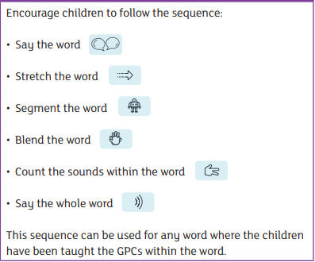
Supporting writing at school and home
The Spelling Sequence
Let’s try this with the word: 'map'
We also practise saying our sentences before we write them to make sure we write the sentence we have planned and to ensure it makes sense!
© Oxford University Press 2021
Notes:
Use the spelling sequence to model 'map'
Writing involves lots of processes - letter formations, speaking skills, segmenting – using a spelling sequence to support writing at home
Say the word – warm it up – stretch the word – robot talk the word – blend the word – count the sounds within the word – say the word >>> MODEL WRITING THE WORD. This is with a word that can be sounded out correctly. What about when your child wants to start writing any words they wish to write?
Also, we love to see PHONETICALLY PLAUSIBLE ATTEMPTS at words. So, for example, a shopping list that your child might make when playing in the home corner might look like this by the end of Phase 3: orinj, apl, pair, bnarna, bred, milk, soop. This is wonderful – because it is your child independently applying the code they have learnt. (Don’t worry – in Phase 5 they will learn alternative spellings for these sounds, and also the more they read, the more they will remember spellings) In Year 1 and beyond they will learn spelling patterns for all words.

Slide 22

ELS Progression
© Oxford University Press 2021
Notes:
Phase 1 – The emphasis is on developing listening skills, encouraging children to tune in to sounds.
Phase 2 – Introduces 19 letter-sound correspondences
Phase 3 – Introduces ‘digraphs’ and ‘trigraphs.’

Slide 23

ELS Progression
© Oxford University Press 2021
Notes:
Phase 4 – Introduces words containing adjacent consonants and polysyllabic words (e.g. CCVC and CVCC words)
We touch on Phase 5 at the end of Reception in preparation for Year 1. This is where we learn alternative spellings for sounds. E.g. in Phase 3, we learn that the /ai/ sound is made by ai digraph, in Phase 5 we learn it can also be made by the ay digraph.

Slide 24
Reading at School
Your child will read a phonetically decodable book with their teacher each week as part of a 'guided reading' group. Your child will only read from books containing the sounds they have been taught.
The teacher will note the book title, date, add a comment and sign your child's Reading Log.​ Please keep your child's book and log in their bag and bring it to school every day!
Children will also read e-books as part of their Review sessions in phonics. E-books will also be set as homework. You will have access to all the books relating to the sounds learned so far..
Storytime is a priority and takes place every day.
© Oxford University Press 2021

Slide 25
Reading at home
We will send home a copy of the flashcards of the sounds we have learnt that week as homework. Use the strategies we have shown you to review the sounds. (Keep the flashcards at home to review regularly). We will send home HRSWs and activity sheets during “review” weeks.
Also, please remember that sharing in stories together is very important. Even when your child can read to you, please keep reading stories to your child.
© Oxford University Press 2021
Notes:
A note about the importance of continuing with story time. Even though we are focusing on your child learning to read, it is so important that you continue to read to your child. We want the children to be exposed to vocabulary and concepts higher than their reading level. Also, we want to children to enjoy stories and encourage reading for pleasure.
To support this, alongside their phonics book, children will also be able to select a reading for pleasure book from our classroom library. That is there for families to read to their children and simply enjoy the story together.

Slide 26
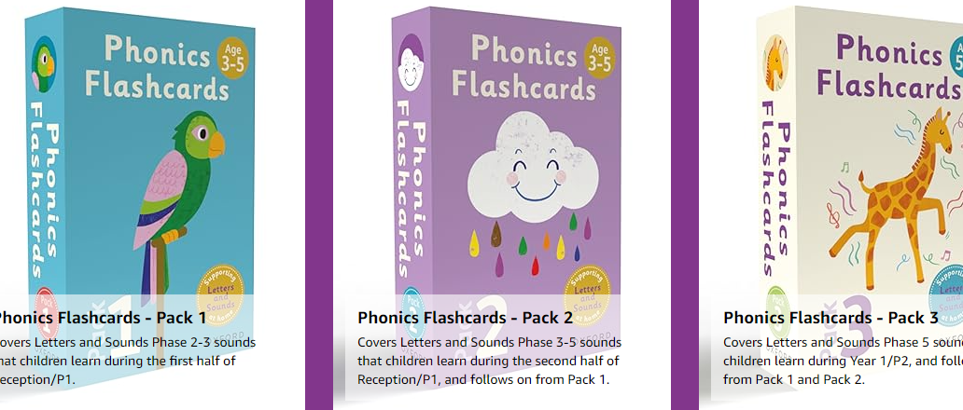
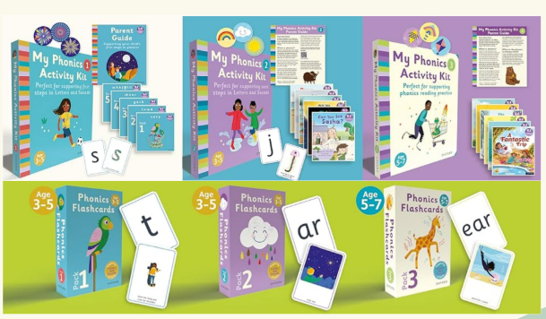
ELS Parent resources are available to buy (flashcards, activity booklets and blending books) if you wish. Available from WH Smiths, Waterstones and Amazon.
Notes:
New parent resources are available to buy – if you do wish to purchase them, make sure they are the ELS ones. However, we will send home the exact same flashcards and the reading books are the same ones that we will send home from school – so, please, absolutely no pressure to buy!!

Slide 27
Supporting reading at home
I've got a book!
​
Start with a walk through:​
Look at the front cover and the title - what might the book be about?​
Prepare using the inside cover:​
Look at the inside cover and practise the sounds and words given (explain that these are the sounds that will be in the book)
There may be some 'Harder to Read and Spell Words' contained within the book.
© Oxford University Press 2021

Slide 28
Supporting reading at home
We want your child to practise reading their book daily across the week working on these skills:
Decode: Read the book the first time to decode each word using your phonic knowledge and blending skills (this may take a number of days and is something to work towards).​
Fluency: Read the book a second time to decode more confidently and to practice reading more fluently. ​
Expression: Read the book a third time to include expression, intonation and to enjoy the story.
​
© Oxford University Press 2021
Notes:
For some children this will be a few pages a day. For others it may be the whole book. Or it may vary from day to day.
Reading daily with your child will hugely support them on their journey to becoming an independent reader.
For children, re-reading words and sentences that they can decode (sound out) until they are fluent (read with ease and precision) is a key part of learning to read. By reading texts several times, children have the greatest opportunity to achieve this fluency.

Slide 29
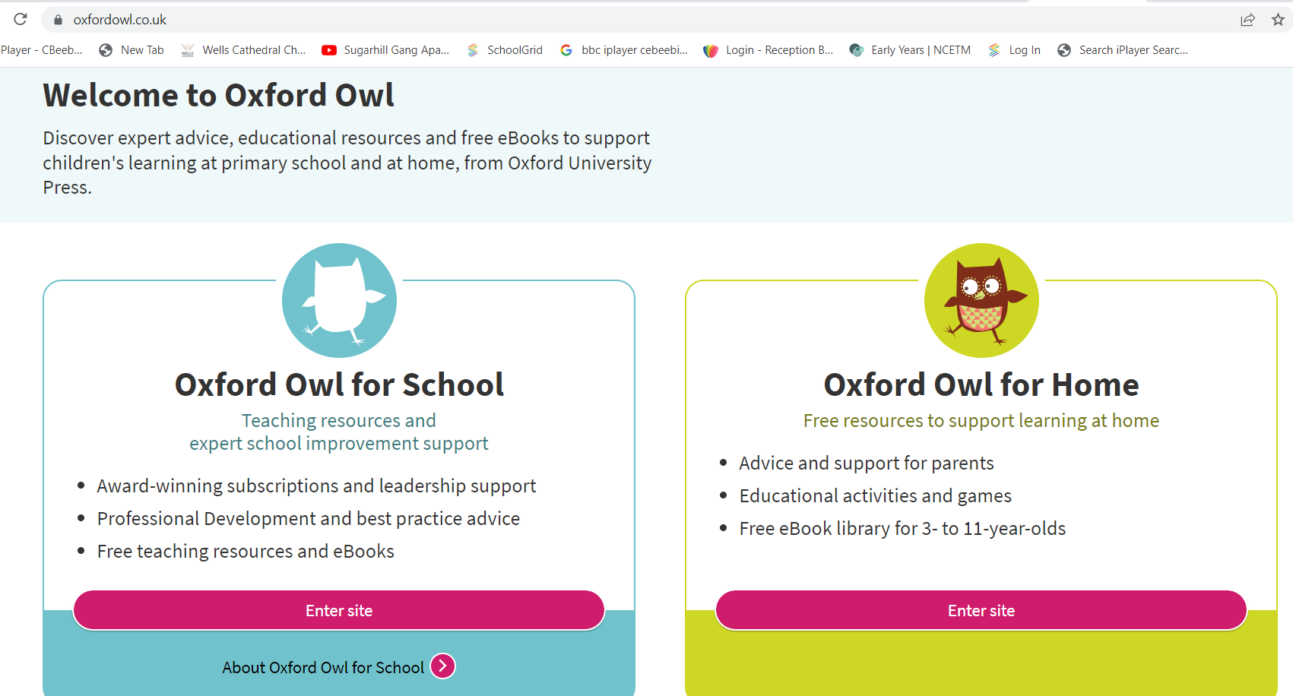
Essential Letters and Sounds eBook Library
Notes:
We are providing access to a greater range of phonetically decodable books matched to your child’s phonics learning. The Little Blending books are a great place to start.
Reading log to show with instructions and demo online live.
Homework sheet to hold up and show how it says not to go beyond the e-book set that week.

Slide 30
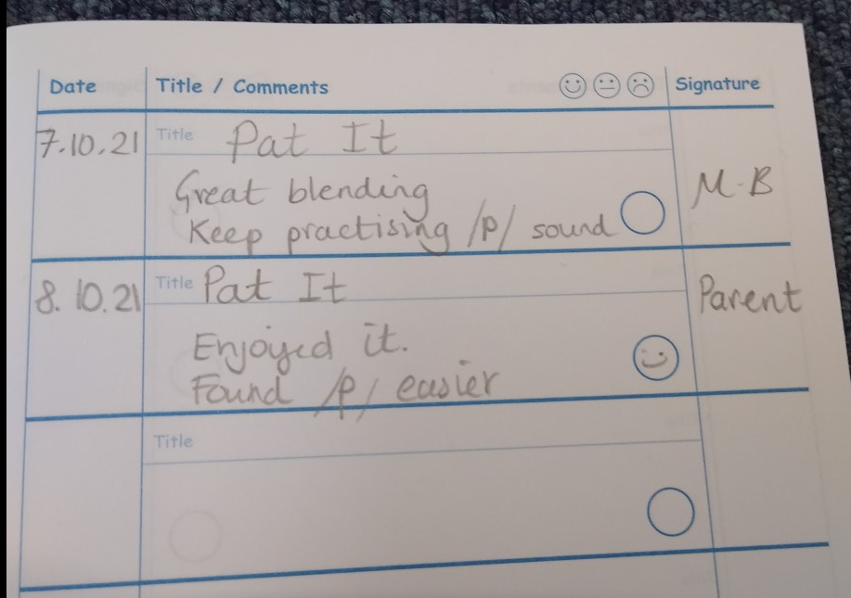
Teamwork
We can make the best of the learning opportunities in Reception when we work together on the same goals for your child.
This means working each week together on a specially selected reading book and the Phonics homework related to our learning in school that week.
It also means communicating with each other about your child’s reading journey in their Guided Reading Log. Please write in your child’s reading log each time they read at home.
Notes:
We would be delighted for your child to even just read one sentence / one page each night if this is the level they are at. We need to know how they're getting on – please write in their reading log.

Slide 31
Thank you for joining us!
We look forward to working with you to give your child the best start we can in their learning journey. If you have any questions, please talk to us.

