Slide 1


Slide 2
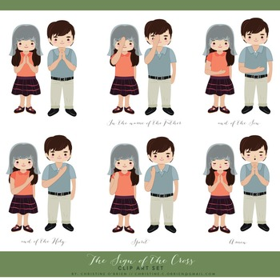

We start with the Sign of the Cross:
In the name of the Father and of the Son
and of the Holy Spirit.

Slide 3
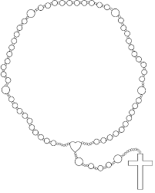
medal

Slide 4
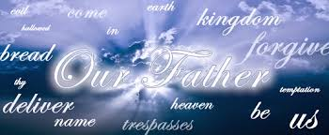
Leaders:
Our Father, who art in heaven,
hallowed be Thy name. Thy kingdom come.
Thy will be done on earth as it is in heaven.
ALL:
Give us this day our daily bread;
and forgive us our trespasses
as we forgive those who trespass against us. And lead us not into temptation,
but deliver us from evil.
Amen.

Slide 5
1st bead

Slide 6
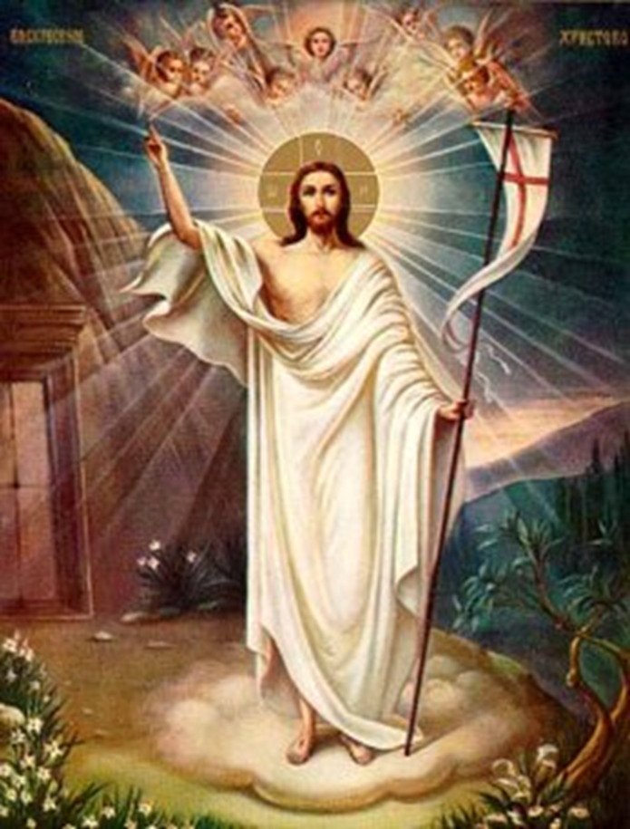
1st Mystery
Jesus is risen from the dead
The Glorious Mysteries
Luke 24:6
Leaders:
Hail Mary, full of grace.
the Lord is with thee.
Blessed art thou among women,
and blessed is the fruit of thy womb,
Jesus.
ALL:
Holy Mary, Mother of God,
pray for us sinners,
now and at the hour of our death.
Amen.

Slide 7
2nd bead

Slide 8
1st Mystery
Jesus is risen from the dead
The Glorious Mysteries
Luke 24:6
Leaders:
Hail Mary, full of grace.
the Lord is with thee.
Blessed art thou among women,
and blessed is the fruit of thy womb,
Jesus.
ALL:
Holy Mary, Mother of God,
pray for us sinners,
now and at the hour of our death.
Amen.

Slide 9

3rd bead

Slide 10
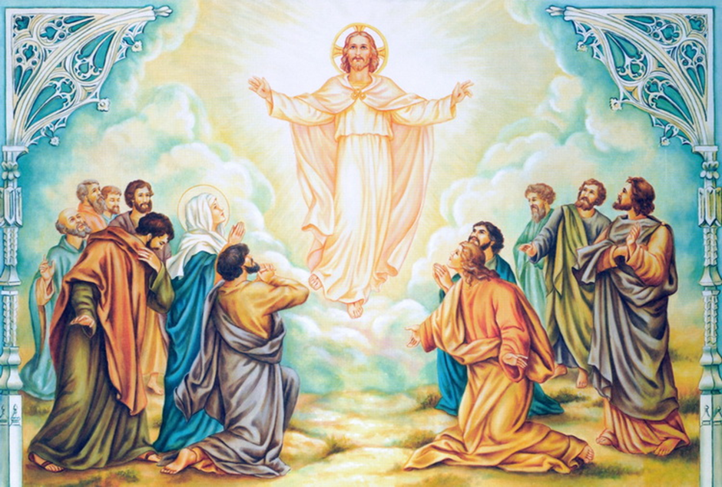
2nd Mystery
The Ascension of Jesus to Heaven
Mark 16:19
The Glorious Mysteries
Leaders:
Hail Mary, full of grace.
the Lord is with thee.
Blessed art thou among women,
and blessed is the fruit of thy womb,
Jesus.
ALL:
Holy Mary, Mother of God,
pray for us sinners,
now and at the hour of our death.
Amen.

Slide 11
4th bead

Slide 12
2nd Mystery
The Ascension of Jesus to Heaven
Mark 16:19
The Glorious Mysteries
Leaders:
Hail Mary, full of grace.
the Lord is with thee.
Blessed art thou among women,
and blessed is the fruit of thy womb,
Jesus.
ALL:
Holy Mary, Mother of God,
pray for us sinners,
now and at the hour of our death.
Amen.

Slide 13
5th bead

Slide 14
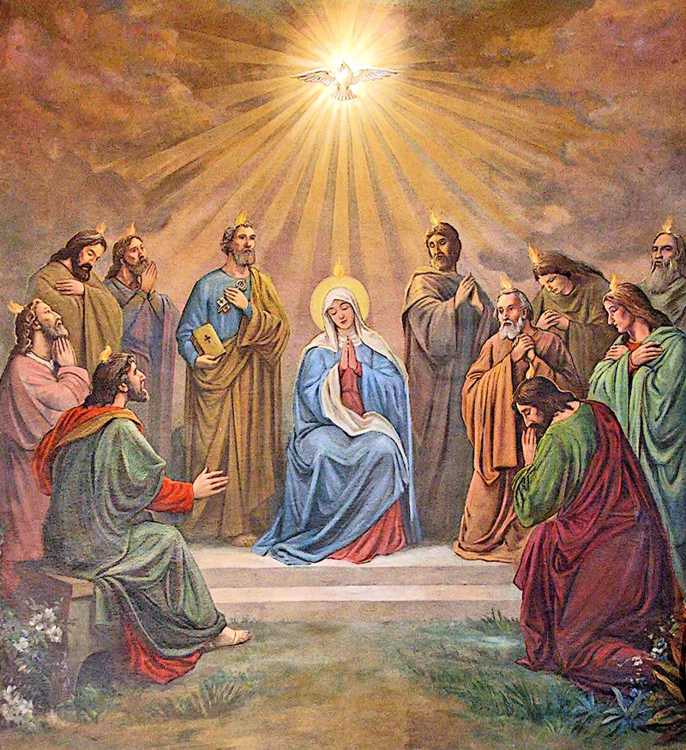
3rd Mystery
The Coming of the Holy Spirit
Acts 2:4, 11
The Glorious Mysteries
Leaders:
Hail Mary, full of grace.
the Lord is with thee.
Blessed art thou among women,
and blessed is the fruit of thy womb,
Jesus.
ALL:
Holy Mary, Mother of God,
pray for us sinners,
now and at the hour of our death.
Amen.

Slide 15
6th bead

Slide 16
3rd Mystery
The Coming of the Holy Spirit
Acts 2:4, 11
The Glorious Mysteries
Leaders:
Hail Mary, full of grace.
the Lord is with thee.
Blessed art thou among women,
and blessed is the fruit of thy womb,
Jesus.
ALL:
Holy Mary, Mother of God,
pray for us sinners,
now and at the hour of our death.
Amen.

Slide 17
7th bead

Slide 18
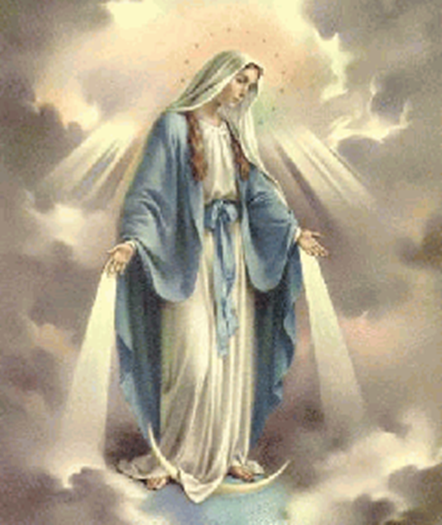
4th Mystery
Assumption of Our Lady
Dogma declared by XXII. Pius (01.11. 1950.)
The Glorious Mysteries
Leaders:
Hail Mary, full of grace.
the Lord is with thee.
Blessed art thou among women,
and blessed is the fruit of thy womb,
Jesus.
ALL:
Holy Mary, Mother of God,
pray for us sinners,
now and at the hour of our death.
Amen.

Slide 19
8th bead

Slide 20
4th Mystery
Assumption of Our Lady
Dogma declared by XXII. Pius (01.11. 1950.
The Glorious Mysteries
Leaders:
Hail Mary, full of grace.
the Lord is with thee.
Blessed art thou among women,
and blessed is the fruit of thy womb,
Jesus.
ALL:
Holy Mary, Mother of God,
pray for us sinners,
now and at the hour of our death.
Amen.

Slide 21
9th bead

Slide 22
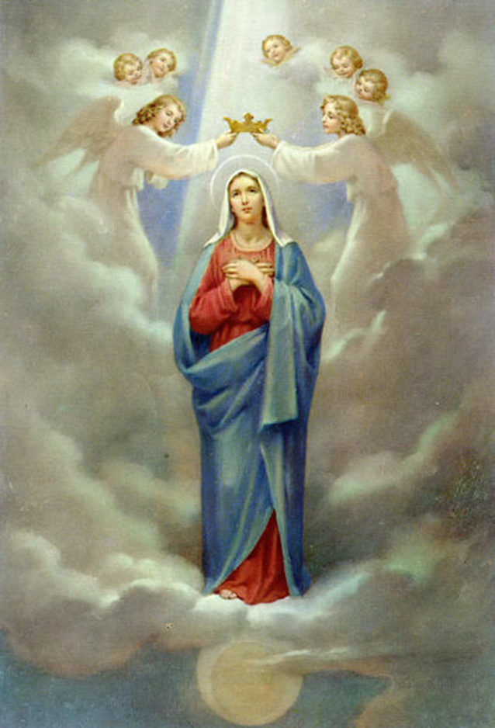
The Coronation of Our Lady in Heaven
(CCC 966)
The Glorious Mysteries
Leaders:
Hail Mary, full of grace.
the Lord is with thee.
Blessed art thou among women,
and blessed is the fruit of thy womb,
Jesus.
ALL:
Holy Mary, Mother of God,
pray for us sinners,
now and at the hour of our death.
Amen.

Slide 23
10th bead

Slide 24
The Coronation of Our Lady in Heaven
(CCC 966)
The Glorious Mysteries
Leaders:
Hail Mary, full of grace.
the Lord is with thee.
Blessed art thou among women,
and blessed is the fruit of thy womb,
Jesus.
ALL:
Holy Mary, Mother of God,
pray for us sinners,
now and at the hour of our death.
Amen.

Slide 25
gap

Slide 26
The Glory Be
Leaders: Glory be to the Father, and to the Son, and to the Holy Spirit.
ALL:
As it was in the beginning, is now and ever shall be, world without end. Amen.
The Fatima Prayer
ALL:
O my Jesus, forgive us our sins, lead all souls to Heaven, especially those who most need thy mercy.

Slide 27
Children’s Offering to Our Lady
ALL:
Mary, my Mother, today I come to you with joy, to give you my whole heart. To you I bring every single person, that I hold in love in my heart: my parents, my brothers and my sisters, all my friends, but also those who have hurt me. Be a Mother to us all, bless and protect us. With you and through you I want to belong completely to Jesus.
Amen.

Slide 28
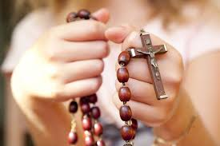
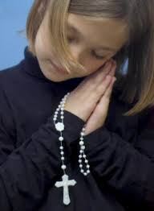
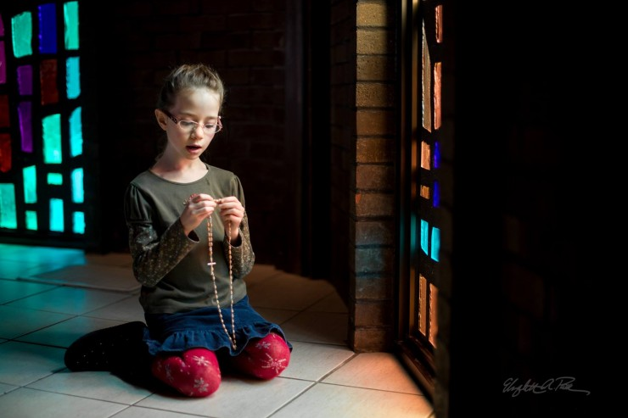
Easy guide
to praying one part
(one decade)
of the
Rosary

Slide 29
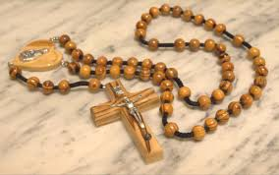
WHAT IS THE ROSARY?
The Rosary is a Catholic prayer based upon the Bible. It focuses on the most important events in the life of Jesus and Mary, the Mother of Jesus. In the Rosary, we call these events: the MYSTERIES.
In the Rosary prayer, we make use of both vocal and mental prayer. Vocal prayer consists of the most well-known prayers, like the Lord’s prayer (Our Father), the Hail Mary and the ‘Glory be’.
Mental prayer is meditating upon the MYSTERIES.

Slide 30
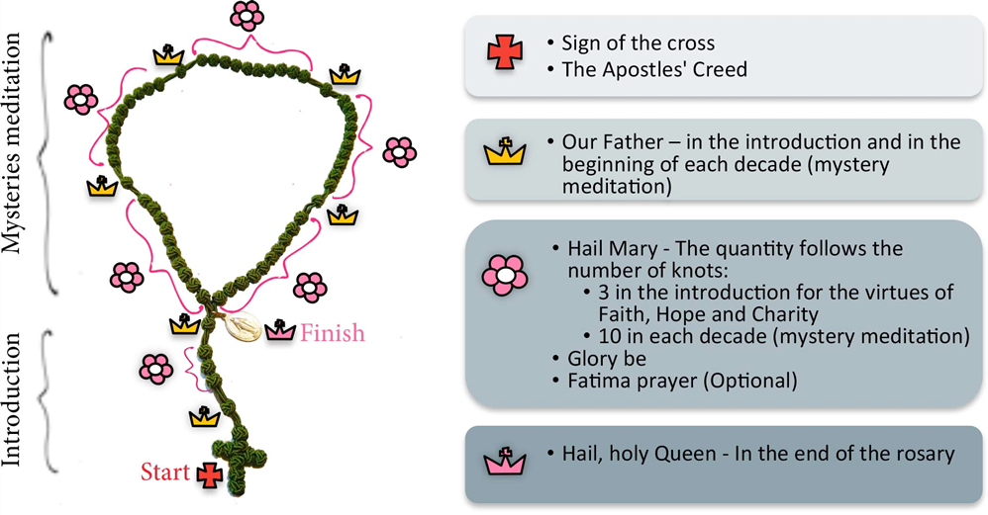

Slide 31
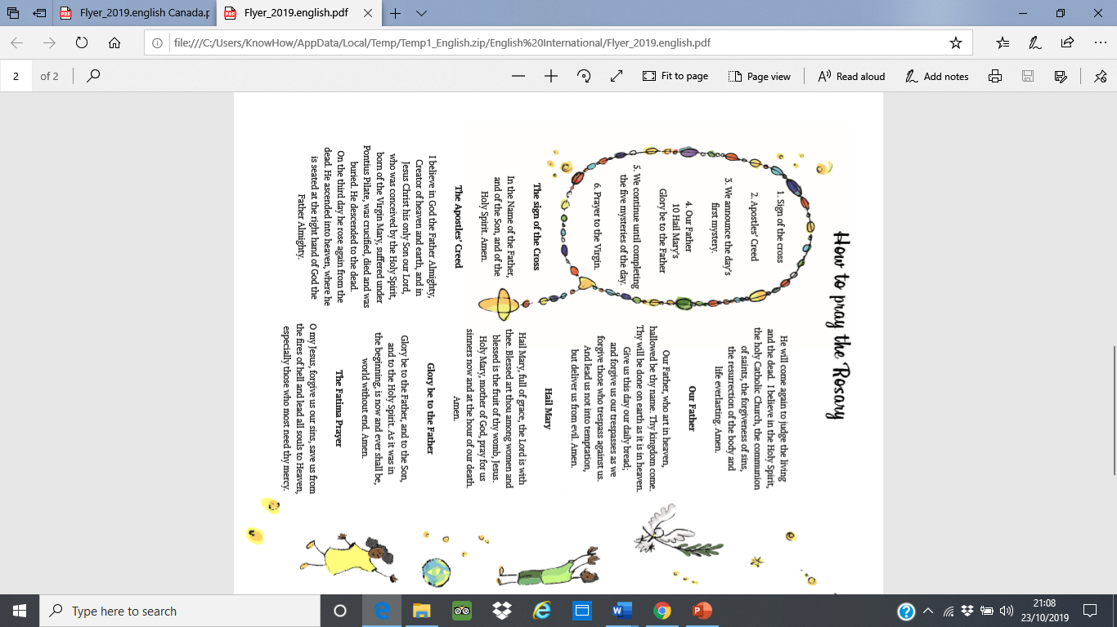
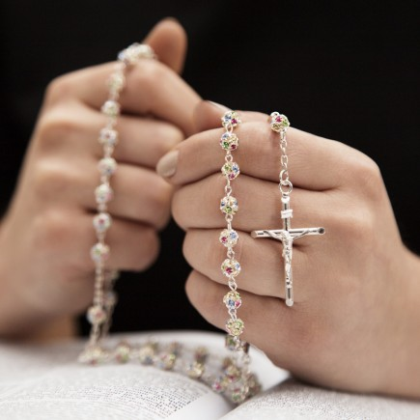

Slide 32


