Slide 1
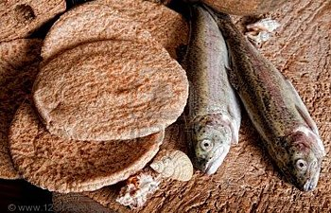
Wednesday of the First Week of Advent
Jesus summoned his disciples and said, “My heart is moved with pity for the crowd, for they have been with me now for three days and have nothing to eat. I do not want to send them away hungry, for fear they may collapse on the way.” Matthew 15:32
Lord, thank You for Your unfailing and perfect concern for every detail of my life.
Thank You for Your perfect attentiveness to my needs.
May I always trust in Your perfect care for me and surrender to Your loving providence.
Jesus, I trust in You.

