Slide 1
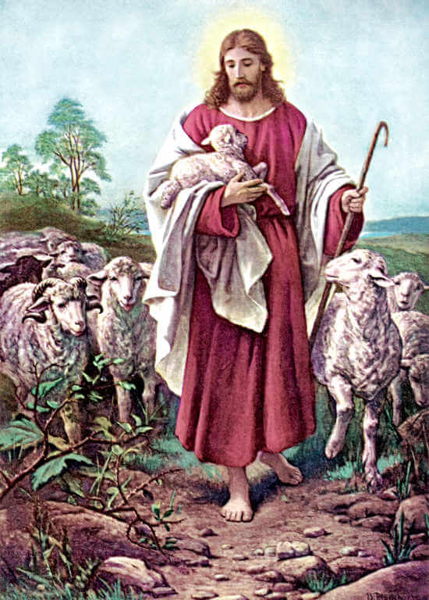
God Never Gives Up on You
“In just the same way, it is not the will of your heavenly Father that one of these little ones be lost.” Matthew 18:14
Lord, in the midst of my need, I turn to You.
I trust that You will seek me out.
May I always trust in Your unconditional love for me.
Jesus, I trust in You.

