Slide 1


CELEBRATION ASSEMBLY
FRIDAY 4TH DECEMBER

Slide 2

Notes:
WORD

Slide 3

Dear Lord,
Please bless our school
As we try to
Love, learn,
Share and respect
In the light of Jesus.
St Alban, pray for us.
Amen

Slide 4

Reception

Slide 5
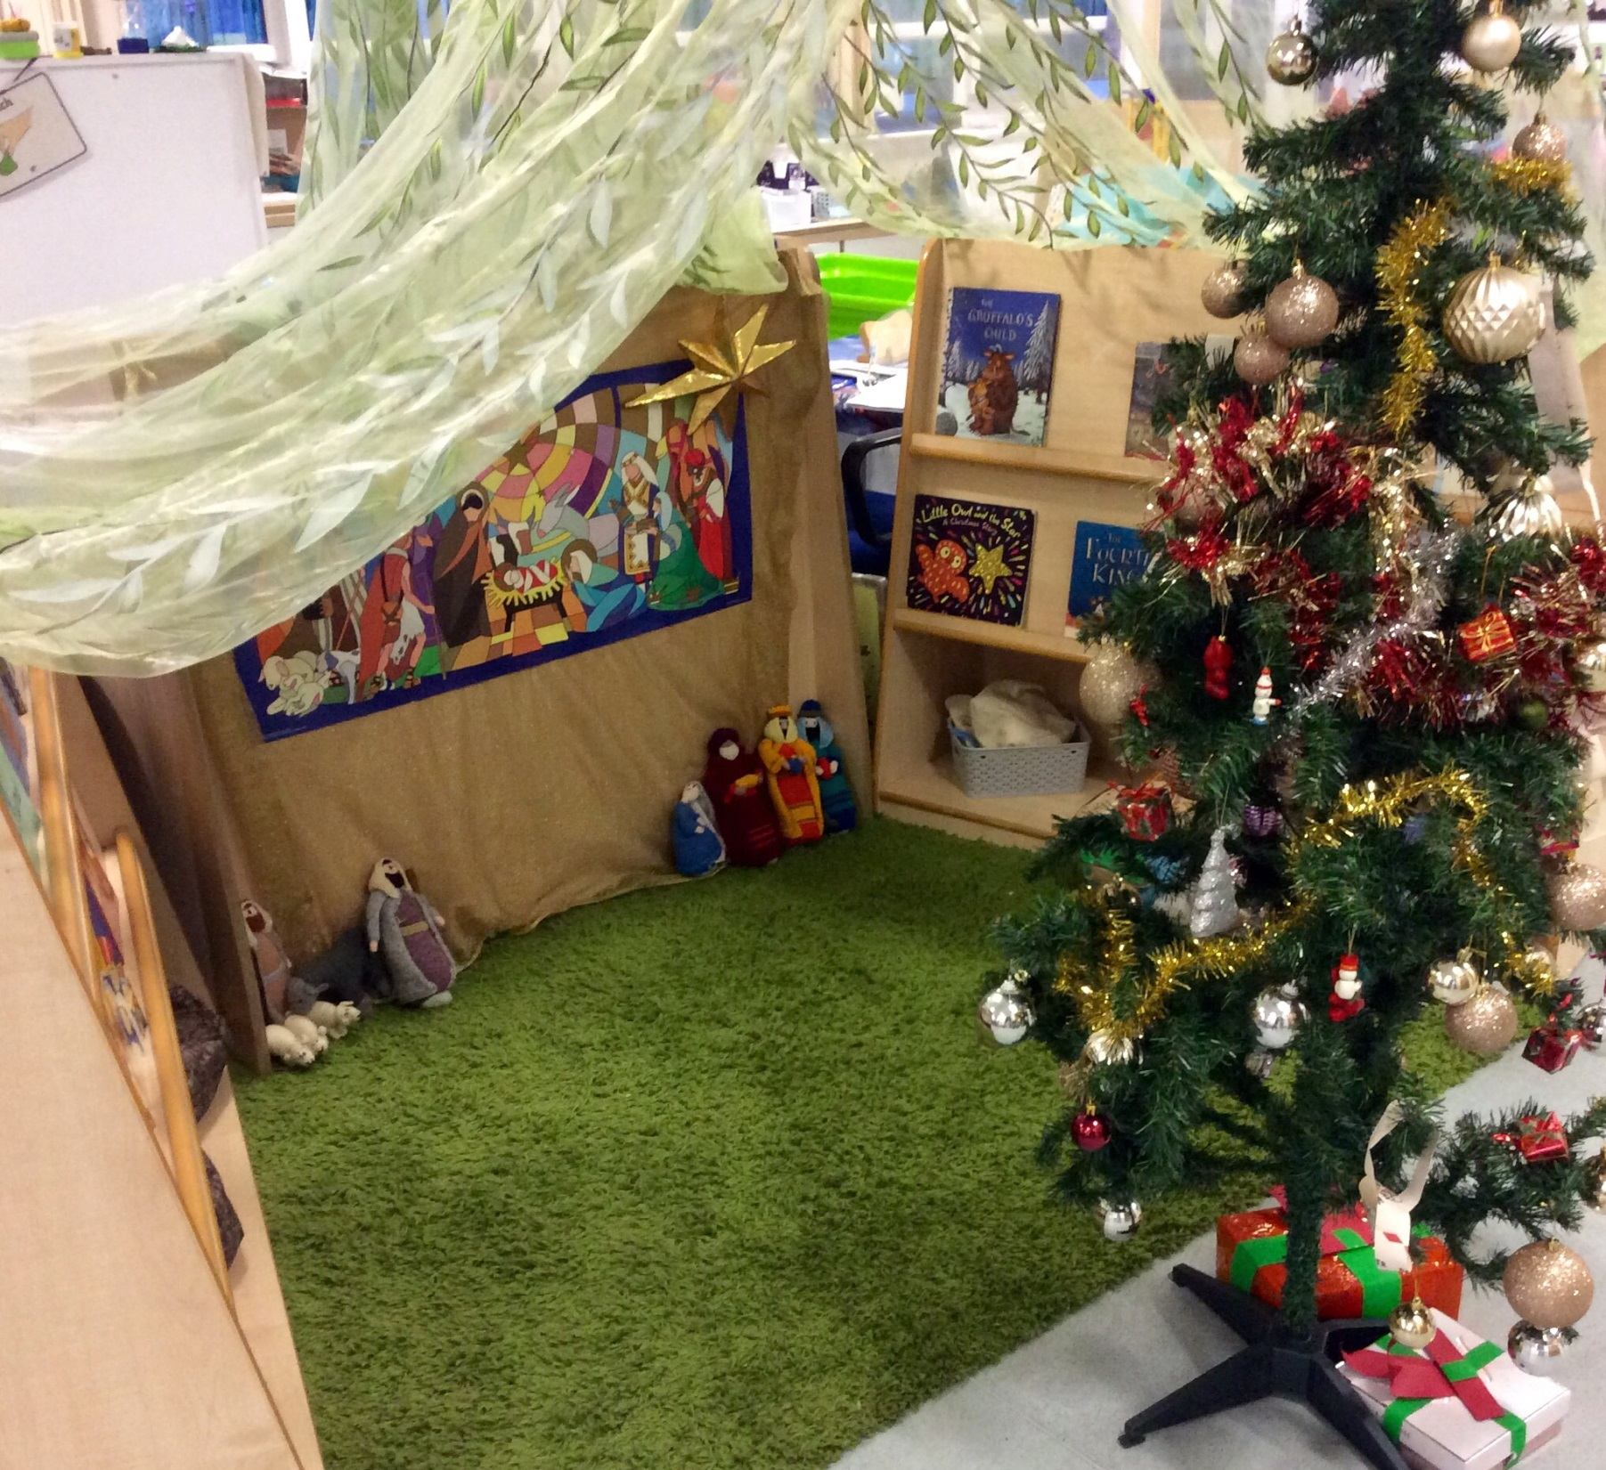

Slide 6
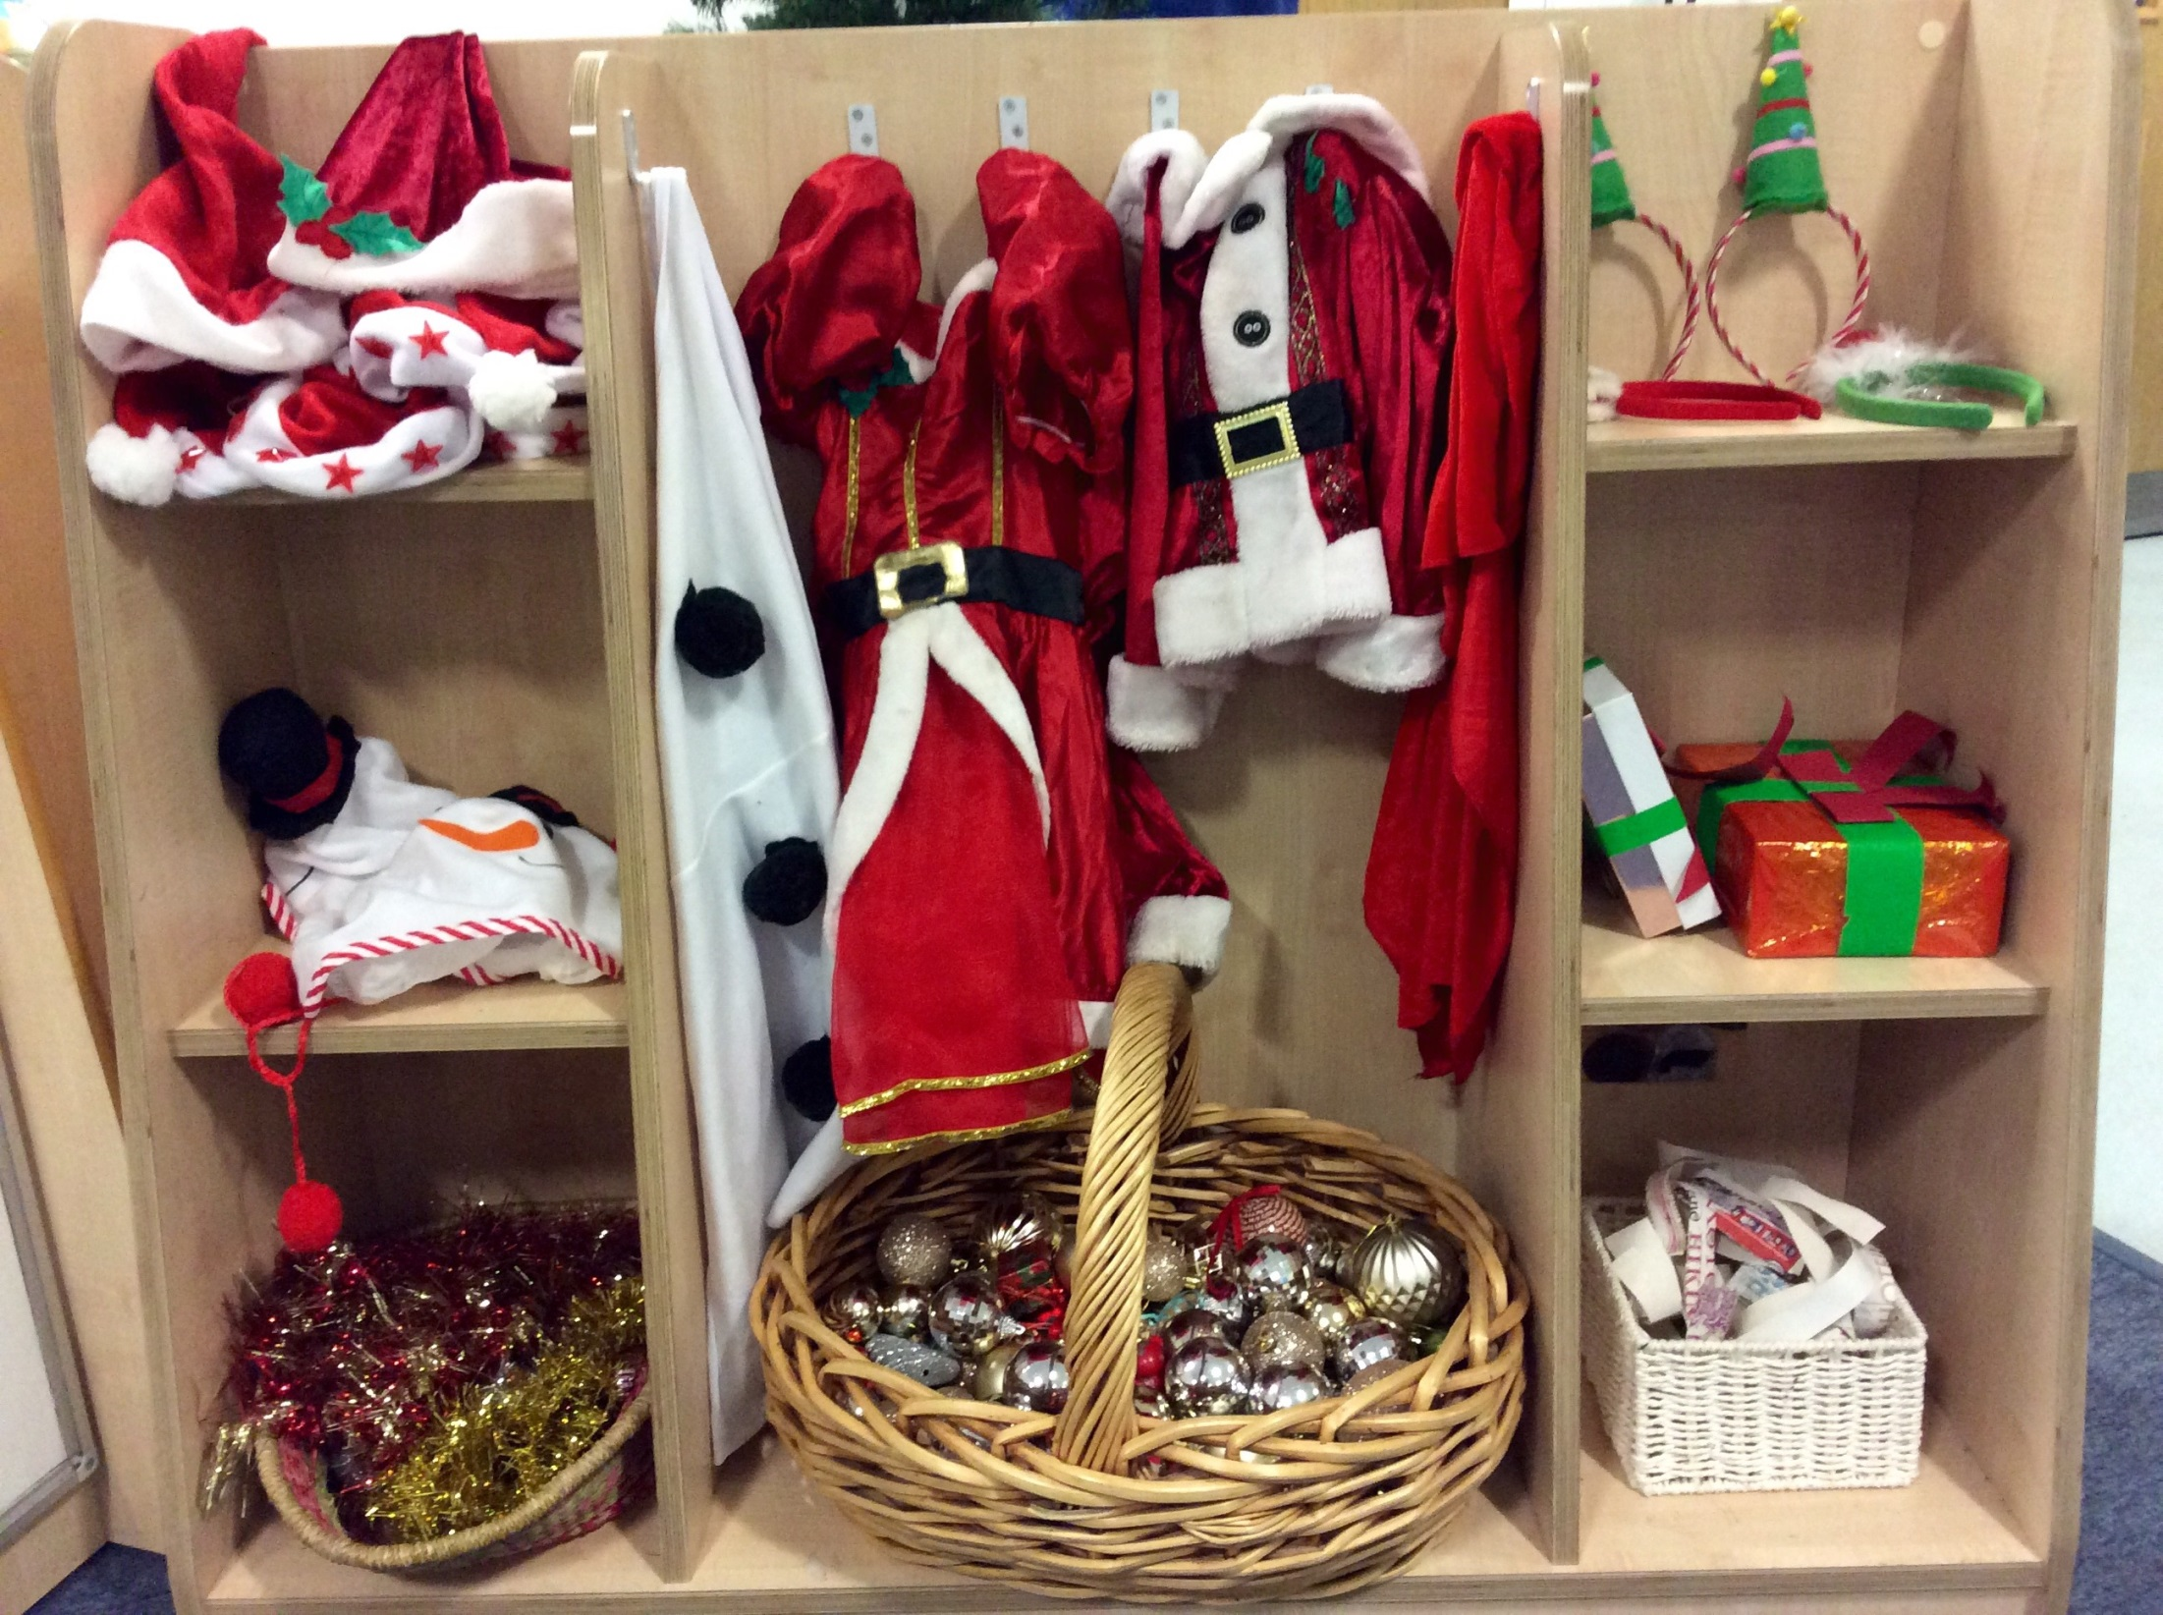

Slide 7
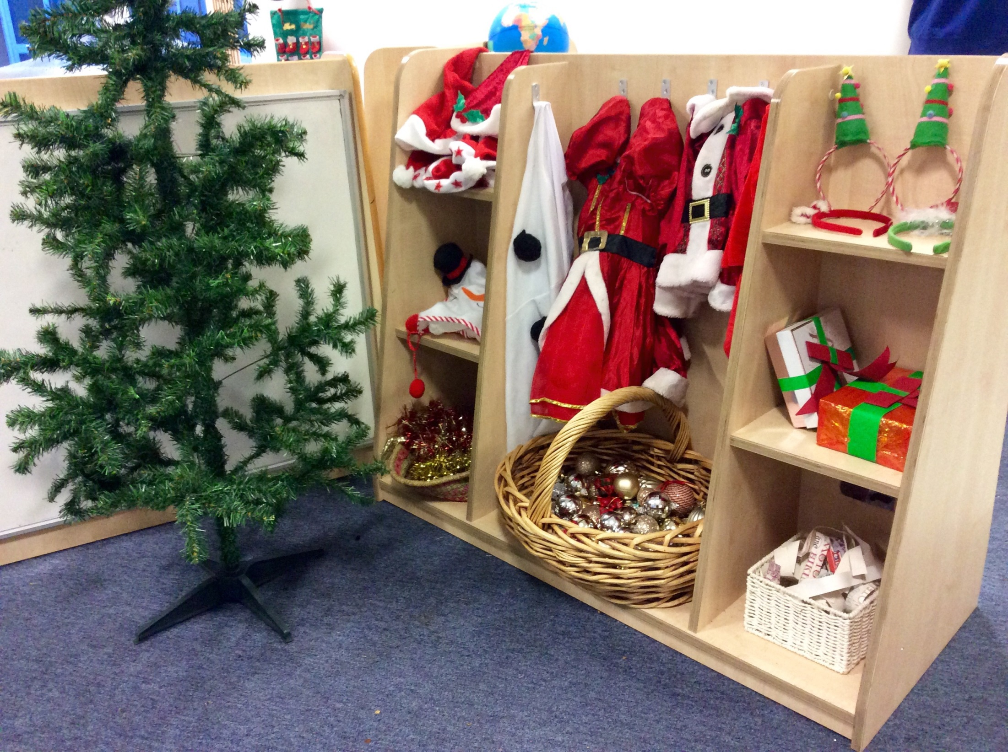

Slide 8
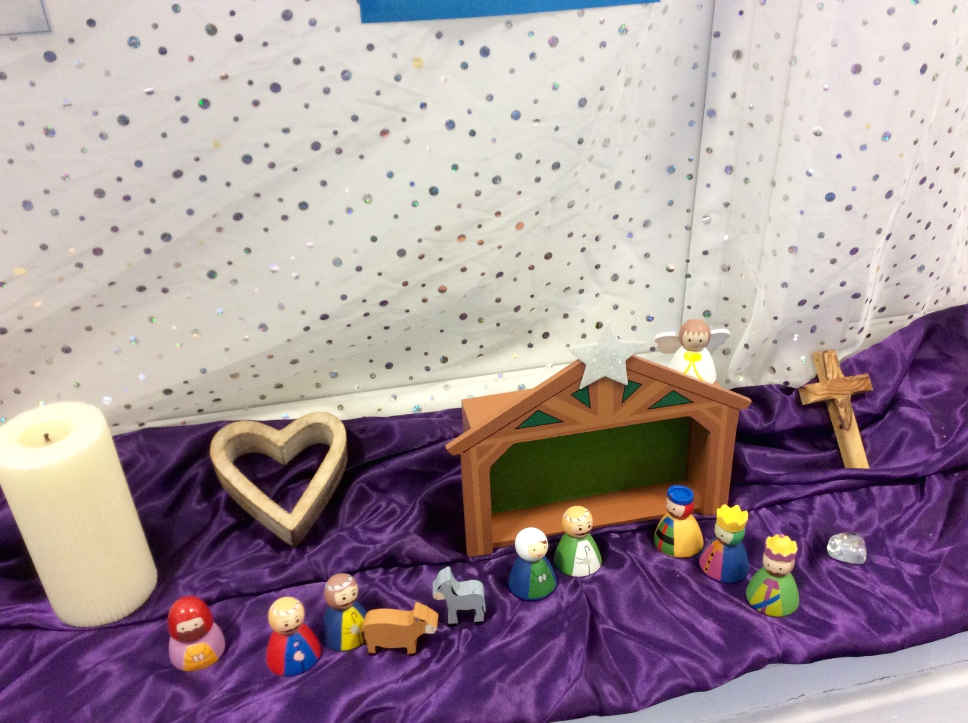

Slide 9
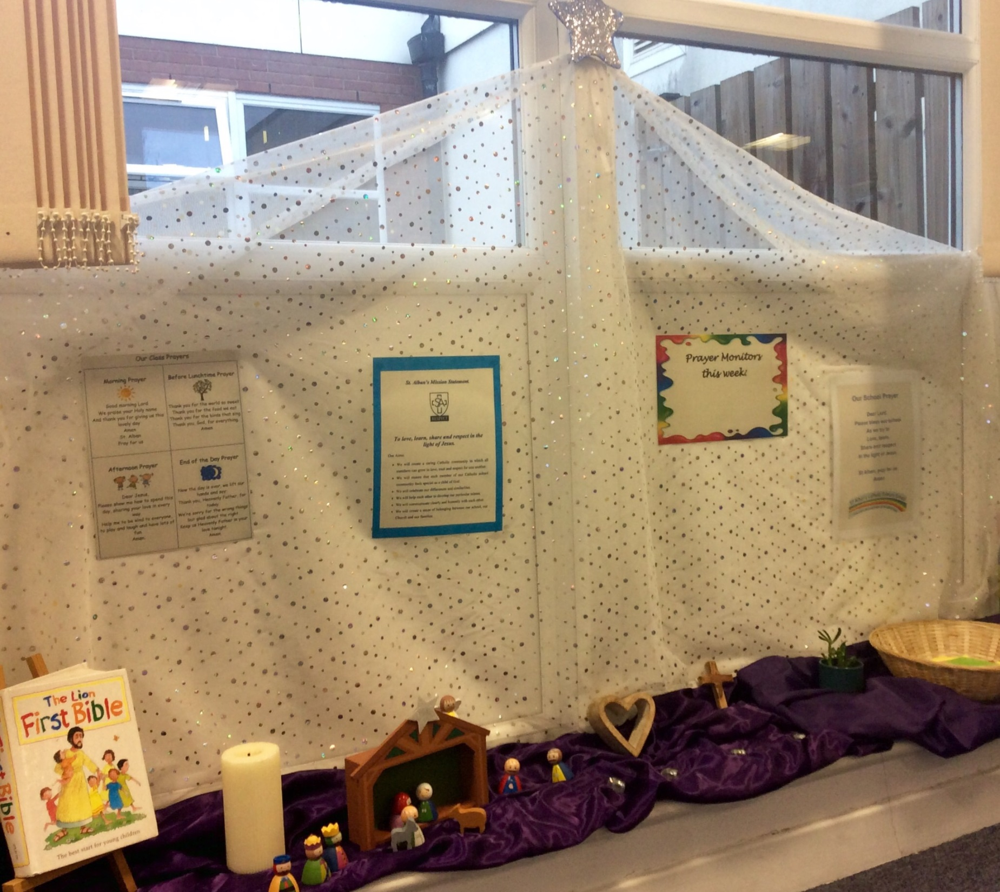

Slide 10
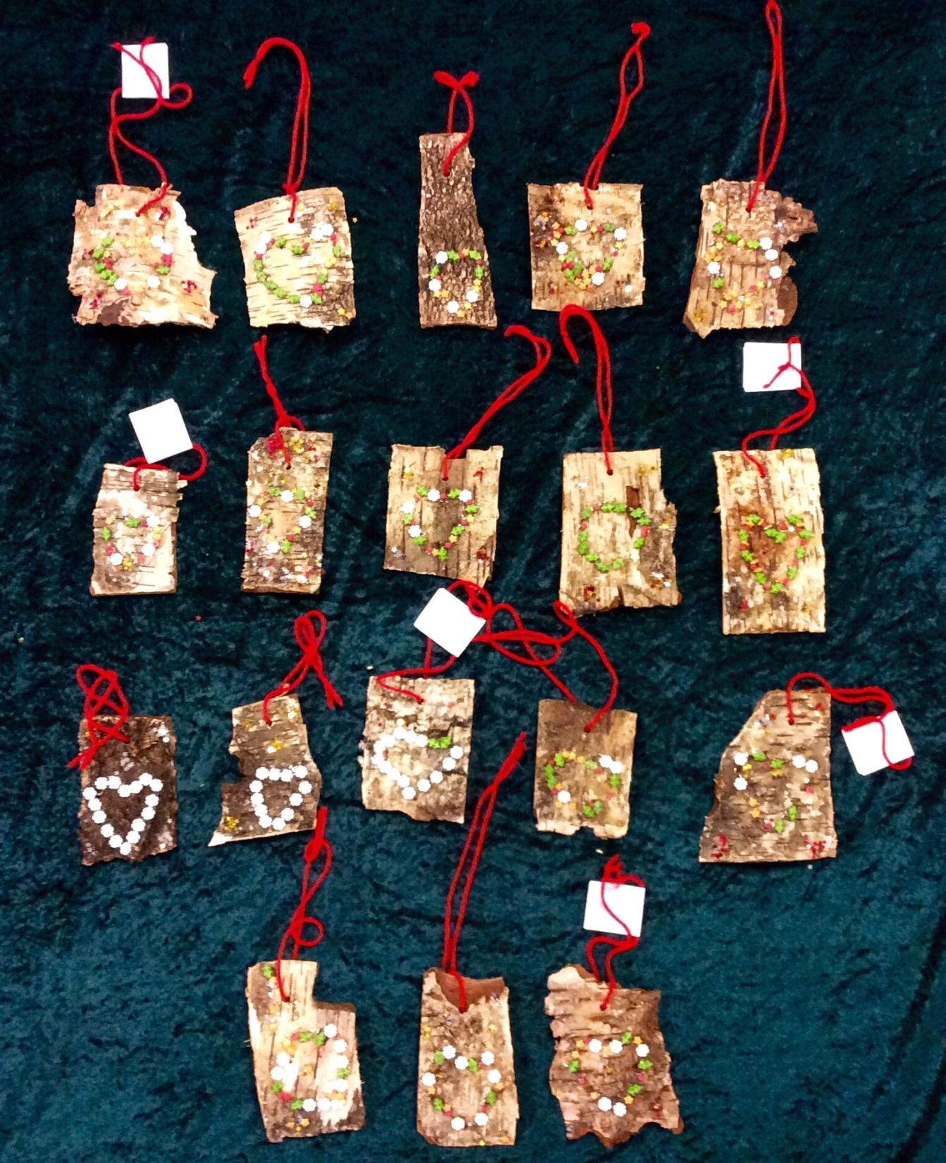

Slide 11
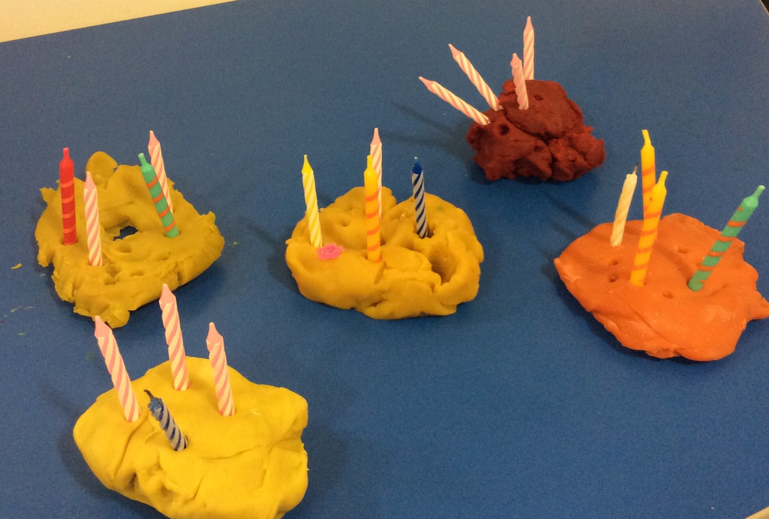

Slide 12
Year 1

Slide 13
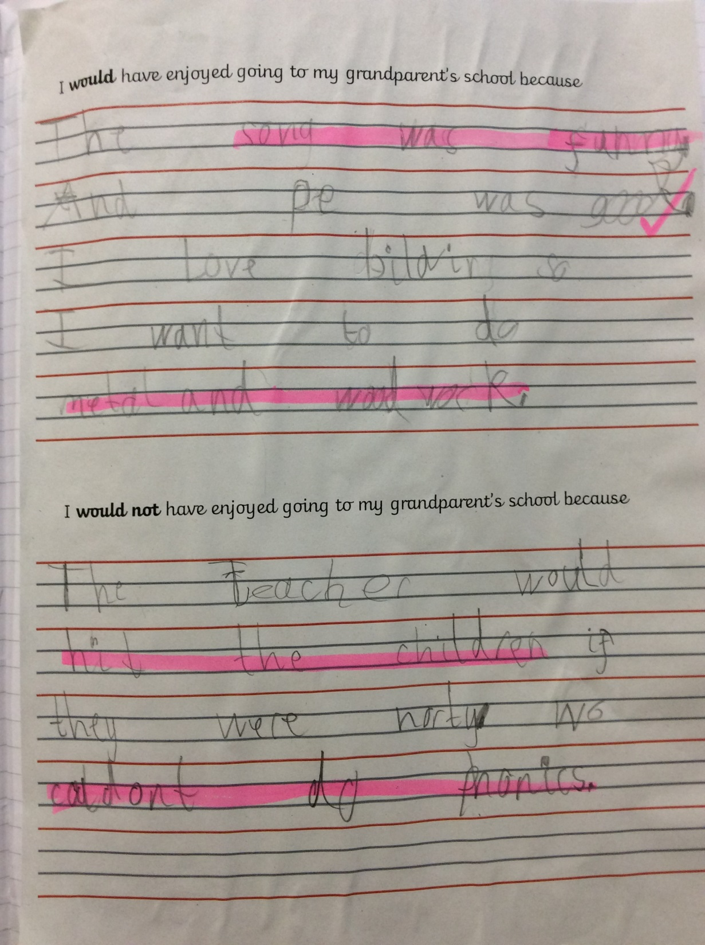

Slide 14
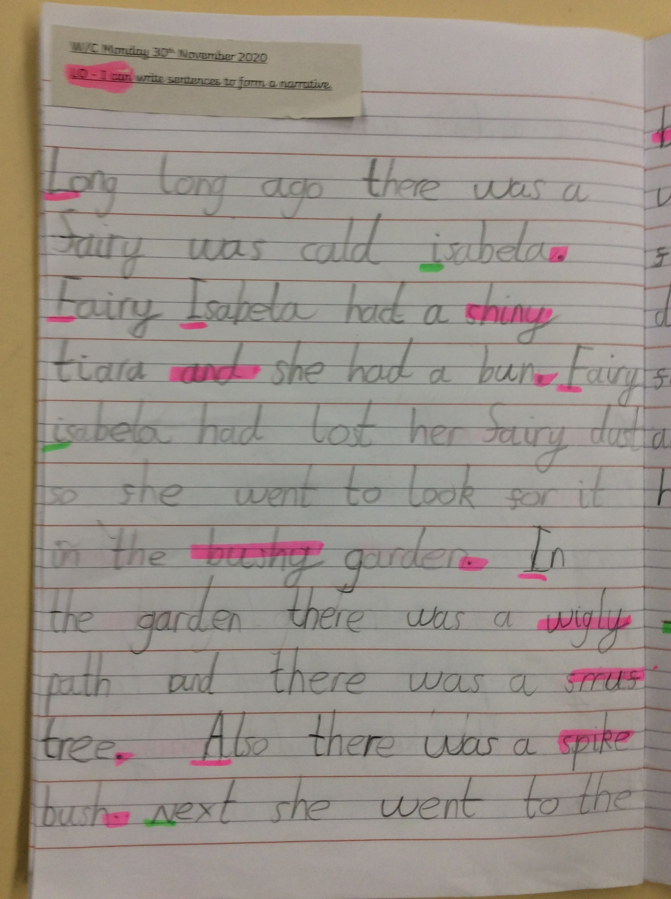

Slide 15
Year 2

Slide 16
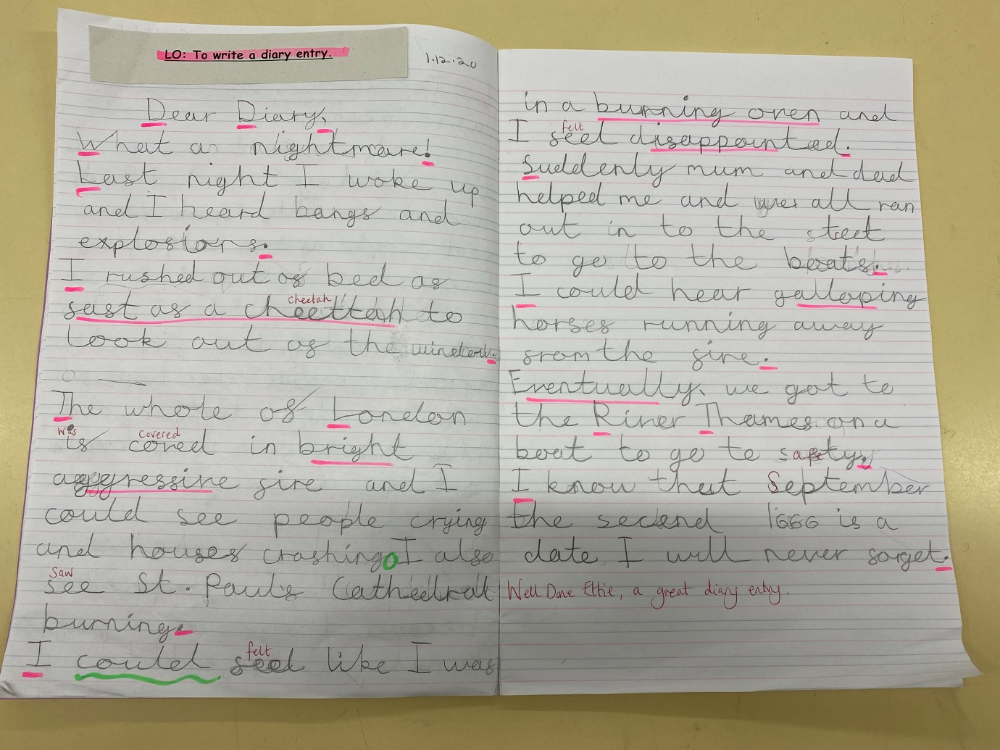

Slide 17
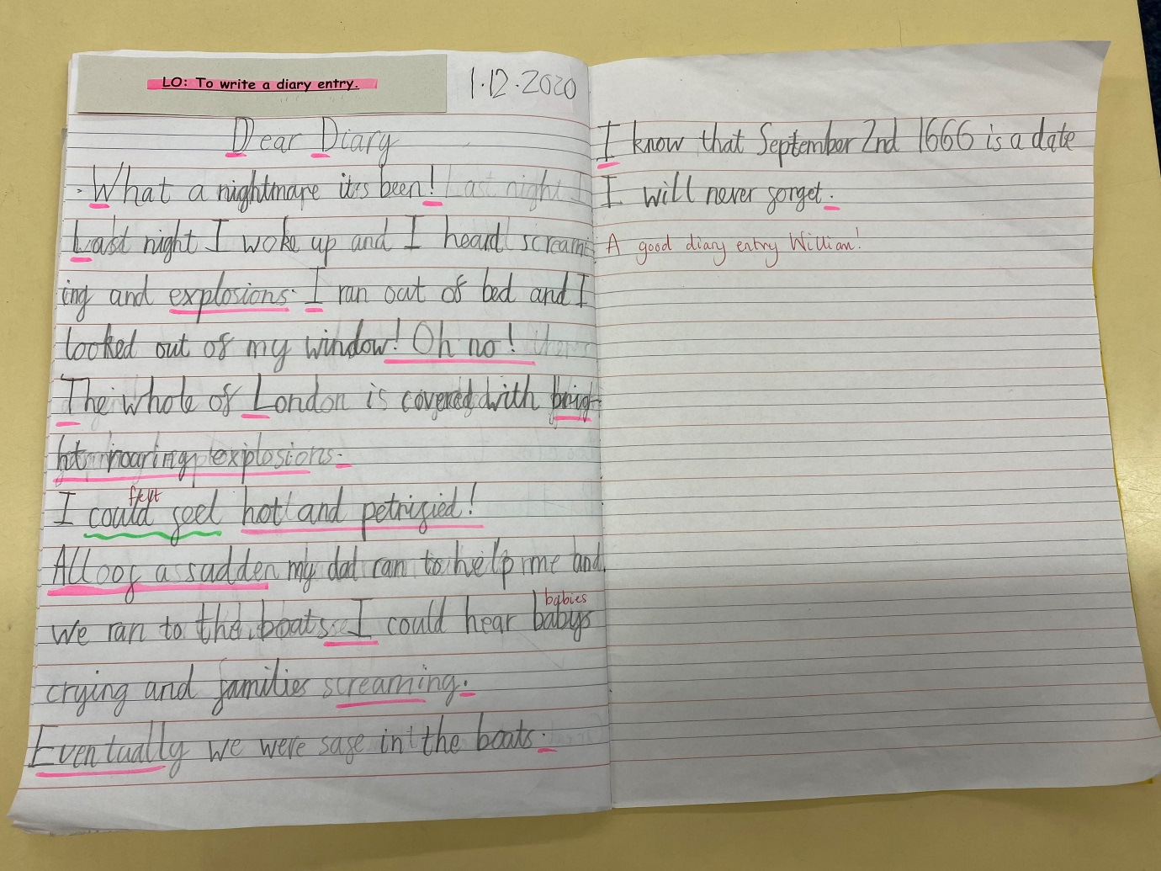

Slide 18
Year 3

Slide 19
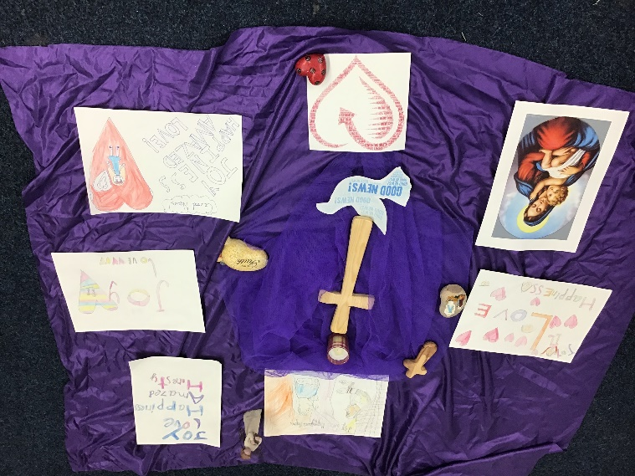

Slide 20
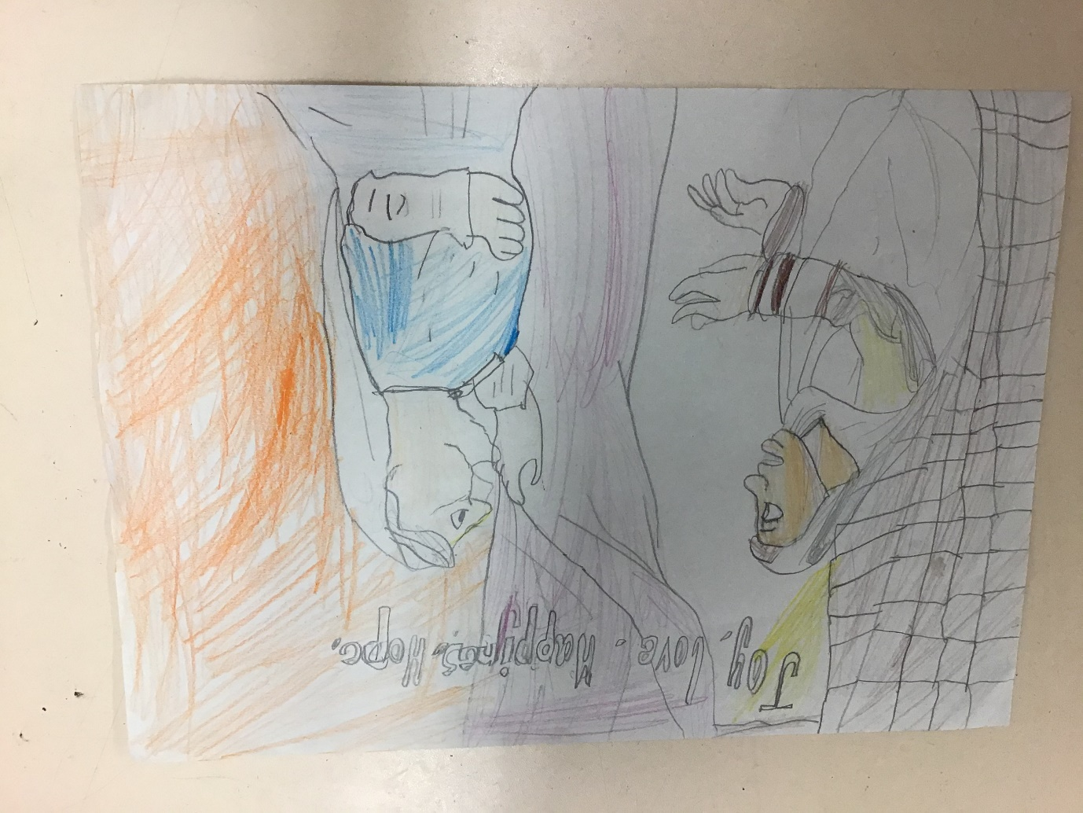

Slide 21
Year 4

Slide 22
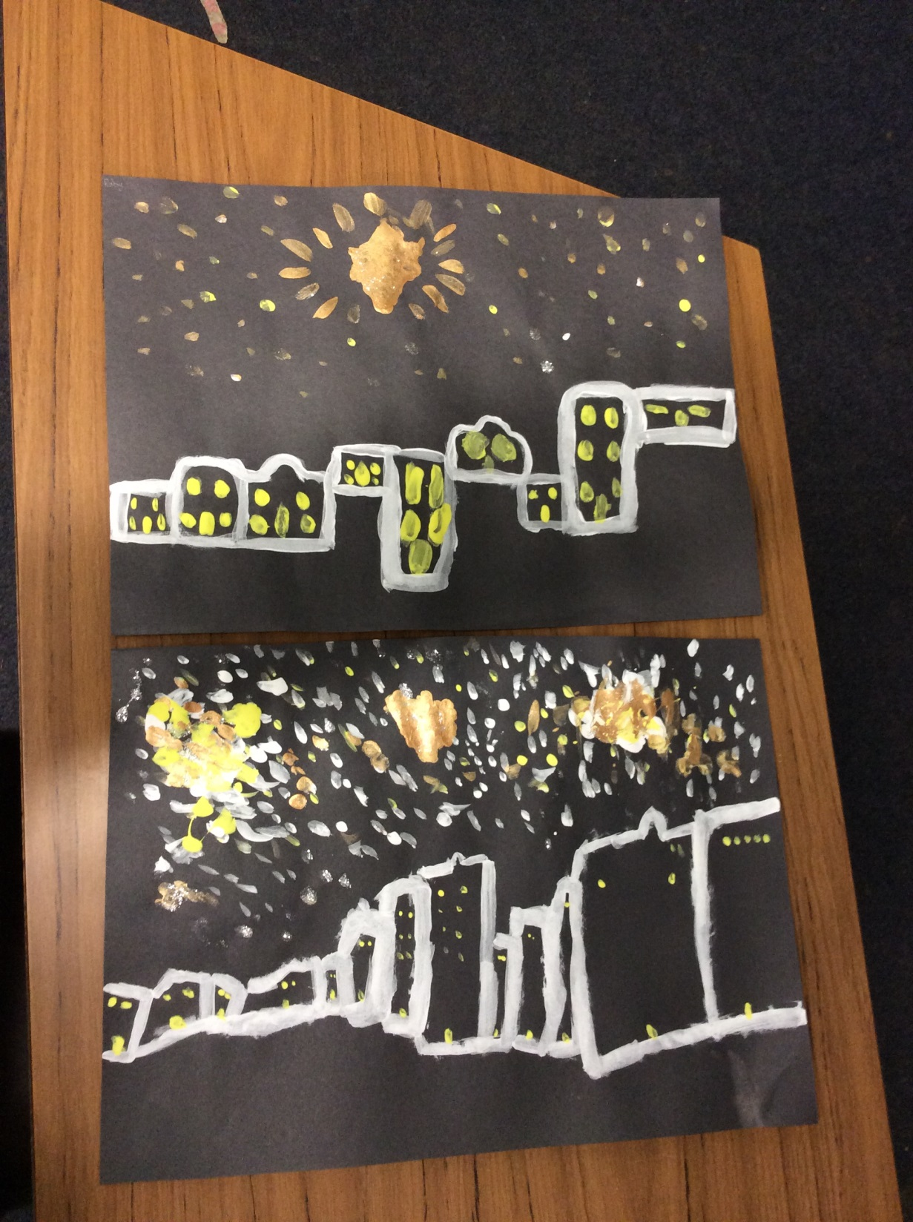

Slide 23
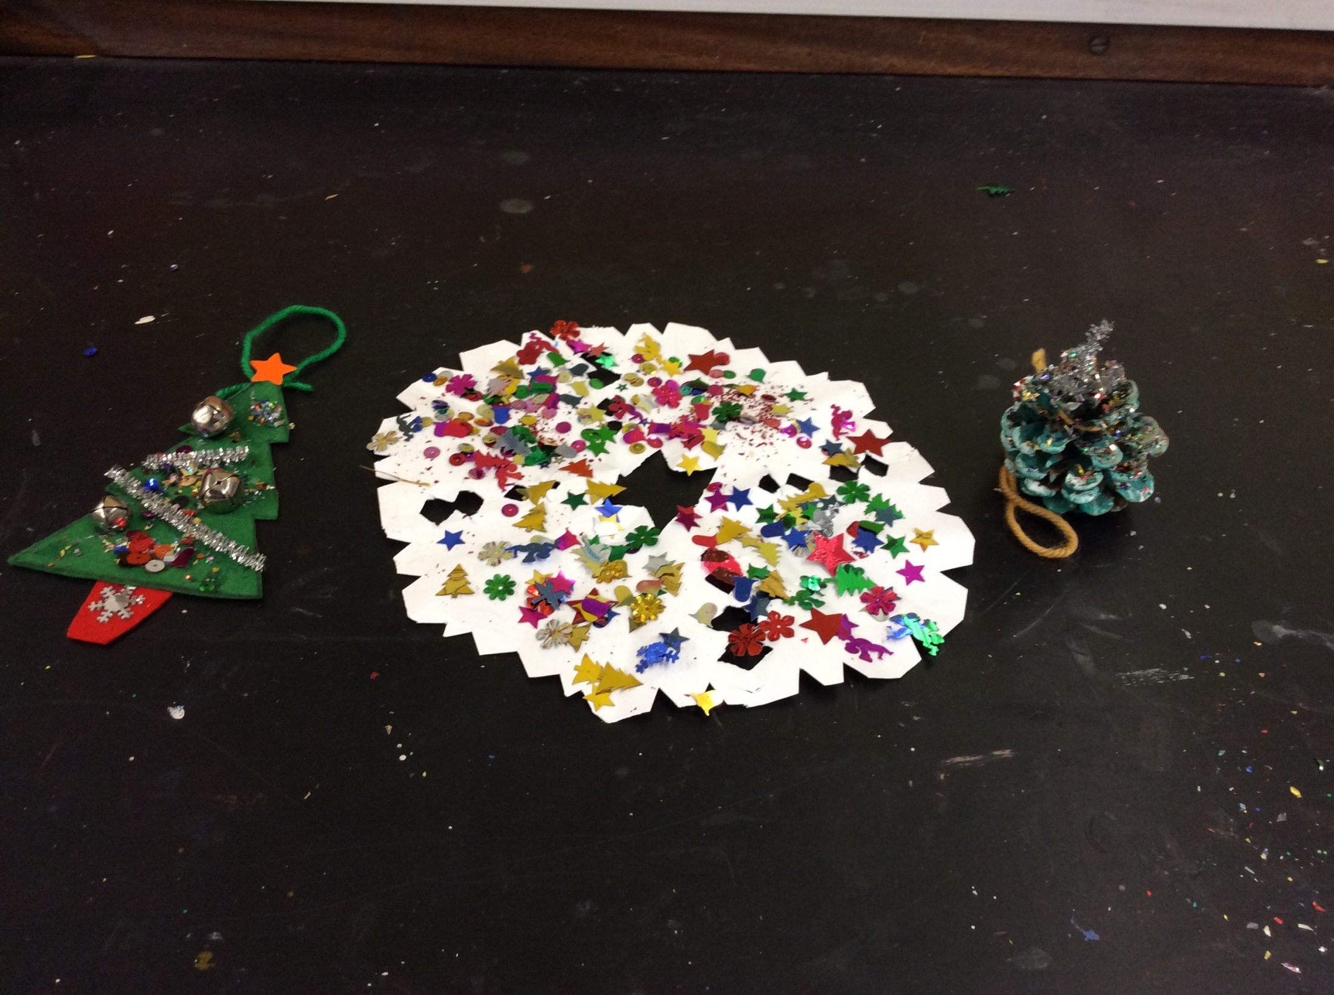

Slide 24
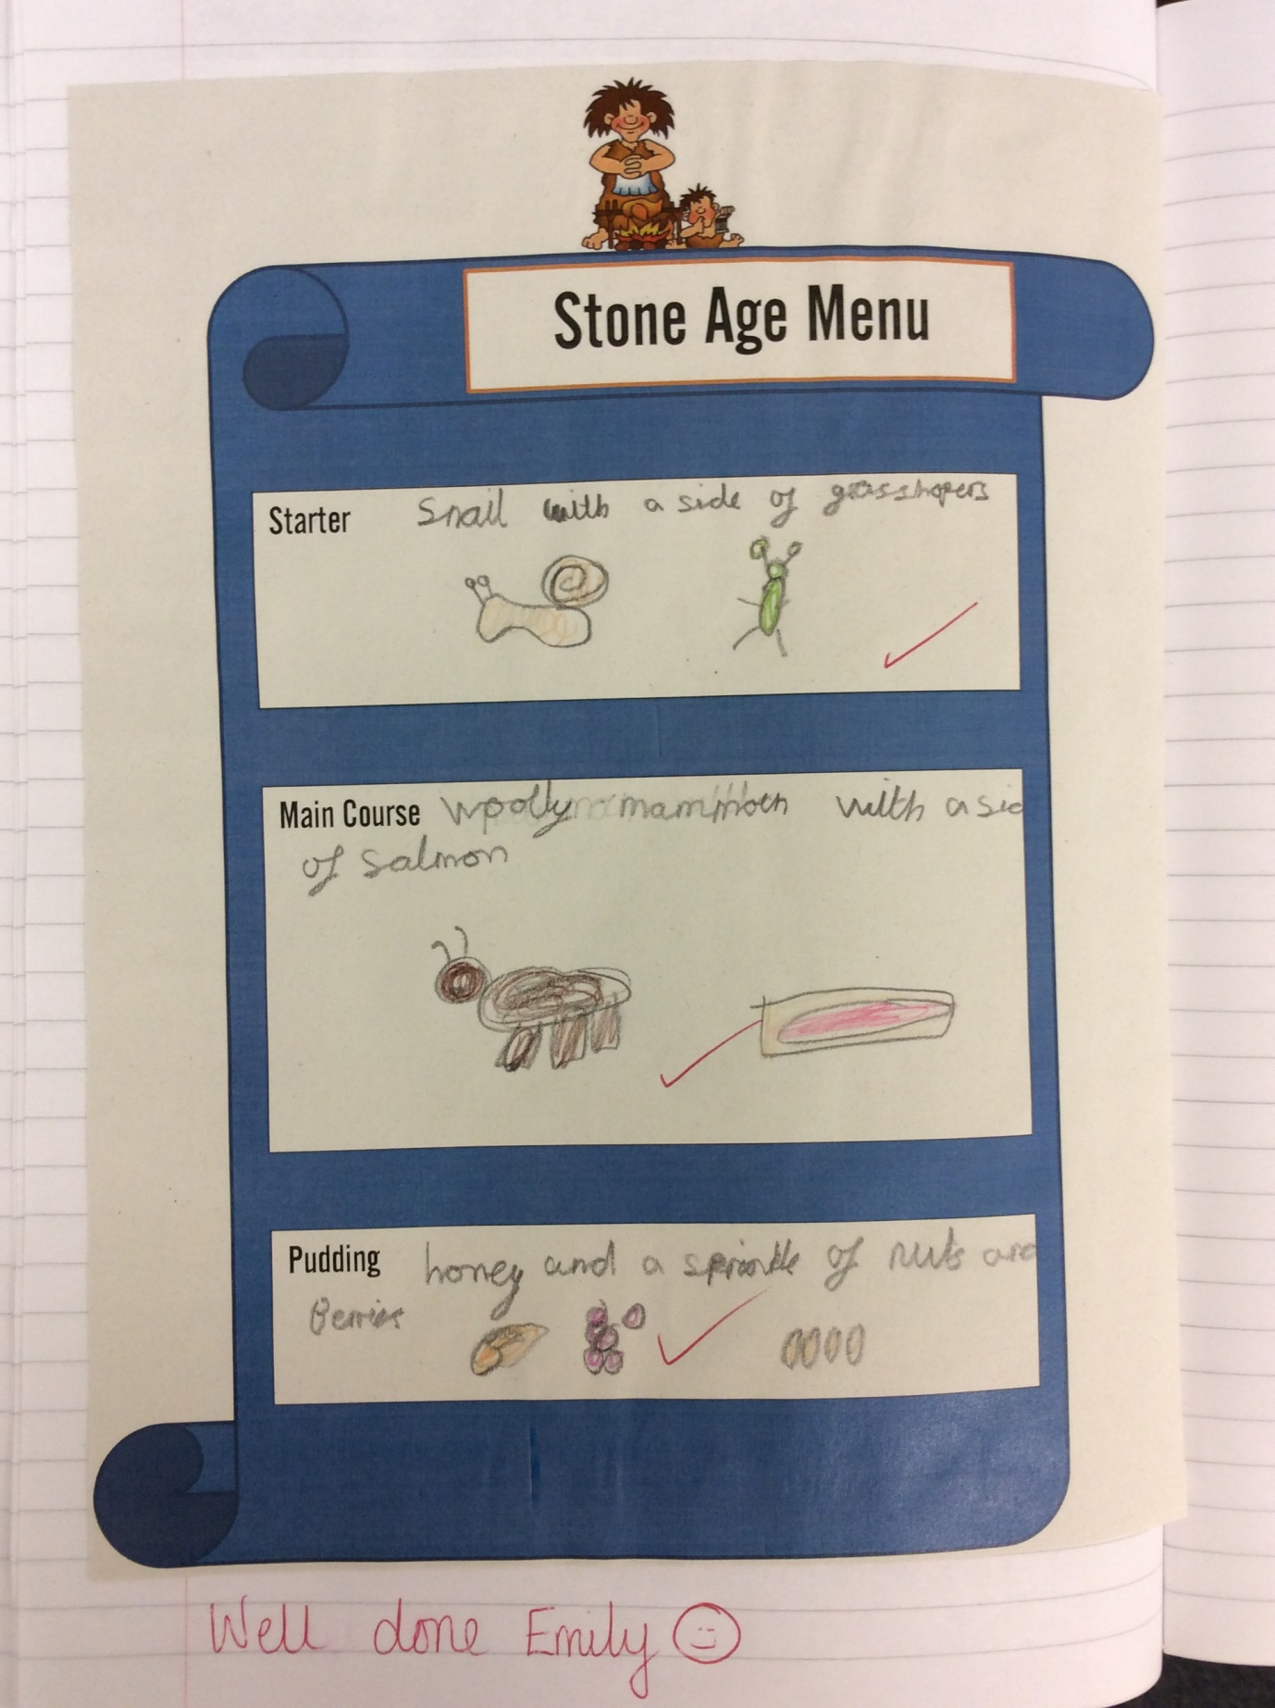

Slide 25
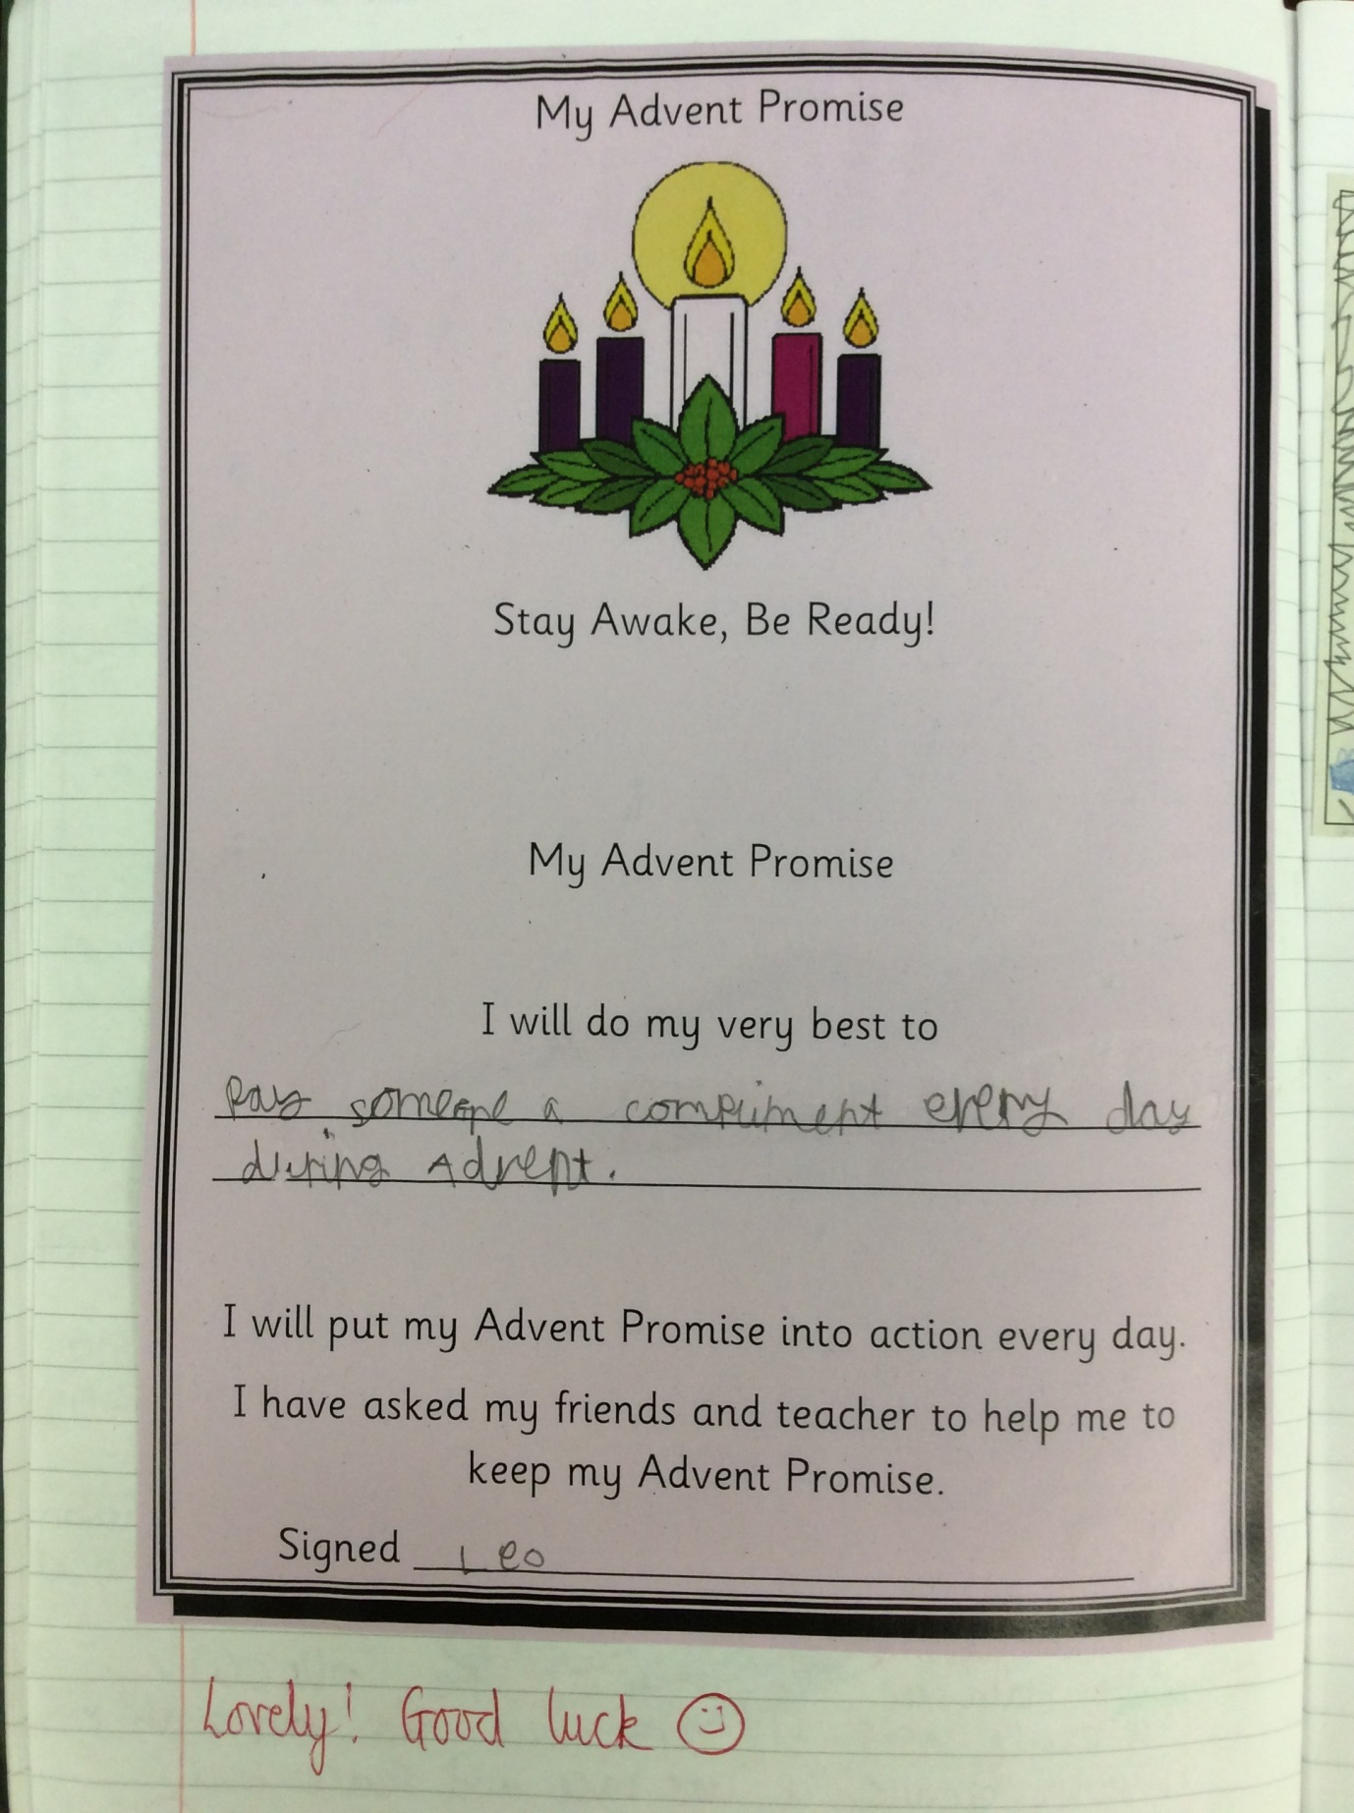

Slide 26
Year 5

Slide 27
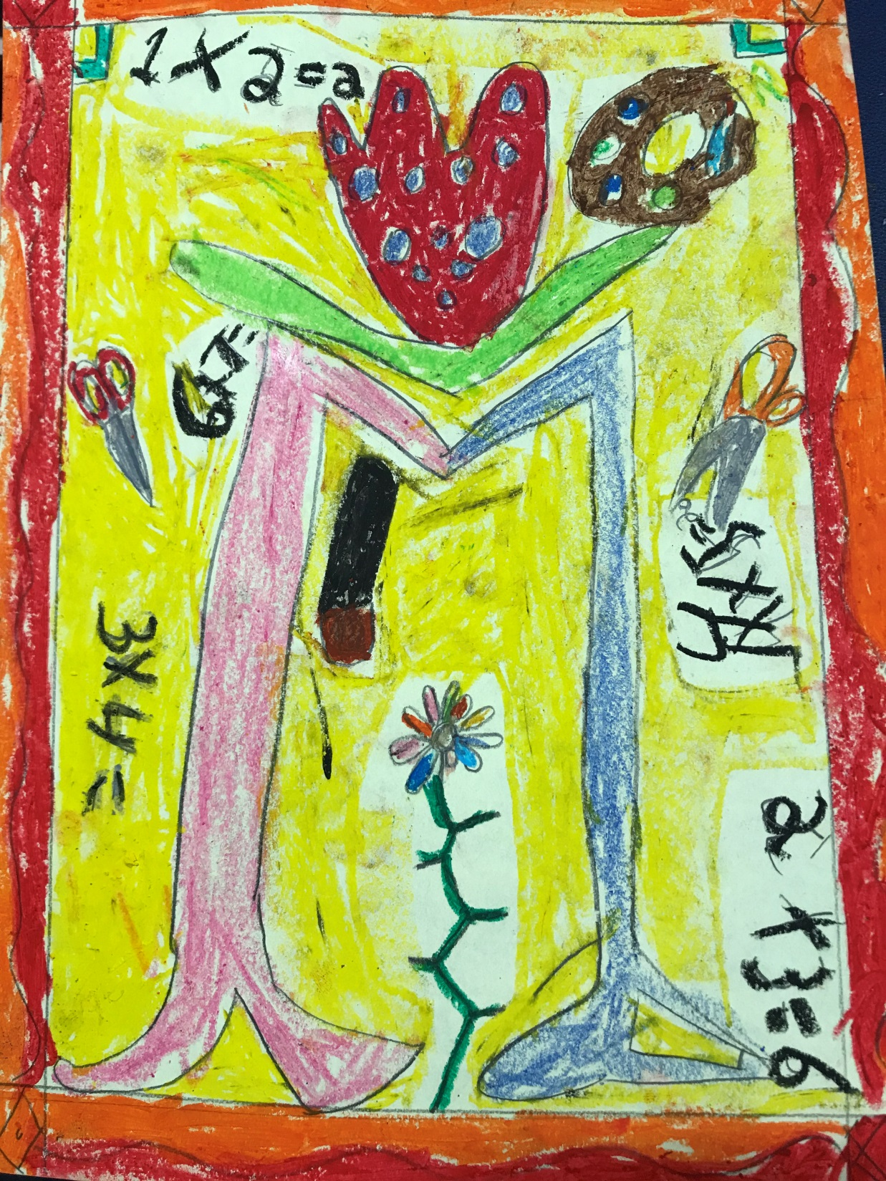

Slide 28
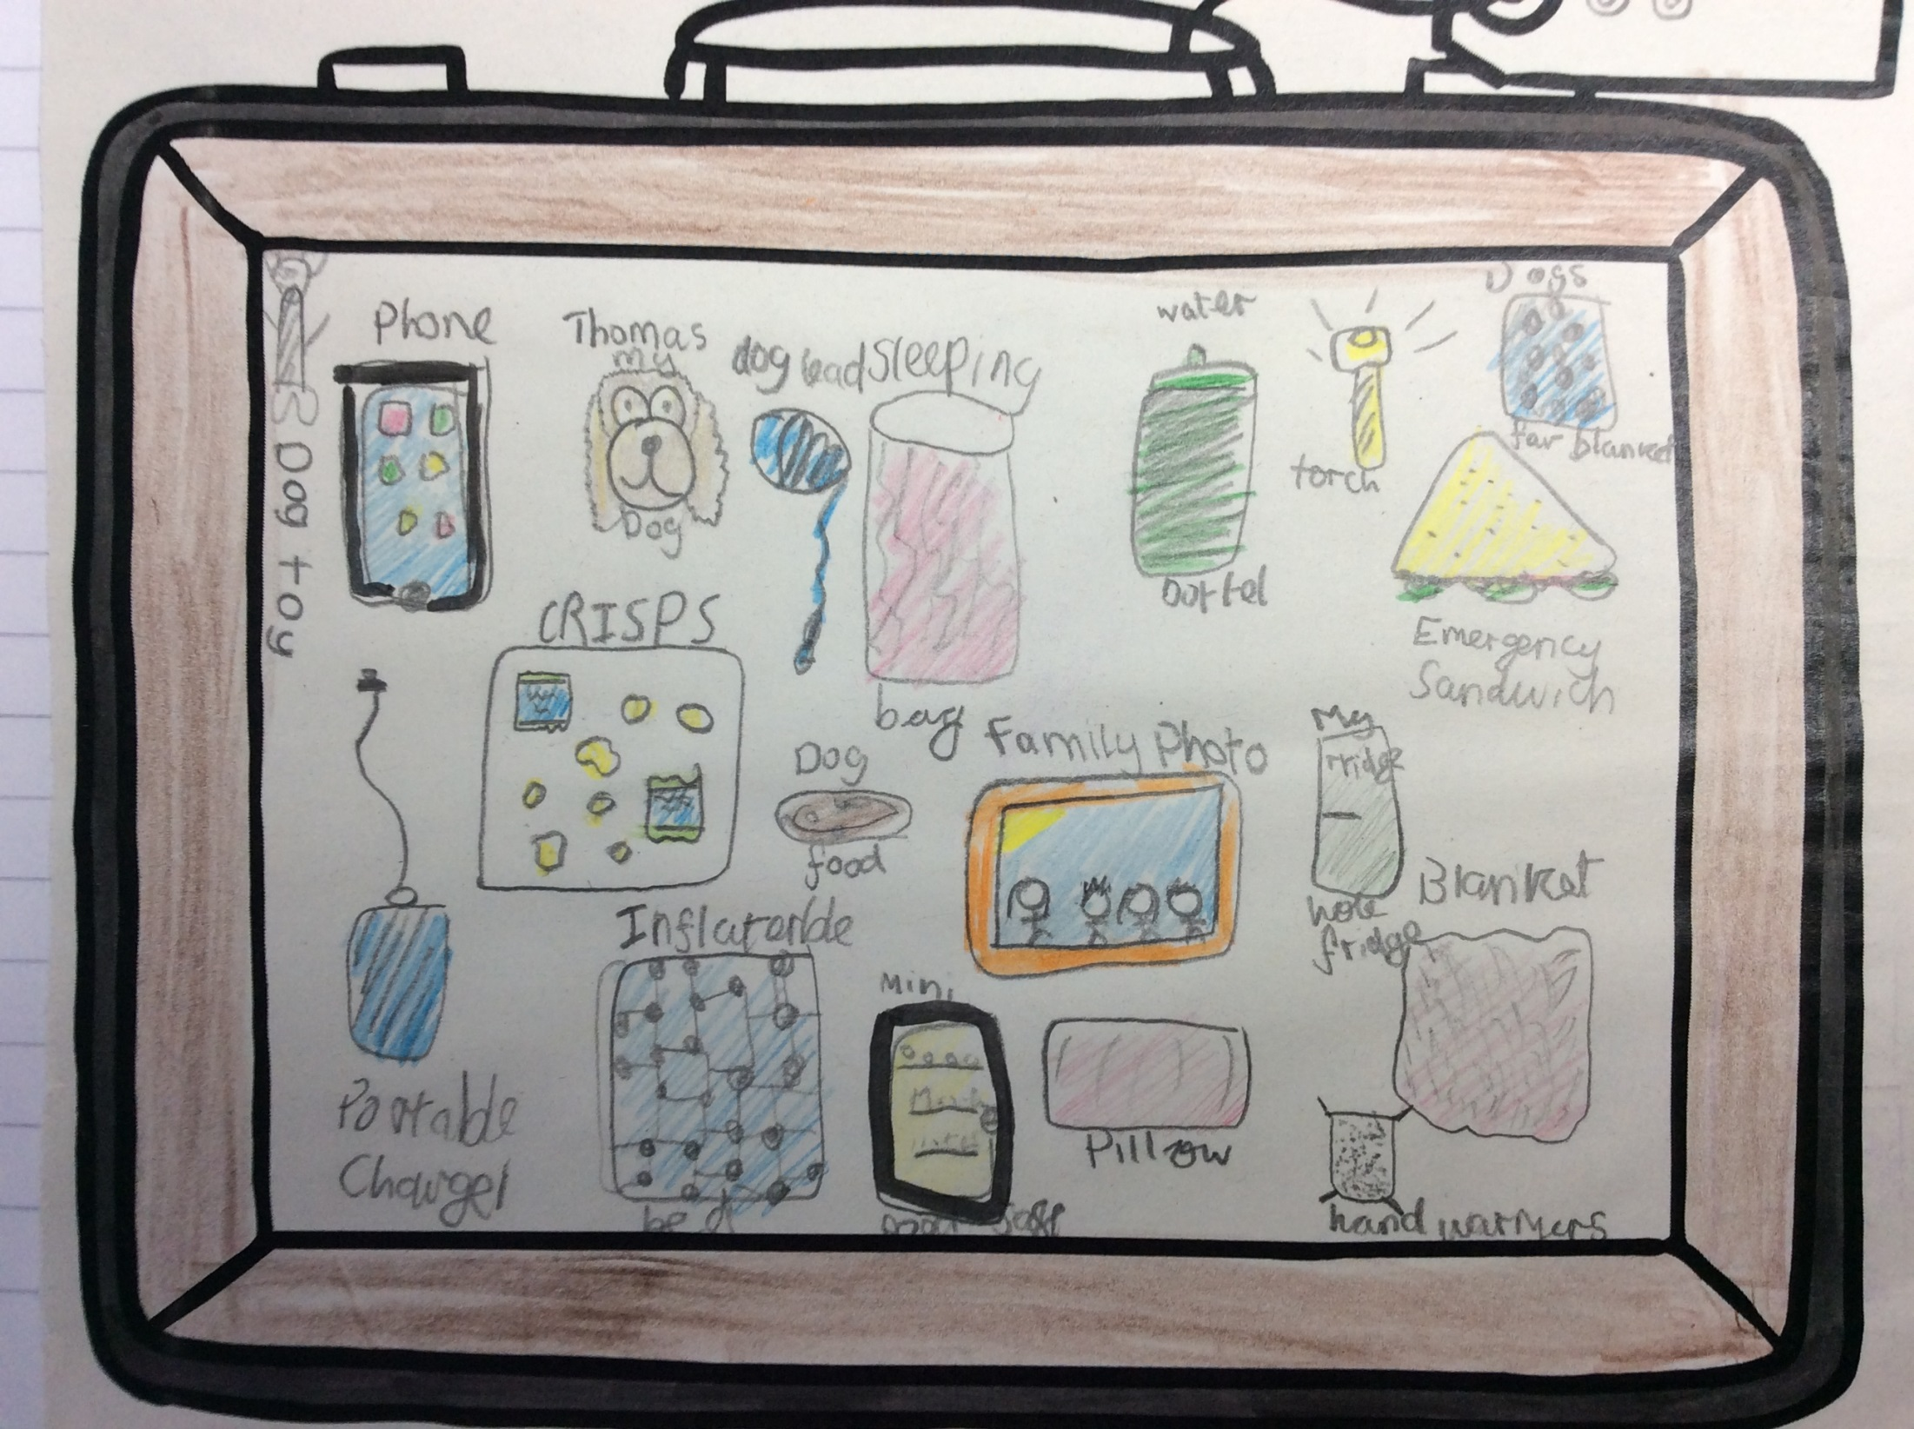

Slide 29
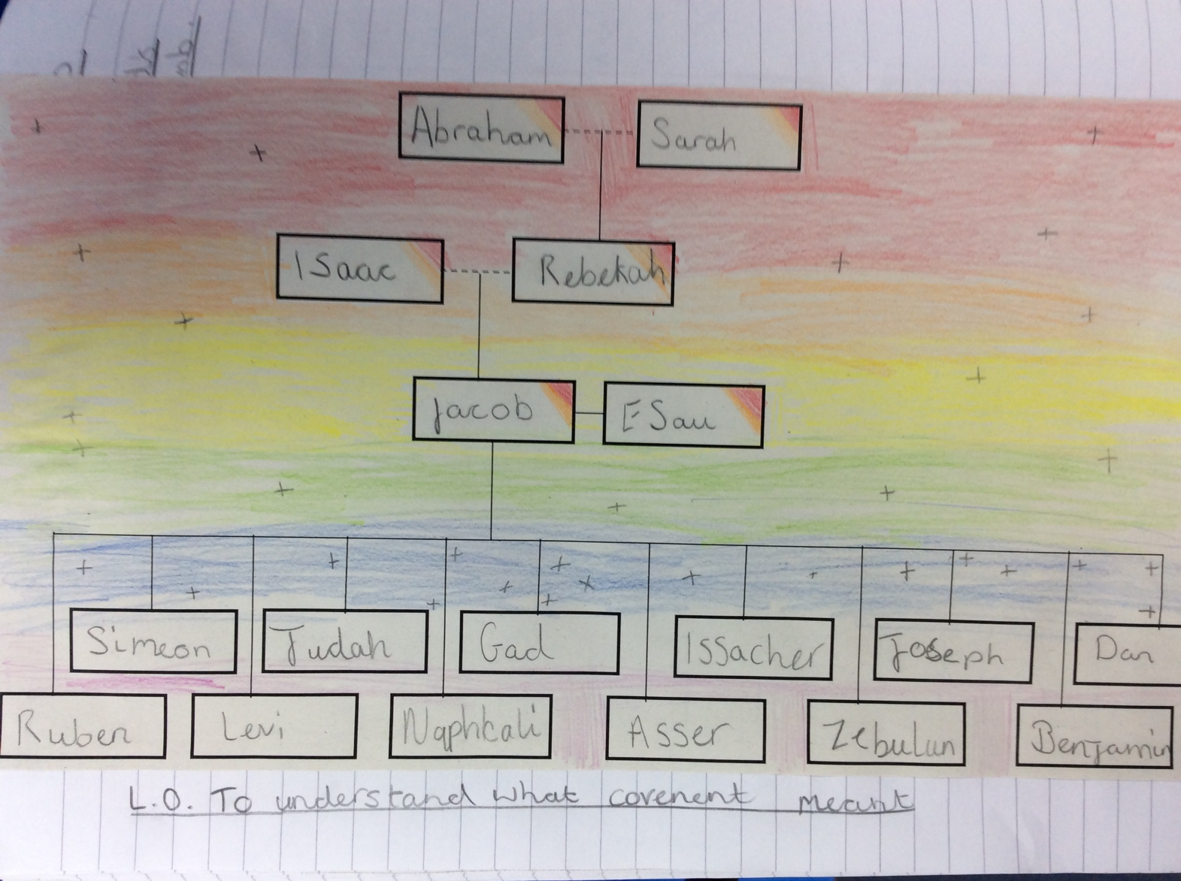

Slide 30
Year 6

Slide 31
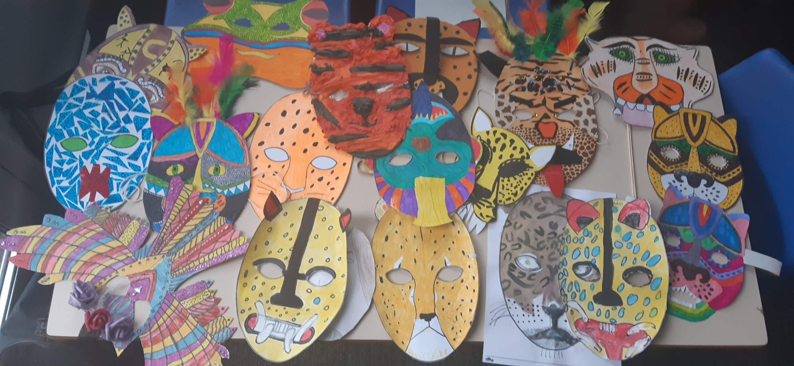

Slide 32
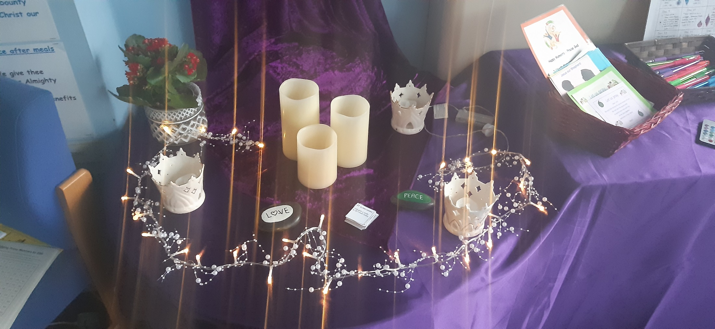

Slide 33


Slide 34


Slide 35


Slide 36
Have you remembered your Advent promises this week?
Notes:
GO FORTH - MISSION

Slide 37
WOW!
WELL DONE EVERYONE!

