Slide 1


CELEBRATION ASSEMBLY
FRIDAY 11TH DECEMBER

Slide 2

Notes:
WORD

Slide 3

Dear Lord,
Please bless our school
As we try to
Love, learn,
Share and respect
In the light of Jesus.
St Alban, pray for us.
Amen

Slide 4

Reception

Slide 5
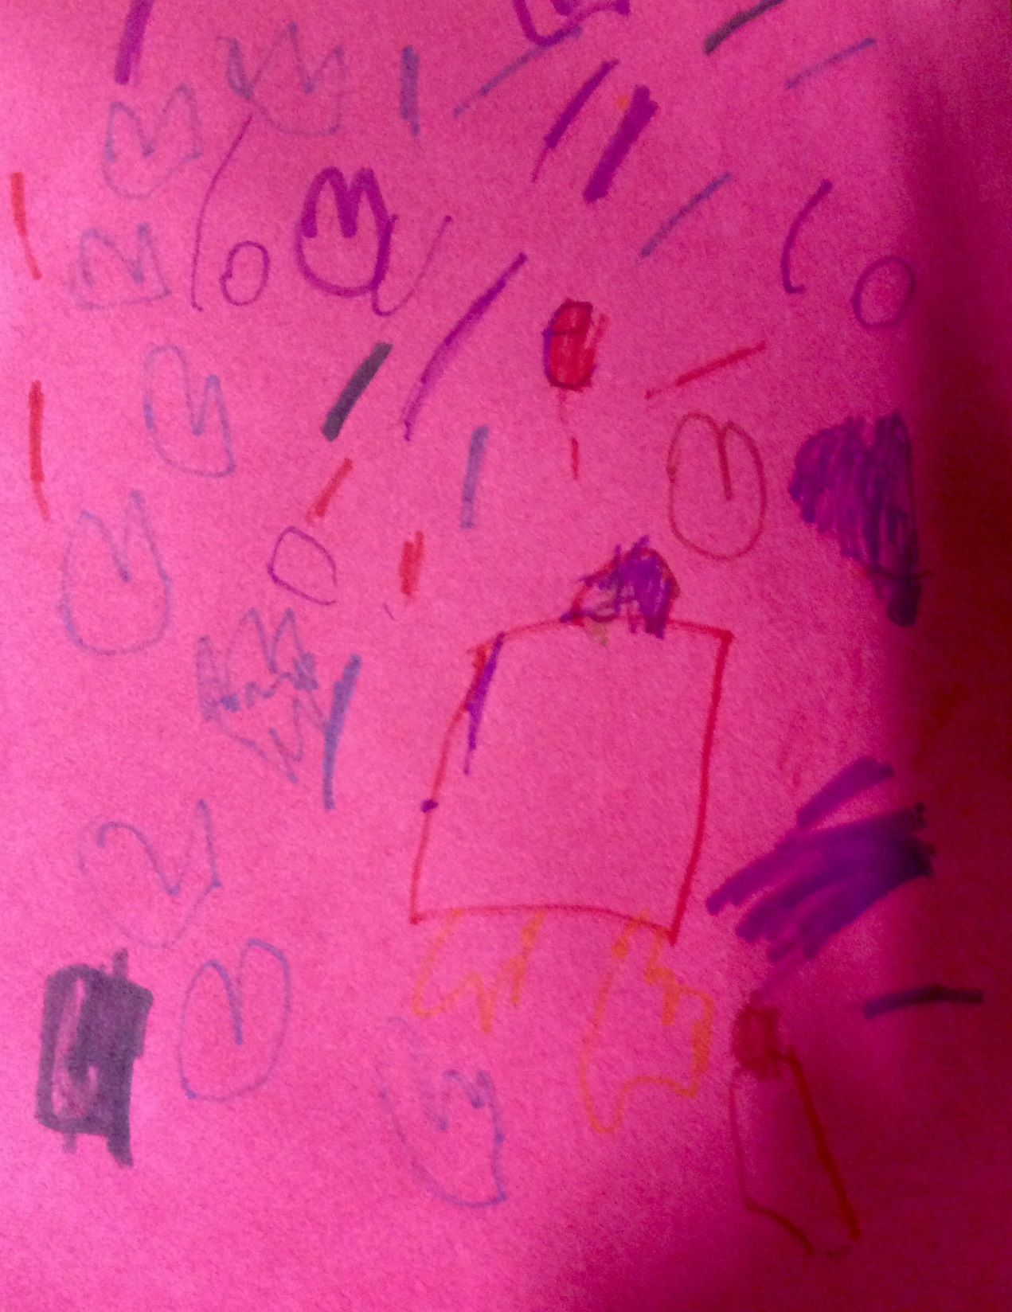

Slide 6
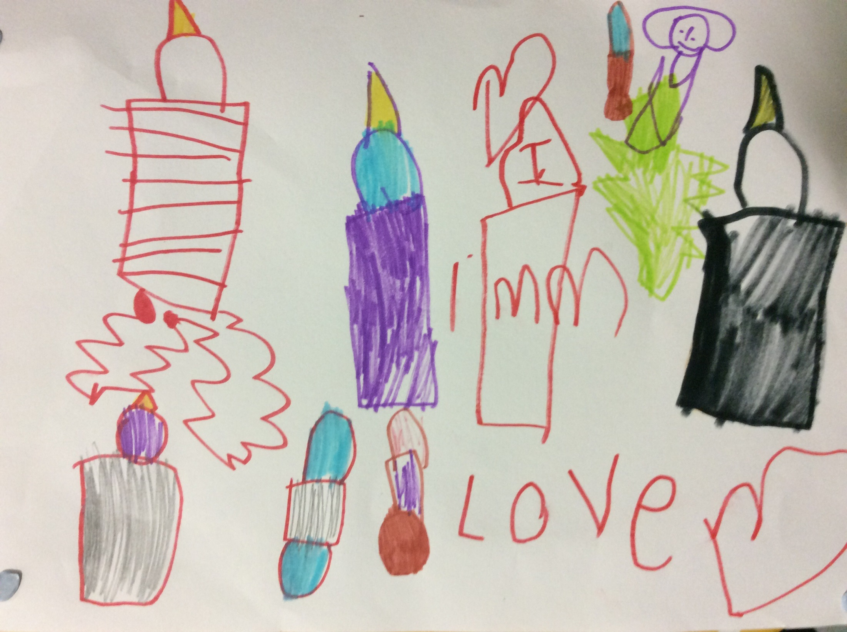

Slide 7
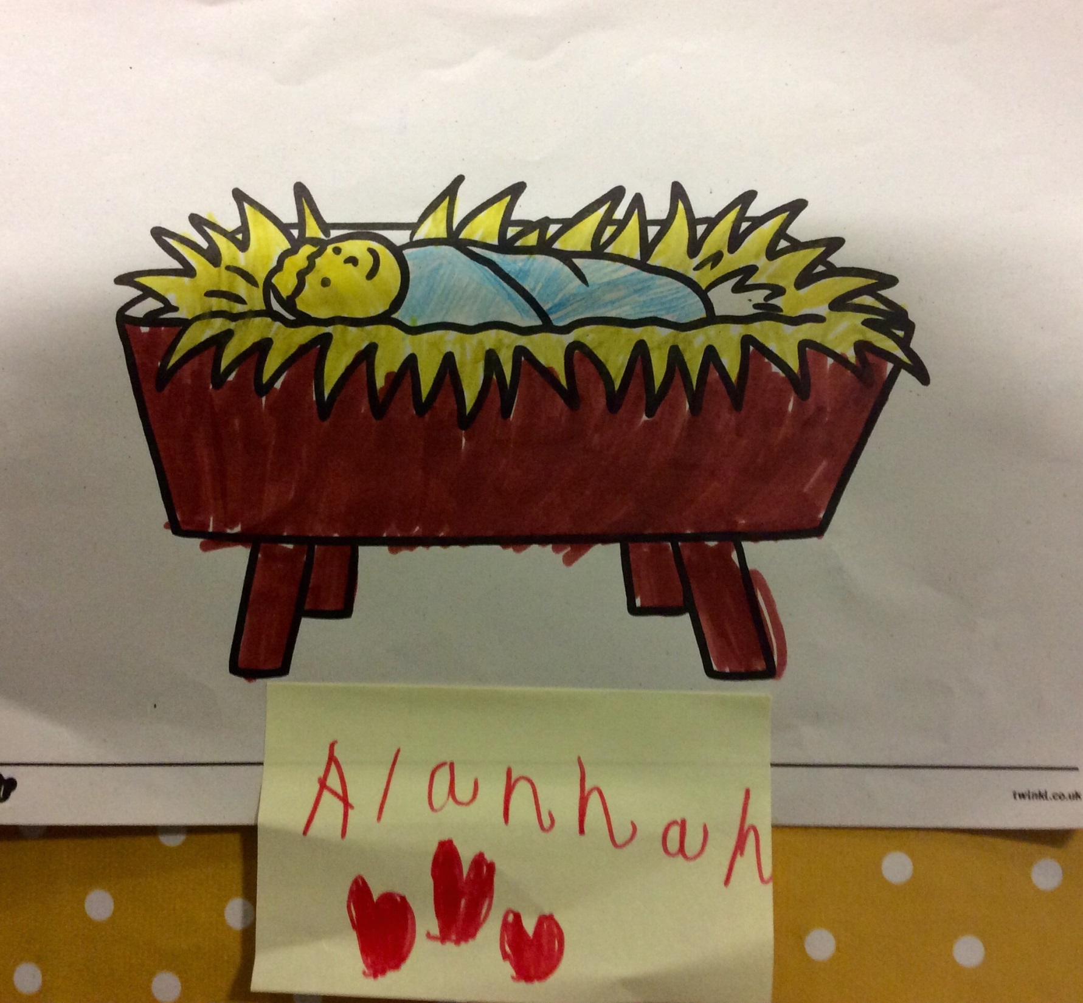

Slide 8
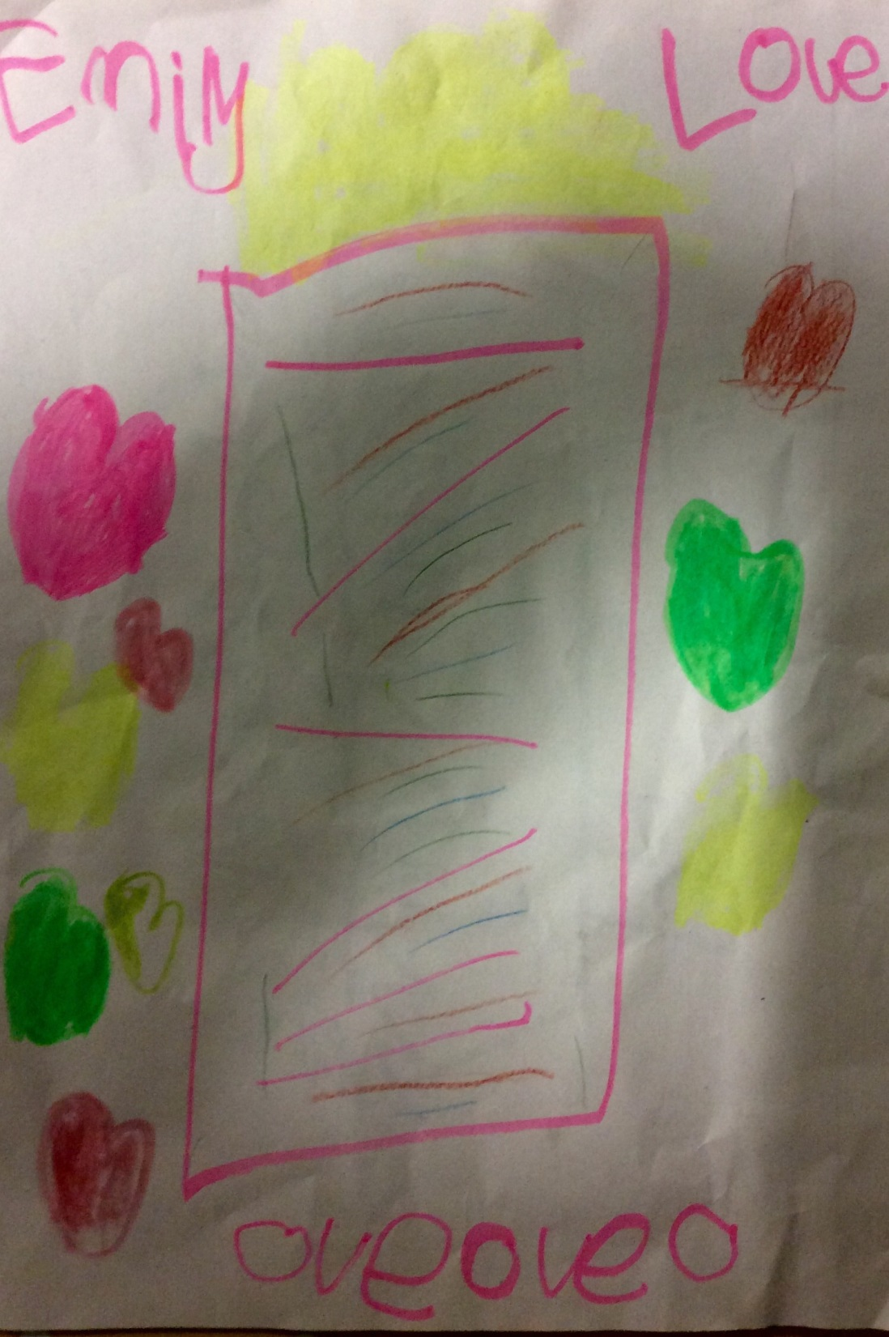

Slide 9
Year 1

Slide 10
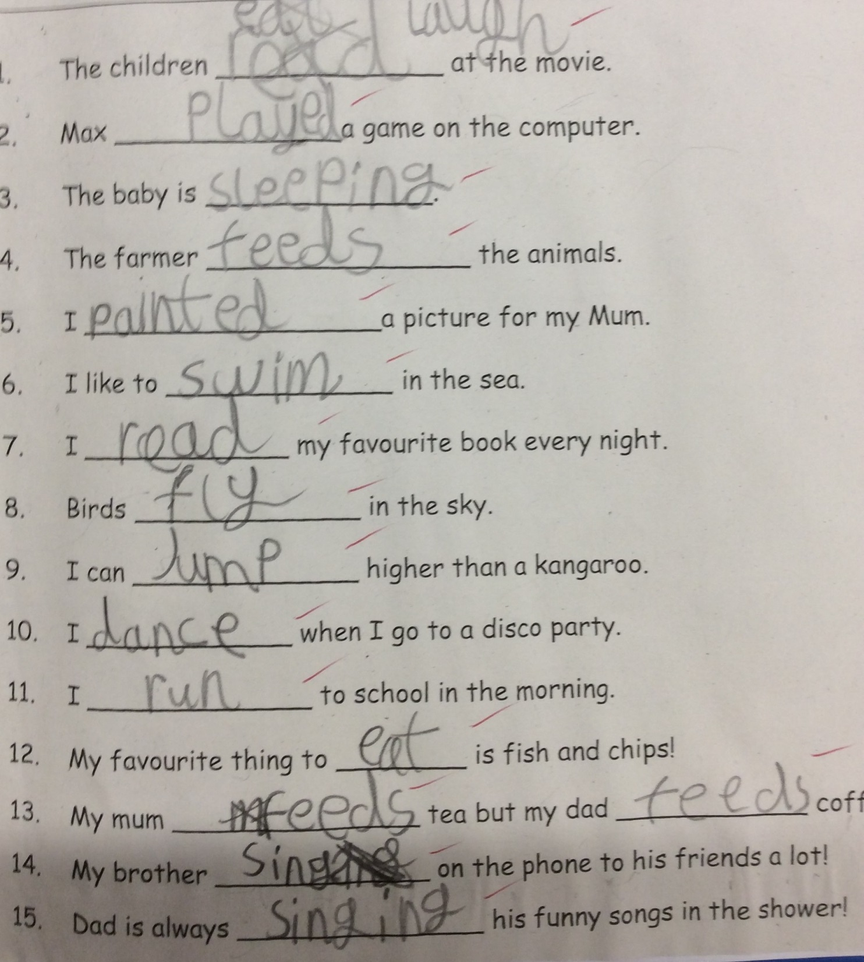

Slide 11
Year 2

Slide 12
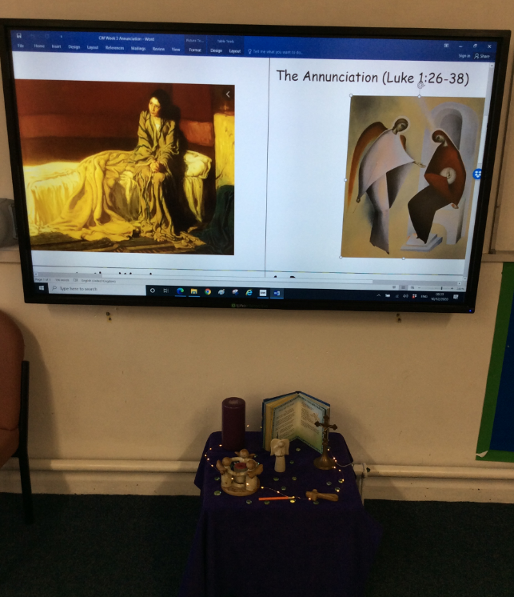

Slide 13
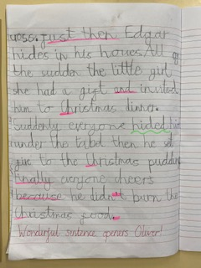

Slide 14
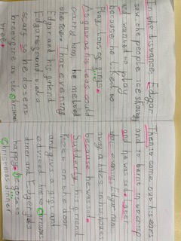

Slide 15
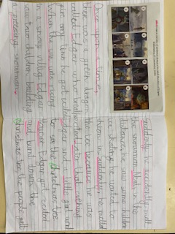

Slide 16
Year 3

Slide 17
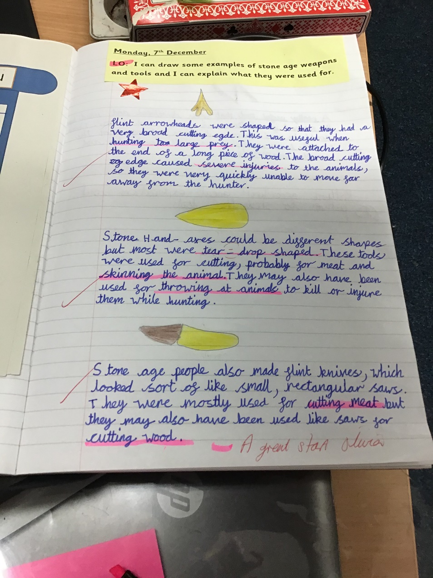

Slide 18
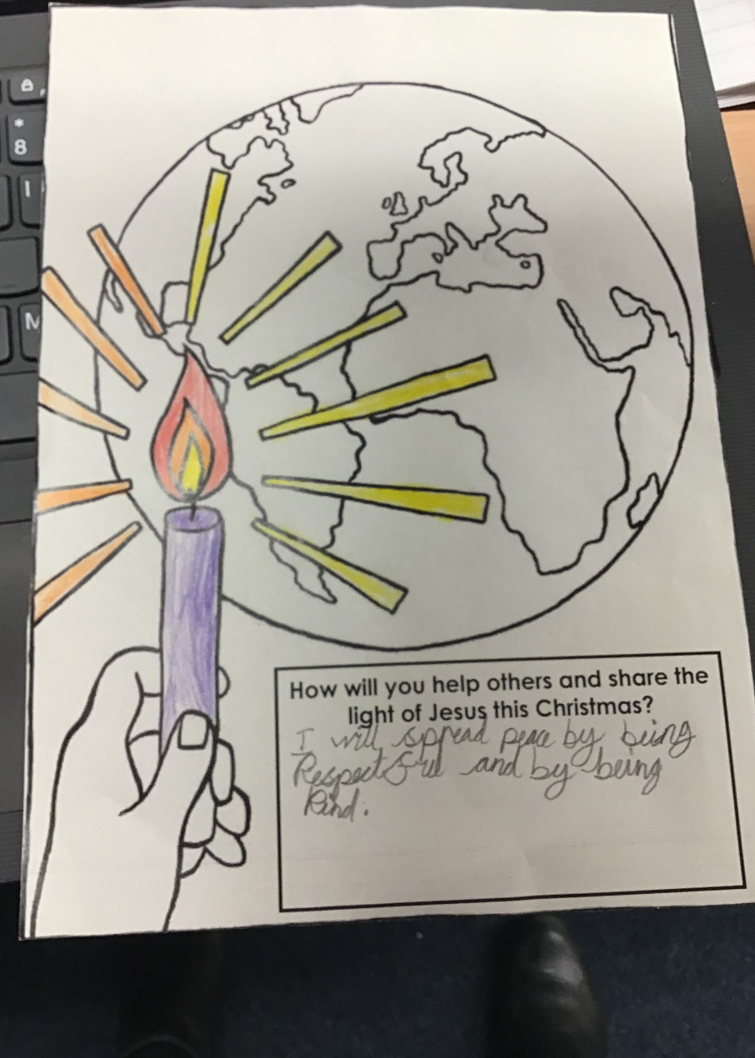

Slide 19
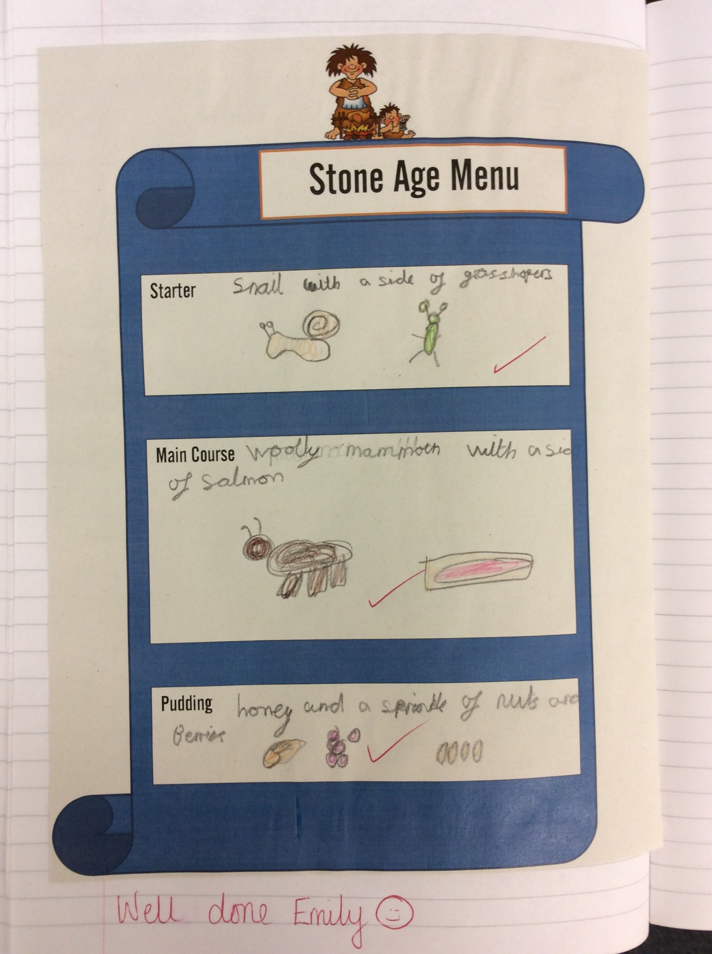

Slide 20
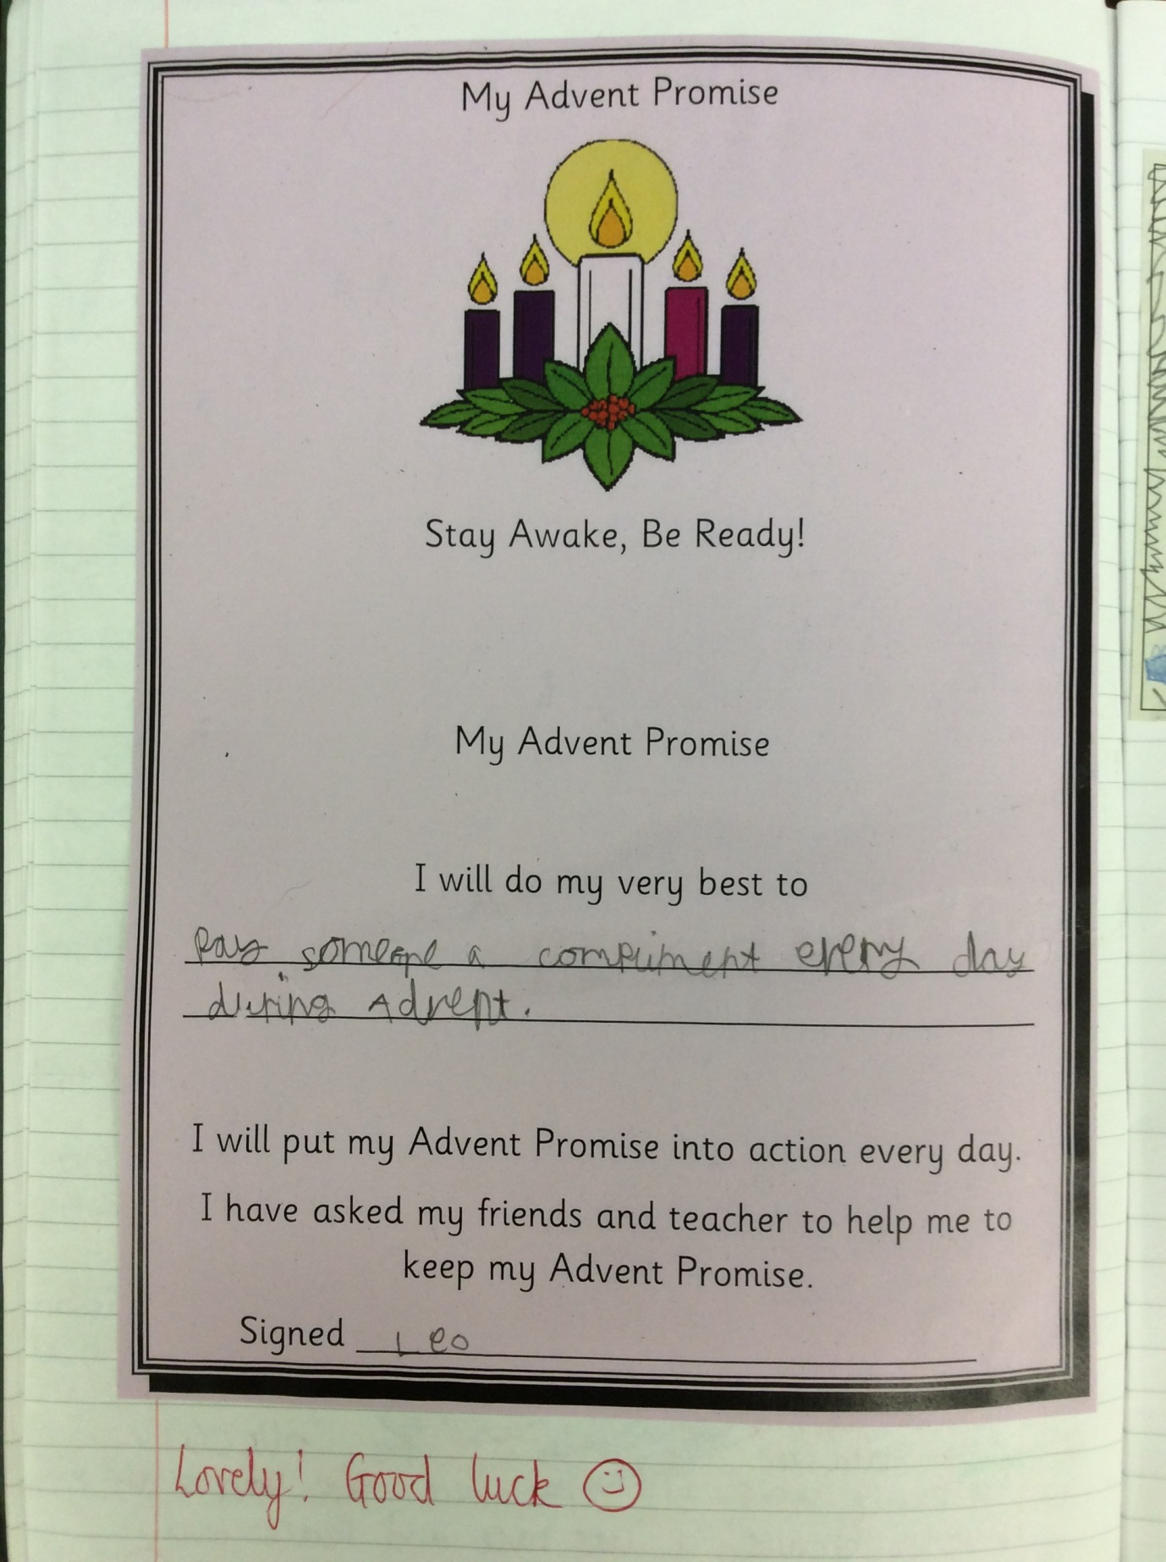

Slide 21
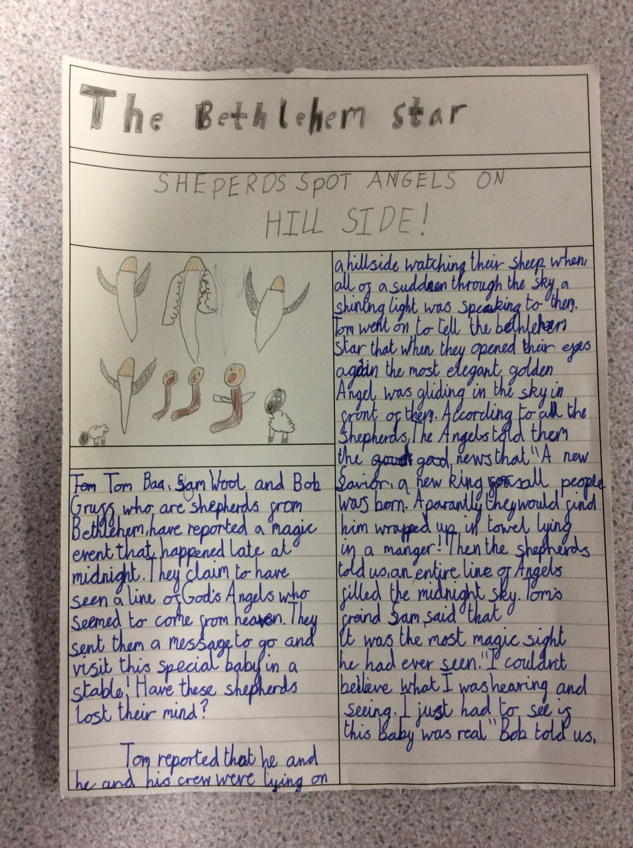

Slide 22
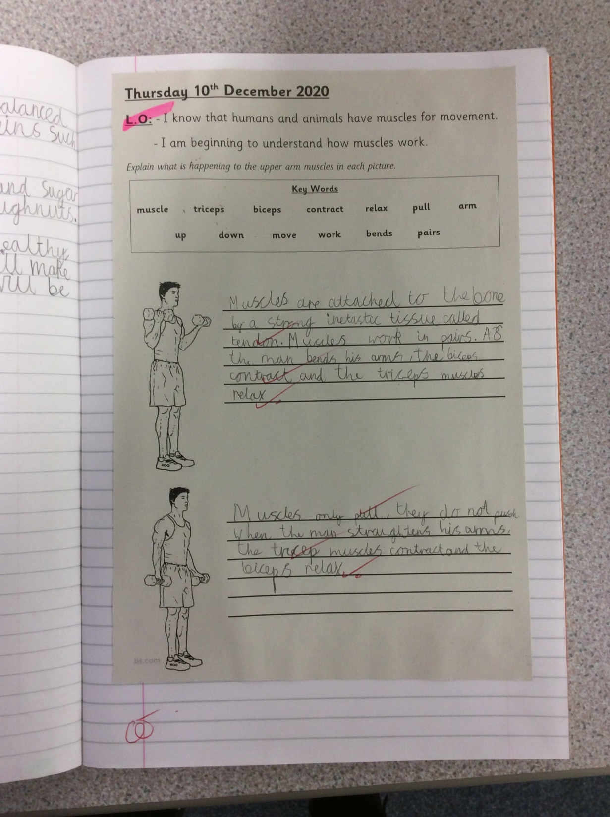

Slide 23
Year 4

Slide 24
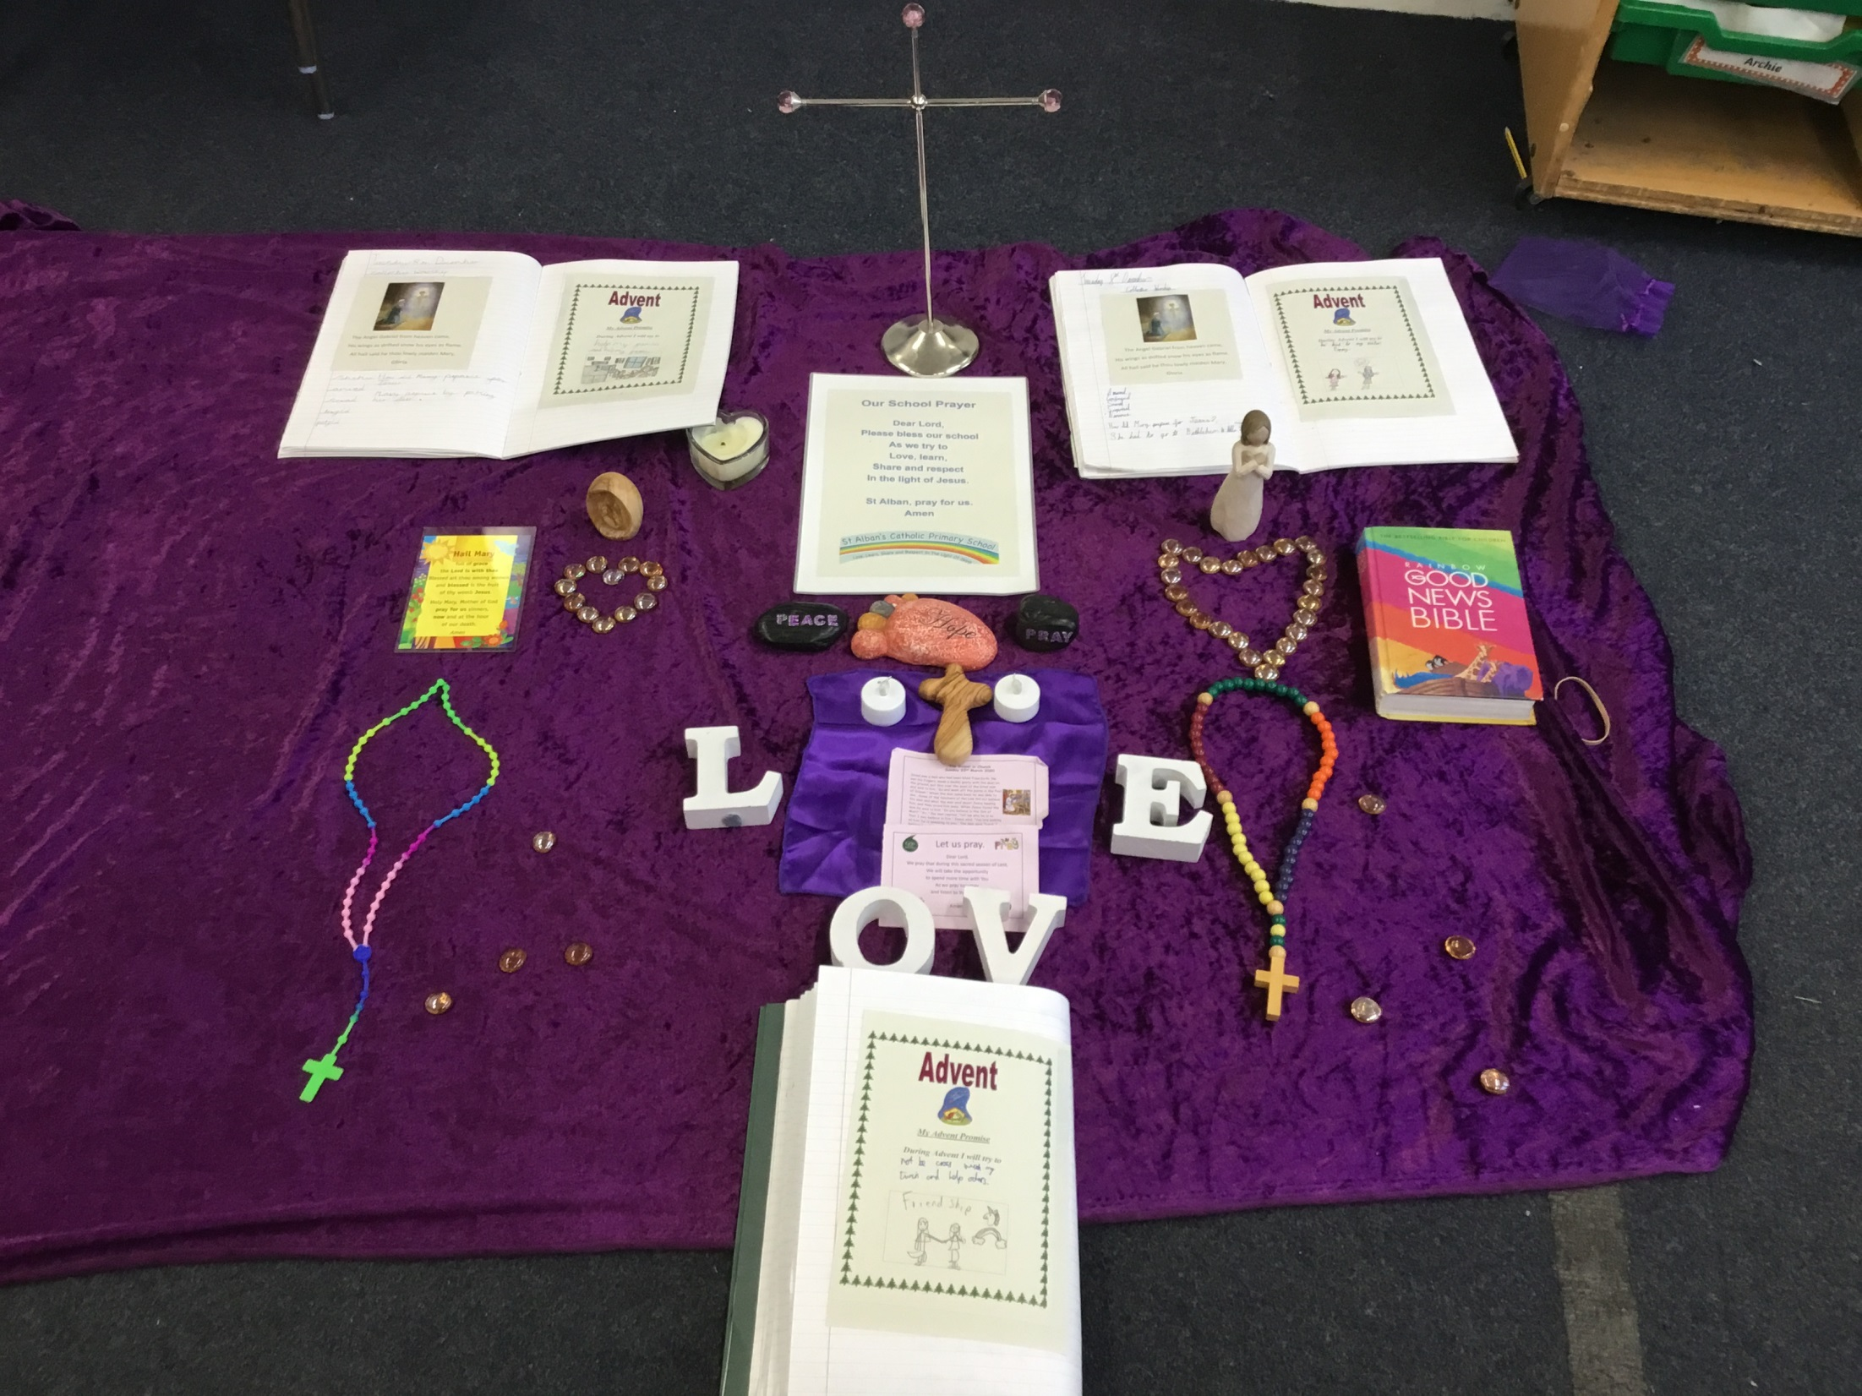

Slide 25
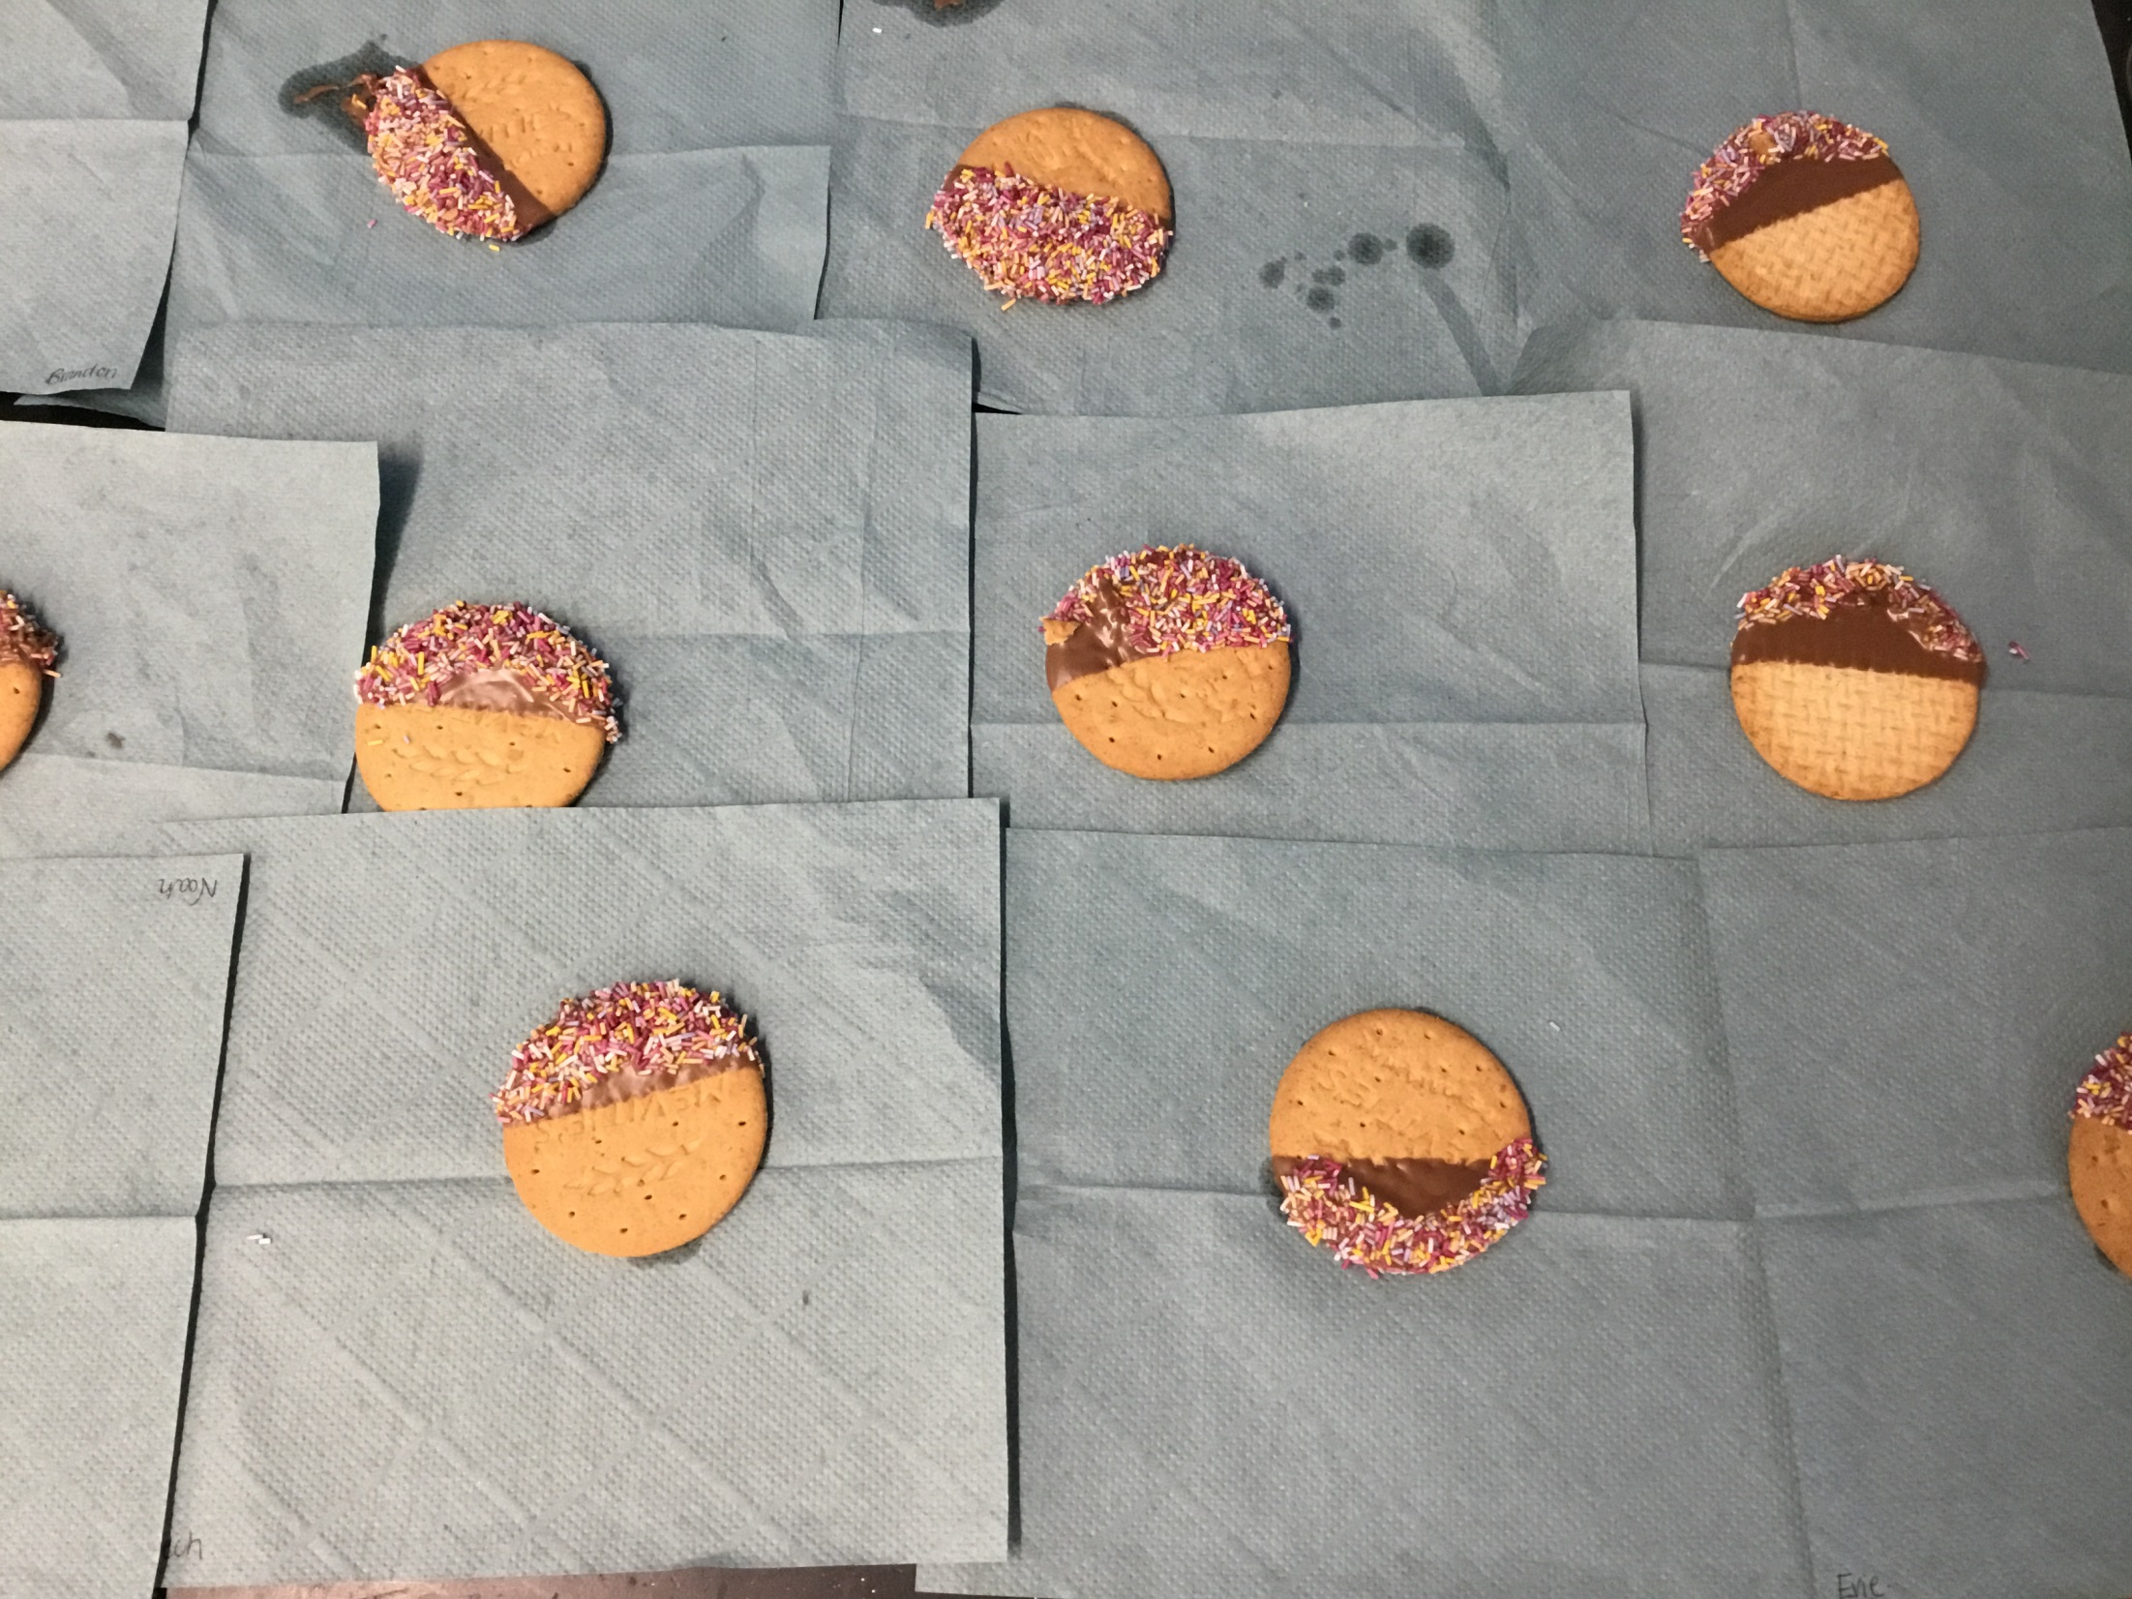

Slide 26
Year 5

Slide 27
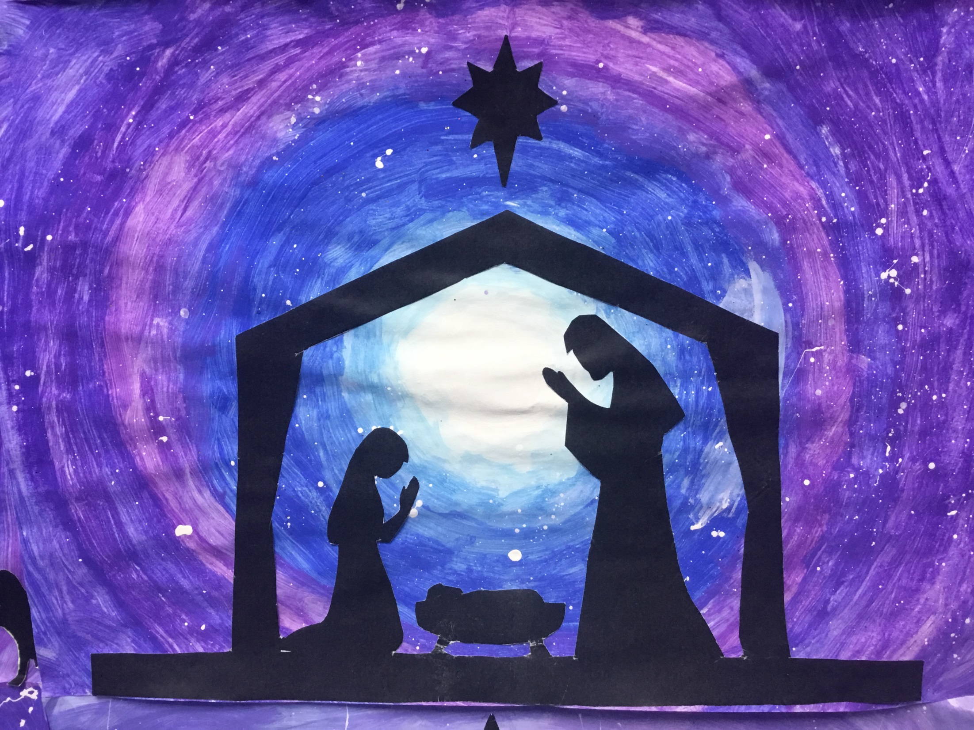

Slide 28
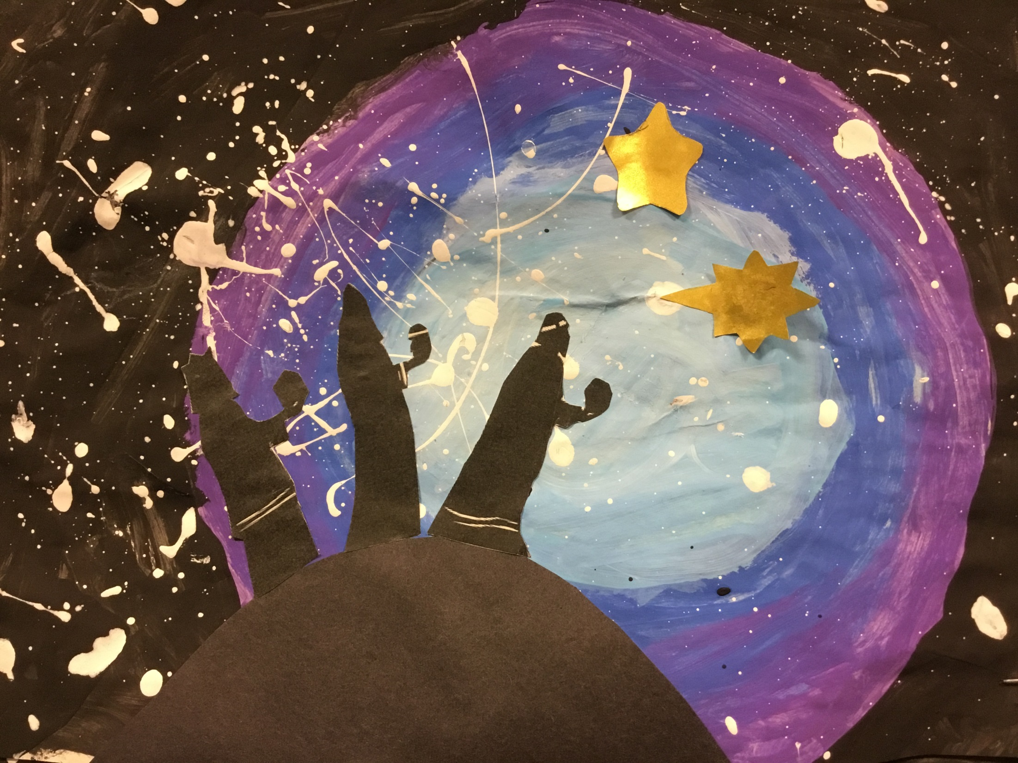

Slide 29
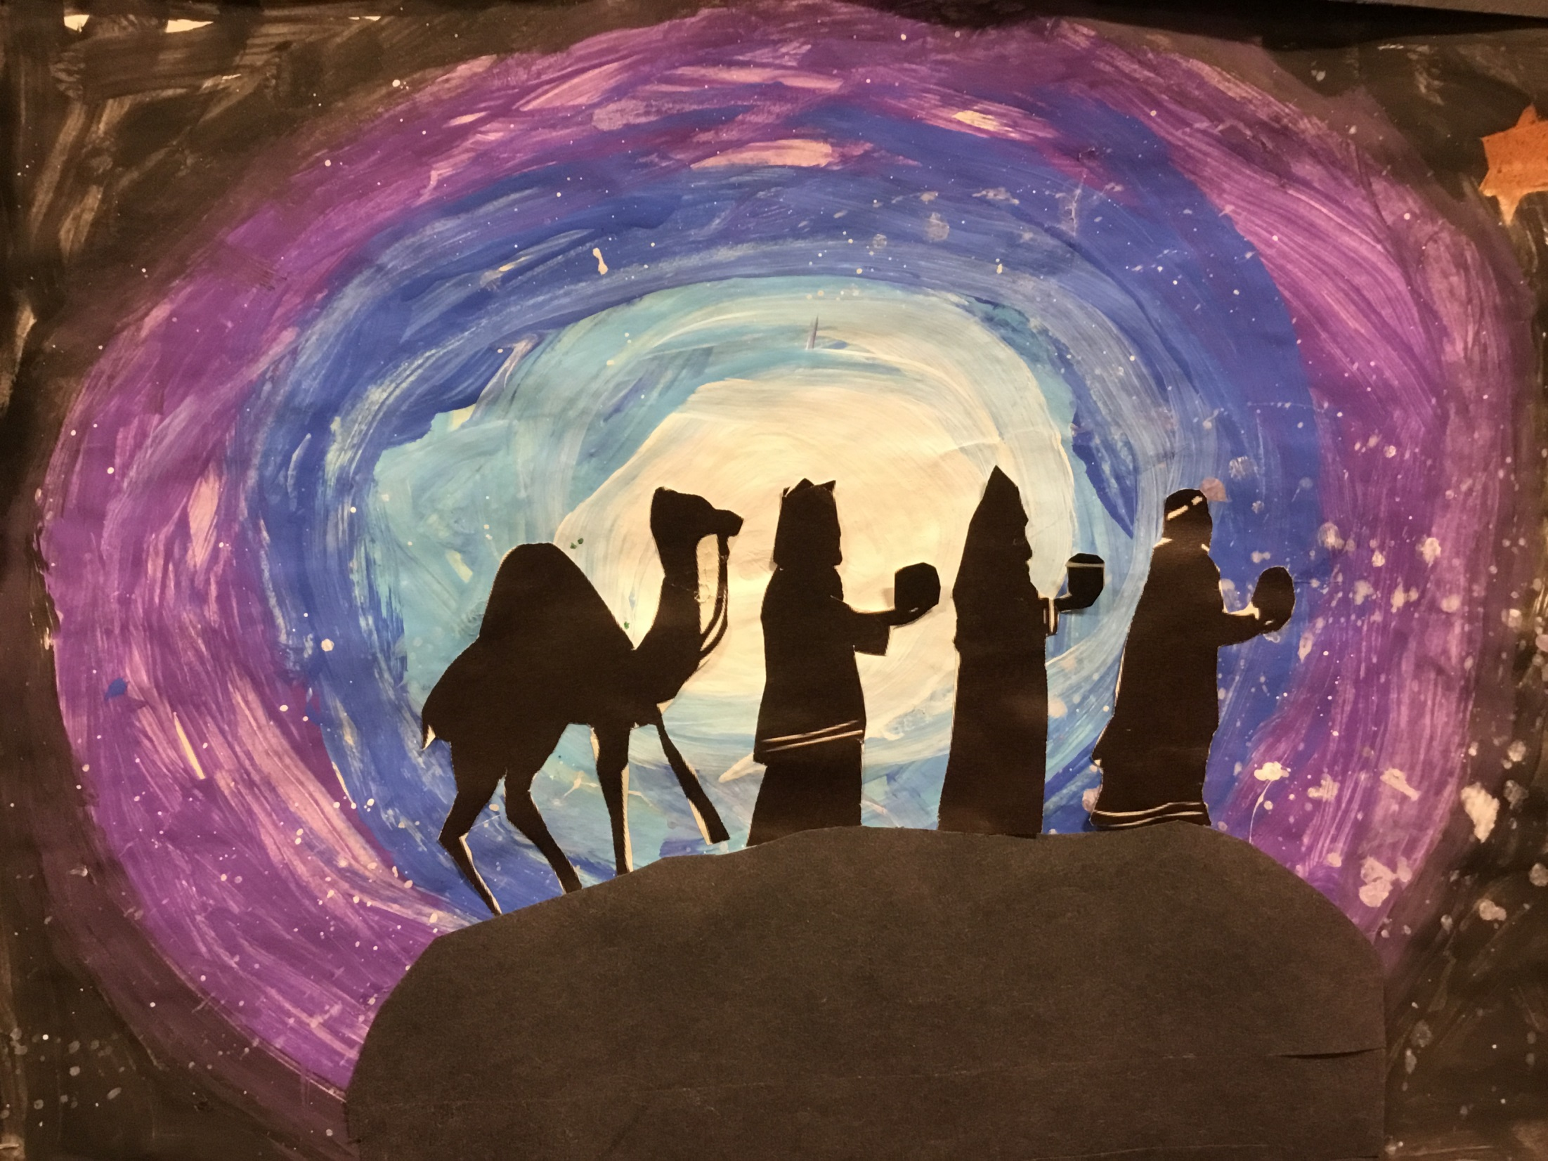

Slide 30
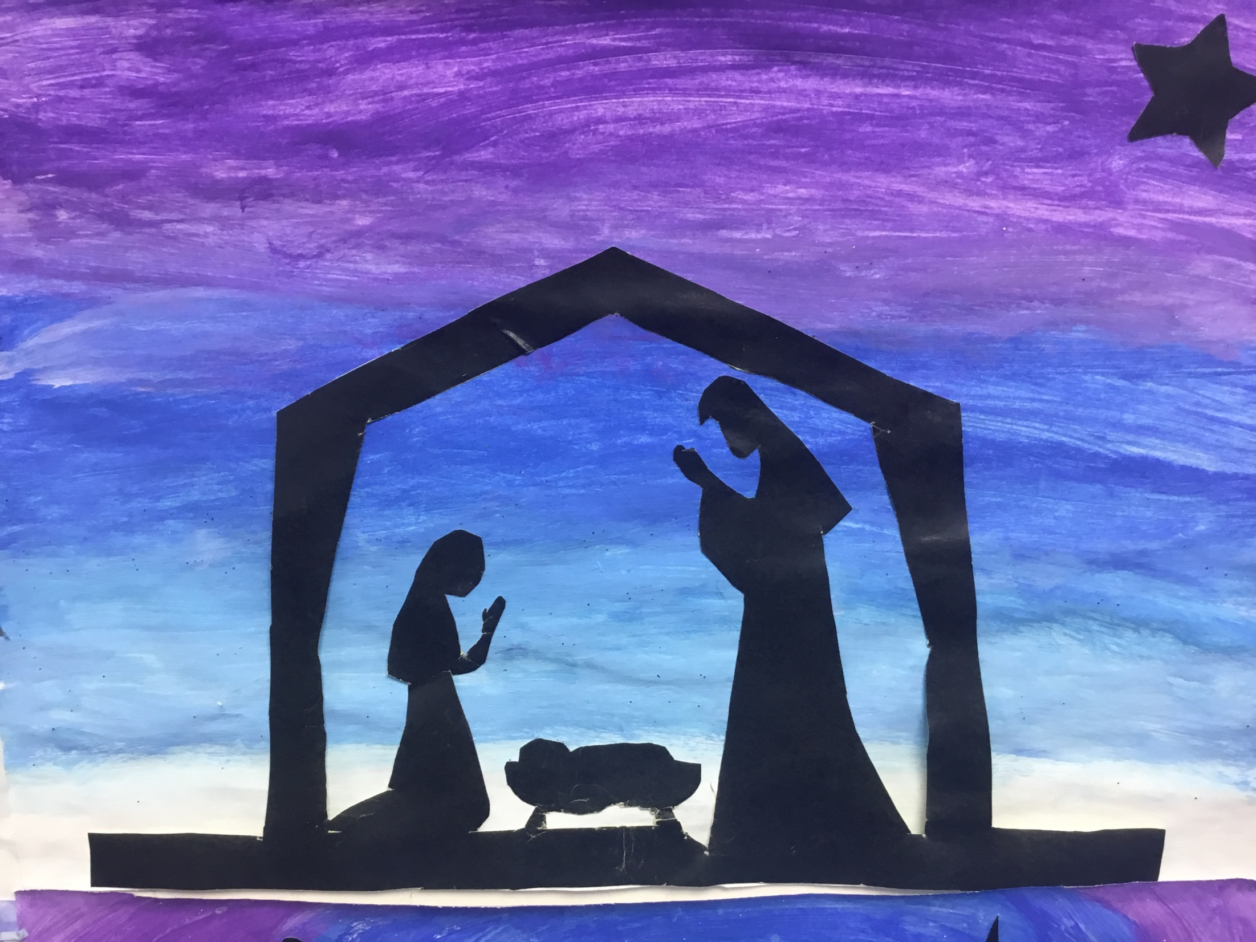

Slide 31
Year 6

Slide 32
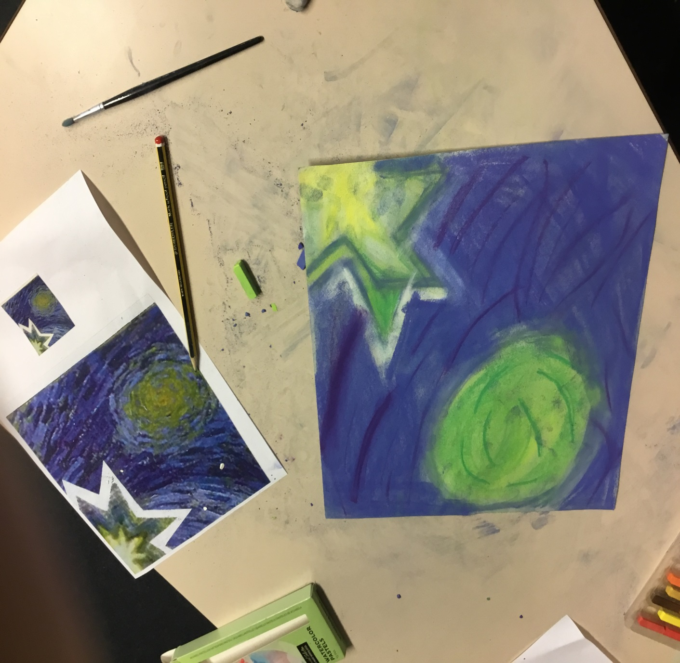

Slide 33
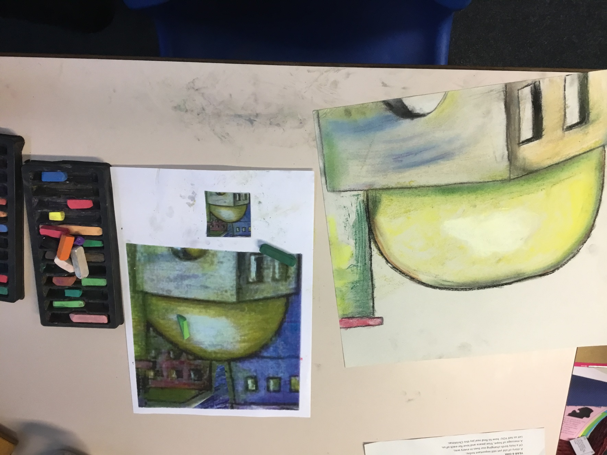

Slide 34


Slide 35


Slide 36


Slide 37
Have you remembered your Advent promises this week?
Notes:
GO FORTH - MISSION

Slide 38
WOW!
WELL DONE EVERYONE!

