Slide 1


CELEBRATION ASSEMBLY
FRIDAY 19TH MARCH

Slide 2

Notes:
WORD

Slide 3
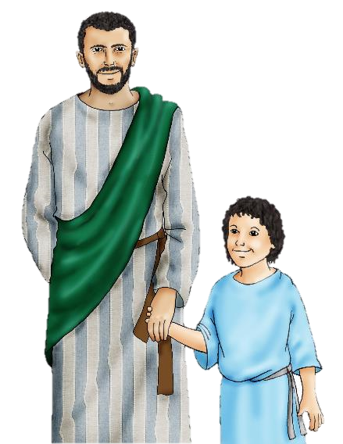
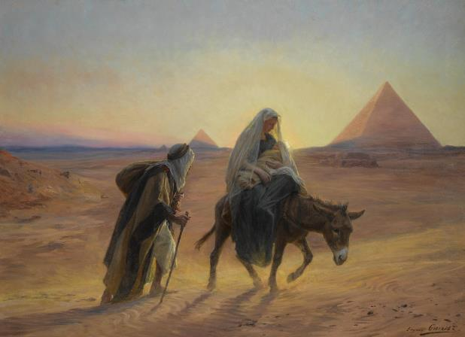
A Week of Prayer to St Joseph
Dear St Joseph,
God trusted you to care for his Son, Jesus and Mary, your wife.
Blessed Joseph,
We ask you to be like a father to us.
Guide us and ask God to give us hope and courage, and to keep us safe from harm.
St Joseph, Pray for us.

Slide 4
Hail Mary
Hail Mary, full of grace
The Lord is with thee.
Blessed art thou among women
And blessed is the fruit
Of thy womb, Jesus.
Holy Mary, mother of God,
Pray for us sinners now
And at the hour of our death.
Amen

Slide 5

Dear Lord,
Please bless our school
As we try to
Love, learn,
Share and respect
In the light of Jesus.
St Alban, pray for us.
Amen

Slide 6

Reception

Slide 7
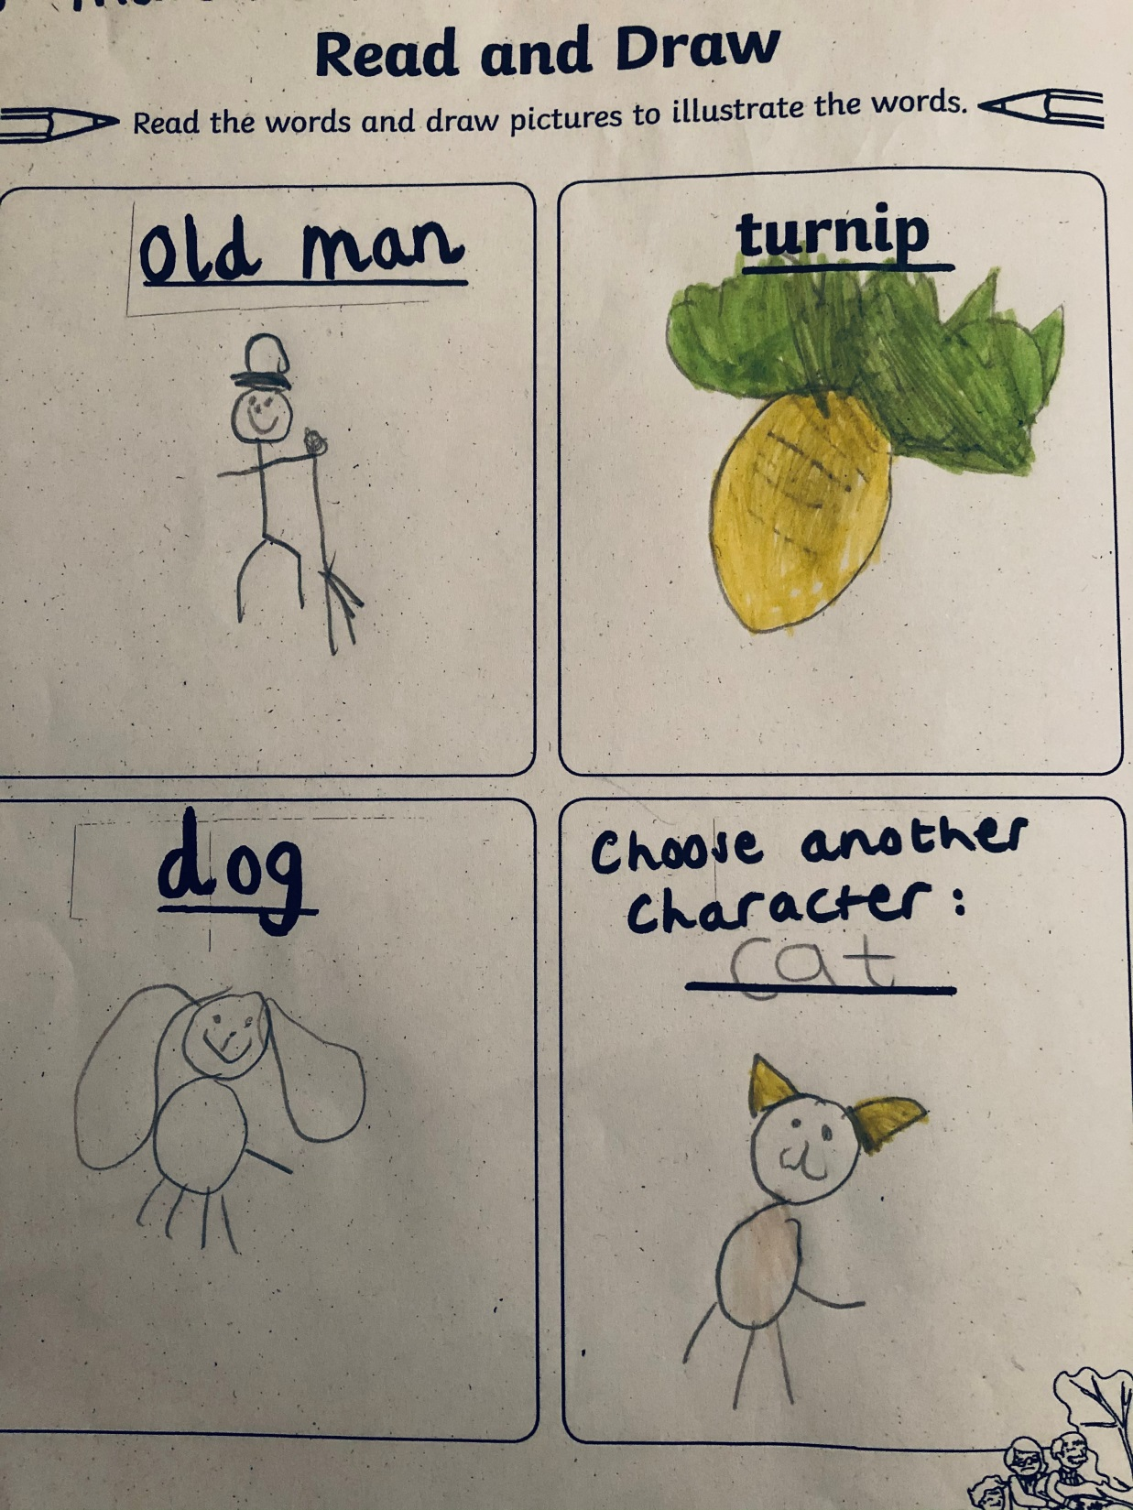

Slide 8
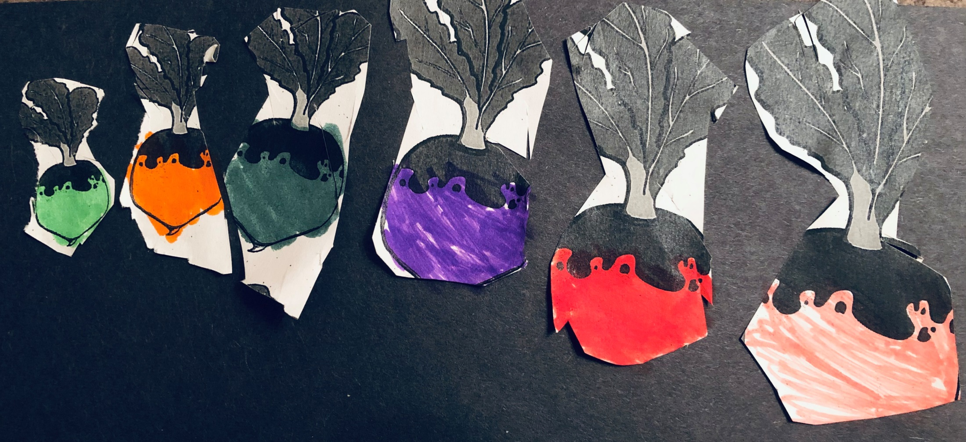

Slide 9
Year 1

Slide 10
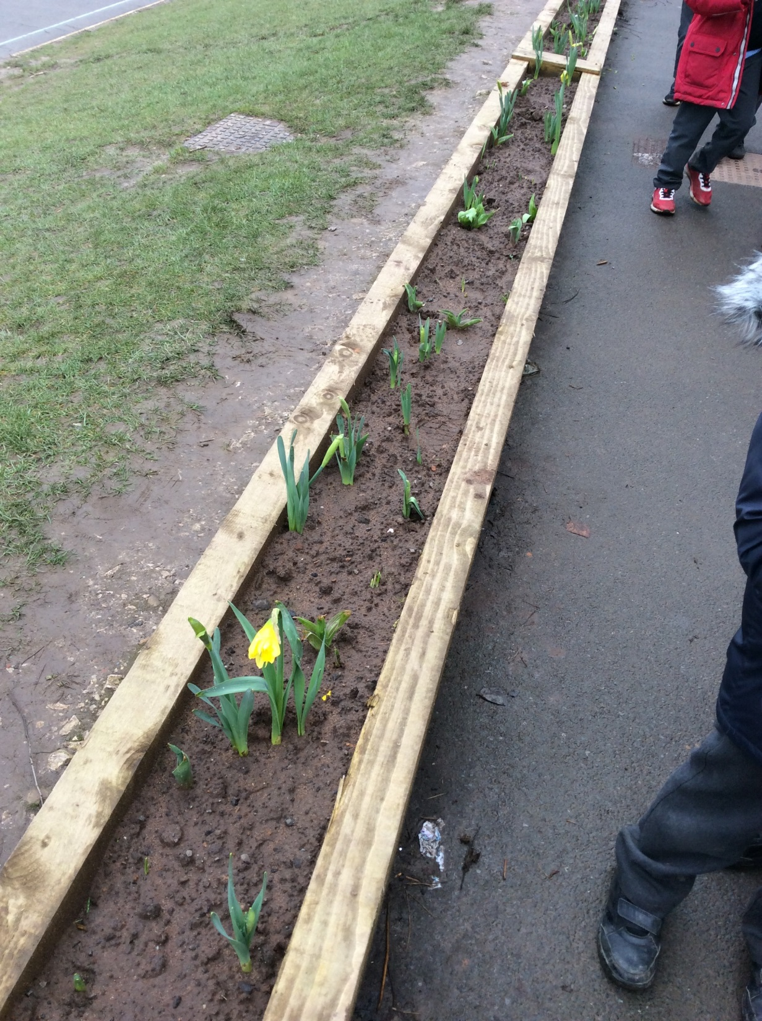

Slide 11
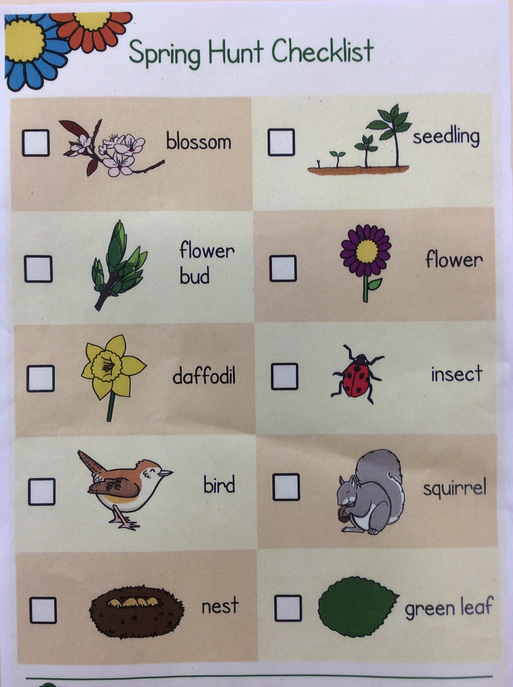

Slide 12
Year 2

Slide 13
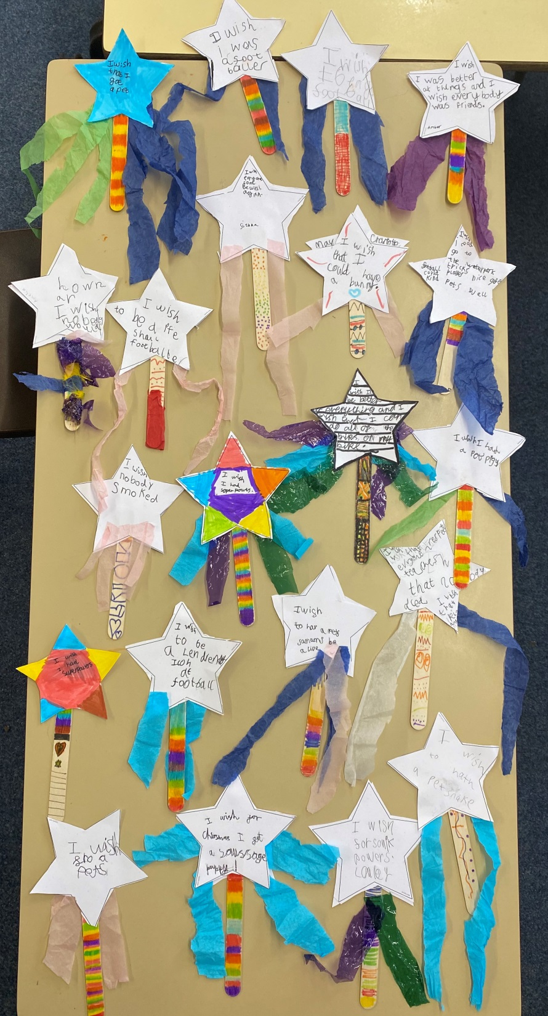

Slide 14


Slide 15
Year 3

Slide 16
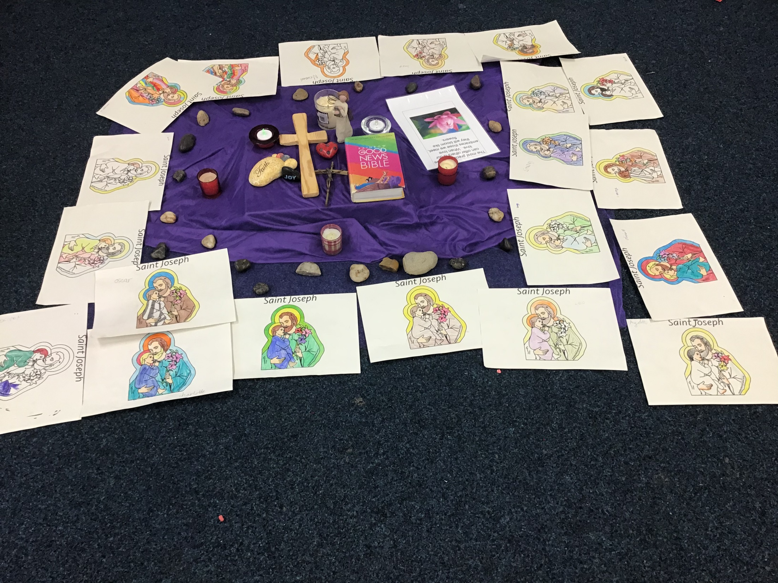

Slide 17
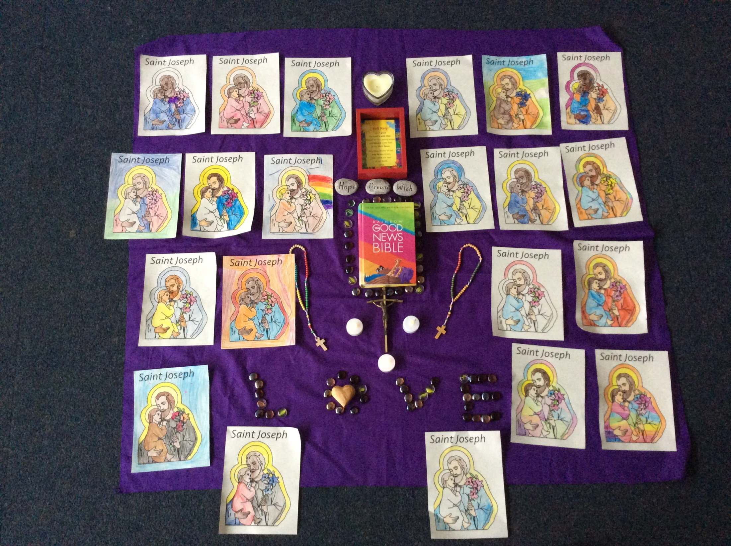

Slide 18
Year 4

Slide 21
Year 5

Slide 22
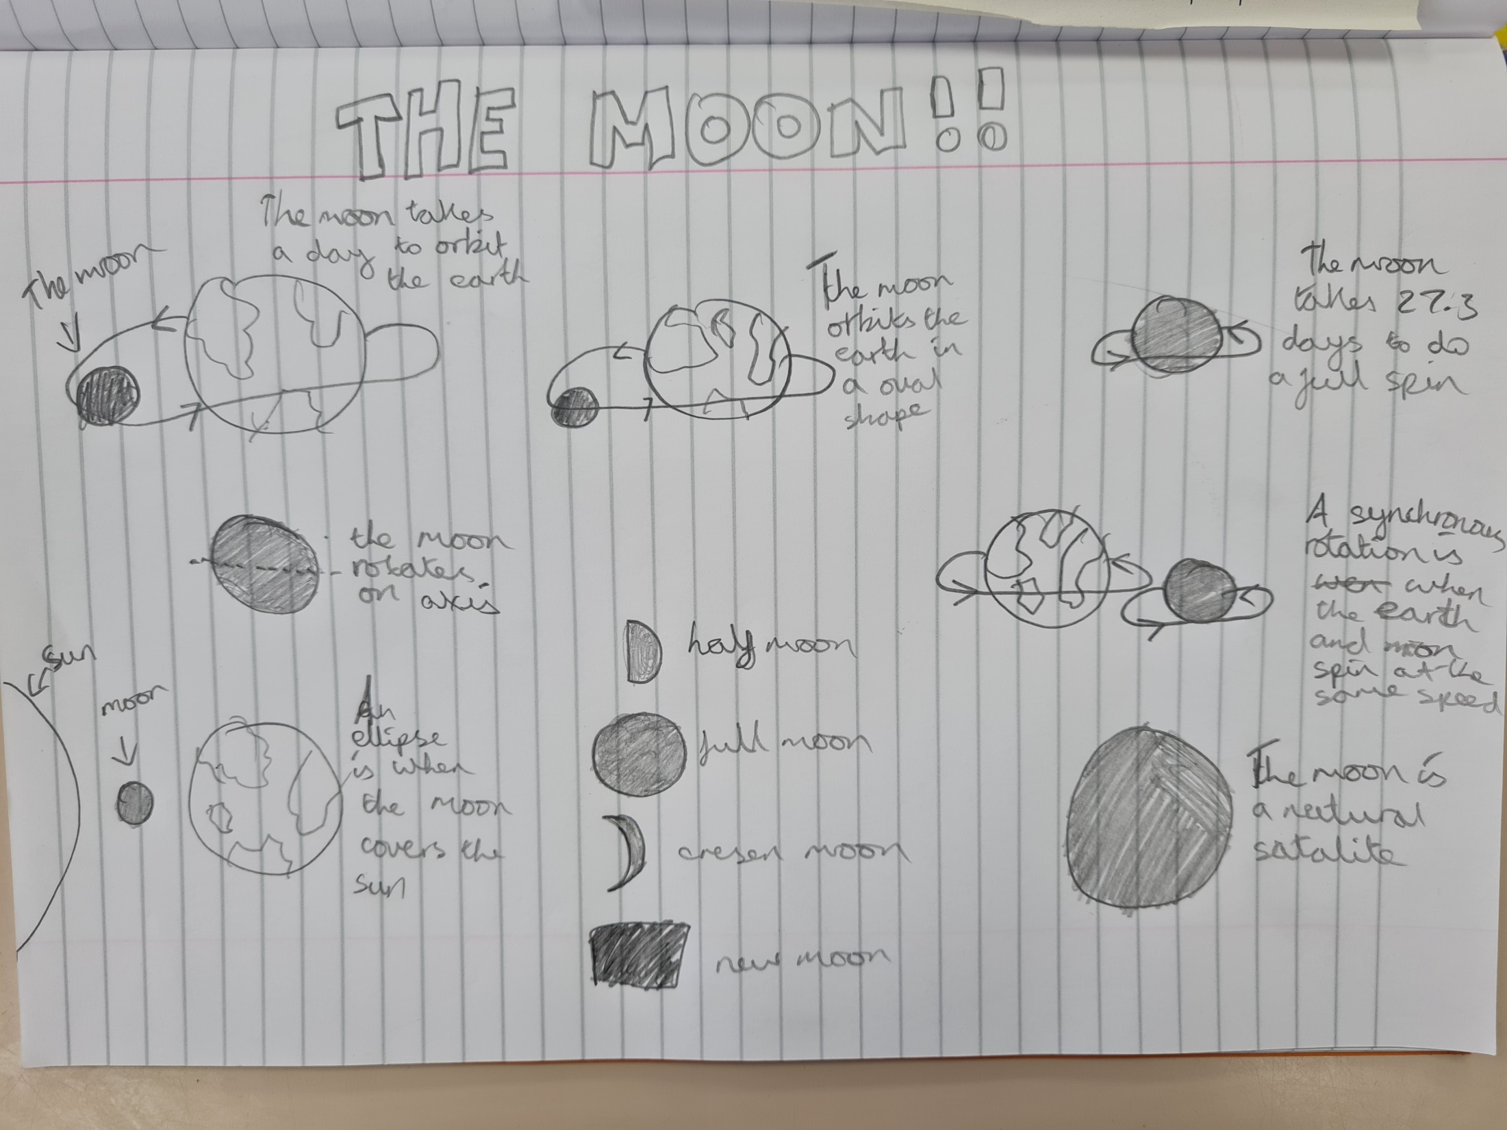

Slide 23
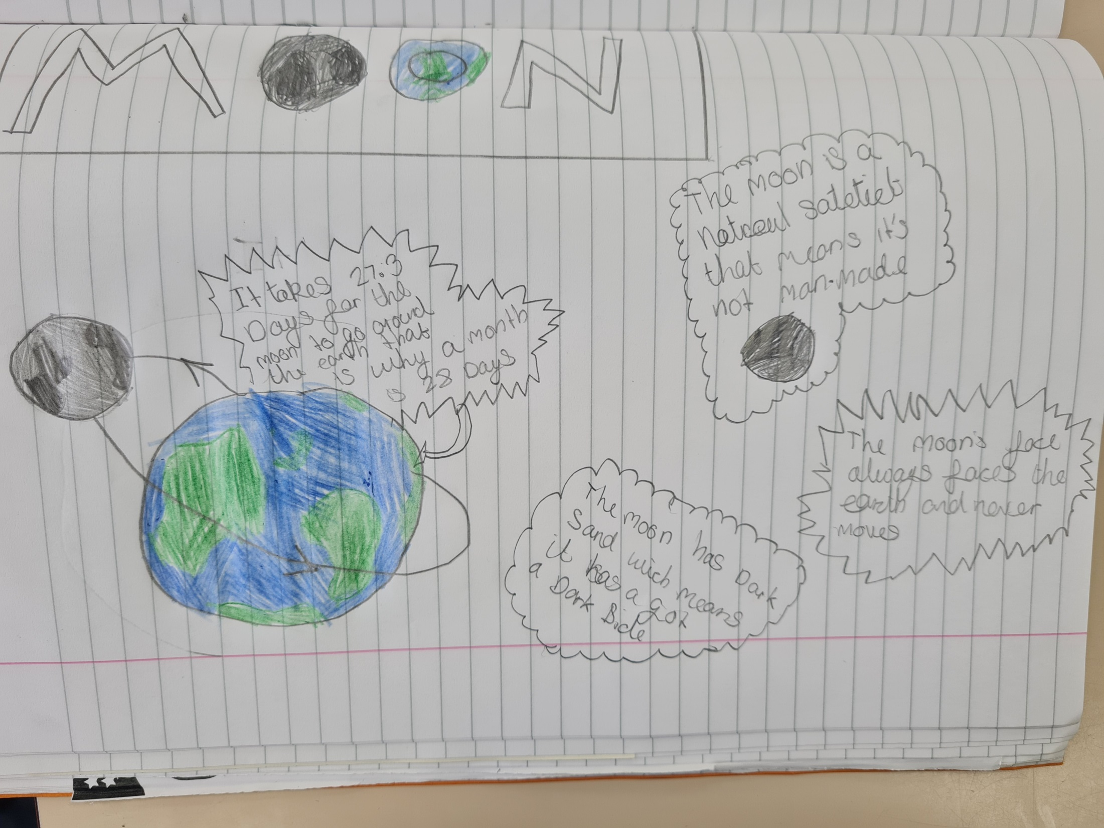

Slide 24
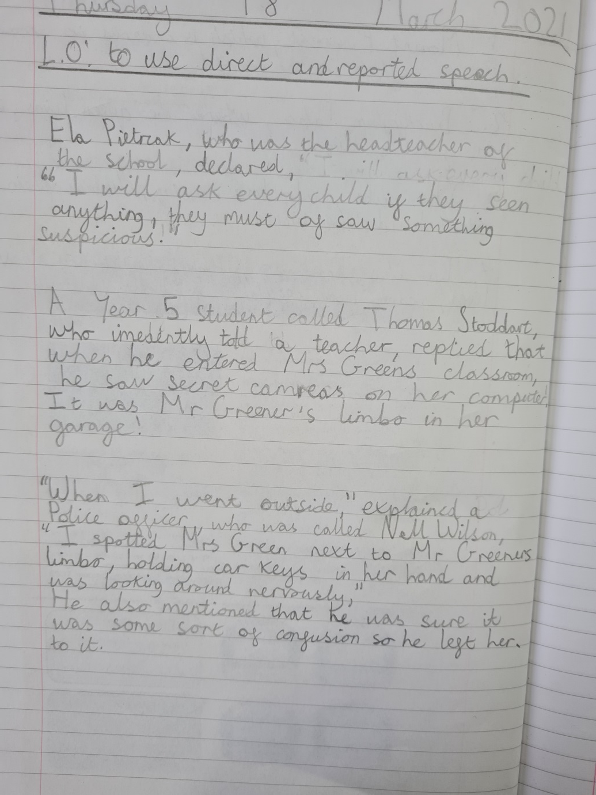

Slide 25
Year 6

Slide 26


Slide 27
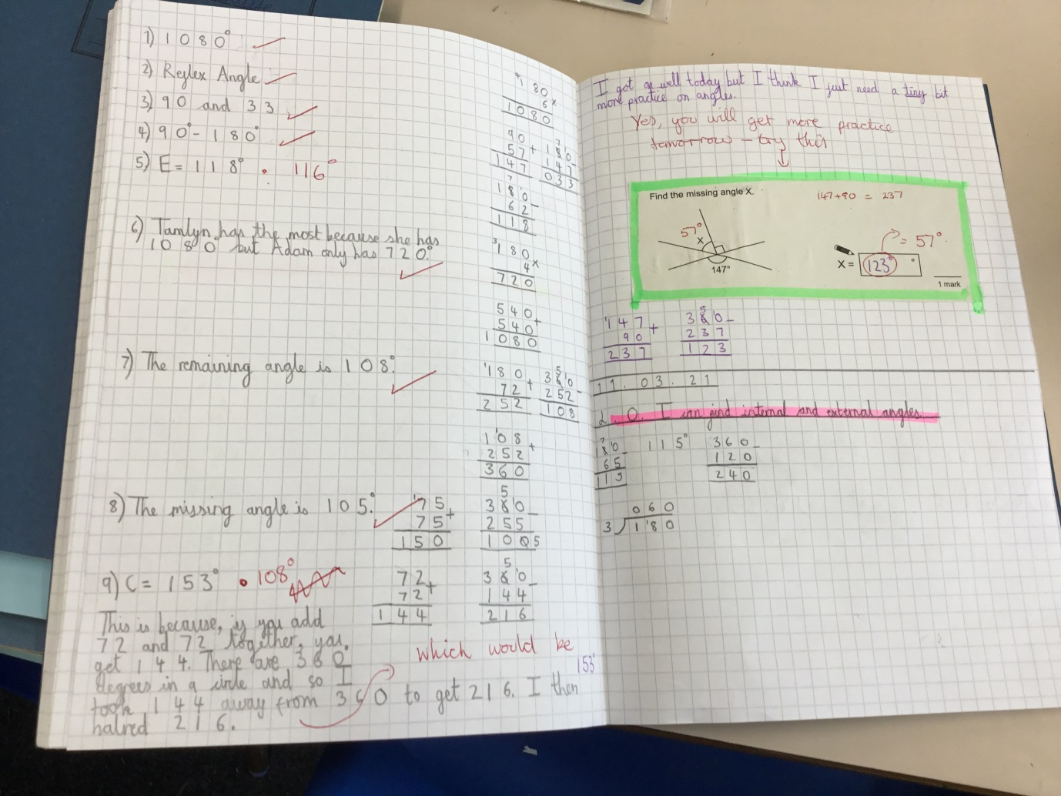

Slide 28


Slide 29


Slide 30


Slide 31


Let’s try to keep our Lenten promises, this week!
Notes:
GO FORTH - MISSION

Slide 32


Let us pray.
Dear St Joseph,
God trusted you to care for his Son, Jesus and Mary, your wife.
Blessed Joseph,
We ask you to be like a father to us.
Guide us and ask God to give us hope and courage, and to keep us safe from harm.
St Joseph, Pray for us.
Amen.

Slide 33


Irish Blessing
May there always be work, for your hands to do,
May your purse always hold a coin or two,
May the sun always shine on your windowpane,
May a rainbow be certain to follow each rain,
May the hand of a friend always be near you,
May God fill your heart with gladness, to cheer you.

Slide 34
WOW!
WELL DONE EVERYONE!

