Slide 1


CELEBRATION ASSEMBLY
THURSDAY 25TH MARCH

Slide 2

Notes:
WORD

Slide 3
Hail Mary
Hail Mary, full of grace
The Lord is with thee.
Blessed art thou among women
And blessed is the fruit
Of thy womb, Jesus.
Holy Mary, mother of God,
Pray for us sinners now
And at the hour of our death.
Amen

Slide 4

Dear Lord,
Please bless our school
As we try to
Love, learn,
Share and respect
In the light of Jesus.
St Alban, pray for us.
Amen

Slide 5

Reception

Slide 6
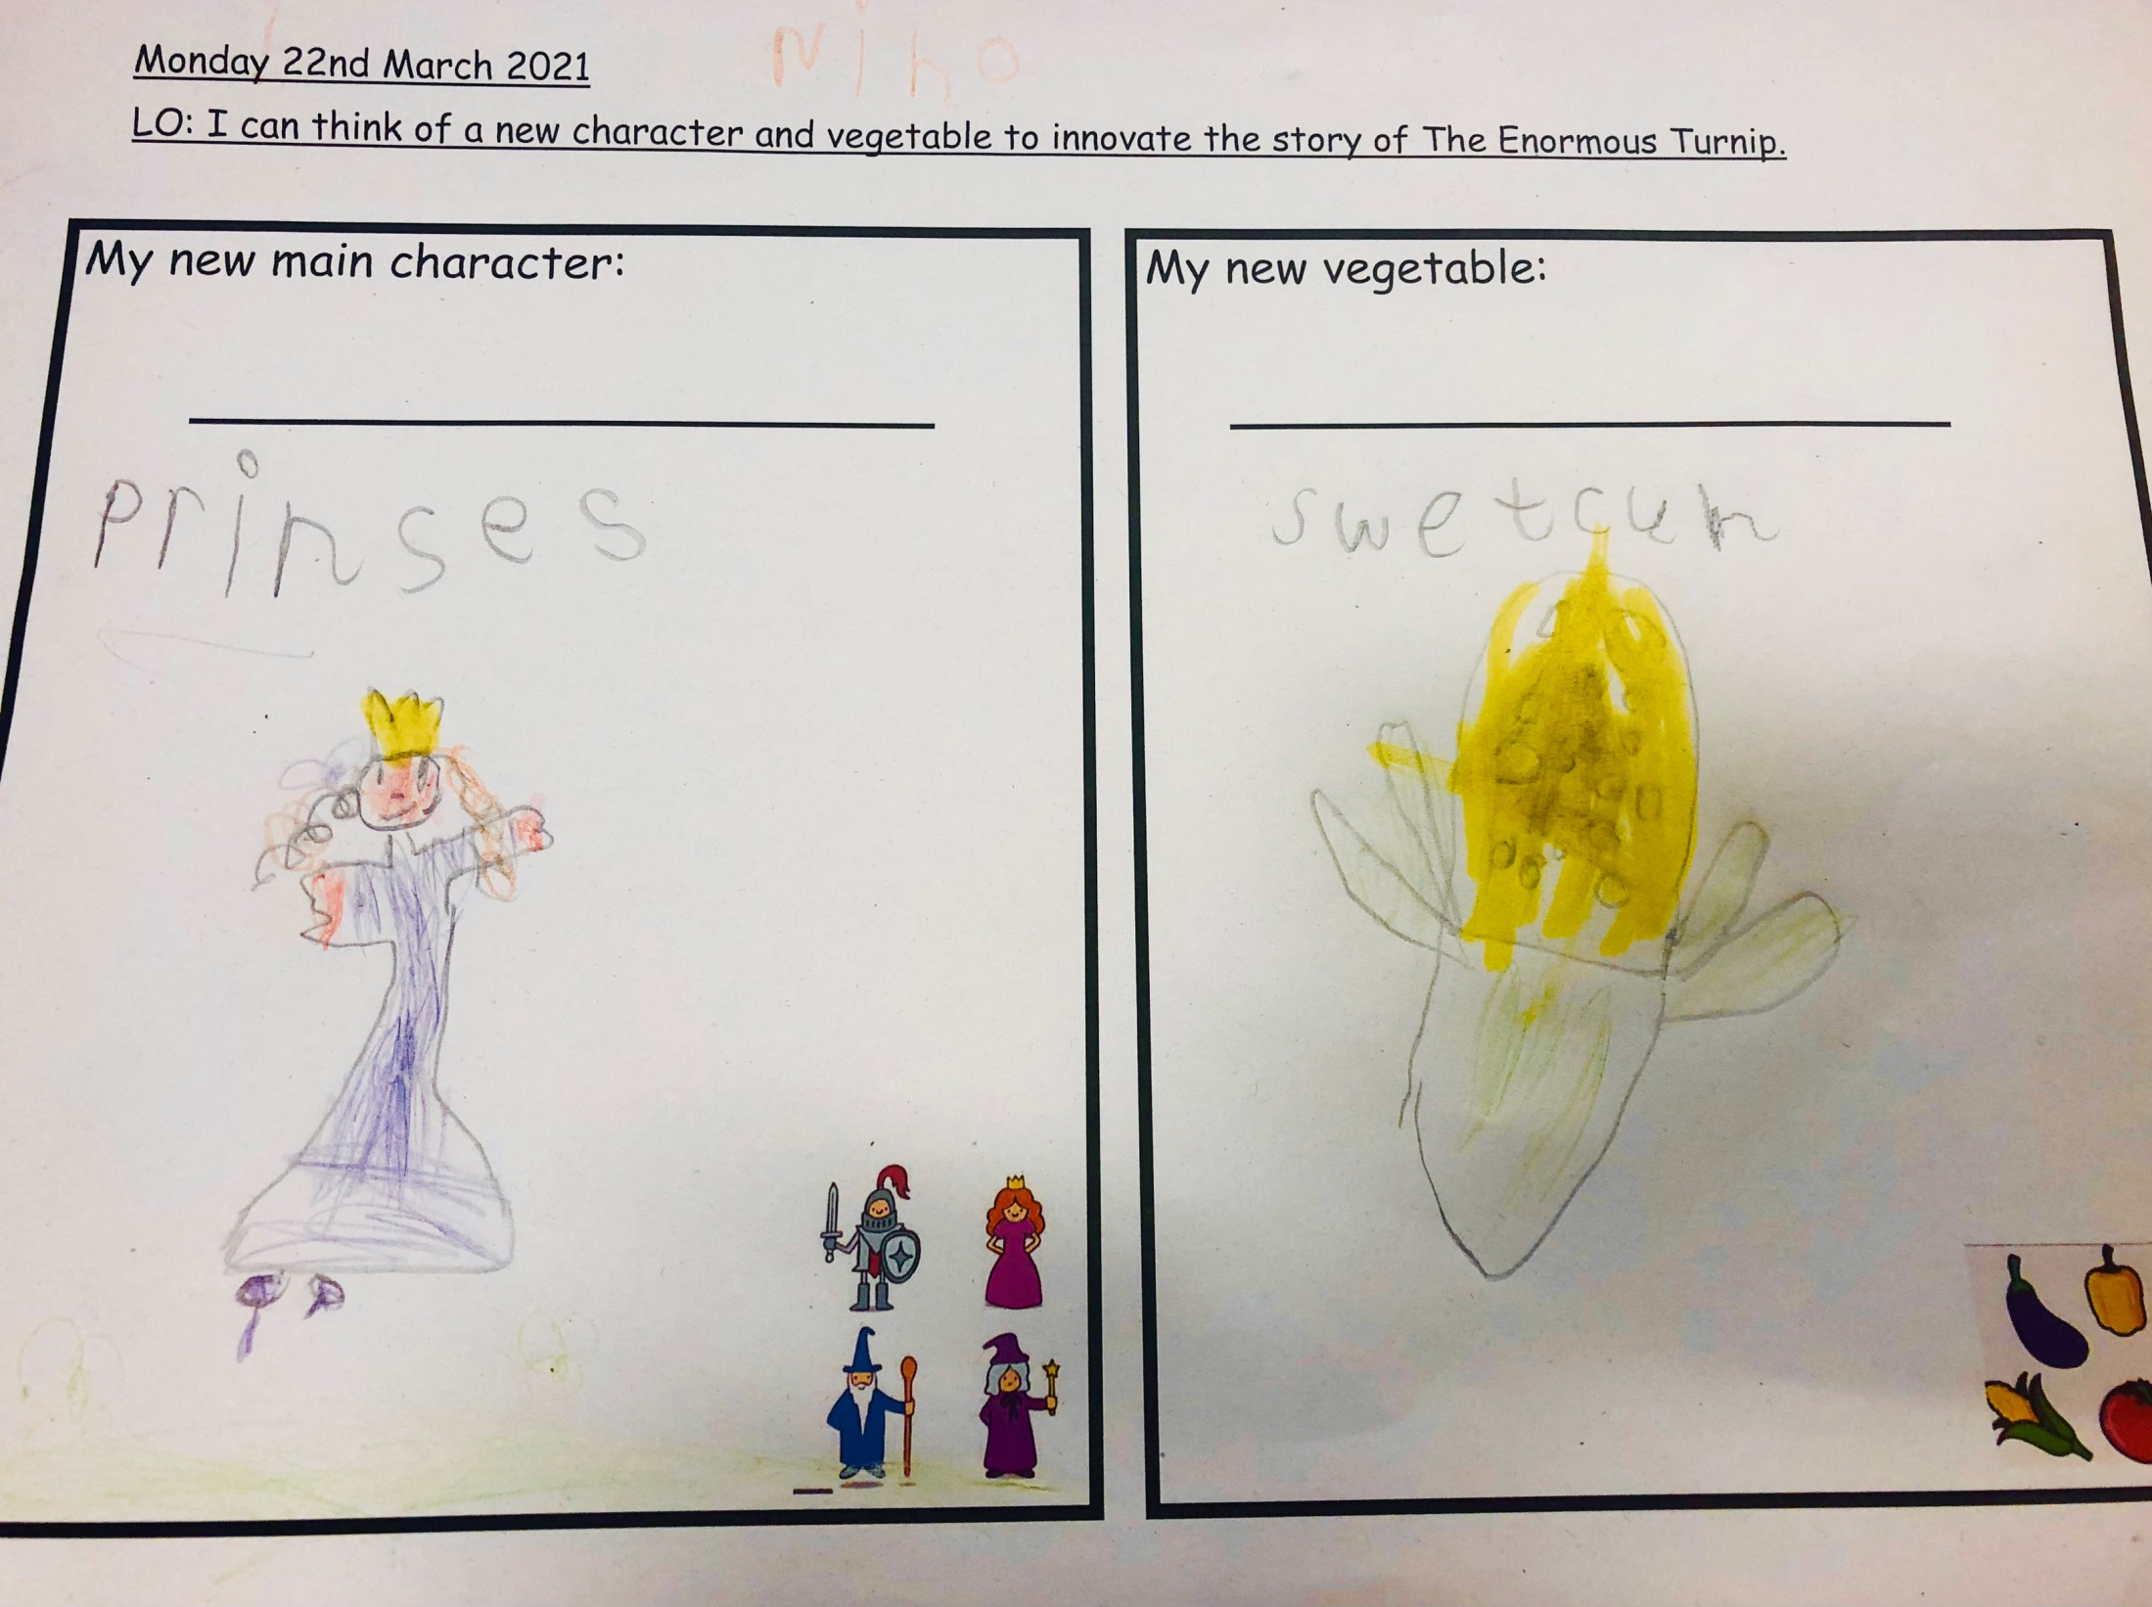

Slide 7
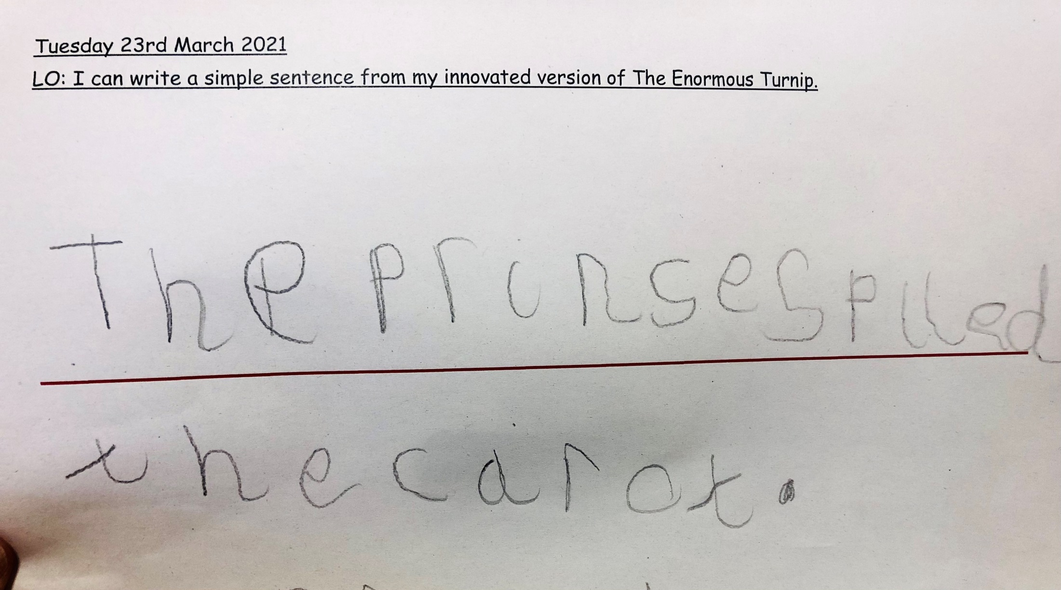

Slide 8
Year 1

Slide 9
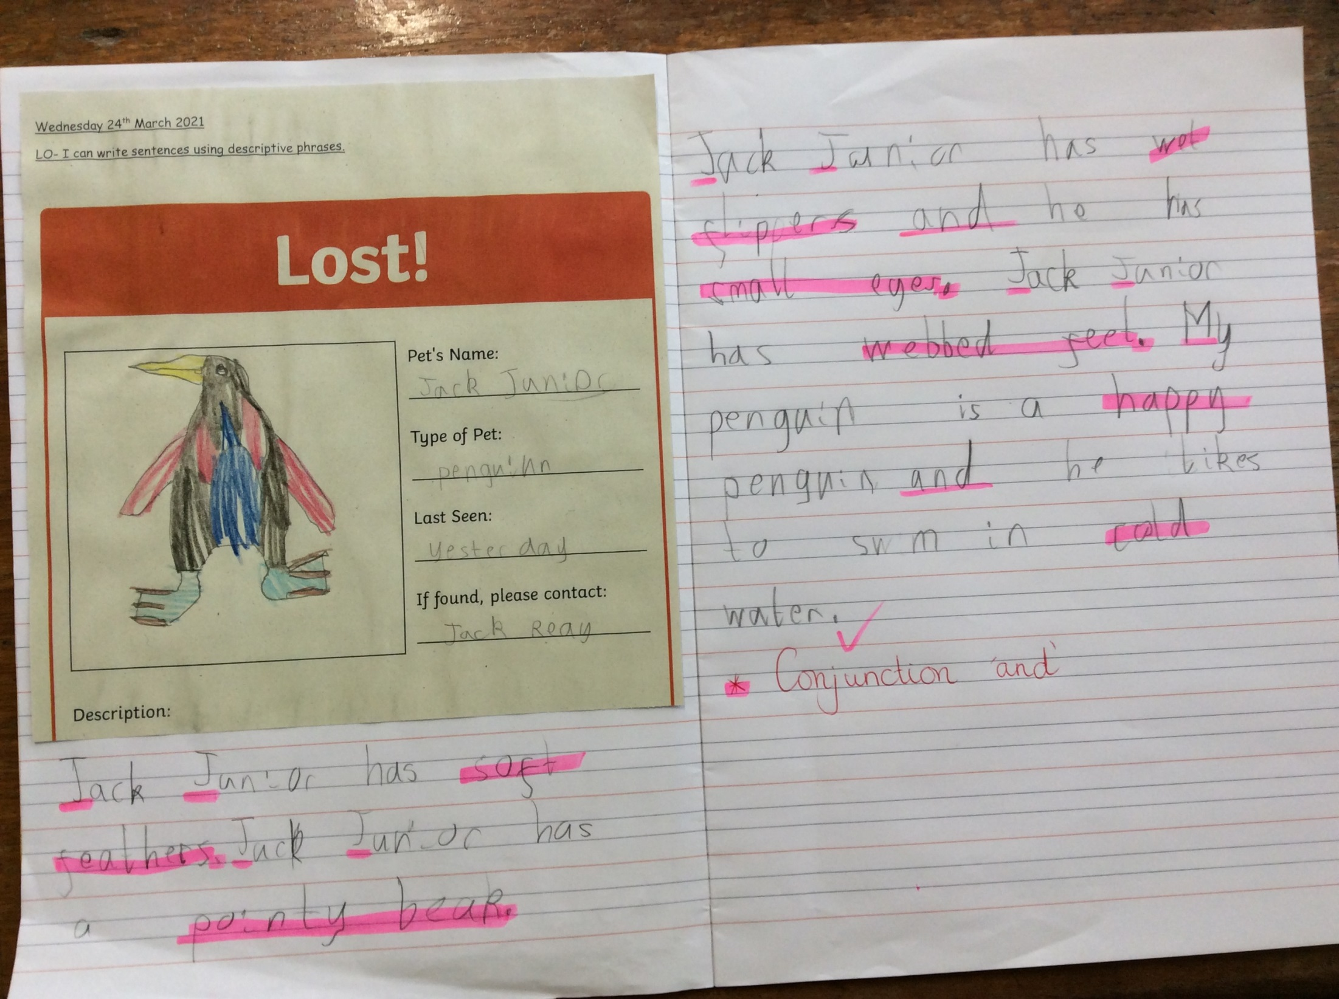

Slide 10
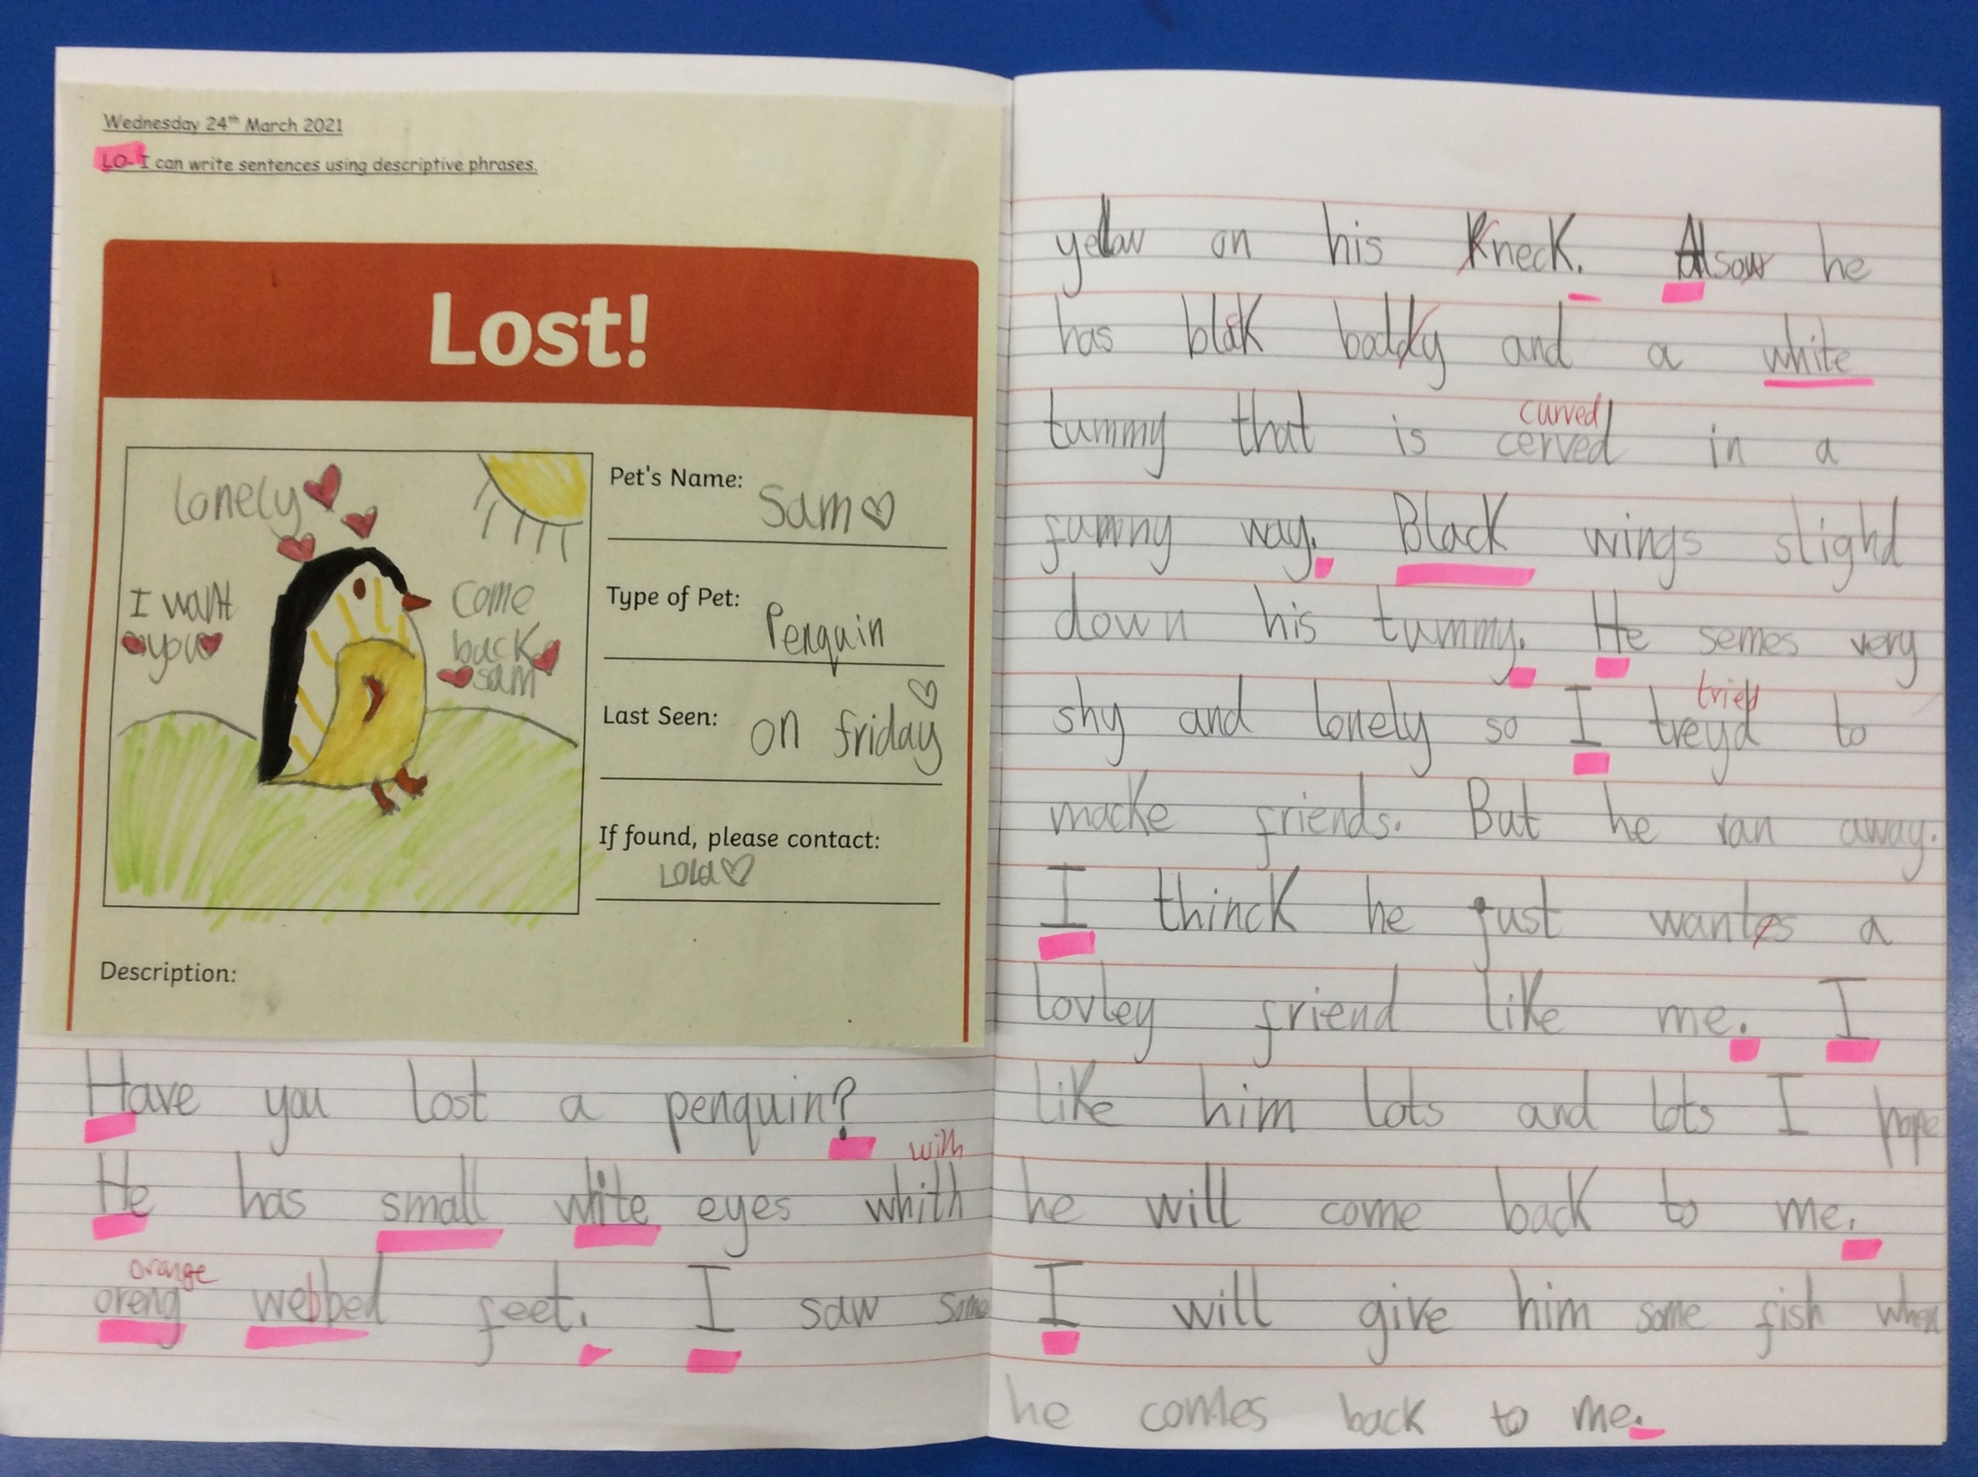

Slide 11
Year 2

Slide 12
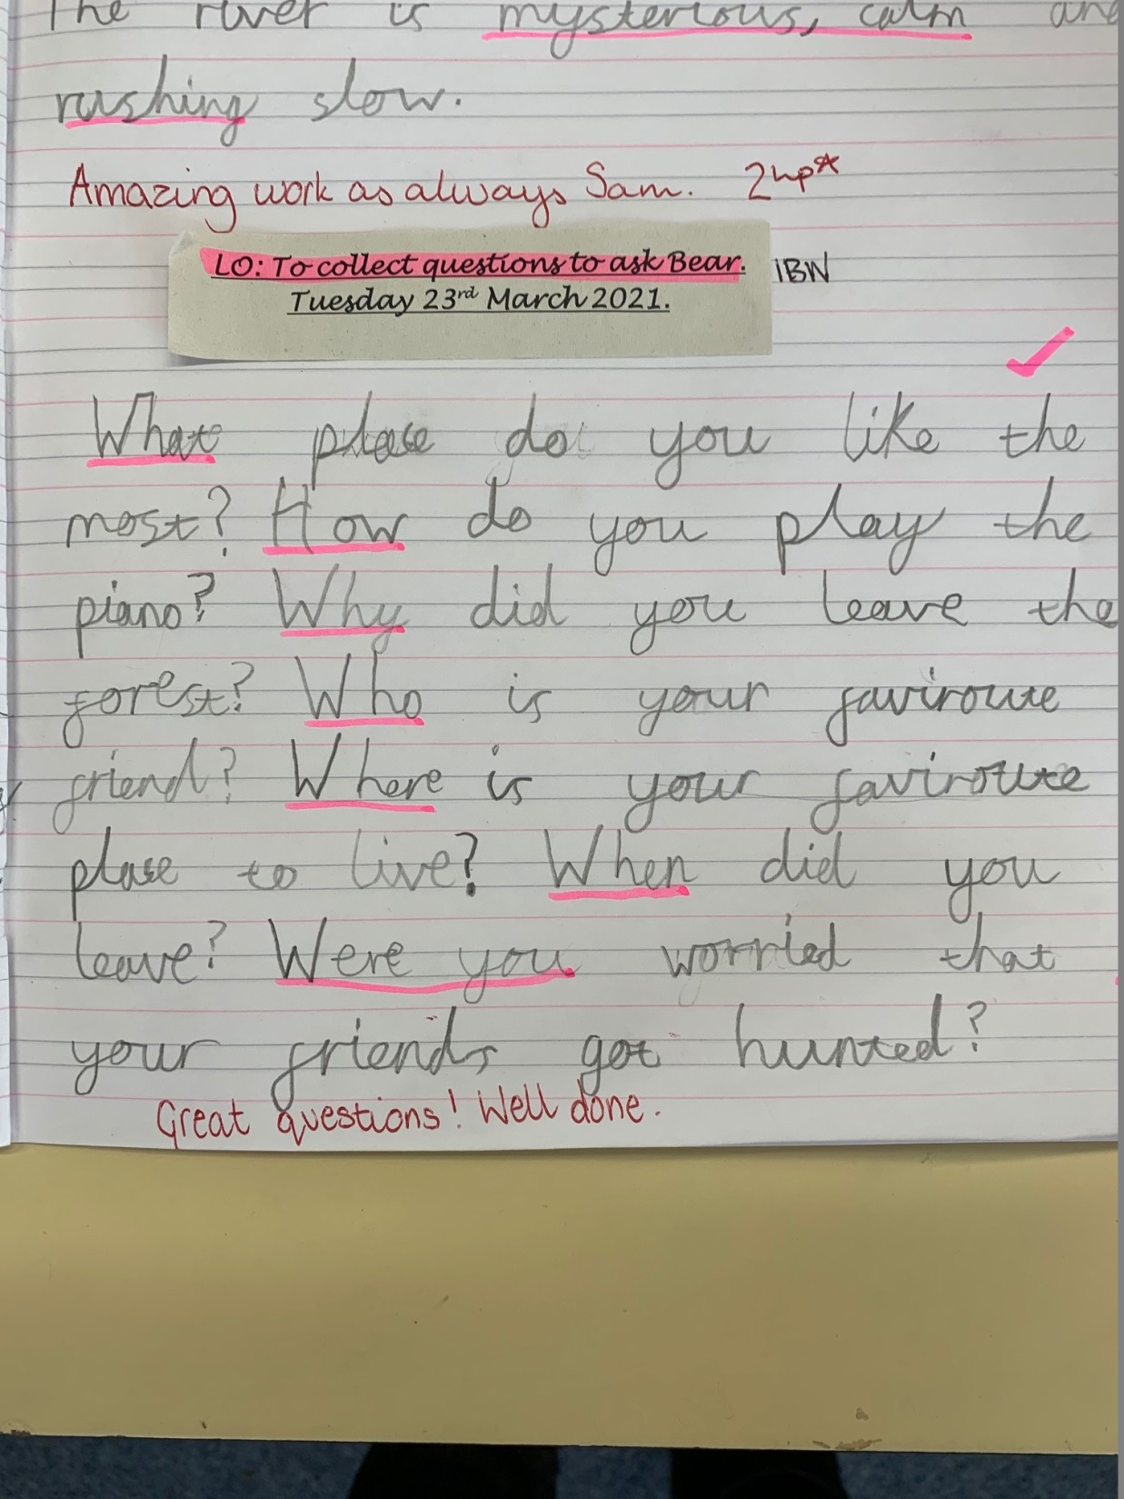

Slide 13
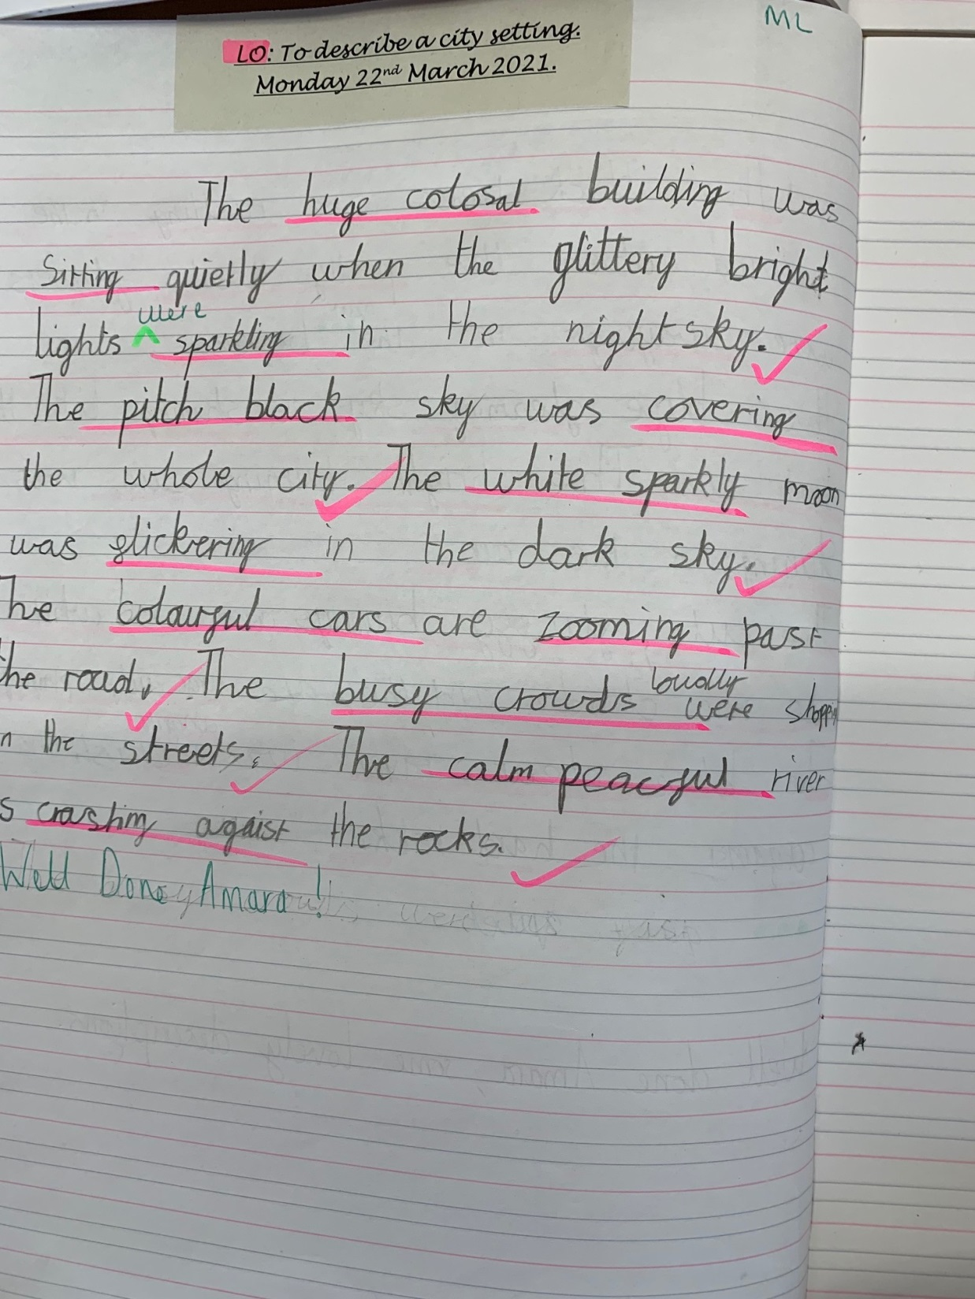

Slide 14
Year 3

Slide 15
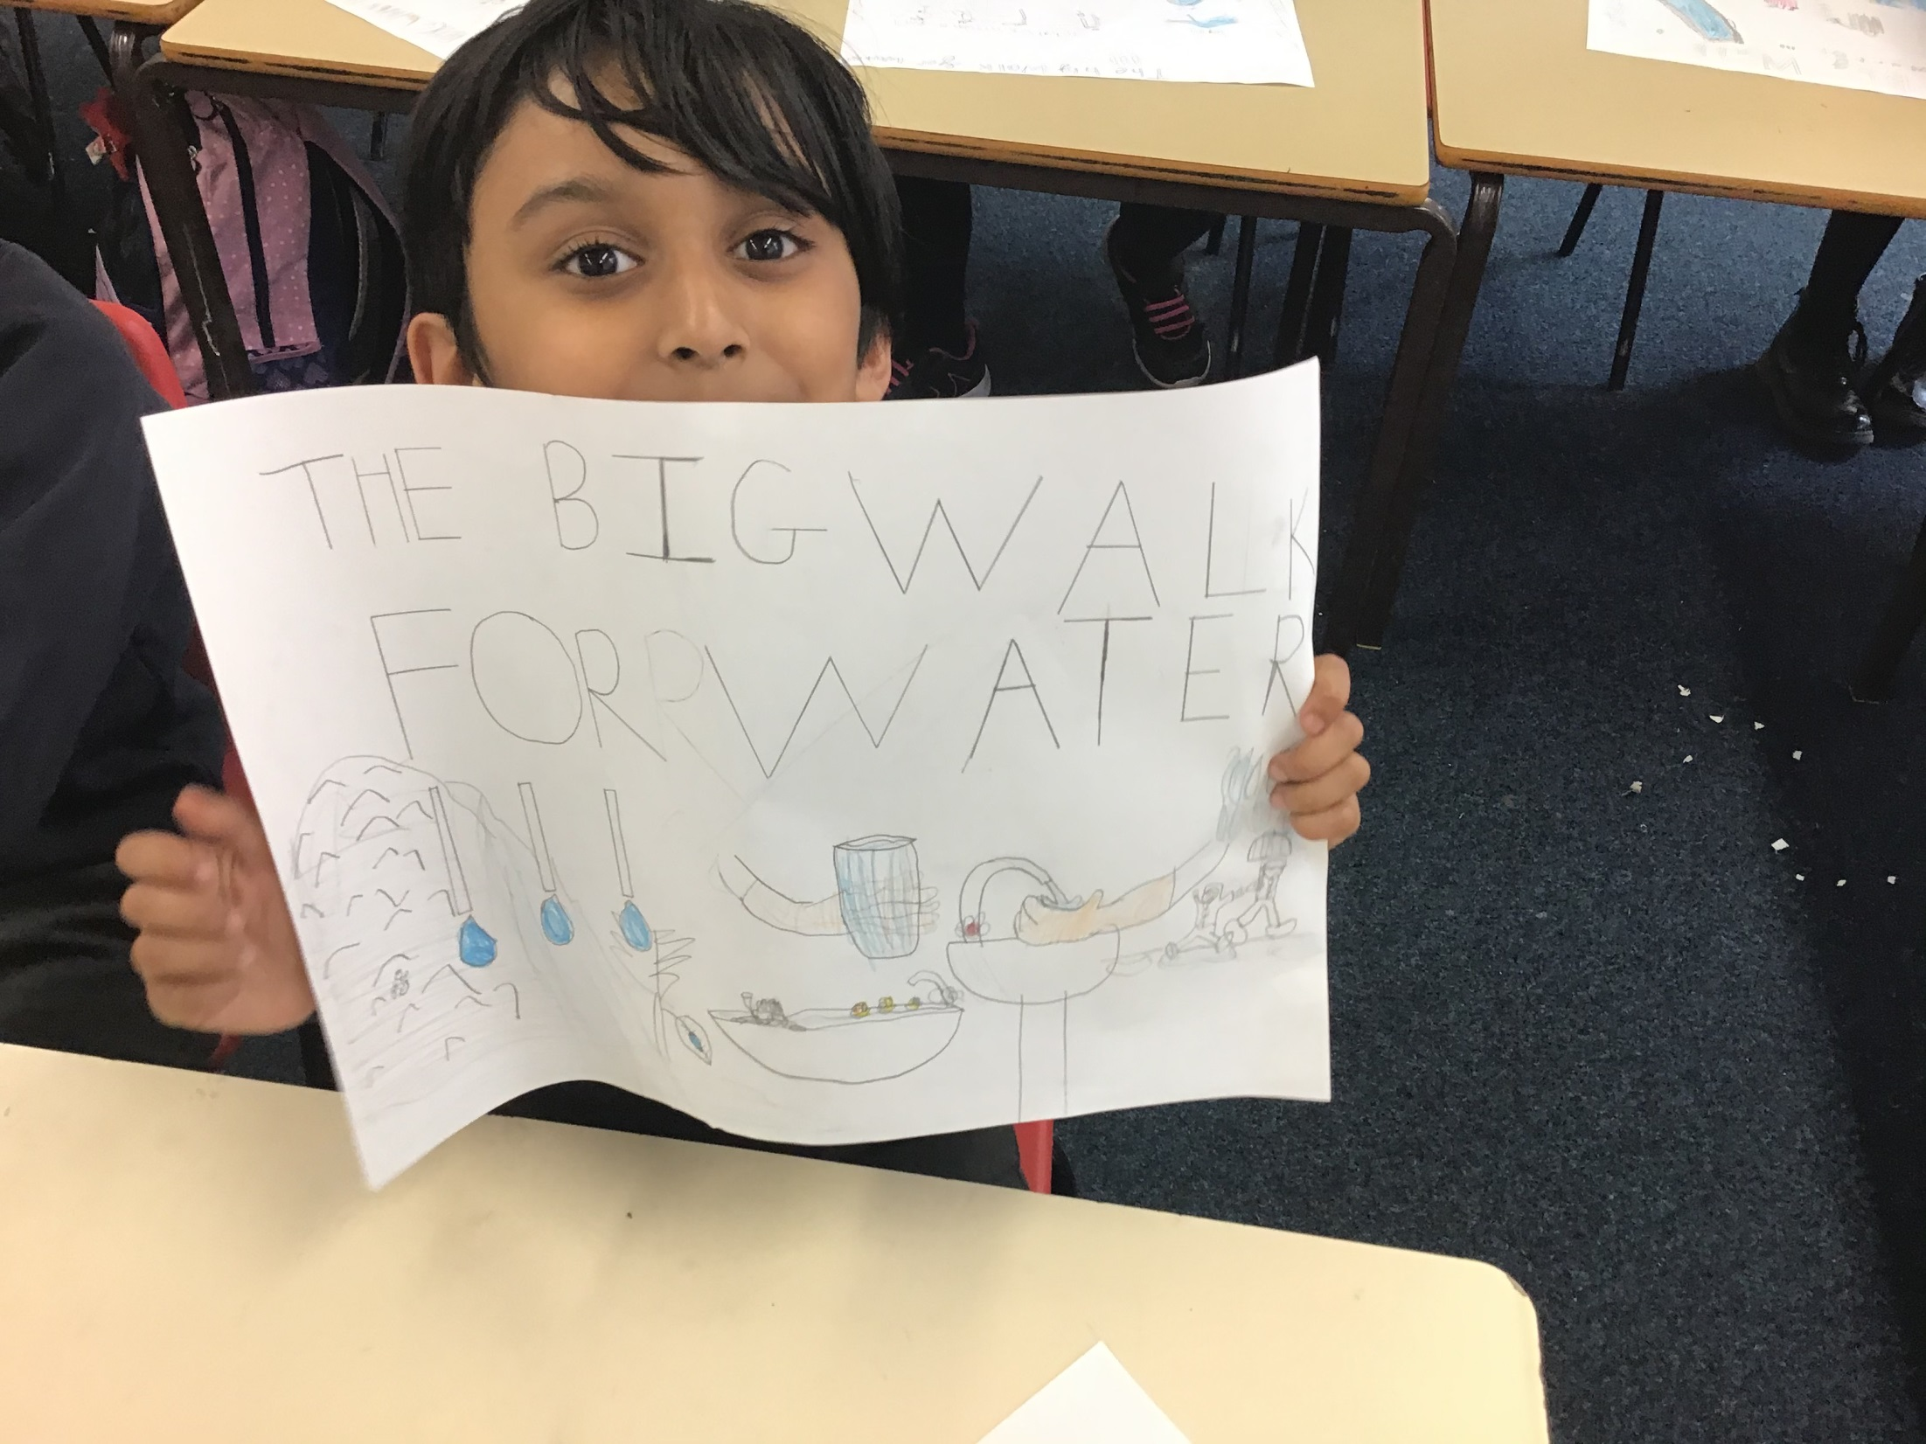

Slide 16
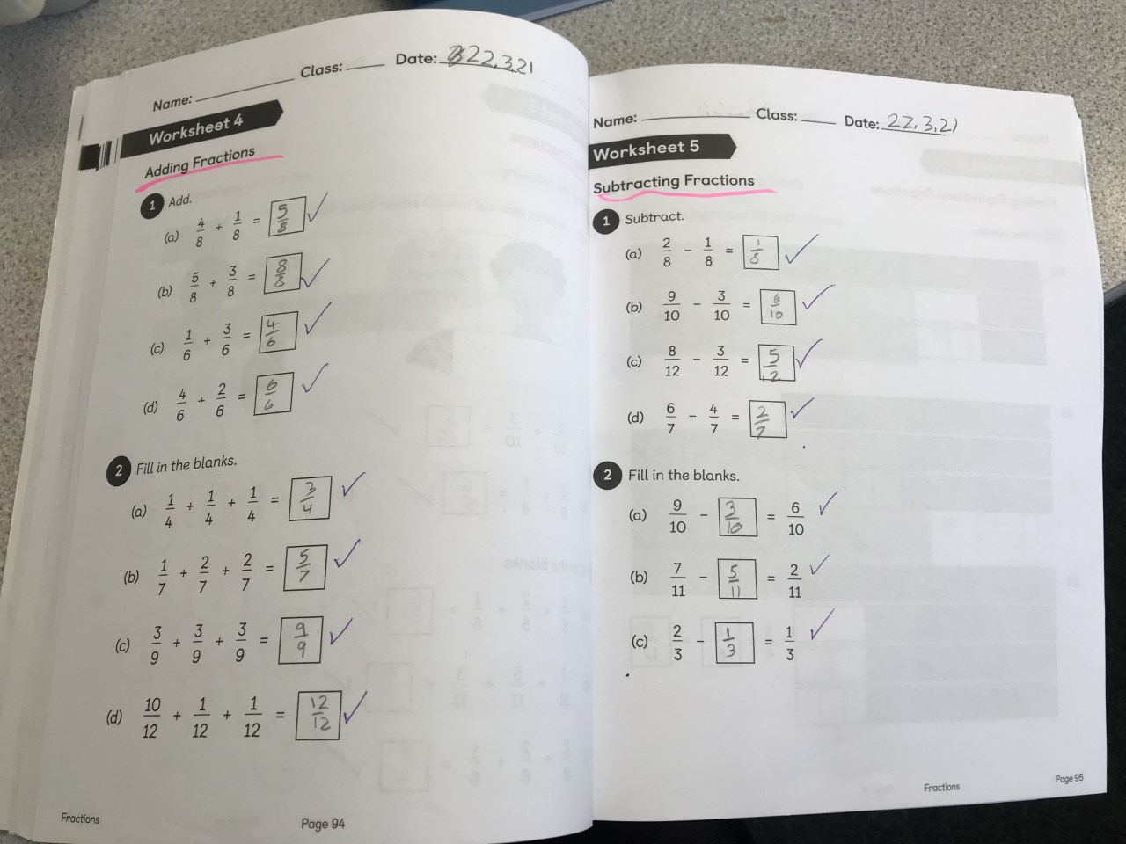

Slide 17
Year 4

Slide 20
Year 5

Slide 21
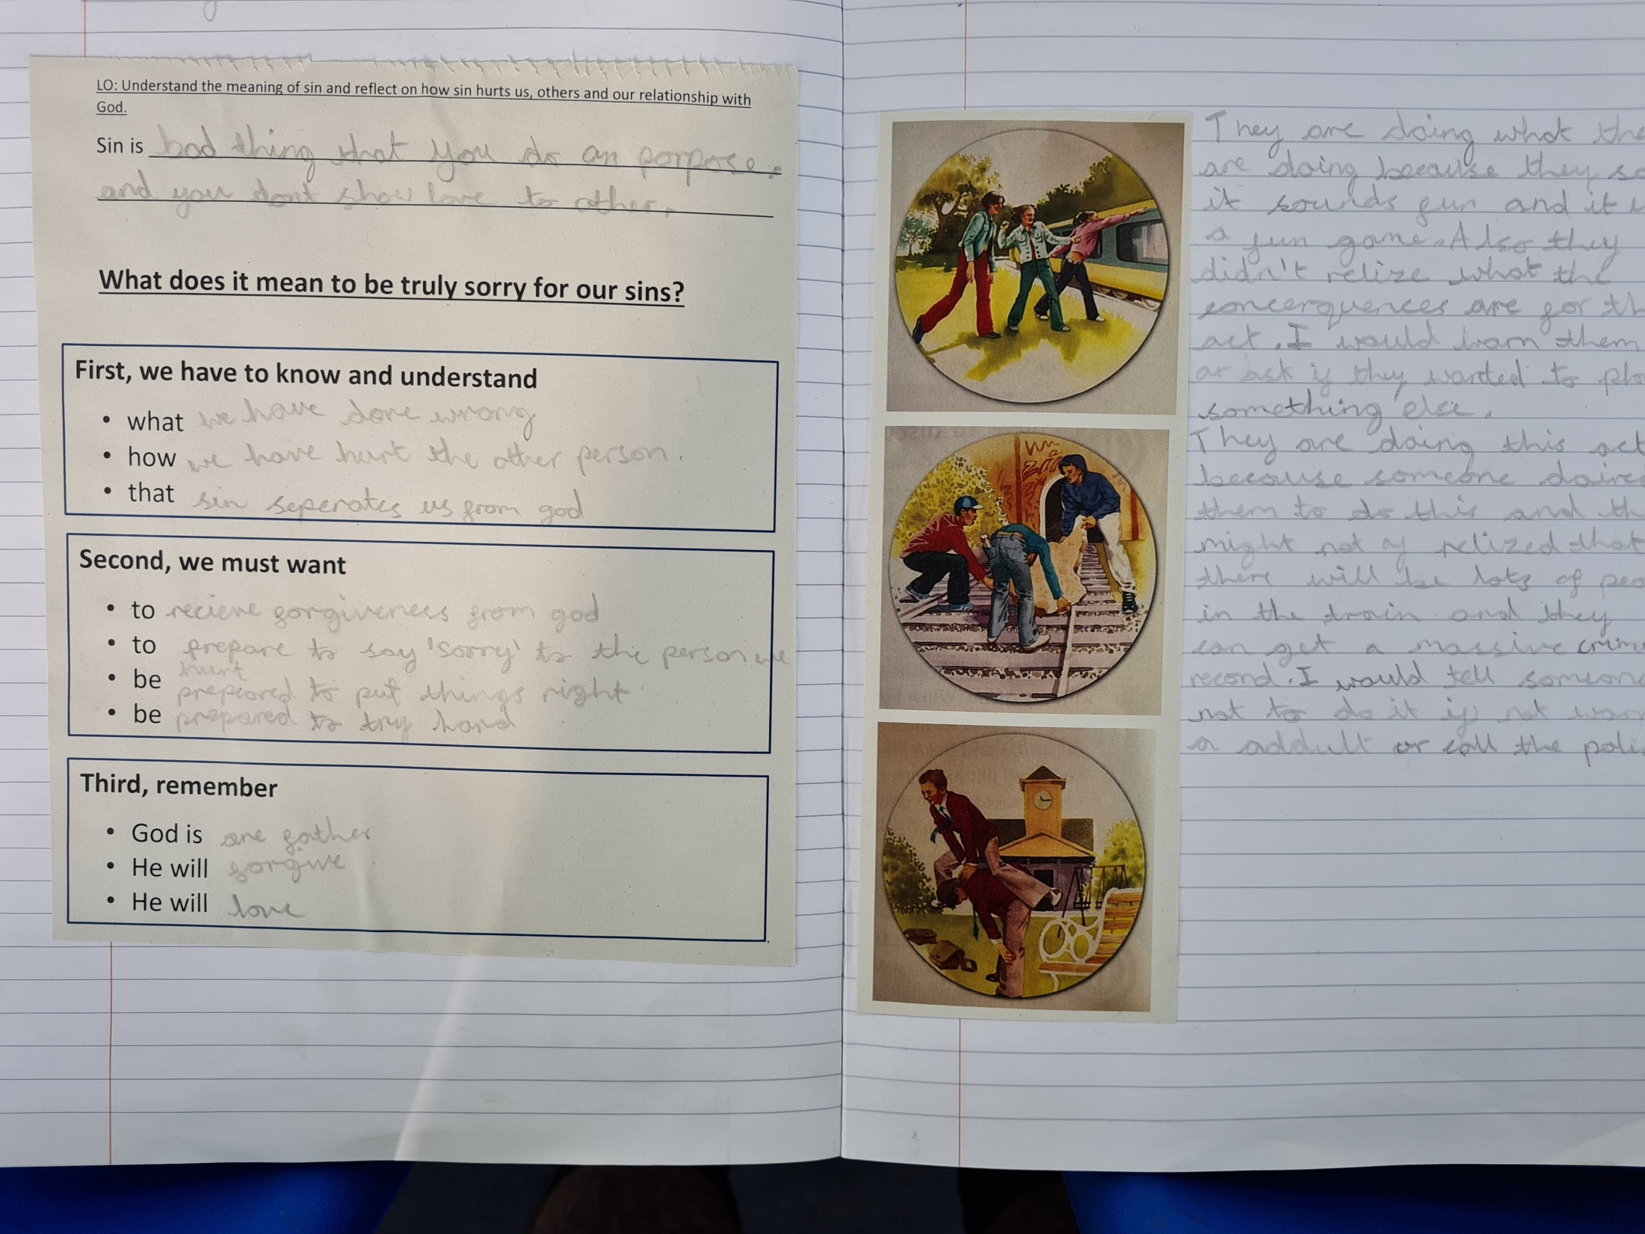

Slide 22
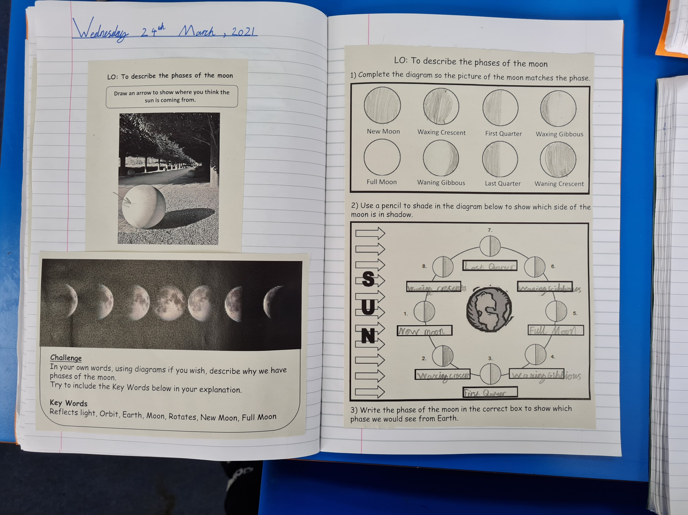

Slide 23
Year 6

Slide 24
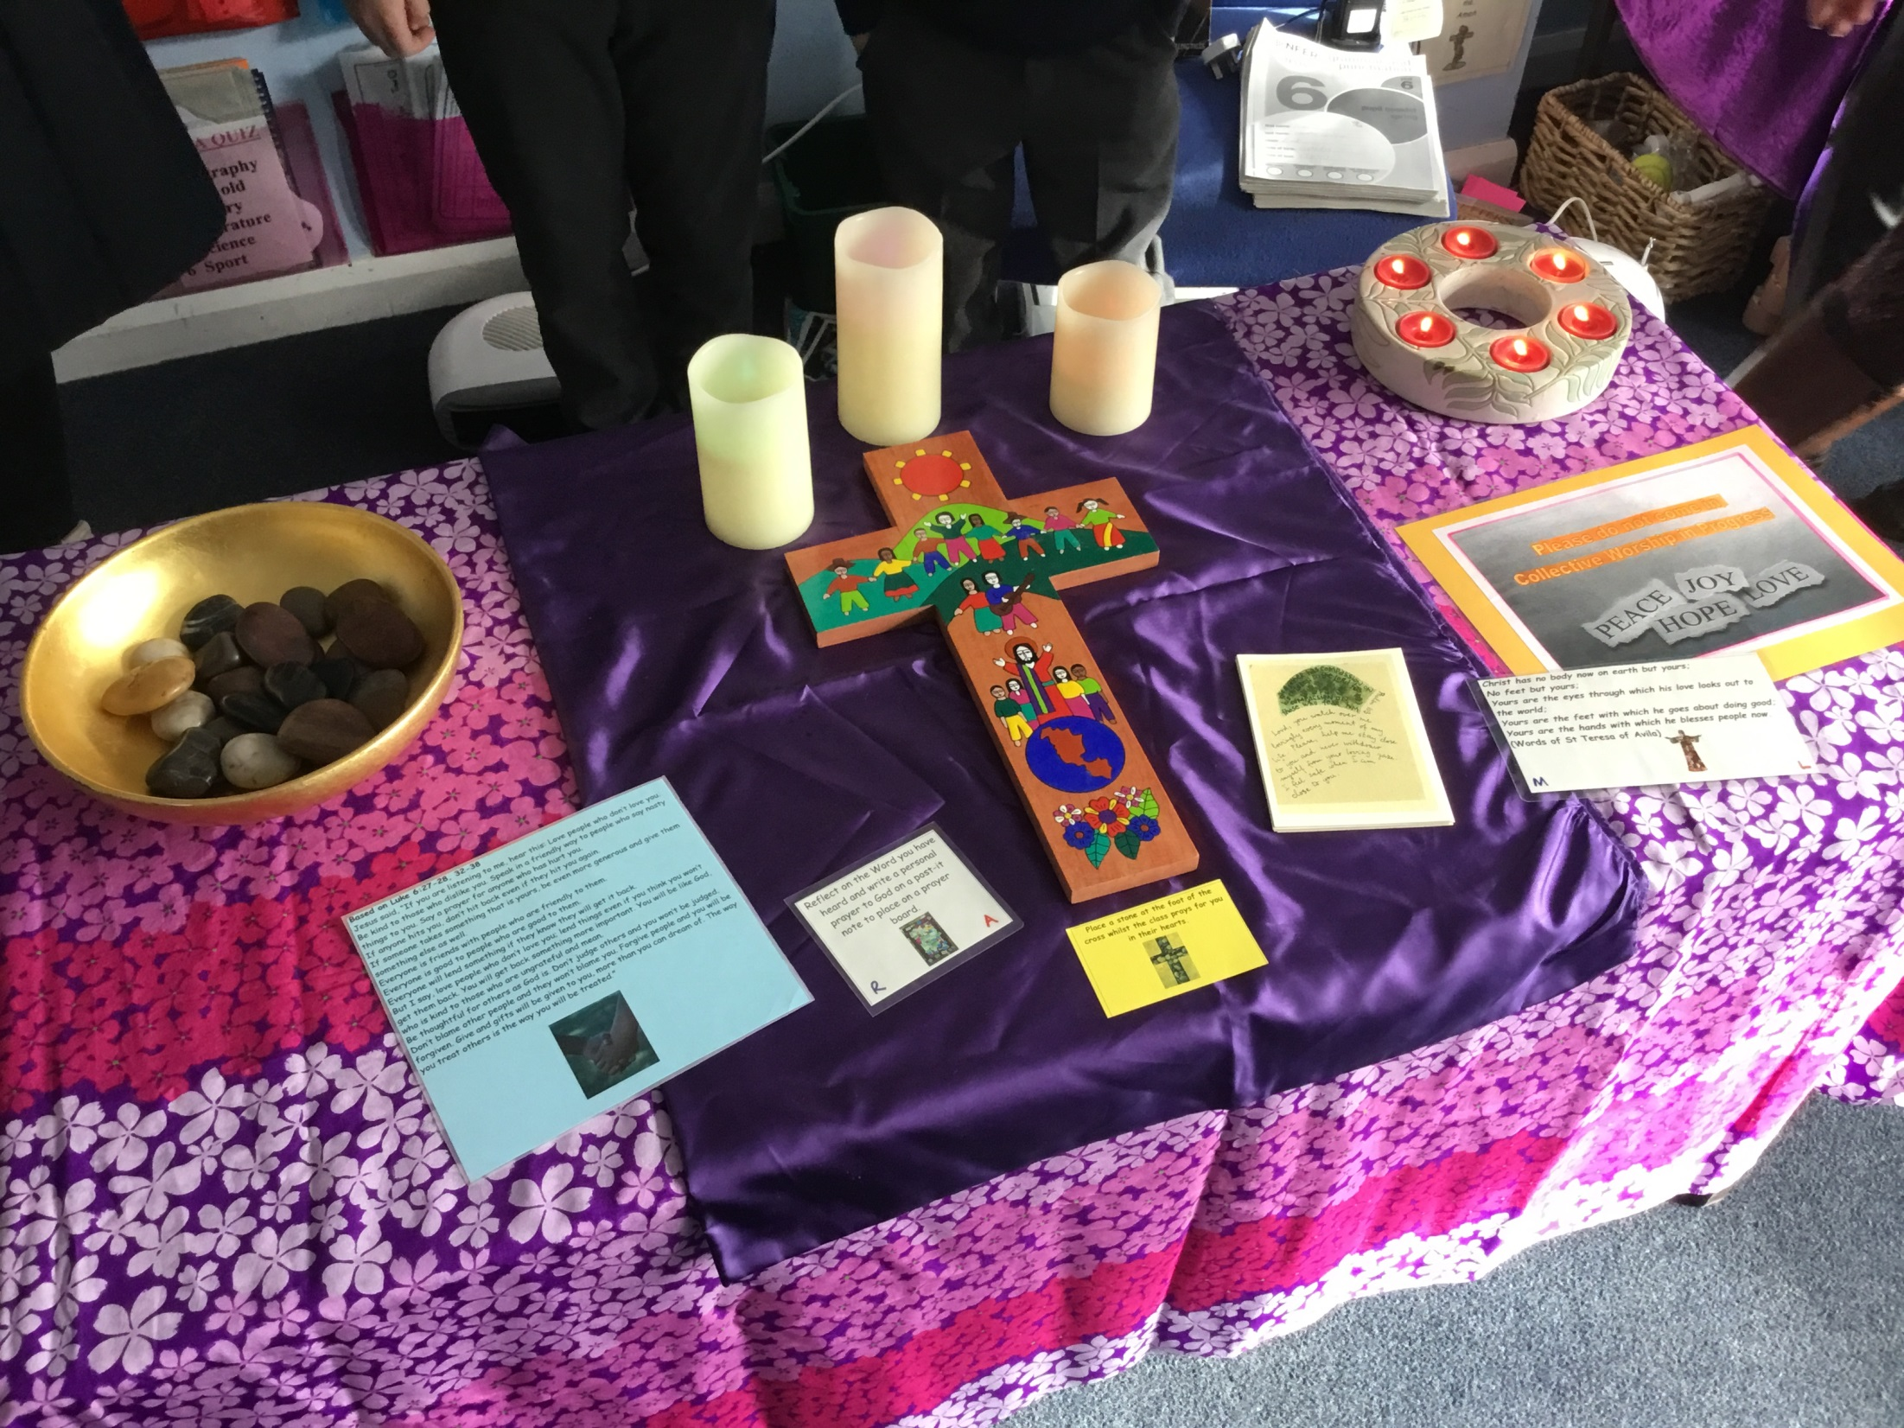

Slide 25
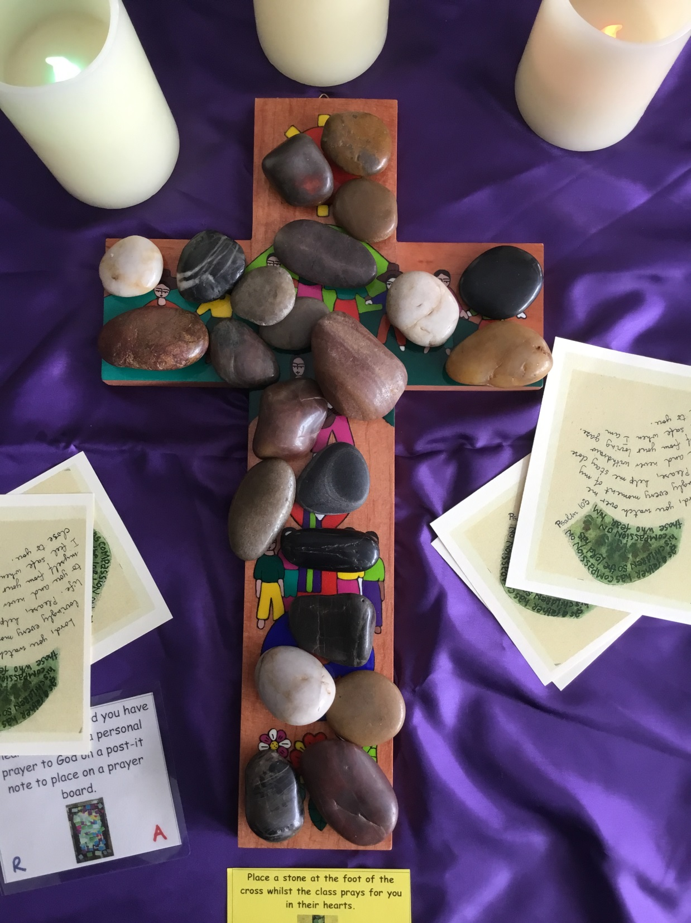

Slide 26
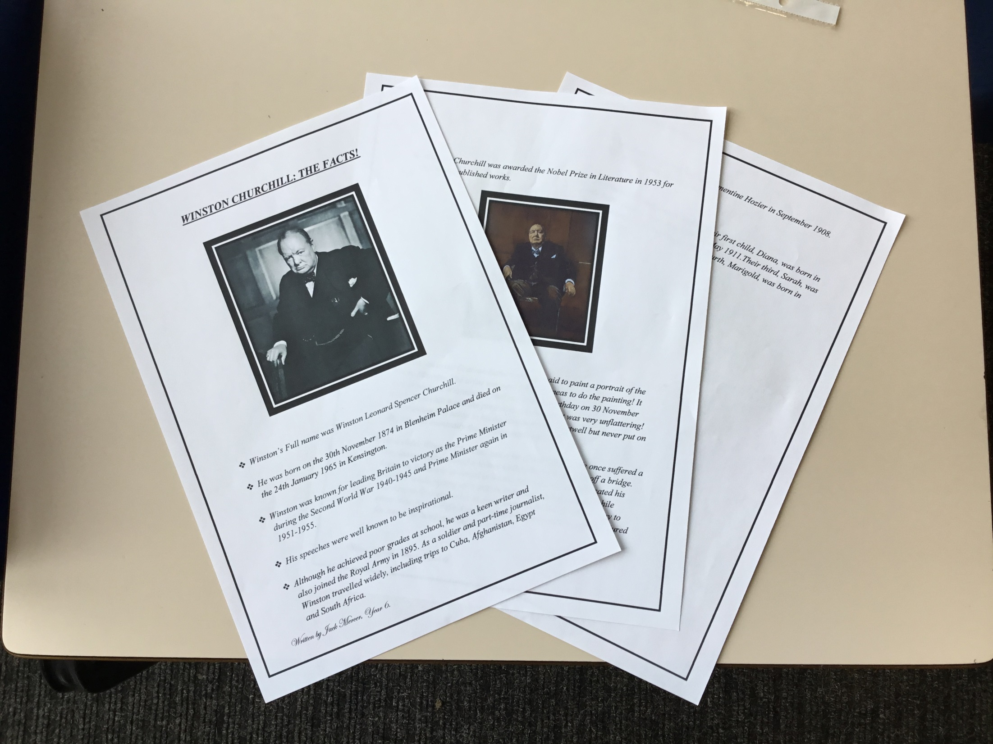

Slide 27


Slide 28


Slide 29


Slide 30


Let’s try to keep our Lenten promises and let’s try to follow Jesus in lots of little ways!
Notes:
GO FORTH - MISSION

Slide 31



Let us pray.
Dear Lord Jesus,
Thank you for giving your life for us and for calling us to follow you
Help us to follow you in all the little things that we do
So that we can help to make our world a better place.
Amen.

Slide 32
WOW!
WELL DONE EVERYONE!

