Slide 1


CELEBRATION ASSEMBLY
THURSDAY 29TH APRIL

Slide 2

Notes:
WORD

Slide 3
Hail Mary
Hail Mary, full of grace
The Lord is with thee.
Blessed art thou among women
And blessed is the fruit
Of thy womb, Jesus.
Holy Mary, mother of God,
Pray for us sinners now
And at the hour of our death.
Amen

Slide 4

Dear Lord,
Please bless our school
As we try to
Love, learn,
Share and respect
In the light of Jesus.
St Alban, pray for us.
Amen

Slide 5

Reception

Slide 6
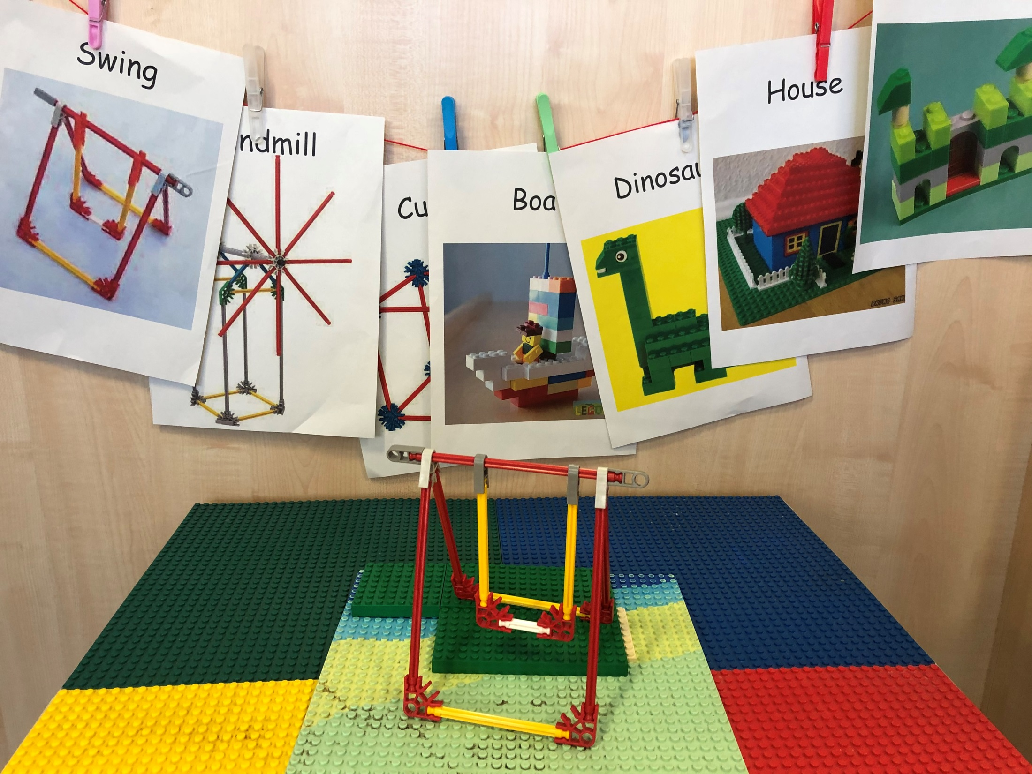

Slide 7
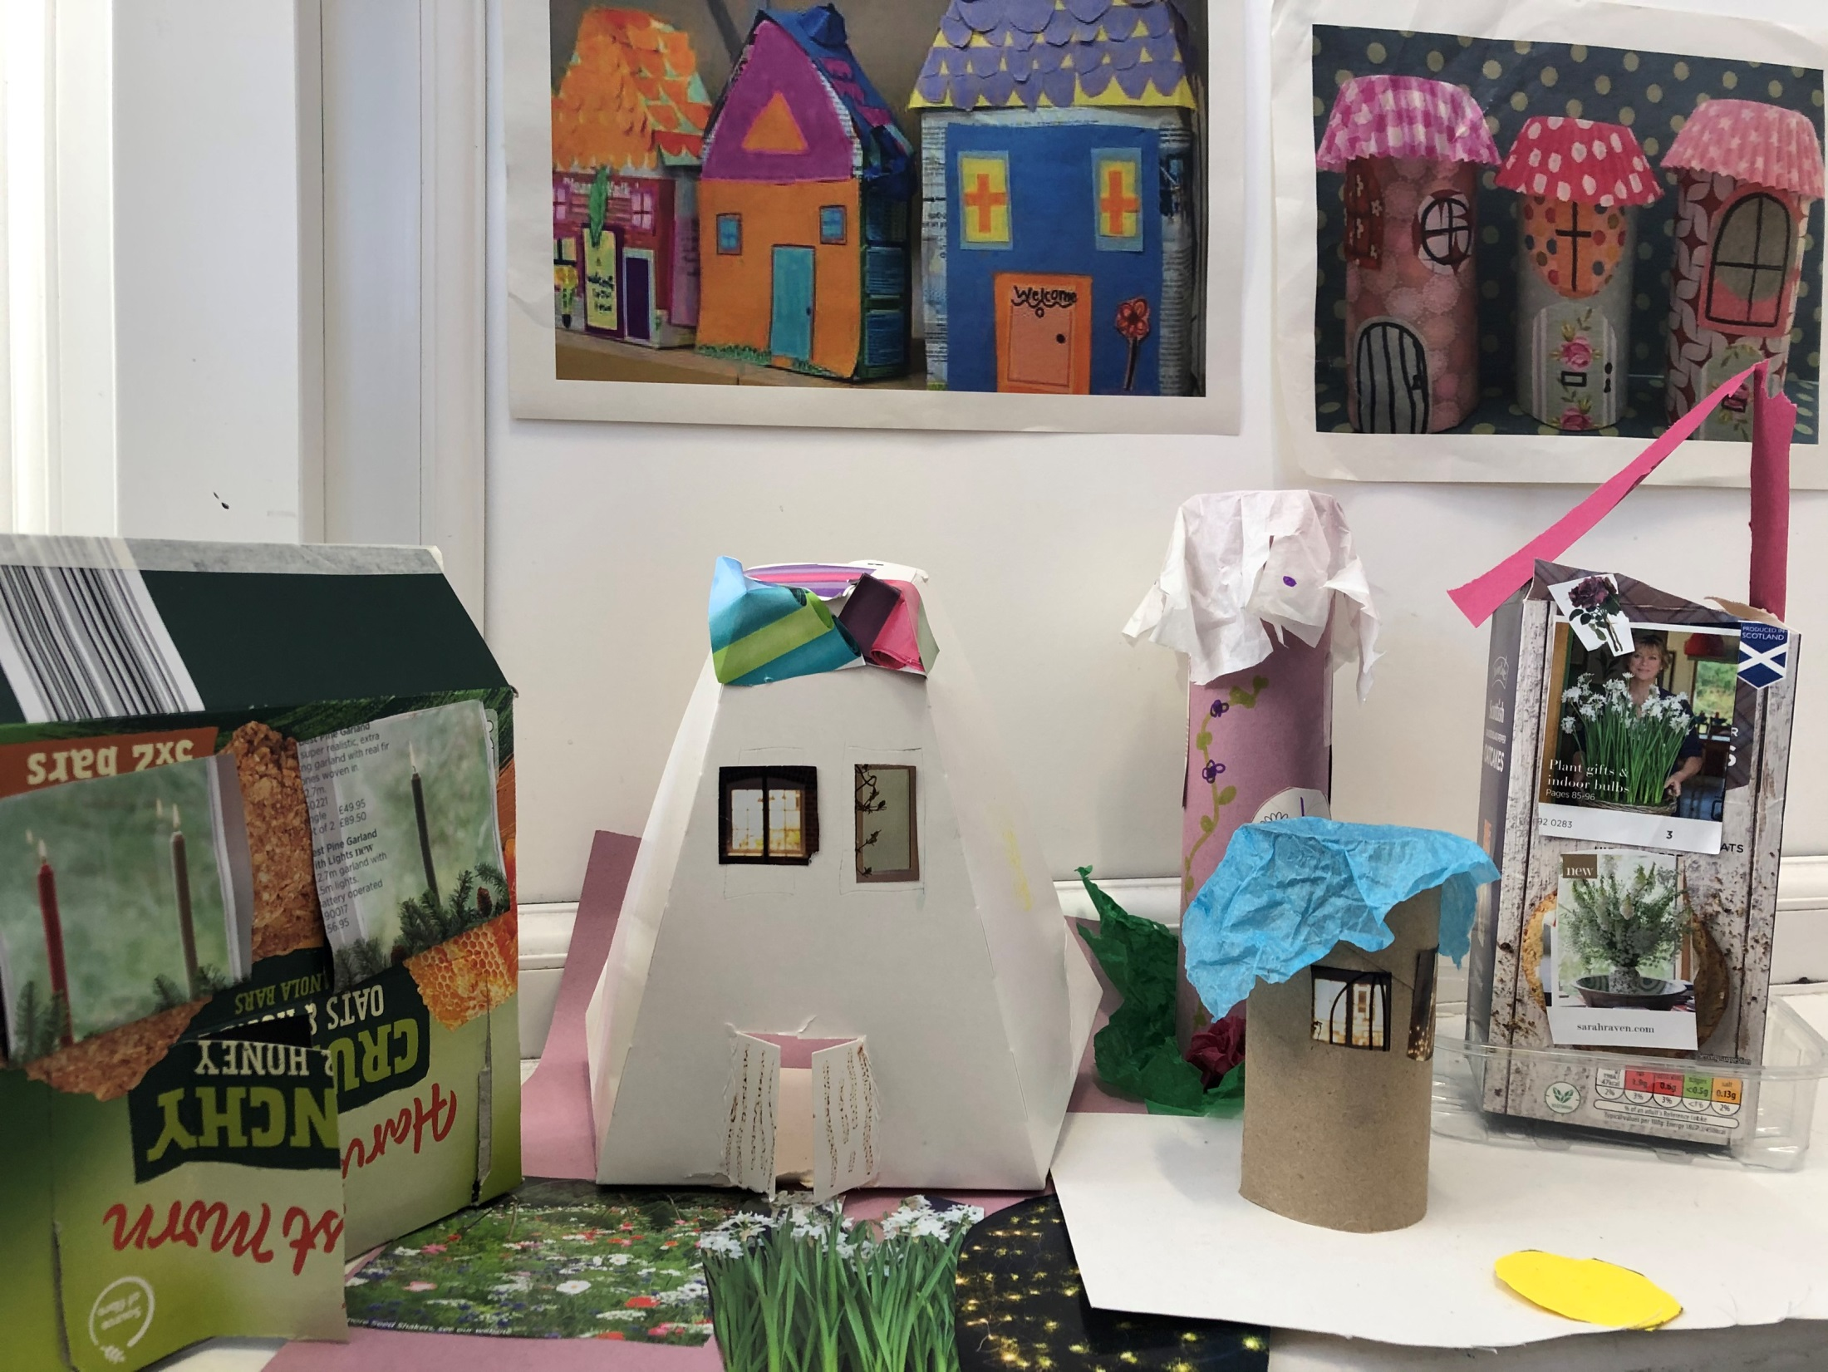

Slide 8
Year 1

Slide 9
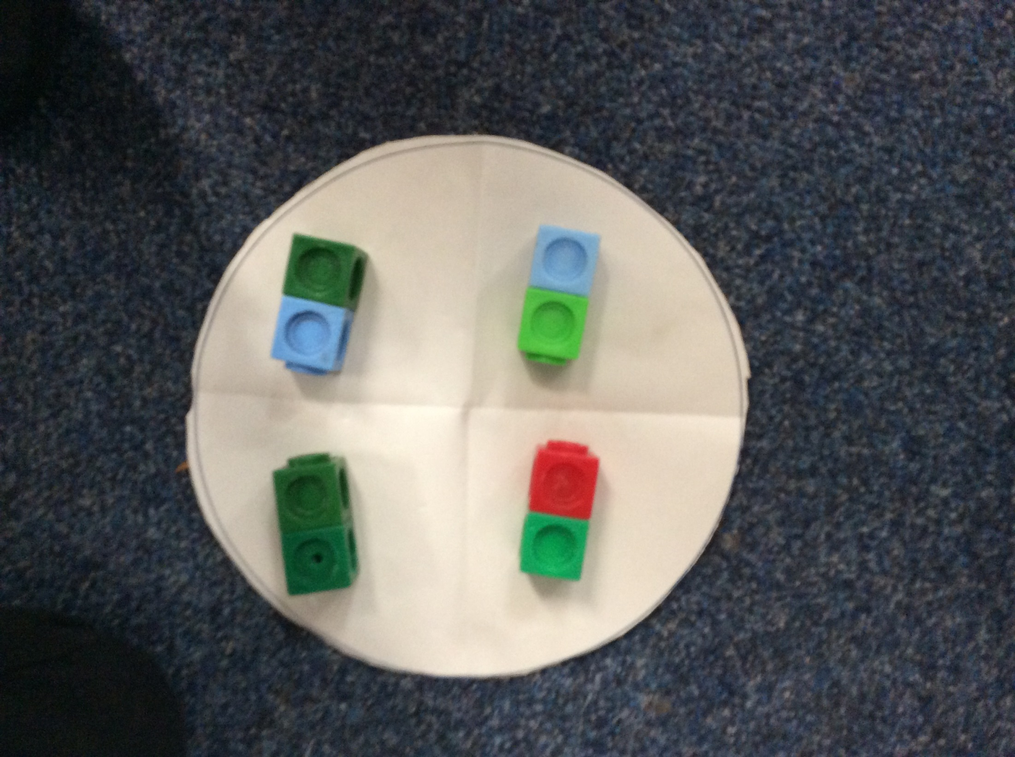

Slide 10
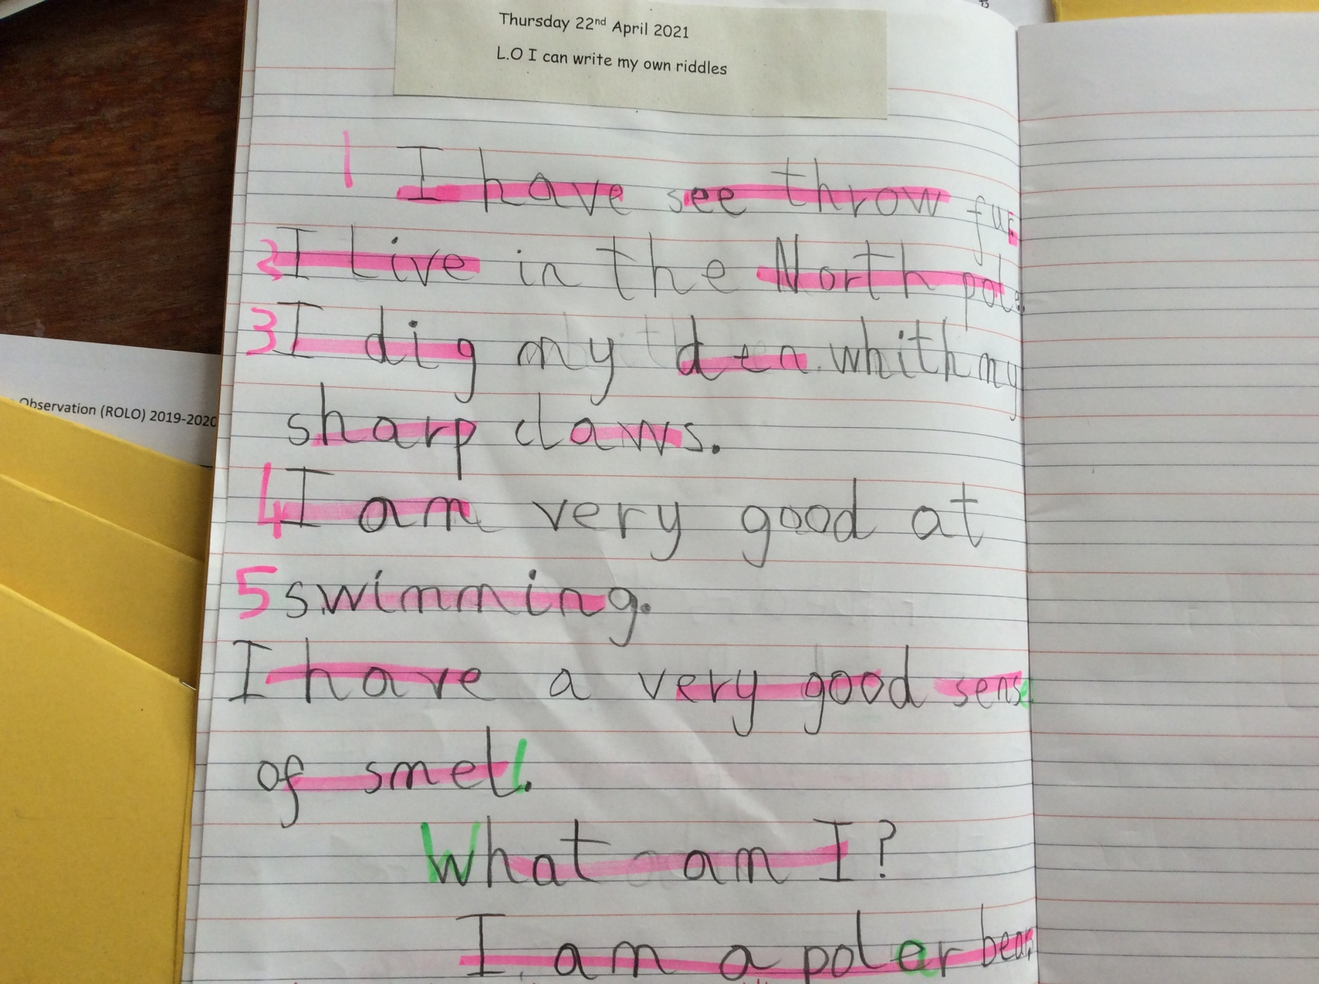

Slide 11
Year 2

Slide 12
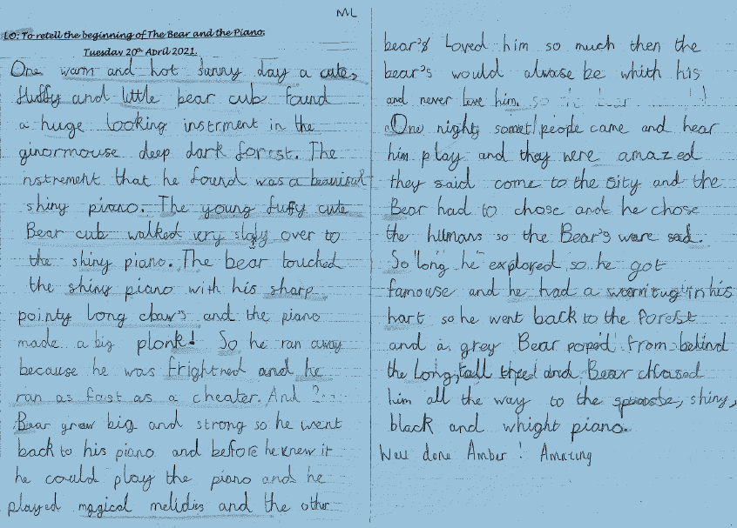

Slide 13
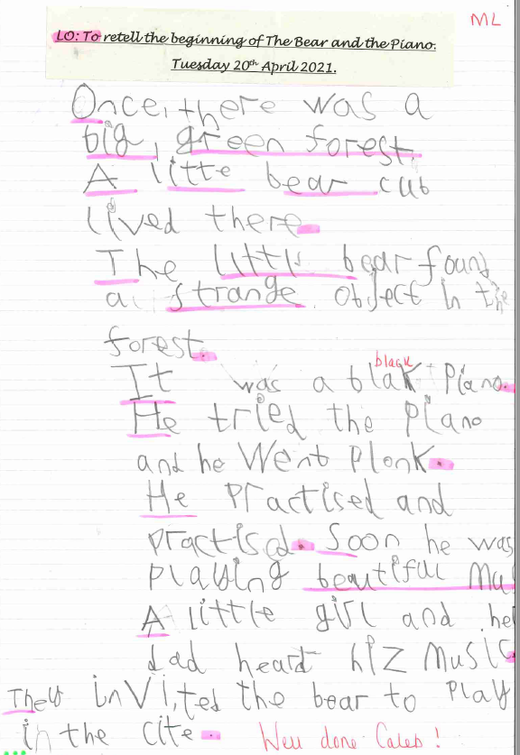

Slide 14
Year 3

Slide 15
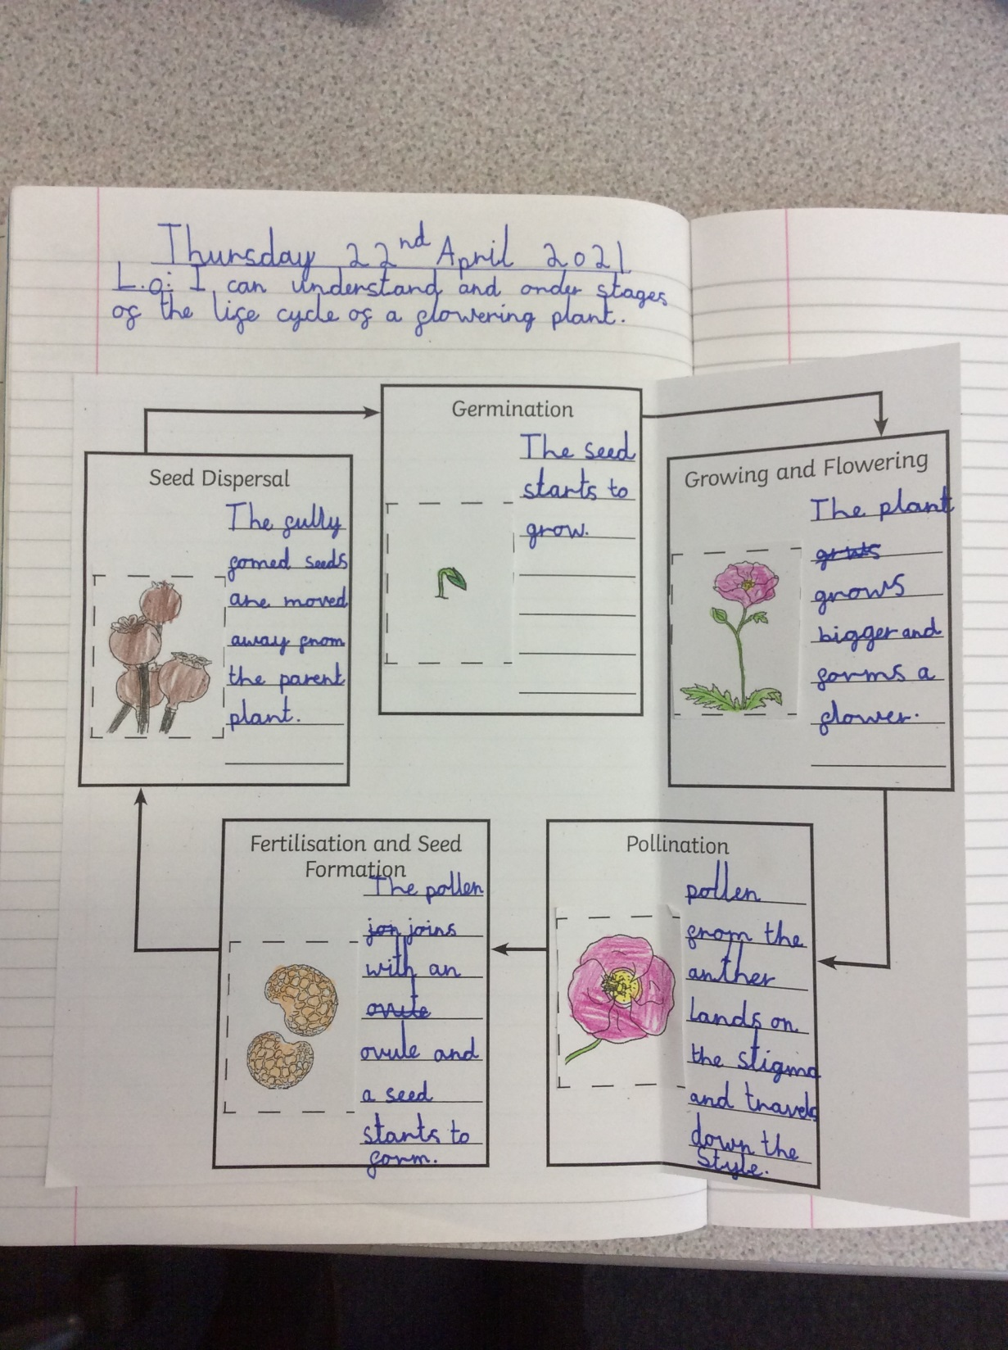

Slide 16
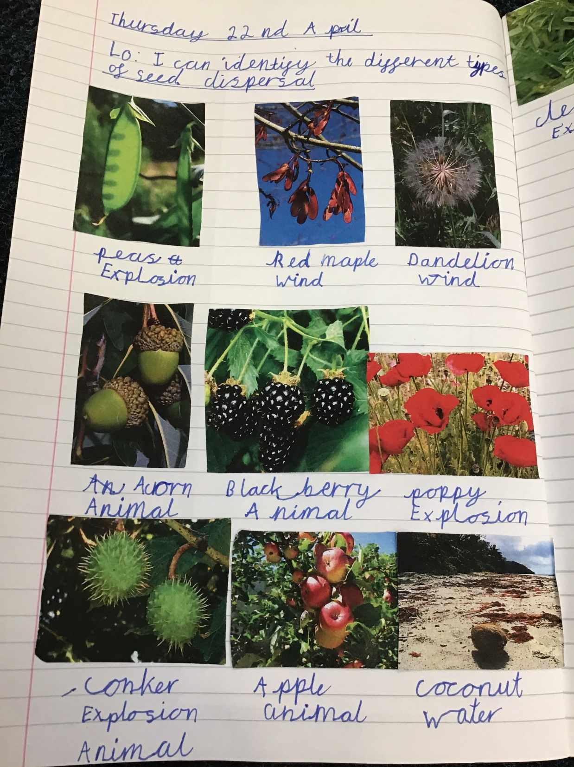

Slide 17
Year 4

Slide 18
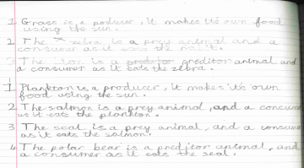

Slide 19
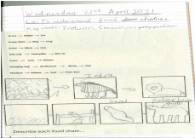

Slide 20
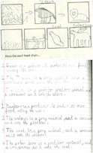

Slide 21
Year 5

Slide 22
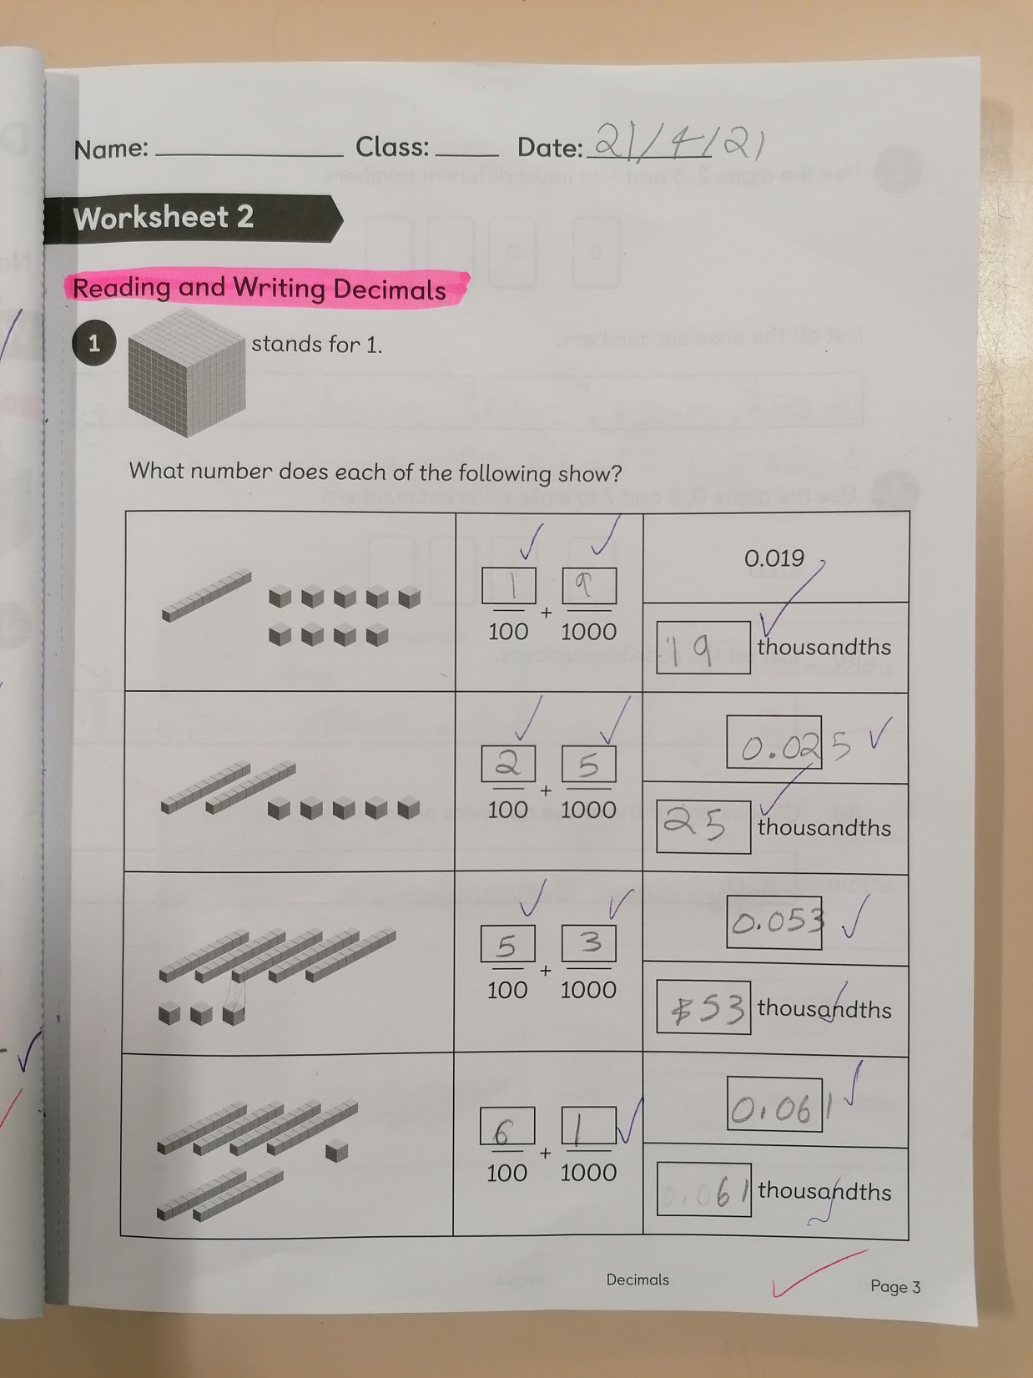

Slide 23
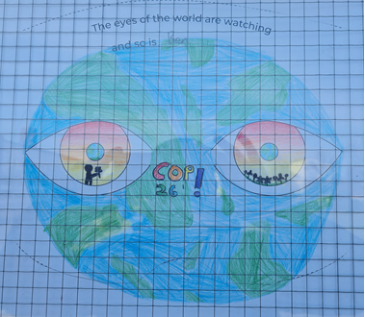

Slide 24
Year 6

Slide 25
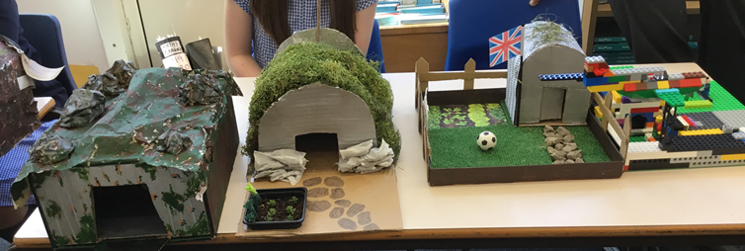

Slide 26
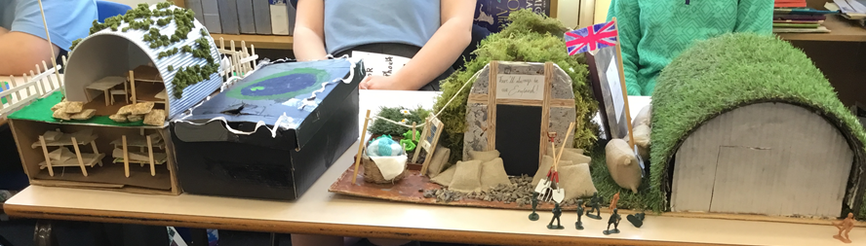

Slide 27


Slide 28


Slide 29


Slide 30
How can we show that we love and care for each other this week?
Notes:
GO FORTH - MISSION

Slide 31



Let us pray.
Dear Lord Jesus,
Thank you for knowing and loving each and every one of us so very, very much.
Thank you for being our good shepherd!
Help us to always look after and care for each other.
Amen.

Slide 32
WOW!
WELL DONE EVERYONE!

