Slide 1


CELEBRATION ASSEMBLY
FRIDAY 14TH MAY

Slide 2

Notes:
WORD

Slide 3

May is the month of Mary.

Slide 4
Hail Mary
Hail Mary, full of grace
The Lord is with thee.
Blessed art thou among women
And blessed is the fruit
Of thy womb, Jesus.
Holy Mary, mother of God,
Pray for us sinners now
And at the hour of our death.
Amen

Slide 5

Dear Lord,
Please bless our school
As we try to
Love, learn,
Share and respect
In the light of Jesus.
St Alban, pray for us.
Amen

Slide 6

Reception

Slide 7
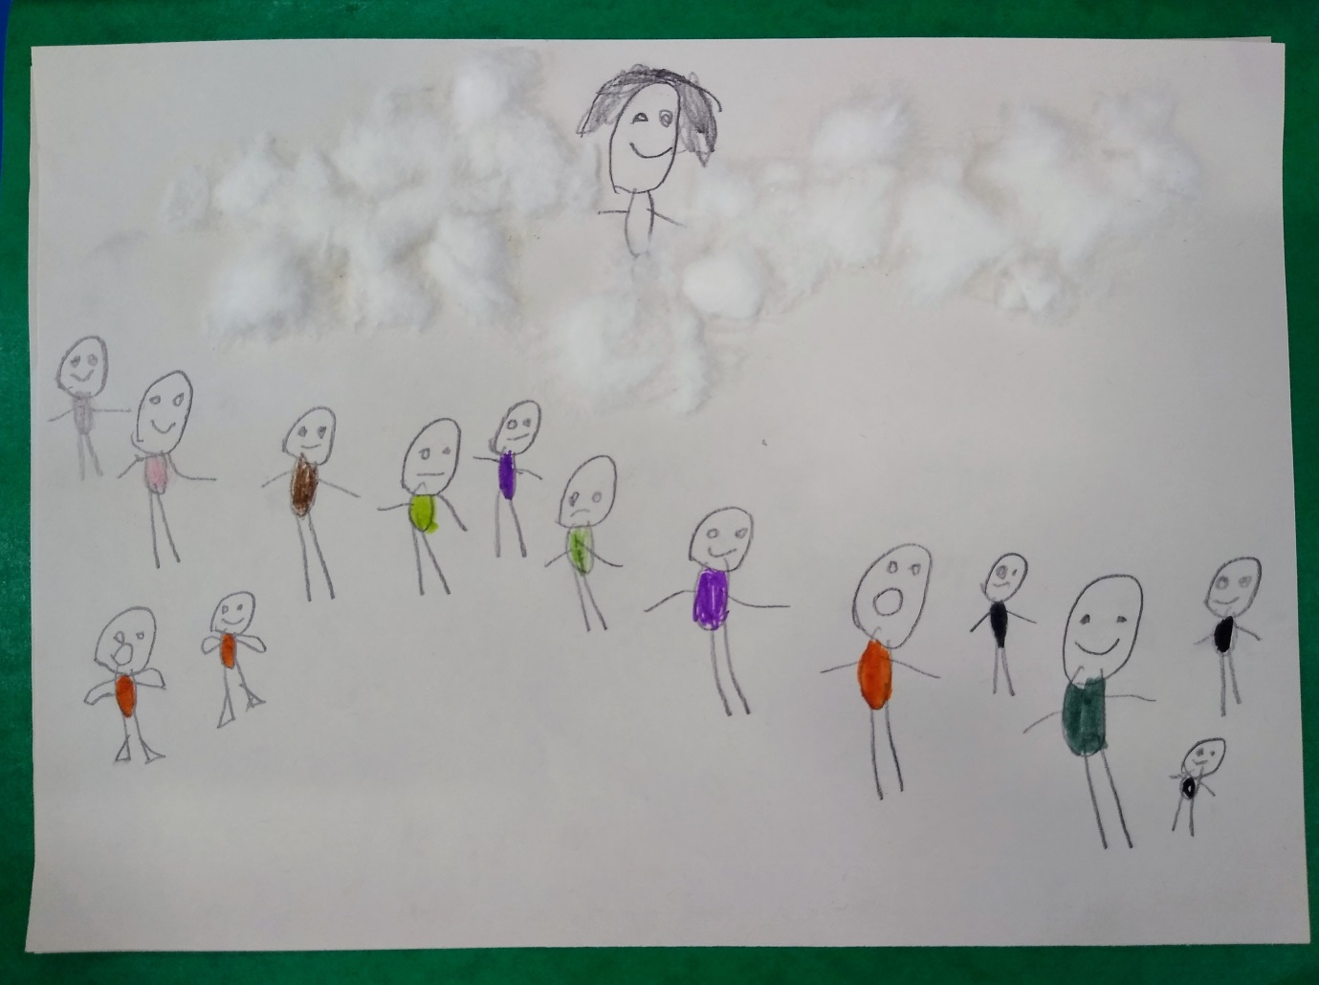

Slide 8
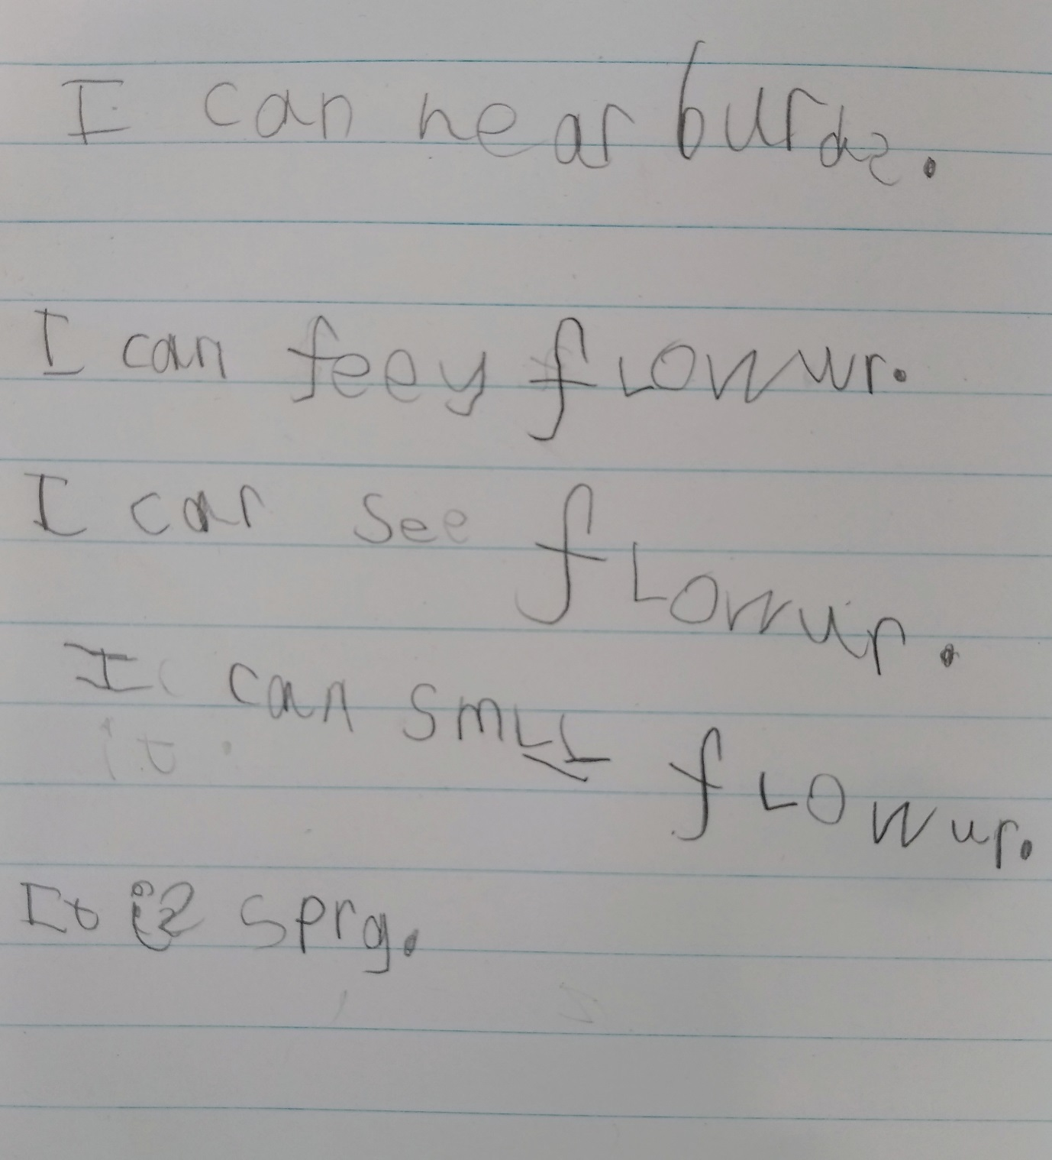

Slide 9
Year 1

Slide 10
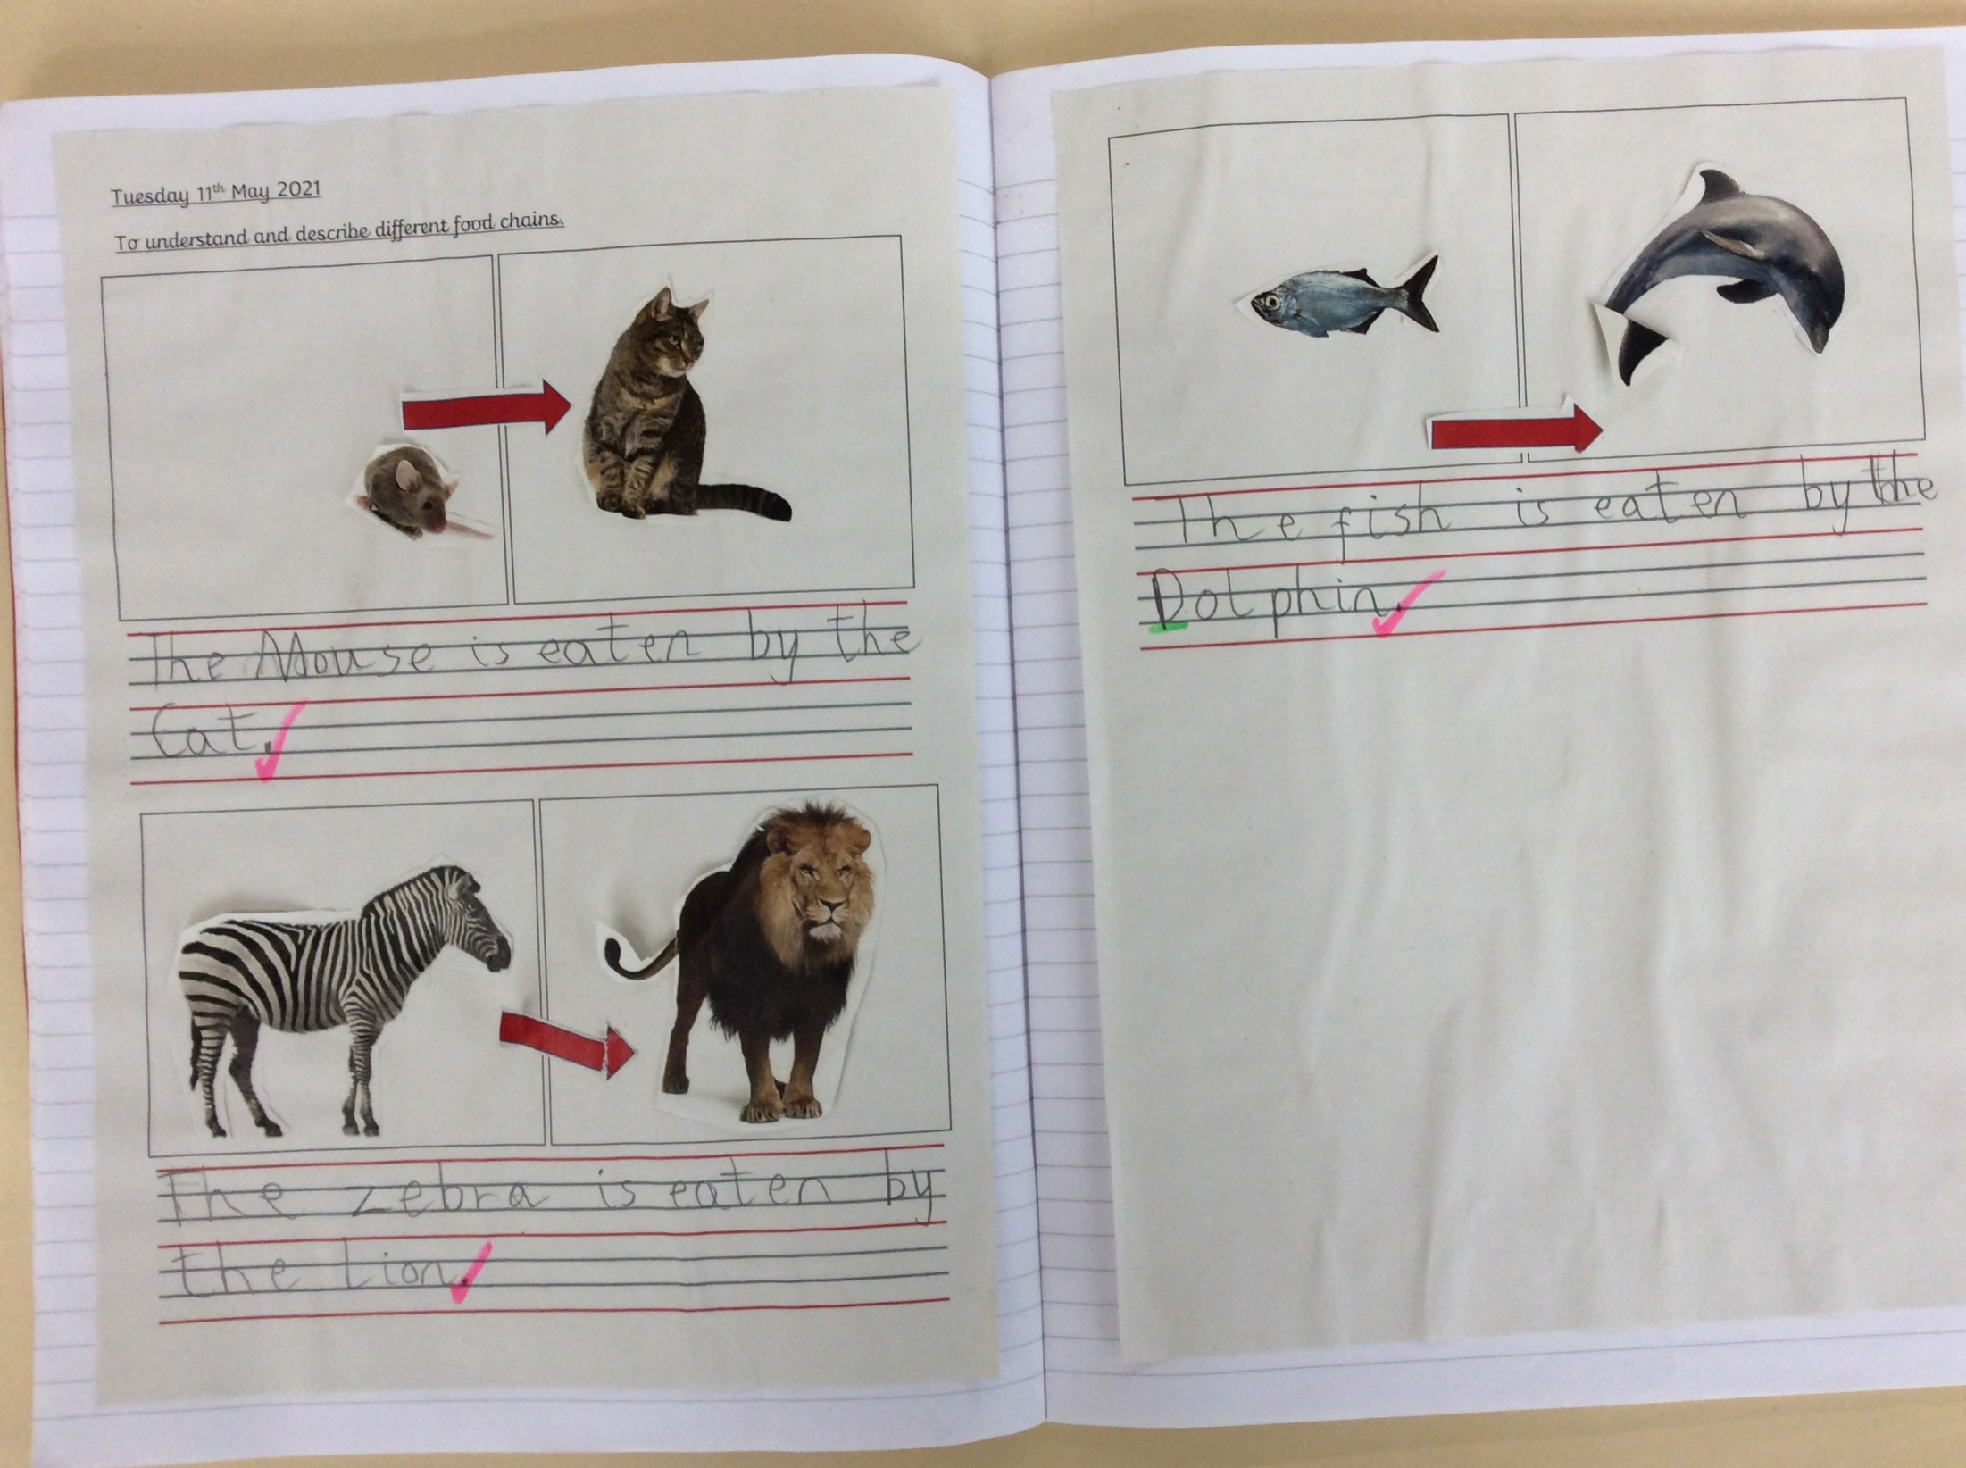

Slide 11
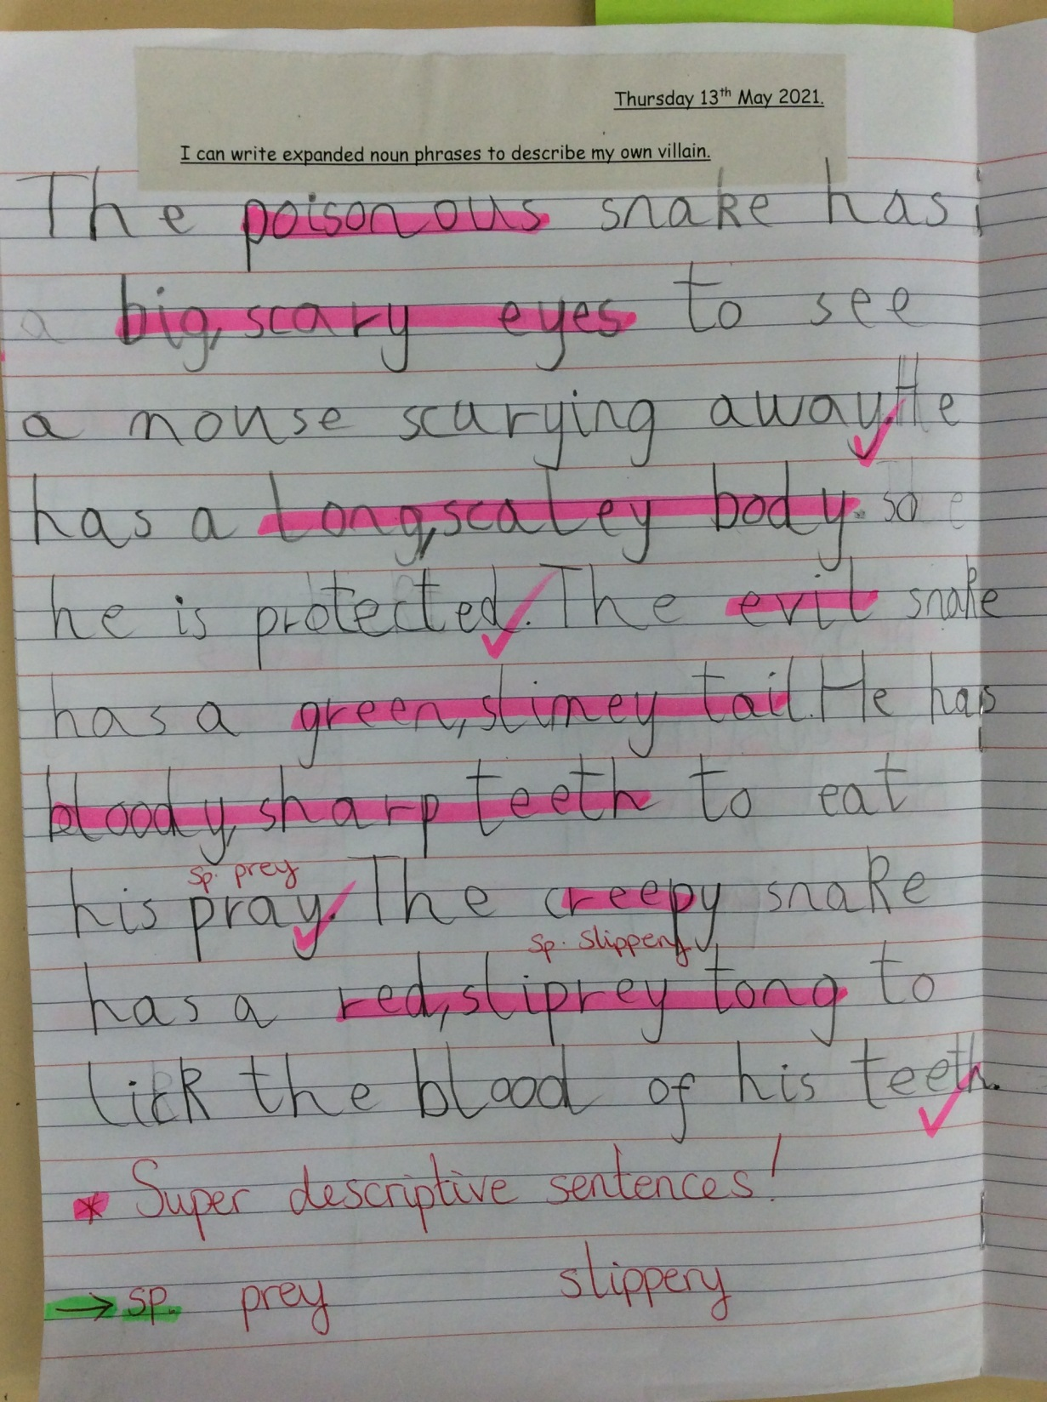

Slide 12
Year 2

Slide 13
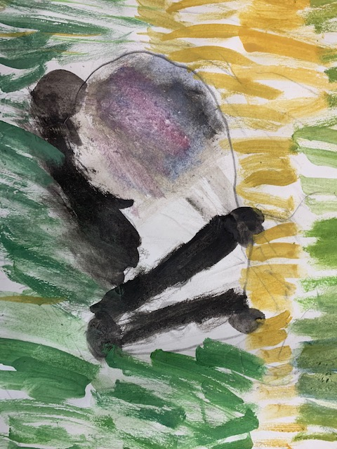

Slide 14
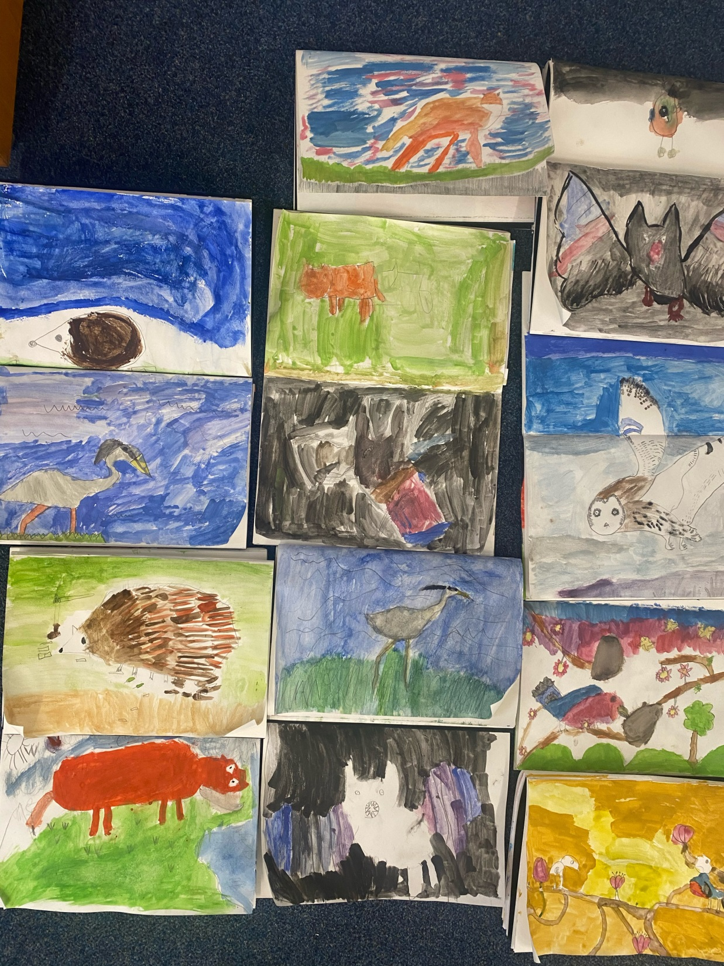

Slide 15
Year 3

Slide 16
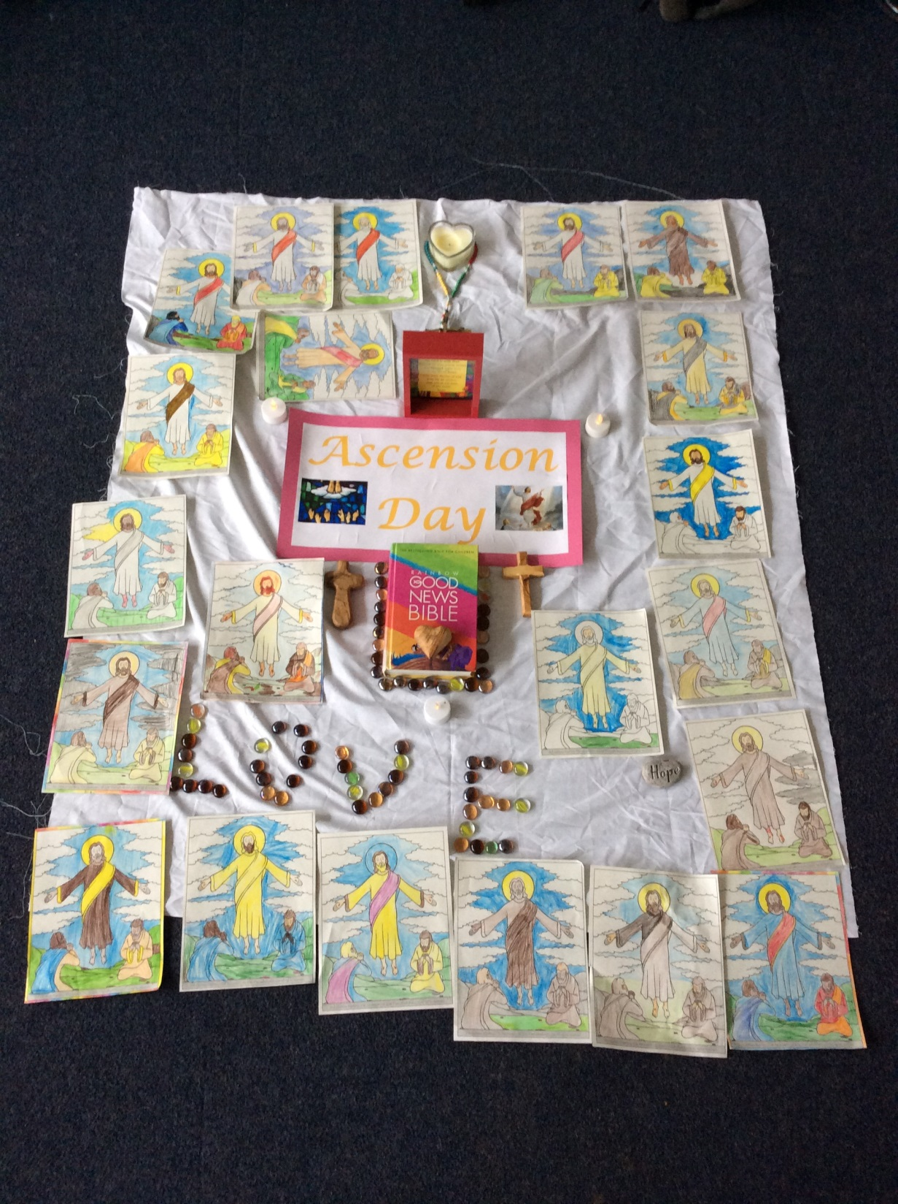

Slide 17
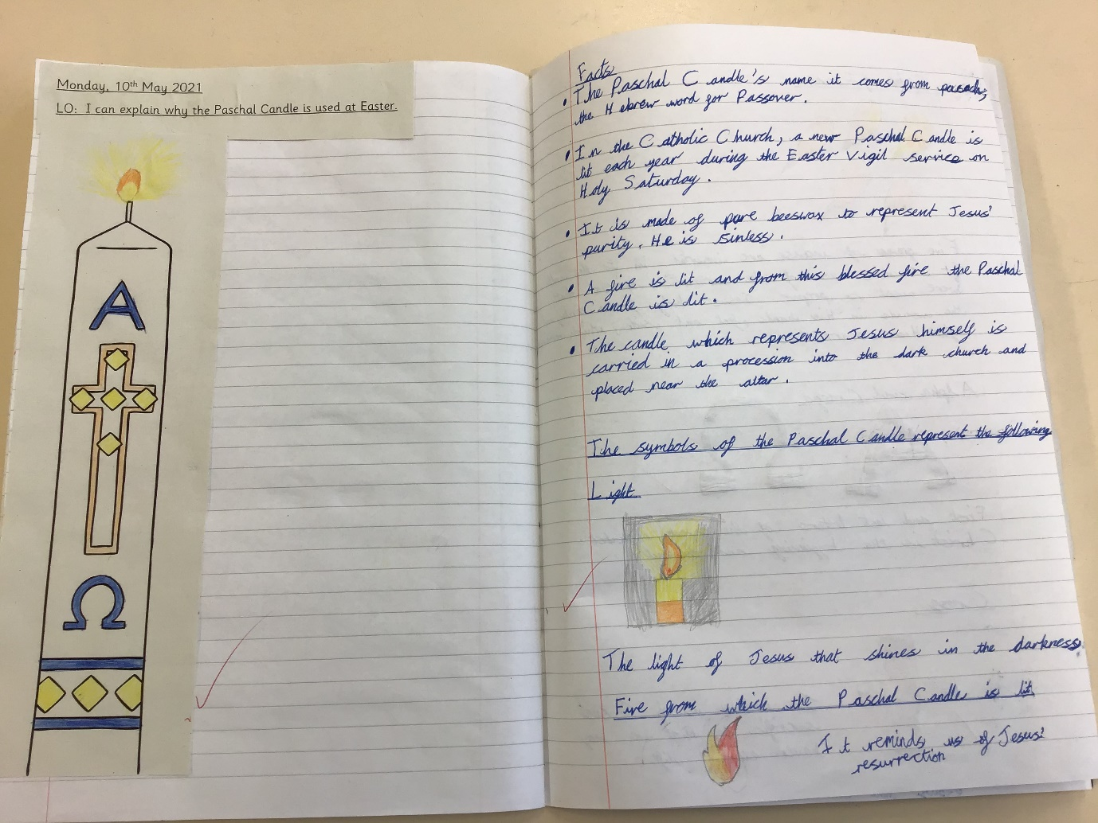

Slide 18
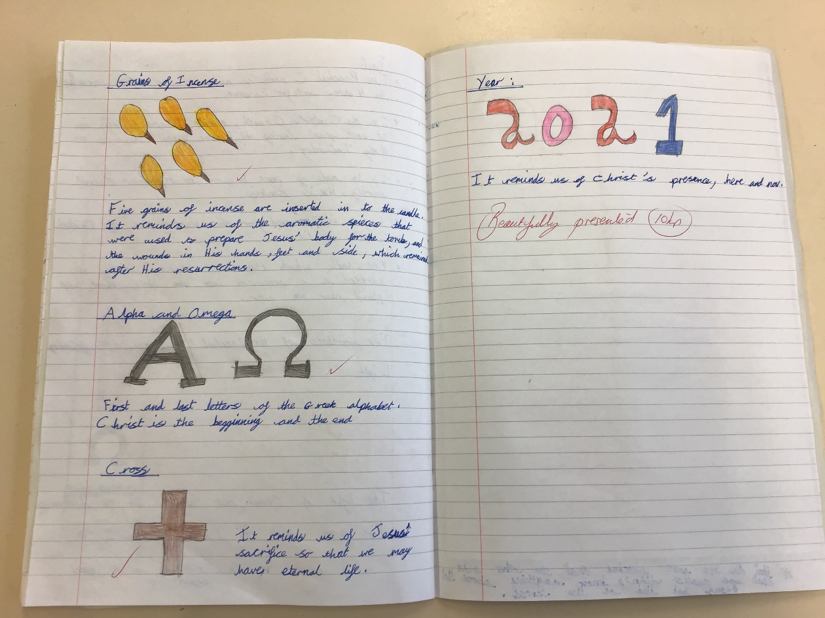

Slide 19
Year 4

Slide 20
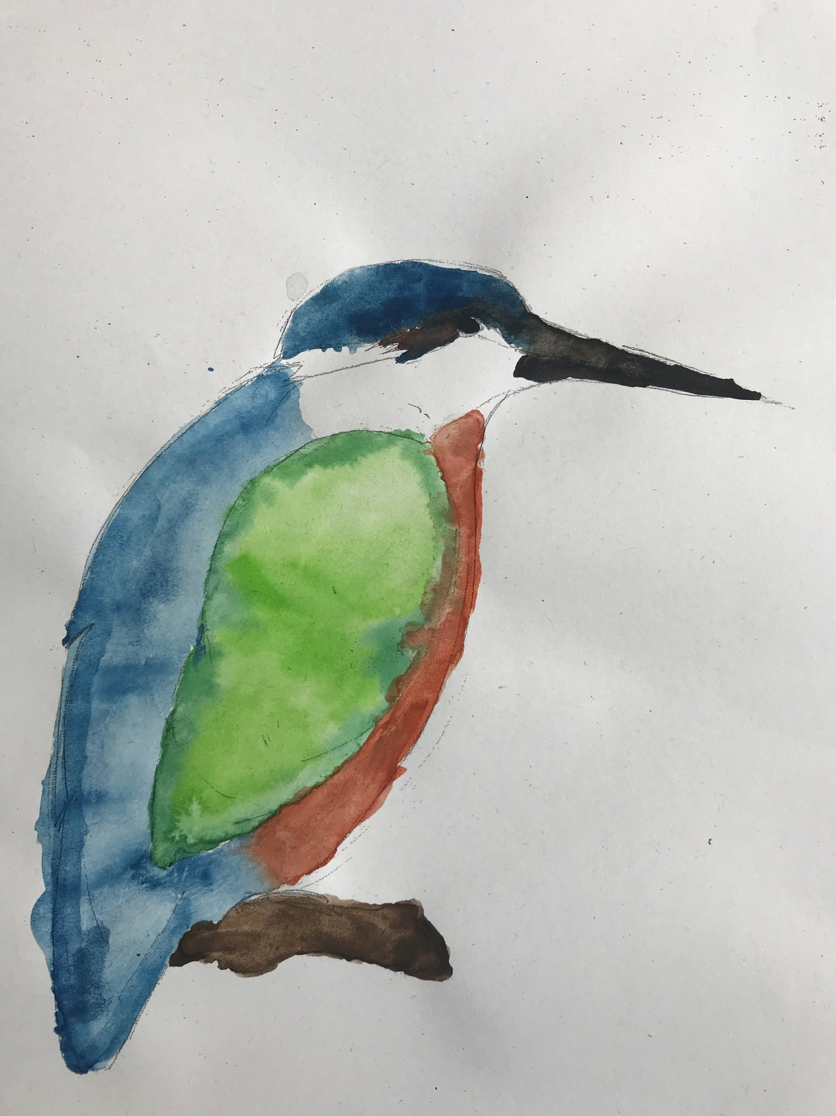

Slide 21
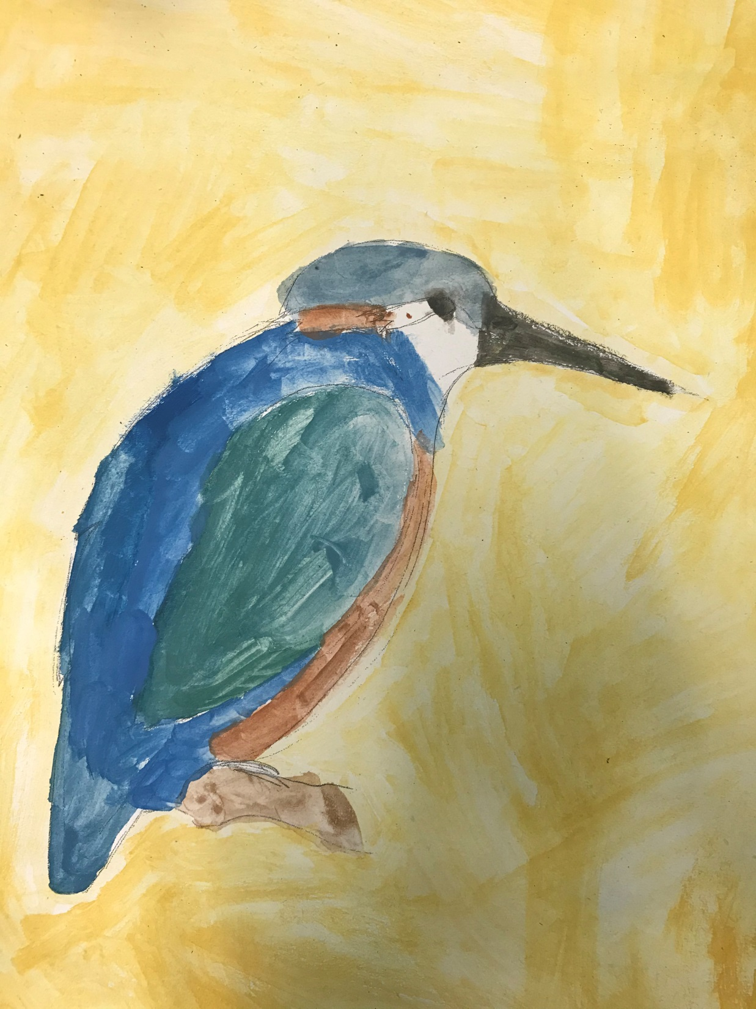

Slide 22
Year 5

Slide 23
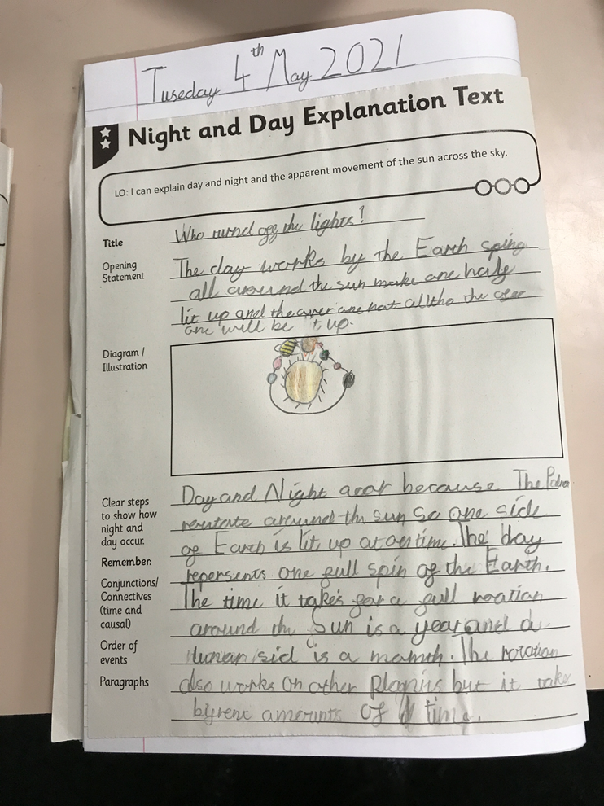

Slide 24
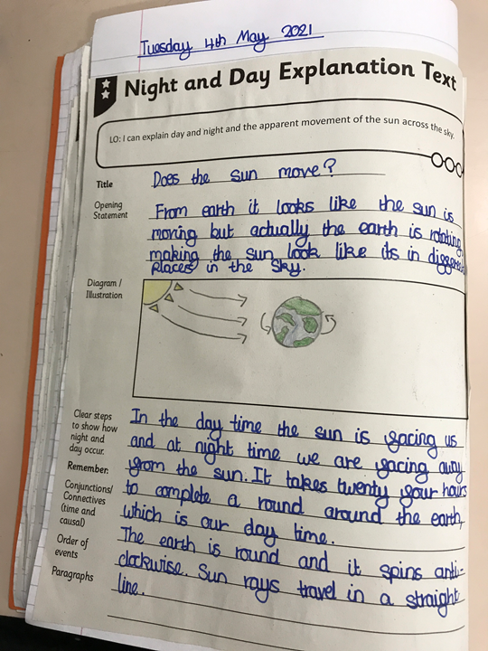

Slide 25
Year 6

Slide 26
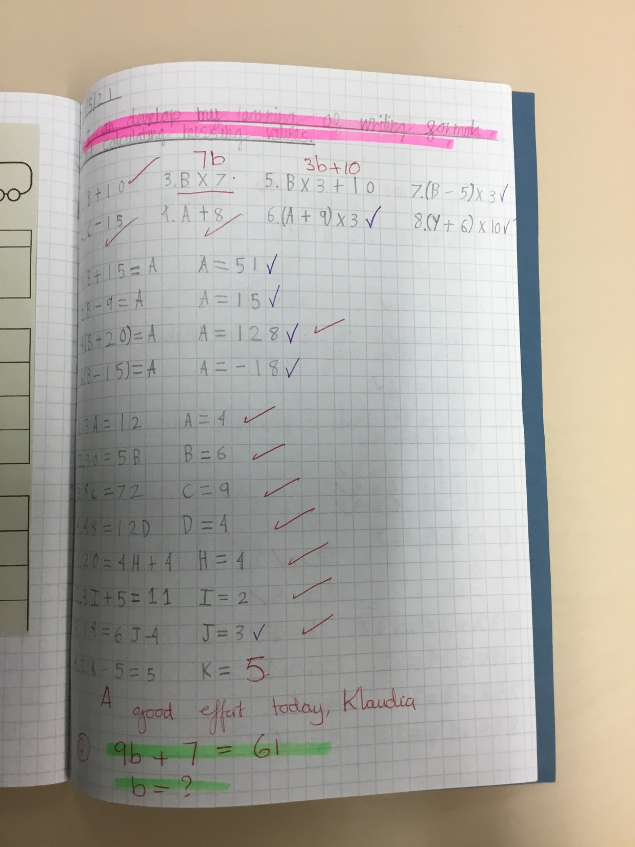

Slide 27
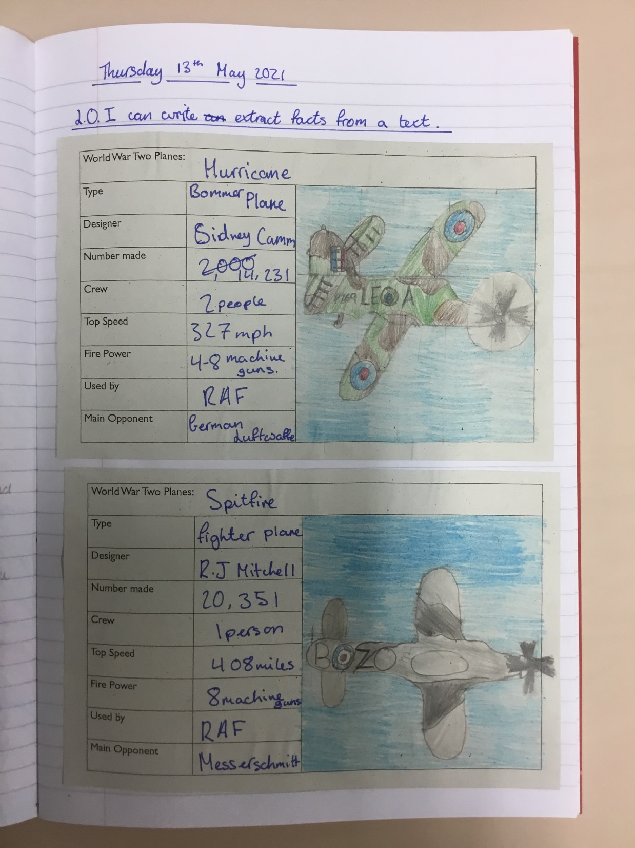

Slide 28


Slide 29


Slide 30


Slide 31
Show your love at home and at school through words and actions this week!
Notes:
GO FORTH - MISSION

Slide 32



Let us pray.
Dear Lord Jesus,
Thank you for loving us.
Please help us to always love you and to keep growing in love for one another.
Please help us to show our love for each other in the things that we say and do at home and at school.
Amen.

Slide 33
WOW!
WELL DONE EVERYONE!

