Slide 1


CELEBRATION ASSEMBLY
FRIDAY 21ST MAY

Slide 2

Notes:
WORD

Slide 3
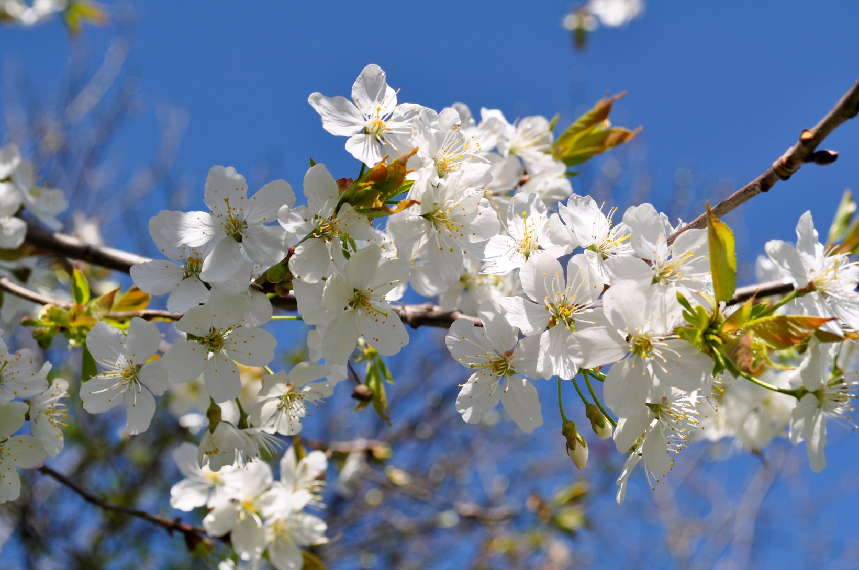
May is the month of Mary.

Slide 4
Hail Mary
Hail Mary, full of grace
The Lord is with thee.
Blessed art thou among women
And blessed is the fruit
Of thy womb, Jesus.
Holy Mary, mother of God,
Pray for us sinners now
And at the hour of our death.
Amen

Slide 5

Dear Lord,
Please bless our school
As we try to
Love, learn,
Share and respect
In the light of Jesus.
St Alban, pray for us.
Amen

Slide 6
In last Sunday’s Gospel, Jesus’ prayer is a reminder of the tremendous care that God has for each person - the care we often experience
through the actions of the people around us.
We are God’s most loved creation and we can be certain that God will always care for us.

Slide 7

Notes:
SYMBOLIC ACTION – FIRST AND LAST IN THE QUEUE

Slide 8
John 17:11-19
The Lord be with you.
And with your spirit
A reading from the Holy Gospel according to John.
Glory to you, O Lord.

Slide 9
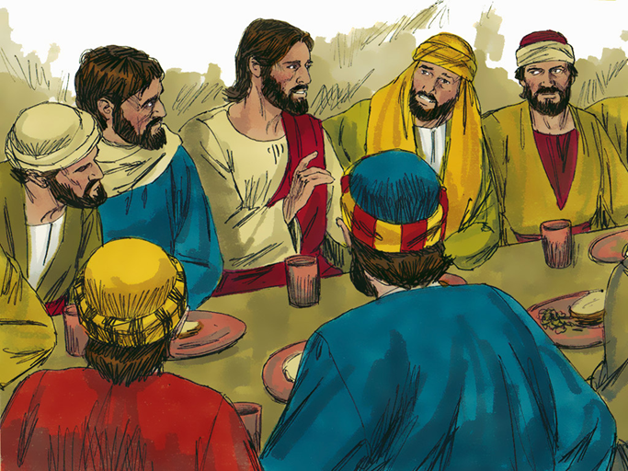
Jesus looked up to heaven and prayed: ‘Holy Father, protect the people you have given to me. Keep them true to your name, so that they may be one with each other, just as you and I are one.

Slide 10
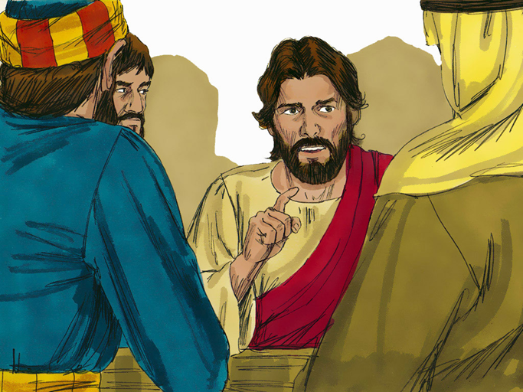
Since I have been with them, I have taken care of them, and I have kept
them true to you. Now I am coming to you. But before I do, I am saying these things to share my joy with them to the full.

Slide 11
John 17:11-19
The Gospel of the Lord
Praise to you, Lord Jesus Christ.

Slide 12

Reception

Slide 13
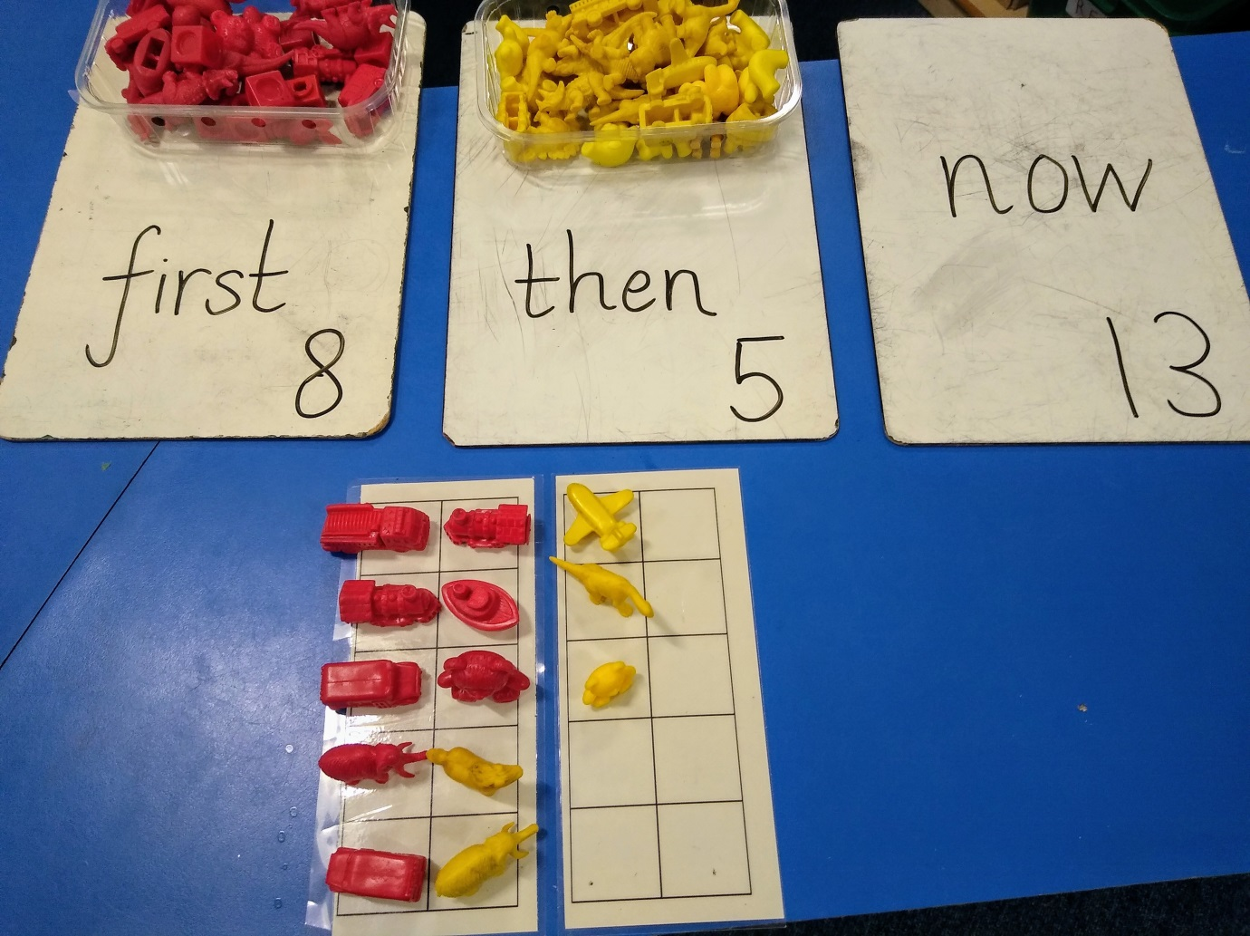

Slide 14
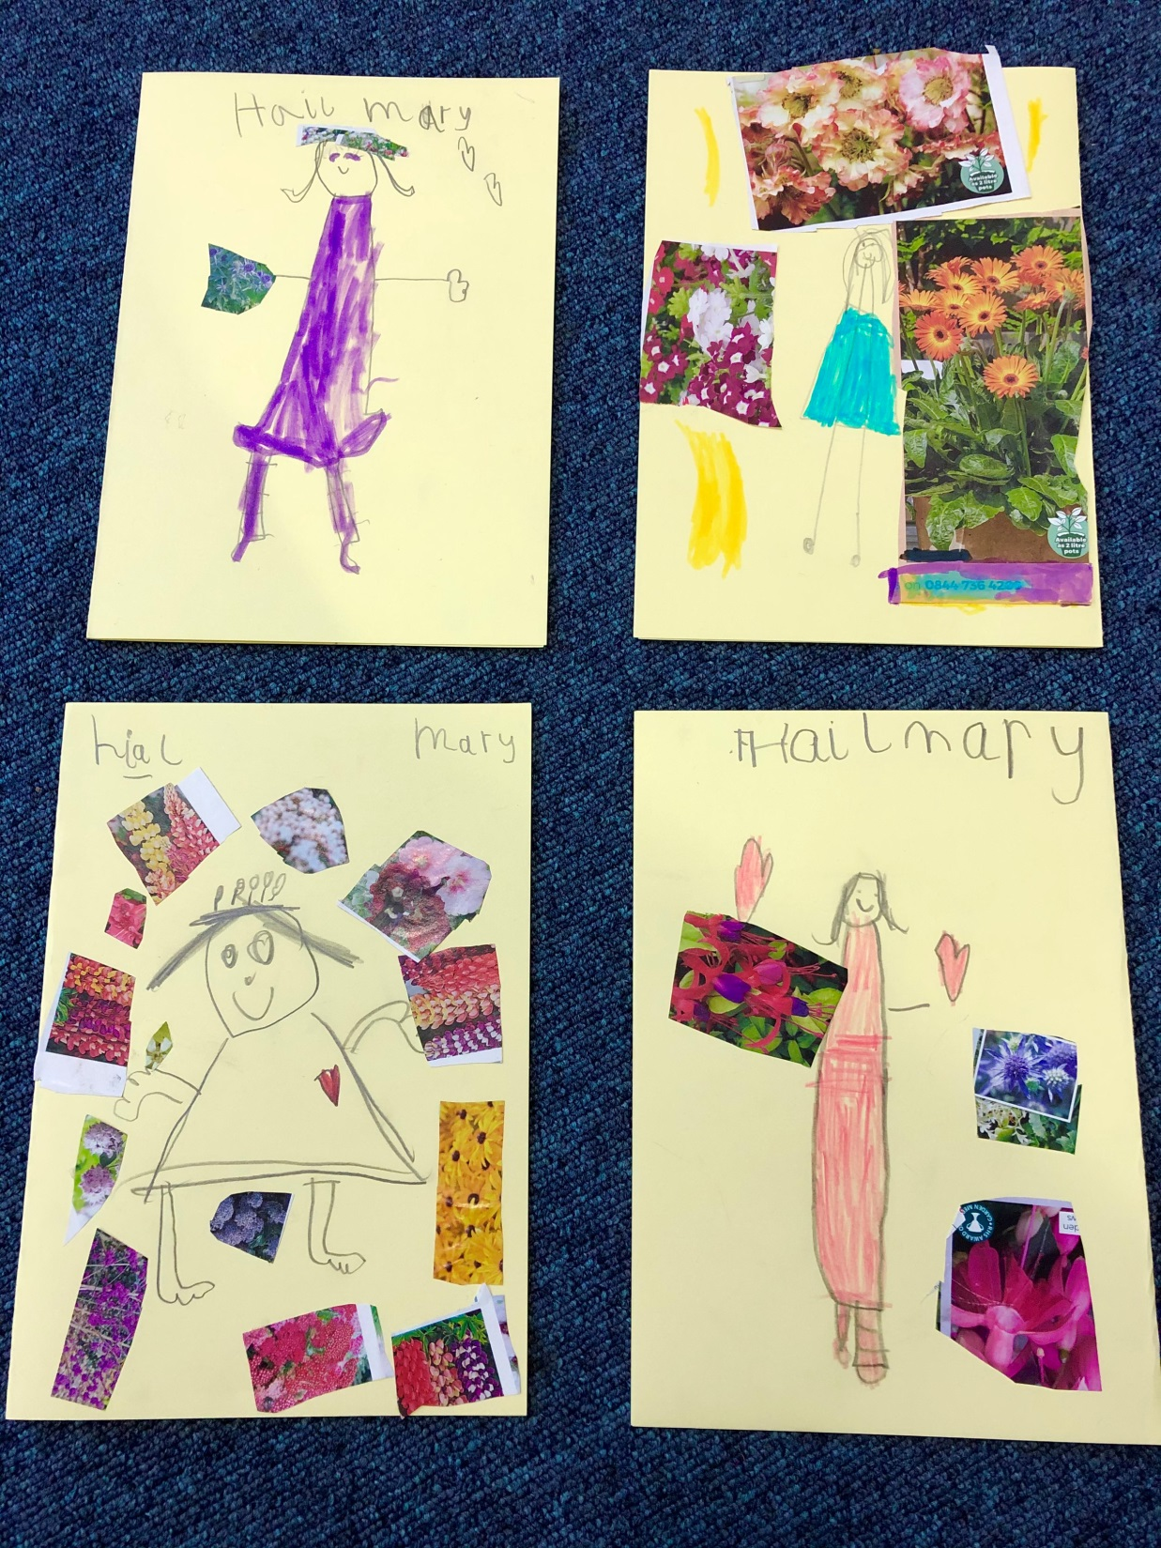

Slide 15
Year 1

Slide 16
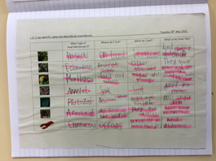

Slide 17
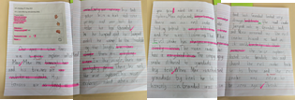

Slide 18
Year 2

Slide 19
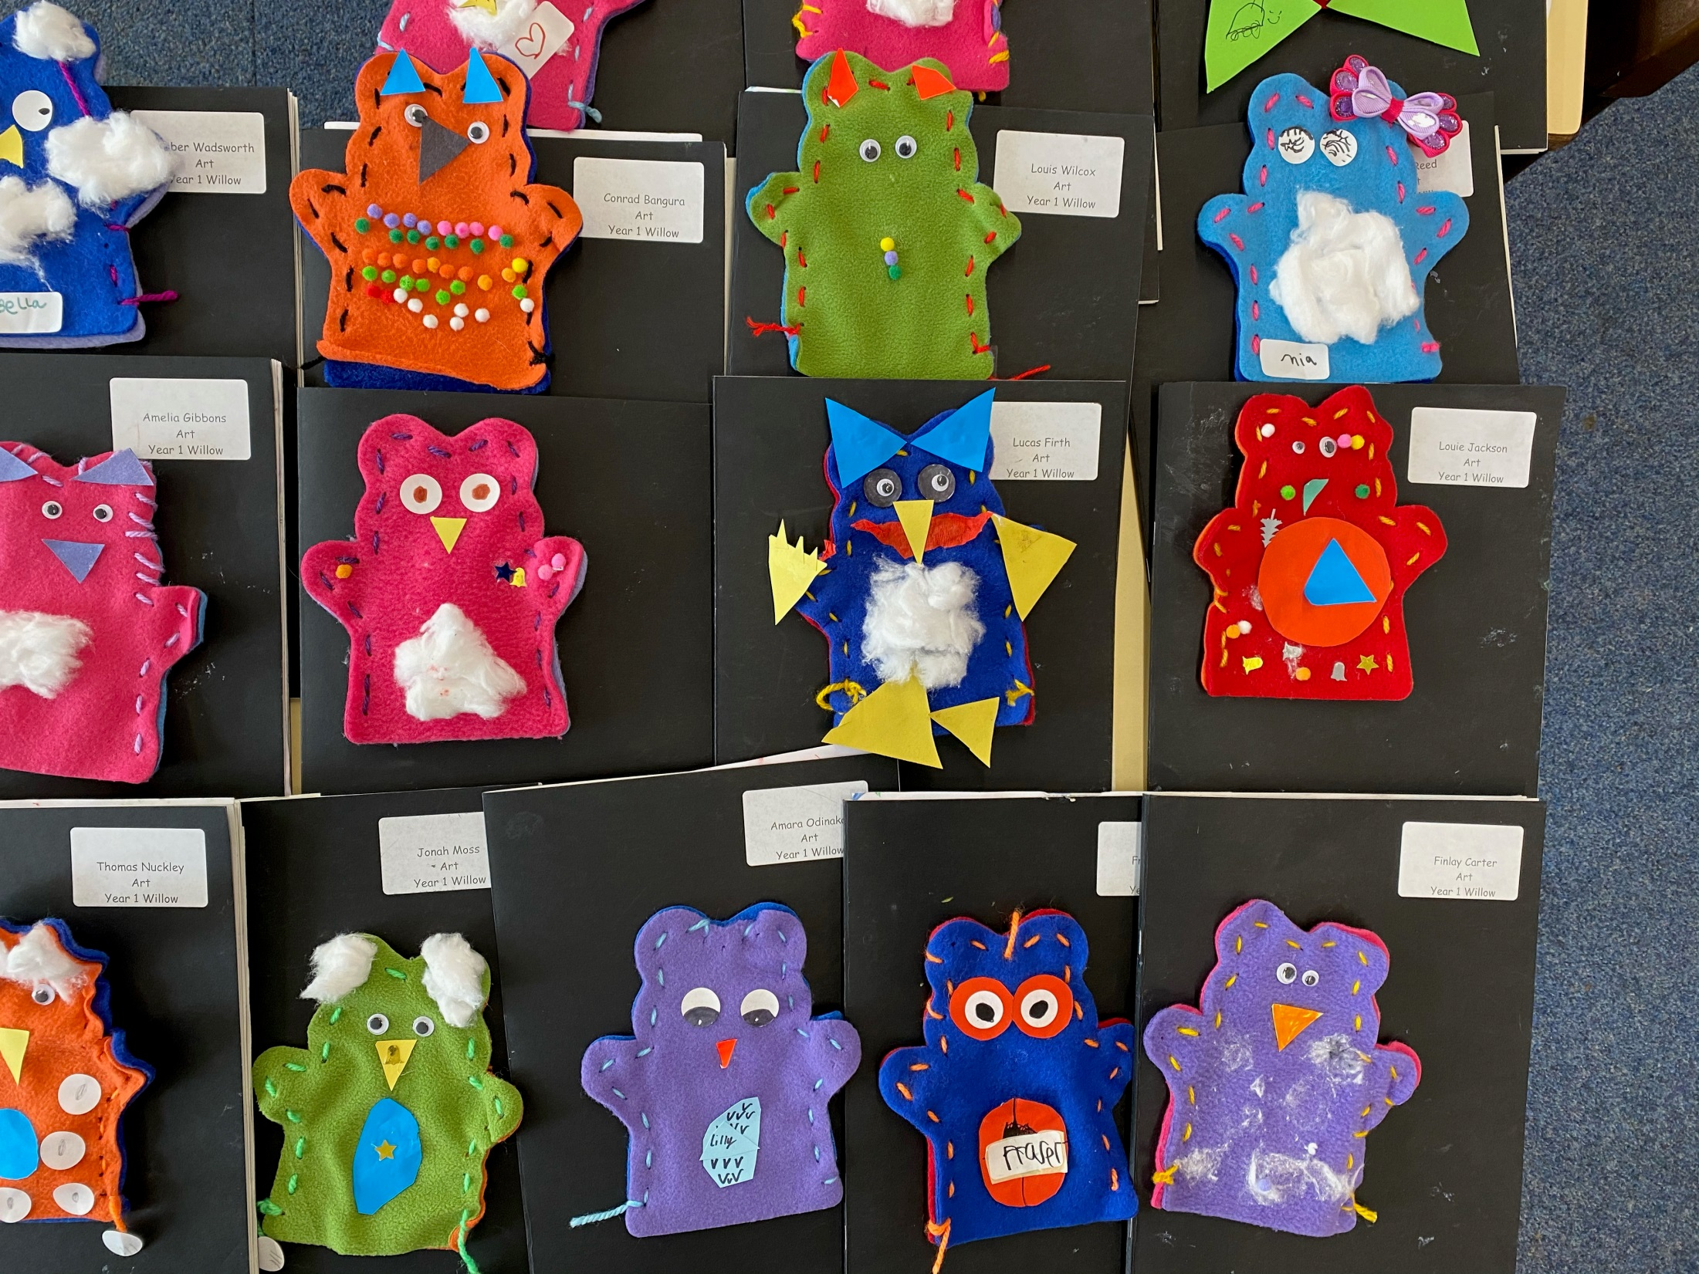

Slide 20
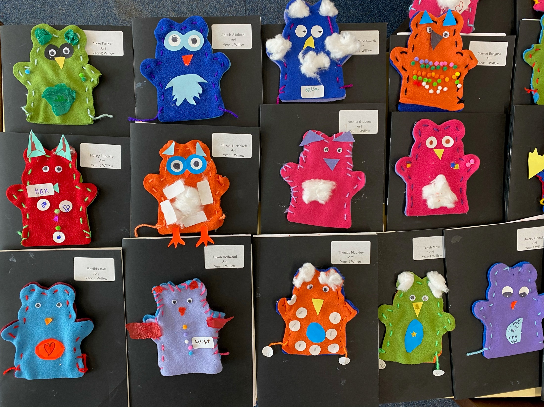

Slide 21
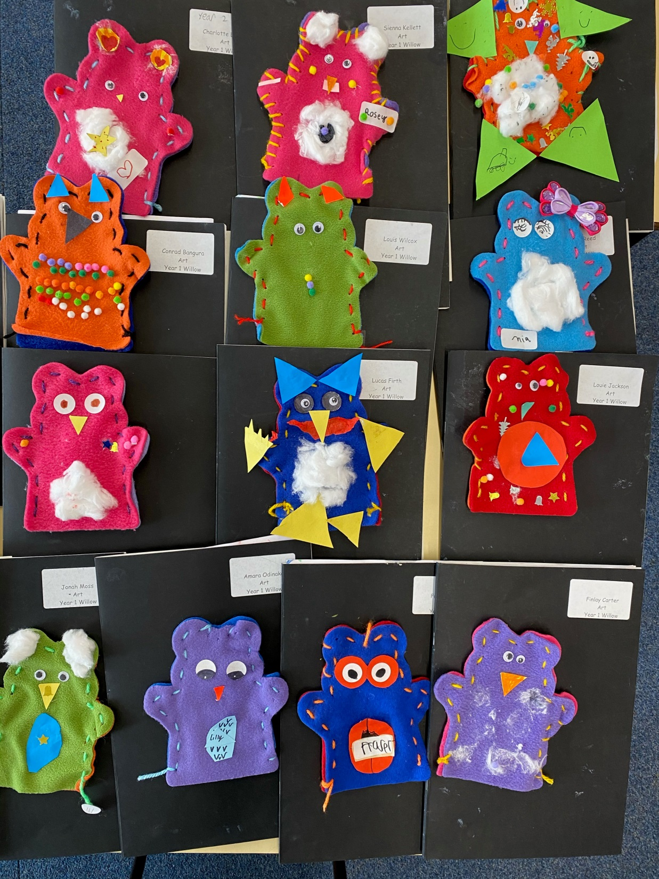

Slide 22
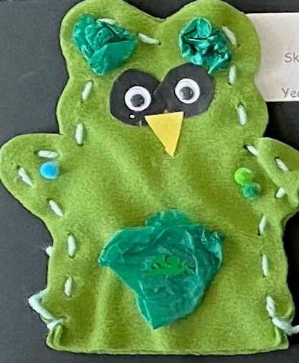

Slide 23
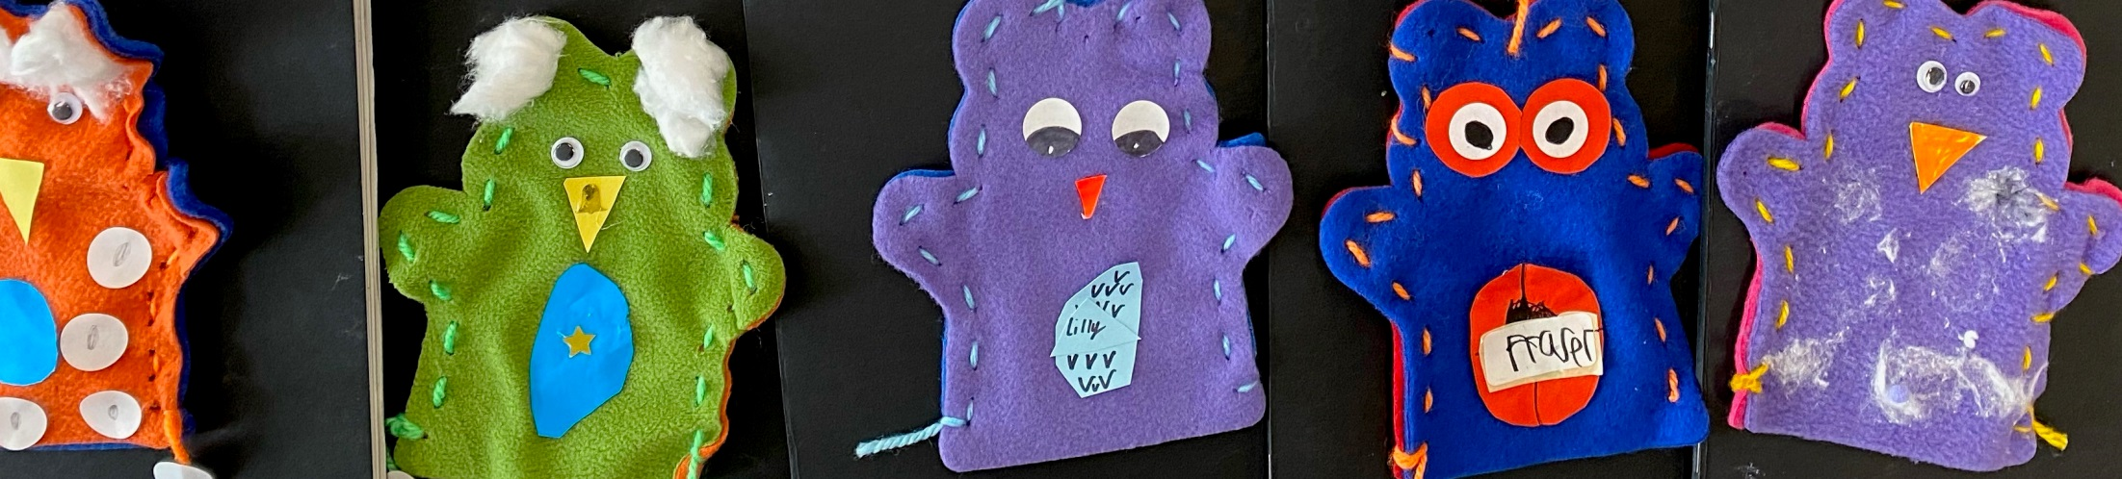

Slide 24
Year 3

Slide 25
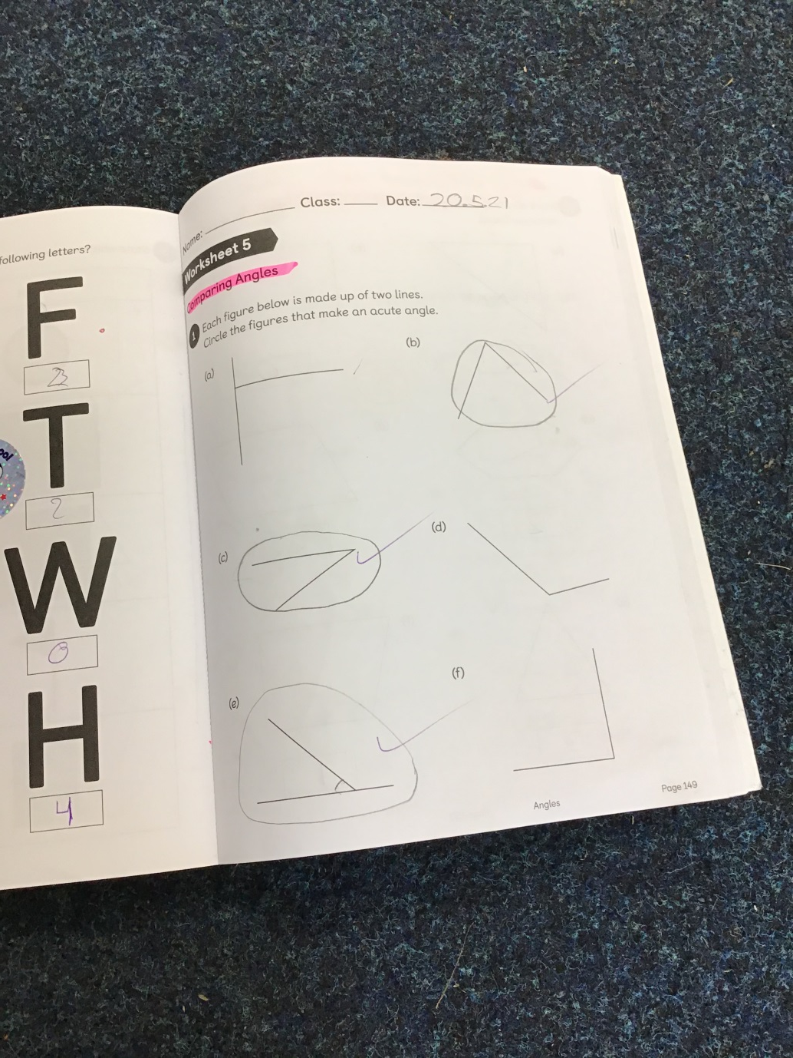

Slide 26
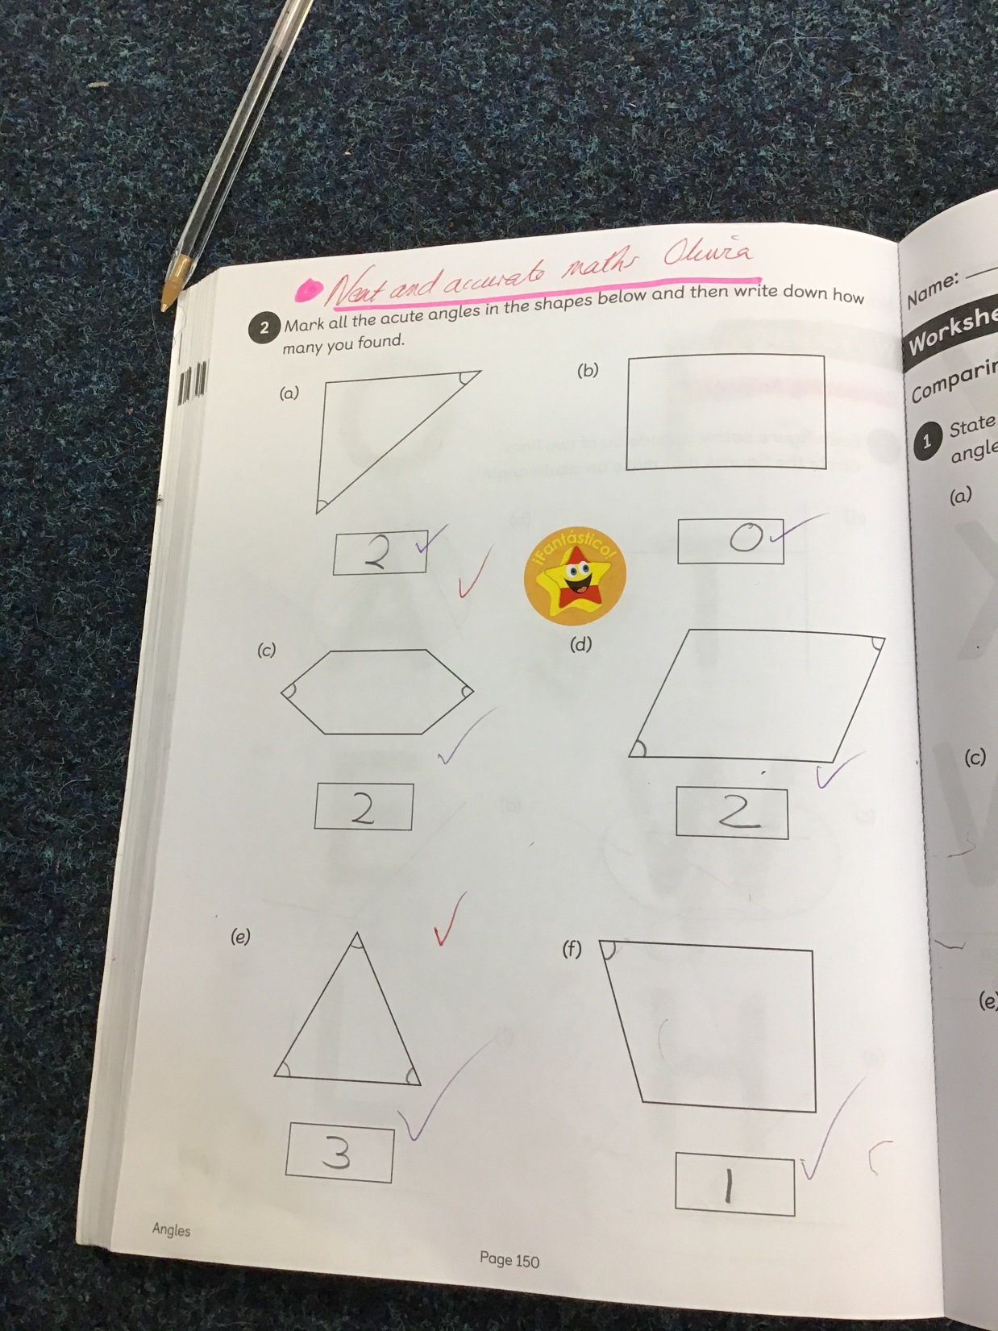

Slide 27
Year 4

Slide 28
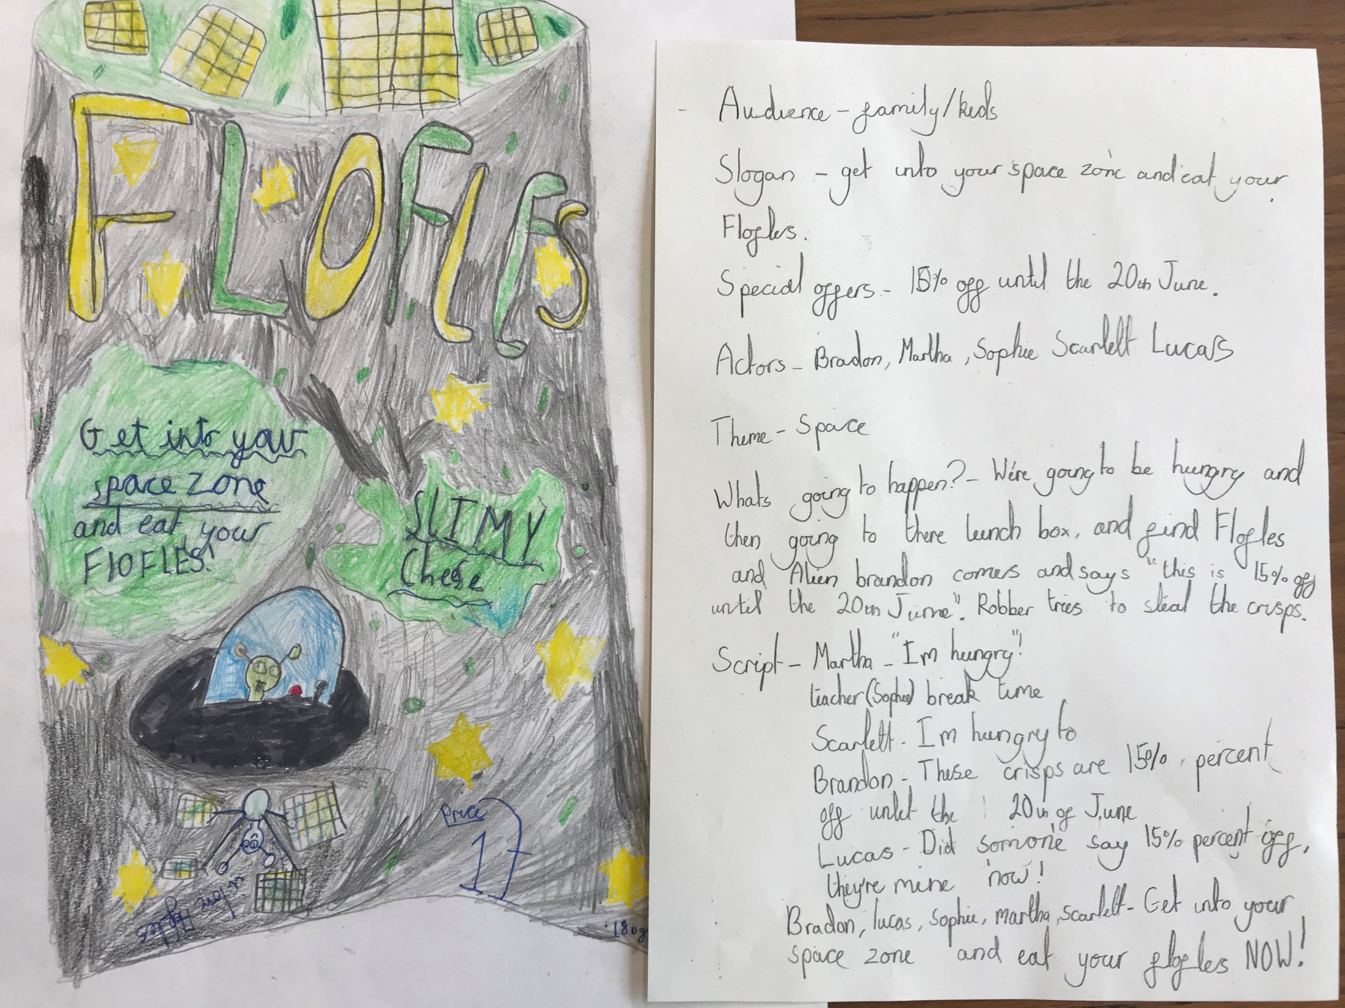

Slide 29
Year 5

Slide 30
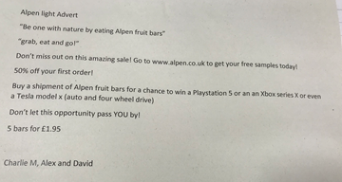

Slide 31
Year 6

Slide 32
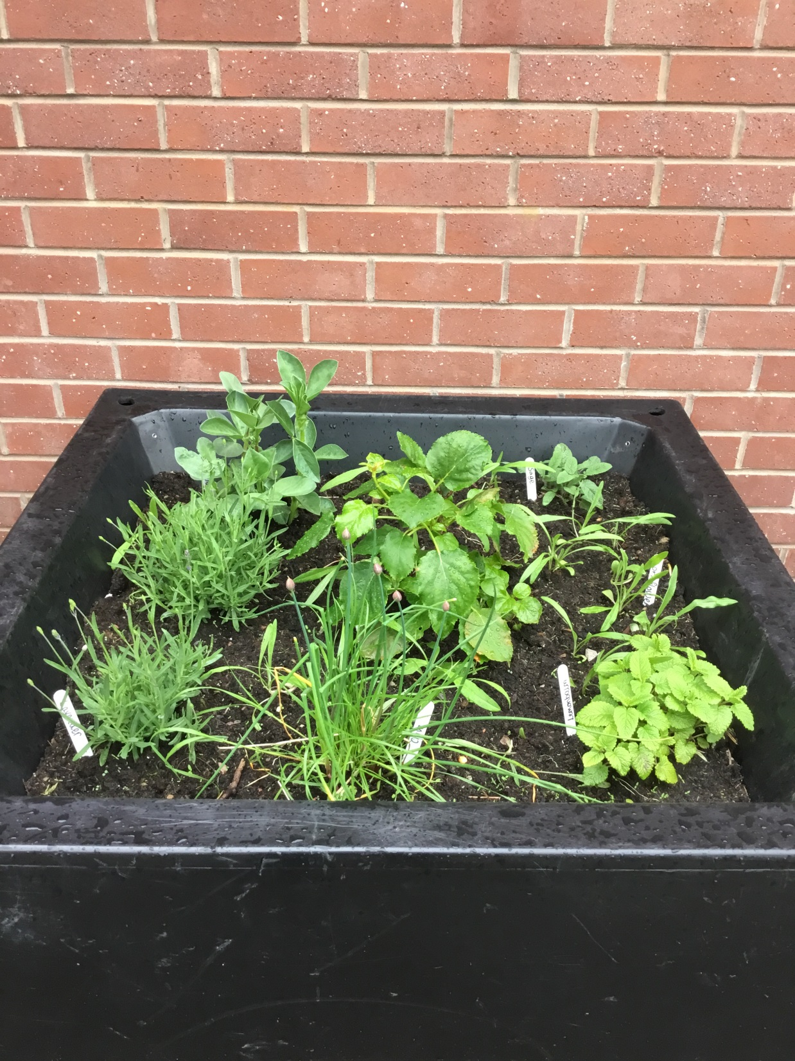

Slide 33
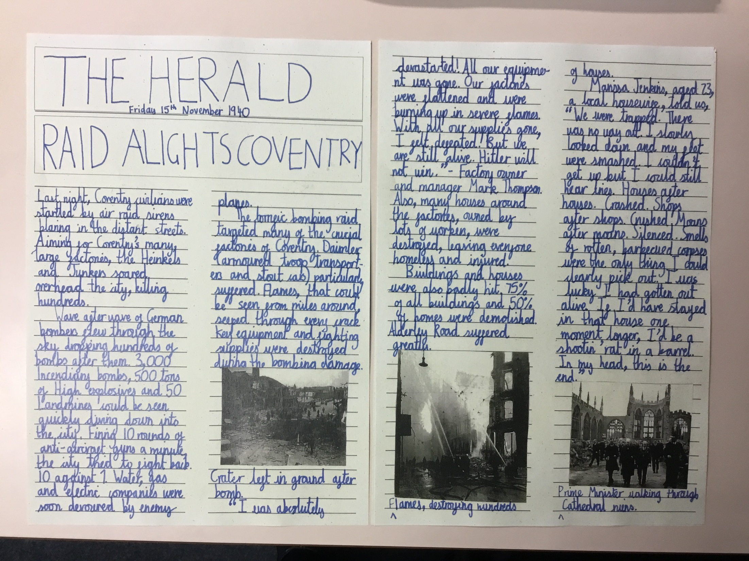

Slide 34
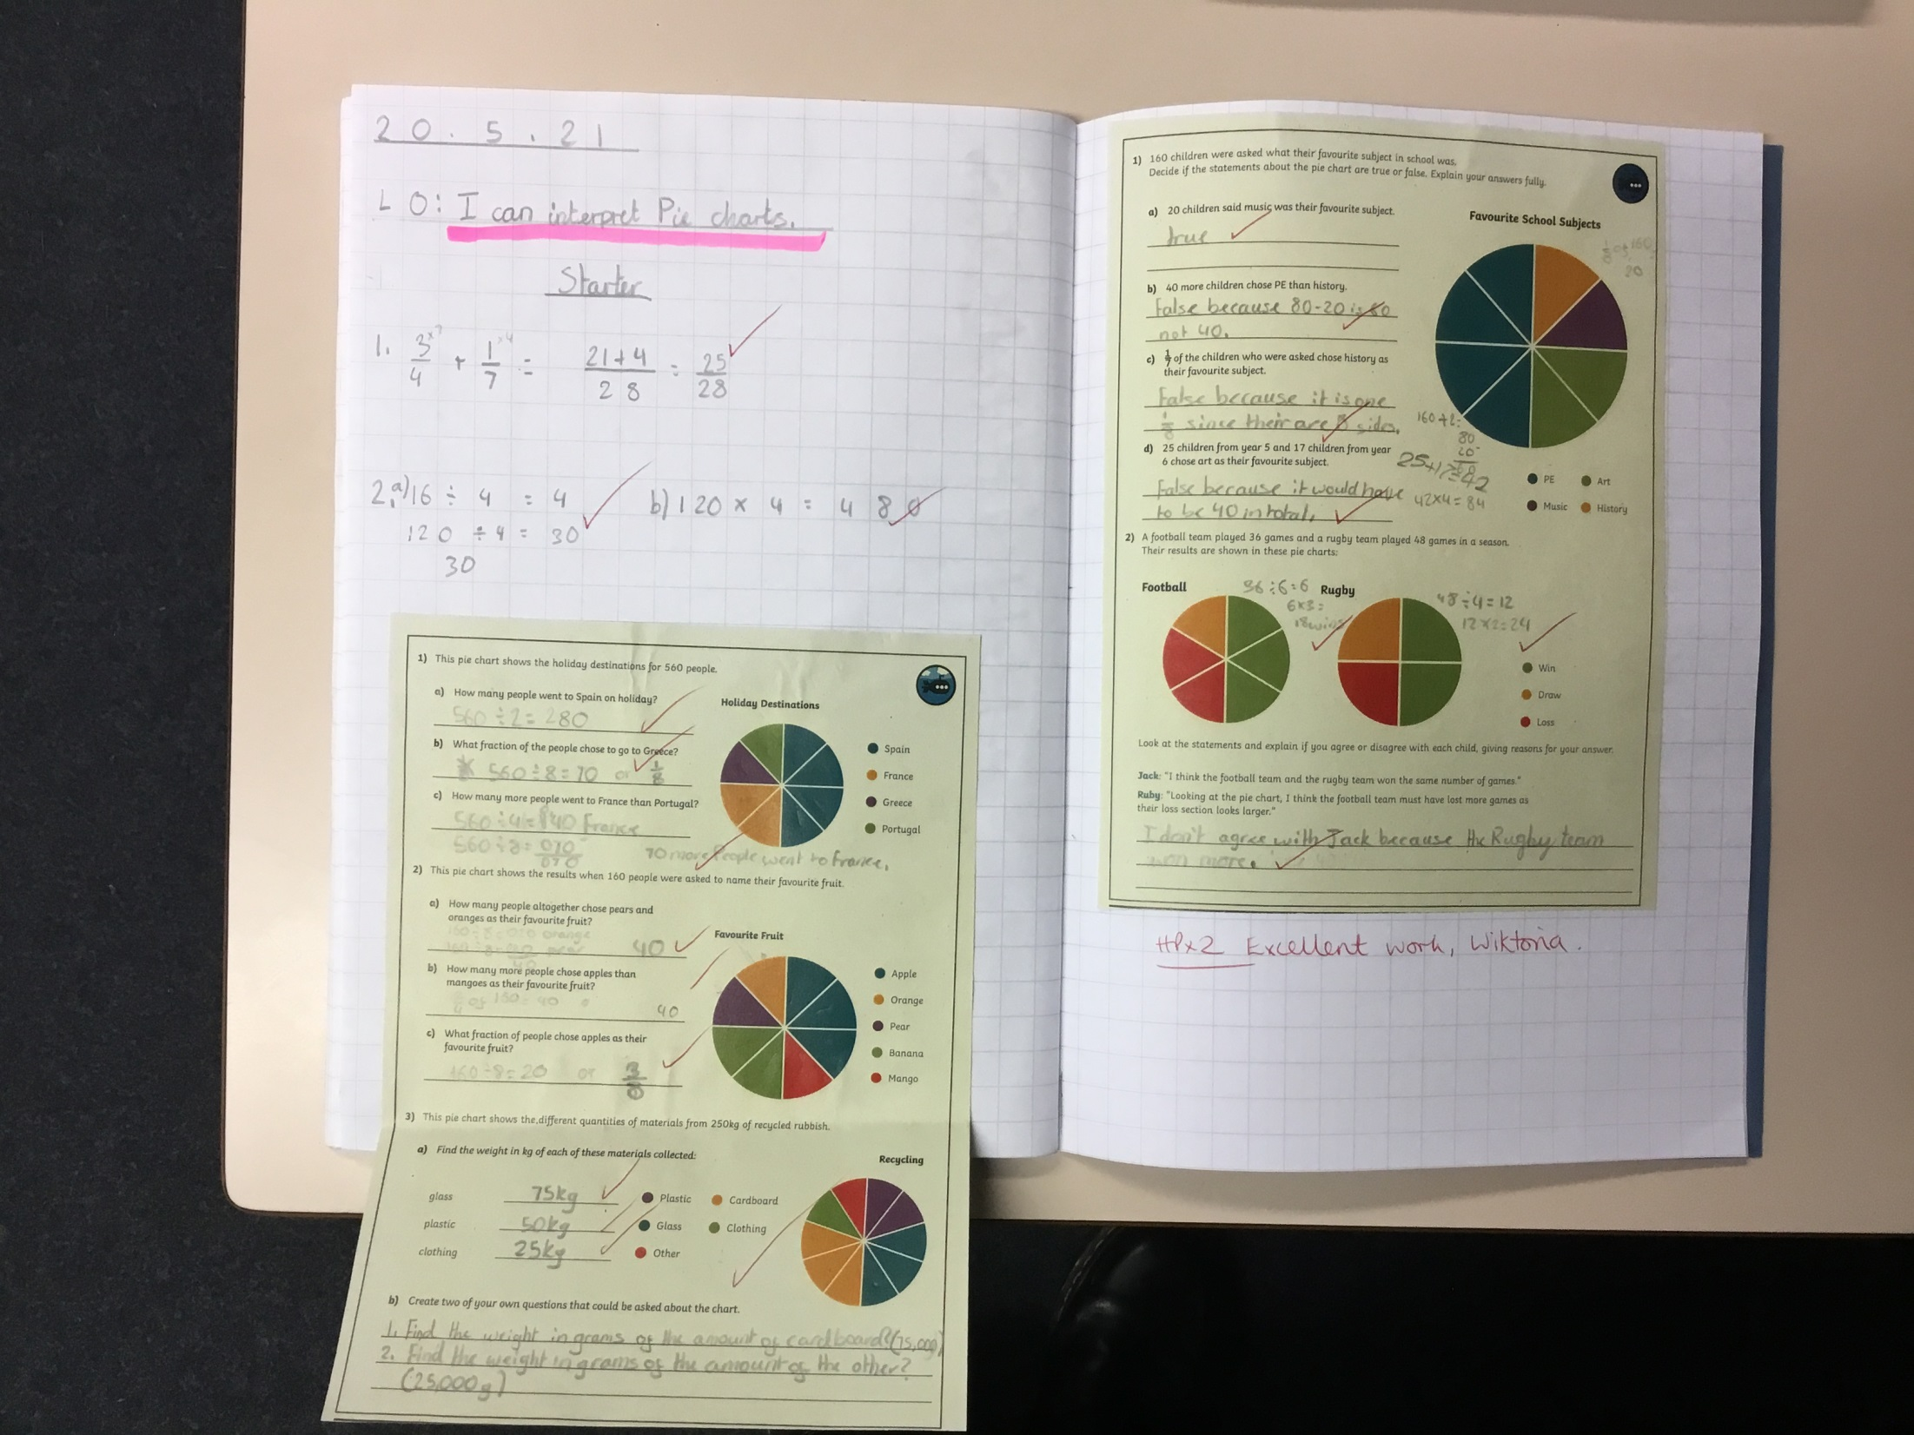

Slide 35


Slide 36
Reception - Hugo & Darcie
Year 1 - Blake & Noah
Year 2 - Freya & Thomas
Year 3 - Maddison & Will
Year 4 - Evie, Sophia & Joshua
Year 5 - Leila, Poppy & Eden
Year 6 - Gabriella & Adrian

Slide 37


Slide 38


Slide 39
Show your care for Creation by your actions this week!
Notes:
GO FORTH - MISSION

Slide 40



Let us pray.
Dear Lord Jesus,
Thank you for your constant love and care.
Help us to always have a loving and caring heart.
Please help us to always look after each other
And work together to care for Creation
May we always appreciate our wonderful world.
Amen.

Slide 41
WOW!
WELL DONE EVERYONE!

