Slide 1


CELEBRATION and GOOD NEWS ASSEMBLY
WEDNESDAY 30TH JUNE

Slide 2

Notes:
WORD

Slide 3
Hail Mary
Hail Mary, full of grace
The Lord is with thee.
Blessed art thou among women
And blessed is the fruit
Of thy womb, Jesus.
Holy Mary, mother of God,
Pray for us sinners now
And at the hour of our death.
Amen

Slide 4

Dear Lord,
Please bless our school
As we try to
Love, learn,
Share and respect
In the light of Jesus.
St Alban, pray for us.
Amen

Slide 5

Notes:
SYMBOLIC ACTION – FIRST AND LAST IN THE QUEUE

Slide 6
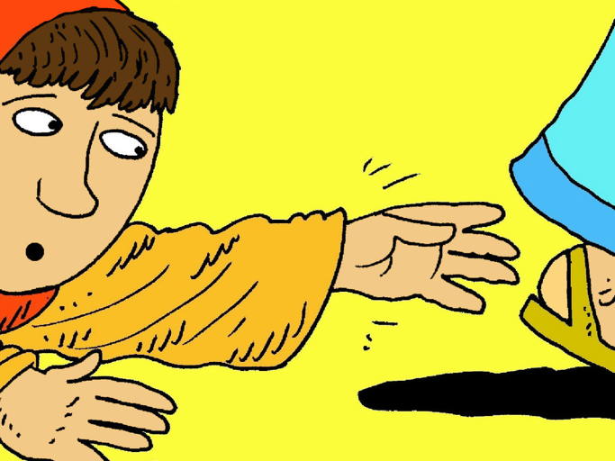
In this Gospel Reading, we hear how a woman had such great faith in Jesus and how her faith was rewarded.

Slide 7
Mark 5:21-43
The Lord be with you.
And with your spirit
A reading from the Holy Gospel according to Mark.
Glory to you, O Lord.

Slide 8
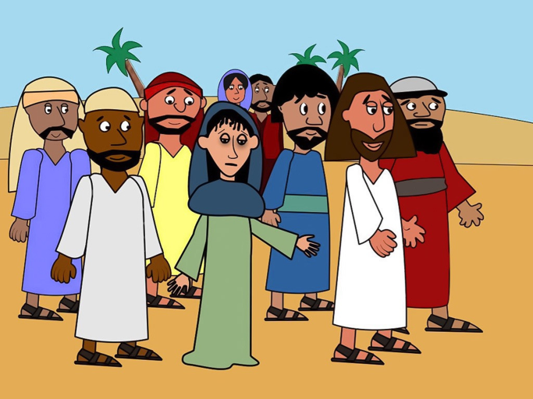
When Jesus had crossed in the boat to the other side of the lake, a large crowd gathered round him and he stayed by the lakeside.

Slide 9
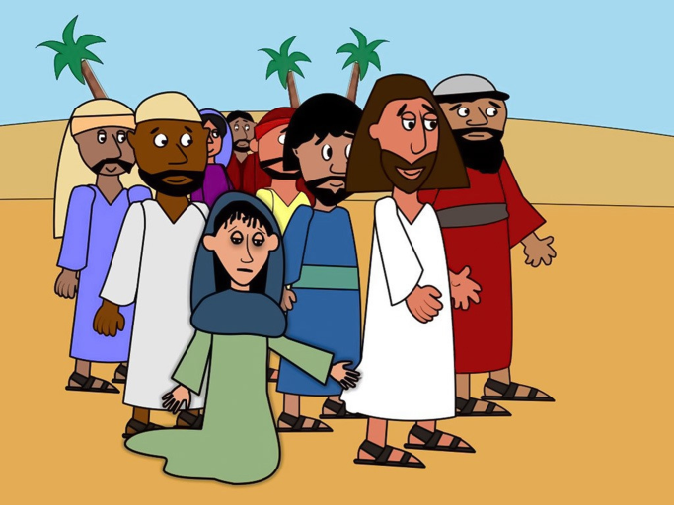
A woman, who had been ill for 12 years, came up behind Jesus and touched his cloak. “If I can touch even his clothes,” she had told herself, “I shall be well again.” She then immediately felt that she was cured.

Slide 10
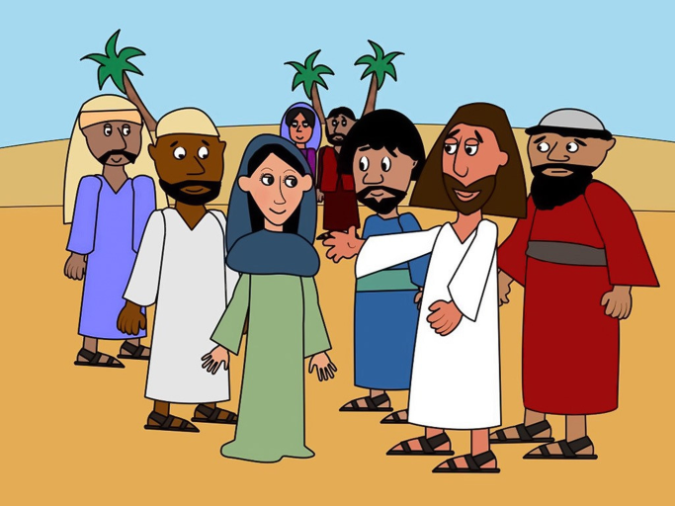
Jesus was immediately aware that power had gone out from him. He turned round and said, “Who touched me?” The woman came forward and told him the truth. Jesus said, “Your faith has restored you to health. Go in peace.”

Slide 11
Mark 5:21-43
The Gospel of the Lord
Praise to you, Lord Jesus Christ.

Slide 12
In this Gospel Reading, we are reminded to always have faith in God, who will help us to overcome any difficulties that we may face on life’s journey.

Slide 13

Reception

Slide 14
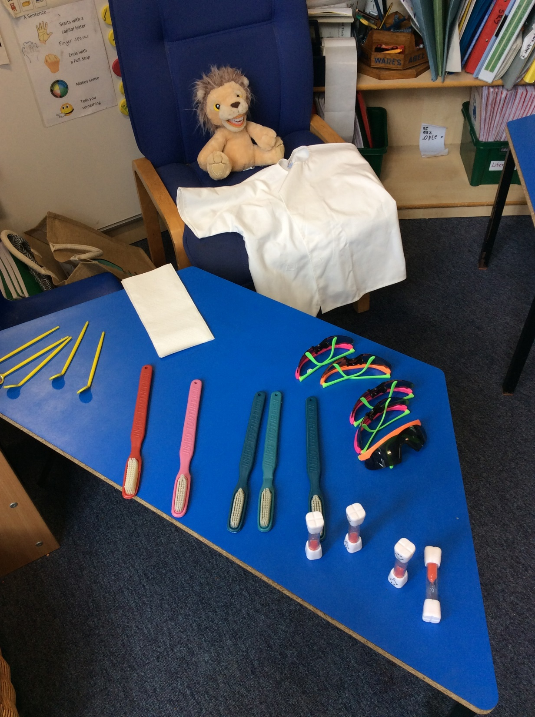

Slide 15
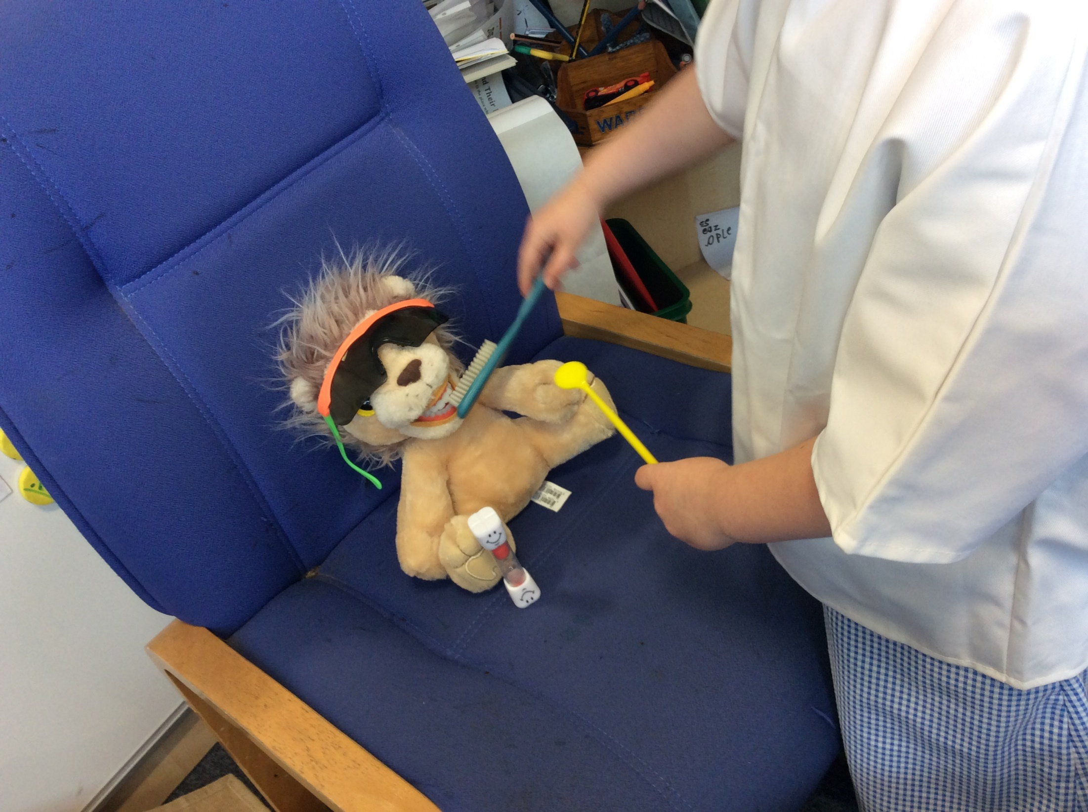

Slide 16
Year 1

Slide 17
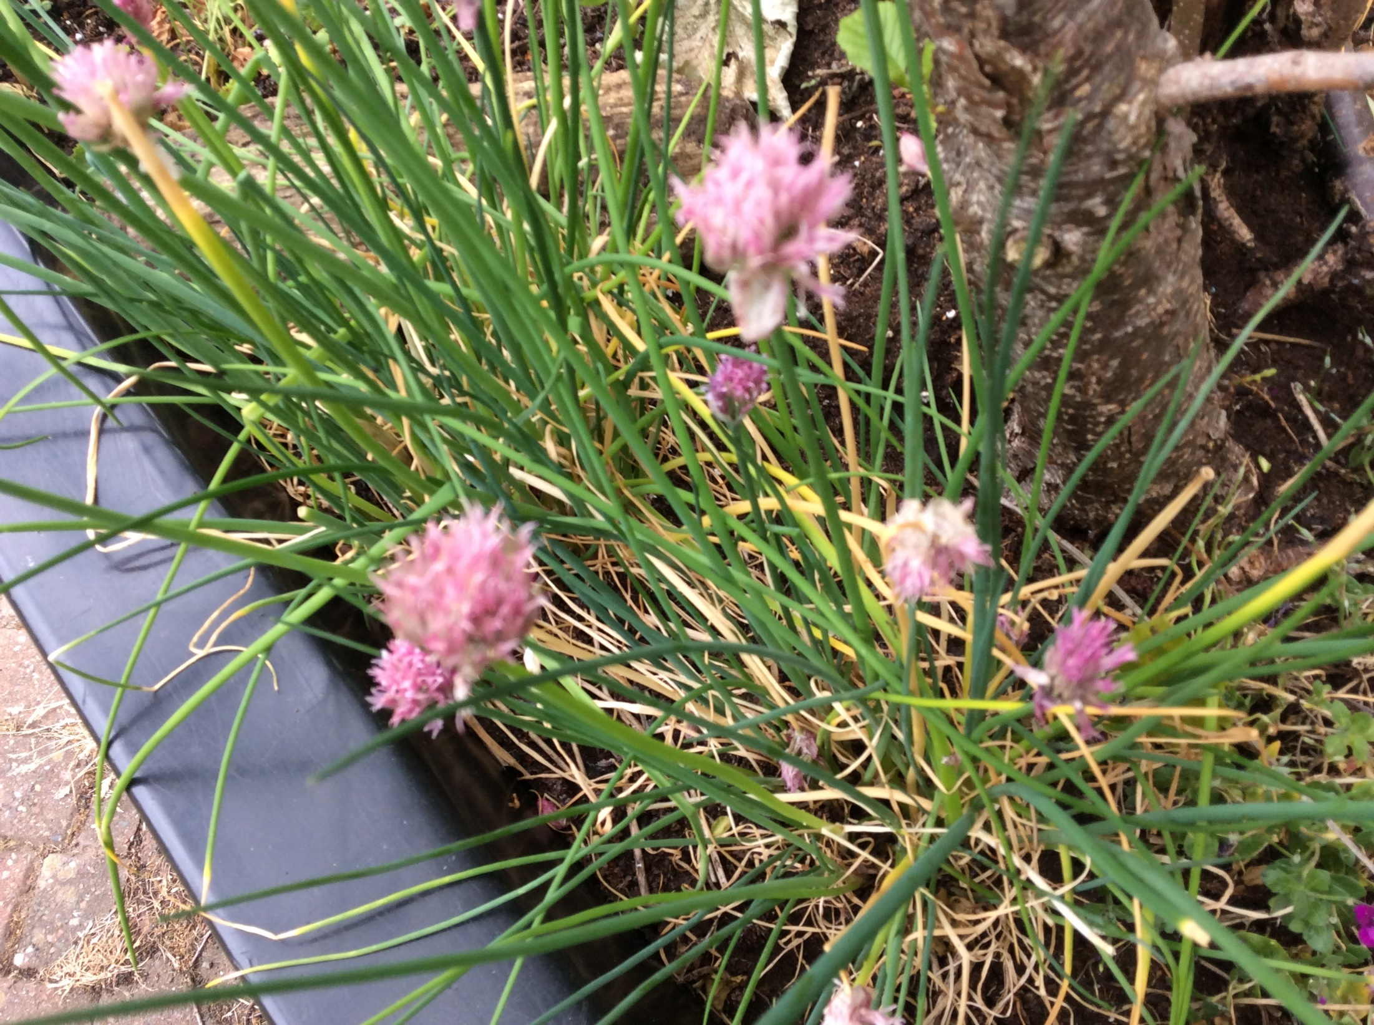

Slide 18
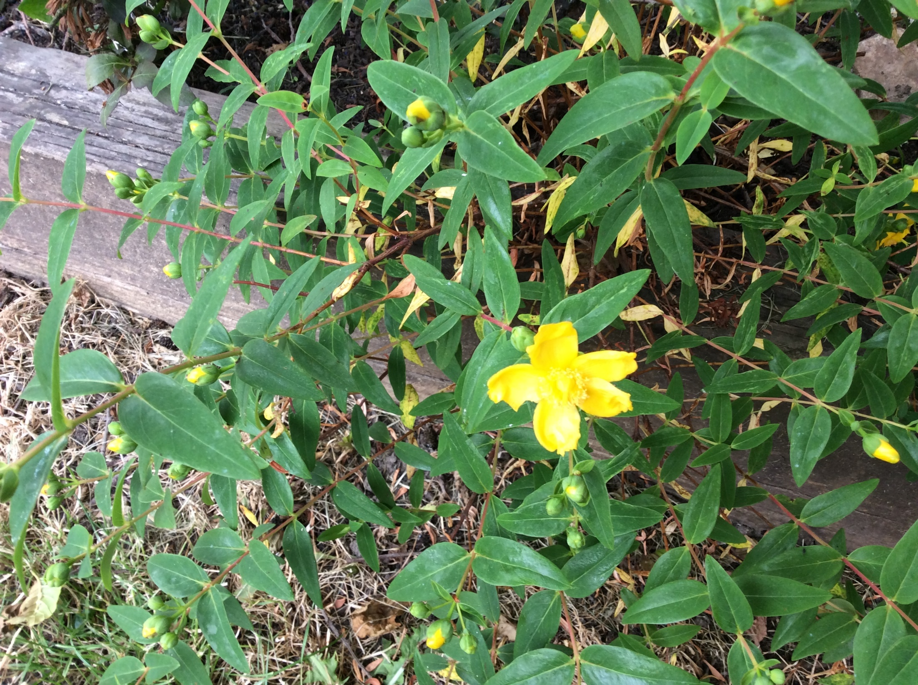

Slide 19
Year 2

Slide 20
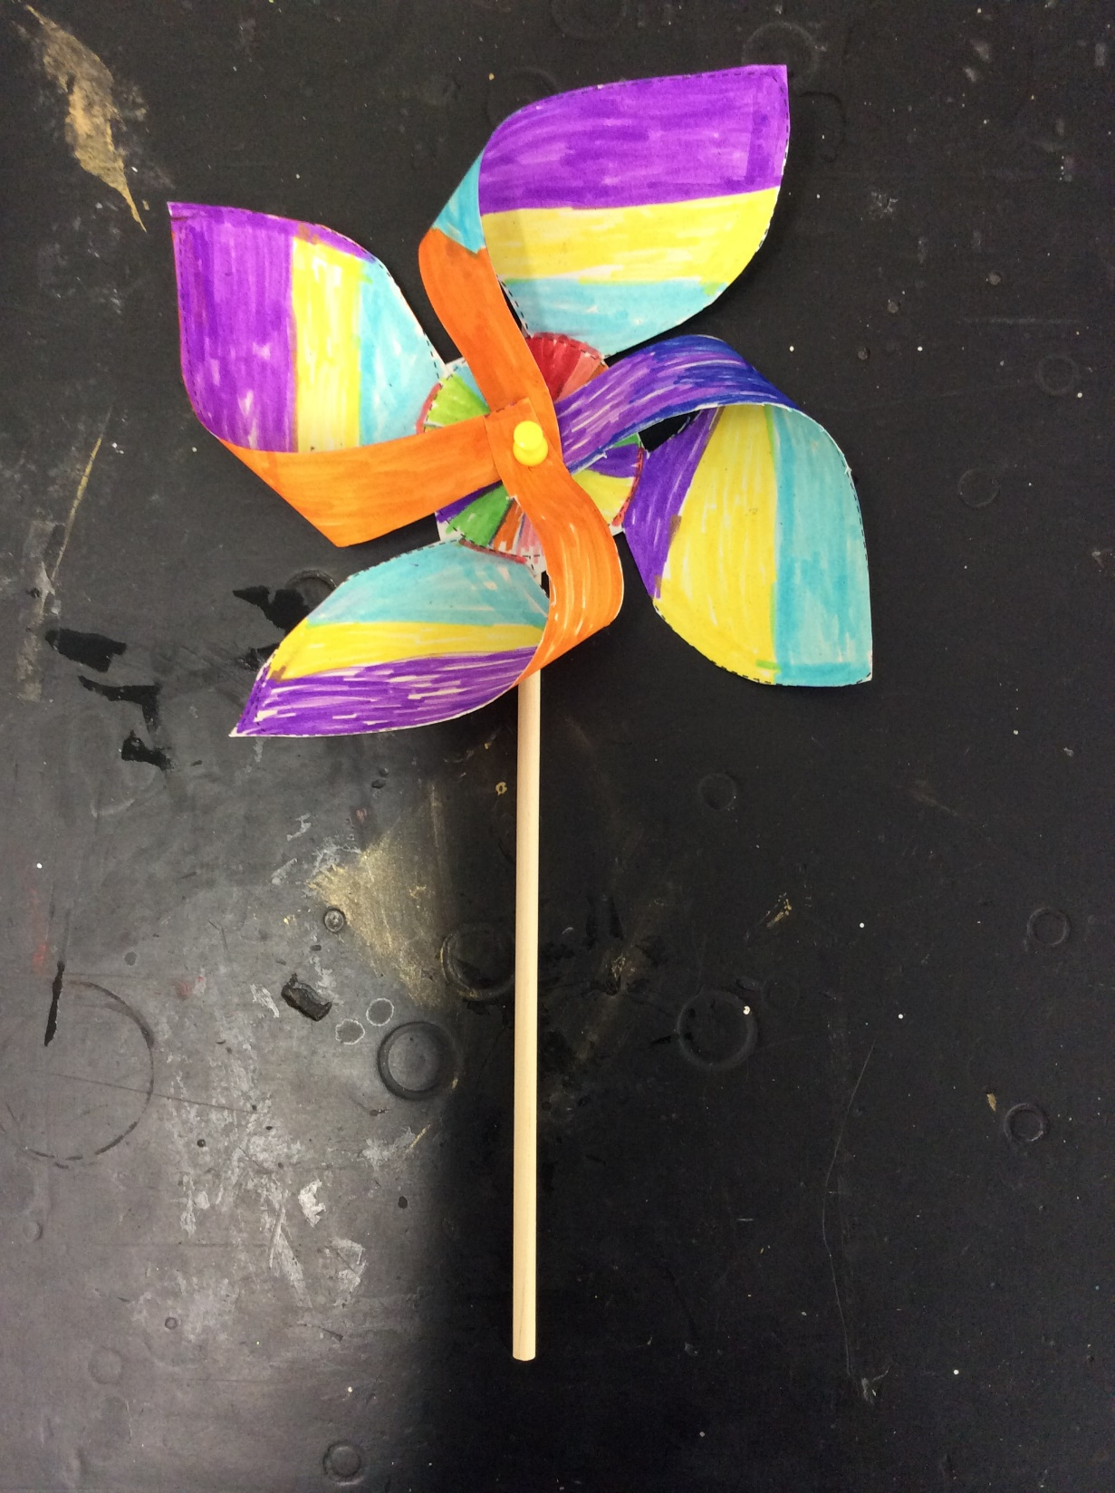

Slide 21
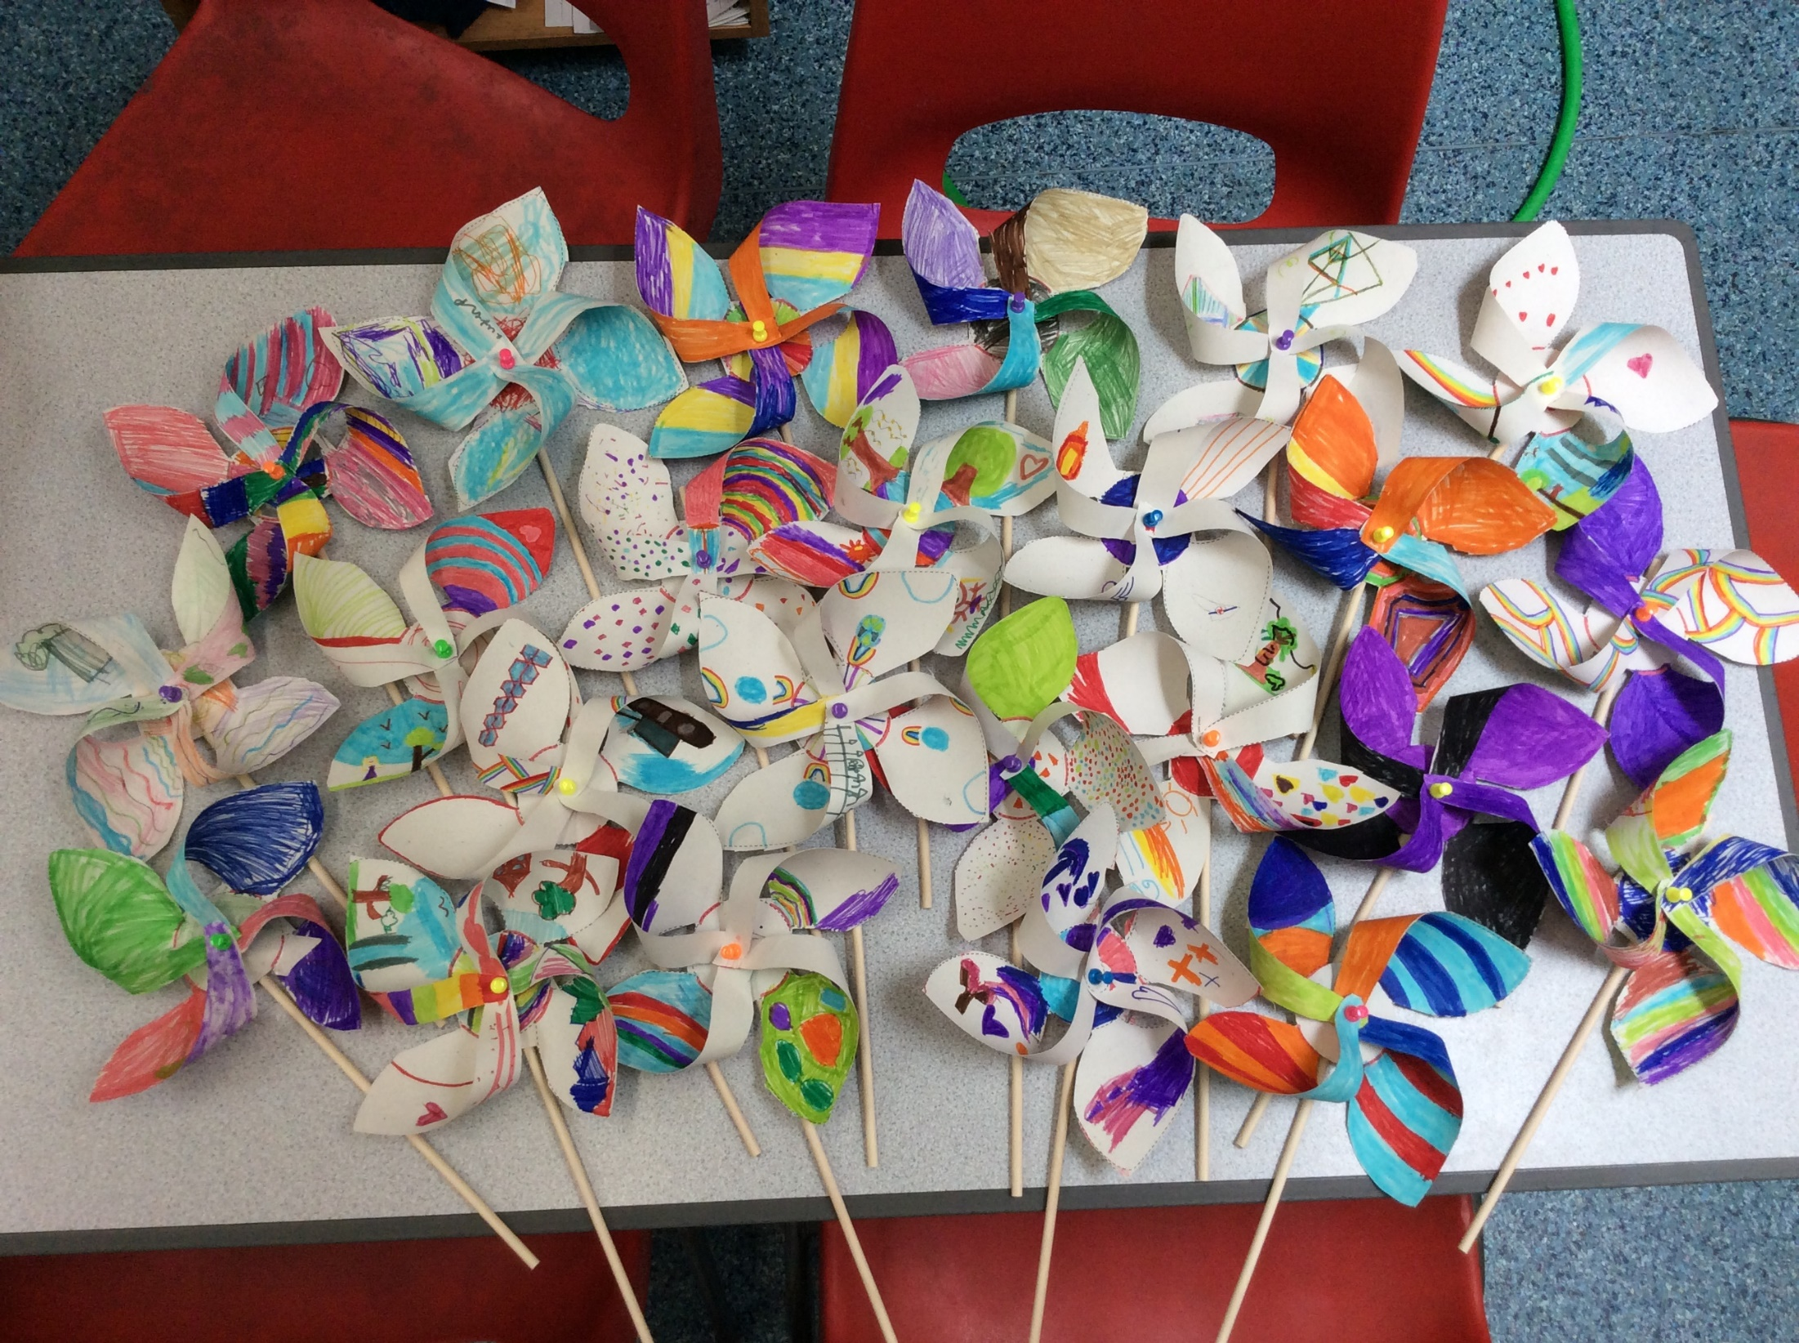

Slide 22
Year 3

Slide 23
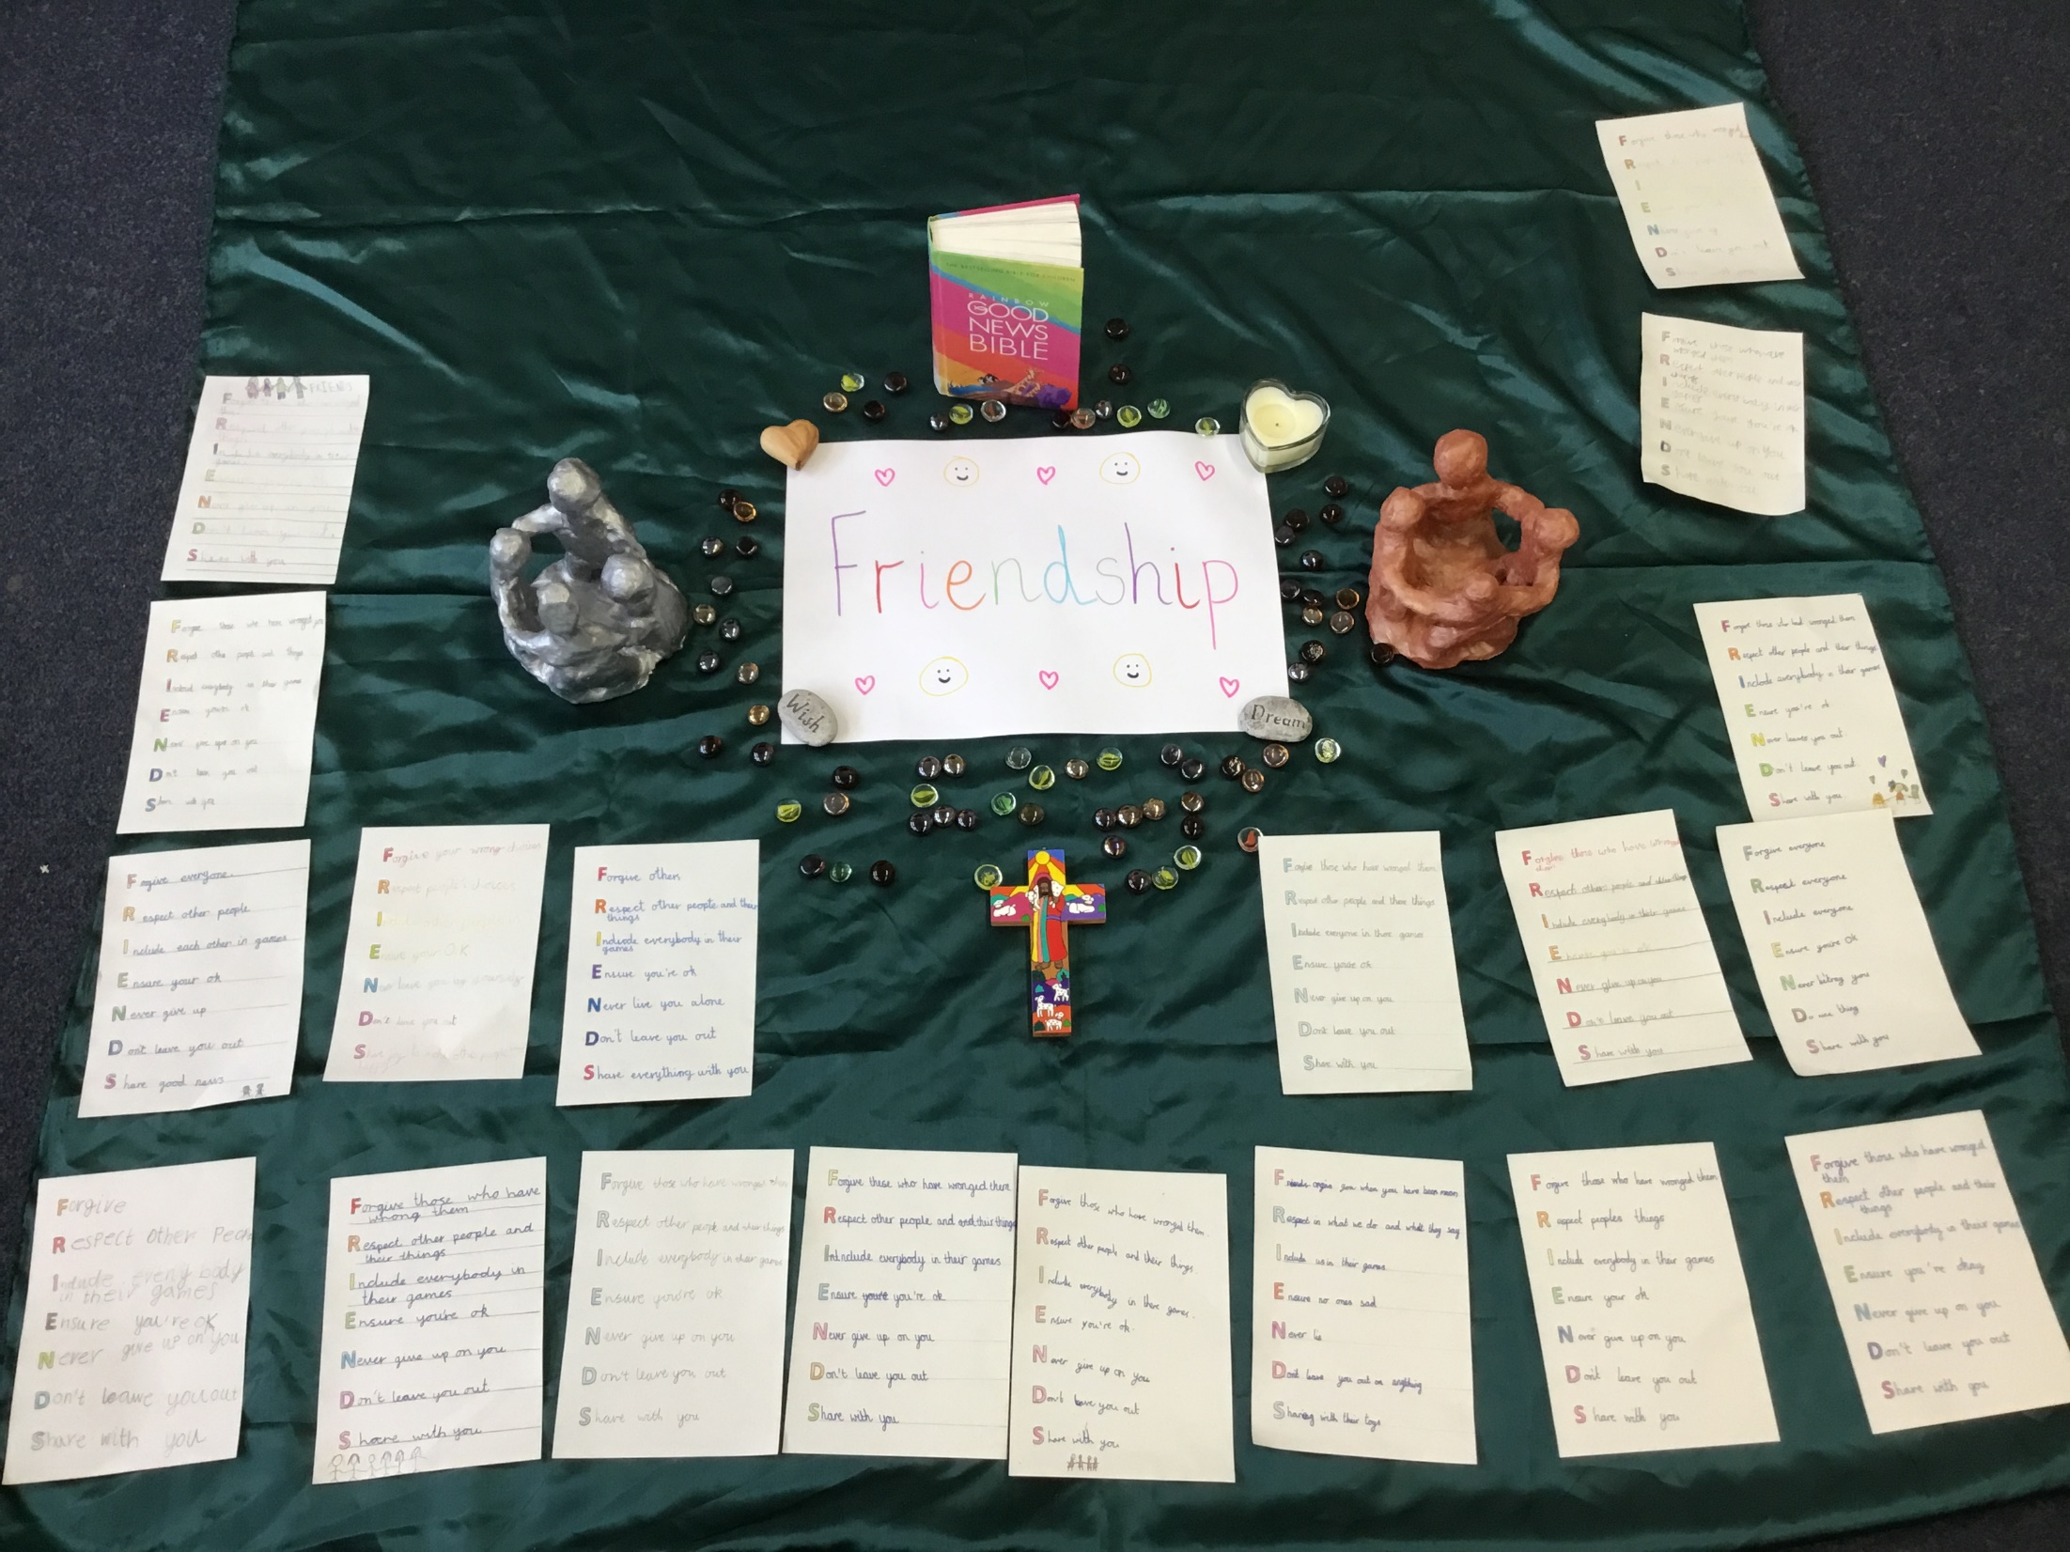

Slide 24
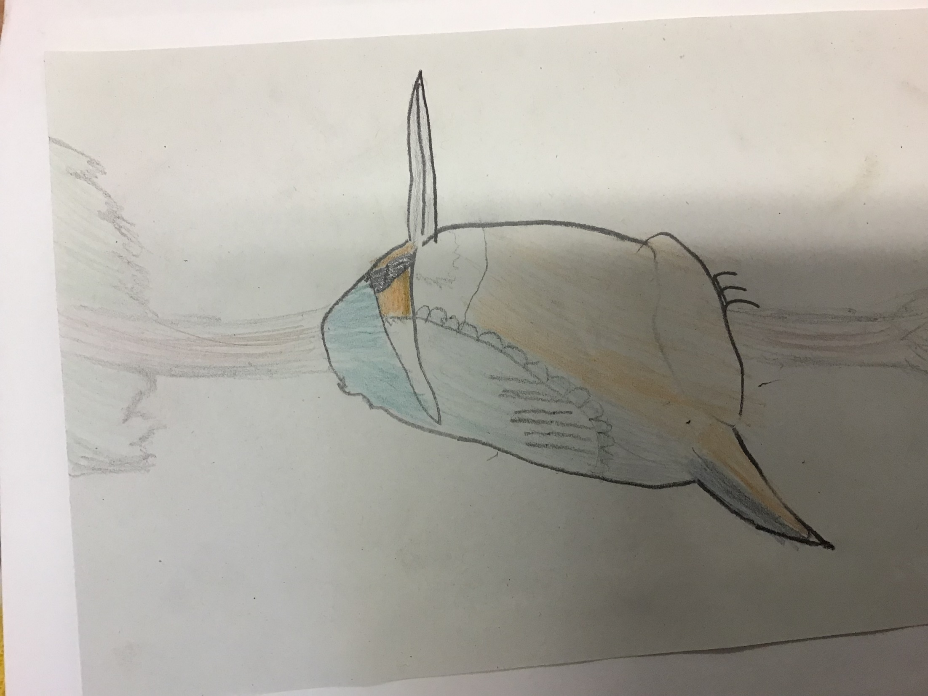

Slide 25
Year 4

Slide 26
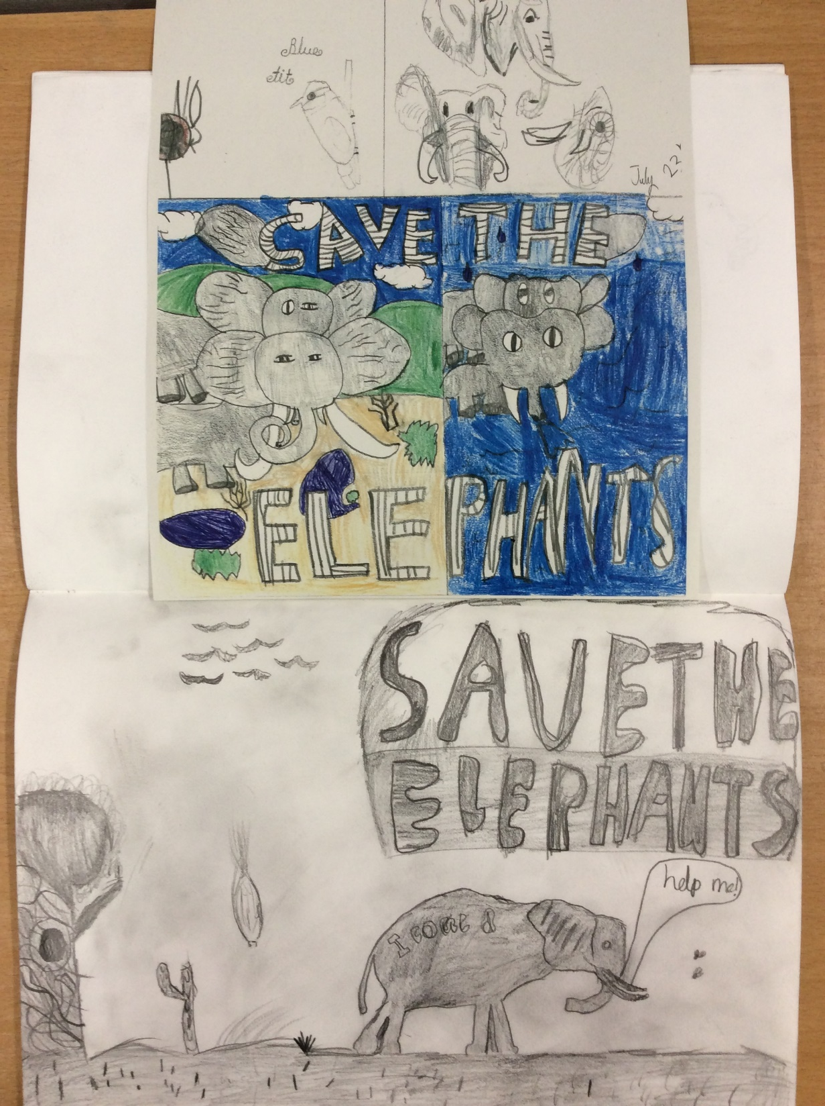

Slide 27
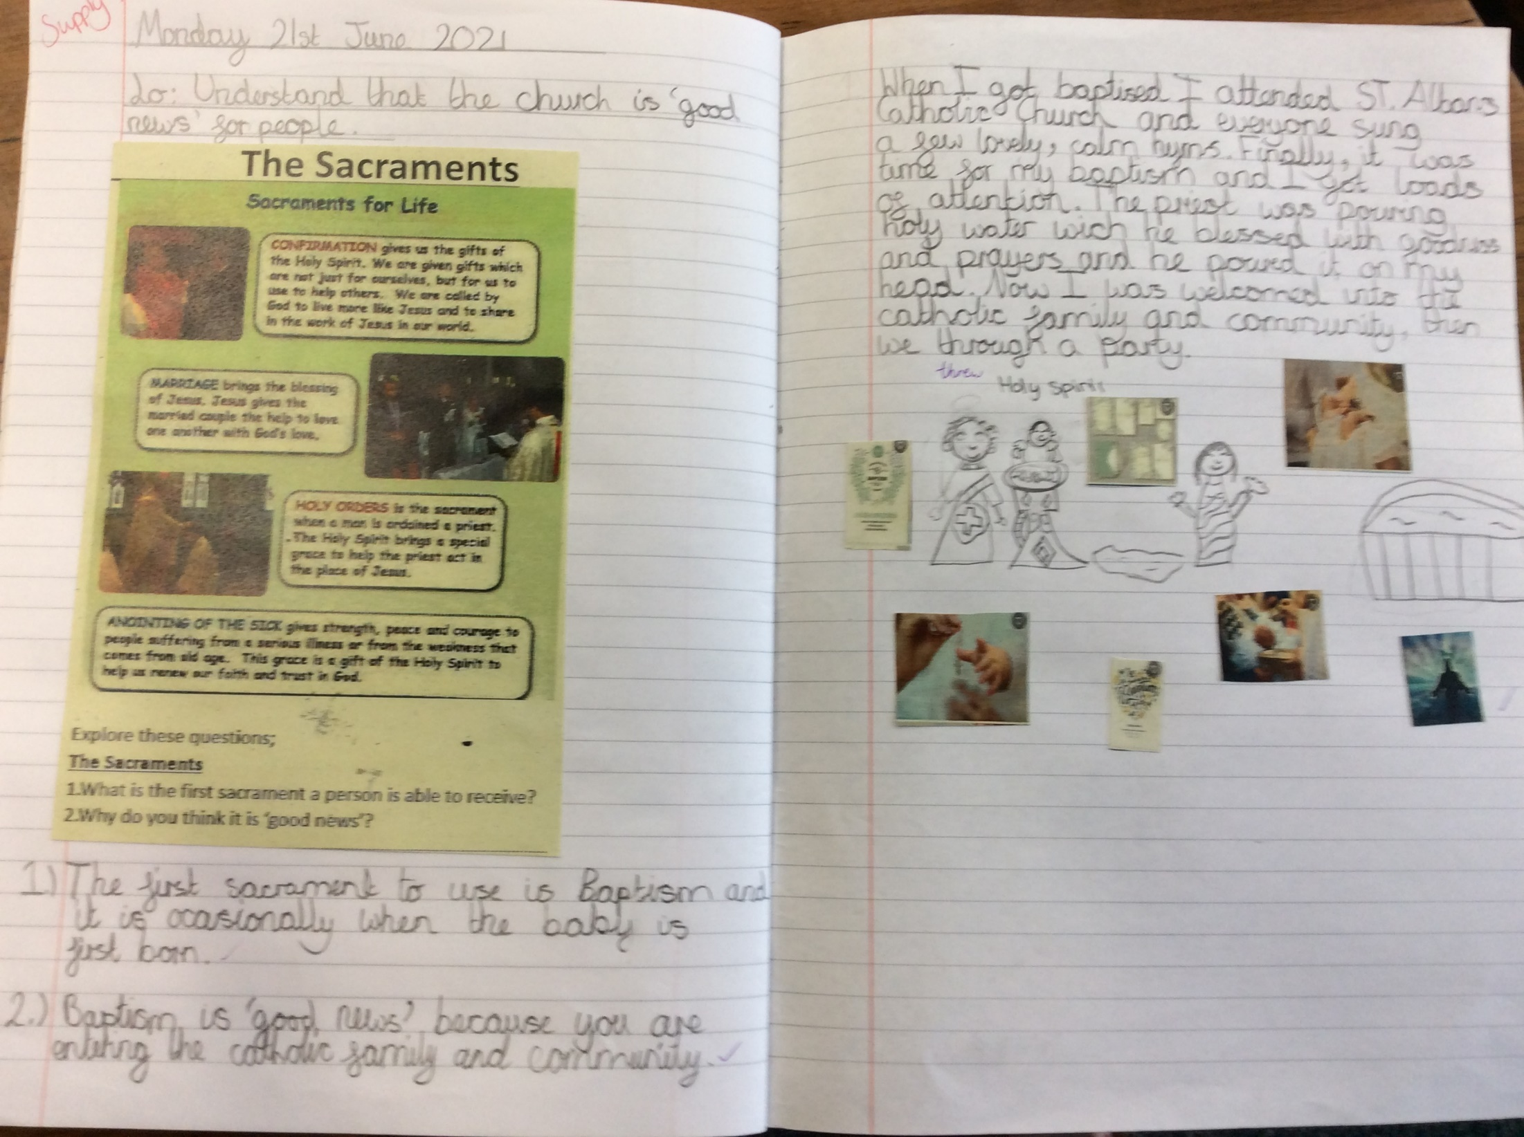

Slide 28
Year 5

Slide 29
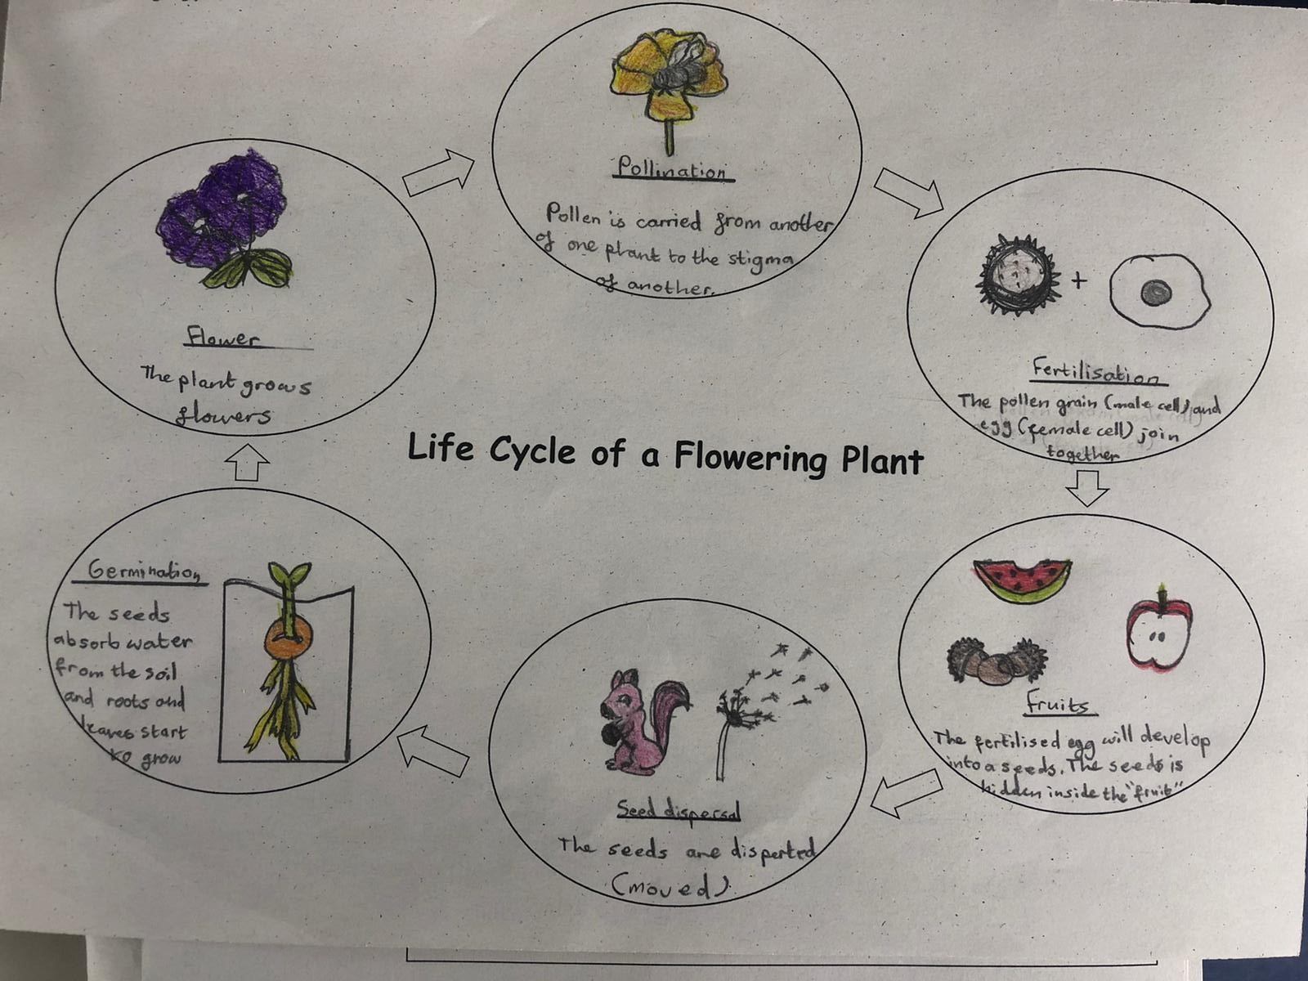

Slide 30
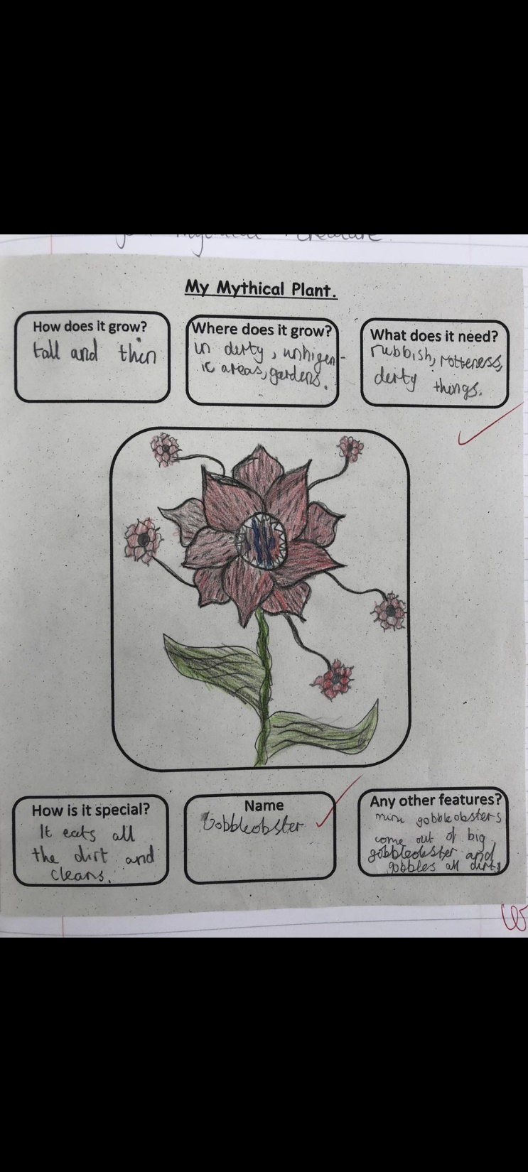

Slide 31
Year 6

Slide 32
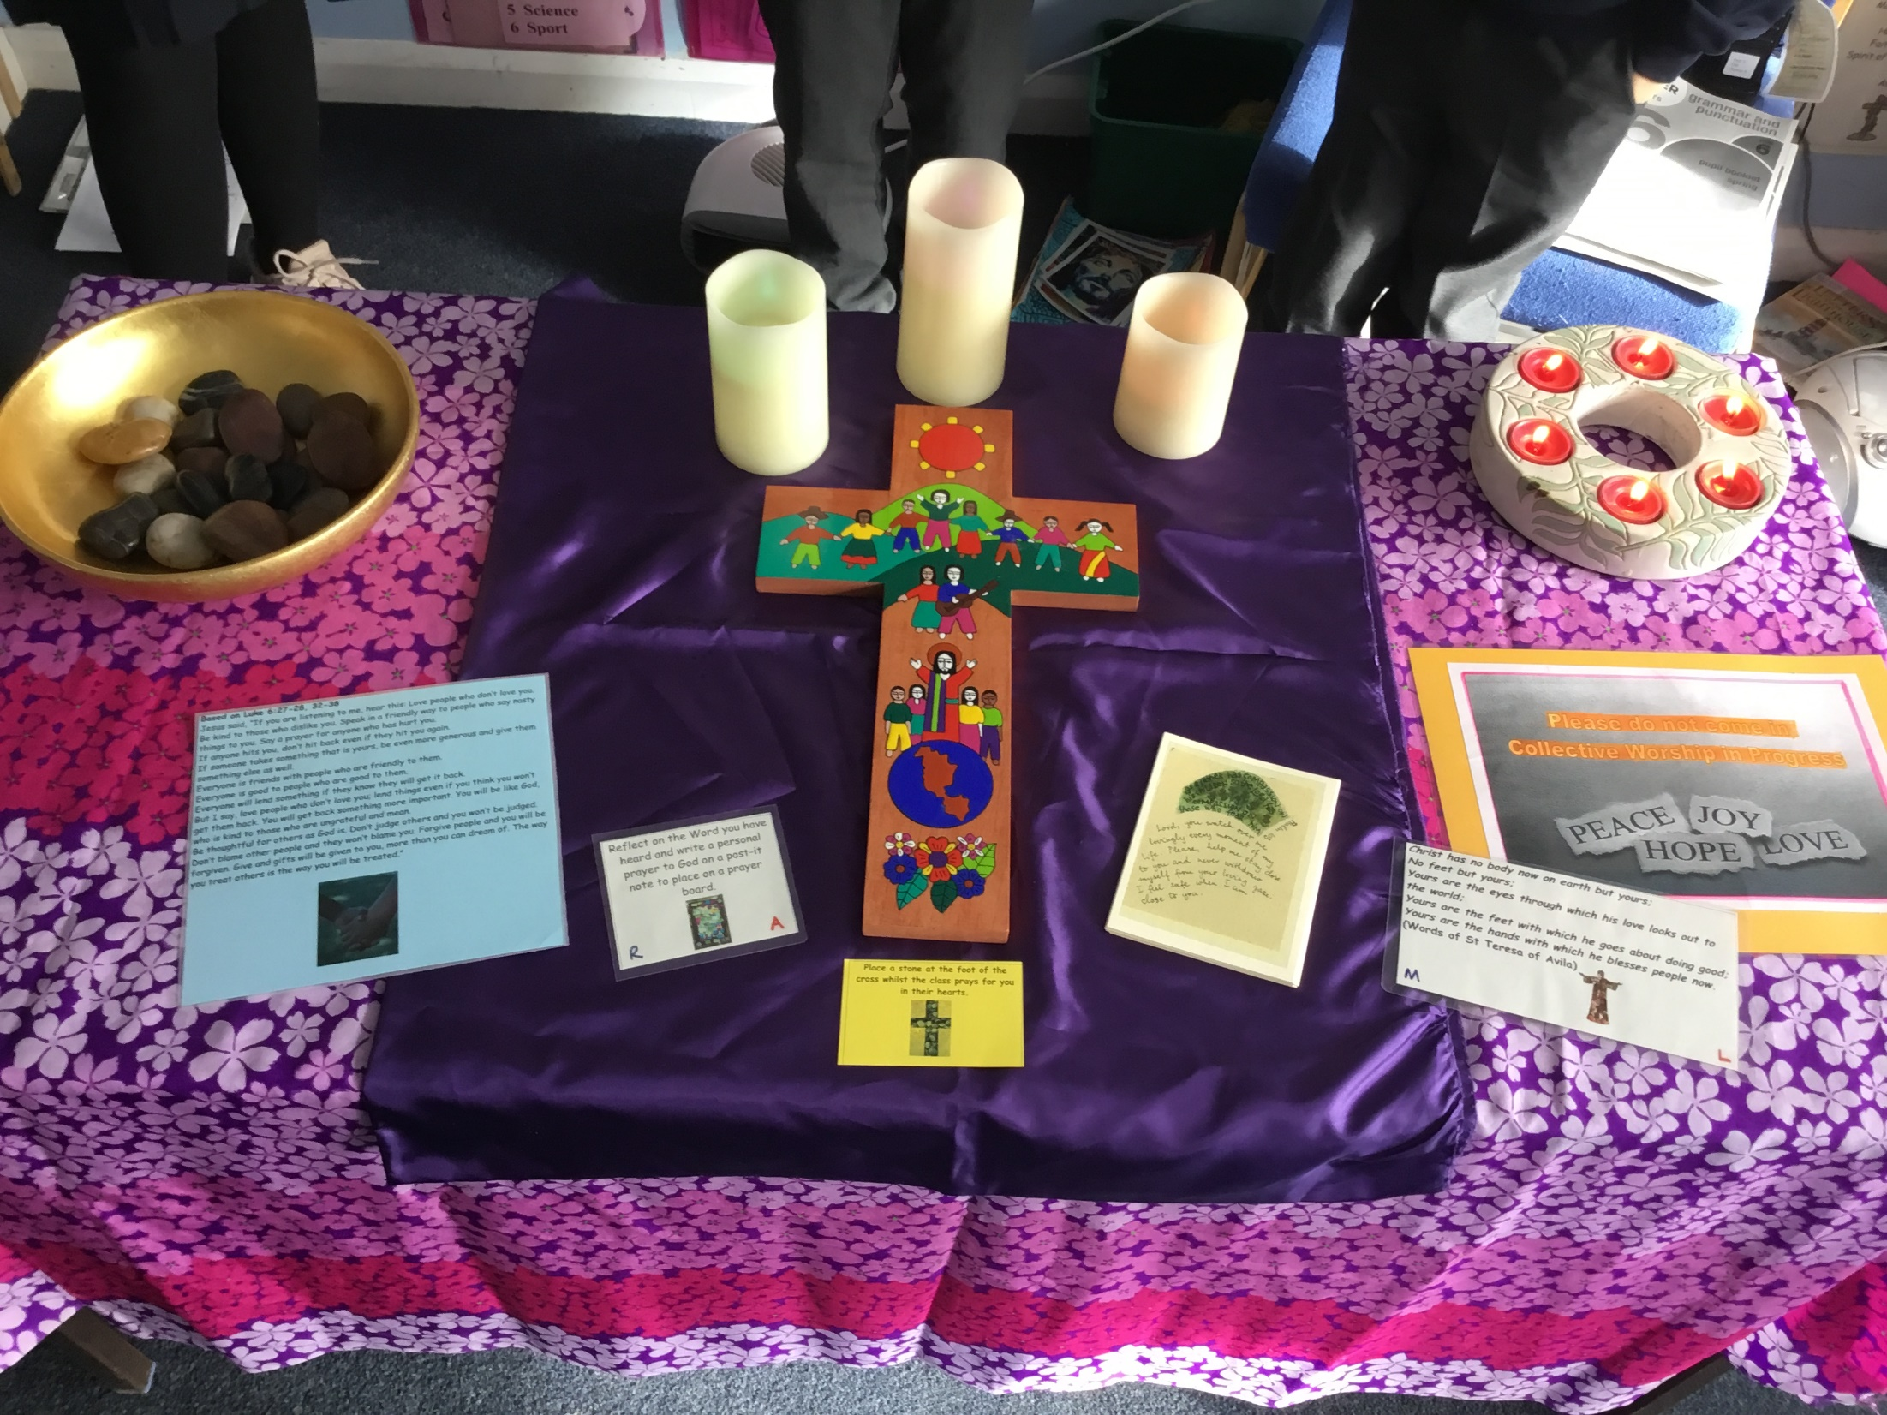

Slide 33
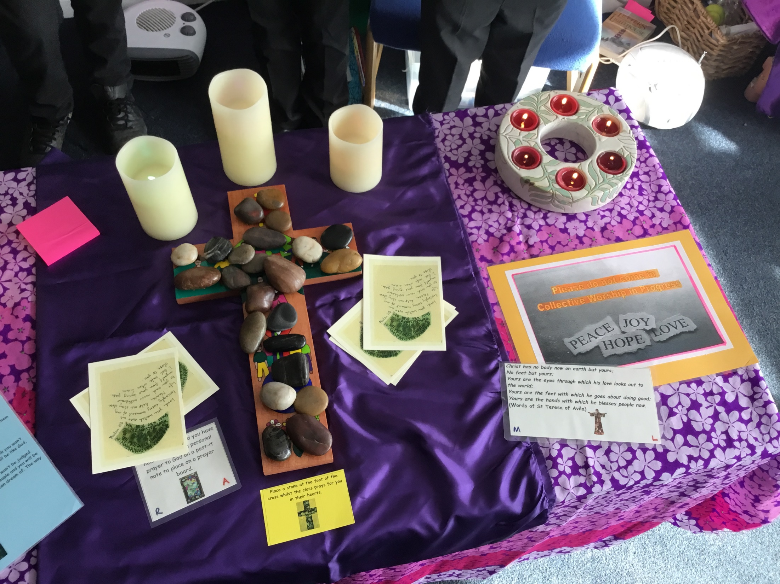

Slide 34


Slide 35
Reception - Daisy & Noah
Year 1 - Johann & Elliot
Year 2 - Kingston & Skye
Year 3 - Cathy & Ava
Year 4 - Elisa & Akash
Year 5 - Freddie & Phoebe
Year 6 - Leon & Ethan

Slide 36


Slide 37


Slide 38
Please remember to pray for those who sick this week!
Notes:
GO FORTH - MISSION

Slide 39



Let us pray.
Dear Blessed Lord,
Please help us to always have faith in you.
So that we may know that you are always with us
To help us to overcome any difficulties that we may face
On life’s journey.
Amen.

Slide 40
WOW!
WELL DONE EVERYONE!

