Slide 1
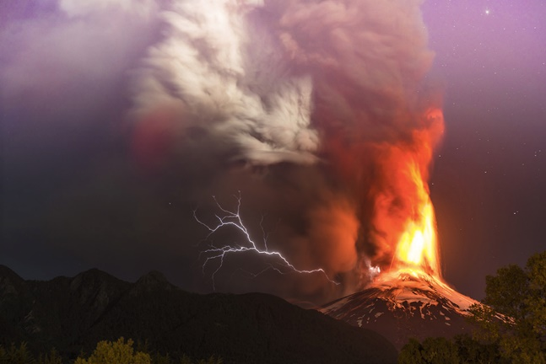

Year 5 Shared Write
The volcano exploded. Smoke went up in the air. Lava went down the side of the mountain. Lightning struck. Thunder was loud.
Monday’s Group 1
An illuminated light conquered the sky! It started from a single flame being carried up, demolishing everything in its path. Smoke billowed into the air in a choking blanket and absorbed the atmosphere in a horrifying gulp. Lightning struck the earth as if the sky gods were angry and thunder rumbled like lions roaring. With violence, lava poured down the volcano like water escaping from a damaged dam.
Monday’s Group 2
In the distance, the vicious volcano exploded with a vengeance. Suffocating smoke darted up in the air like a rocket. Bright lava flew down the side of the enormous mountain. Mightily, the evil lightning struck bolts of light across the sky as monstrous thunder shouted mortifyingly in depths of the night.

Slide 2
Year 5 Shared Write
The volcano exploded. Smoke went up in the air. Lava went down the side of the mountain. Lightning struck. Thunder was loud.
Thursday’s Group
In the depths of the night, the evil volcano erupted. Smoke rose up and chocked the star-speckled, midnight sky. Violently, a lava ball flew out of the volcano and went rushing down the side of the mountain to fulfil its vengeance. Suddenly, lightning sprinted through the sky, slicing through the smoke. Thunder bellowed mightily like a roaring monster.
Friday’s Group
Treacherously, the ghastly , horrifying volcano sent magma leaping into the air like a deadly viper. Swift Lightning, a dream-crusher, dashed across the smoke-covered, night sky. The melting Lava started to drip and flow down the side of the evil mountain. The scene was breath-takingly boiling as the horrified people almost fainted, they had never witnessed power like that before. The still burning lava destroyed their homes.

Slide 3

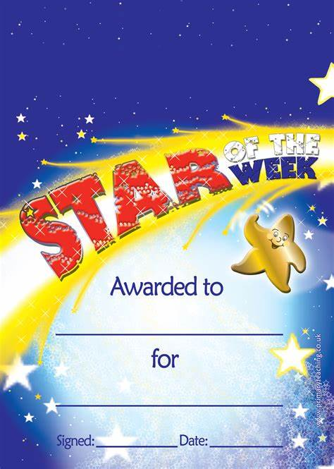

Slide 4

Well done Adam for working so hard in school this week. You’ve presented some excellent writing and done brilliantly in your SPaG. You’ve preserved really well through some challenging maths and are making excellent progress.
Keep up the wonderful work!
Mrs Green and Mr Greener
Adam

Slide 5
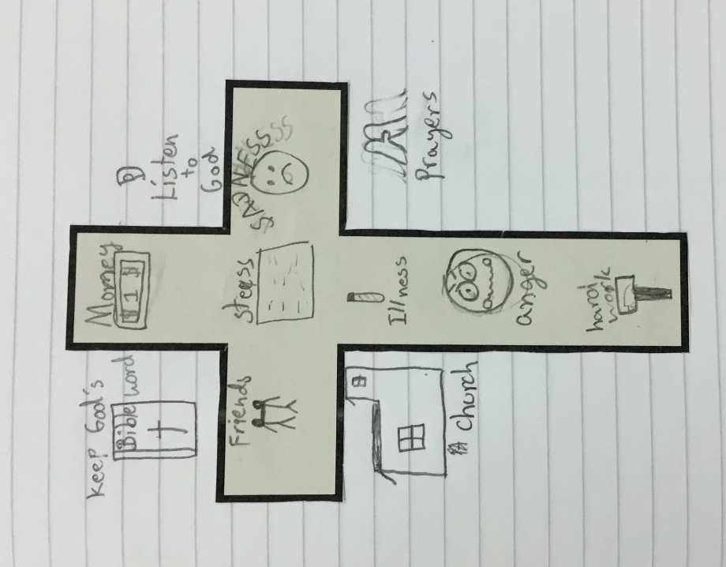
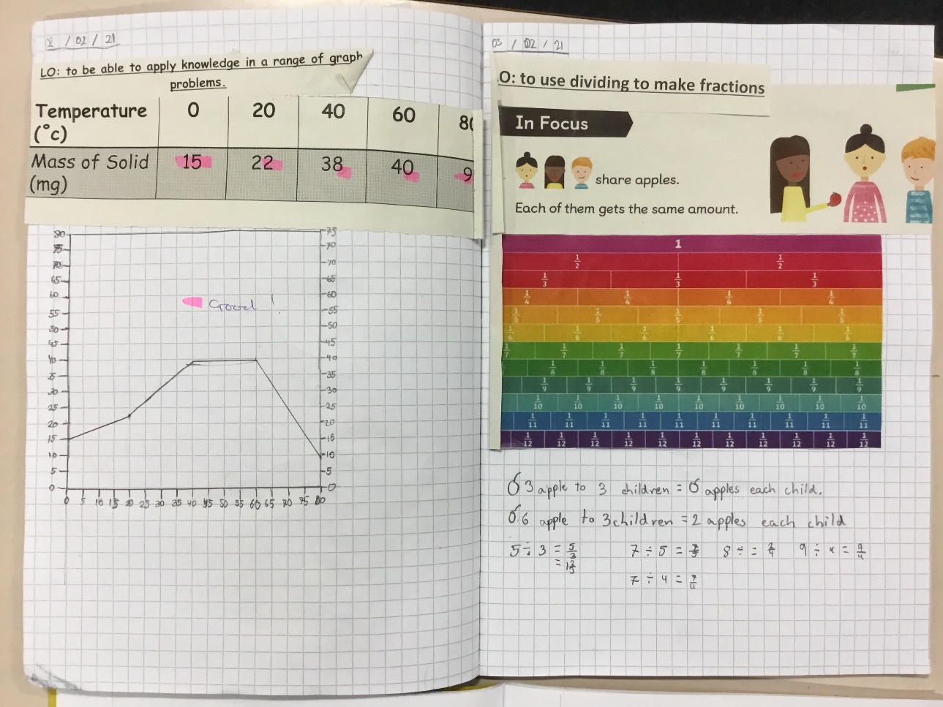
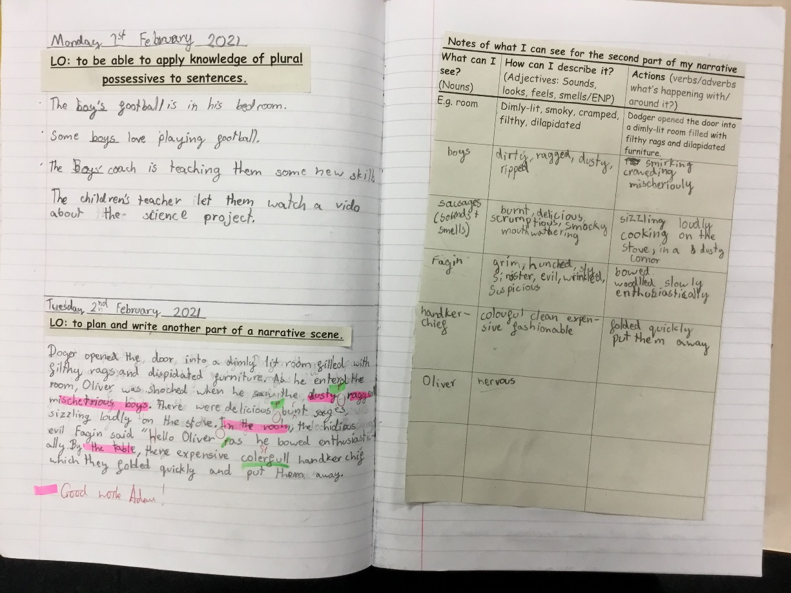

Slide 6
Has been sending in lots of beautifully presented pieces of work, clearly putting a lot of effort into all of her pieces. She has worked hard on using lovely and effective vocabulary in her English work as well.
Nauvoo

Slide 7
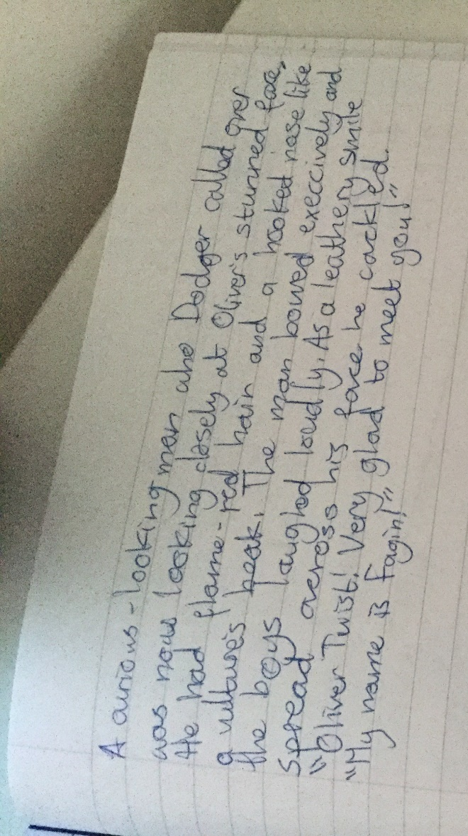
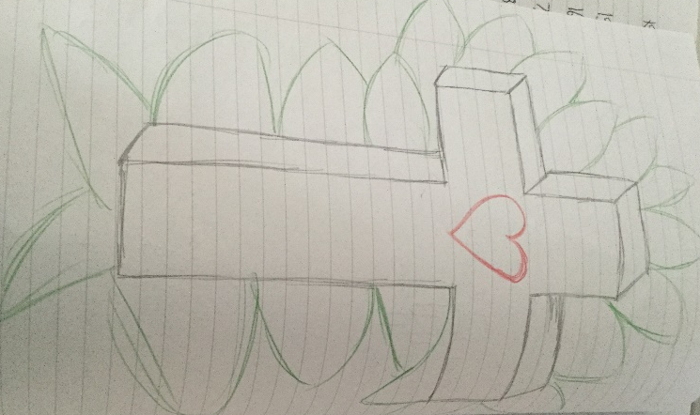
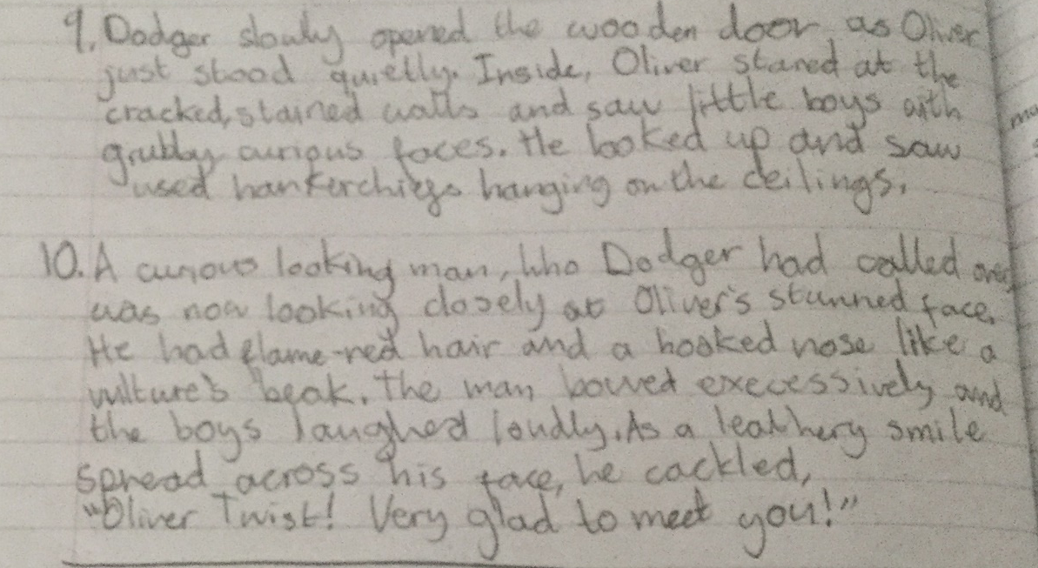
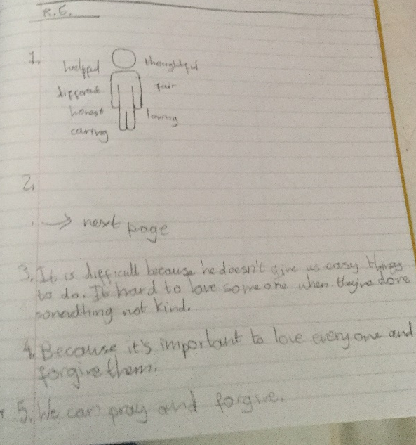

Slide 8


WELL DONE!

