Slide 1
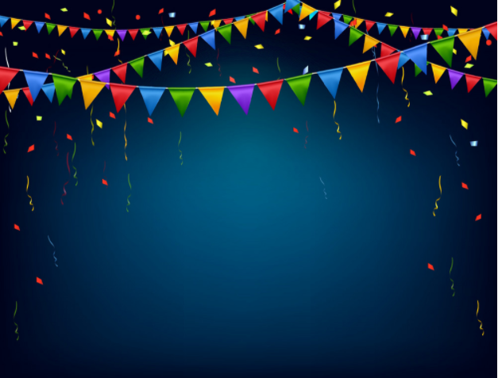

Welcome Year 5 to our
Celebration Assembly
Friday 5th February 2021

Slide 2

Dear Lord,
Please bless our school
As we try to
Love, learn,
Share and respect
In the light of Jesus.
St Alban, pray for us.
Amen

Slide 3
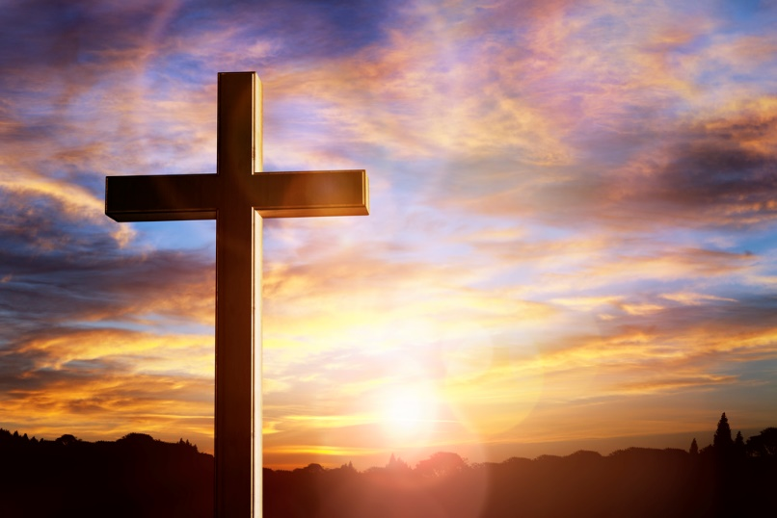
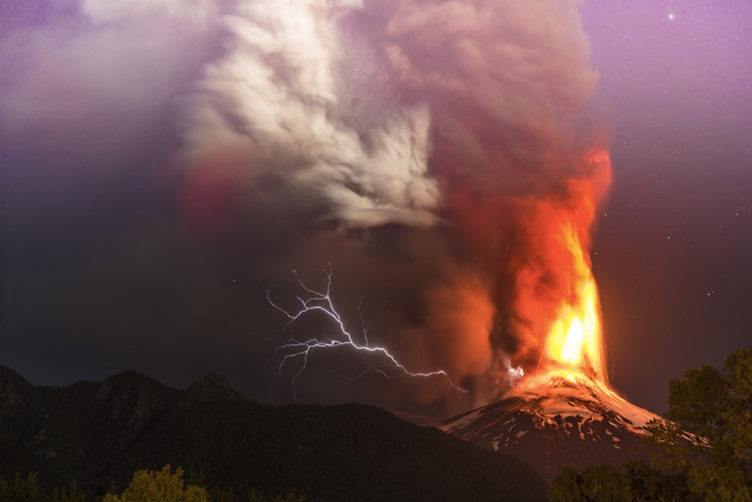
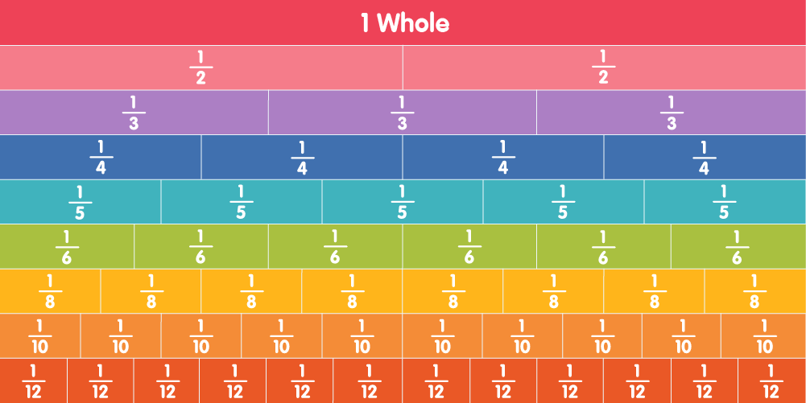
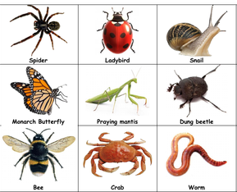
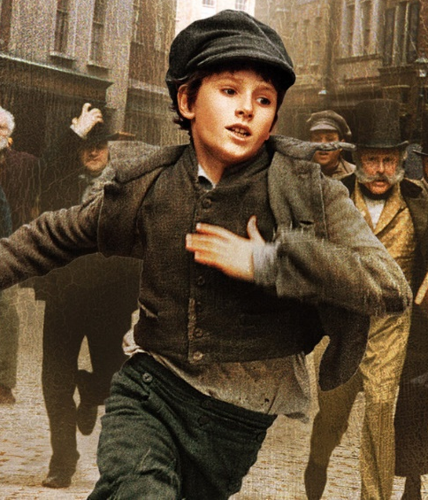
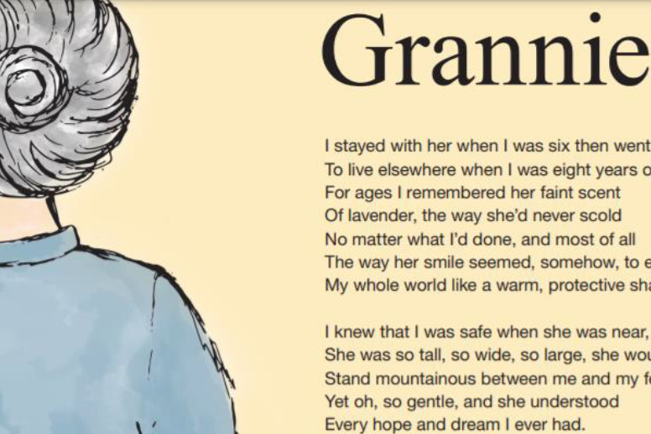
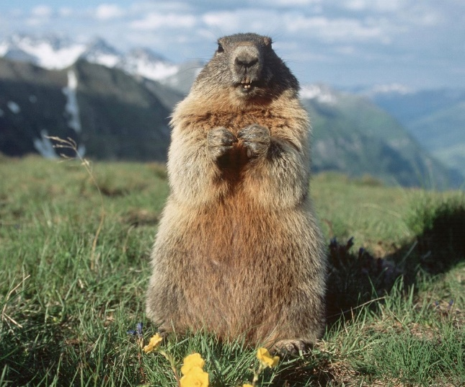
This week we have been looking at…

Slide 4
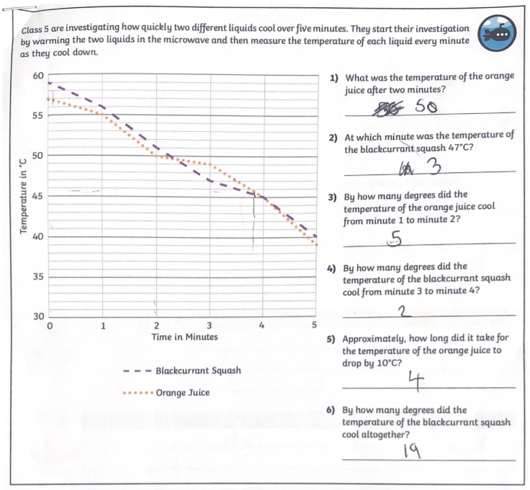
Maths: Reading and interpreting graphs
Very good interpretation of graphs and tables!
By Phoebe,
Year 5 Maple

Slide 5
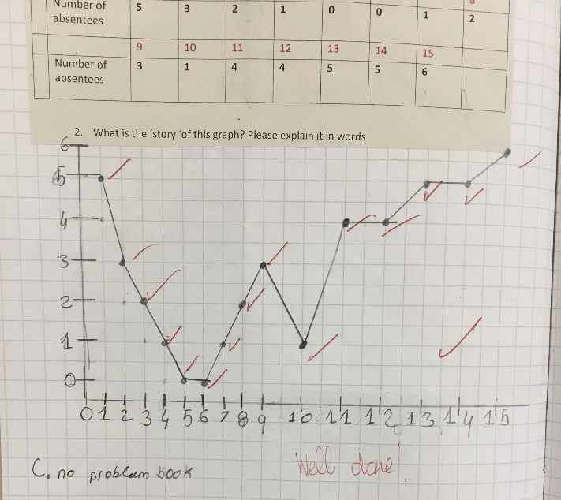
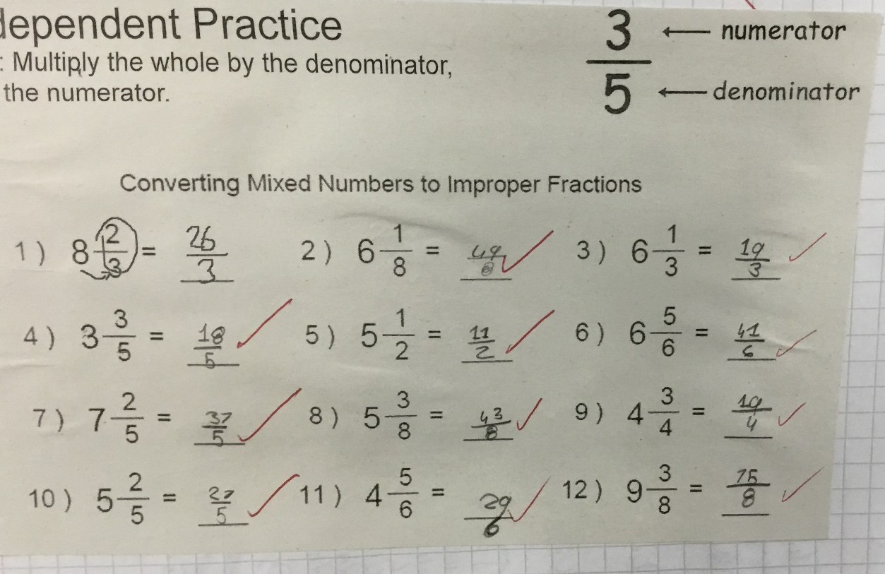
Well presented and accurate Graph work and good fraction knowledge too!
By Pat,
Year 5 Rowan

Slide 6
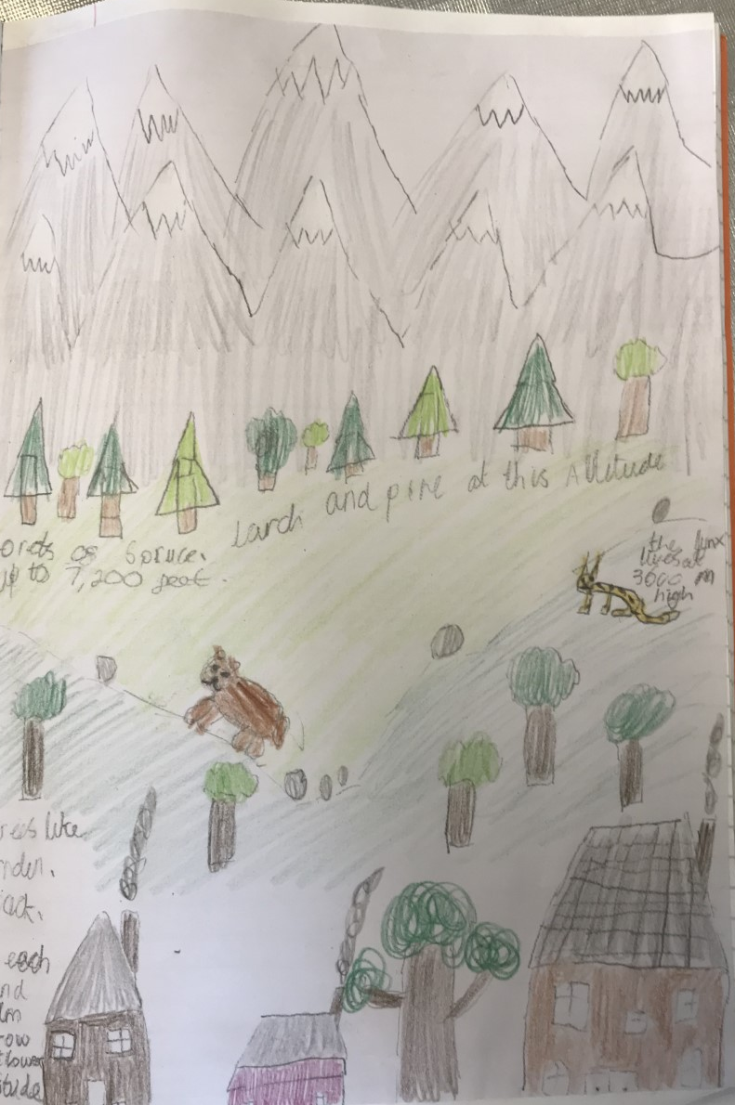
An Alpine Mountain Range
A wonderful illustration of where plants, animals and settlements can be found in the Alps. Lovely annotations which give facts about elevation heights and species.
By Bobby,
Year 5 Maple

Slide 7
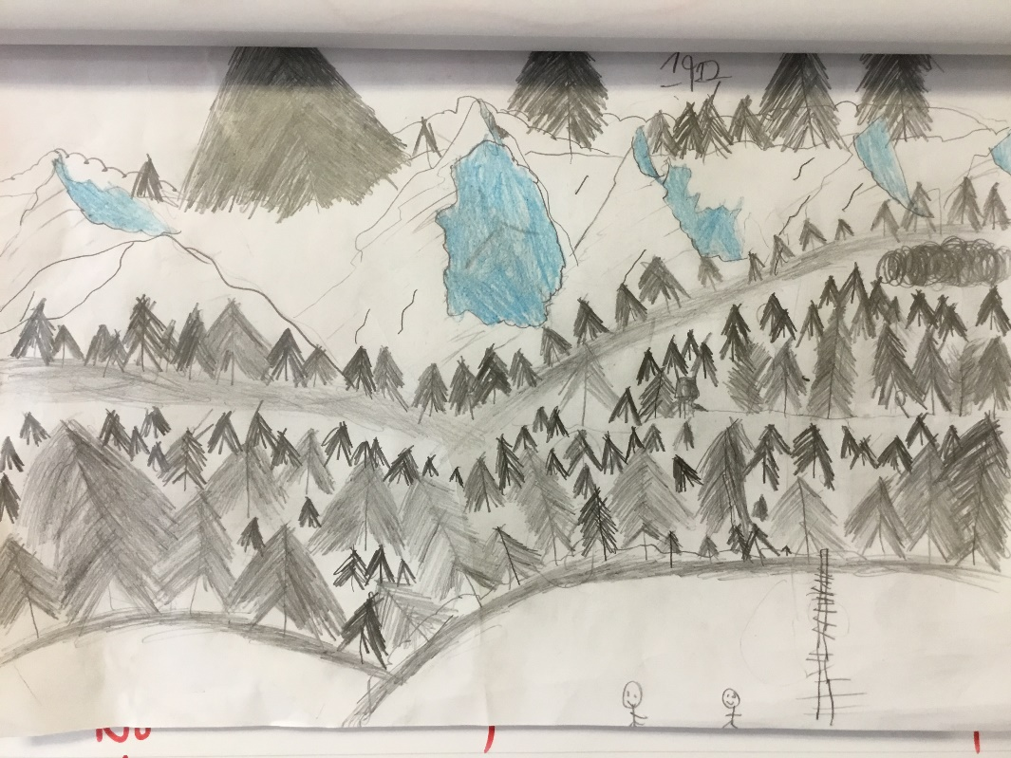
He worked so hard on this making sure there was a deep forest in his alpine scen with mountains in the background.
By Jared,
Year 5 Rowan

Slide 8
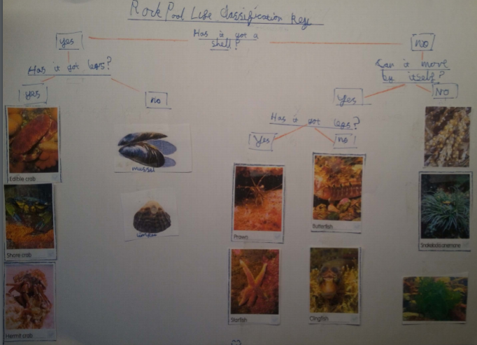
Science: Classifications
As he couldn’t get outside, David made his own classification chart. Great questions and very well laid.
By David,
Year 5 Maple

Slide 9
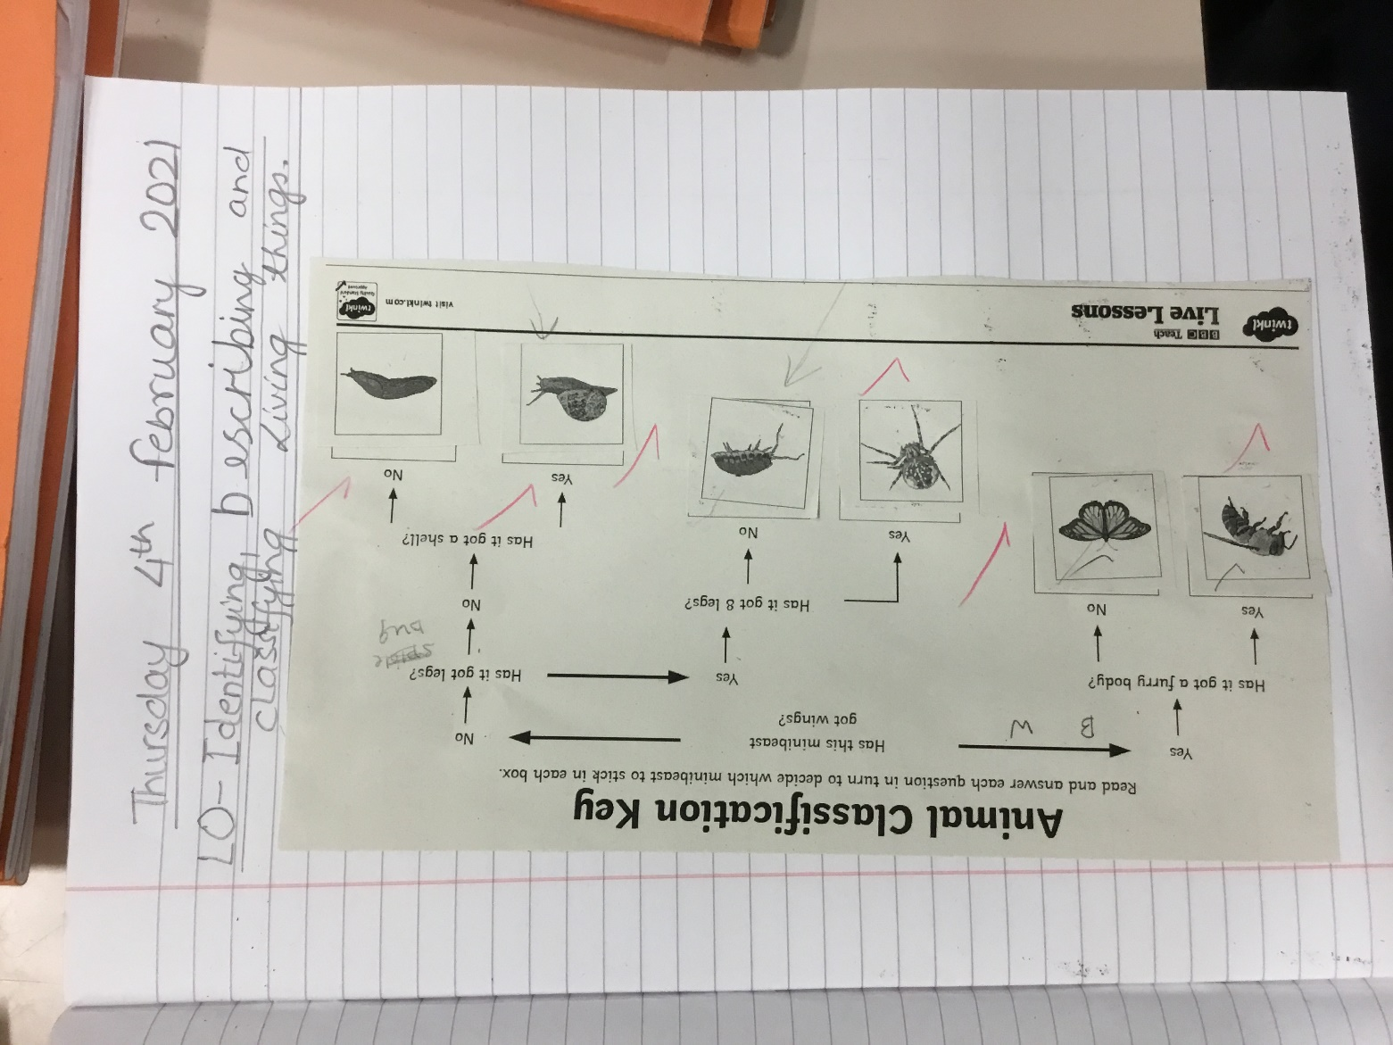
Well worked and presented classification key!
By Kai,
Year 5 Maple

Slide 10
Narrative Writing
All of a sudden, the grim door slowly opened and an unpleasant smell came flooding from inside. Feeling uncomfortable, Oliver peered around anxiously. He could see a dimly-lit, room packed with dilapidated furniture. Reluctantly, Oliver stepped into the small, cramped room with fear in his eyes and stared down at the creaky, wooden floorboards. The sound of laughter filled his ears and Oliver apprehensively lifted his head. Staring at him were sly, beady eyes looking straight at him. They belonged to a group of boys who were grinning mischievously at Oliver. They looked unkempt and dirty. Behind them, Oliver noticed a washing line of damp, just washed handkerchiefs, drying in the dusty, smoky air. Beside the fireplace, on the cluttered shelves were ancient pots and pans and hanging from rusty hooks were worn knives and cutlery.
A stranger, with a scary smile under a mass of scruffy beard, bowed deeply towards Oliver. He had a low voice and a long, crooked nose.
“Oliver Twist, I’m very glad to meet you! Welcome to our home. I am Fagin…”
Excellent range of vocabulary used to describe setting and characters and clever devices to show not tell how the characters are feeling and what they are like.
By Eden,
Year 5 Maple

Slide 11
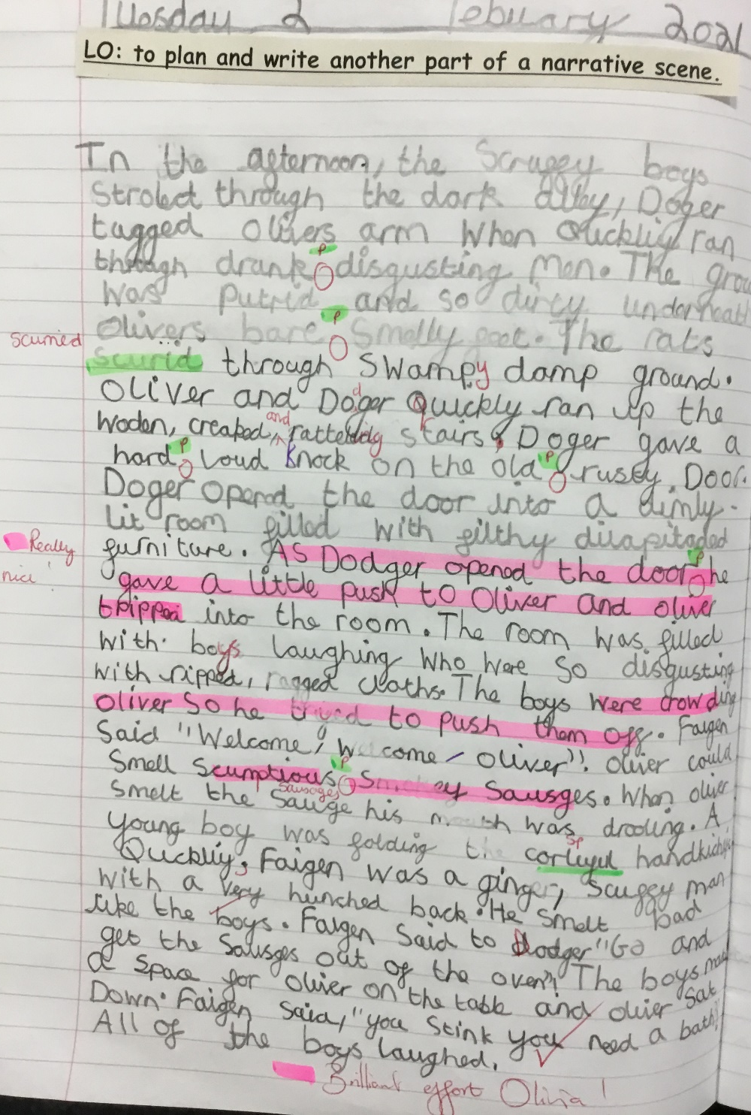
A massive amount of effort went into this piece and she has really captured the tone of the Oliver story!
By Olivia C,
Year 5 Maple

Slide 12
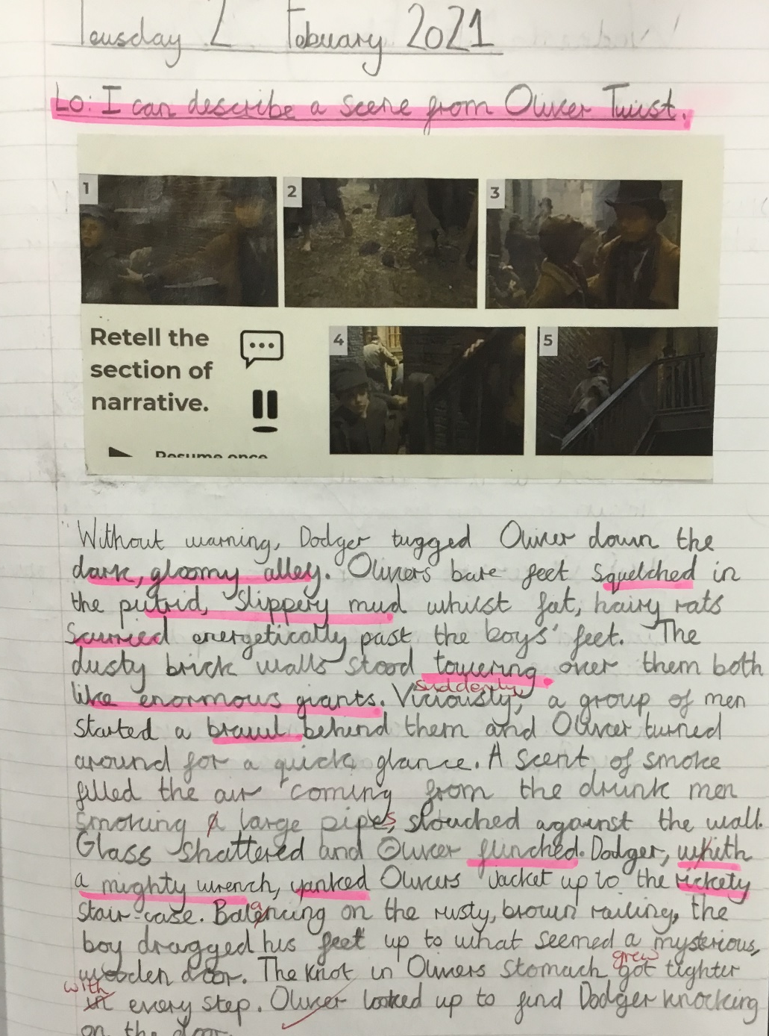
Beautifully written Oliver narrative. Similes used as well as really effective expanded noun phrases!
By Nell,
Year 5 Rowan

