Slide 1

Year 2
Celebration Assembly!
Friday 5th February 2021

Slide 2

It is time to celebrate all the fantastic work you have been doing this week. ☺

Slide 3
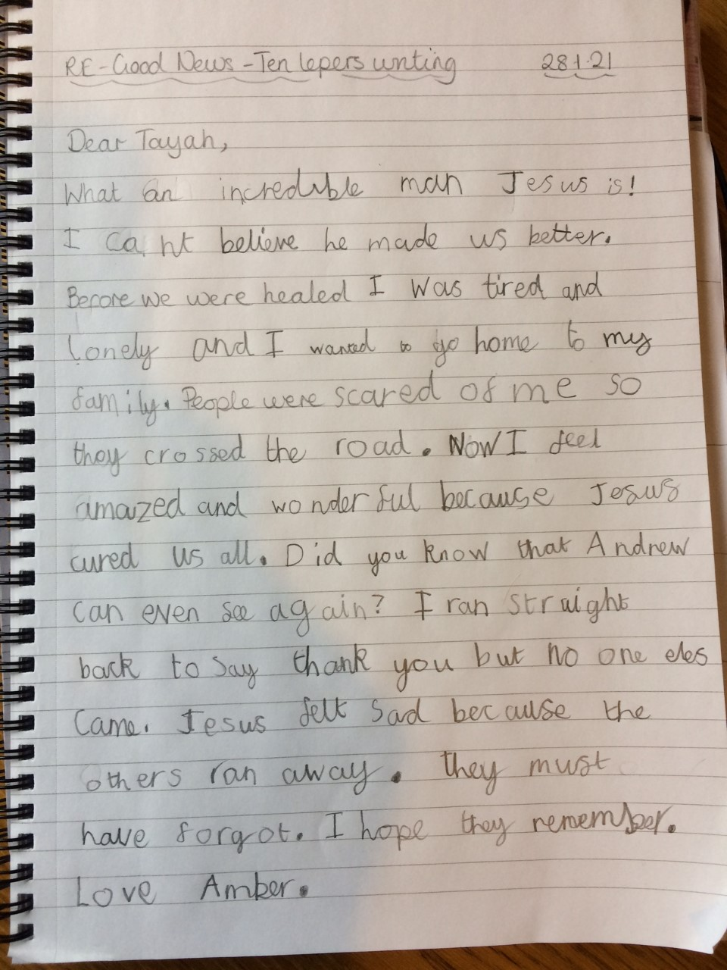
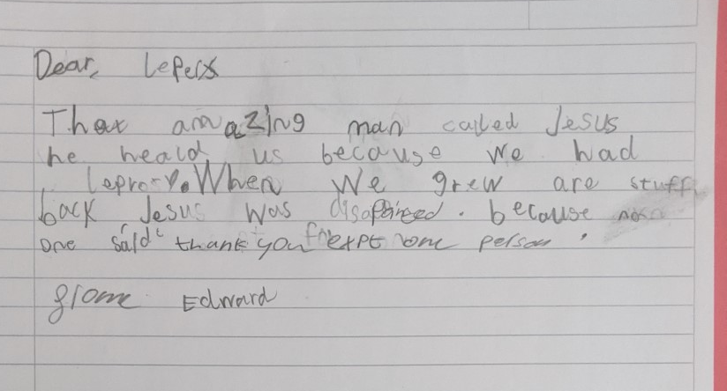

Religious Education
Edward
Amber

Slide 4
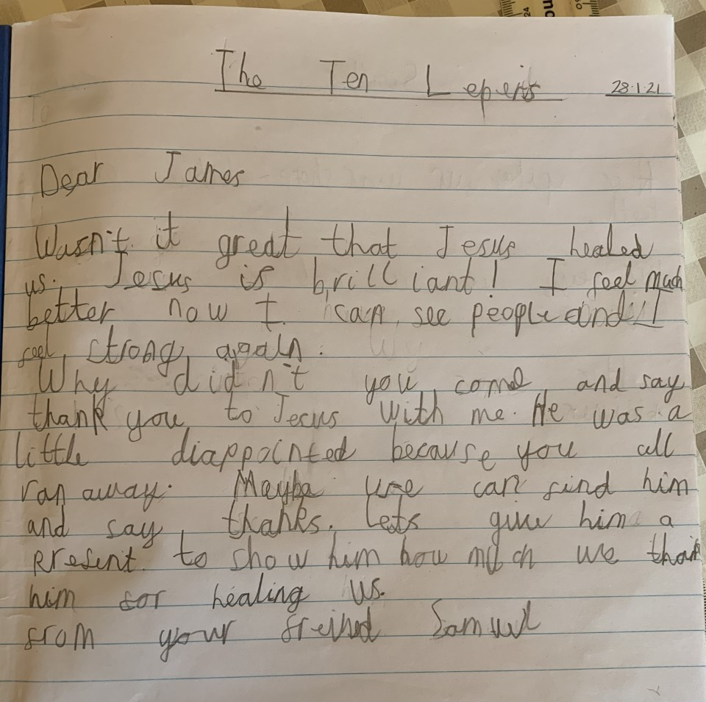
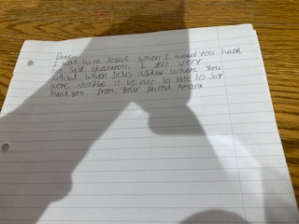
Amara
Sam

Slide 5
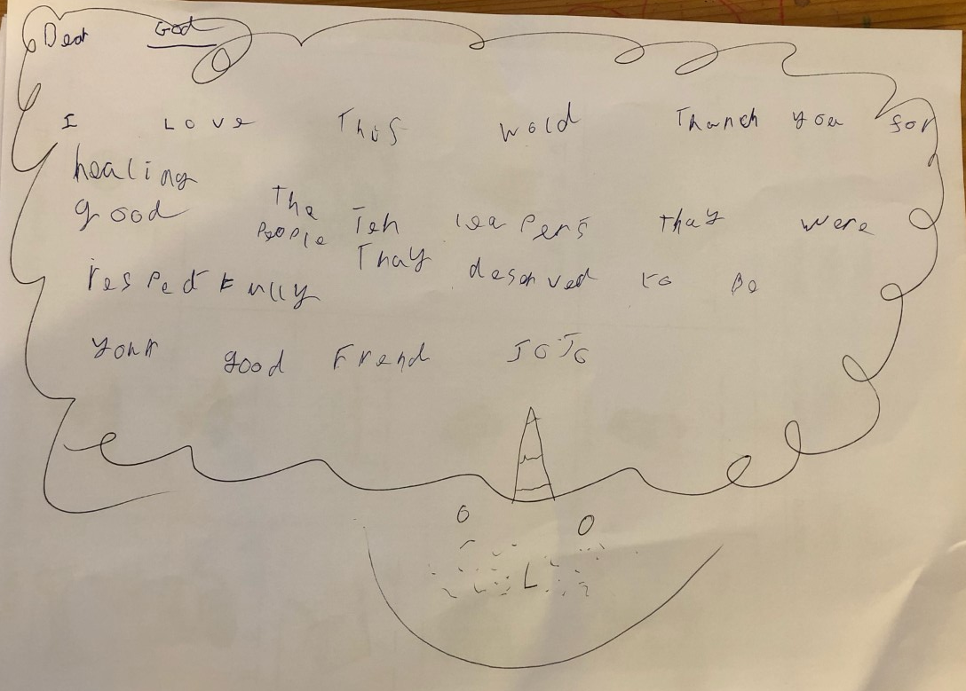
Jo Jo

Slide 6
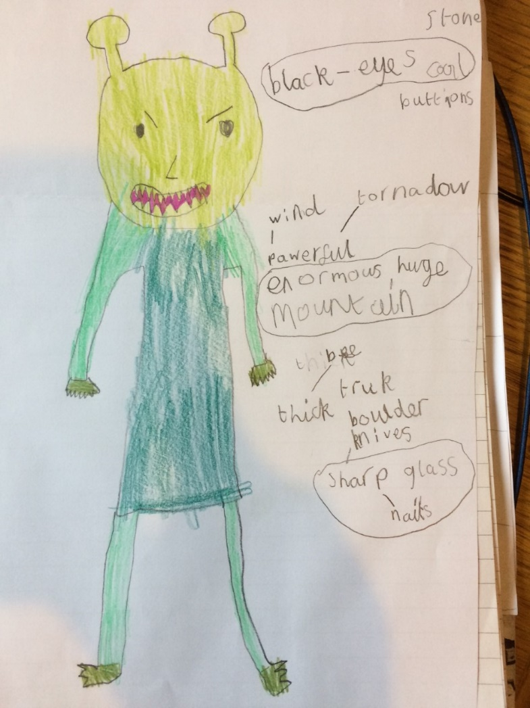
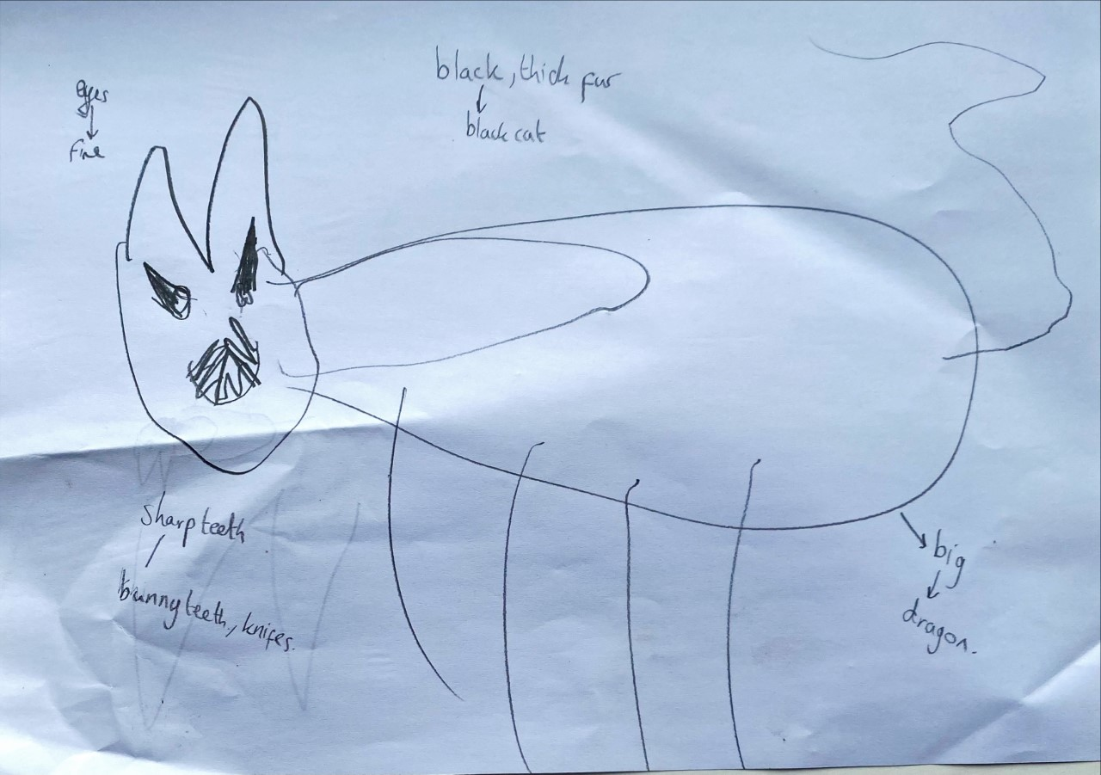
English work
Jonah’s monster
Amber’s Monster

Slide 7
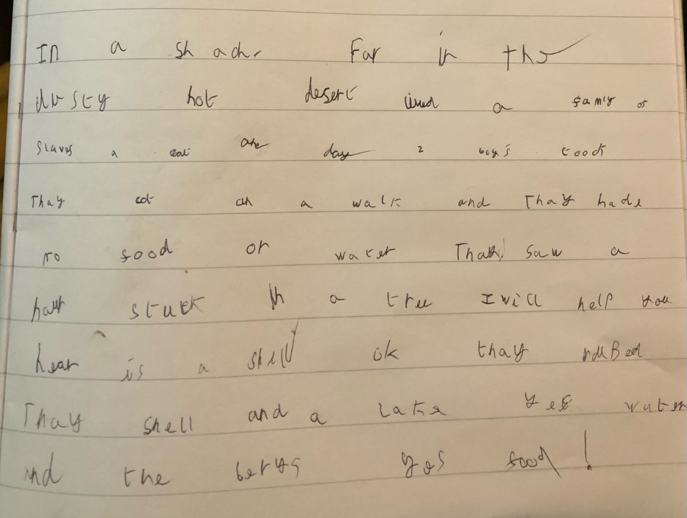
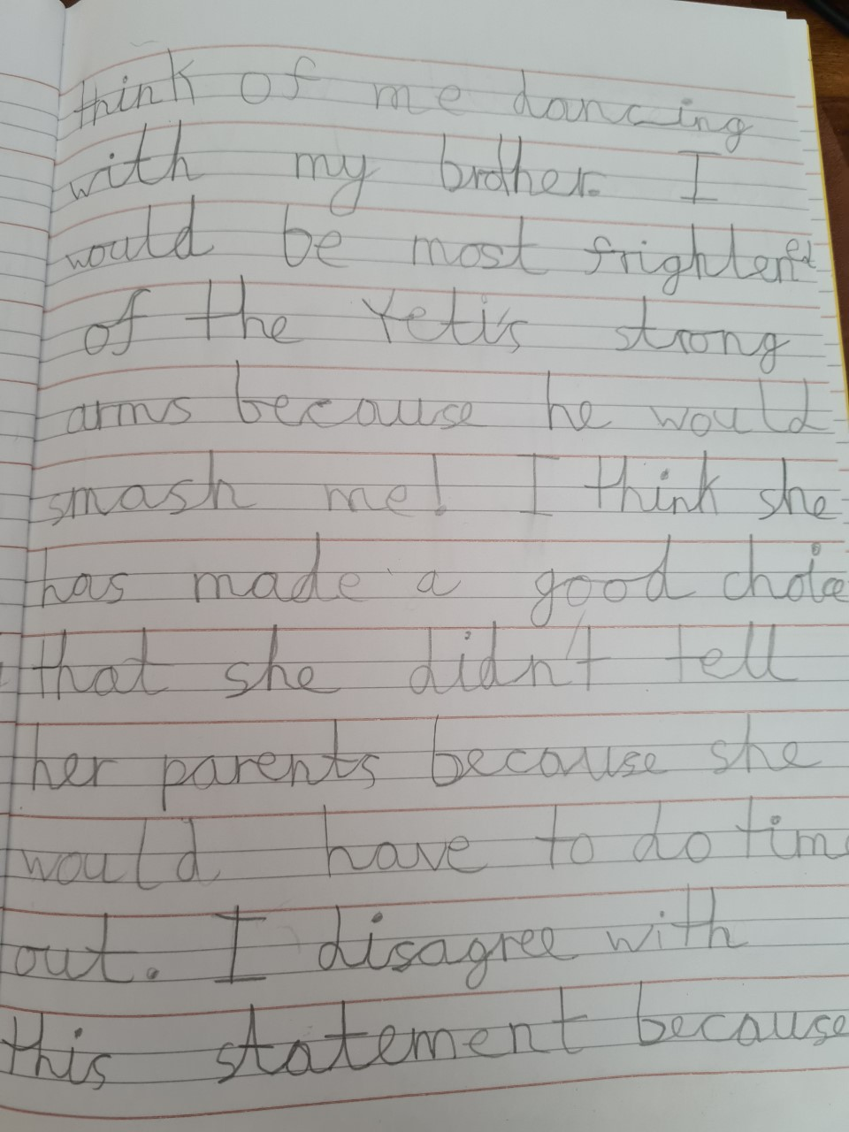
Jo Jo
Lily

Slide 8
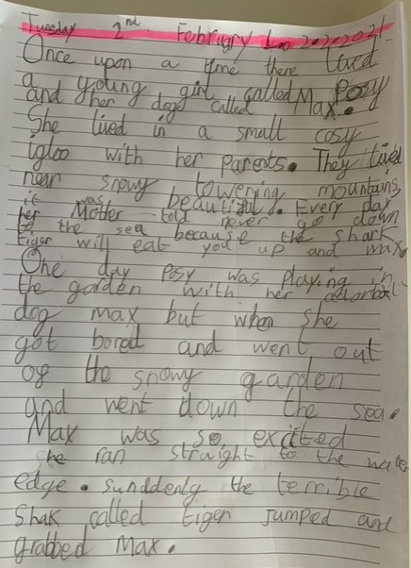
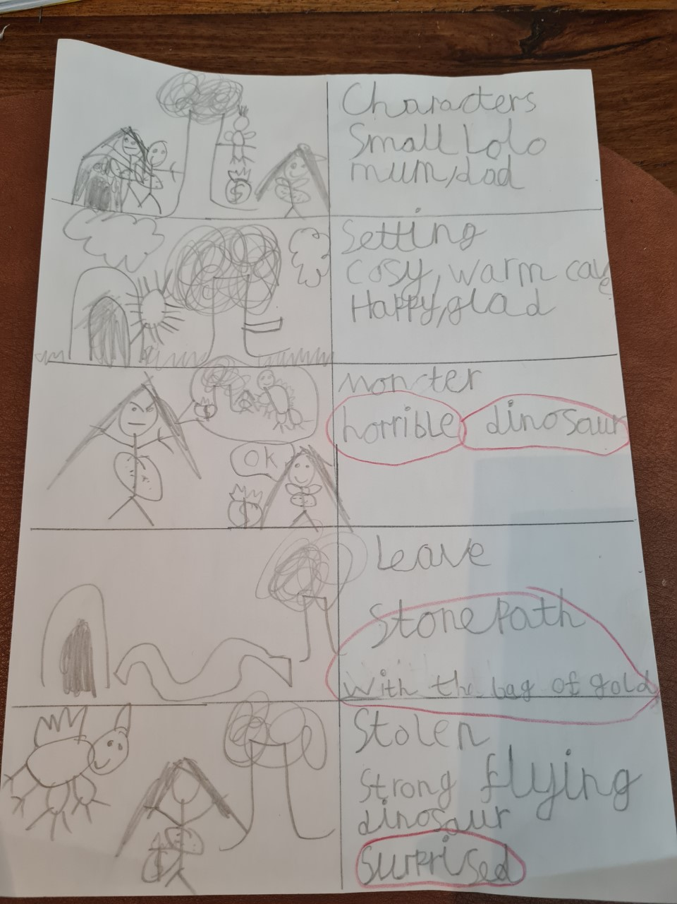
Lily
Charlotte

Slide 9
Amber typed almost all this herself...
AMBER ‘S ADVENTURE STORY
Once upon a time, there lived a young girl called Elizabeth. She lived in a tiny, cosy igloo with a fluffy cute rabbit called Snowdrop and her Mum and Dad. There were enormous snow-capped mountains, fresh white snow and dancing snowflakes floating gently all around them.
Elizabeth’s mother told her not to leave the igloo because the angry alien will eat you both!
One day Elizabeth was feeling bored, so she went out to play in the snow with Snowdrop. They were happy and excited and not worried because they had never seen the alien. They were walking down the snowy path and enjoying making footprints.
Suddenly, a powerful Eagle swooped down and grabbed the rabbit with its sharp claws and took it to the mean alien. Elizabeth was shocked and stunned!
Amber

Slide 10
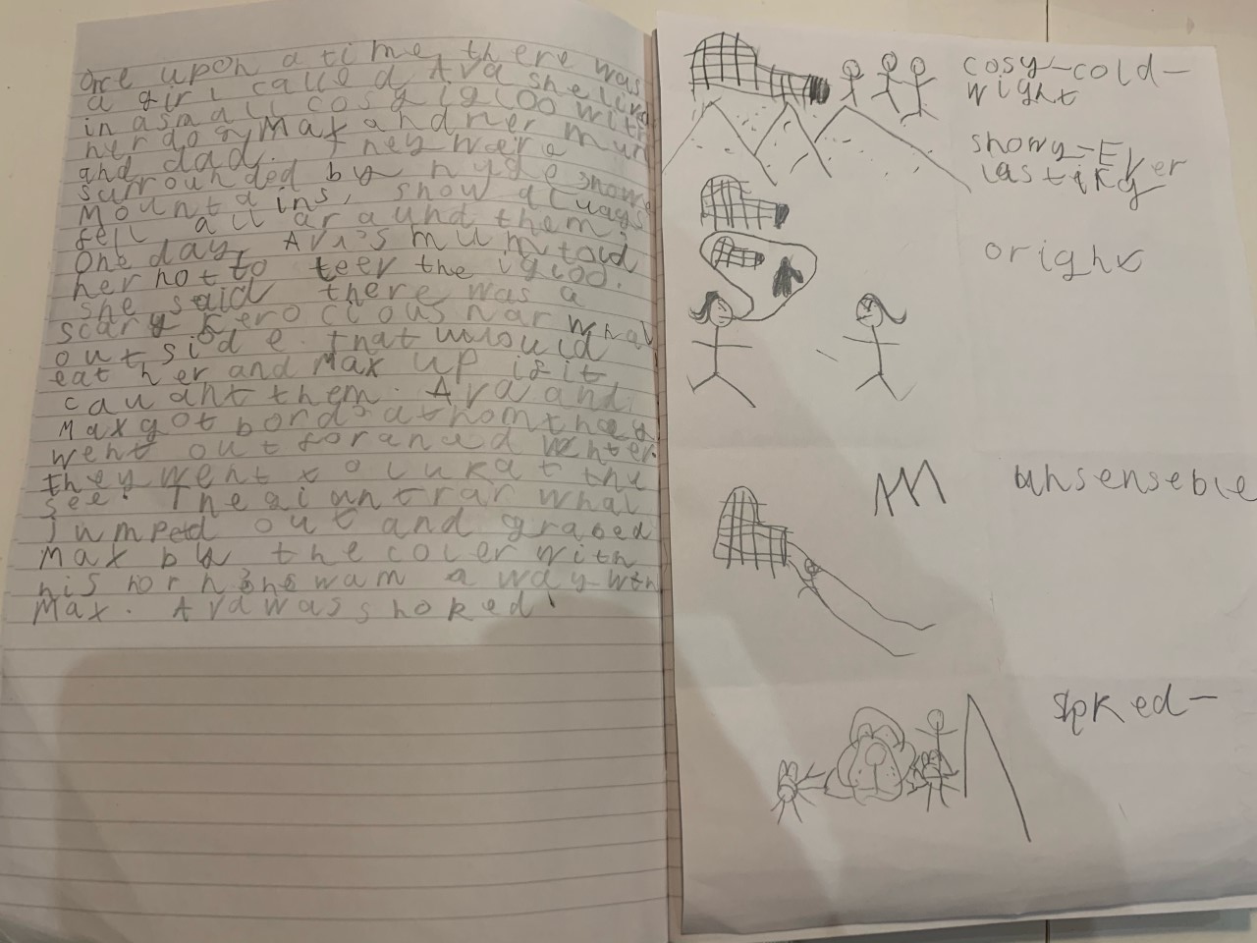
Harry

Slide 11
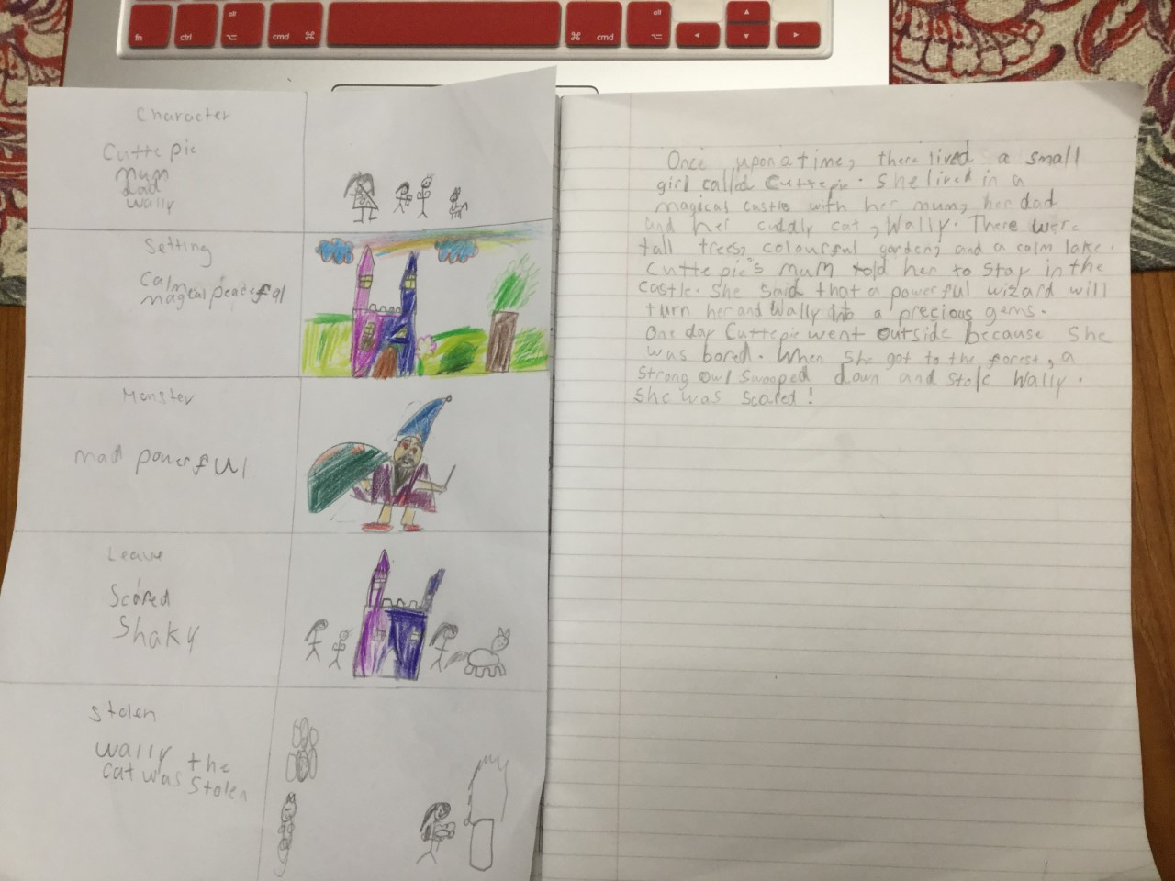
Evie

Slide 12
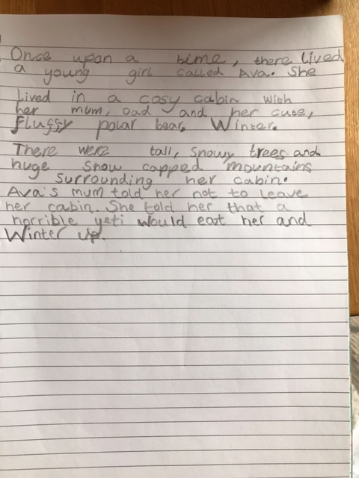
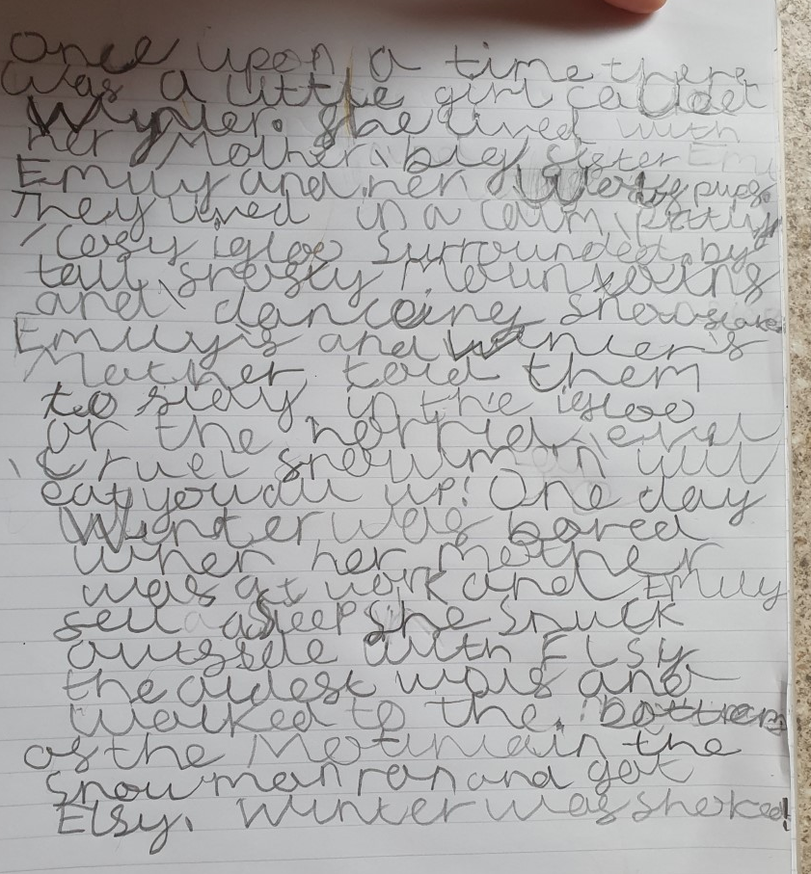
Izzy
Ettie

Slide 13
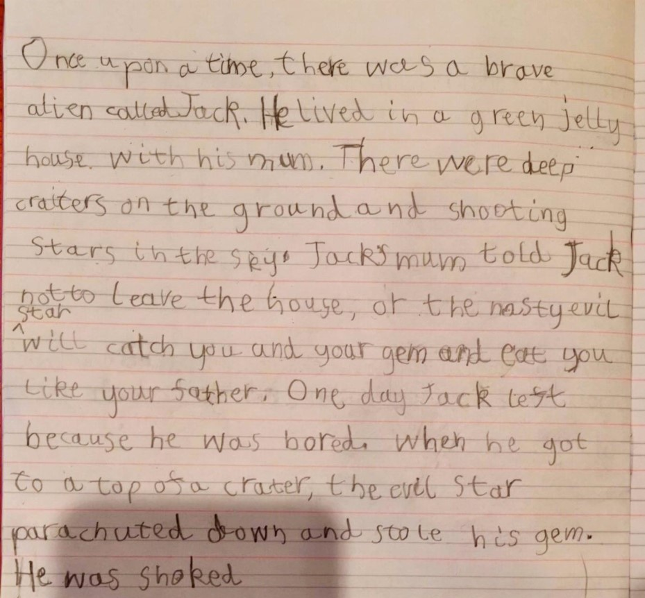
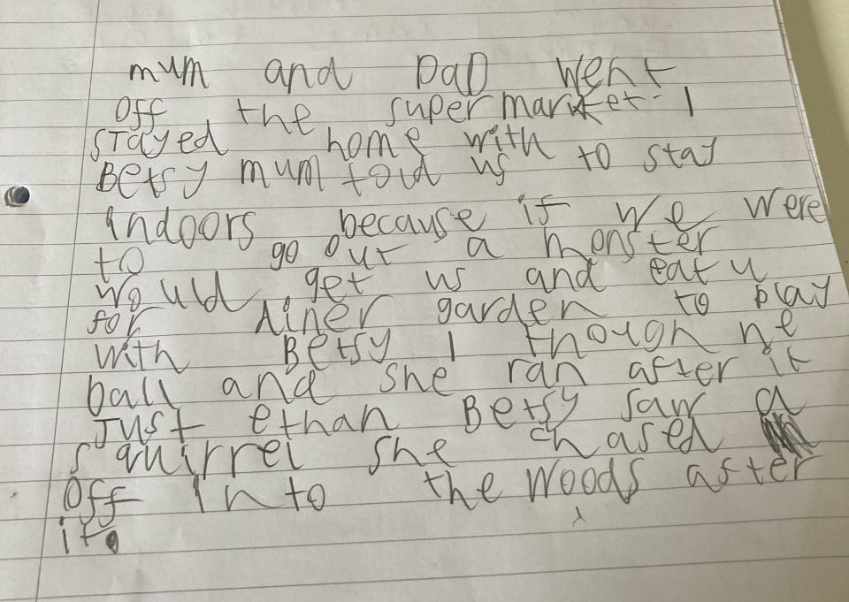
Ruben
Noah

Slide 14
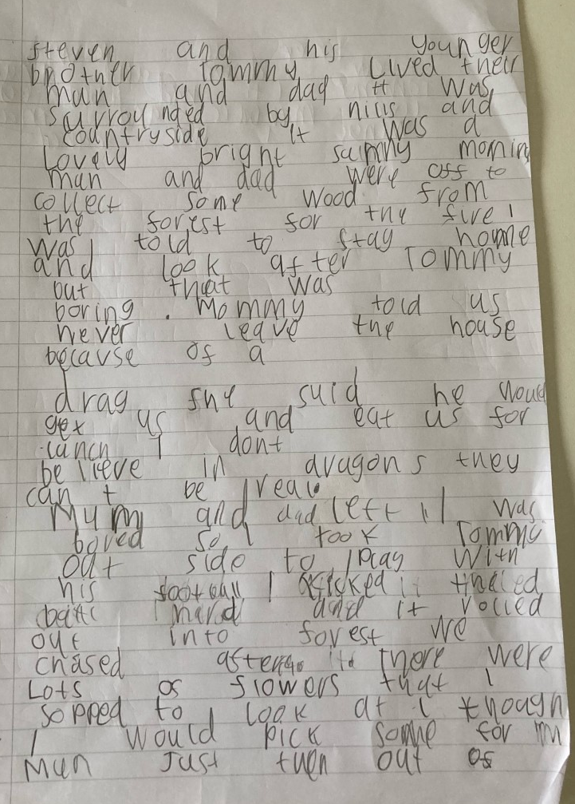
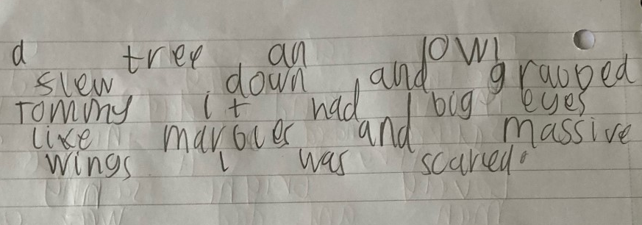
Zac

Slide 15
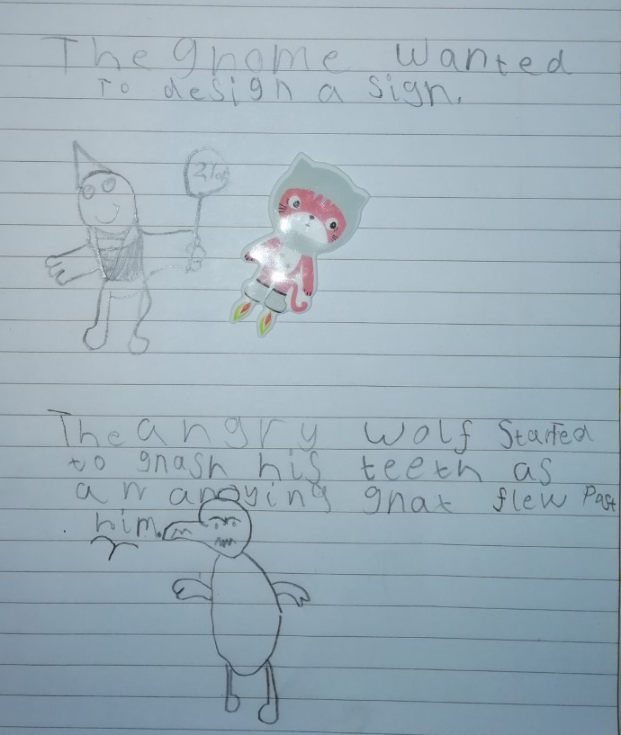
Phonics
Matilda

Slide 16
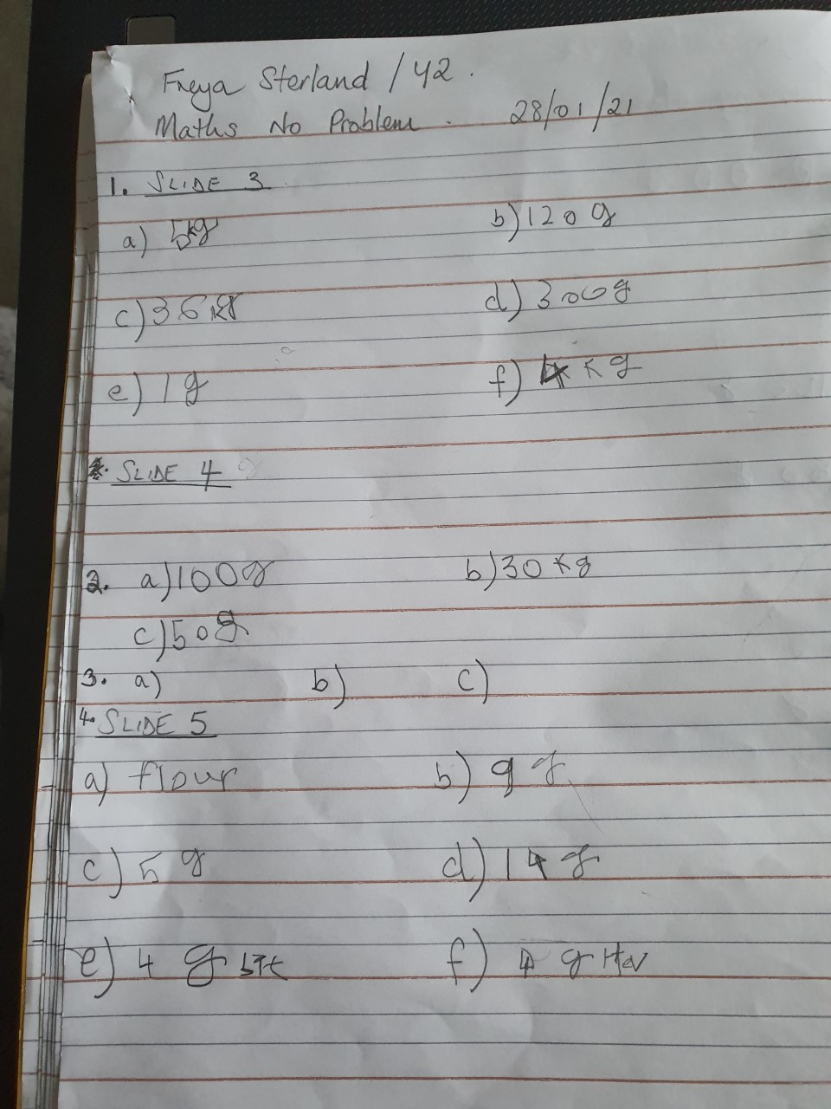
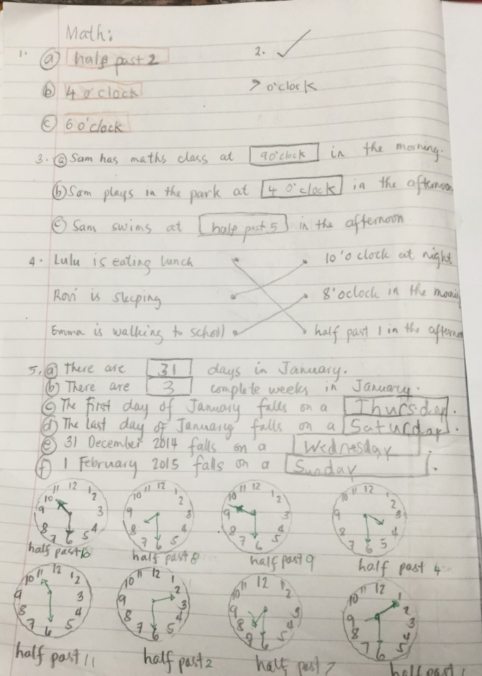
Maths
Freya
Evie

Slide 17
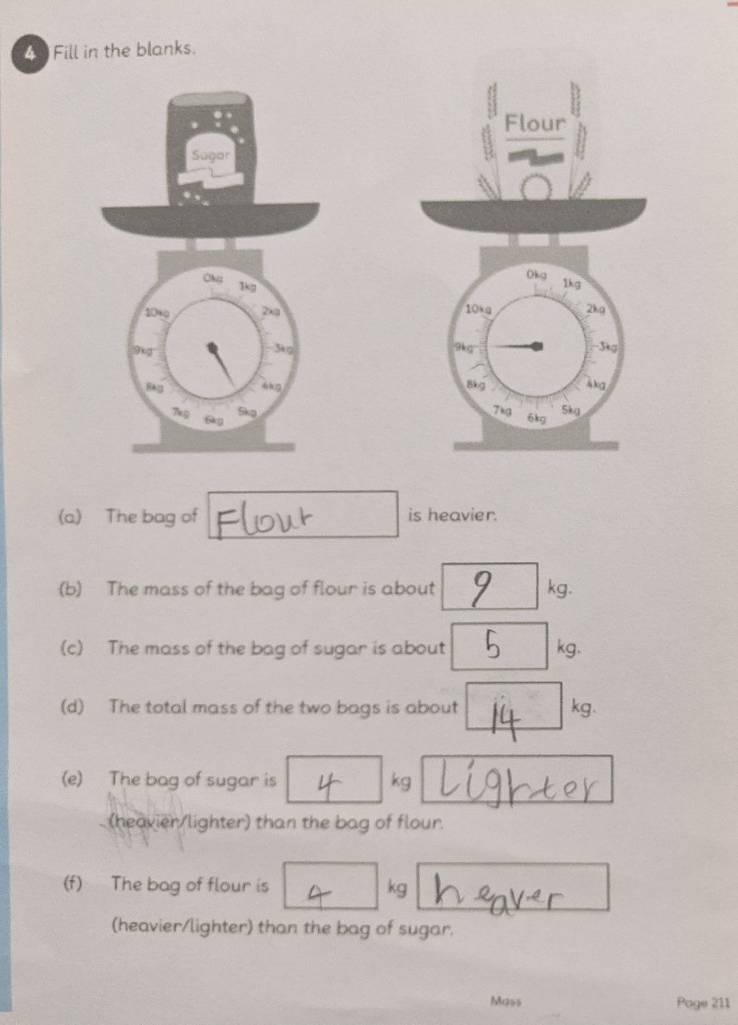
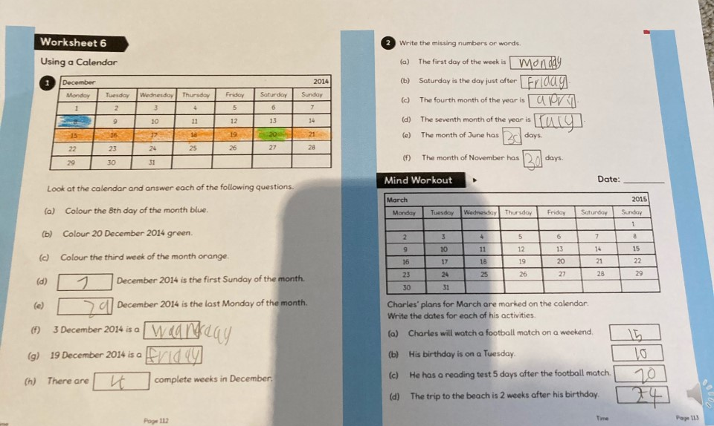
Edward
Zac

Slide 18
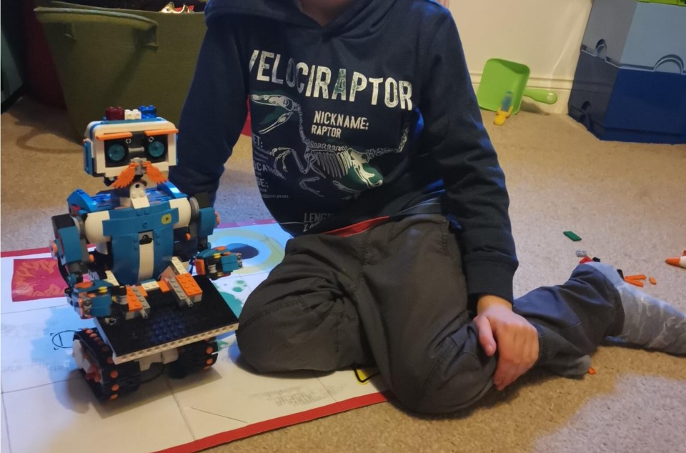
Noah’s Lego Robot

Slide 19


Year 2 Hazel
Star of the Week is
Noah
Noah
your fantastic story writing
Mrs Sherratt
Mrs Wadsworth
5/02/2021

Slide 20
Year 2 Juniper
Star of the Week is
Tayah
Tayah
all your hard work
Miss Wakefield
5/02/2021

Slide 21


Slide 22
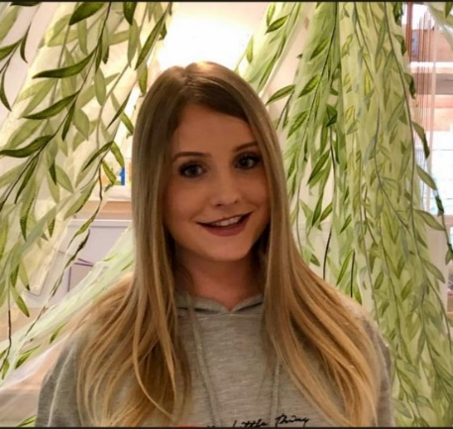
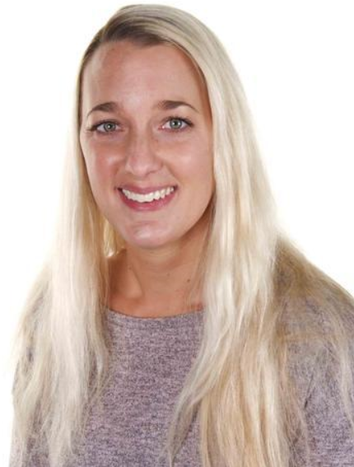
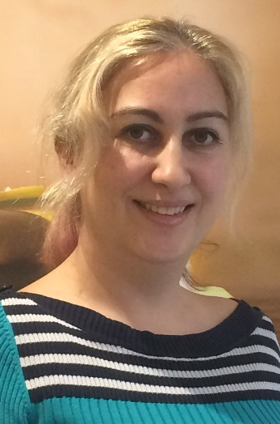
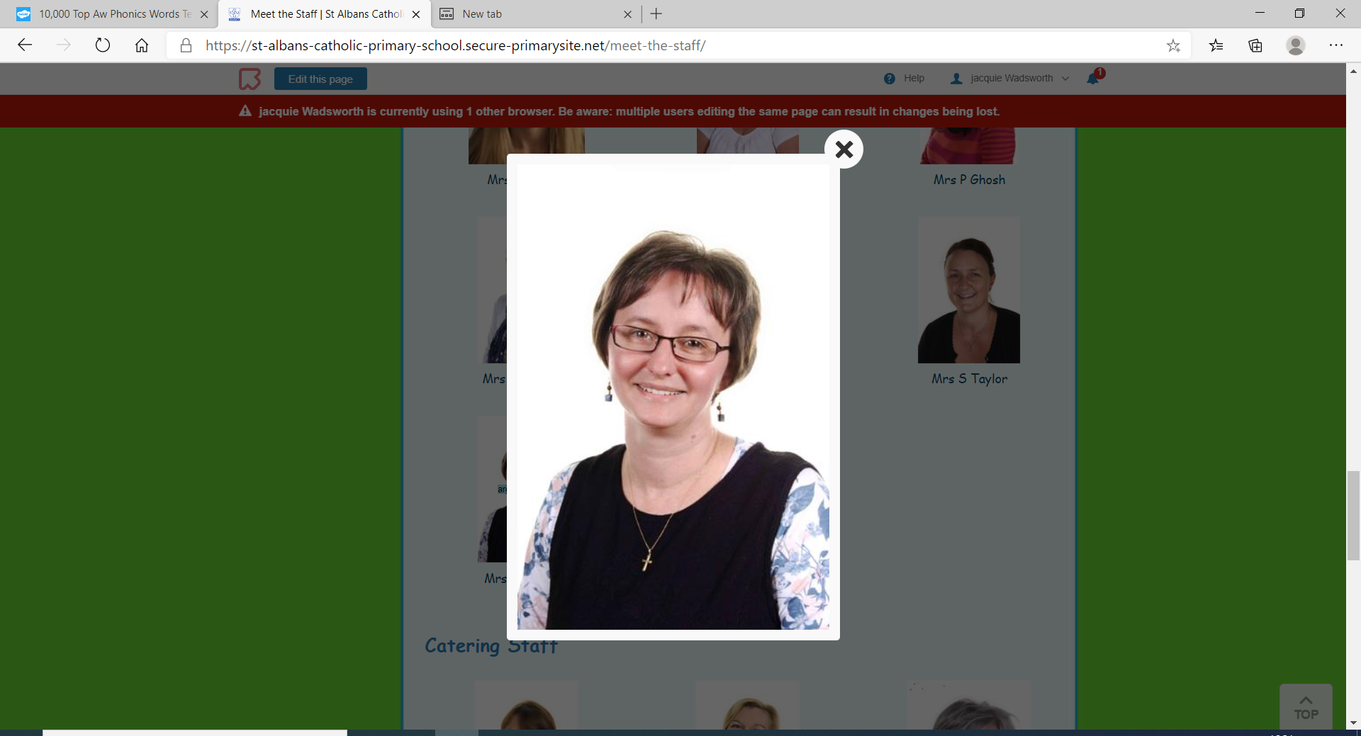
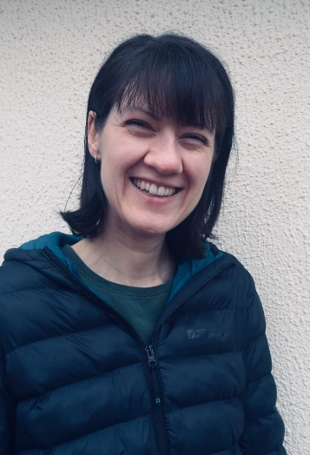
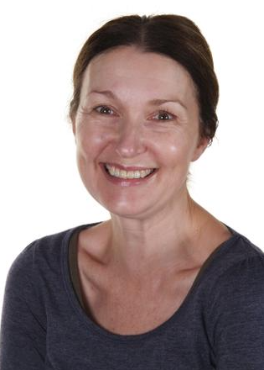
Well done everyone. ☺
Have a lovely weekend!!

