Slide 1


CELEBRATION ASSEMBLY
FRIDAY 19th November 2021

Slide 2

This is the day that the Lord has made!

Slide 3

Notes:
WORD

Slide 4
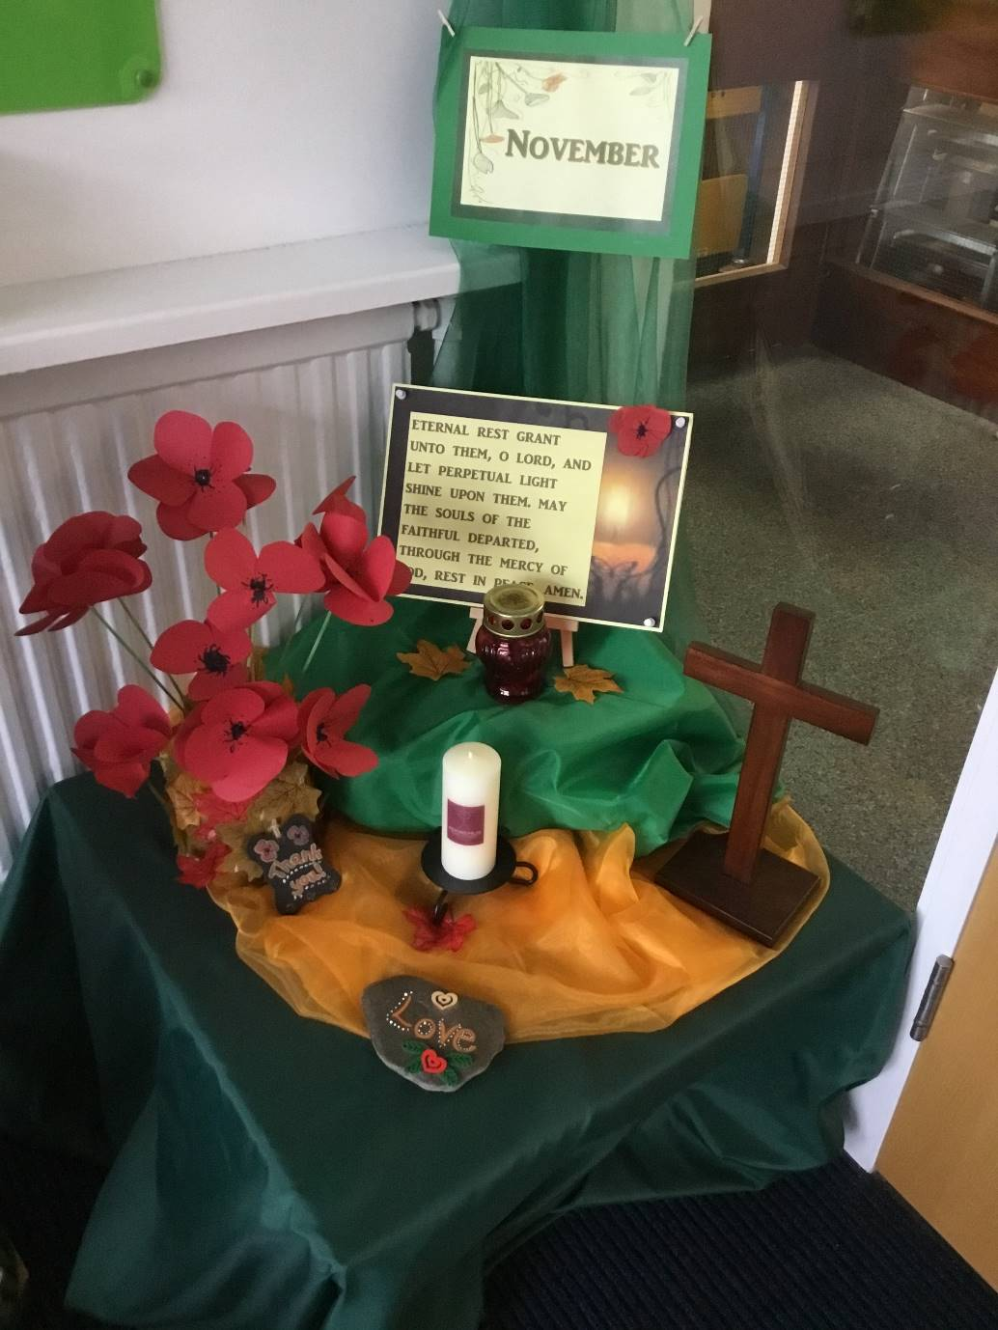

Slide 5
Hail Mary
Hail Mary, full of grace
The Lord is with thee.
Blessed art thou among women
And blessed is the fruit
Of thy womb, Jesus.
Holy Mary, mother of God,
Pray for us sinners now
And at the hour of our death.
Amen

Slide 6
Our Father
Our Father, Who art in Heaven,
Hallowed be Thy name.
Thy Kingdom come,
Thy will be done on earth as it is in Heaven.
Give us this day our daily bread
and forgive us our trespasses
as we forgive those who trespass against us
and lead us not into temptation
but deliver us from evil.
Amen

Slide 7
Dear Lord,
Please bless our school
As we try to
Love, learn,
Share and respect
In the light of Jesus.
St Alban, pray for us.
Amen

Slide 8

Reception

Slide 9
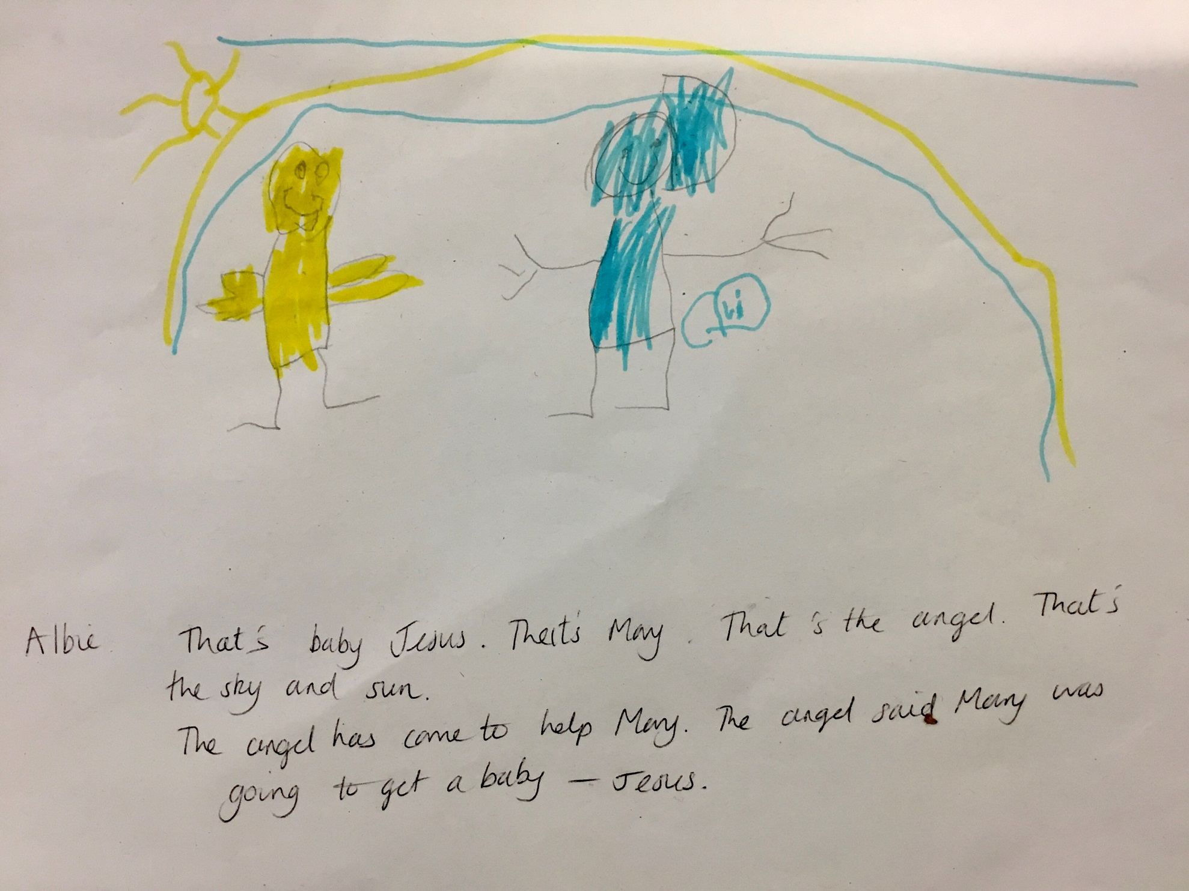

Slide 10
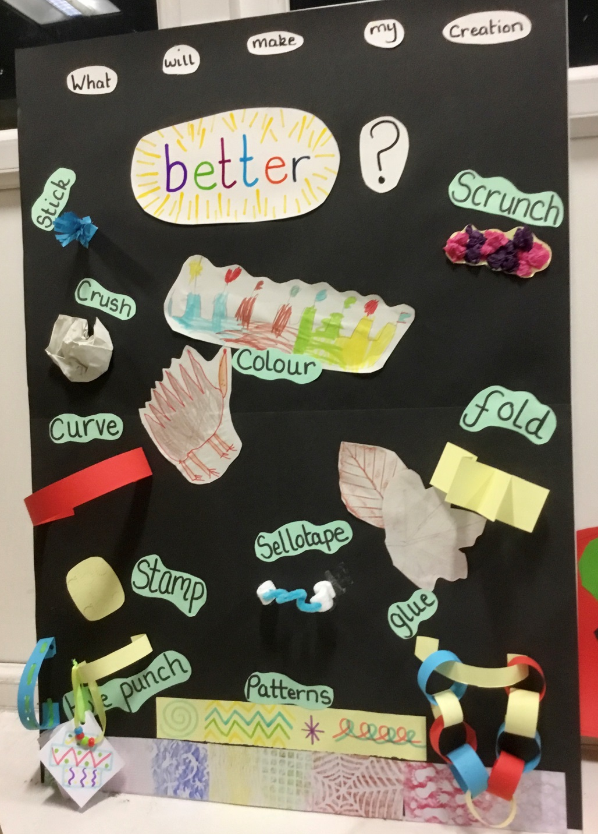

Slide 11
Year 1

Slide 12
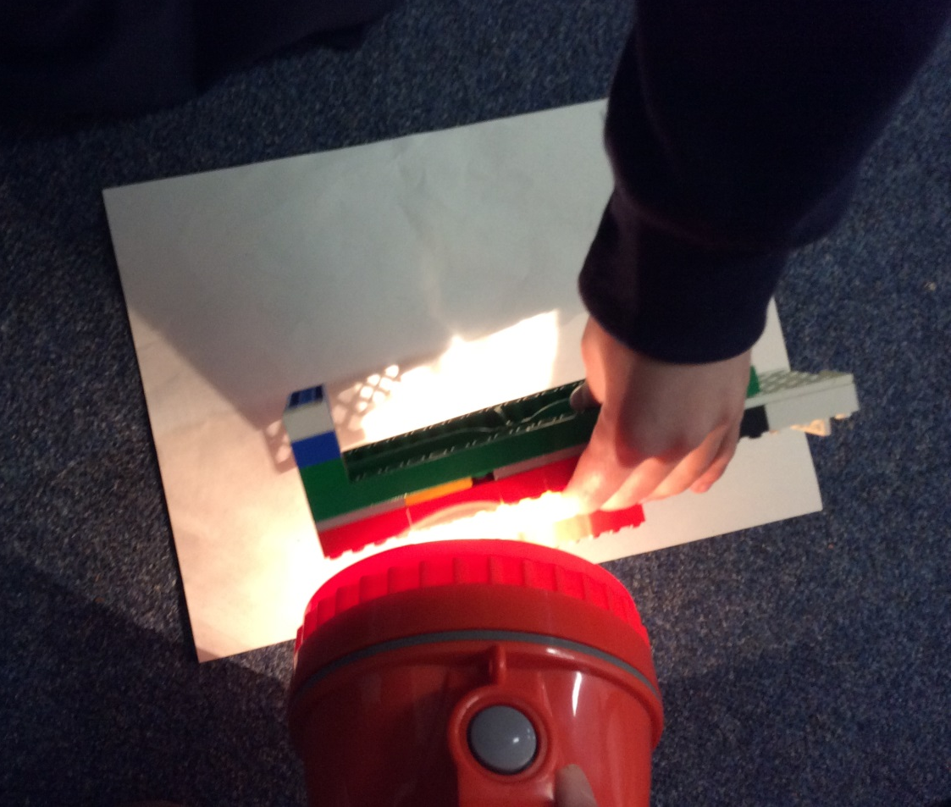
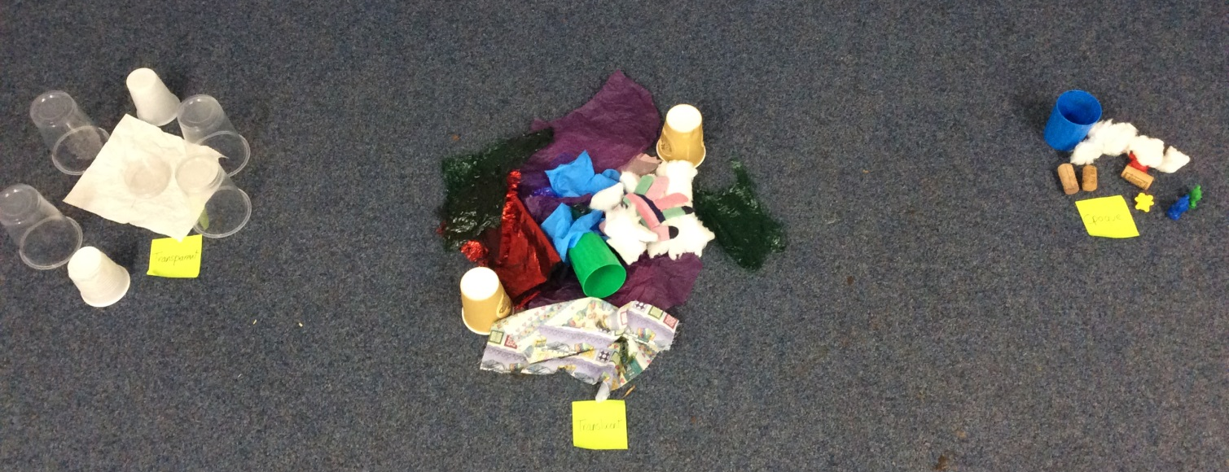

Slide 13
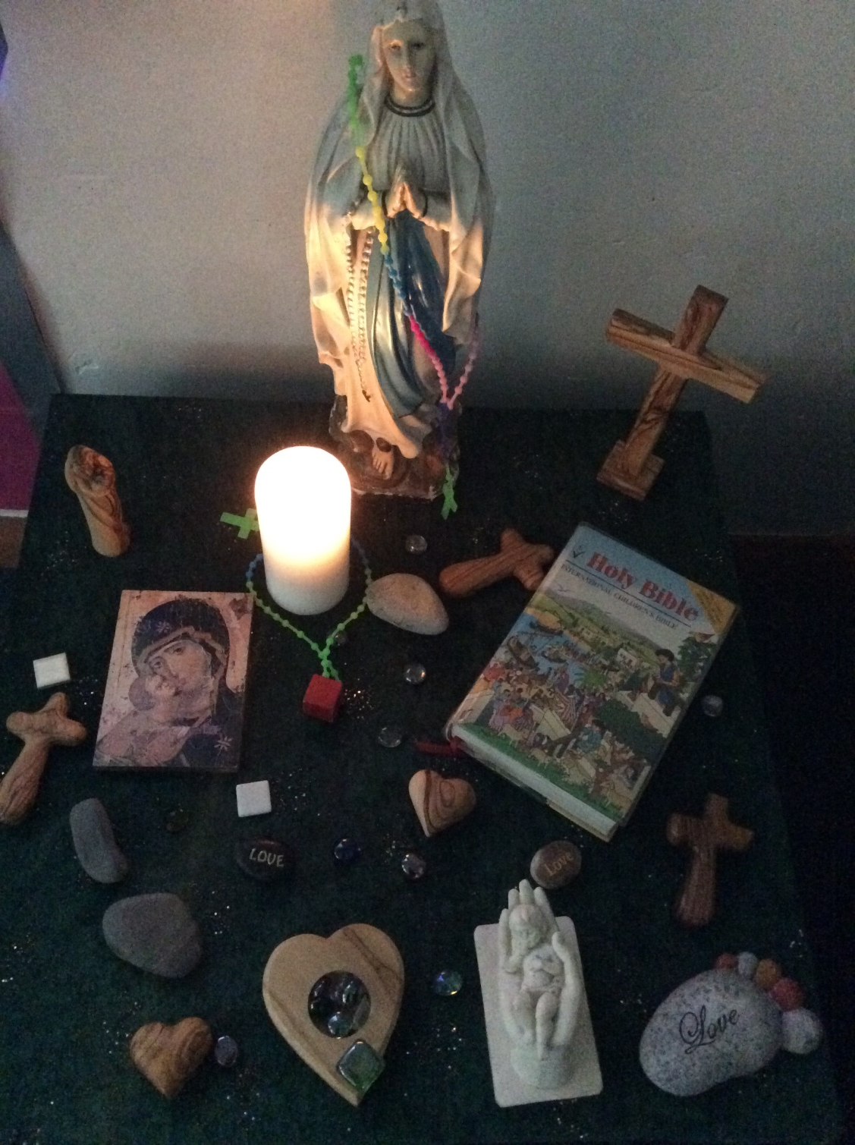

Slide 14
Year 2

Slide 15
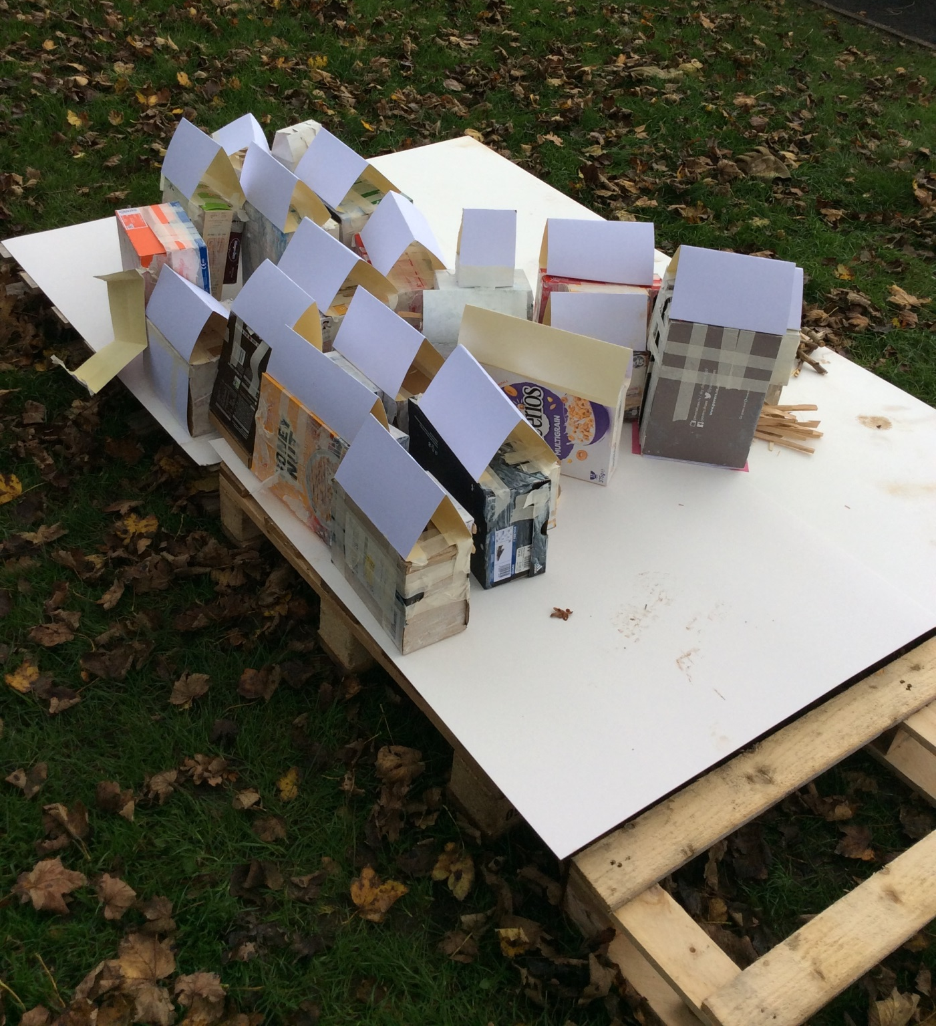

Slide 16
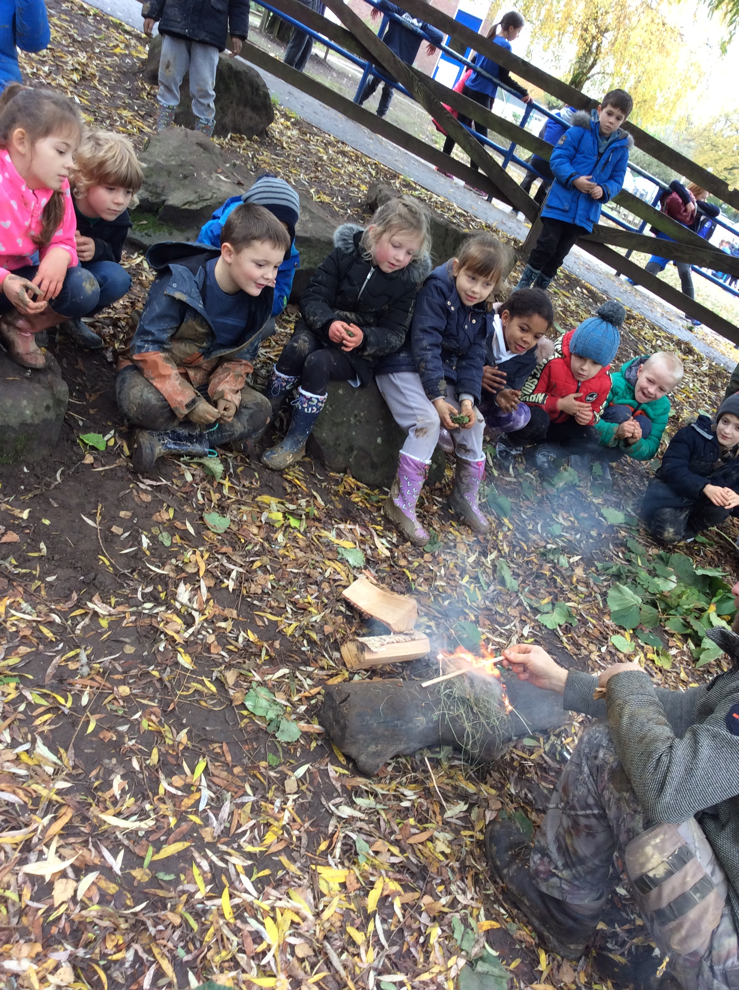

Slide 17
Year 3

Slide 18
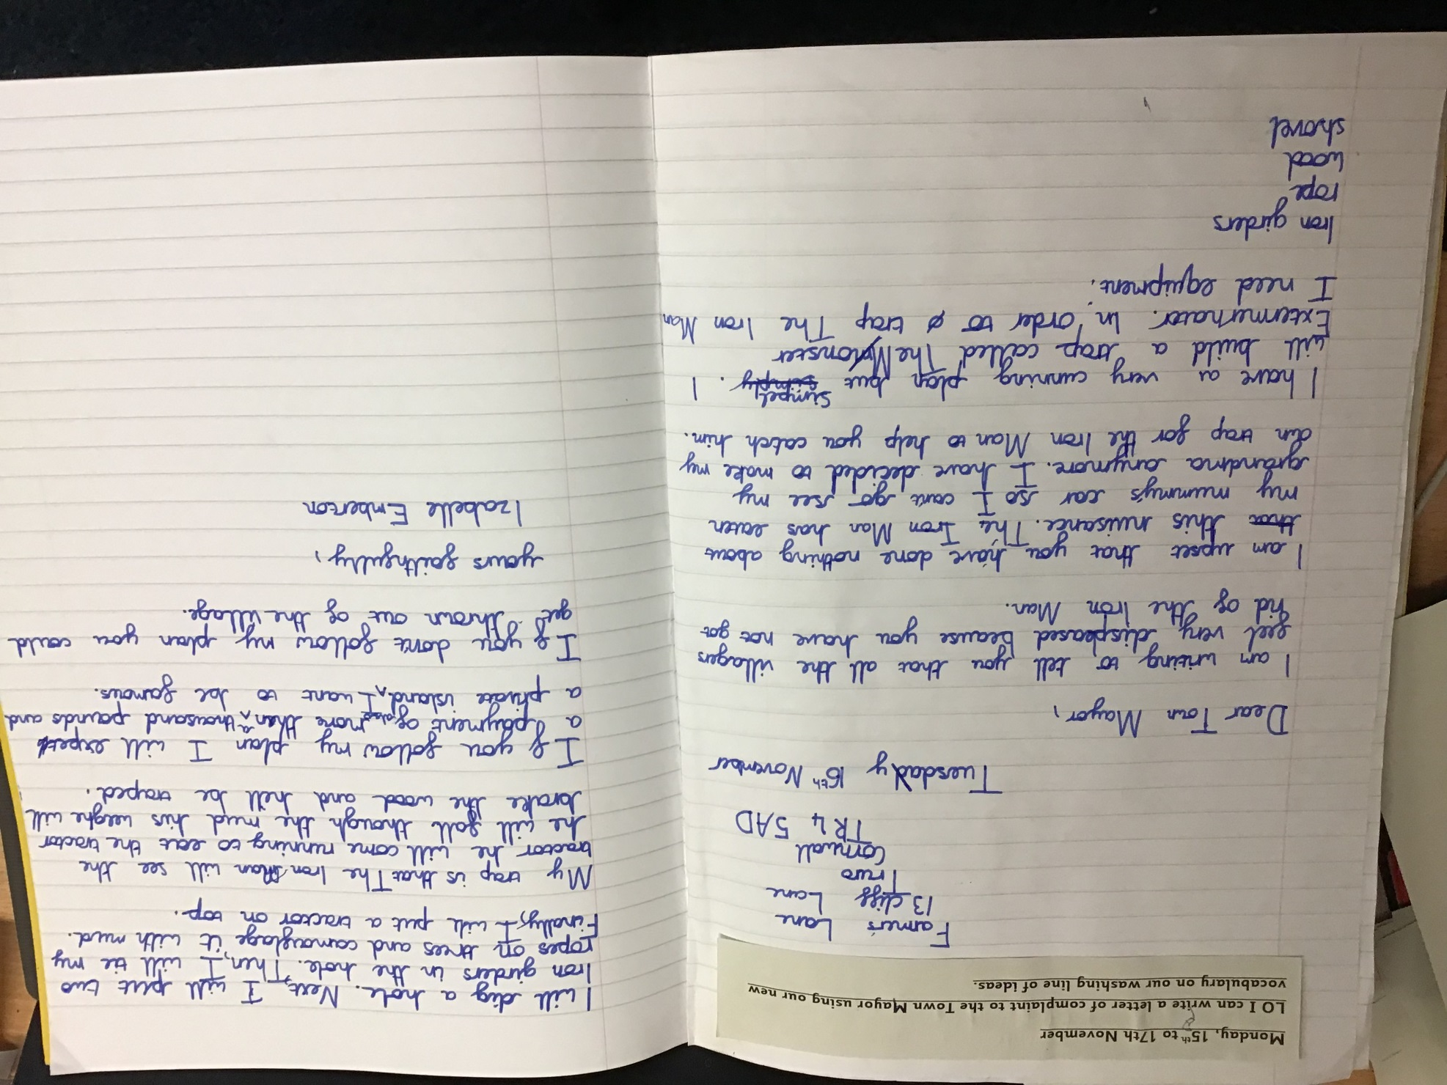

Slide 19
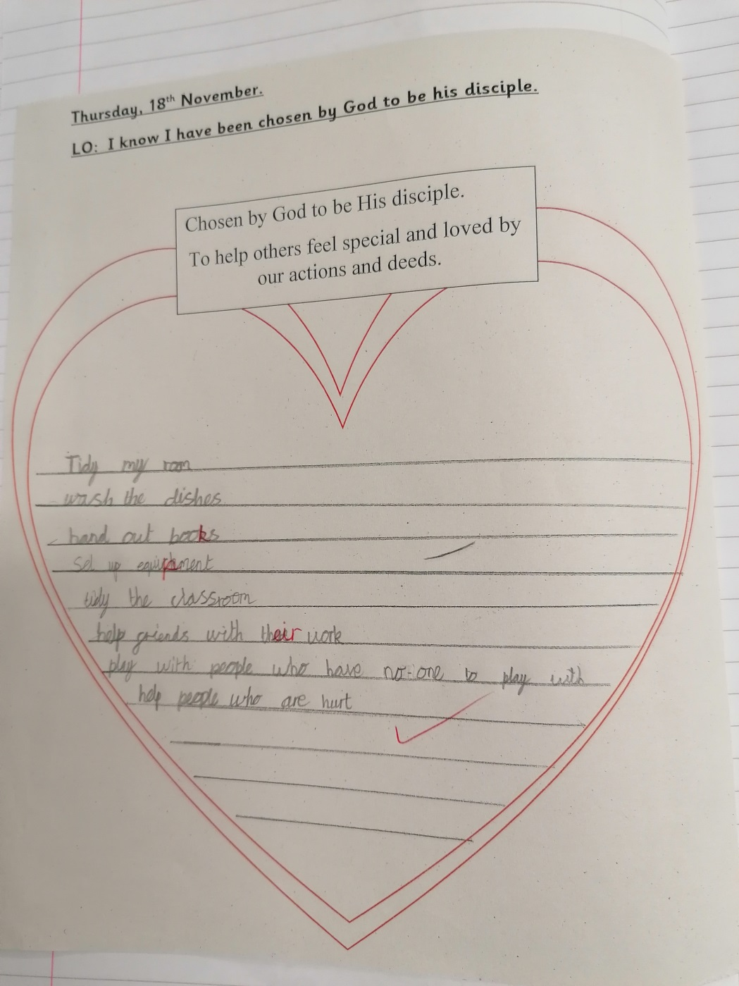
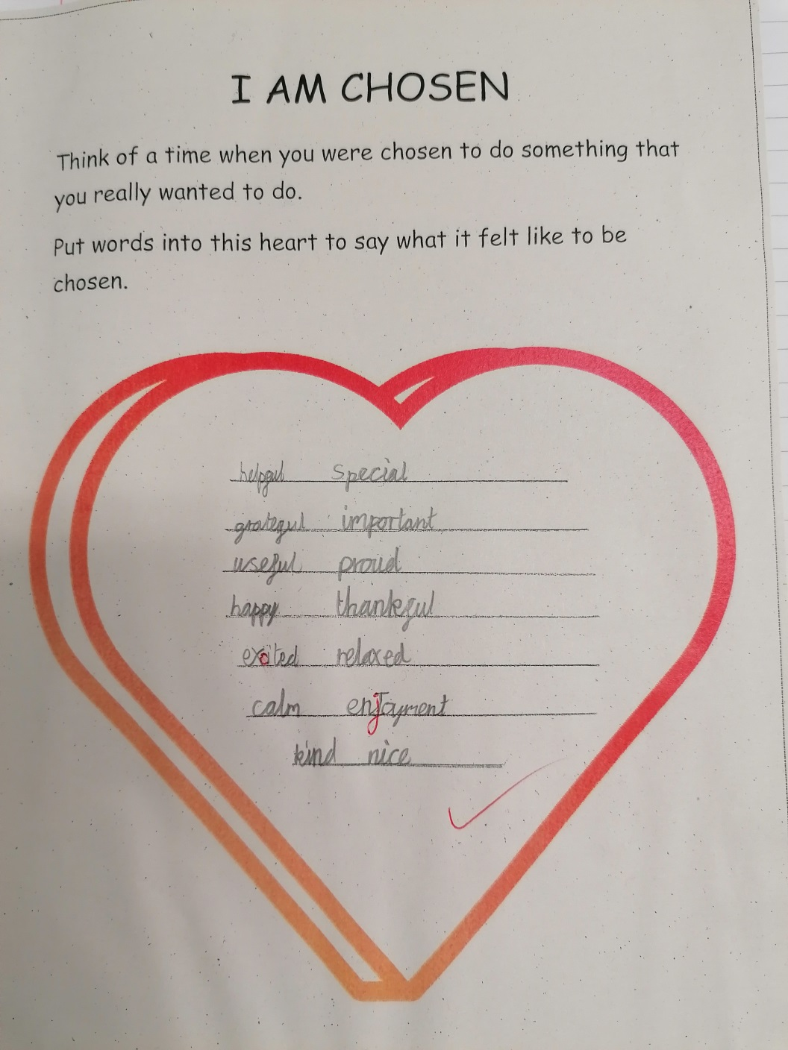

Slide 20
Year 4

Slide 21
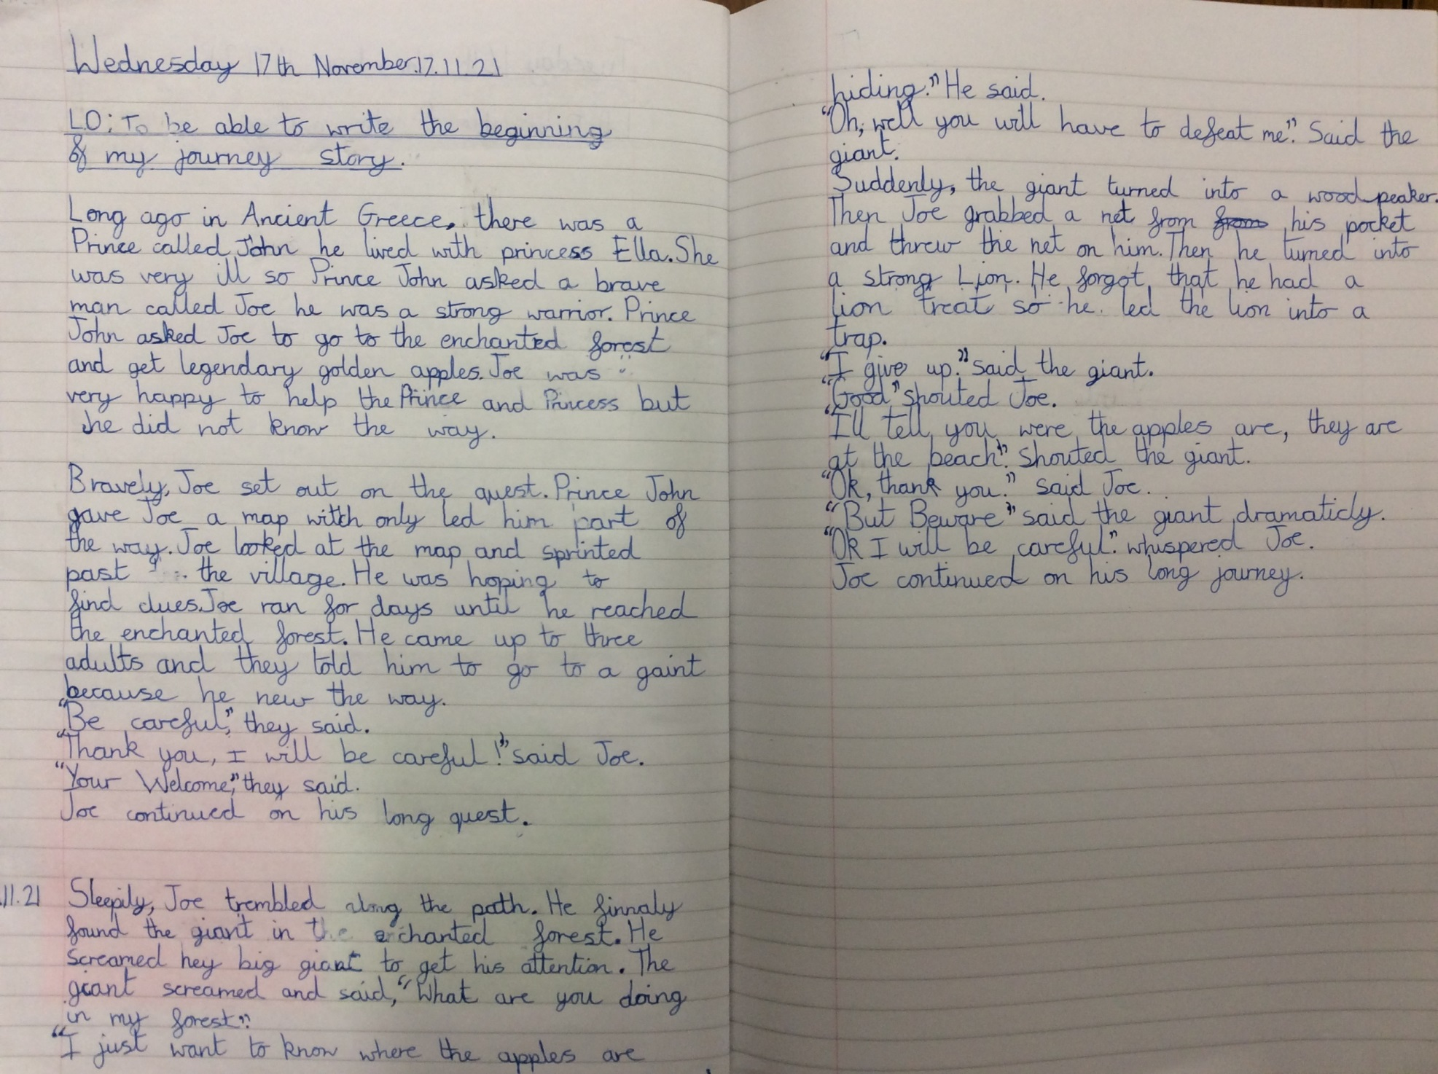

Slide 22
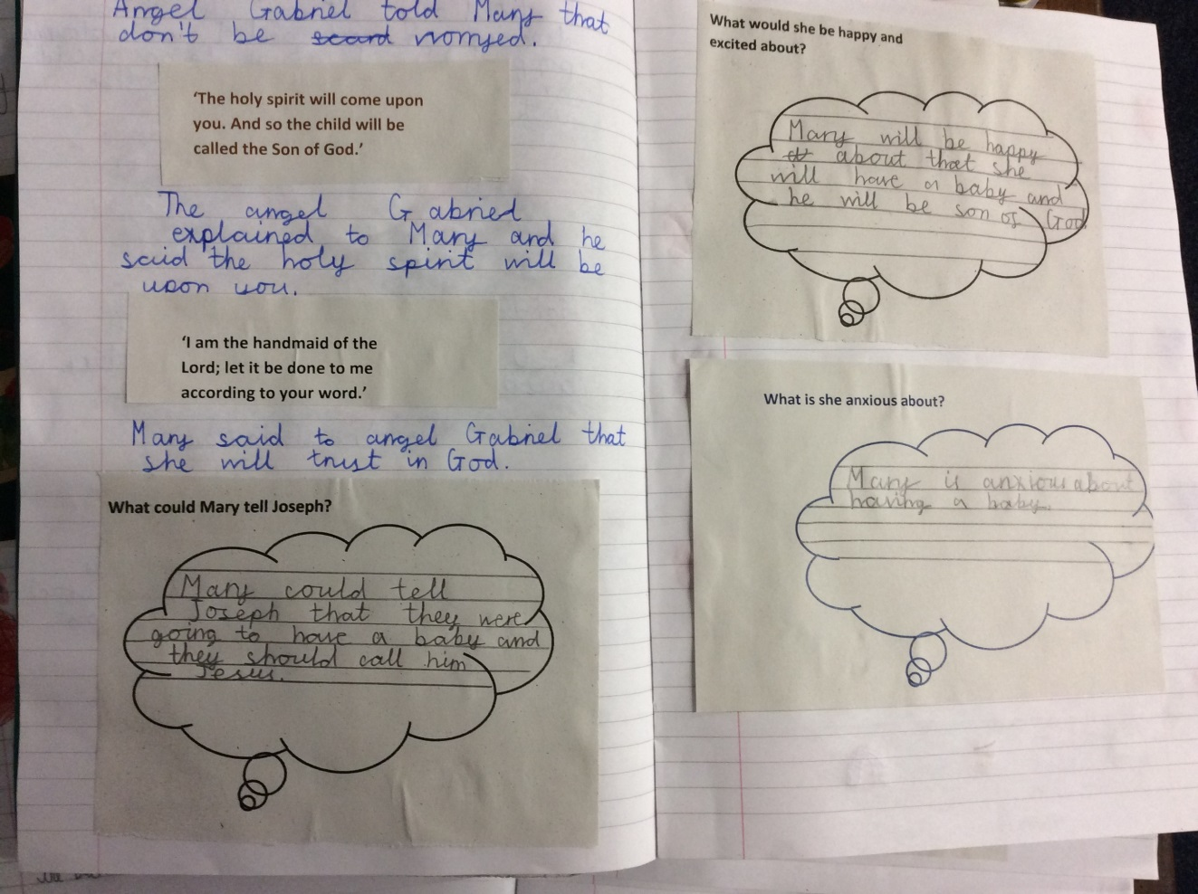
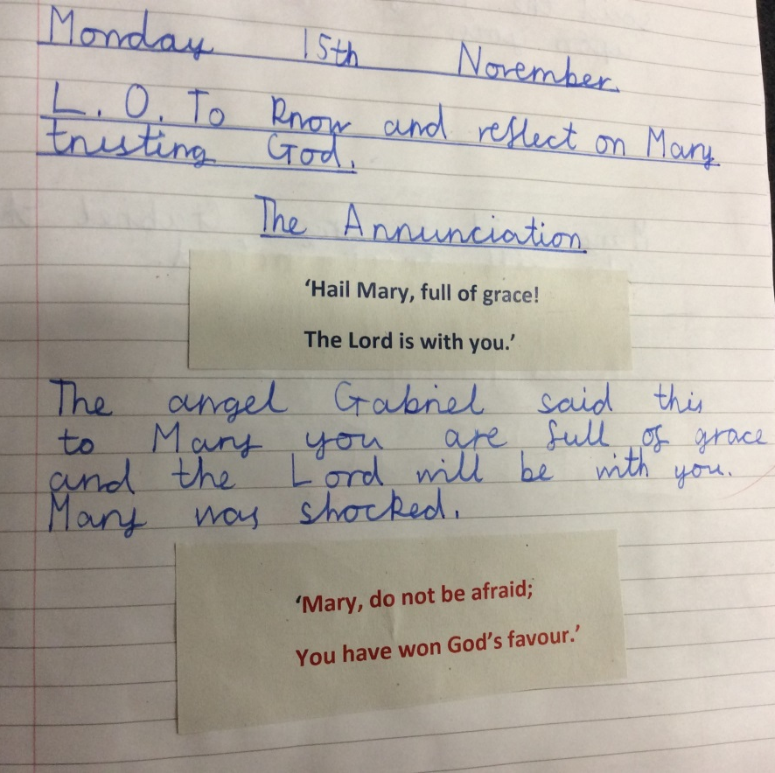

Slide 23
Year 5

Slide 24
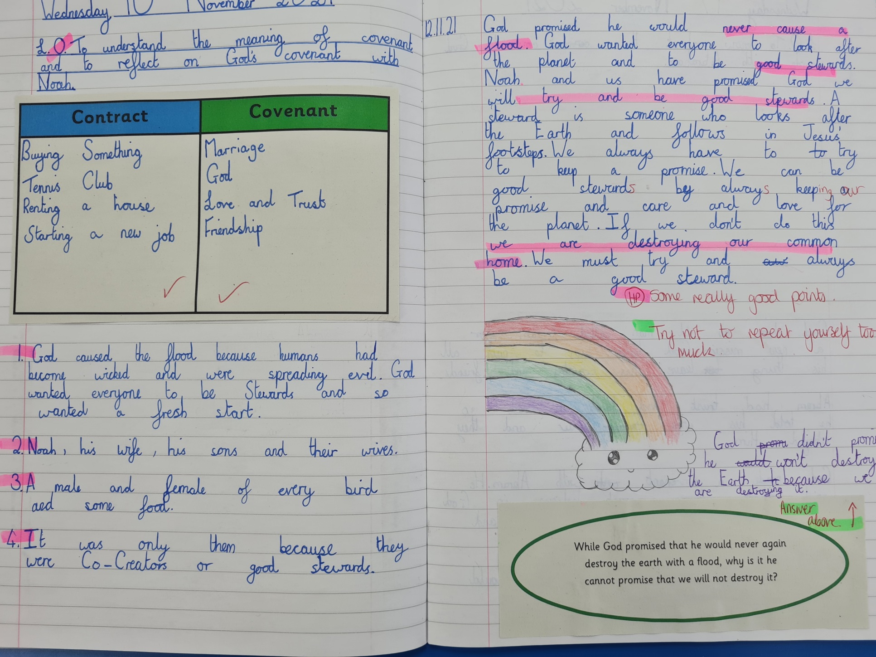

Slide 25
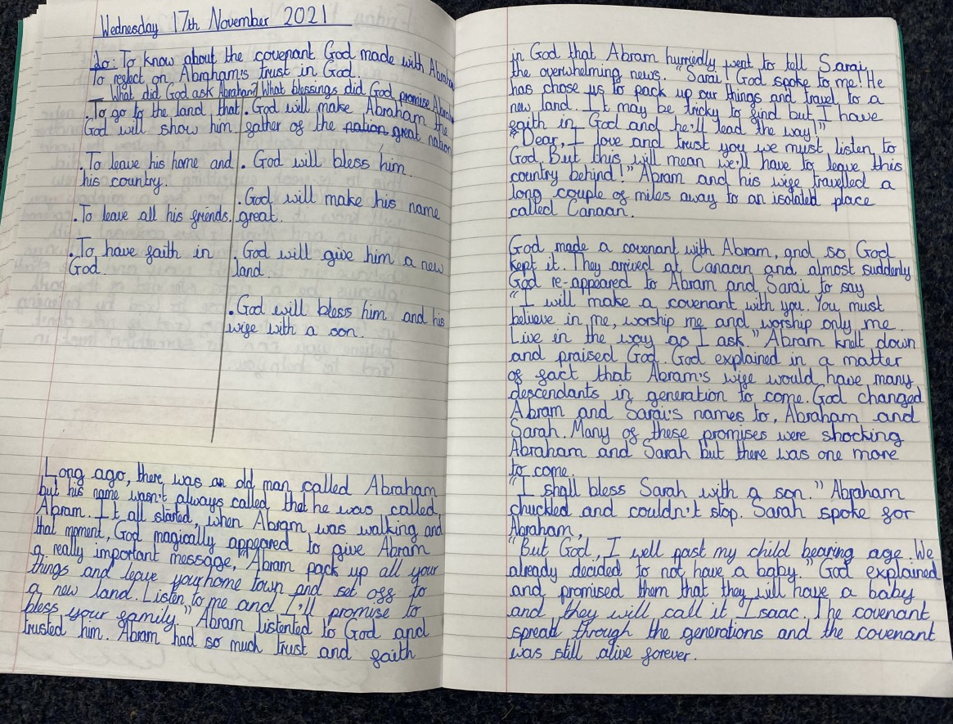

Slide 26
Year 6

Slide 27
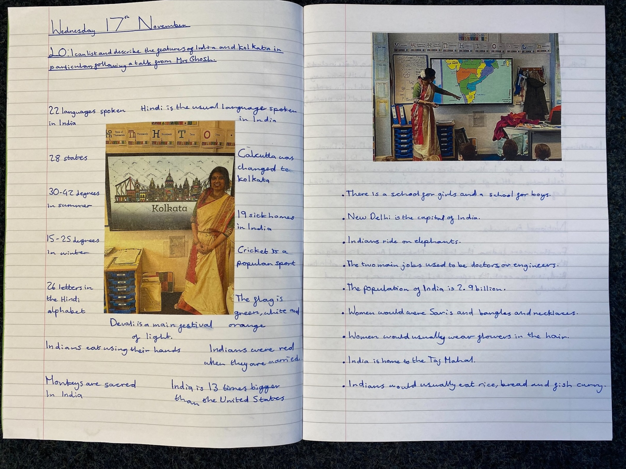

Slide 28
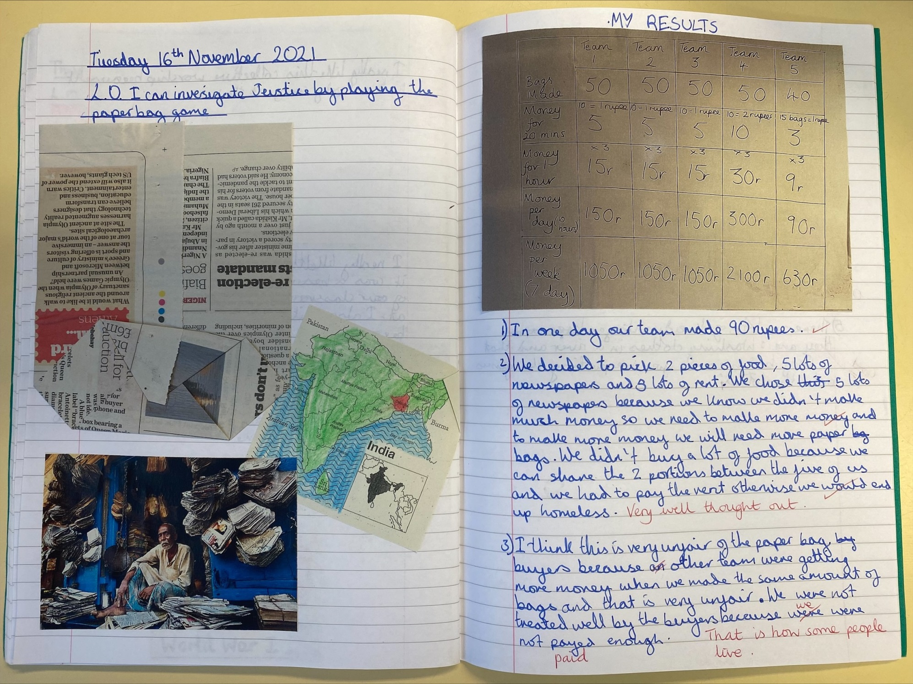

Slide 29
SPORTING SUPERSTARS!!

Slide 30


Slide 31
Congratulations to all of our stars of the week!

Slide 32


Slide 33


Slide 34
In Sunday’s Gospel, Jesus assured us that although many things in the world may change, his words will last forever.

Slide 35


Thank you for being a part of
Anti-Bullying
Week 2021

Slide 36



Let us pray.
Dear Blessed Lord,
Thank you for your everlasting love.
May your words stay with us and guide us as we try to be the best that we can be.
Amen

Slide 37
Show your love for others with a daily act of kindness this week!
Remember the power of “one kind word”!
Notes:
GO FORTH - MISSION

Slide 38
WOW!
WELL DONE EVERYONE!

