Slide 1


CELEBRATION ASSEMBLY
FRIDAY 12th November 2021

Slide 2

This is the day that the Lord has made!

Slide 3
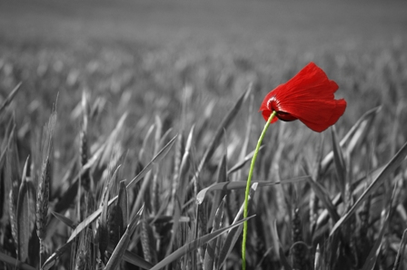
REMEMBRANCE DAY

Slide 4
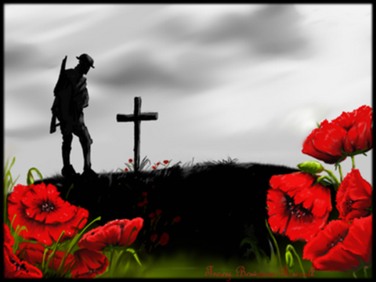
Remembrance Day
On the eleventh hour of the eleventh day of the eleventh month in 1918 the Great War ended.
The first Remembrance Day was held in 1919 to commemorate the end of the war.
King George V initiated a 2 minute silence to remember those who had given their lives.
Originally this day was known as Armistice Day.

Slide 5


Slide 6
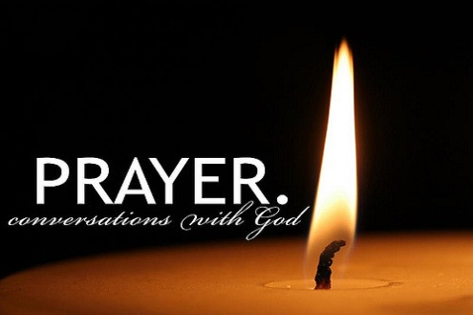
Notes:
WORD

Slide 7
Hail Mary
Hail Mary, full of grace
The Lord is with thee.
Blessed art thou among women
And blessed is the fruit
Of thy womb, Jesus.
Holy Mary, mother of God,
Pray for us sinners now
And at the hour of our death.
Amen

Slide 8
Our Father
Our Father, Who art in Heaven,
Hallowed be Thy name.
Thy Kingdom come,
Thy will be done on earth as it is in Heaven.
Give us this day our daily bread
and forgive us our trespasses
as we forgive those who trespass against us
and lead us not into temptation
but deliver us from evil.
Amen

Slide 9
Dear Lord,
Please bless our school
As we try to
Love, learn,
Share and respect
In the light of Jesus.
St Alban, pray for us.
Amen

Slide 10

Reception

Slide 11
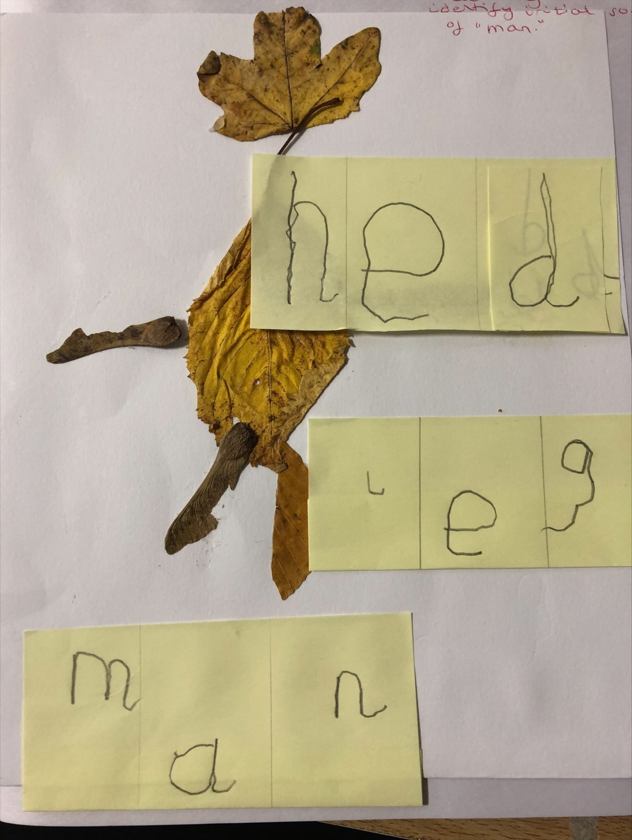

Slide 12
Year 1

Slide 13
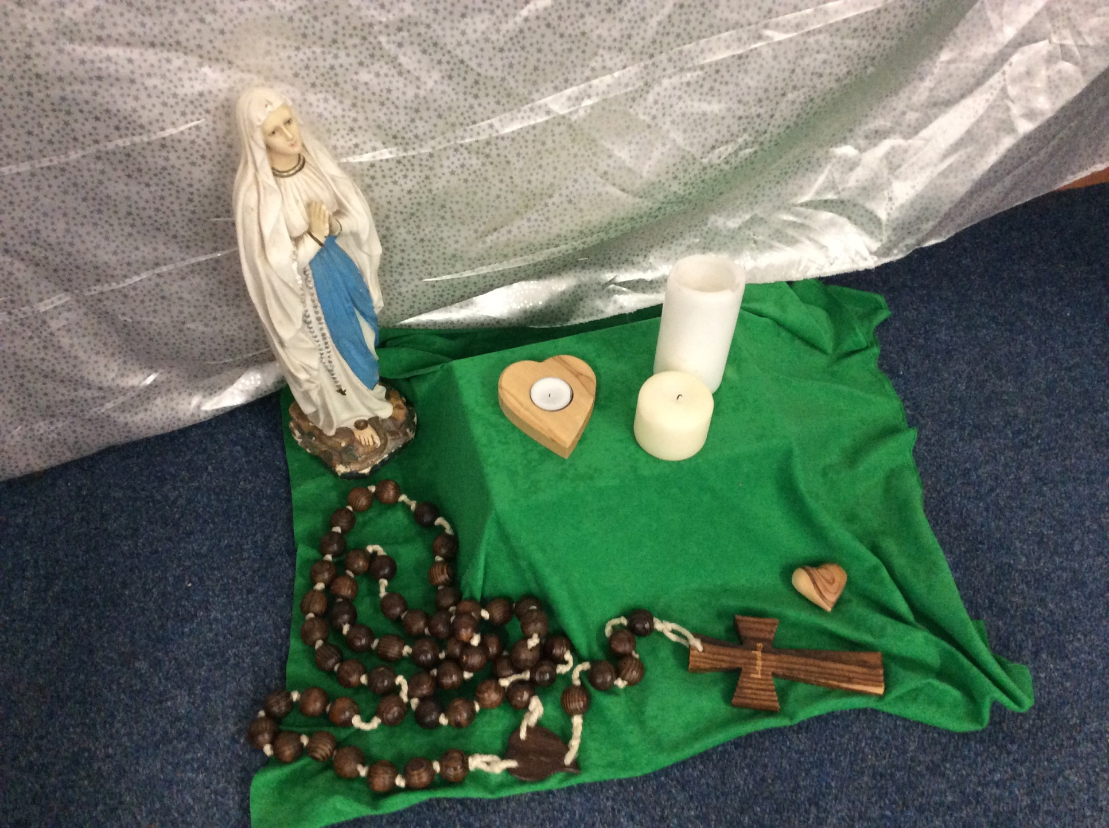

Slide 14
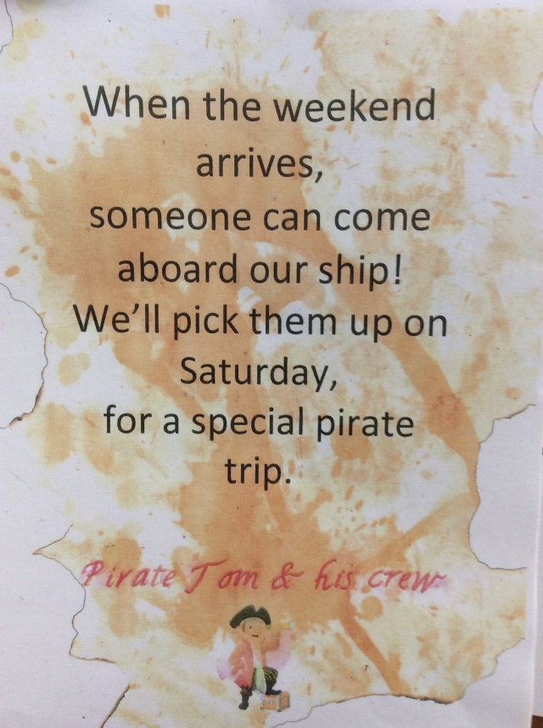
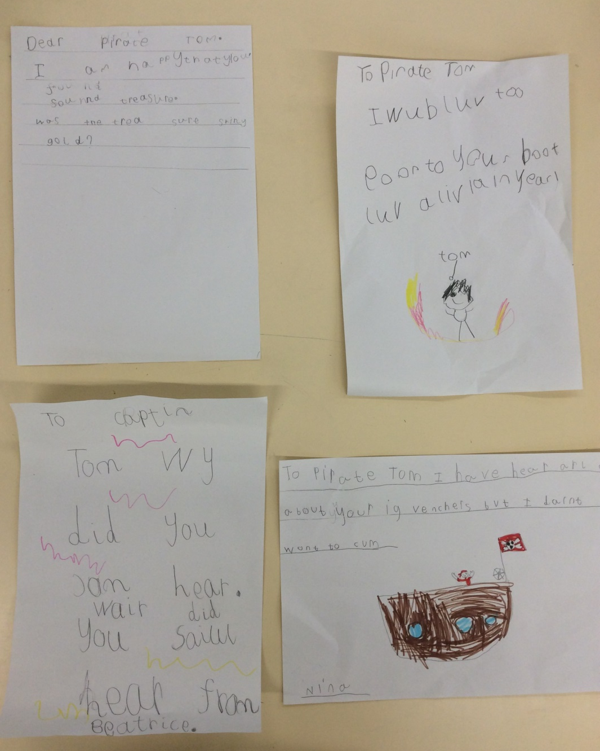
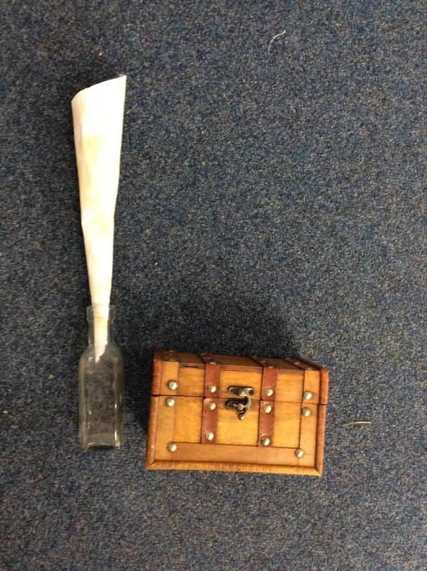

Slide 15
Year 2

Slide 16
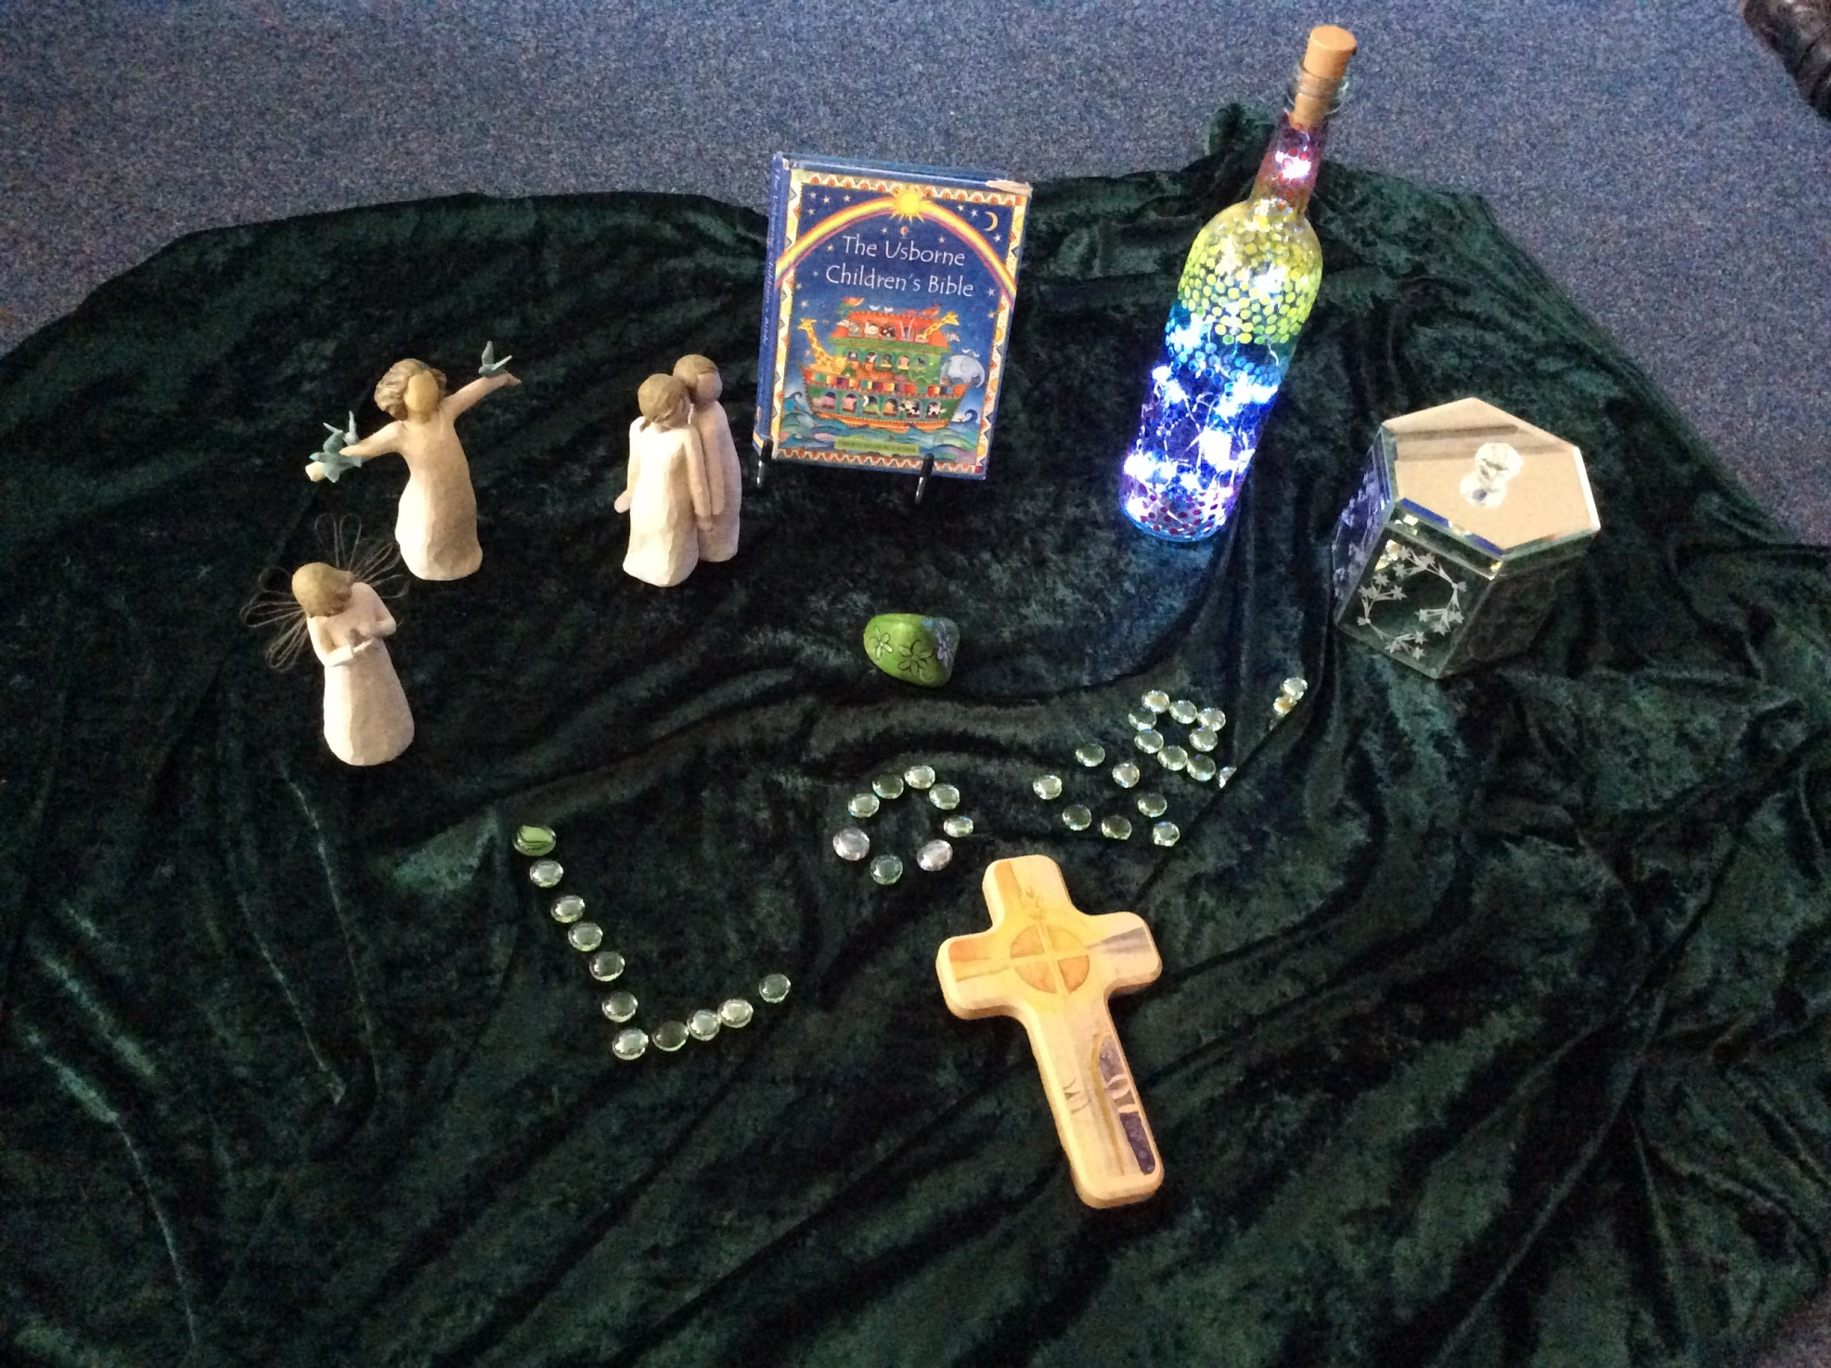

Slide 17
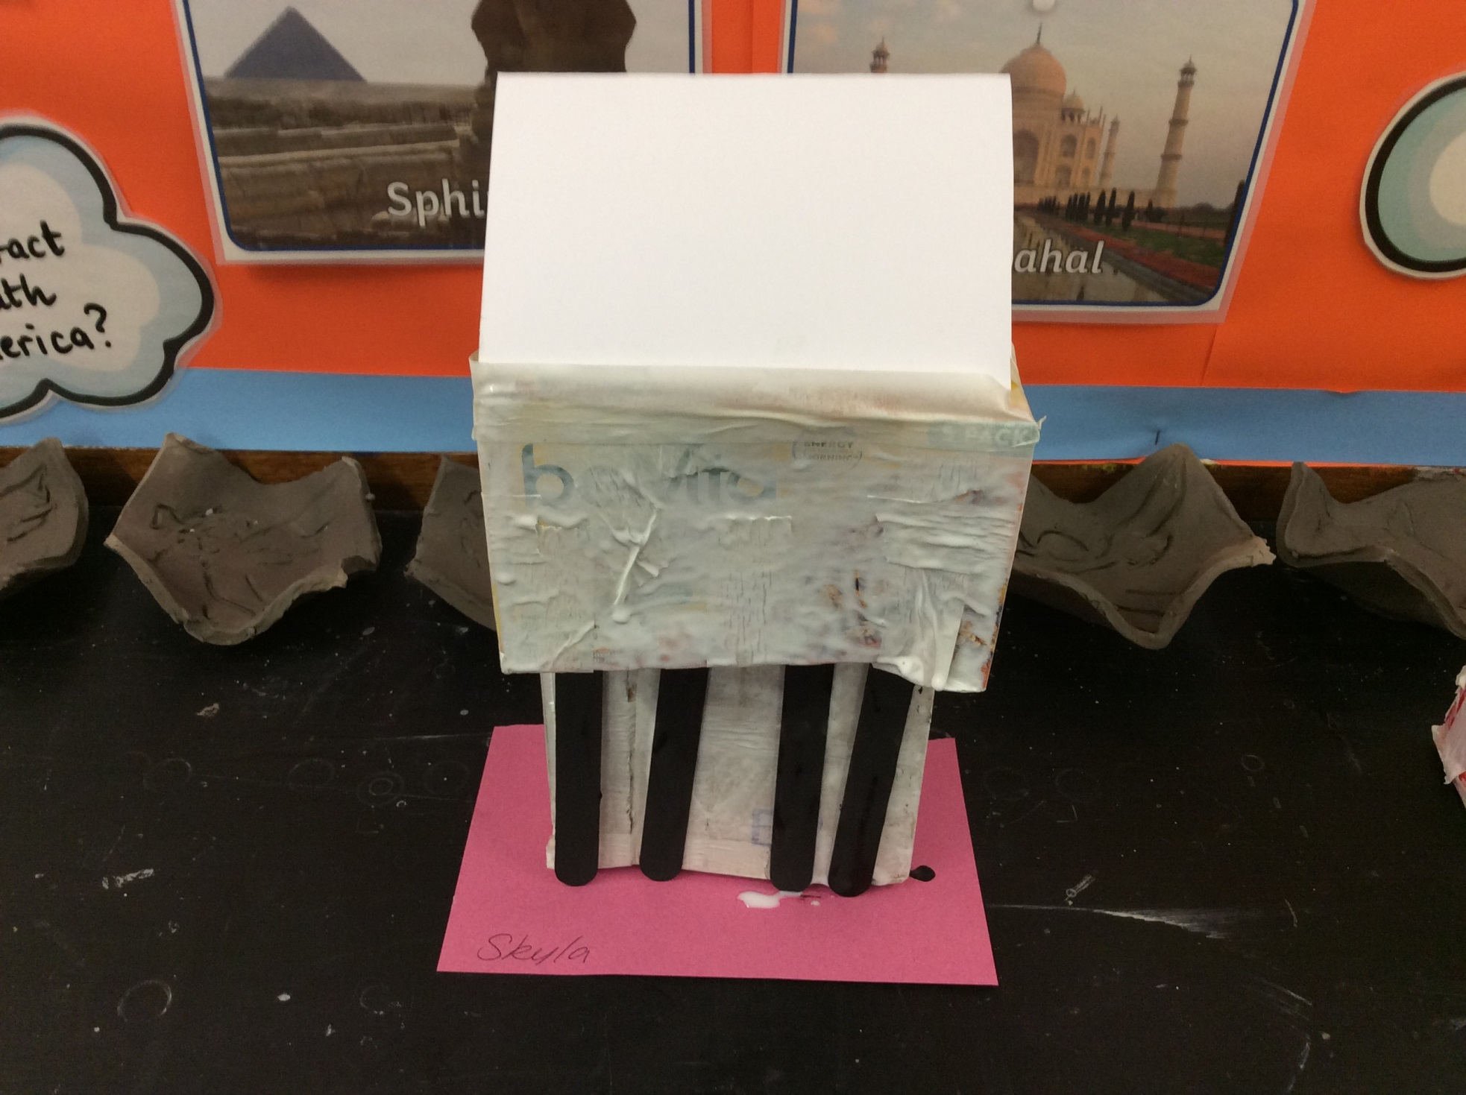

Slide 18
Year 3

Slide 19
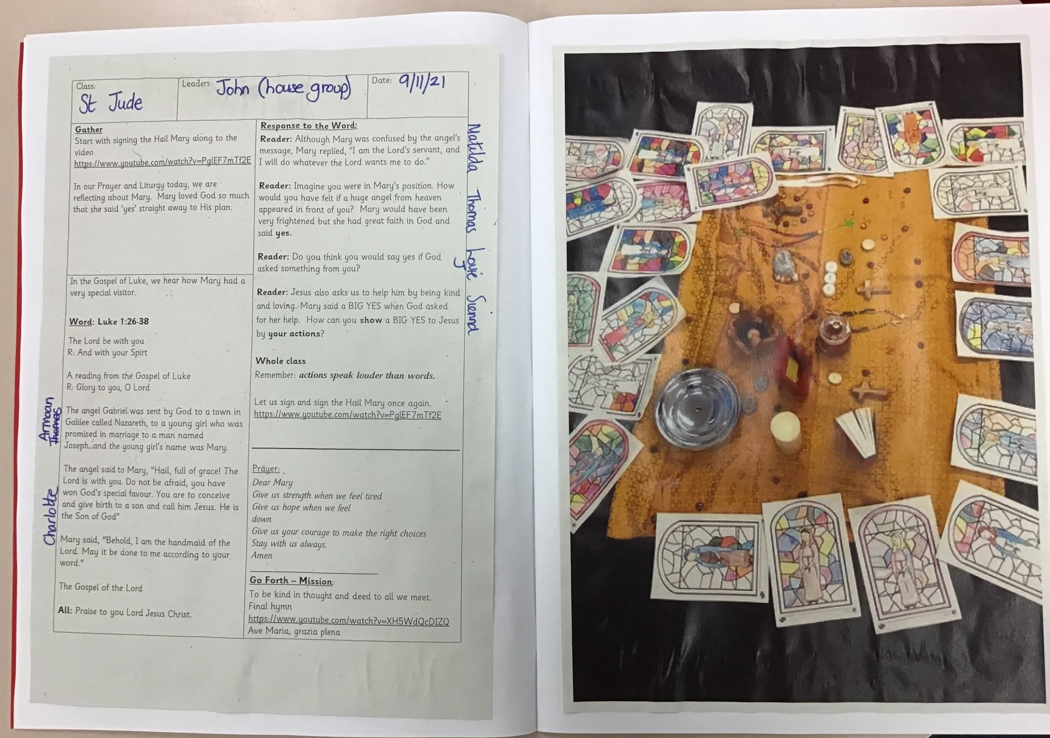

Slide 20
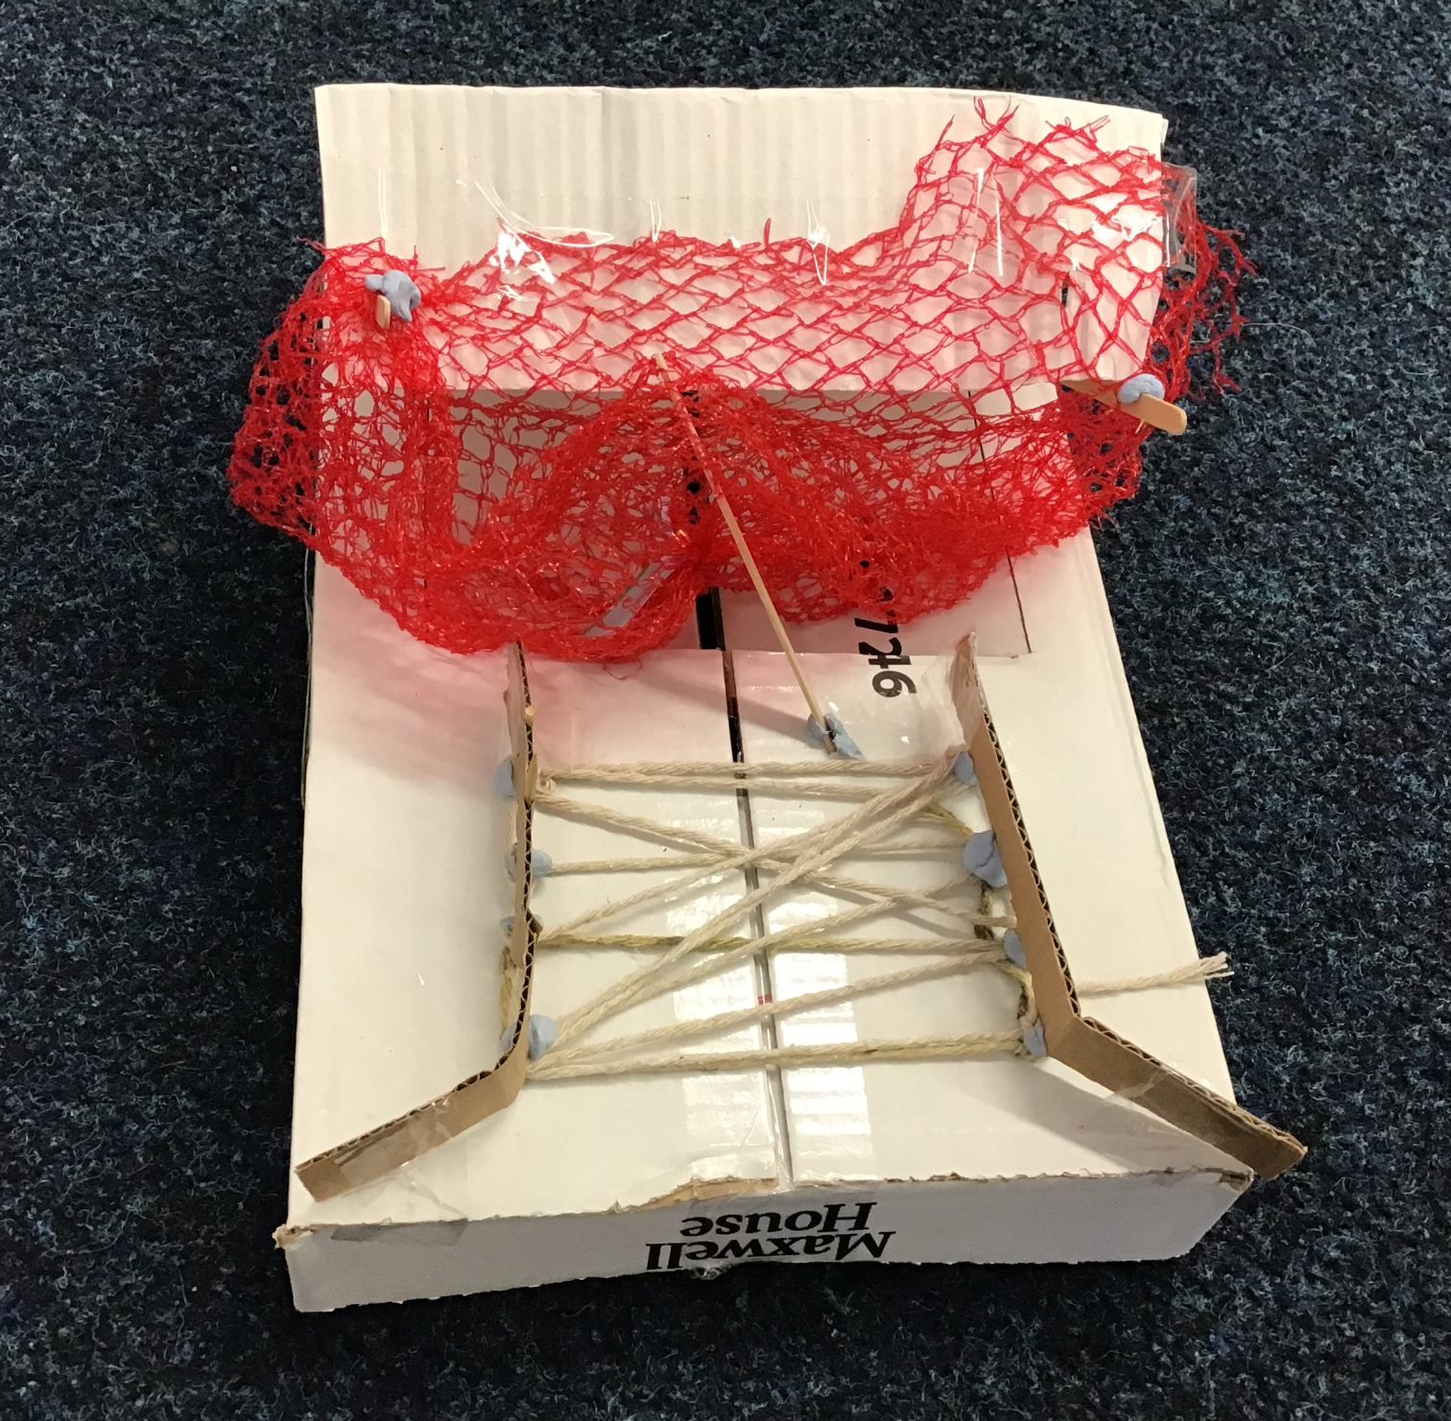

Slide 21
Year 4

Slide 22
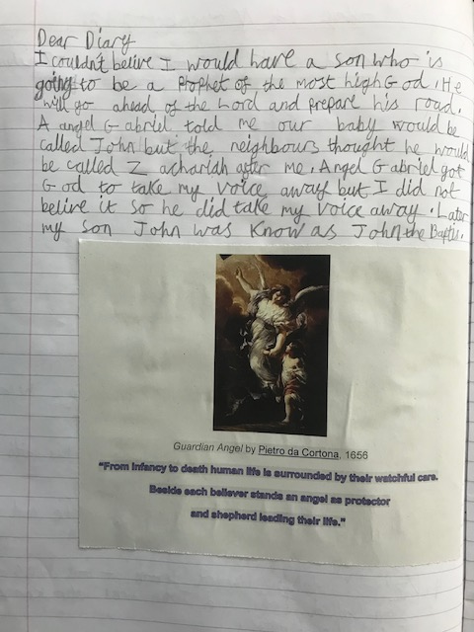
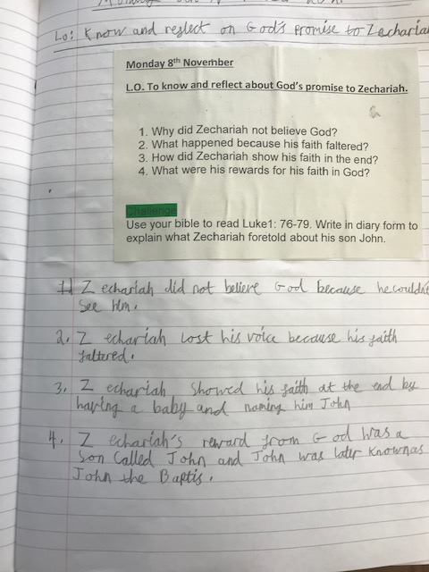

Slide 23
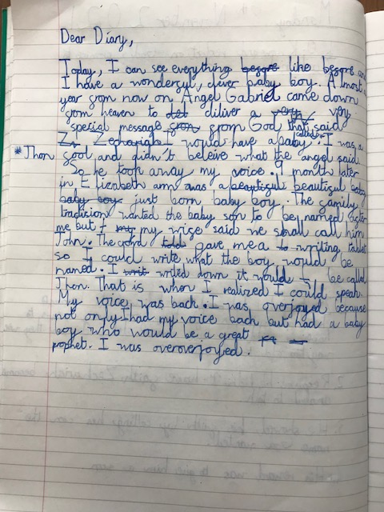
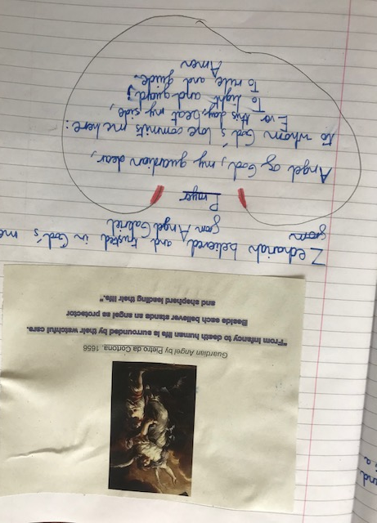

Slide 24
Year 5

Slide 25
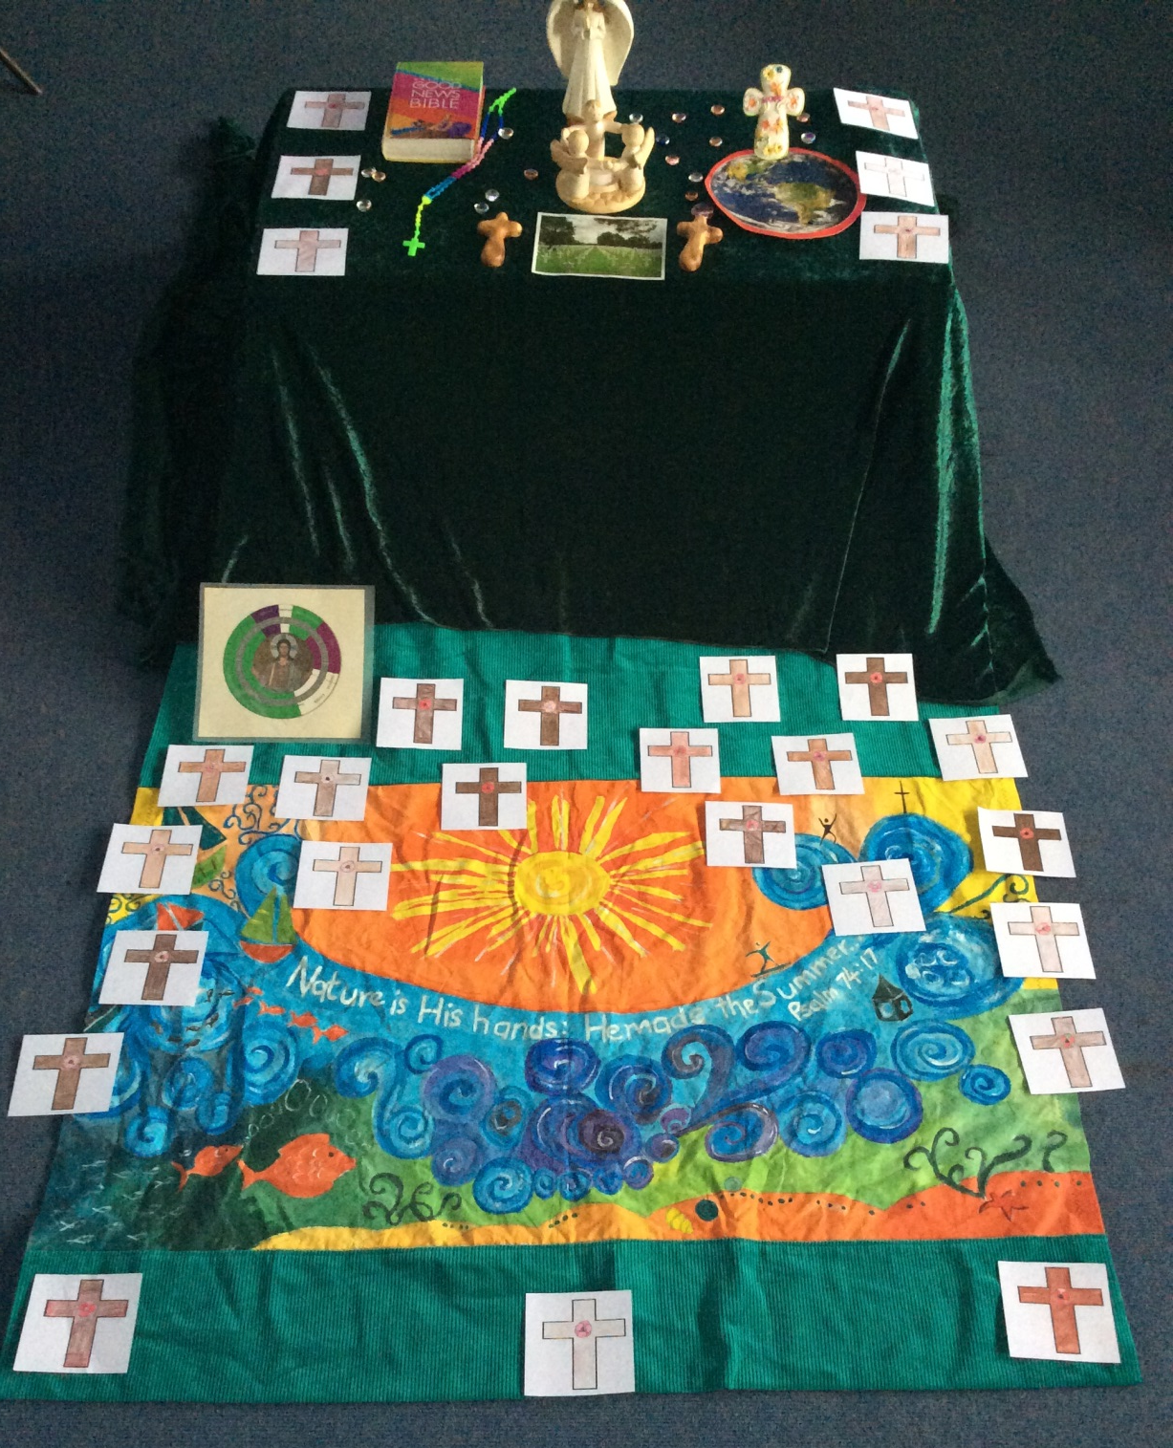

Slide 26
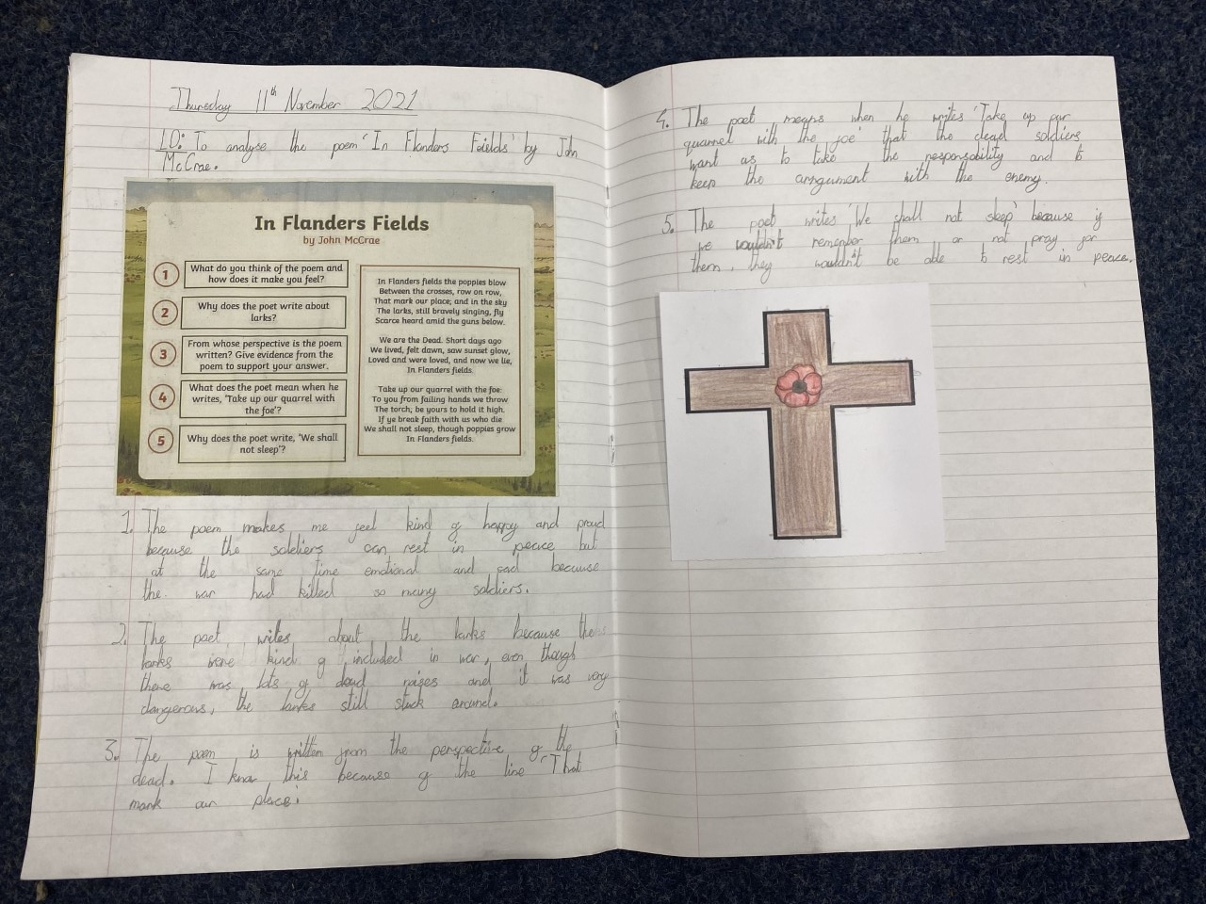
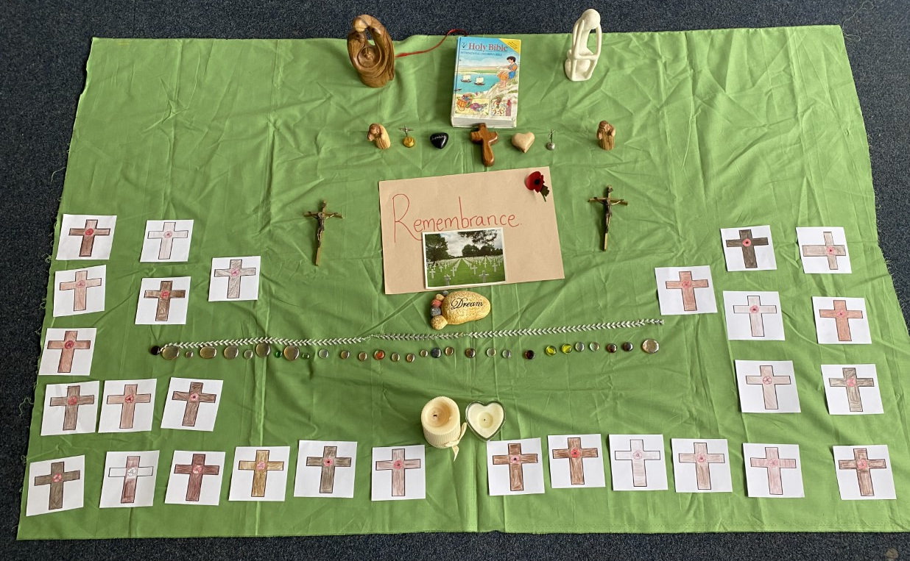

Slide 27
Year 6

Slide 28
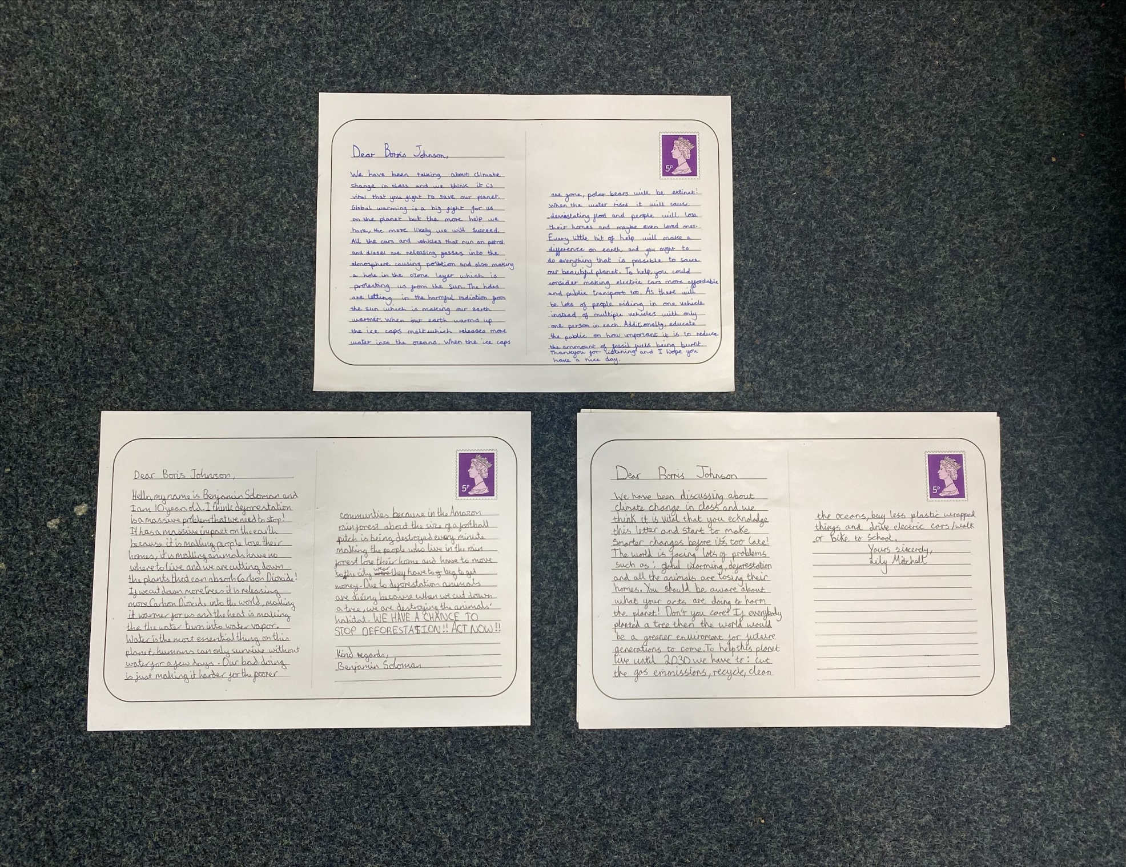

Slide 29
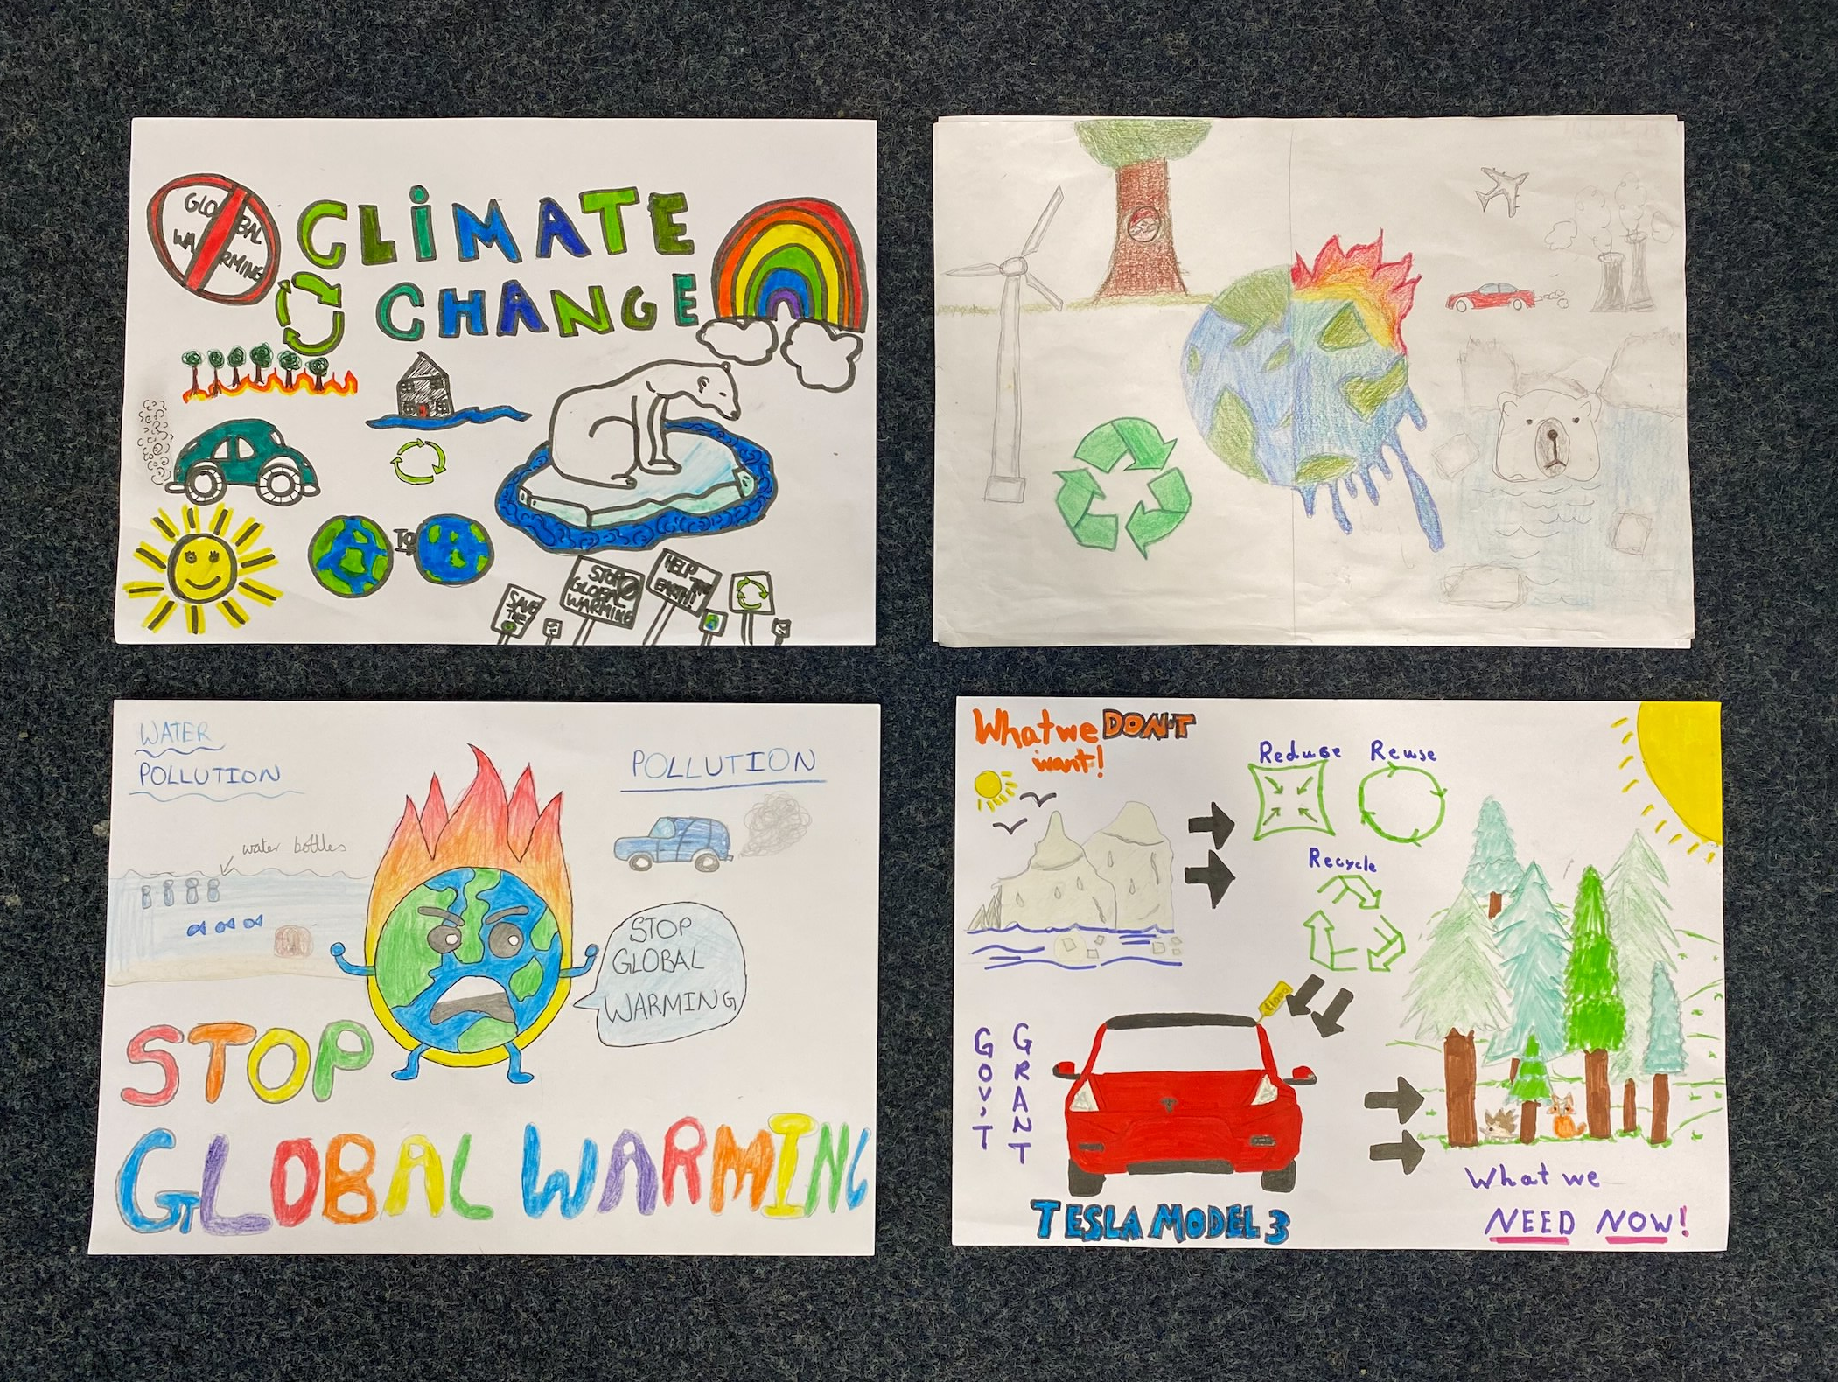

Slide 30
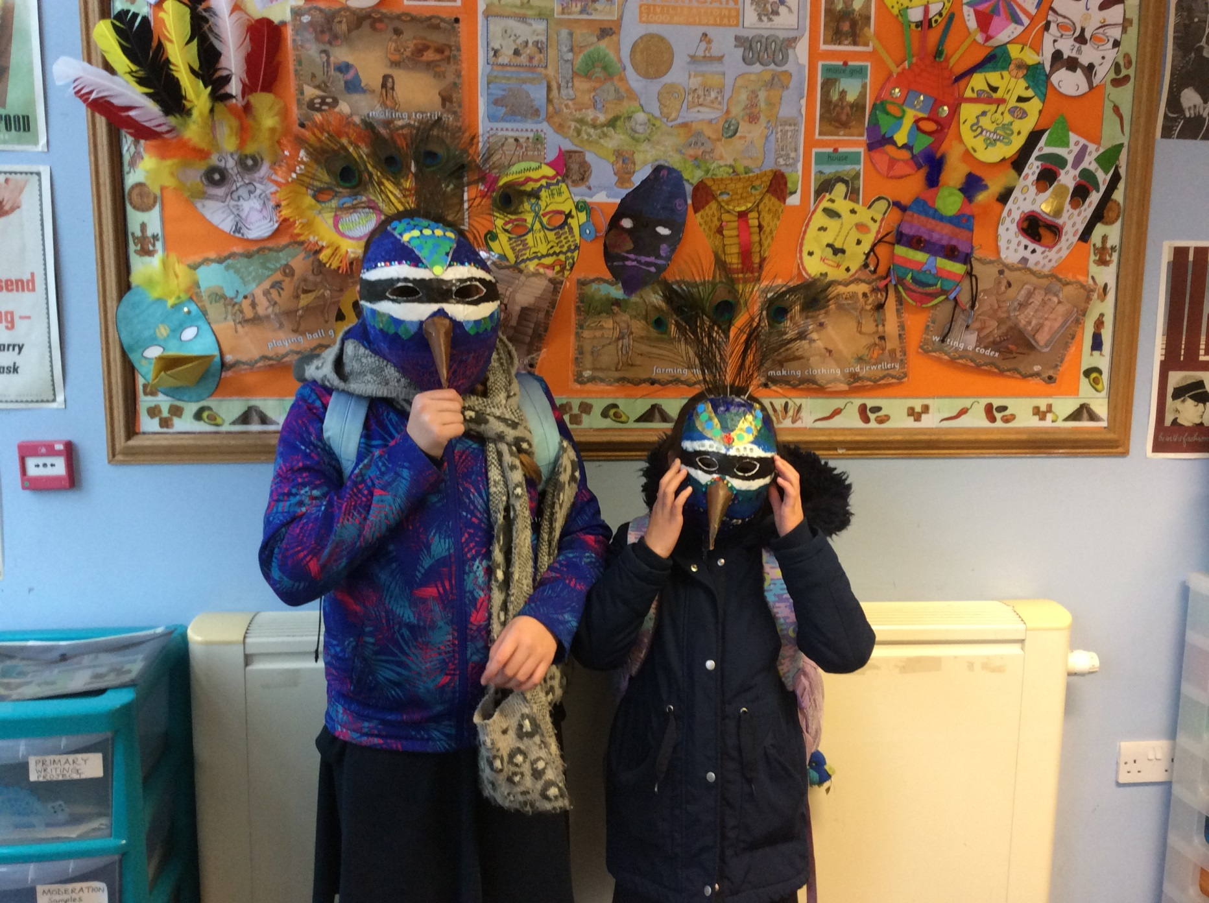

Slide 31
SPORTING SUPERSTARS!!
Tag Rugby Team at All Hallows

Slide 32
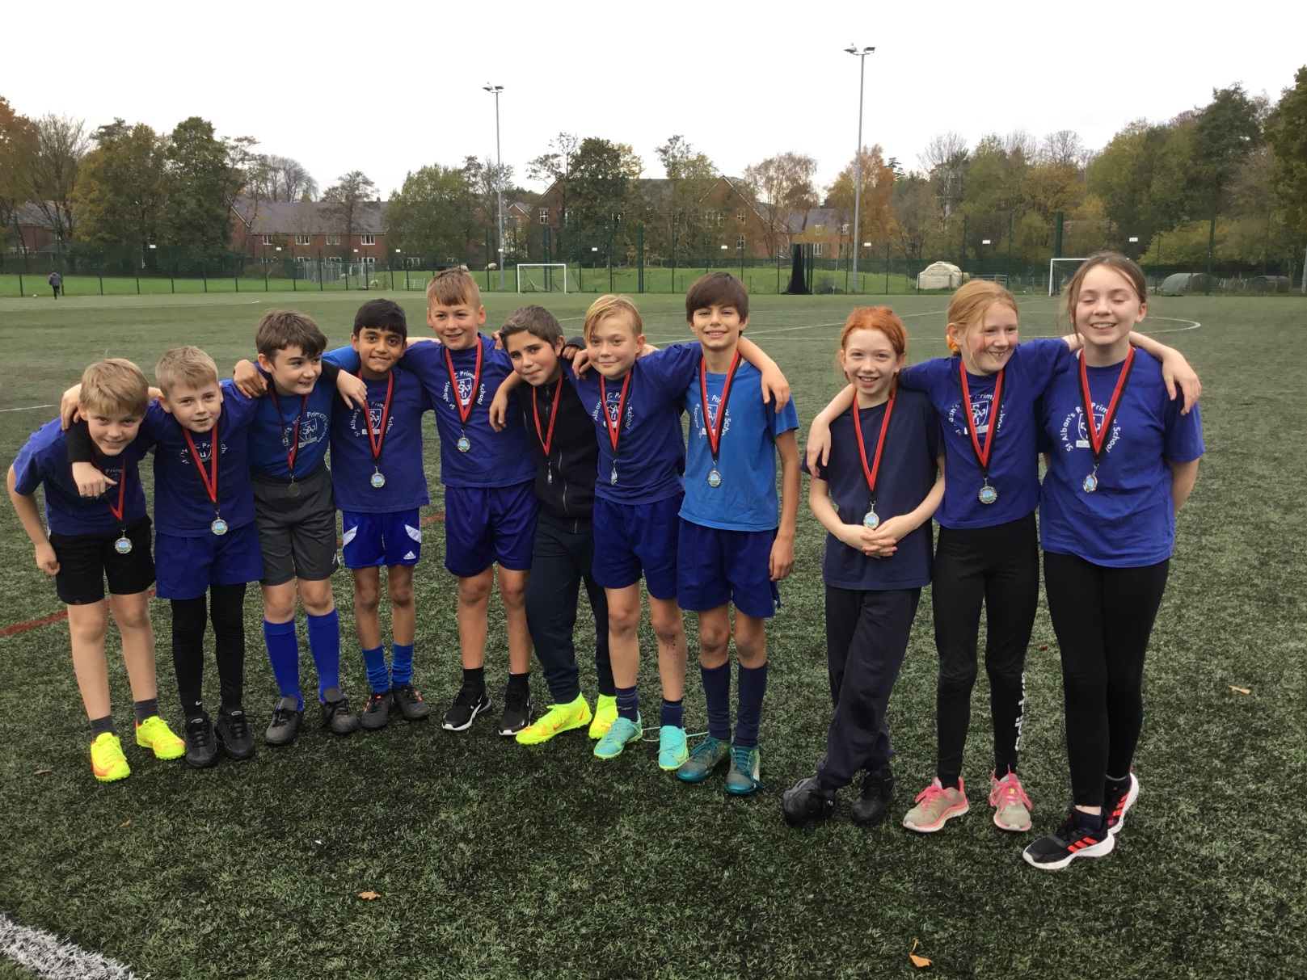
The team finished second (silver medal) and were only 1 point off coming joint first. We scored the most tries over all, 23.

Slide 33


Slide 34
Congratulations to all of our stars of the week!

Slide 35


Slide 36


Slide 37

A prayer for COP26
Loving God
You are present in the whole universe, and in the smallest of creatures.
We all have a part to play in looking after the earth.
May the Holy Spirit inspire all political leaders at COP26
as they make decisions for the planet and its people.
Give them the courage to think of fairer solutions
for the poorest and most vulnerable people,
so that every nation cares for our common home.
Amen
Notes:
Adapted from a prayer written by the Catholic Bishops’ Conference of England and Wales (CBCEW) working in partnership with CAFOD, to encourage people to pray for the leaders meeting at COP26 in November.

Slide 38
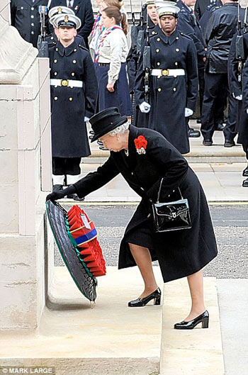
Remembrance Sunday
Remembrance Sunday is the second Sunday in November.
On this day people remember those who have given their lives in war.
A number of special remembrance services are held throughout Britain.
People leave wreaths and poppies at the Cenotaph to remember the dead.

Slide 39
Let us pray.
Dear Blessed lord,
Let us remember all the people who have given their lives during time of war and conflict.
Let us remember the sacrifices that these very special people have made.
Let us remember the peacemakers and the people who strive for peace in our world today.
Let us remember that we enjoy freedom today because of people who risked their lives for us.
Let us remember all the unknown people who have died for us.
And finally
Let us never forget why we remember them and enjoy a peaceful life.
Amen

Slide 40


Slide 41
Share your gifts of love, friendship and kindness with others this week!
Notes:
GO FORTH - MISSION

Slide 42
WOW!
WELL DONE EVERYONE!

