Slide 1


CELEBRATION ASSEMBLY
FRIDAY 5th November 2021

Slide 2

This is the day that the Lord has made!

Slide 3

Notes:
WORD

Slide 4
Hail Mary
Hail Mary, full of grace
The Lord is with thee.
Blessed art thou among women
And blessed is the fruit
Of thy womb, Jesus.
Holy Mary, mother of God,
Pray for us sinners now
And at the hour of our death.
Amen

Slide 5
Our Father
Our Father, Who art in Heaven,
Hallowed be Thy name.
Thy Kingdom come,
Thy will be done on earth as it is in Heaven.
Give us this day our daily bread
and forgive us our trespasses
as we forgive those who trespass against us
and lead us not into temptation
but deliver us from evil.
Amen

Slide 6



Let us pray.
Dear Lord Jesus,
Please help me to see and admire
the saintly qualities in others
and help me to grow more like you each day.
Amen

Slide 7
Dear Lord,
Please bless our school
As we try to
Love, learn,
Share and respect
In the light of Jesus.
St Alban, pray for us.
Amen

Slide 8
“Blessed are the poor in spirit,
for theirs is the kingdom of heaven.”

Slide 9
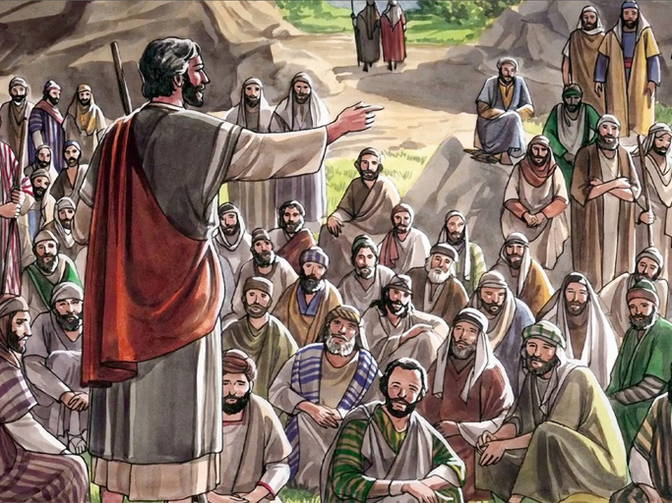
“Blessed are those who hunger and thirst for righteousness,
for they will be satisfied.”

Slide 10

Reception

Slide 11
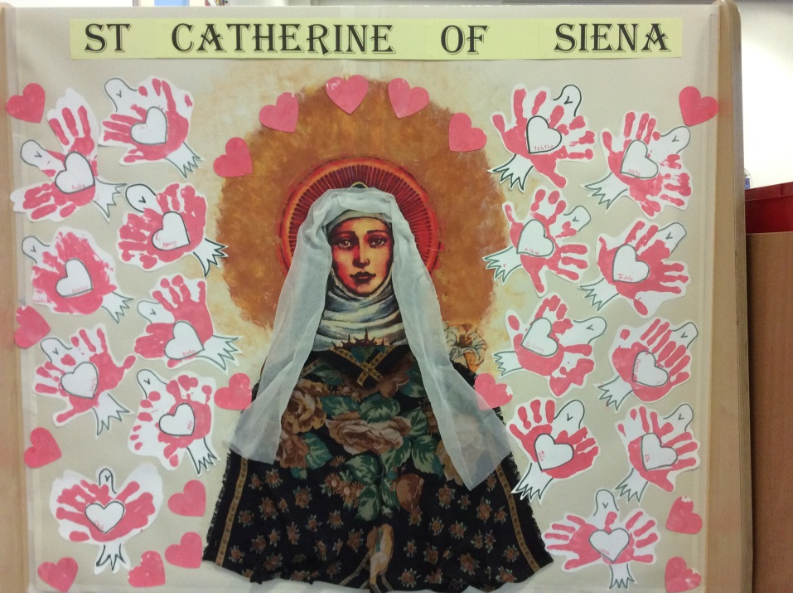
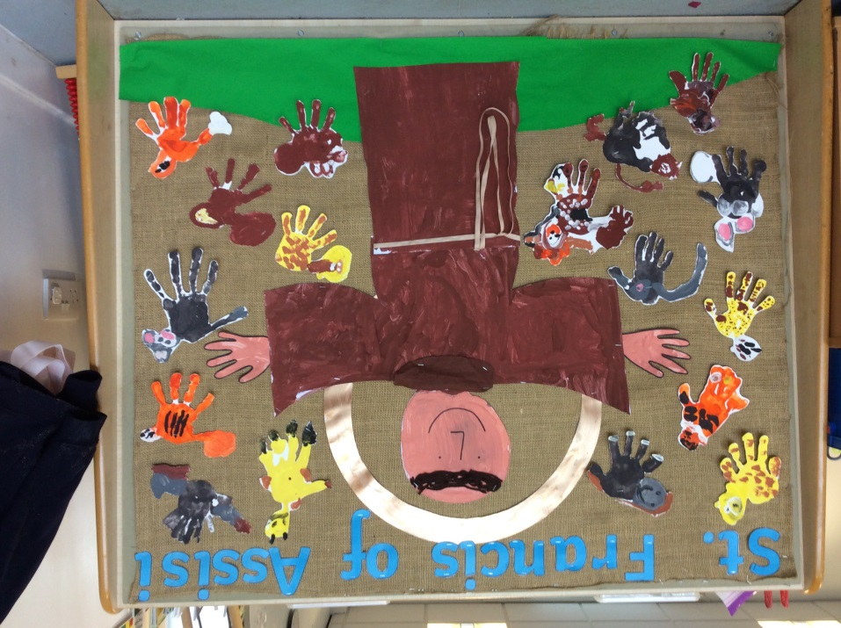

Slide 12
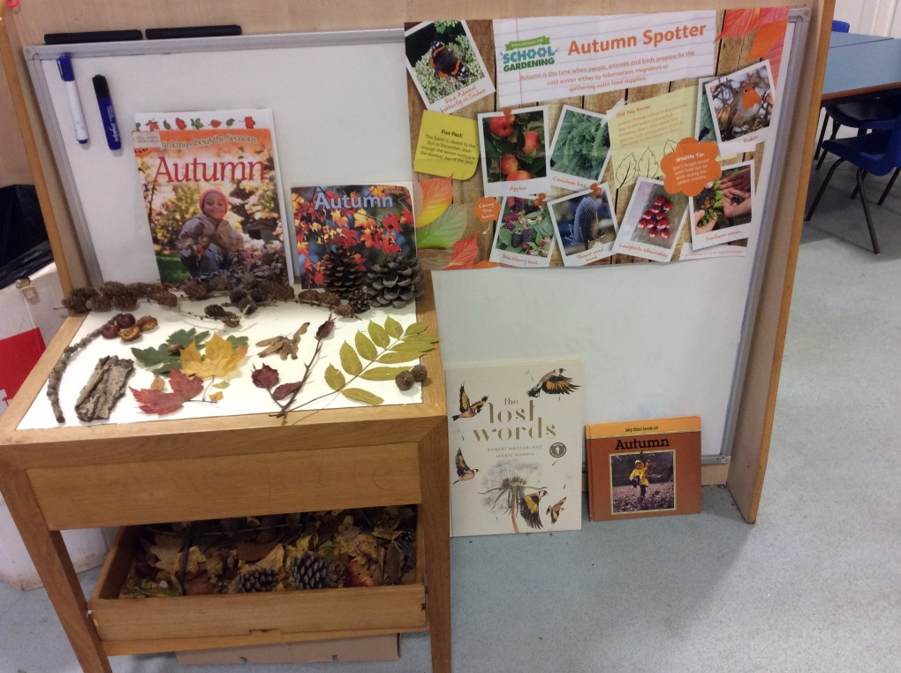
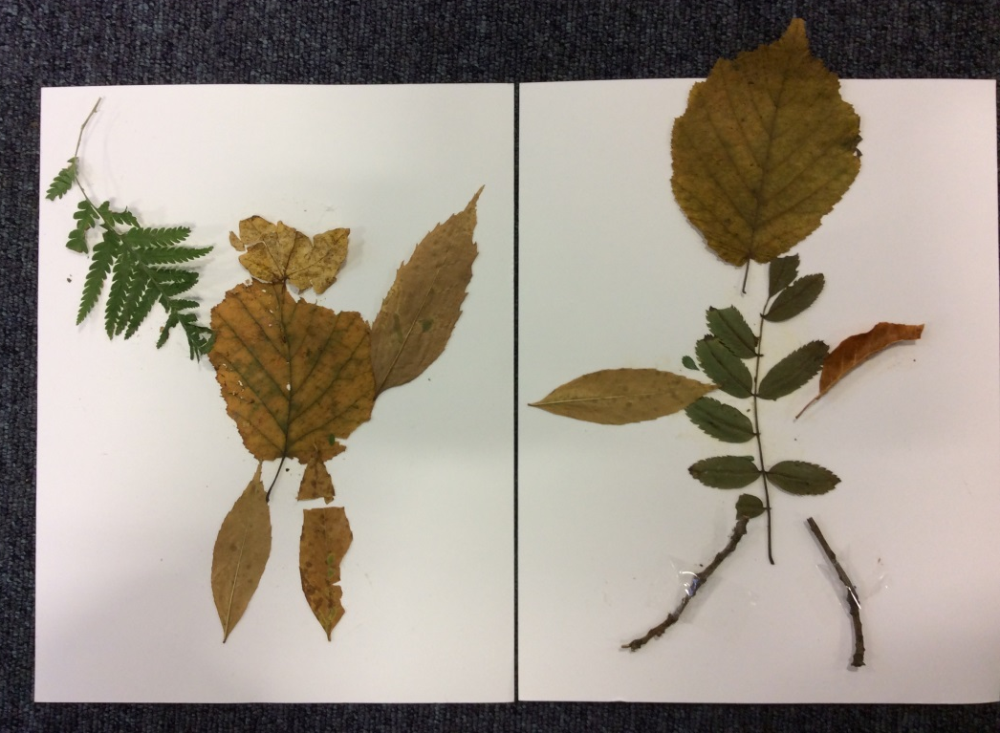

Slide 13
Year 1

Slide 14
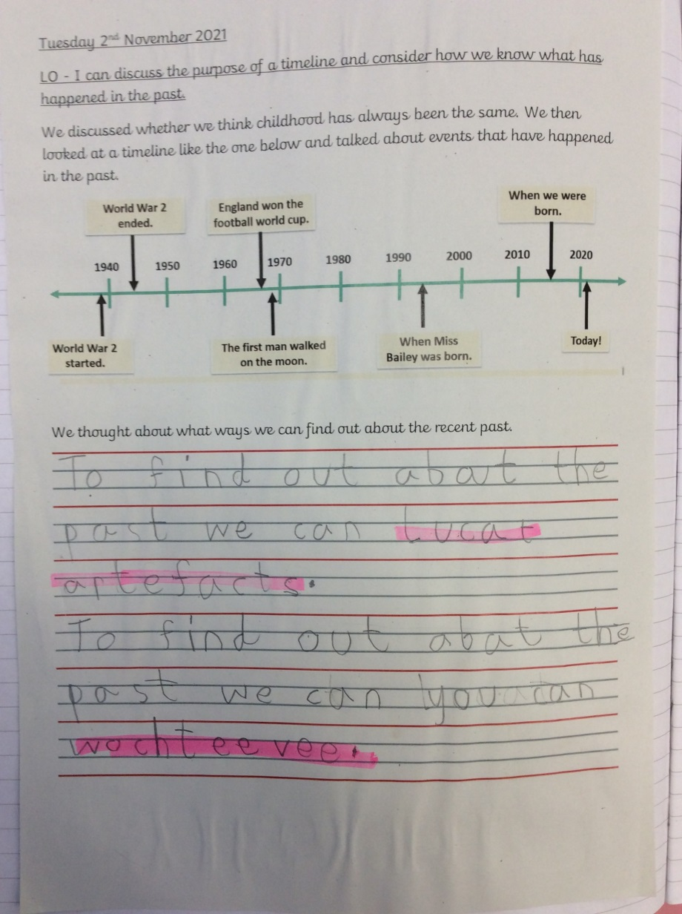
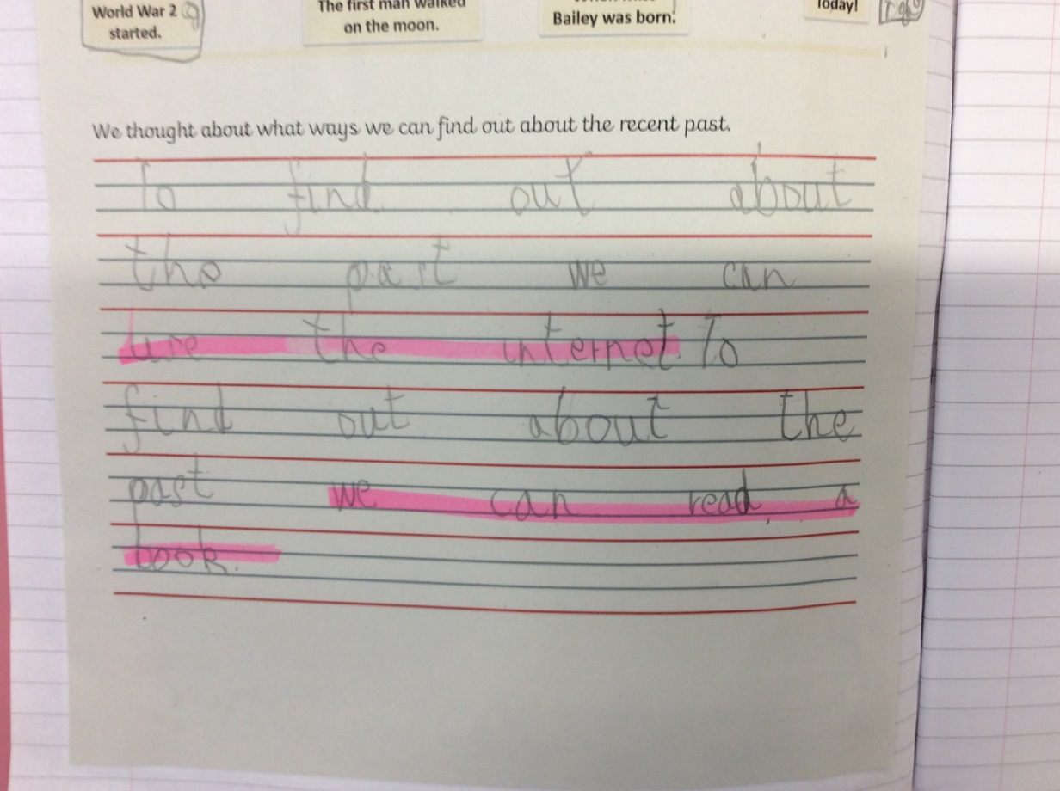

Slide 15
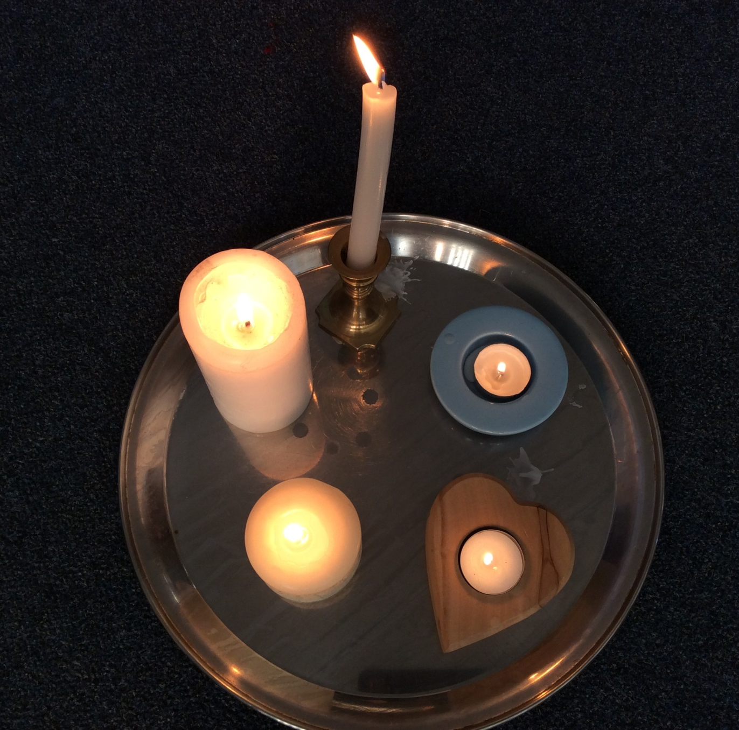

Slide 16
Year 2

Slide 17
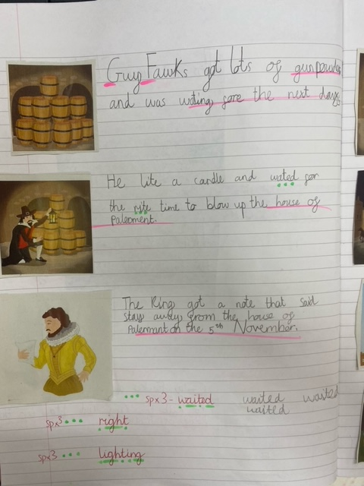
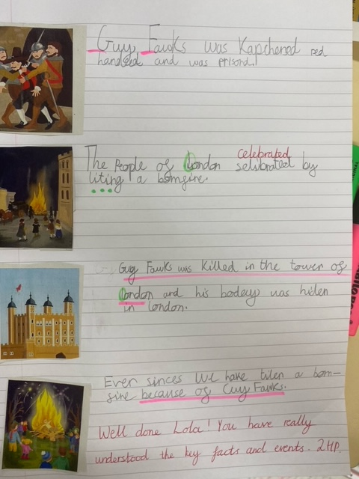

Slide 18
Year 3

Slide 19
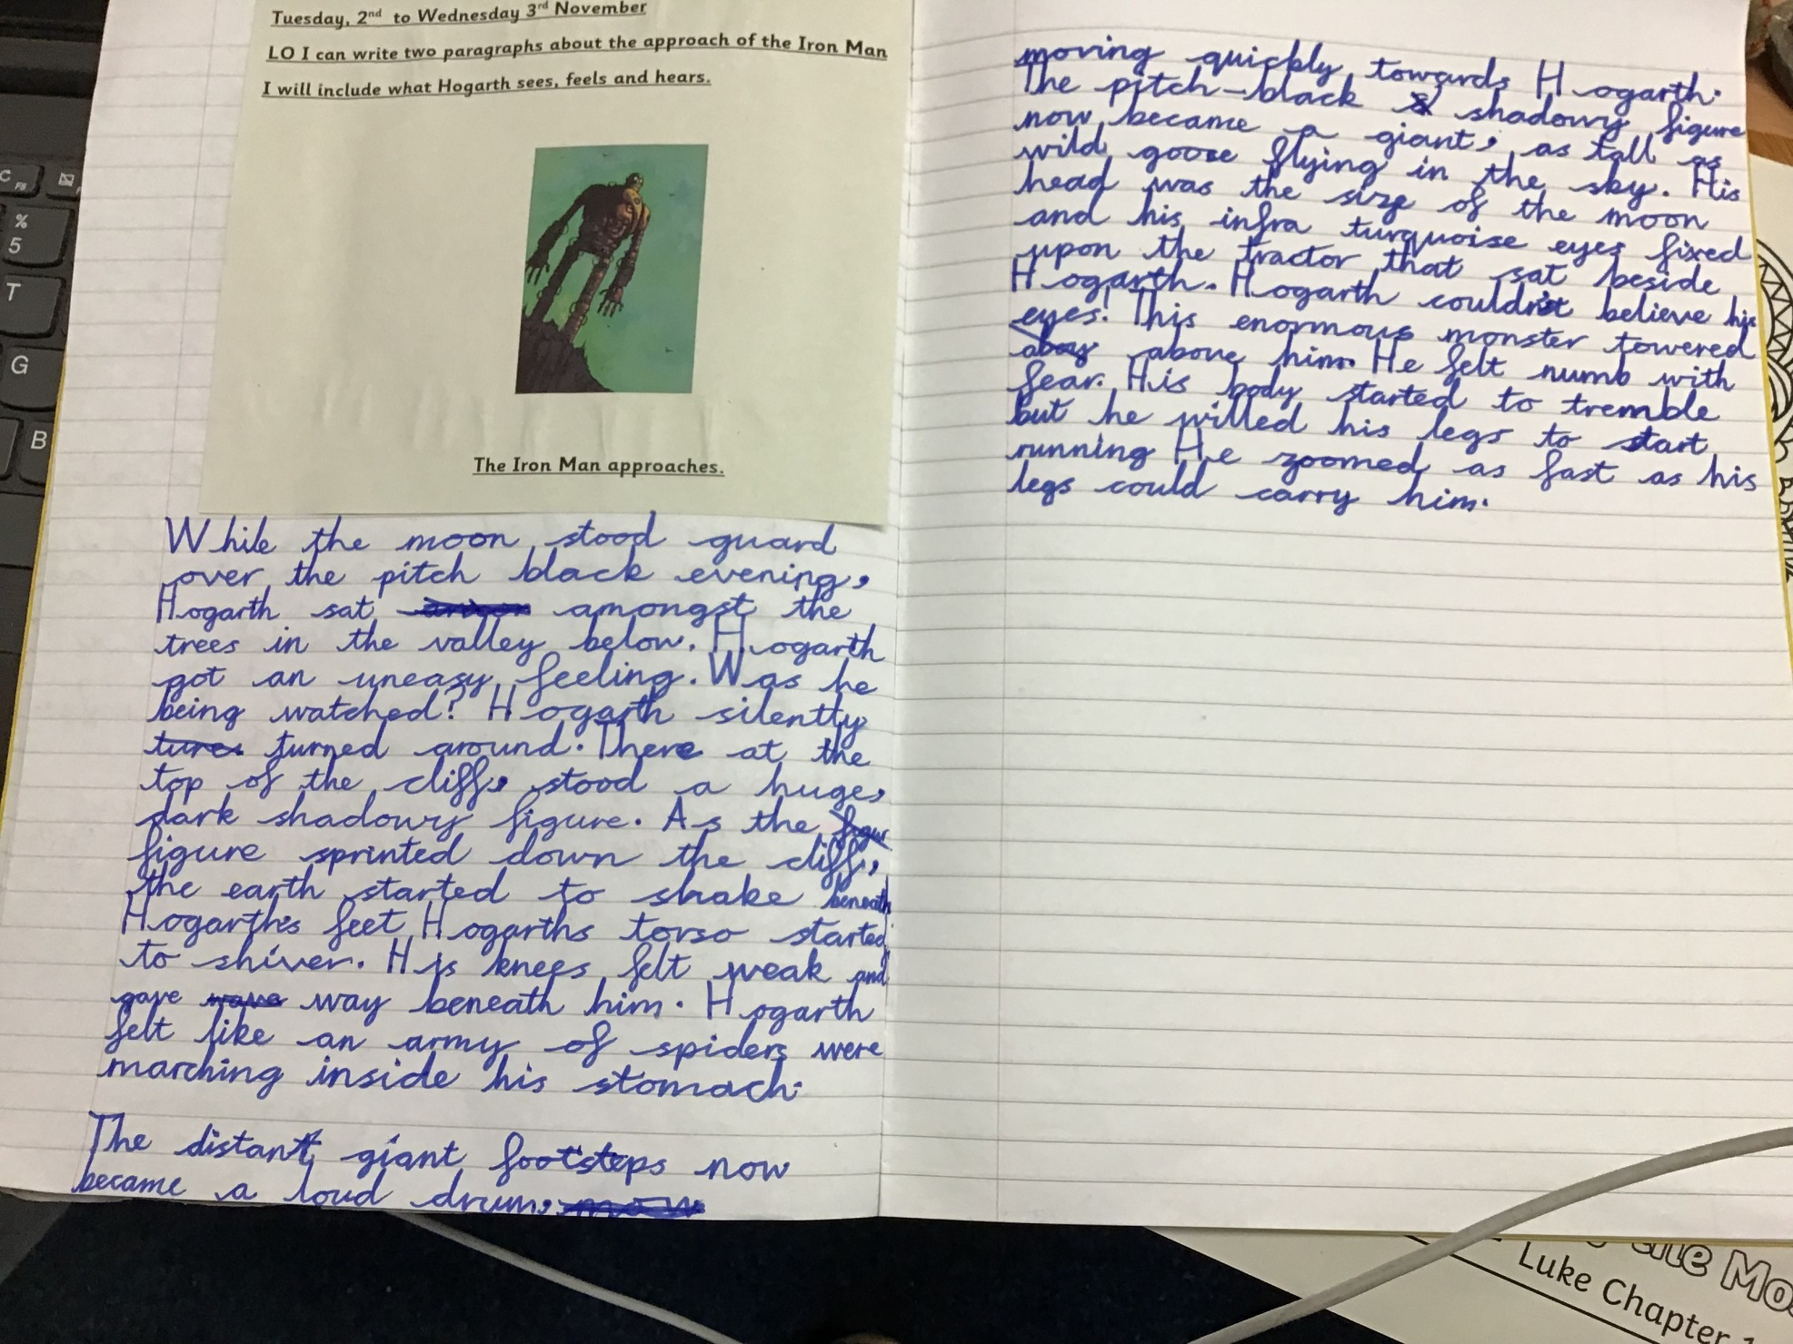

Slide 20
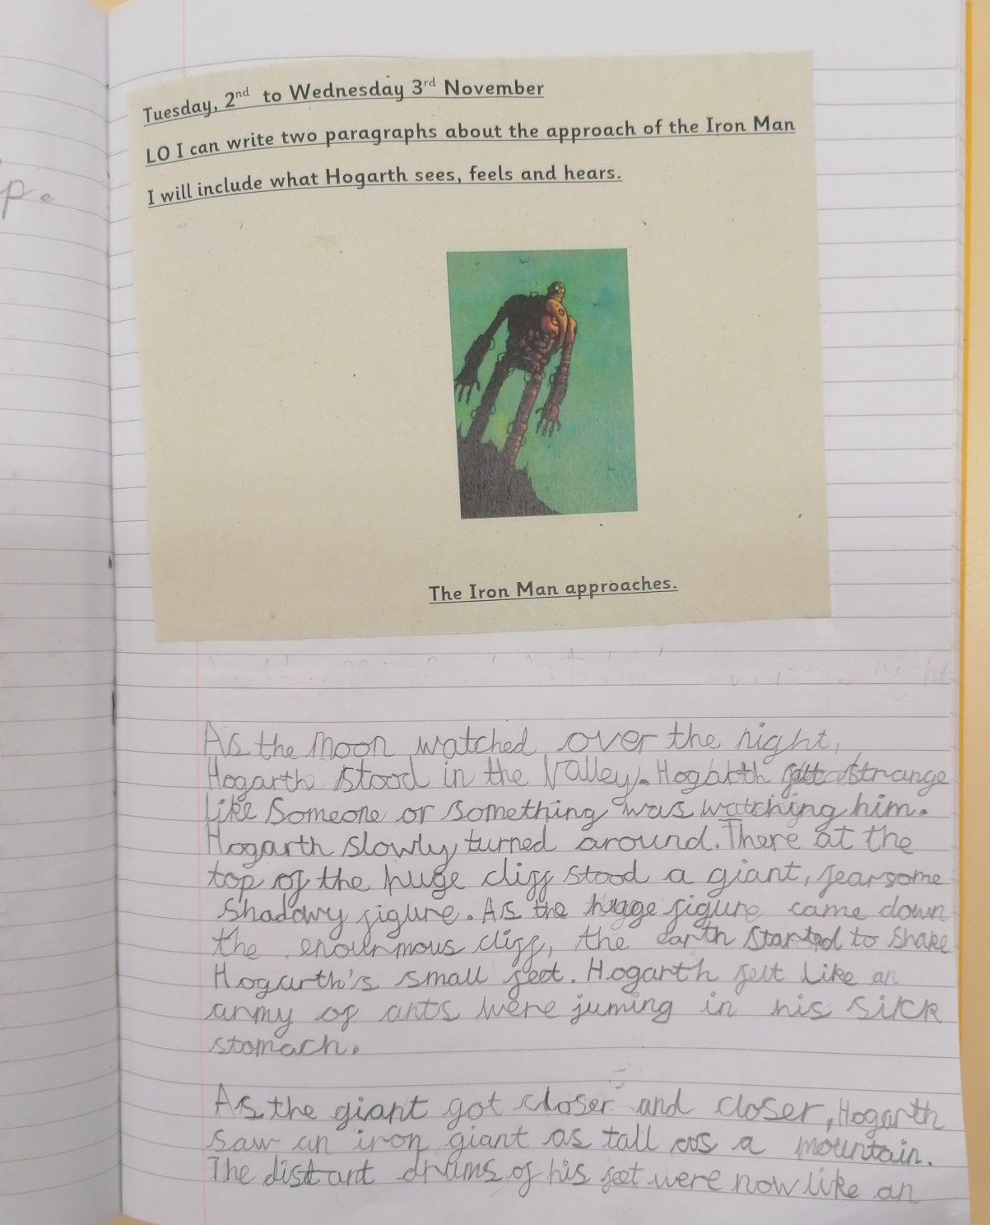

Slide 21
Year 4

Slide 22
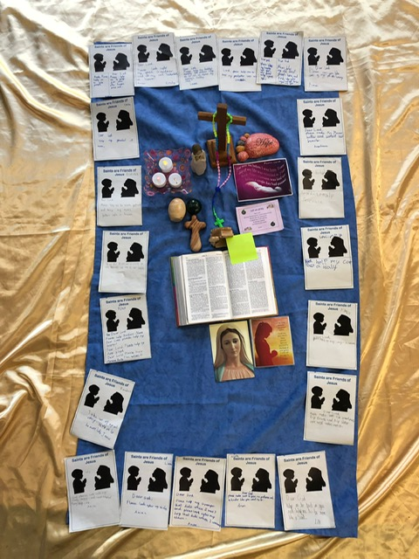

Slide 23
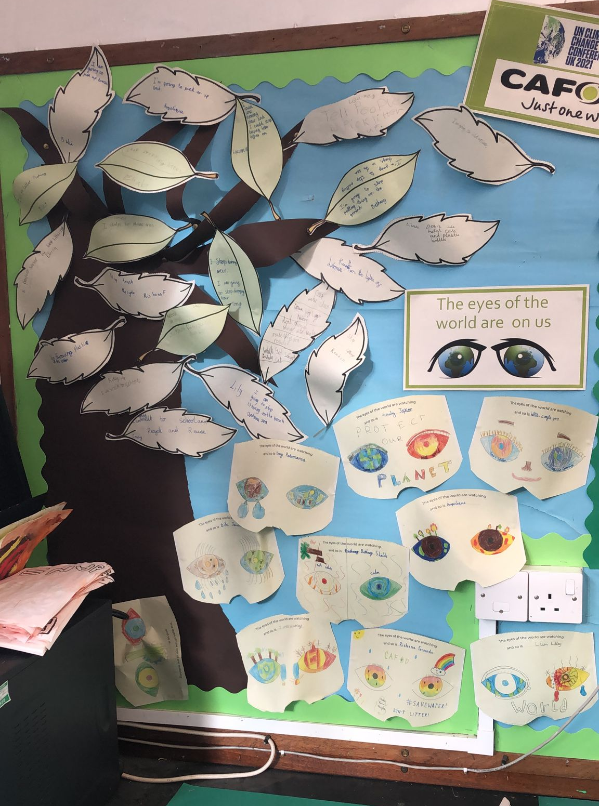

Slide 24
Year 5

Slide 25
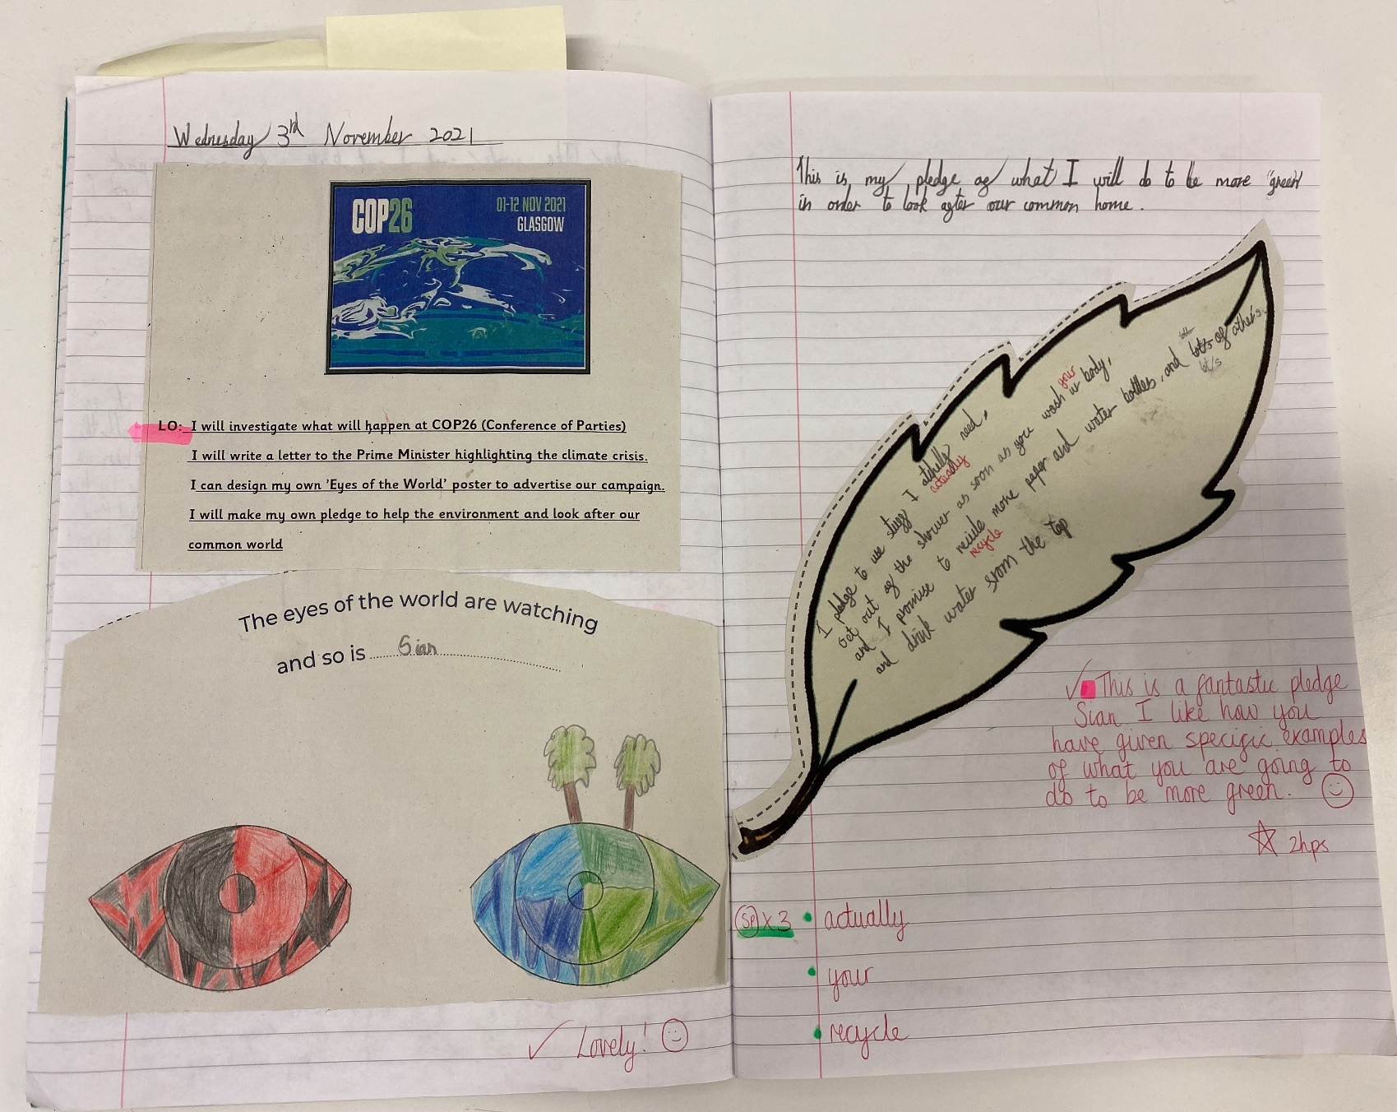

Slide 26
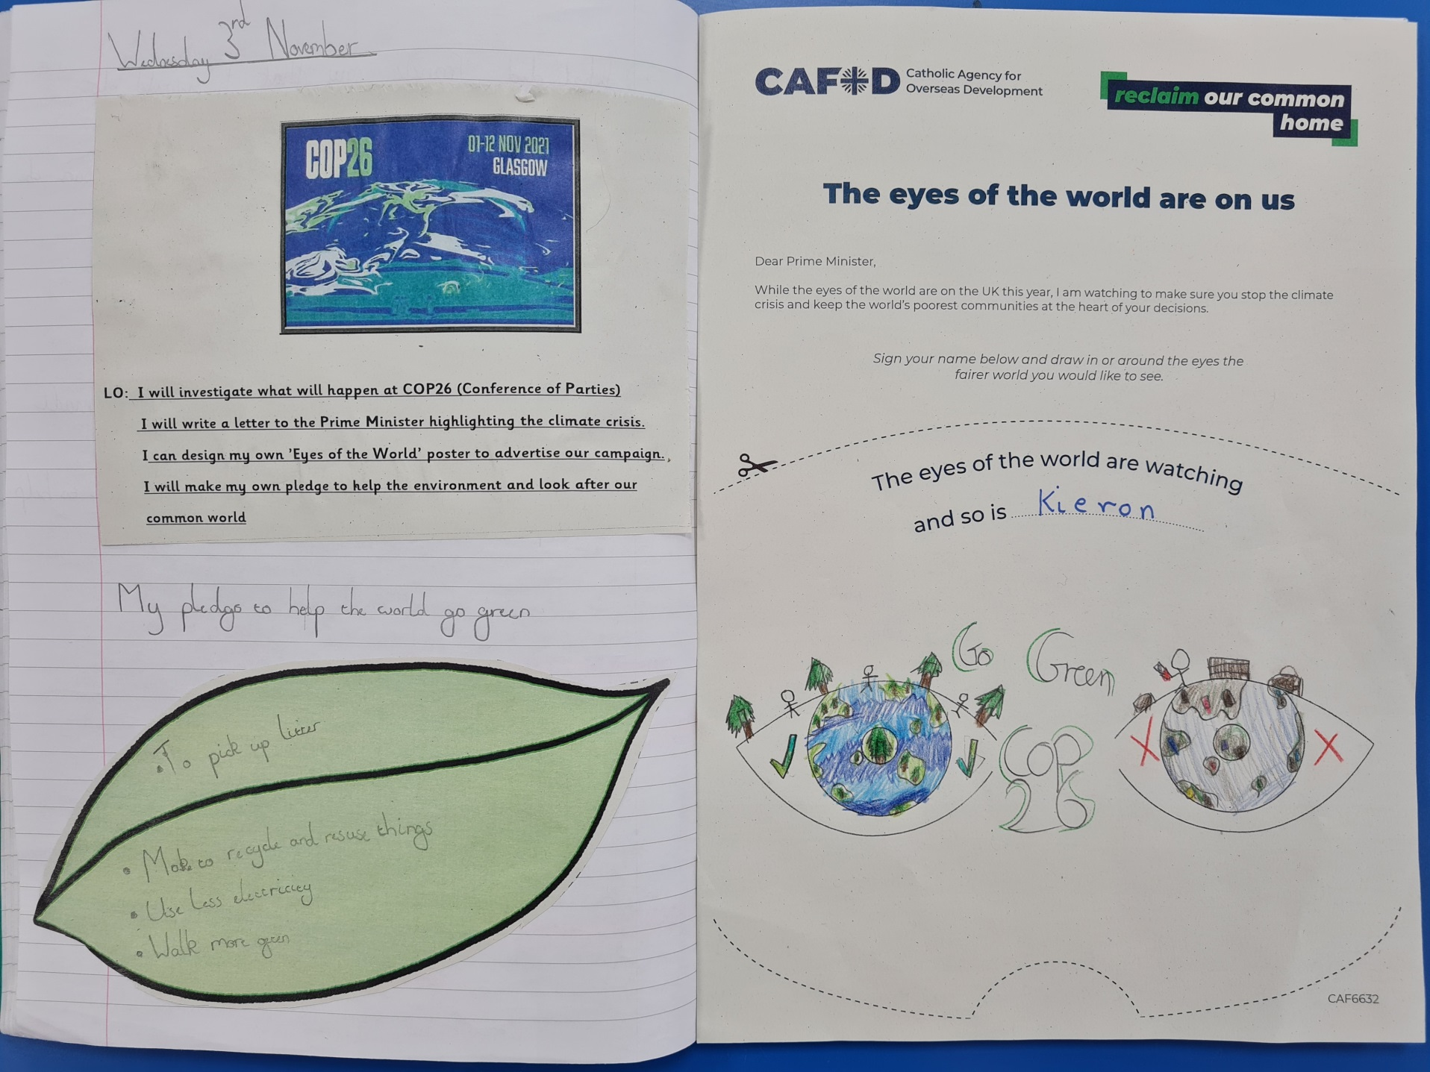

Slide 27
Year 6

Slide 28
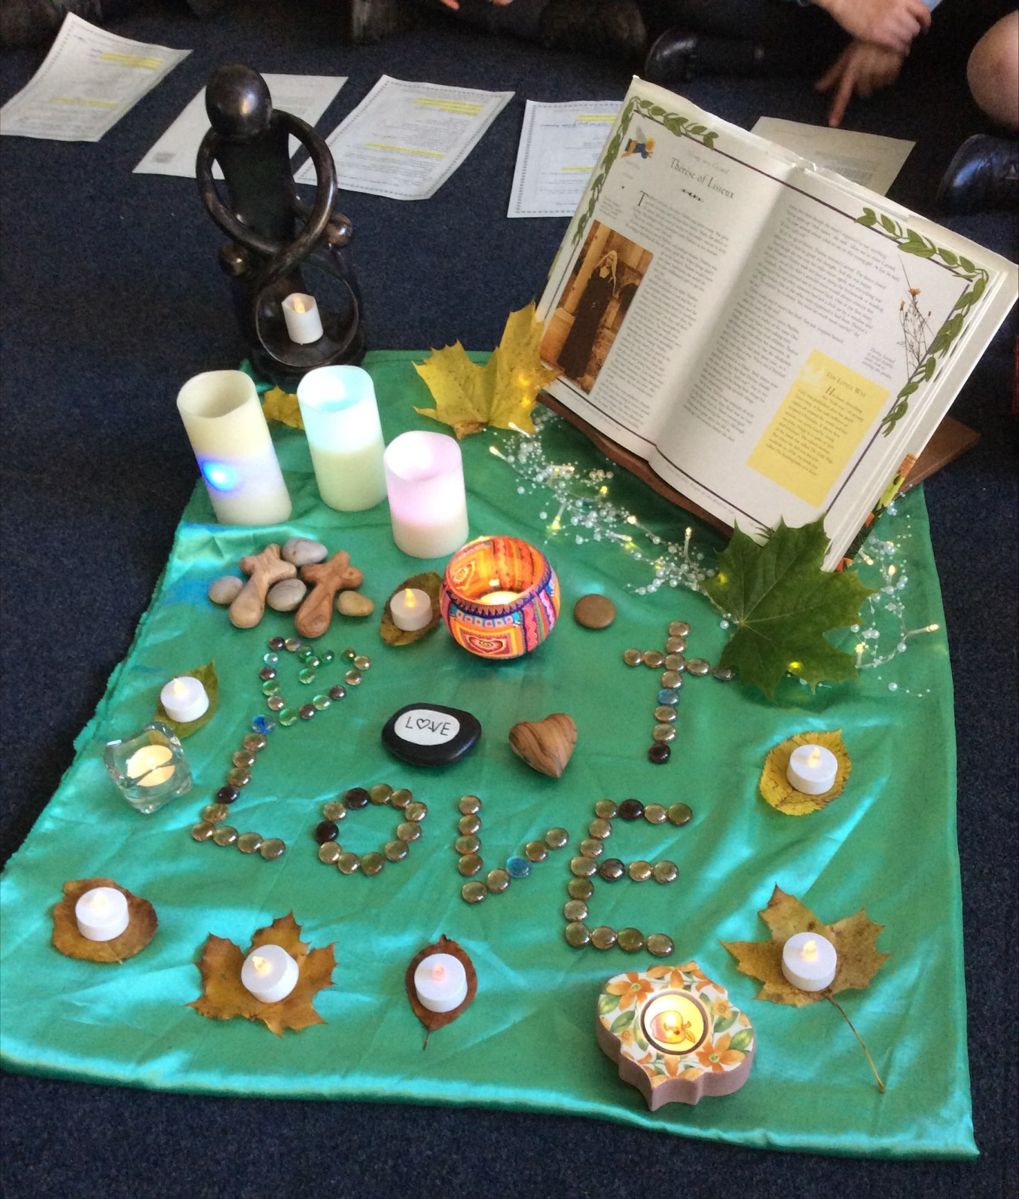

Slide 29
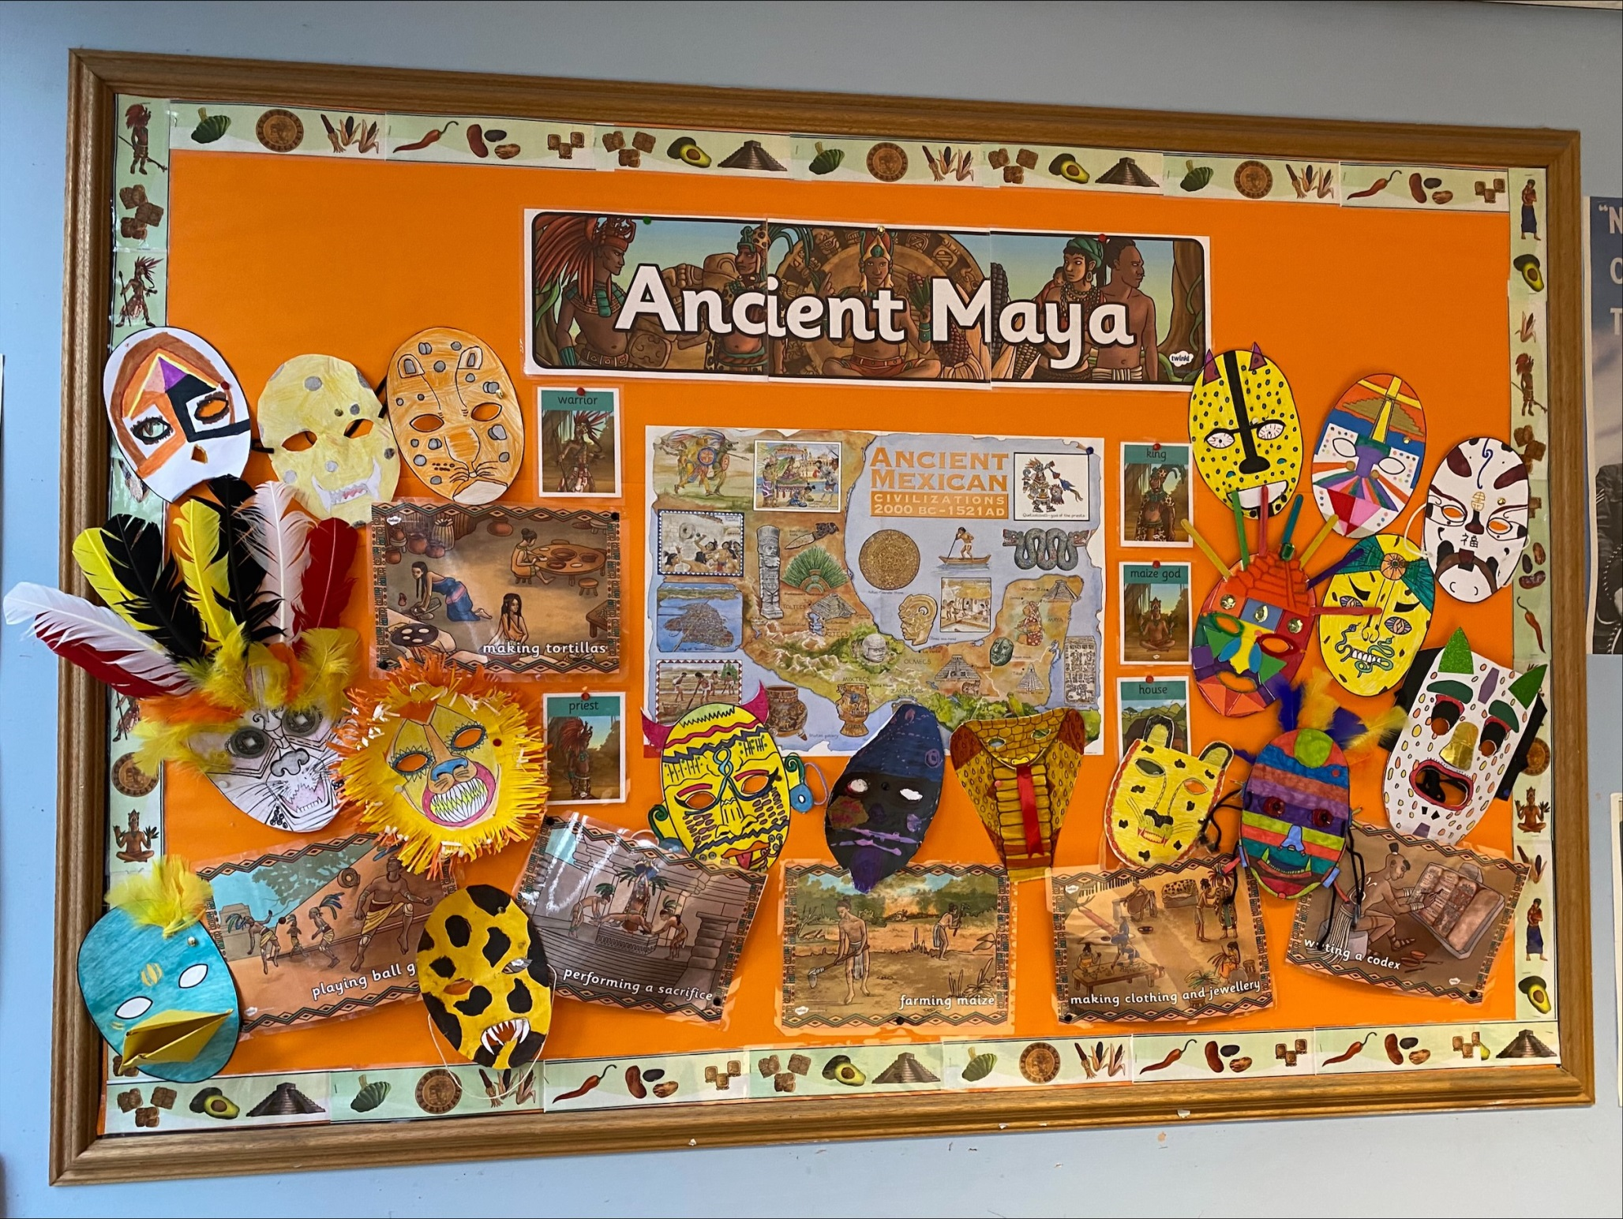

Slide 30
SPORTING SUPERSTARS!!
Football A & B Teams at home against Kings

Slide 31


Slide 32
Congratulations to all of our stars of the week!

Slide 33


Slide 34


Slide 35
Let us pray.
Dear Lord Jesus,
Help us to always hunger and thirst
for what is right.
Help us to have the courage to do the right thing
And help the world leaders to do the right thing at COP26.
Amen

Slide 36

A prayer for COP26
Loving God
You are present in the whole universe, and in the smallest of creatures.
We all have a part to play in looking after the earth.
May the Holy Spirit inspire all political leaders at COP26
as they make decisions for the planet and its people.
Give them the courage to think of fairer solutions
for the poorest and most vulnerable people,
so that every nation cares for our common home.
Amen
Notes:
Adapted from a prayer written by the Catholic Bishops’ Conference of England and Wales (CBCEW) working in partnership with CAFOD, to encourage people to pray for the leaders meeting at COP26 in November.

Slide 37
Pray for wise and courageous decisions at COP26 this week!
Notes:
GO FORTH - MISSION

Slide 38
WOW!
WELL DONE EVERYONE!

