Slide 1


CELEBRATION ASSEMBLY
FRIDAY 22nd OCTOBER 2021

Slide 2

This is the day that the Lord has made!

Slide 3
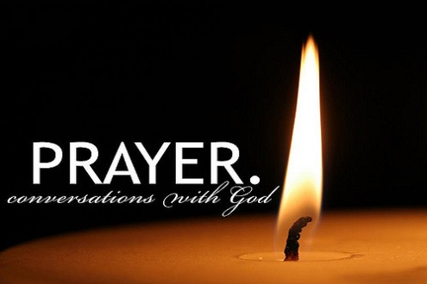
Notes:
WORD

Slide 4
Hail Mary
Hail Mary, full of grace
The Lord is with thee.
Blessed art thou among women
And blessed is the fruit
Of thy womb, Jesus.
Holy Mary, mother of God,
Pray for us sinners now
And at the hour of our death.
Amen

Slide 5
Our Father
Our Father, Who art in Heaven,
Hallowed be Thy name.
Thy Kingdom come,
Thy will be done on earth as it is in Heaven.
Give us this day our daily bread
and forgive us our trespasses
as we forgive those who trespass against us
and lead us not into temptation
but deliver us from evil.
Amen

Slide 6
Dear Lord,
Please bless our school
As we try to
Love, learn,
Share and respect
In the light of Jesus.
St Alban, pray for us.
Amen

Slide 7
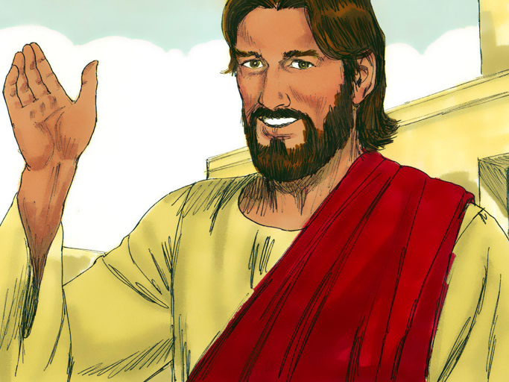
“Everything is possible for God.”

Slide 8

Reception
This week, the children in Reception have been enjoying gardening and have been getting our flower beds ready for Winter. We had a very exciting moment when we pulled out what we thought was a "weed" and out popped a carrot! We were all very surprised! The children have also enjoyed daily shared reading sessions with big books and e-books on the big whiteboard. They have helped to read the book to each other using their new phonics skills and knowledge of how books work.

Slide 9
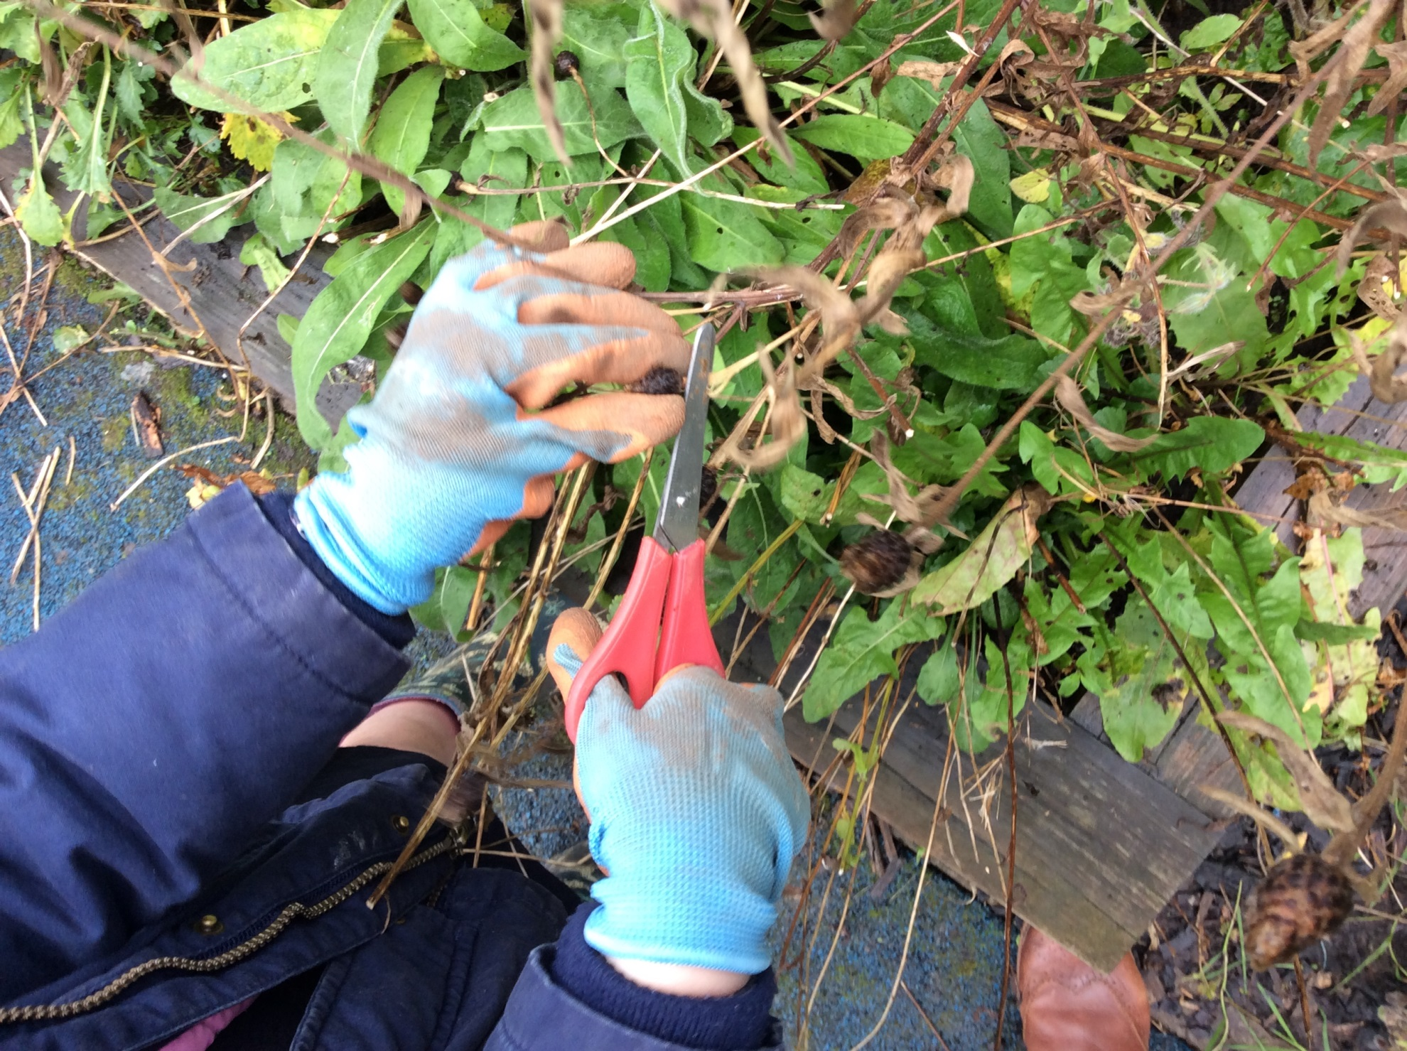

Slide 10
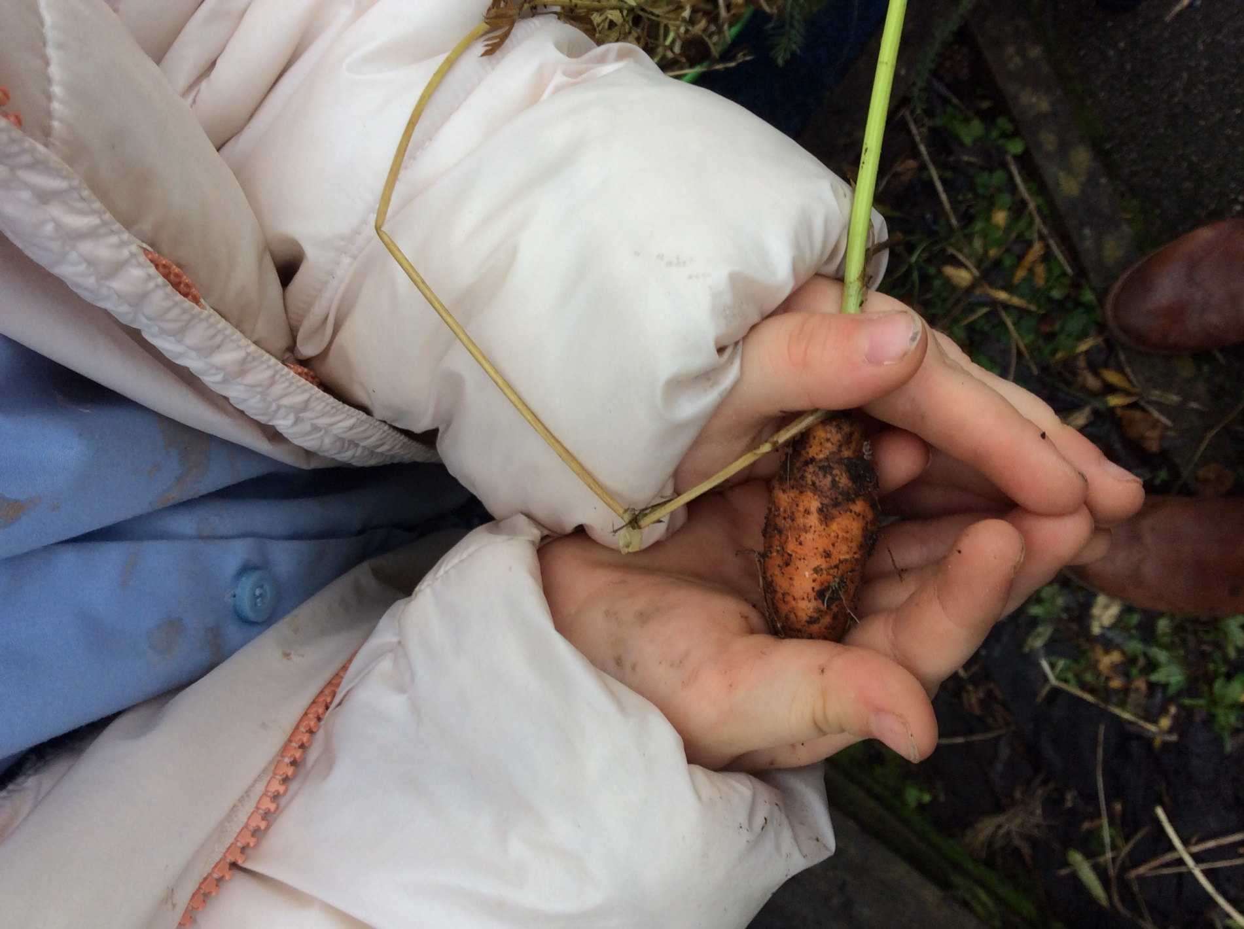

Slide 11
Year 1
This week in Year One, the children have done lots of work on the story of Noah's Ark. First, they were reminded of the story through looking at a mini world scene. Then the children worked hard to retell the story in their own words. The children also had the opportunity to build their own arks out of various materials including Lego, natural objects and large construction blocks (which they then thoroughly enjoyed engaging in imaginative play in).

Slide 12
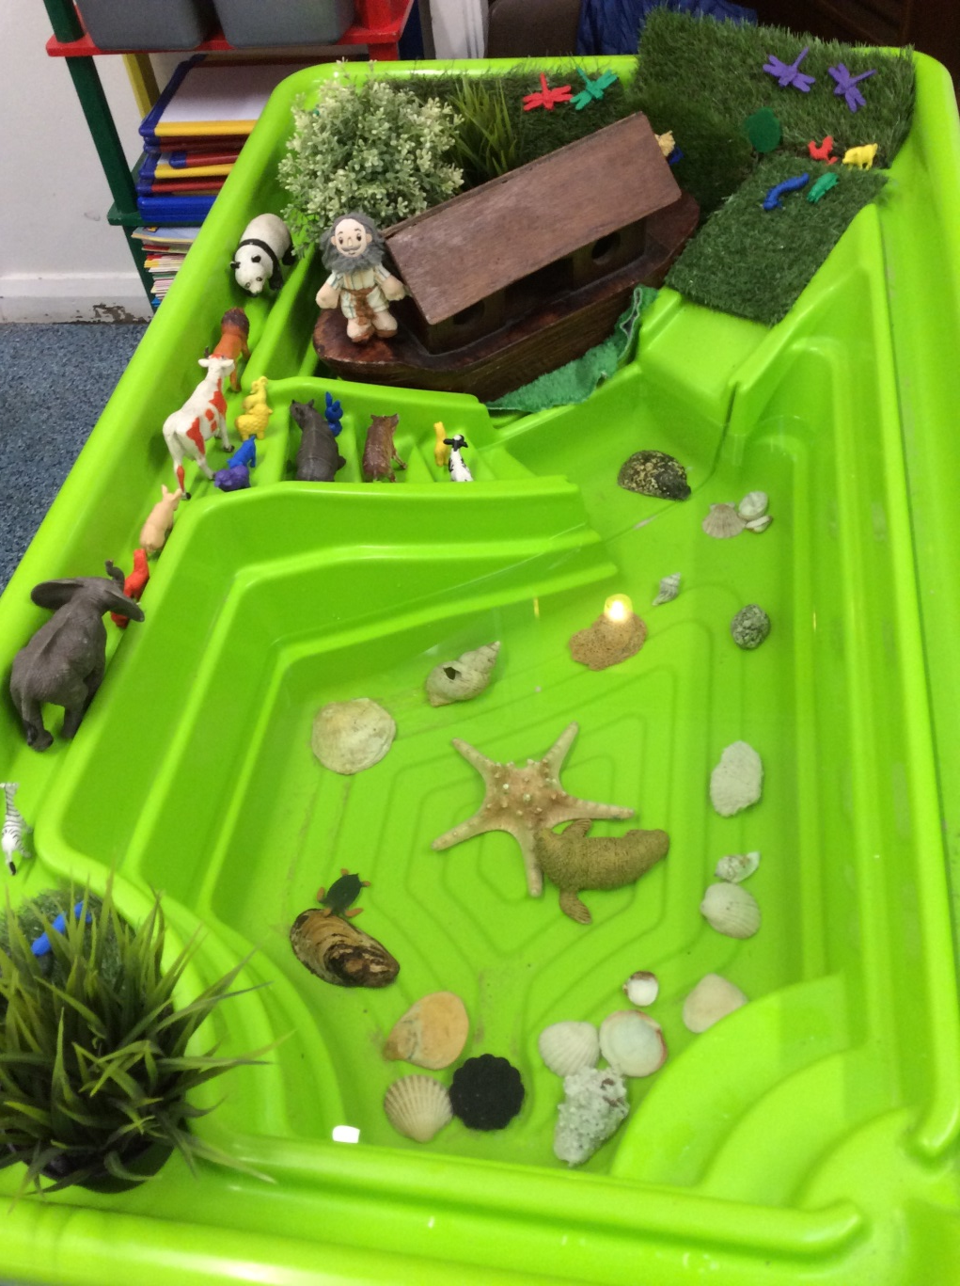
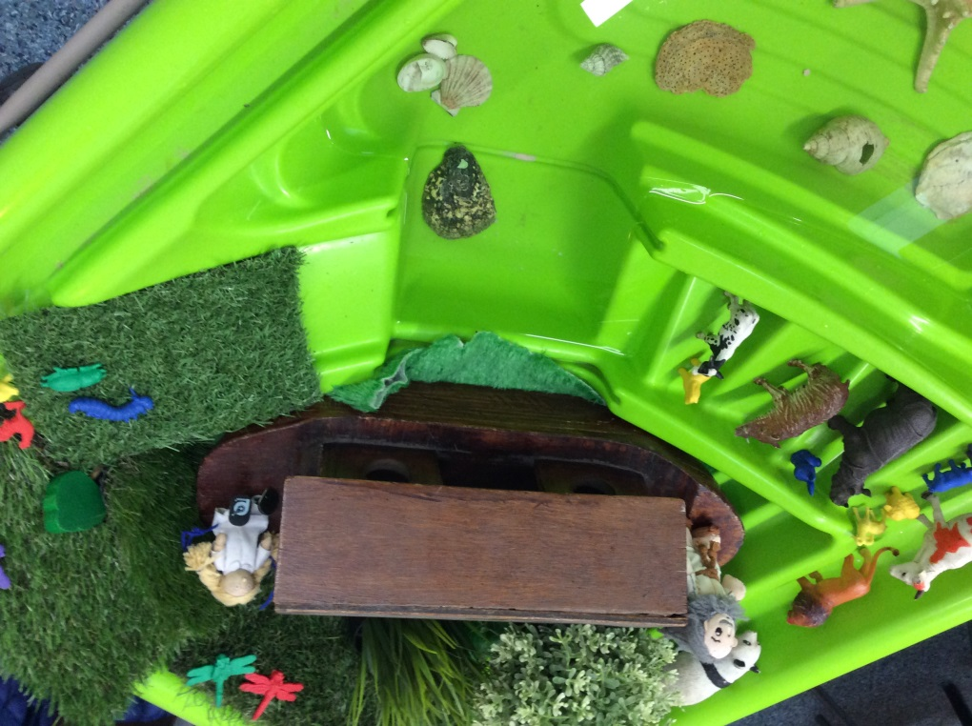

Slide 13
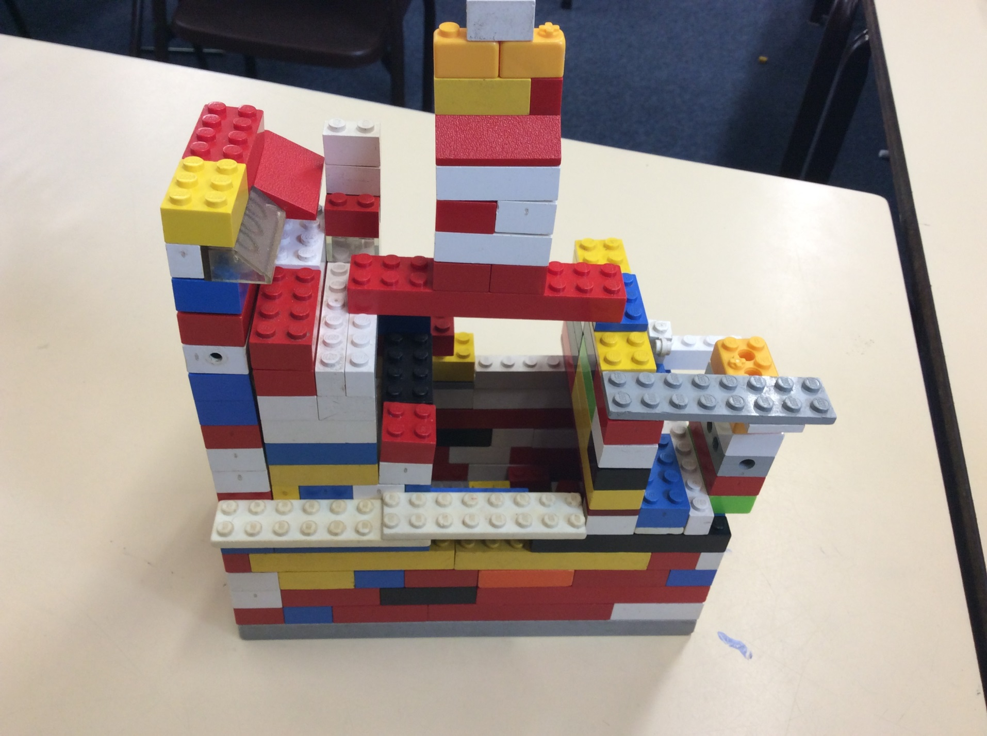

Slide 14
Year 2

Slide 15
Year 3
This week, Year 3 have been continuing their investigations into how different types of rocks are formed. We have studied metamorphic. This word comes from the Greek word metamorphism meaning to transform and change. Alex did a wonderful scientific diagram to explain what happens. We then listened to the BBC Teach video on Mary Anning and have written up about her life and work as a palaeontologist - a person who studies fossils. Mary lived 200 years ago and discovered the fossils of many sea creatures and dinosaurs. She was the first person to uncover a fossil of an Ichythosaurus and the flying dinosaur called the Pterodactyl.

Slide 16
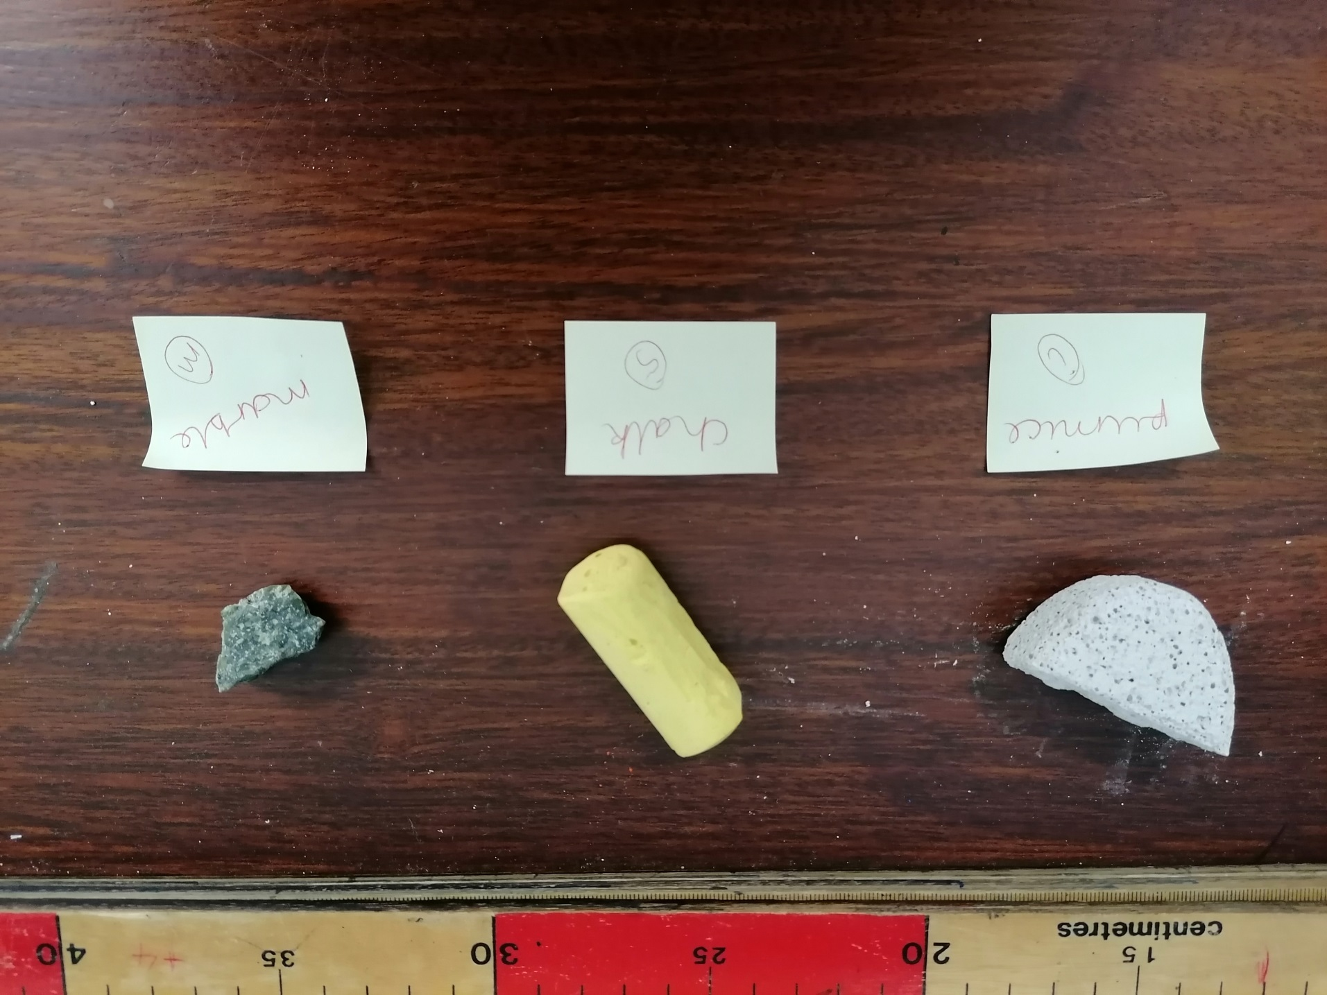

Slide 17
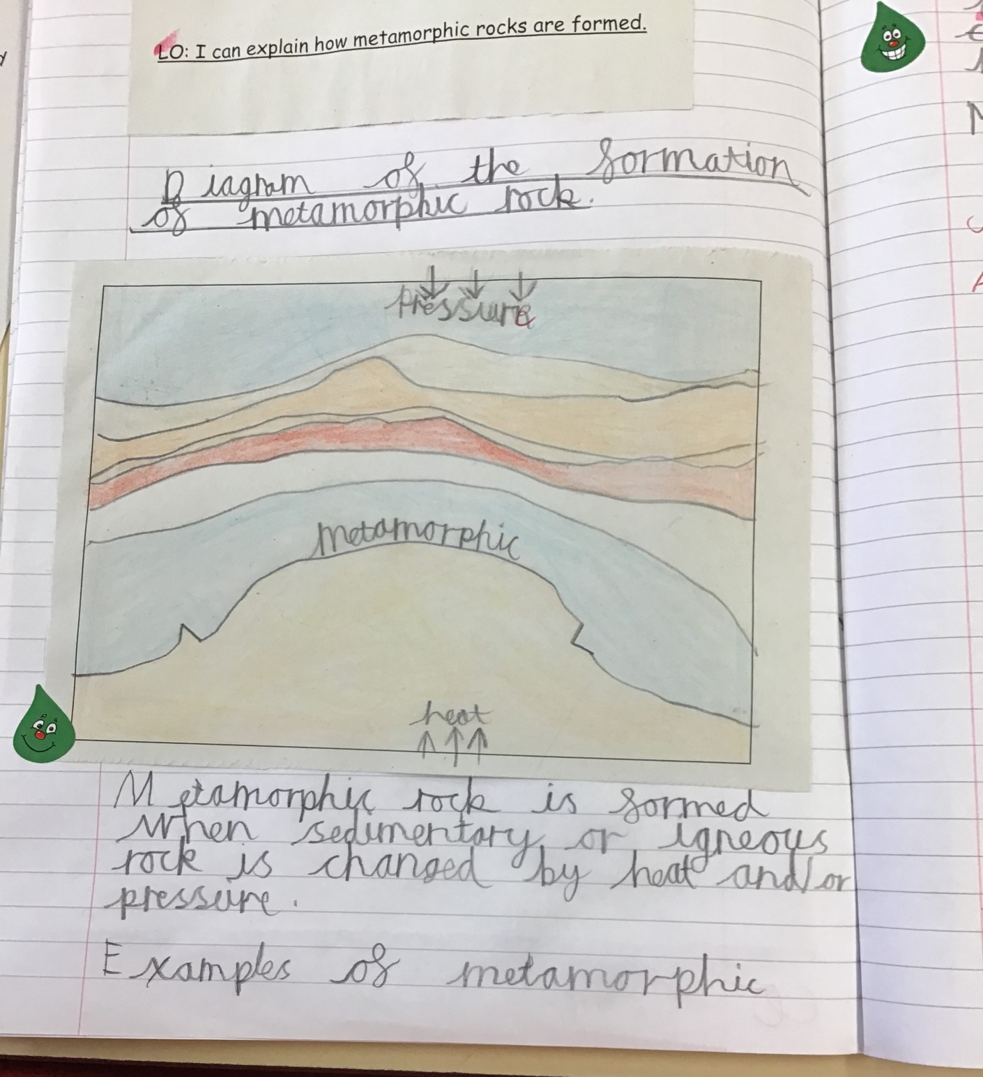

Slide 18
Year 4
This week in year 4 we have been working hard on our creative writing. We have reimagined the ending of the myth Pandora’s Box. In Prayer and Liturgy, we read the story of the prodigal son and thought about the importance of forgiveness.

Slide 19
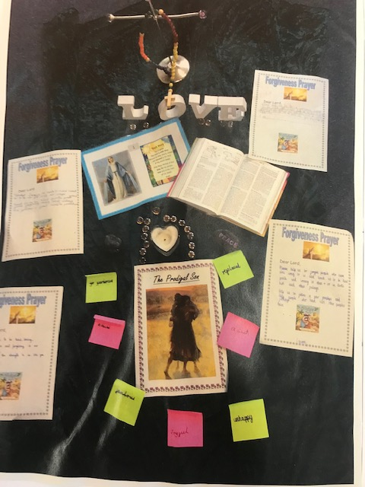

Slide 20
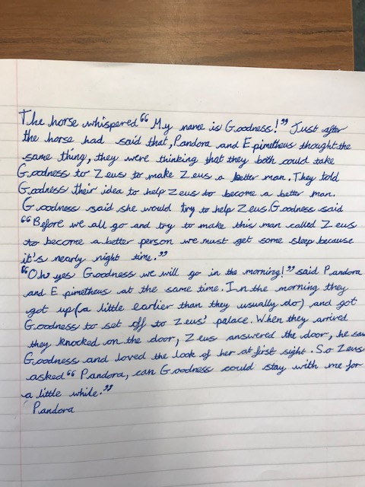
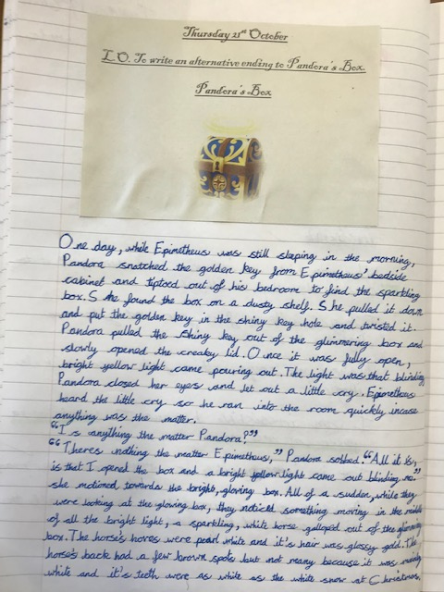

Slide 21
Year 5
This past week, Year 5 have taken part in a variety of experiments to develop our understanding of our 'Material World'. These have included, investigating thermal conductors and insulators, dissolving in water and separating mixtures. The children have really enjoyed the experiments and presented their results in a scientific manner. Here are Iwan's investigations and results.

Slide 22
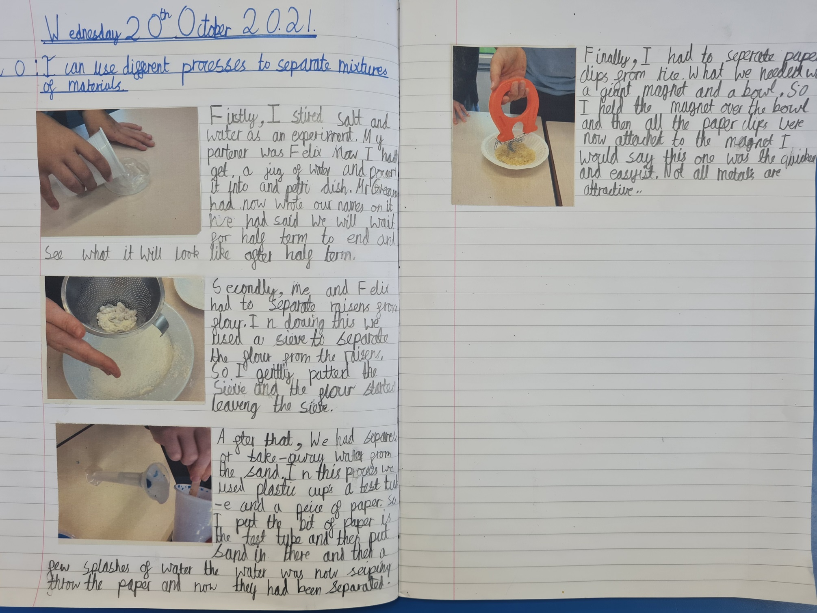

Slide 23
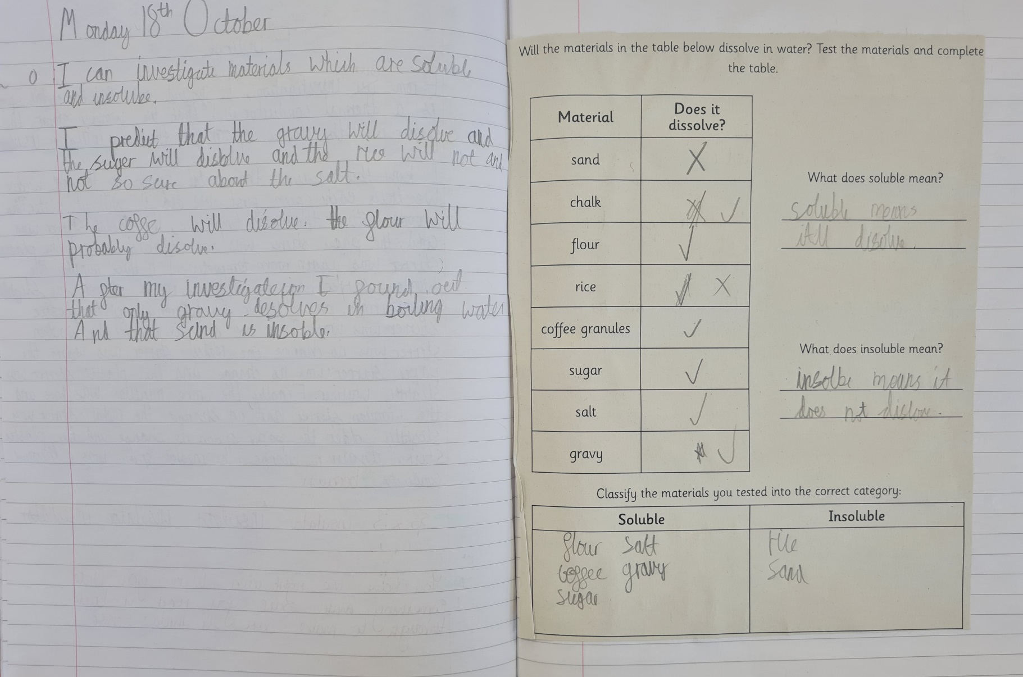
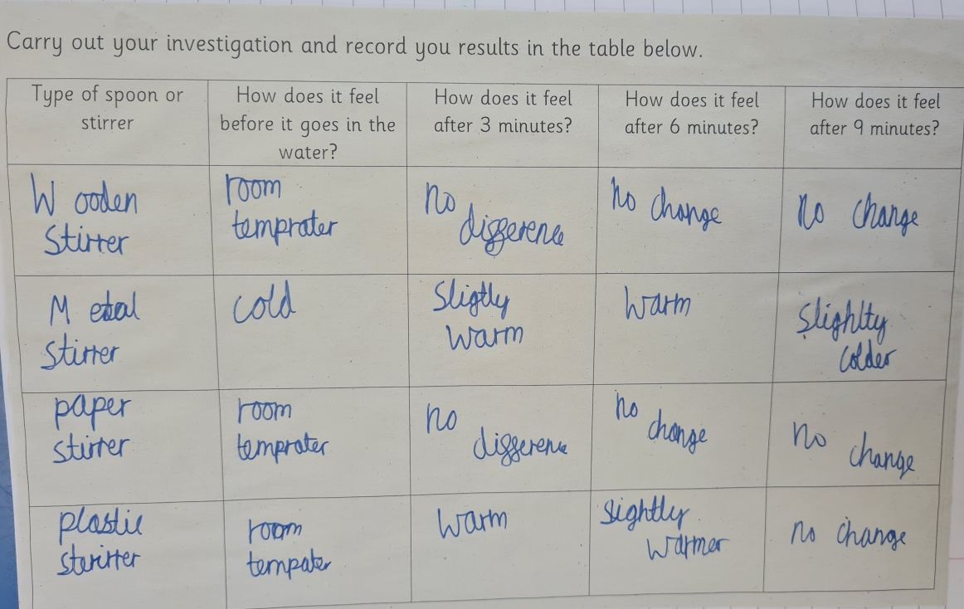

Slide 24
Year 6

Slide 25
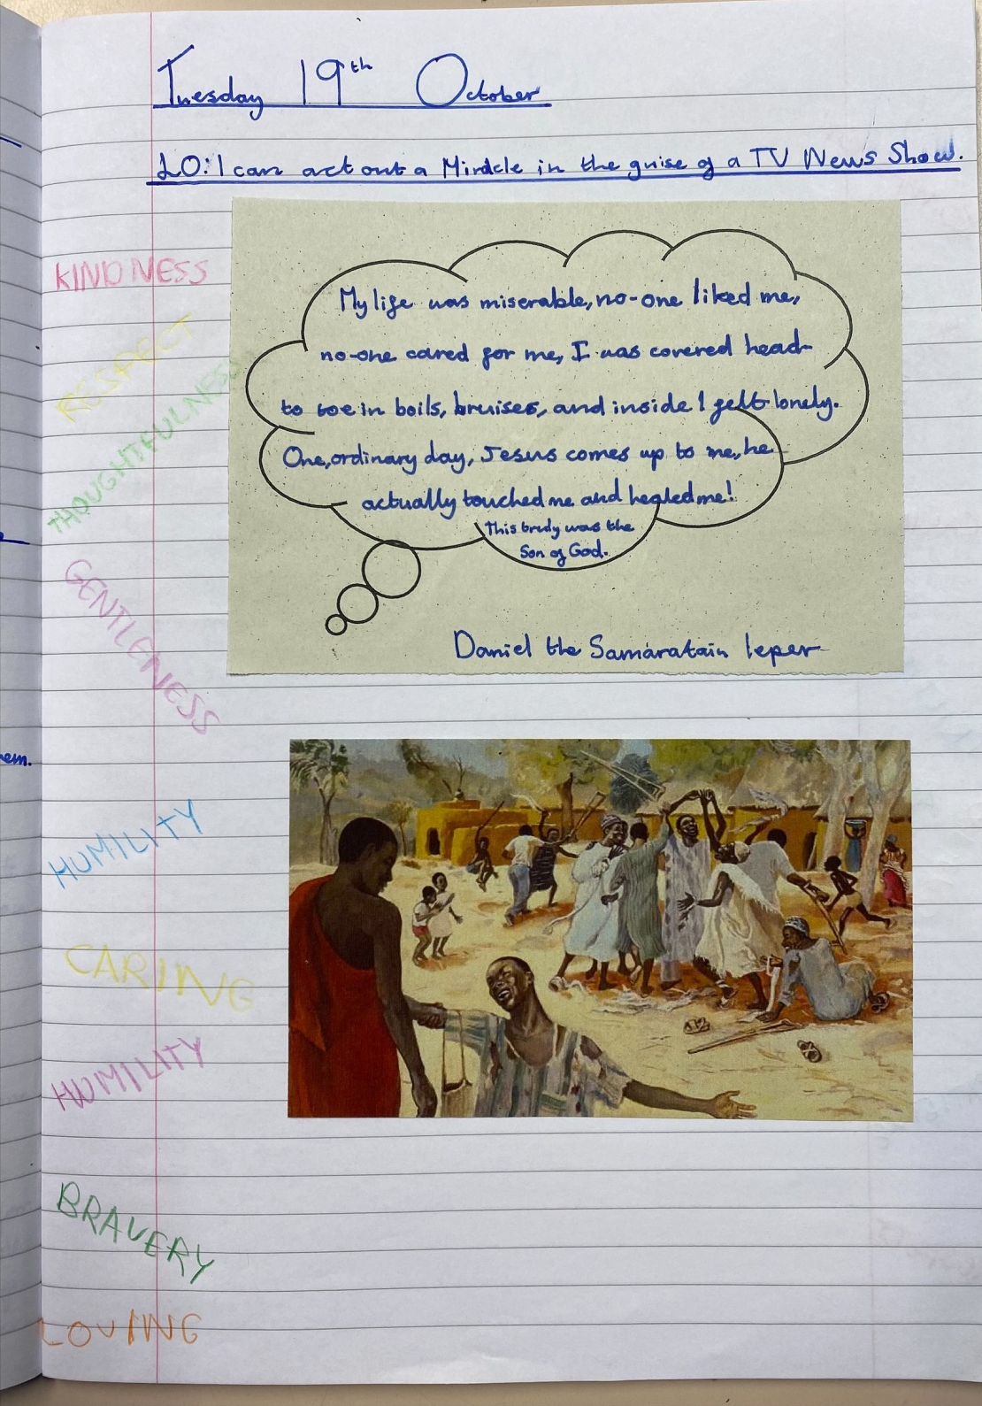

Slide 26
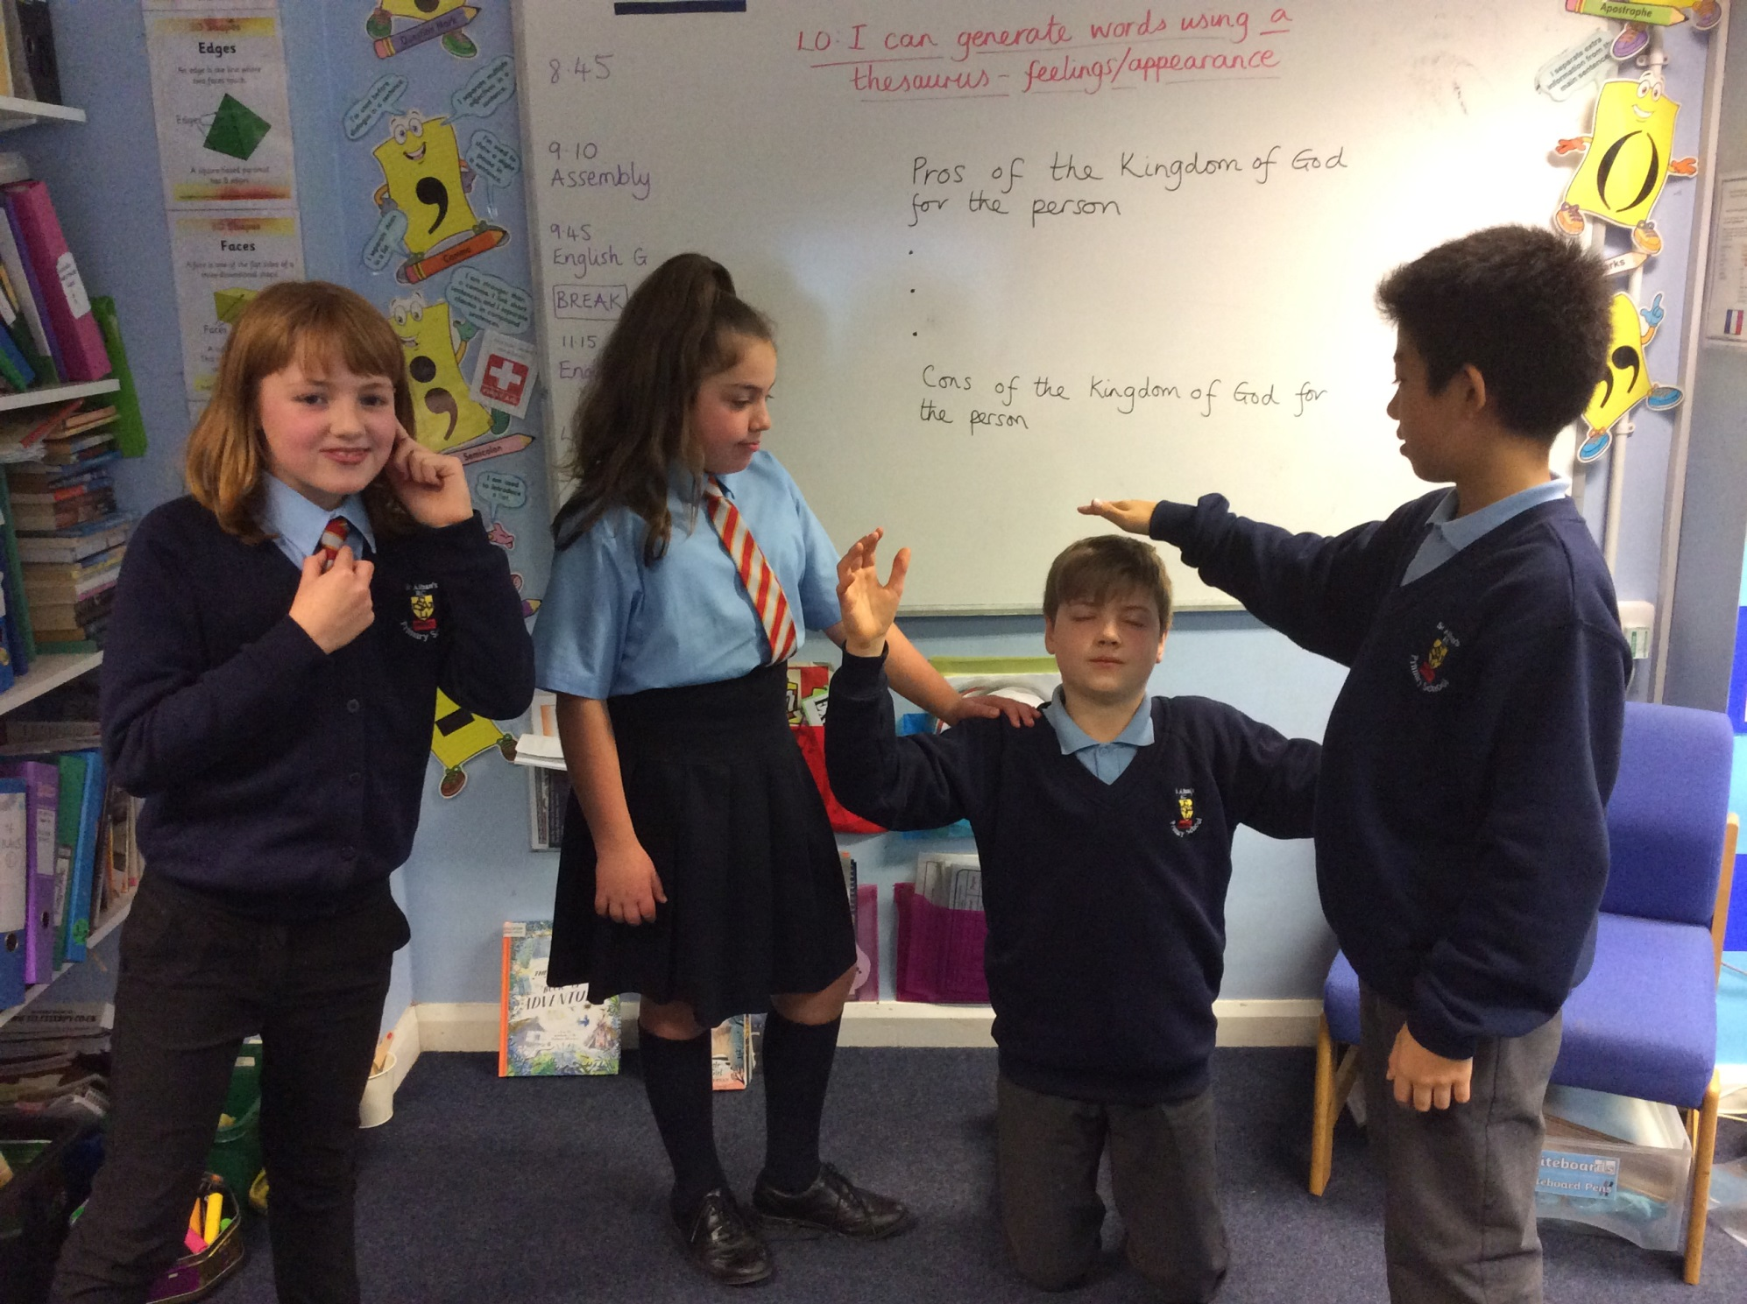

Slide 27
SPORTING SUPERSTARS!!
Cross Country
Y3 & Y4 Runners

Slide 28
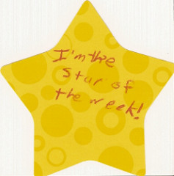

Slide 30
Congratulations to all of our stars of the week!

Slide 31


Slide 32


Slide 33
“We will be the happiest people in the world if we belong to God.”
(St Teresa of Calcutta)

Slide 34


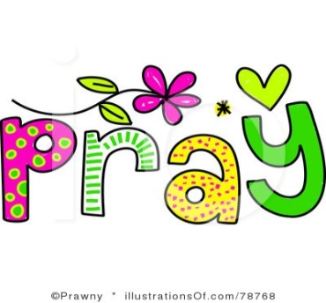
Let us pray.

Slide 35
Spread some happiness this week!
Notes:
GO FORTH - MISSION

Slide 36
WOW!
WELL DONE EVERYONE!

