Slide 1


CELEBRATION ASSEMBLY
FRIDAY 15TH OCTOBER 2021

Slide 2

This is the day that the Lord has made!

Slide 3
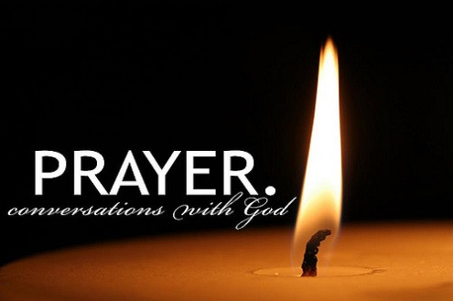
Notes:
WORD

Slide 4
Hail Mary
Hail Mary, full of grace
The Lord is with thee.
Blessed art thou among women
And blessed is the fruit
Of thy womb, Jesus.
Holy Mary, mother of God,
Pray for us sinners now
And at the hour of our death.
Amen

Slide 5
Our Father
Our Father, Who art in Heaven,
Hallowed be Thy name.
Thy Kingdom come,
Thy will be done on earth as it is in Heaven.
Give us this day our daily bread
and forgive us our trespasses
as we forgive those who trespass against us
and lead us not into temptation
but deliver us from evil.
Amen

Slide 6
Dear Lord,
Please bless our school
As we try to
Love, learn,
Share and respect
In the light of Jesus.
St Alban, pray for us.
Amen

Slide 7
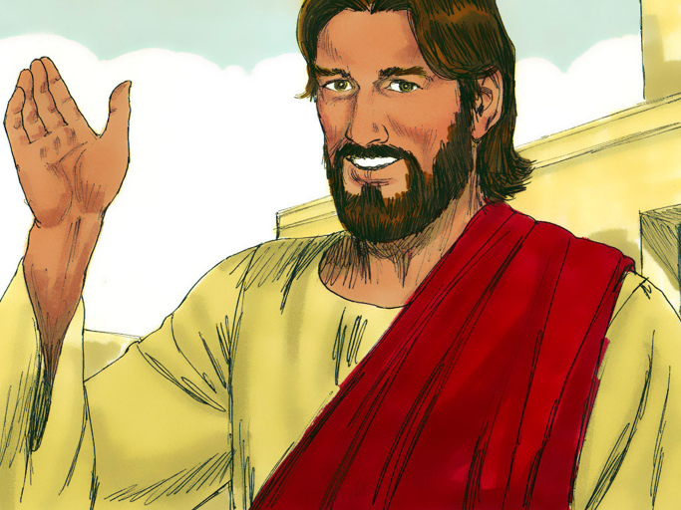
“Everything is possible for God.”

Slide 8

Reception
In Reception this week, the children have started to use phoneme frames and their segmenting skills to spell words with 3 phonemes. They are starting to form some letters correctly and have been working very hard.
We have also begun making artwork for a display about our class saint names. For Saint Francis of Assisi the children are making animals using their hand prints. For Saint Catherine of Siena the children have made doves of peace with hearts of love using their hand prints.

Slide 9
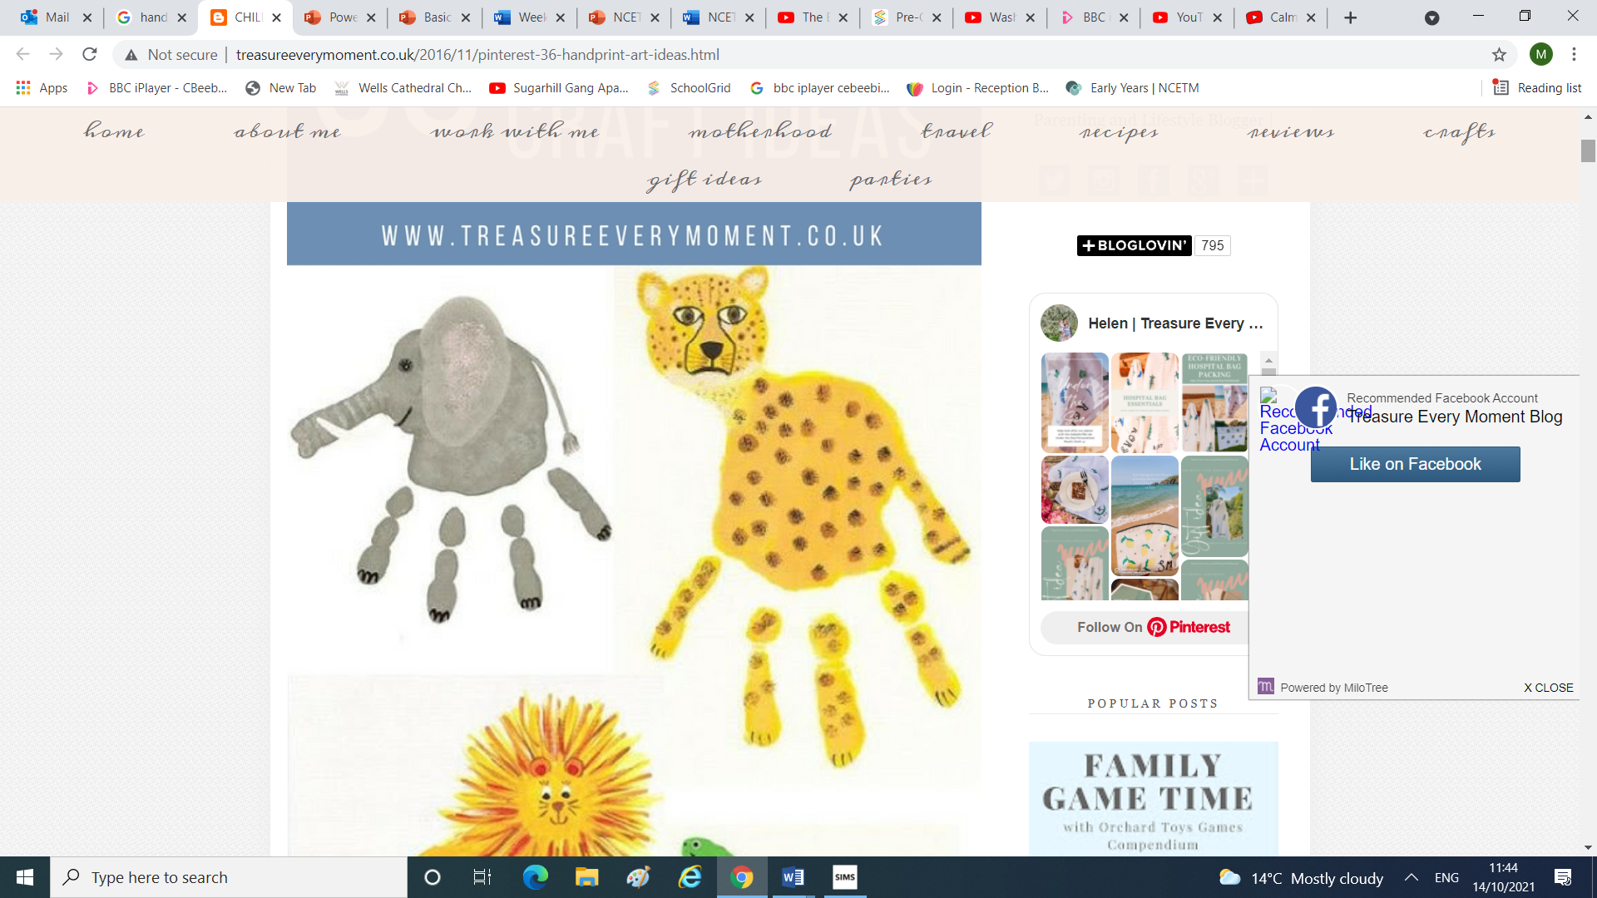
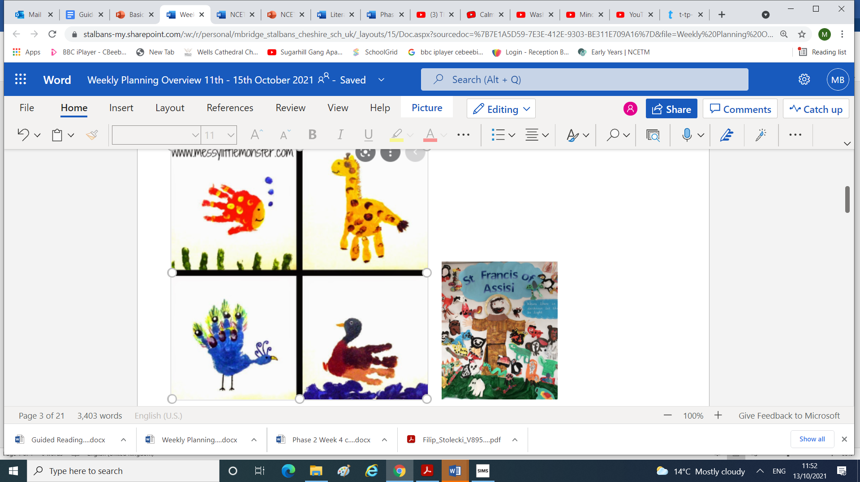

Slide 10
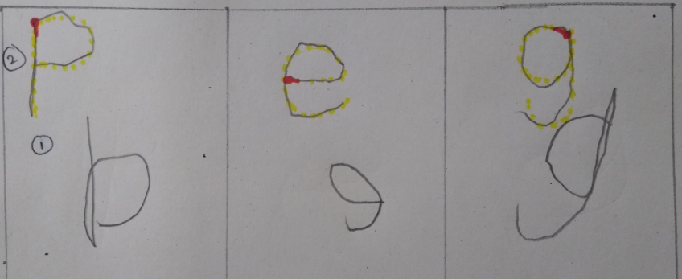
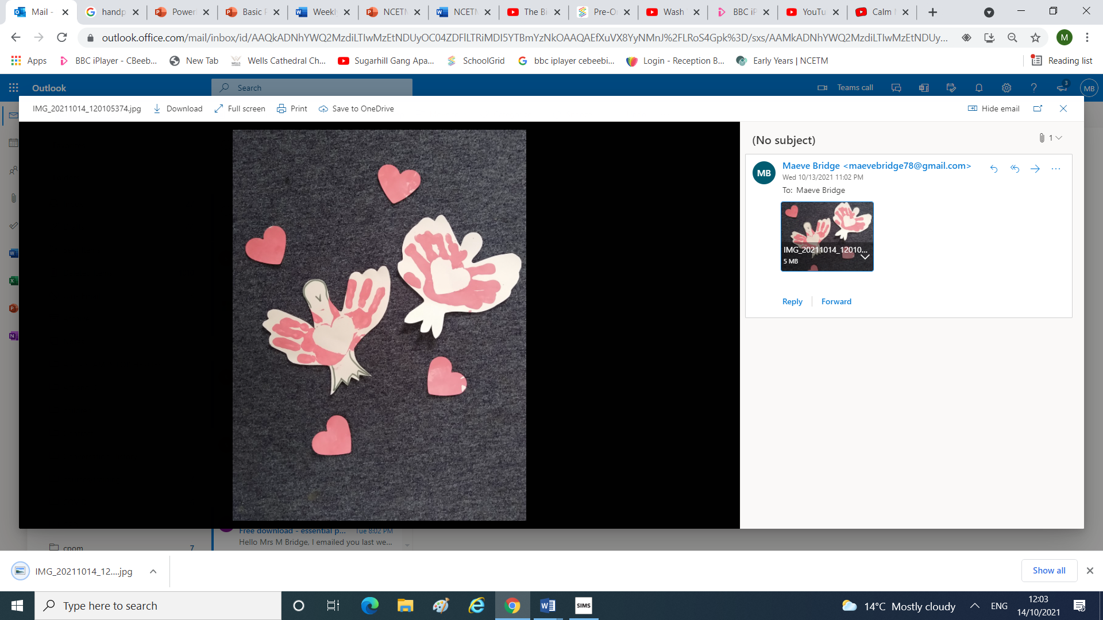
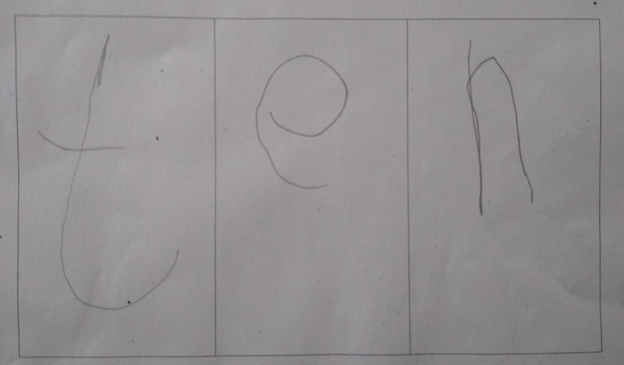

Slide 11
Year 1
This week, Year One have learned about the story of Noah's Ark. First, they saw a beautiful painting by a man named Edward Hicks and thought about what the painting might represent. After hearing the story, we discussed why the story of Noah’s Ark is also known as the story of the rainbow and why this symbol is important as a sign of God’s promise. The children then thought of their own promise that they could make to God. In Maths, the children have been learning about the mathematical vocabulary less/fewer and more by sorting objects (and their friends!) into different sized groups. In science, we discussed what we know about the season of autumn before going outside and collecting various objects that we thought reflect this time of year. We collected different coloured leaves, seeds, berries, acorns and more! When we returned to the classroom we talked about the changes in weather, what we see, what we eat and what we wear during the Autumn months. We know it feels colder in the Autumn than in the Summer. We found out that temperature is measured using a thermometer. Today the temperature was 15 degrees, and we all needed our jumpers and coats on at break time.

Slide 12
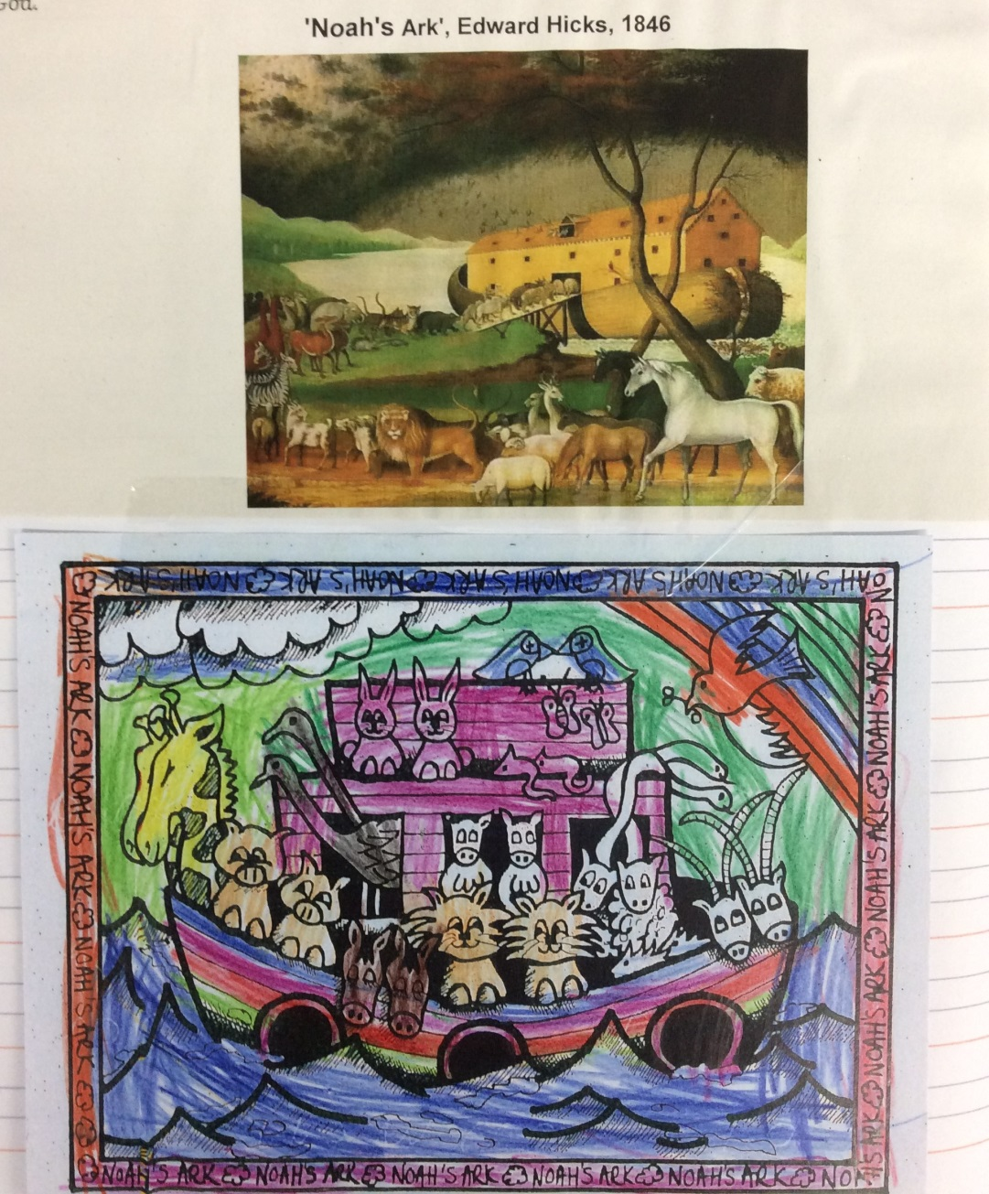
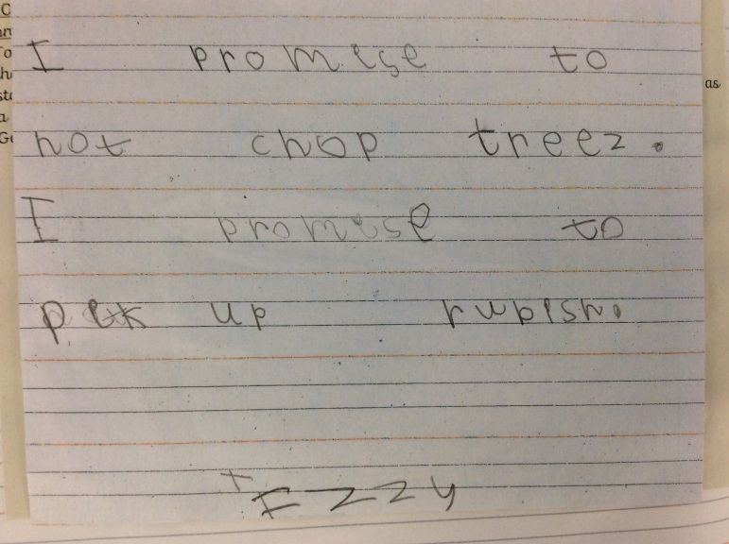

Slide 13
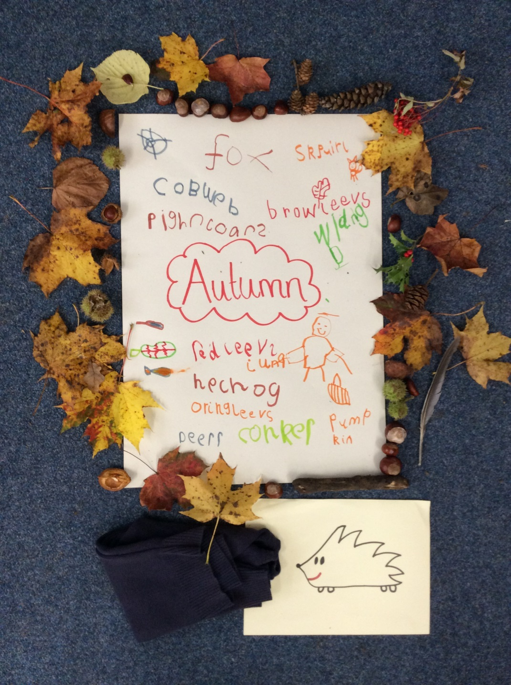

Slide 14
Year 2

Slide 15
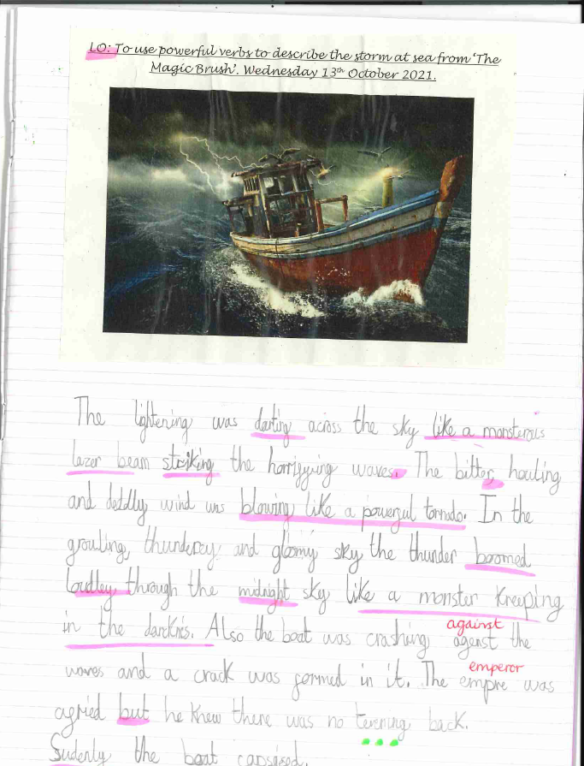
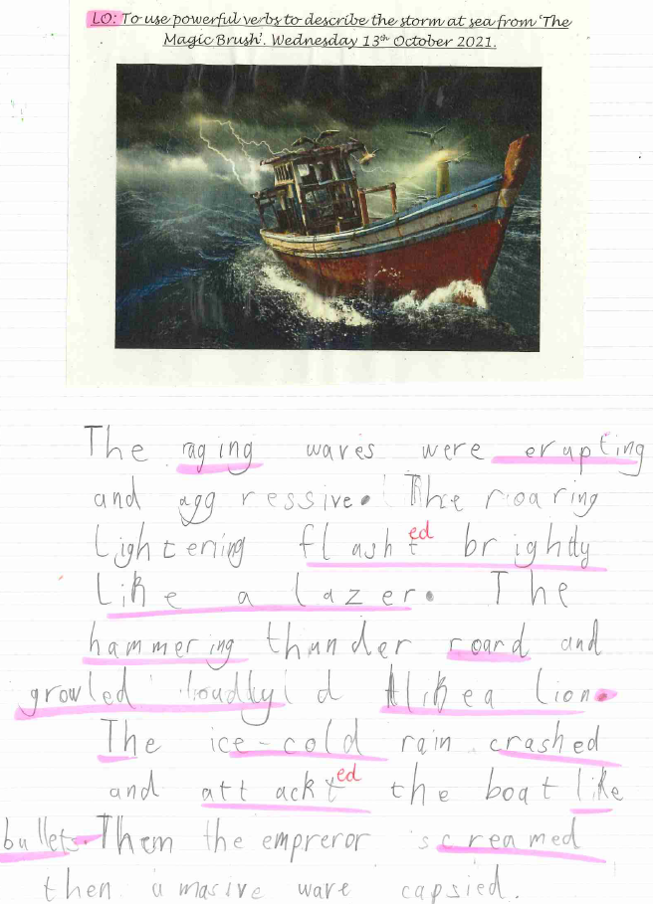

Slide 16
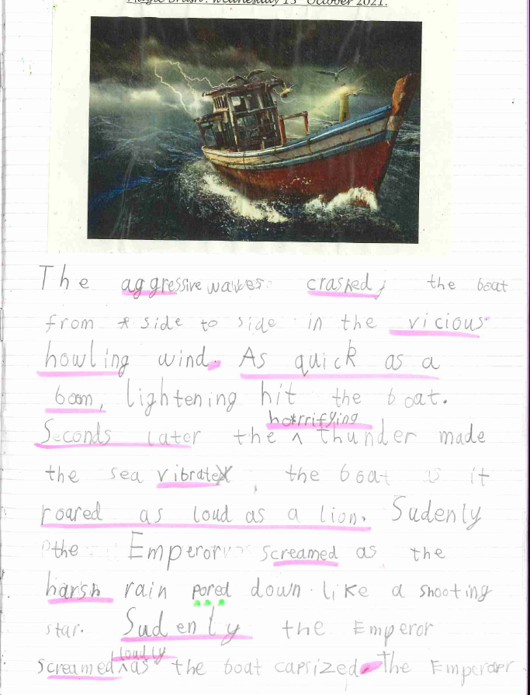

Slide 17
Year 3
This week, the children had a very special visitor, Father Peter. Year 3 enjoyed asking lots of questions to find out all about the life of our Parish Priest. A very big thank you to Father Peter for giving up so much of his time to be with us. In Science, the children have been finding out all about sedimentary rocks and how they are formed. We learnt that the White Cliffs of Dover are made from a type sedimentary rock called chalk. In English, Year 3 have also been busy writing their own introduction to The Iron Man story by Ted Hughes. We have been thinking about how to make the atmosphere sound threatening in order to introduce our main character, the Iron Man.

Slide 18
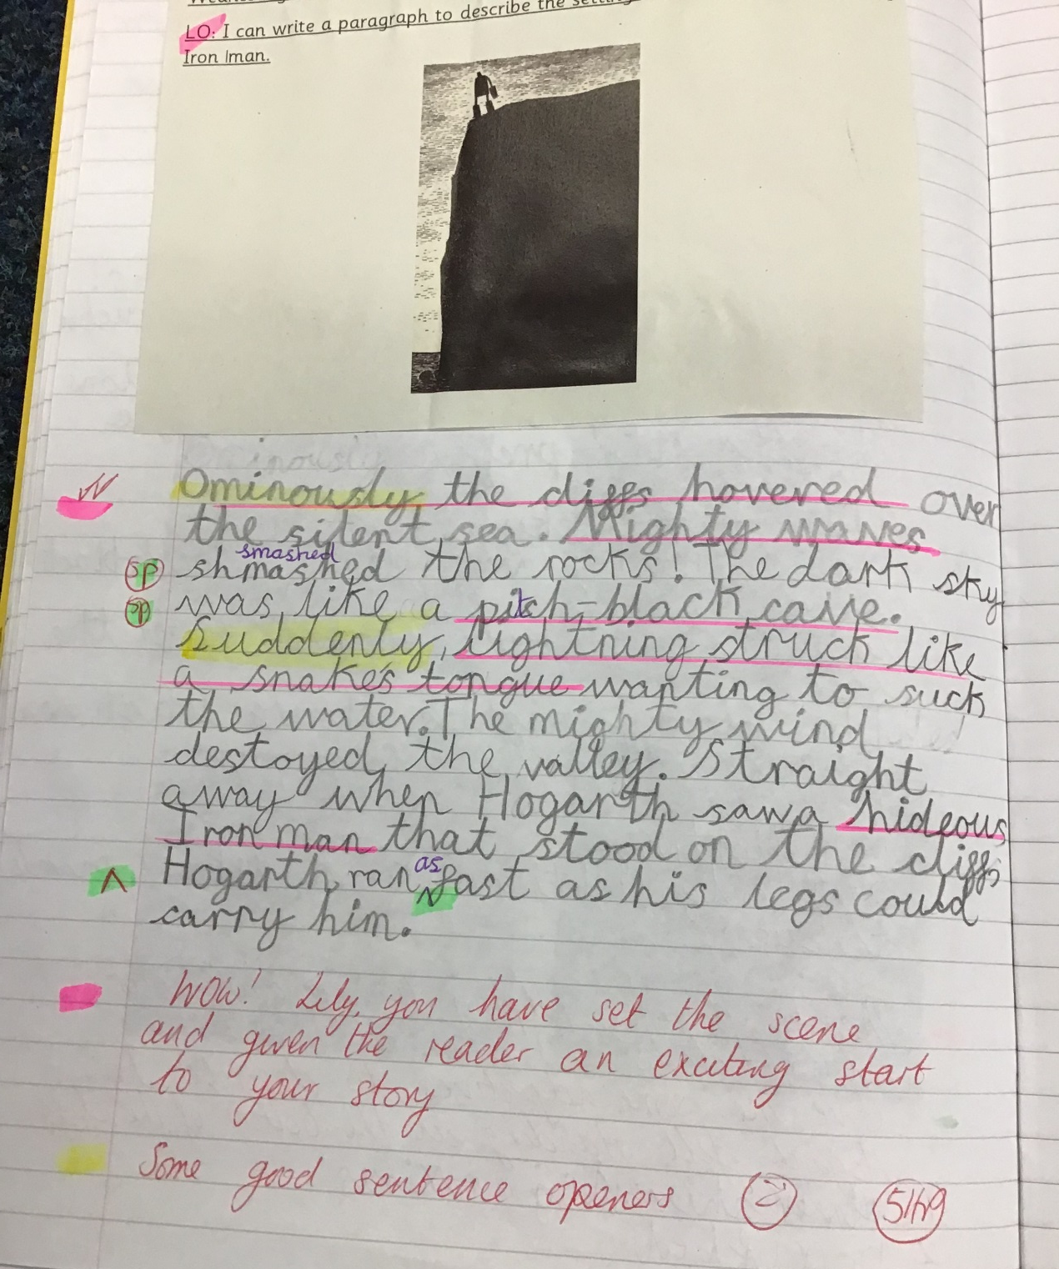

Slide 19
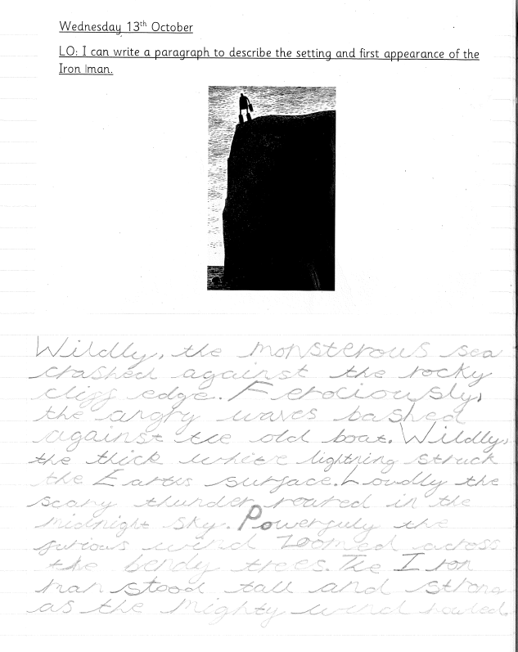

Slide 20
Year 4
This week in Year 4, we have been writing animal poetry and a short burst description of Pandora’s Box. When writing the poem we thought about what we could use to describe our animal’s voice, teeth, claws and fur. When writing our Pandora’s Box description we thought about lots of exciting adjectives to make our writing more interesting.

Slide 21
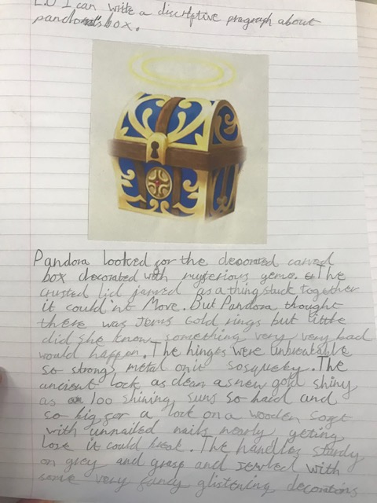
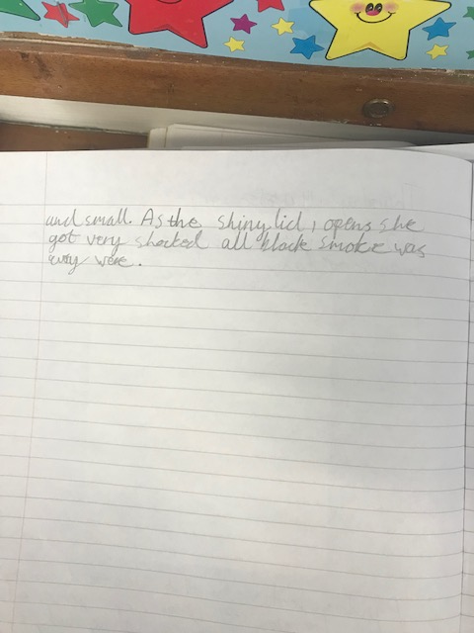

Slide 22
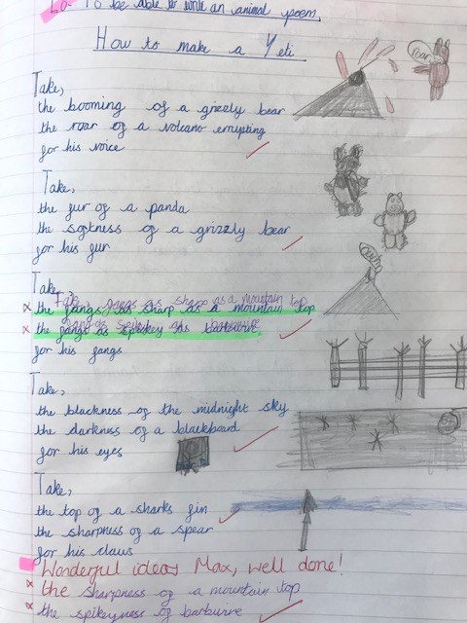

Slide 23
Year 5
Year 5 have been really enjoying looking at the Veowulf story this week. We have been looking at what makes an effective hero and monster and got into character as them both. We have also written effective descriptions of Beowulf and Gender from the story.

Slide 24
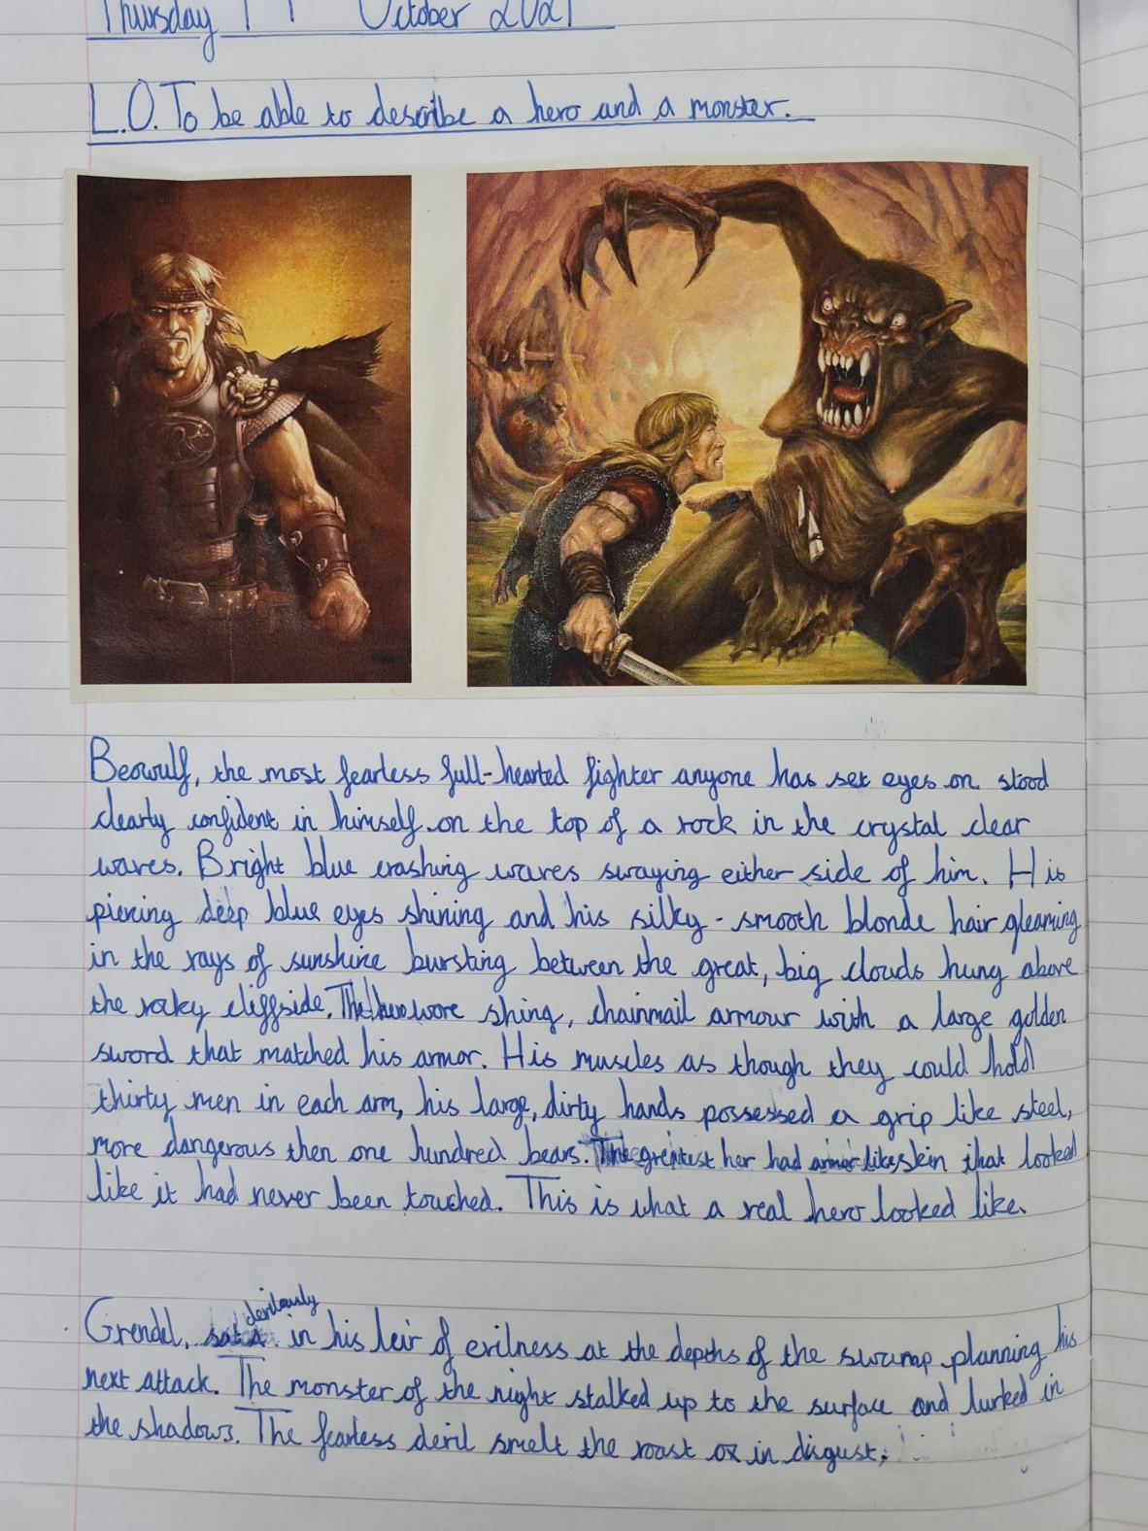

Slide 25
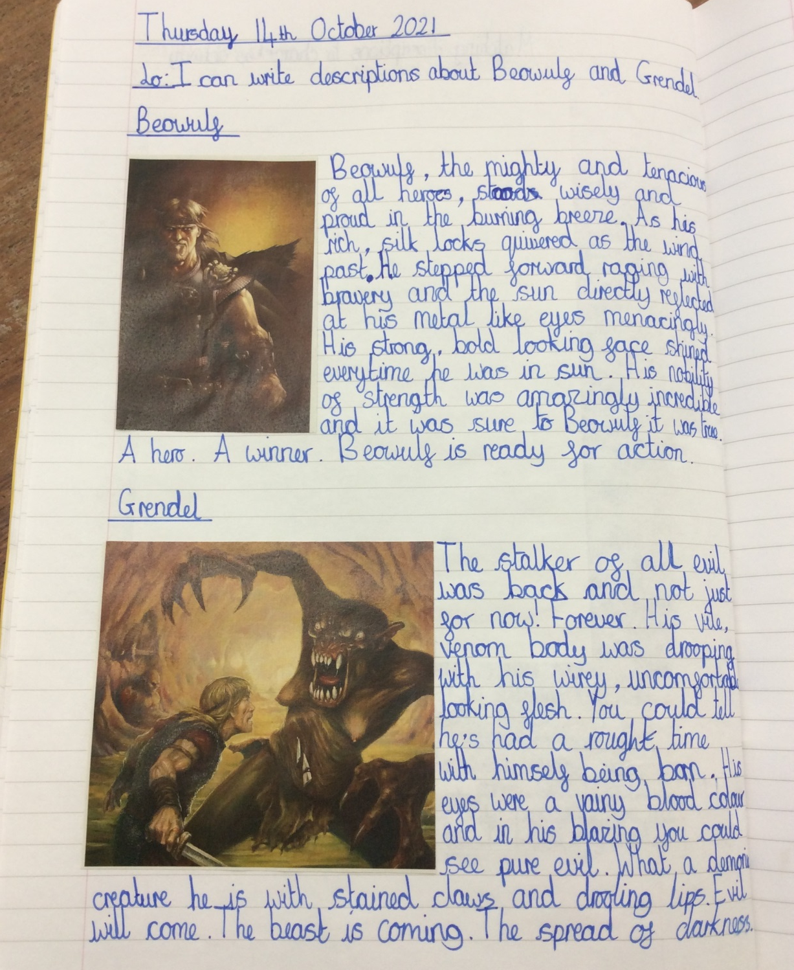

Slide 26
Year 6
This week, Year 6 have been creating branching keys in Science and exploring the Mayan hierarchy in History. In English they have been exploring expanded noun phrases to create descriptions whilst in Maths they have continued to look at problem solving.

Slide 27
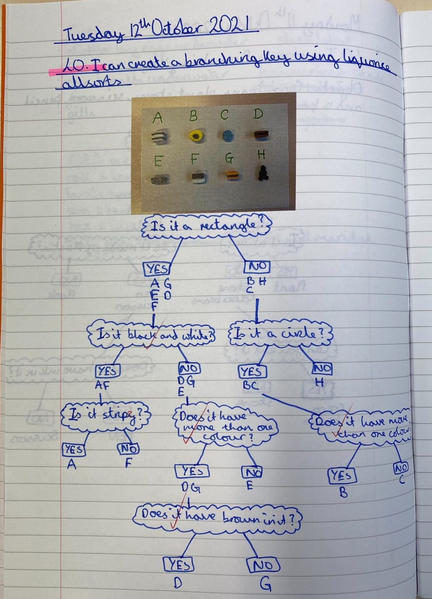

Slide 28
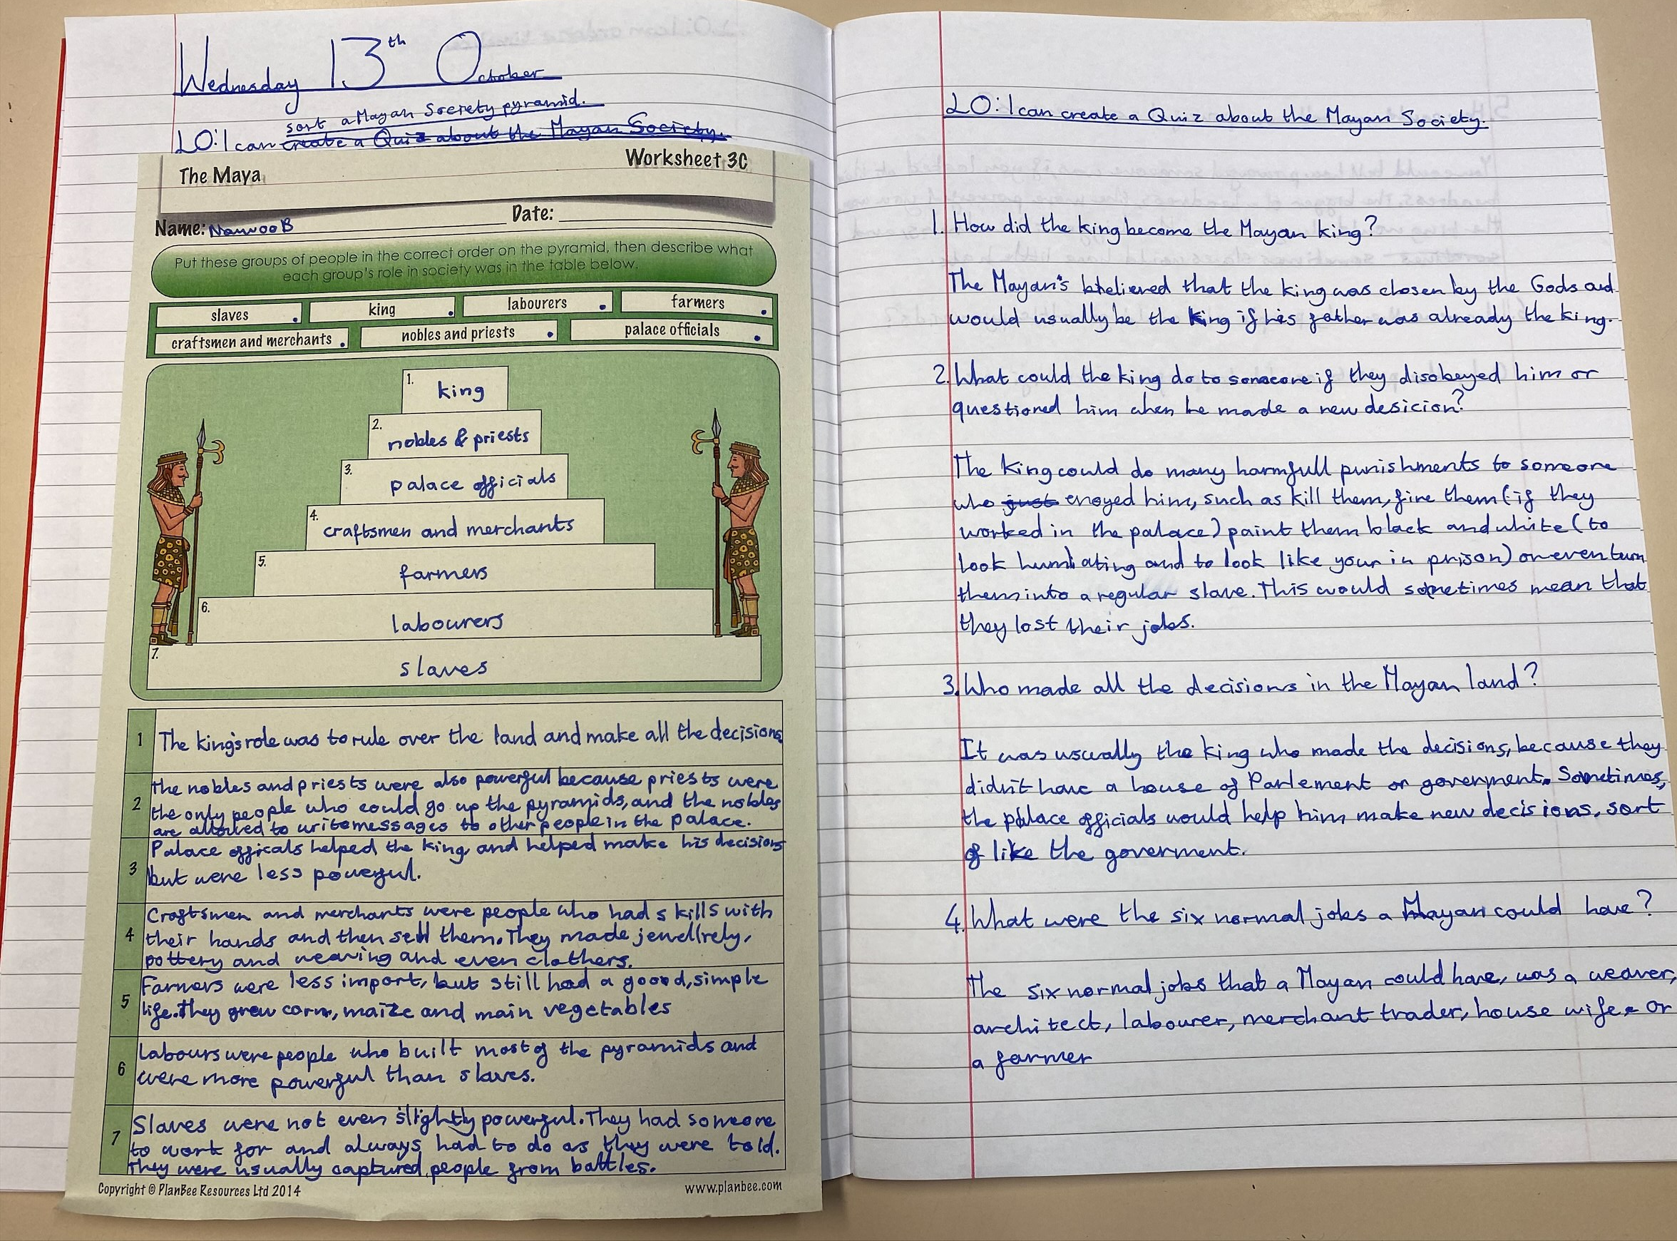

Slide 29
SPORTING SUPERSTARS!!
Football away at Prestbury
A Team lost 3-2
B Team lost 1-0
Cross Country
Y5&6 Boys Team 3rd
Ben 3rd

Slide 30
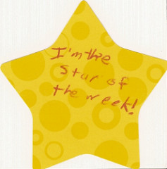

Slide 32
Congratulations to all of our stars of the week!

Slide 33


Slide 34


Slide 35
“We will be the happiest people in the world if we belong to God.”
(St Teresa of Calcutta)

Slide 36



Let us pray.
Dear Lord Jesus,
May we be rich in love
and filled with the happiness
which comes from serving you and others.
Amen

Slide 37
Spread some happiness this week!
Notes:
GO FORTH - MISSION

Slide 38
WOW!
WELL DONE EVERYONE!

