Slide 1


CELEBRATION ASSEMBLY
THURSDAY 30TH SEPTEMBER 2021

Slide 2

This is the day that the Lord has made!

Slide 3

Notes:
WORD

Slide 4
Hail Mary
Hail Mary, full of grace
The Lord is with thee.
Blessed art thou among women
And blessed is the fruit
Of thy womb, Jesus.
Holy Mary, mother of God,
Pray for us sinners now
And at the hour of our death.
Amen

Slide 5
Our Father
Our Father, Who art in Heaven,
Hallowed be Thy name.
Thy Kingdom come,
Thy will be done on earth as it is in Heaven.
Give us this day our daily bread
and forgive us our trespasses
as we forgive those who trespass against us
and lead us not into temptation
but deliver us from evil.
Amen

Slide 6
Dear Lord,
Please bless our school
As we try to
Love, learn,
Share and respect
In the light of Jesus.
St Alban, pray for us.
Amen

Slide 7
Celebrate goodness!

Slide 8

Reception

Slide 9
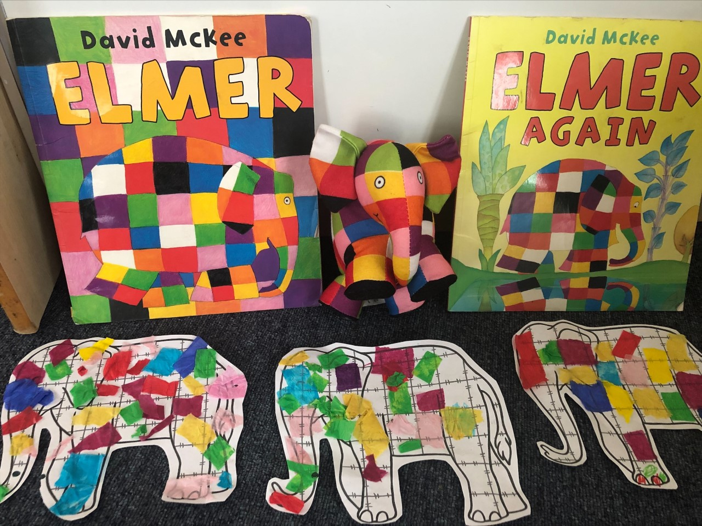

Slide 10
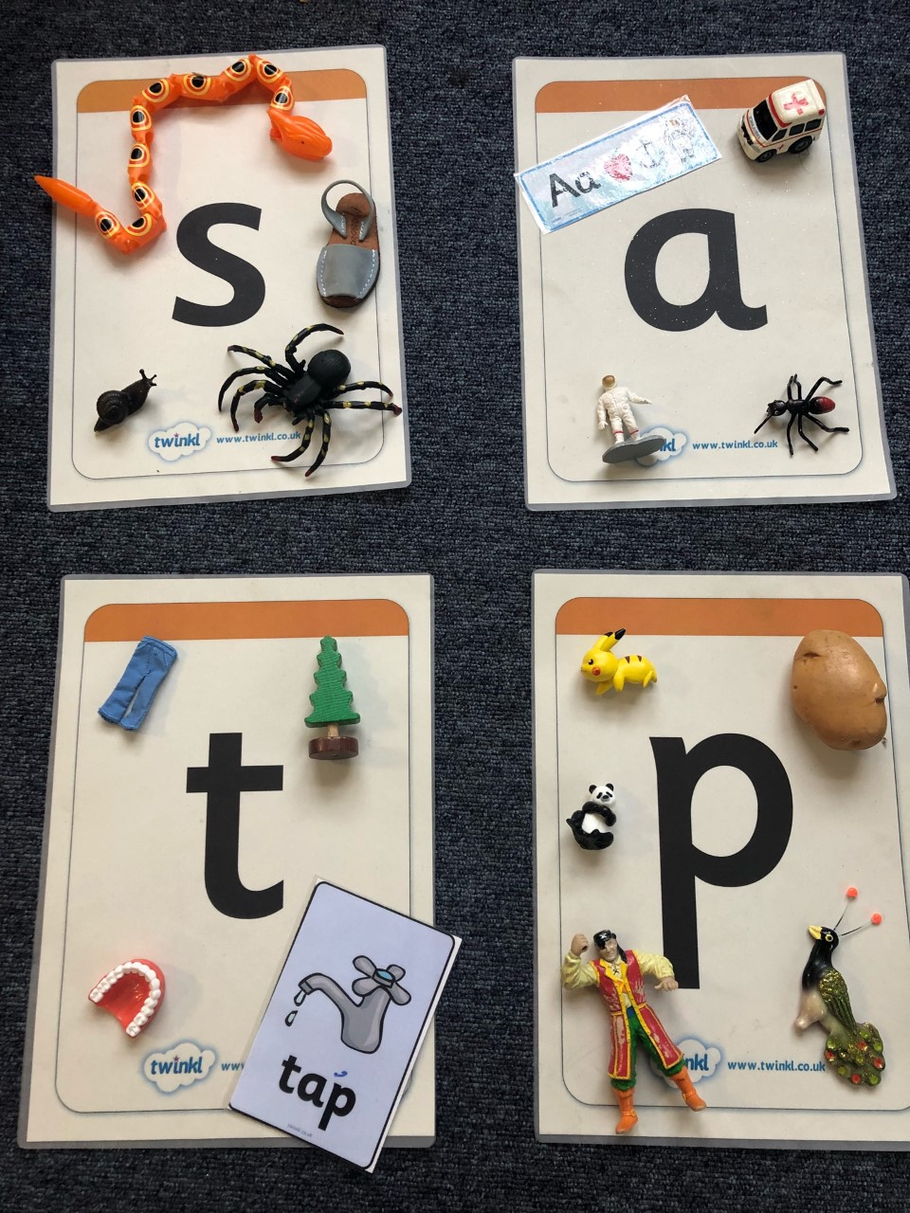

Slide 11
Year 1

Slide 12
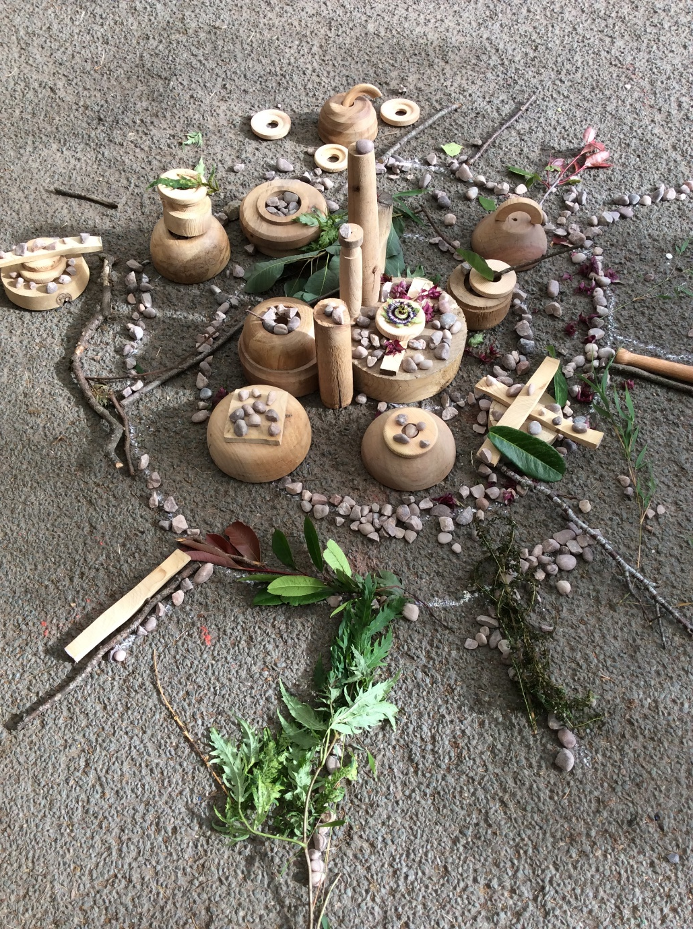

Slide 13
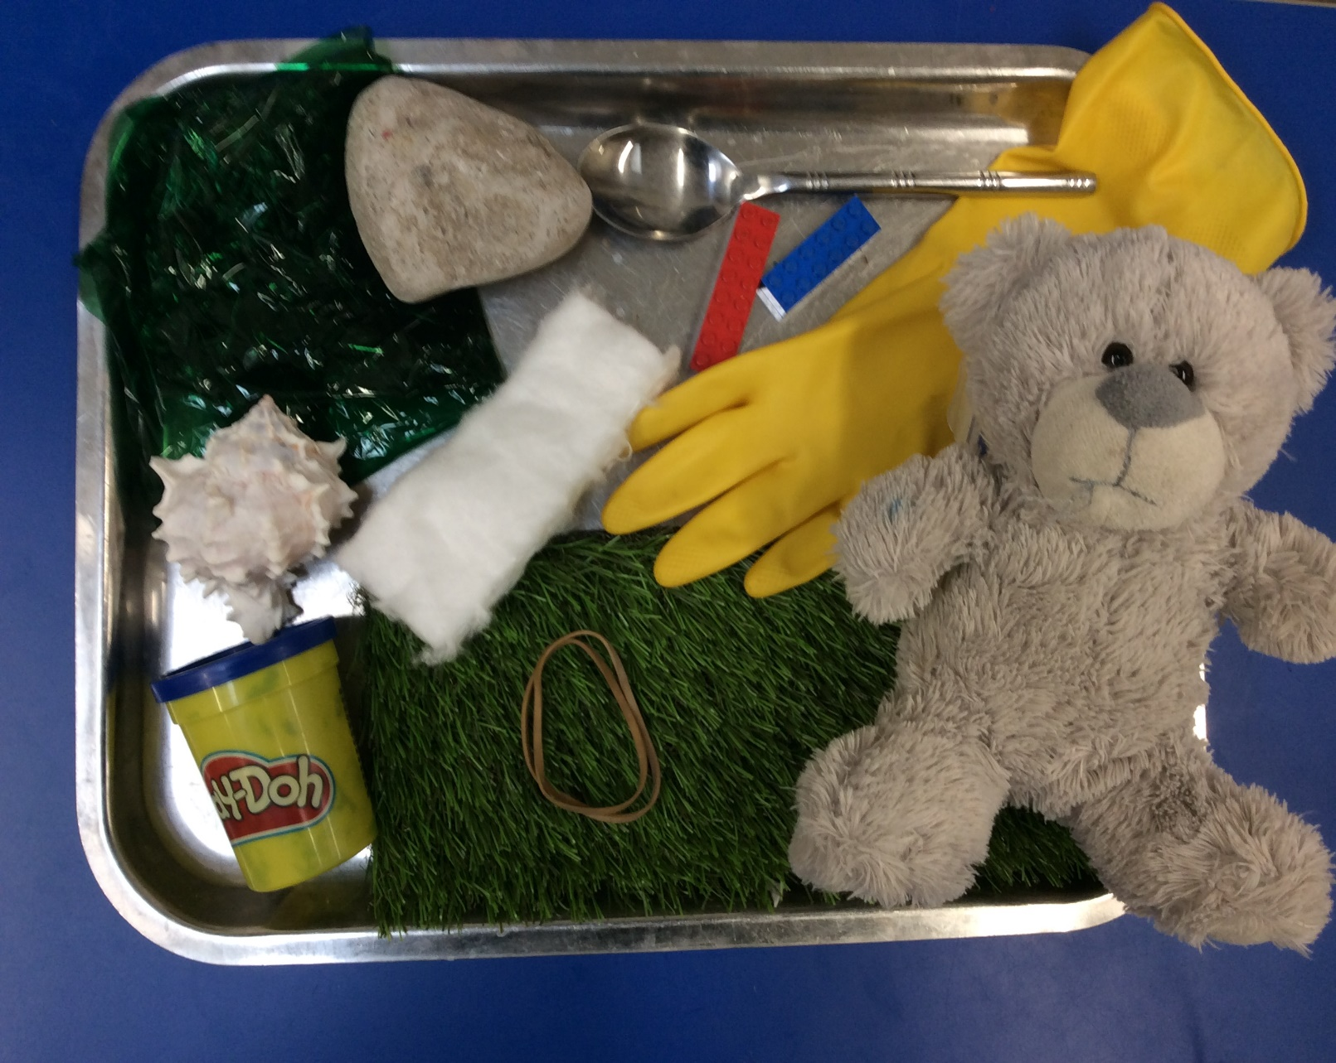

Slide 14
Year 2

Slide 15
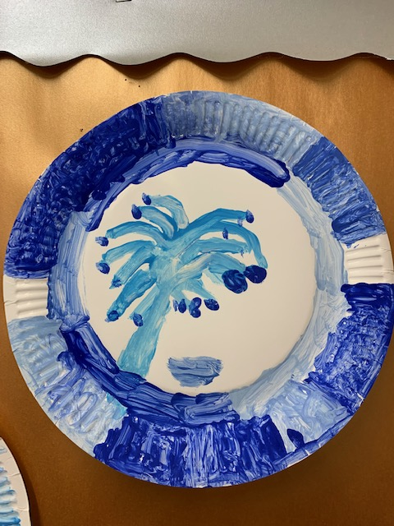

Slide 16
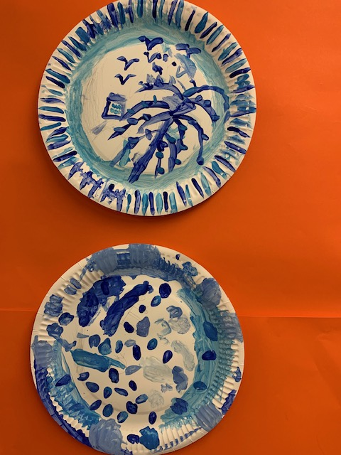

Slide 17
Year 3

Slide 18
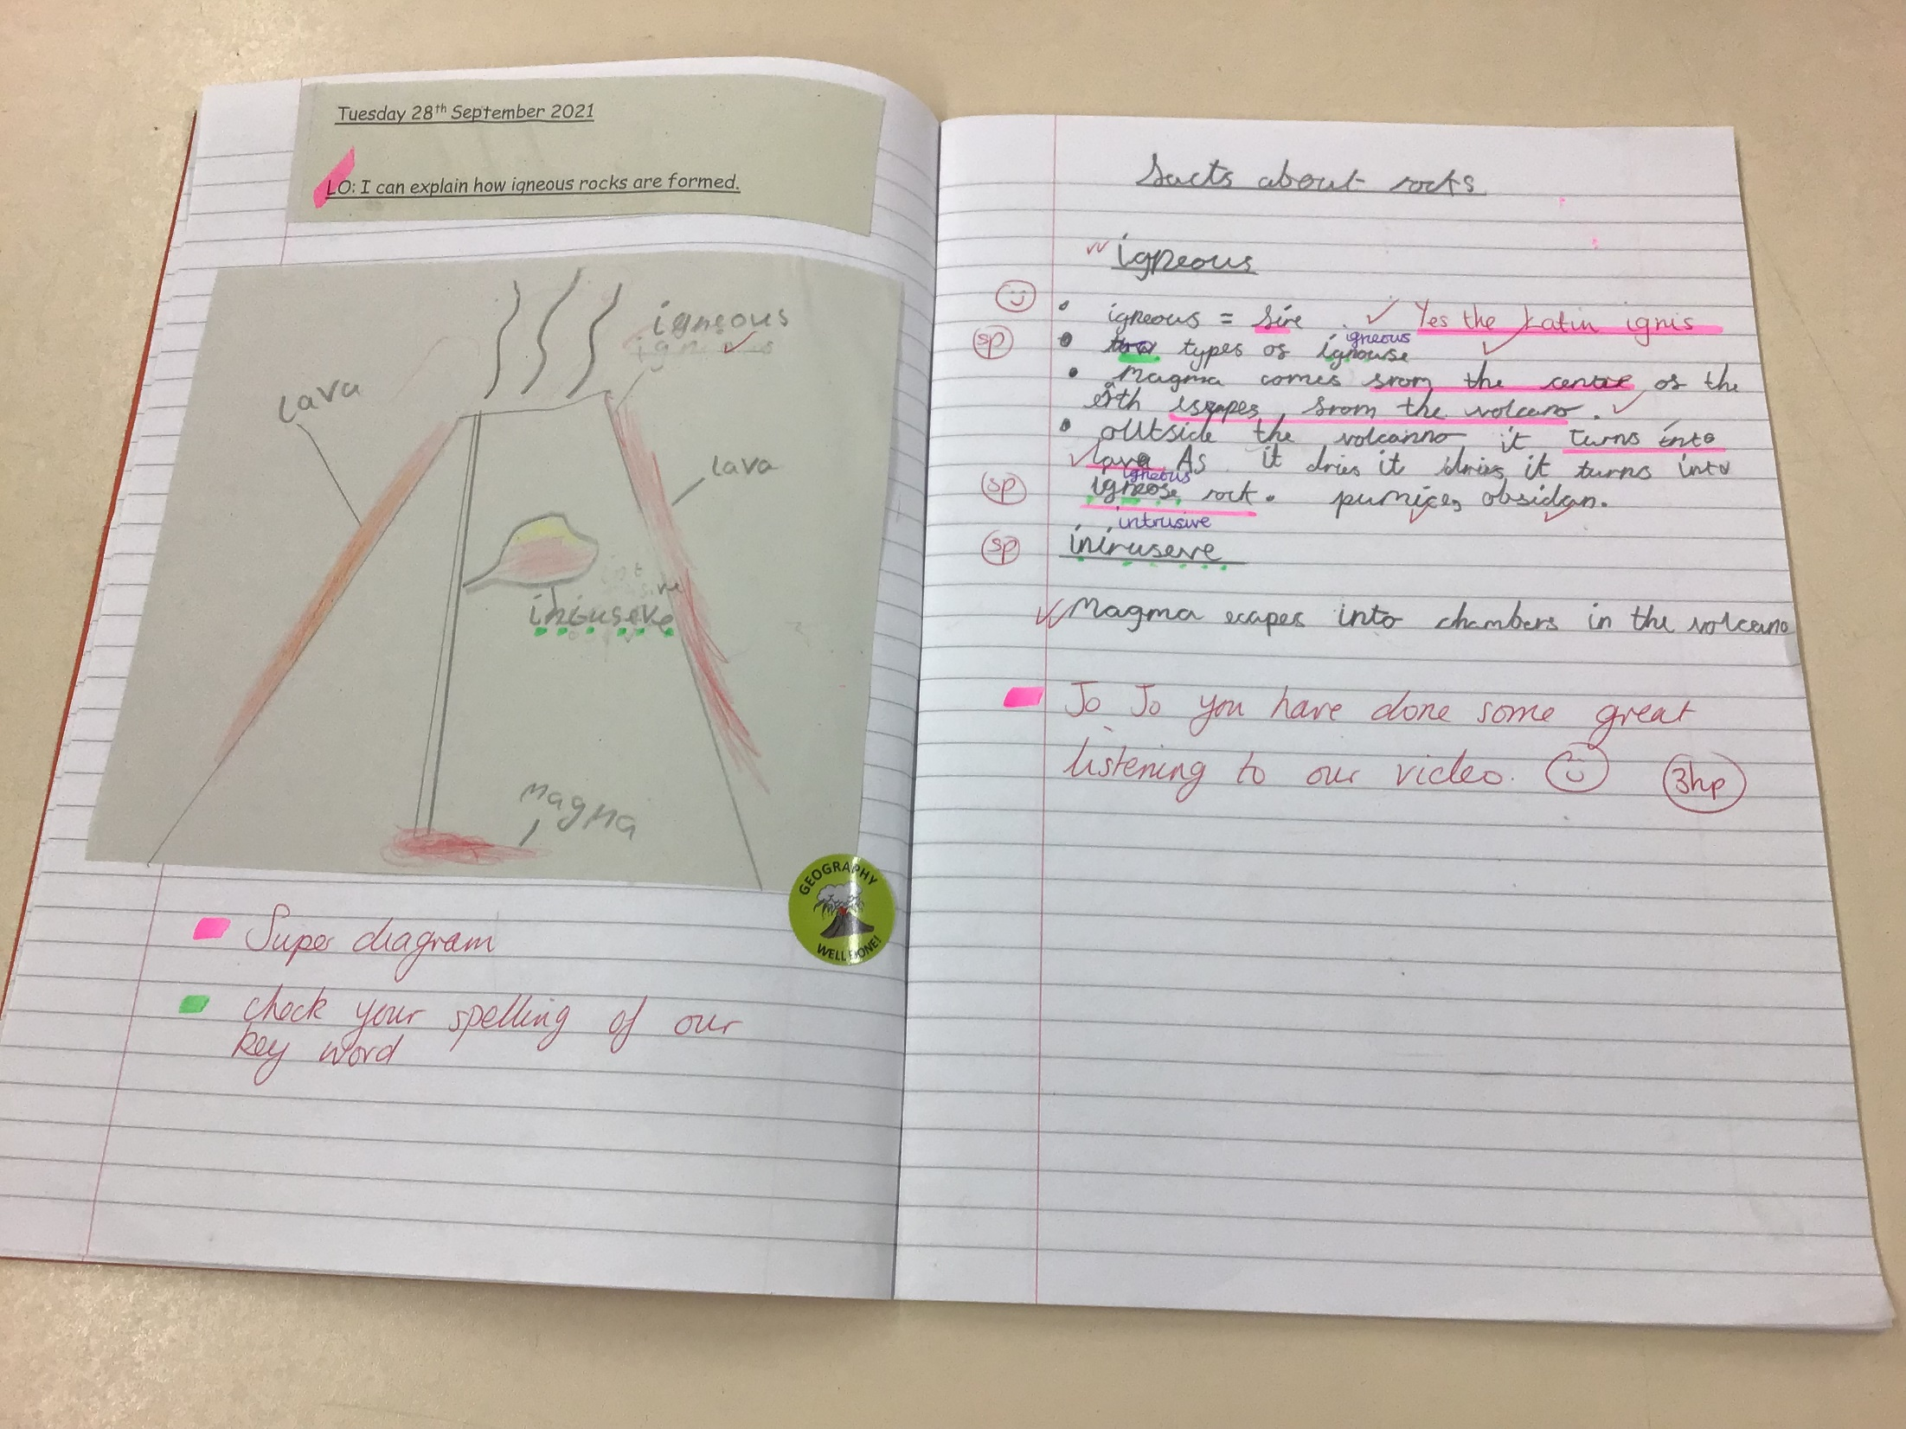

Slide 19
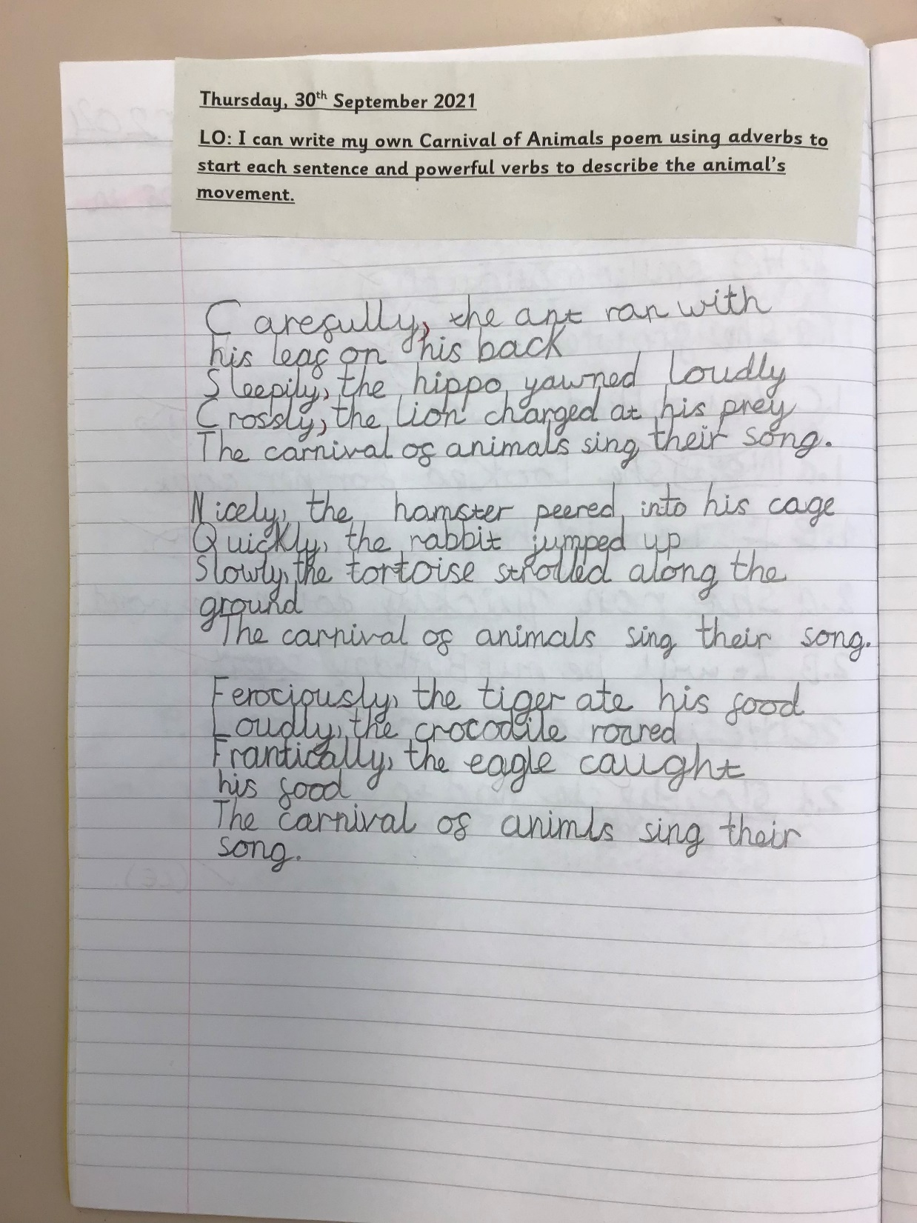

Slide 20
Year 4

Slide 21
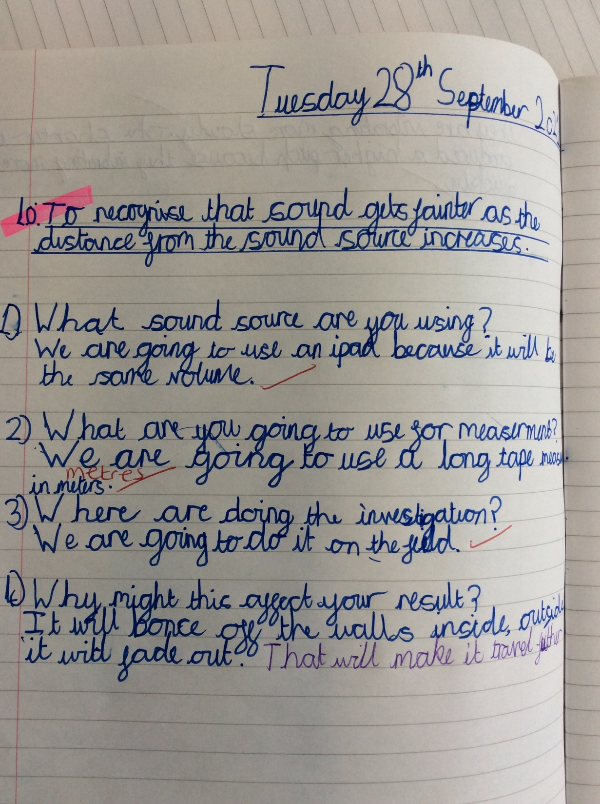

Slide 22
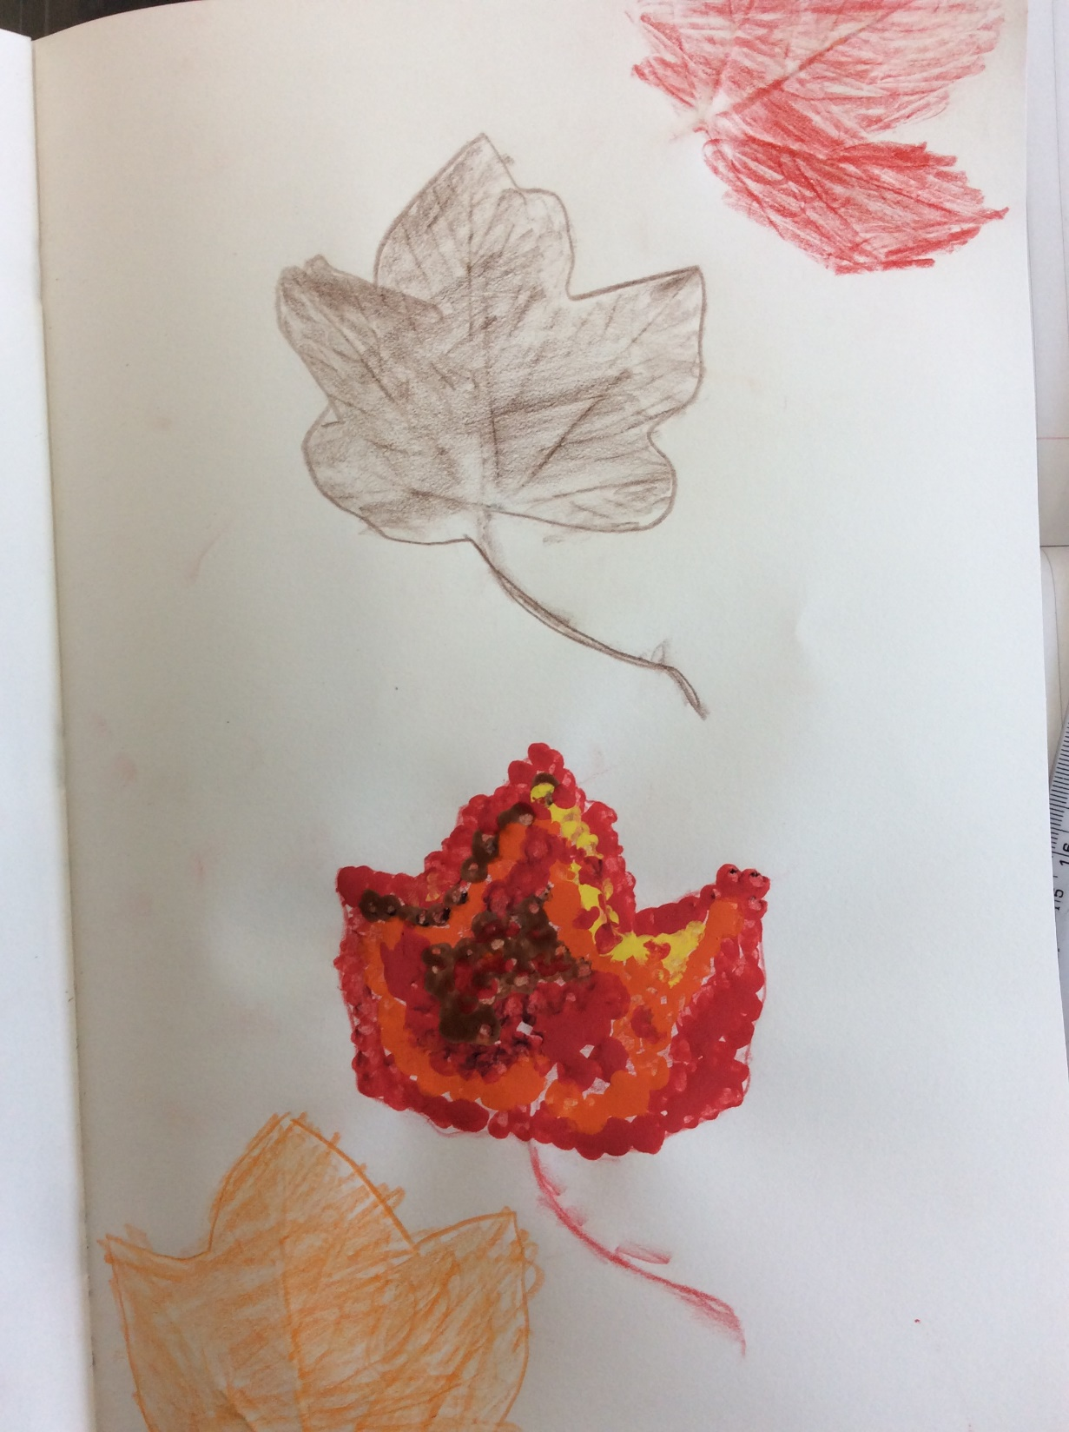

Slide 23
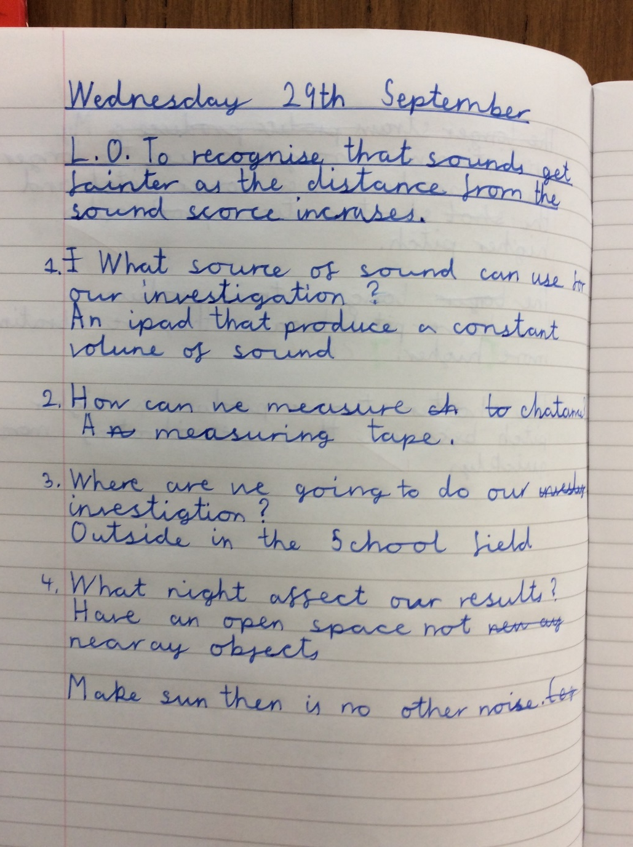

Slide 24
Year 5

Slide 25
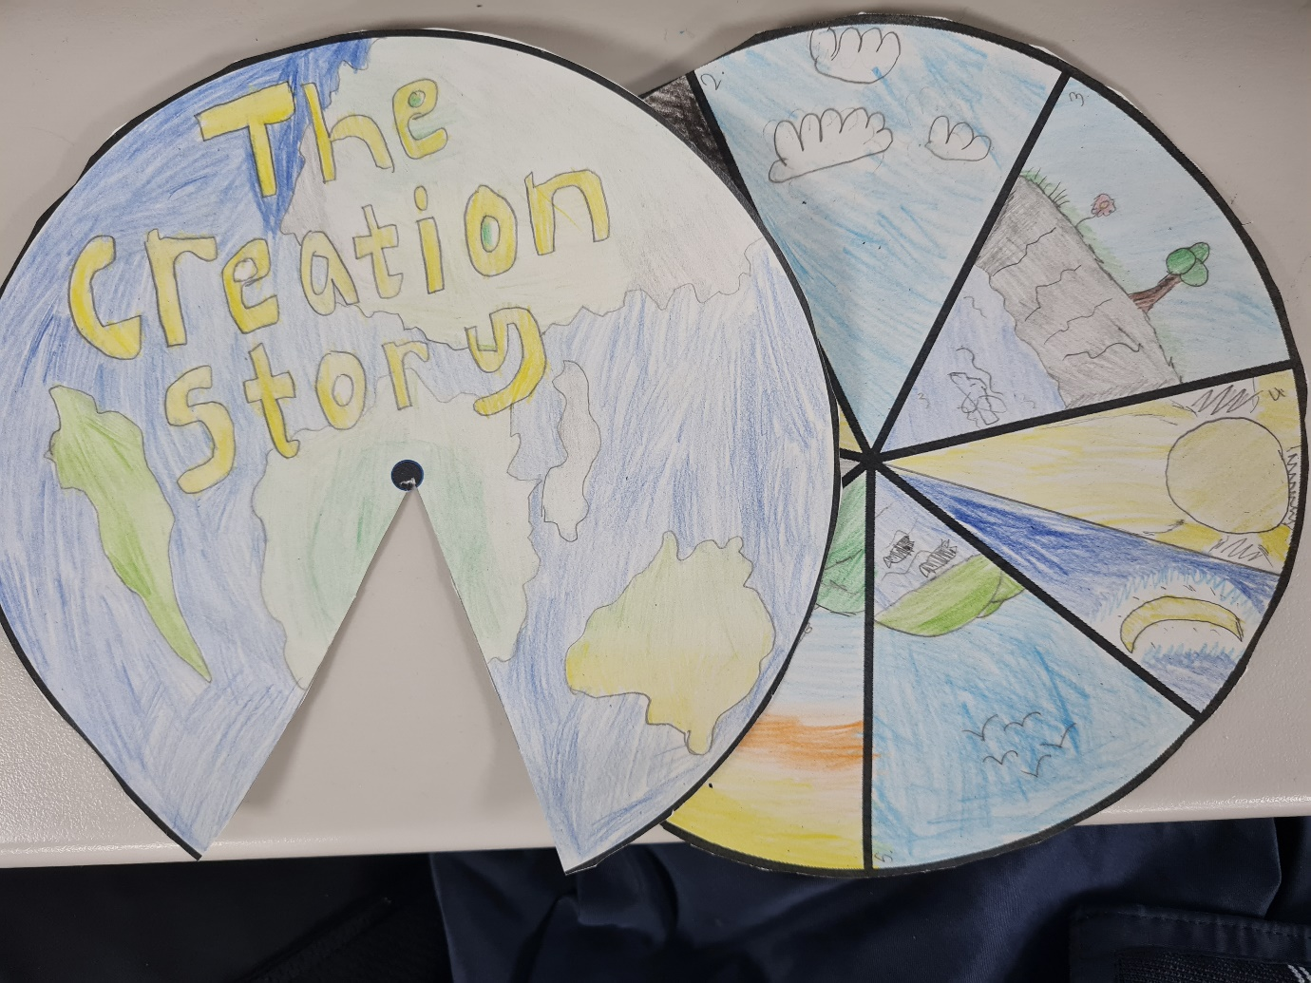

Slide 26
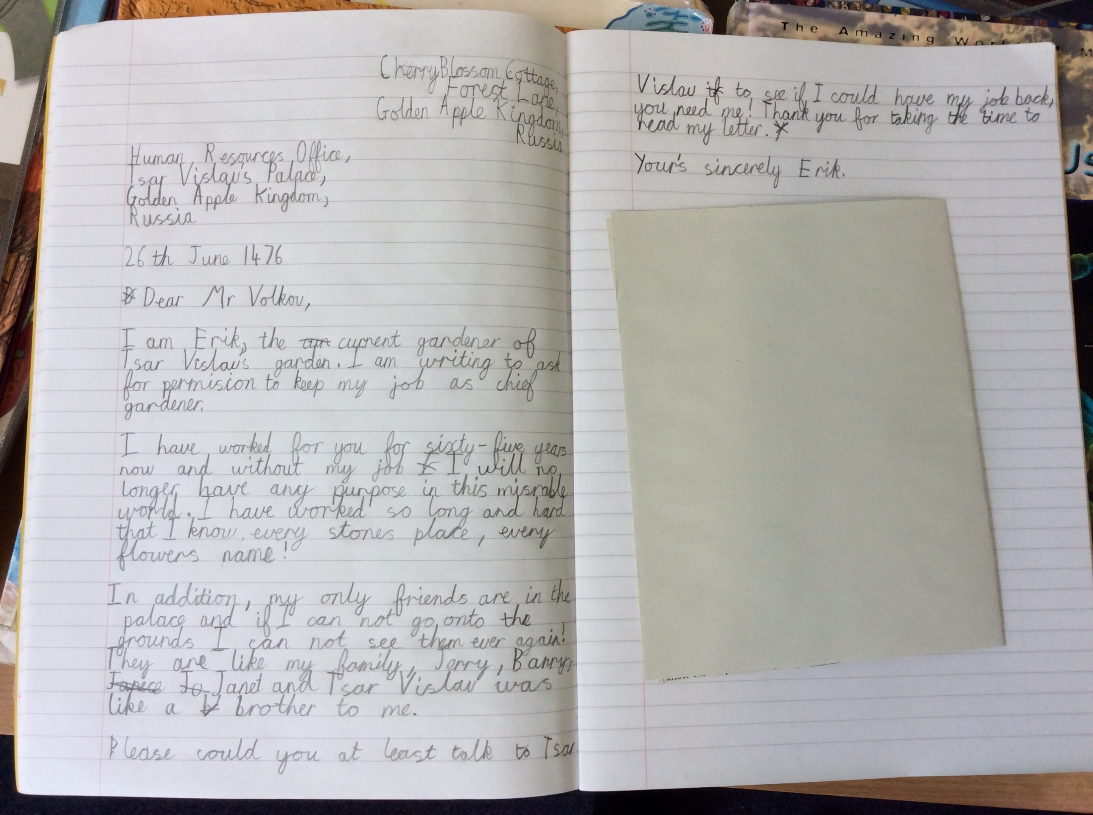

Slide 27
Year 6

Slide 28
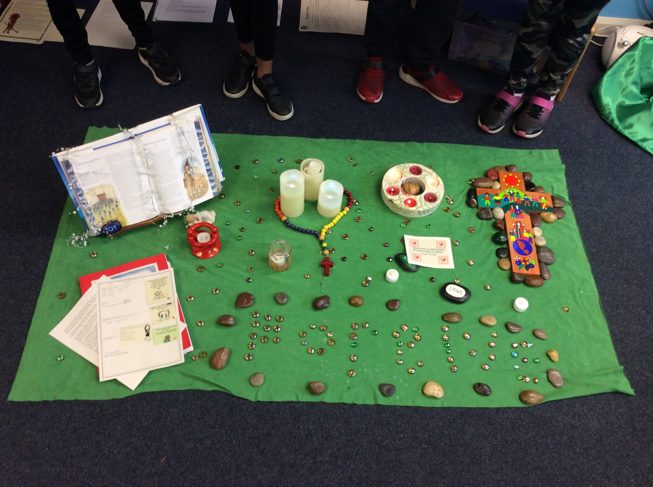

Slide 29
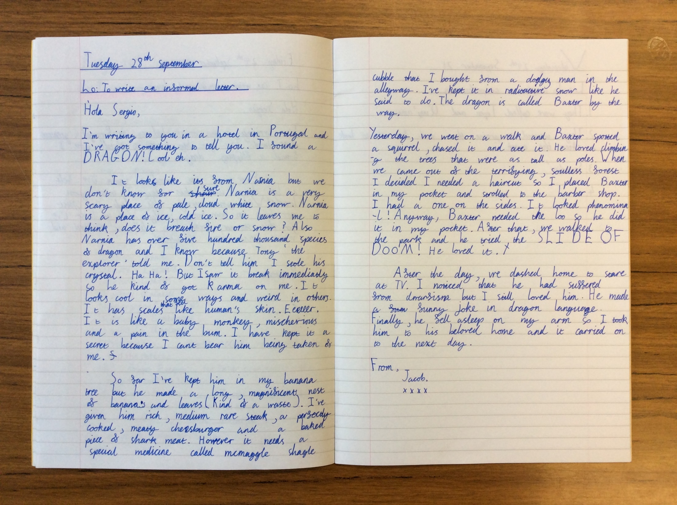

Slide 30
SPORTING SUPERSTARS!!

Slide 31
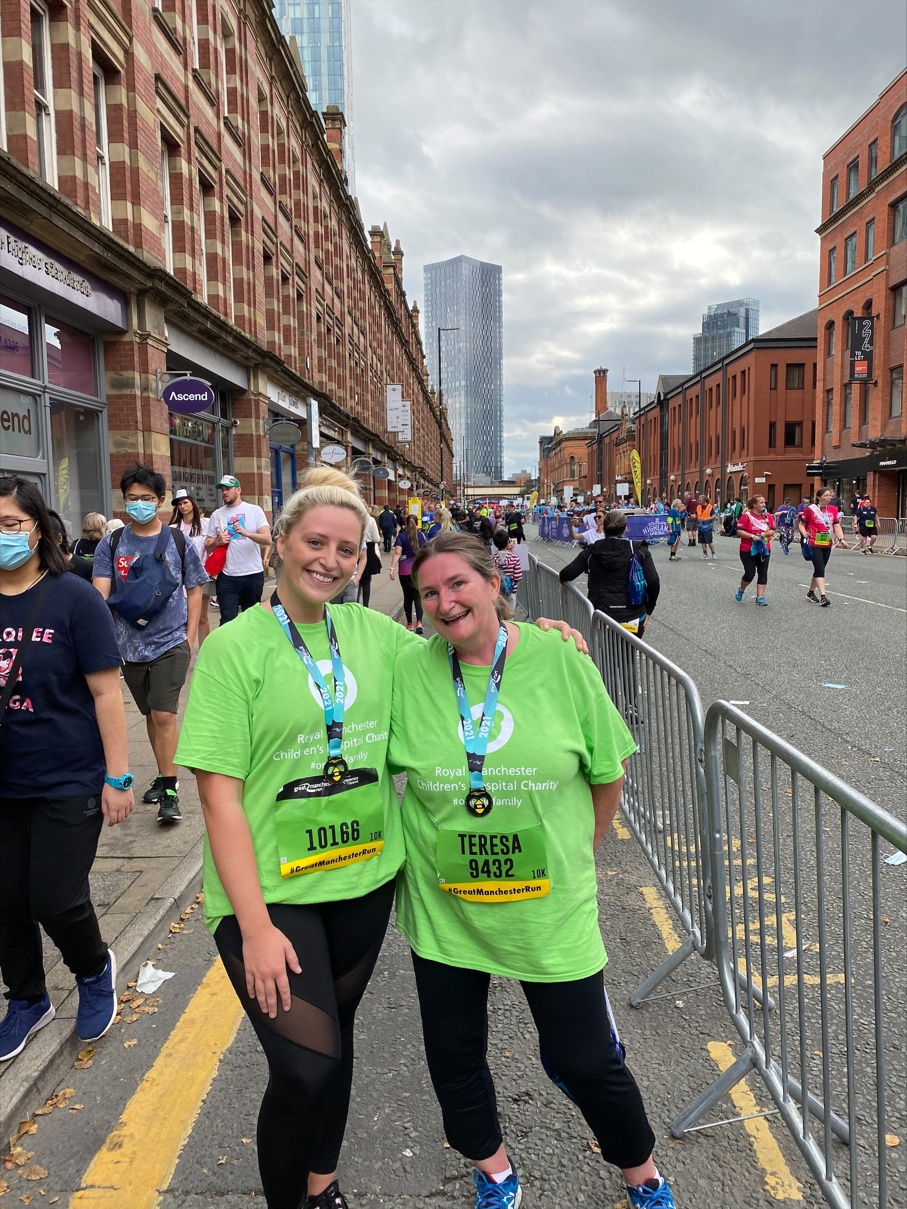

Slide 32


Slide 33
Congratulations to all of our stars of the week!

Slide 34


Slide 35


Slide 36
“Let us allow God to fill our hearts with his goodness.”
(Pope Francis)

Slide 37



Let us pray.
Dear Lord Jesus,
You are the source of all goodness.
Thank you for all the people who help us to grow in goodness
and become the best that we can be.
Amen

Slide 38
Think of a good deed that you can do for others this week!
Notes:
GO FORTH - MISSION

Slide 39
WOW!
WELL DONE EVERYONE!

