Slide 1


CELEBRATION ASSEMBLY
FRIDAY 24TH SEPTEMBER 2021

Slide 2

This is the day that the Lord has made!

Slide 3

Notes:
WORD

Slide 4
Hail Mary
Hail Mary, full of grace
The Lord is with thee.
Blessed art thou among women
And blessed is the fruit
Of thy womb, Jesus.
Holy Mary, mother of God,
Pray for us sinners now
And at the hour of our death.
Amen

Slide 5
Our Father
Our Father, Who art in Heaven,
Hallowed be Thy name.
Thy Kingdom come,
Thy will be done on earth as it is in Heaven.
Give us this day our daily bread
and forgive us our trespasses
as we forgive those who trespass against us
and lead us not into temptation
but deliver us from evil.
Amen

Slide 6
Dear Lord,
Please bless our school
As we try to
Love, learn,
Share and respect
In the light of Jesus.
St Alban, pray for us.
Amen

Slide 7
“If anyone wants to be first, they must put themselves last of all and become the servant of all.”

Slide 8

Reception

Slide 9
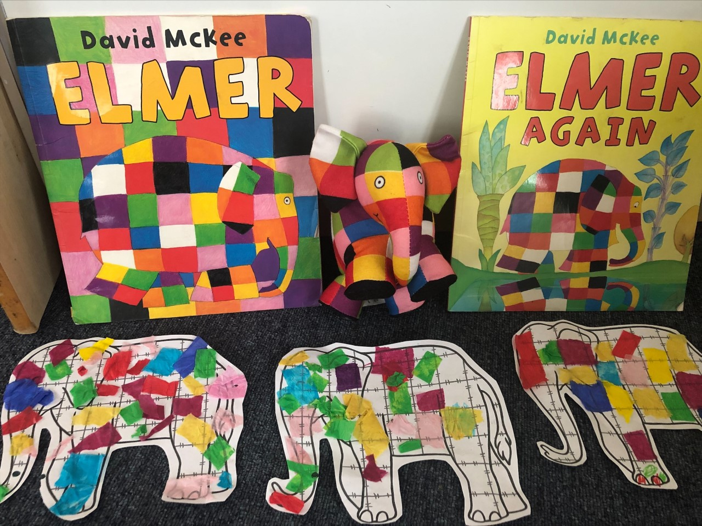

Slide 10
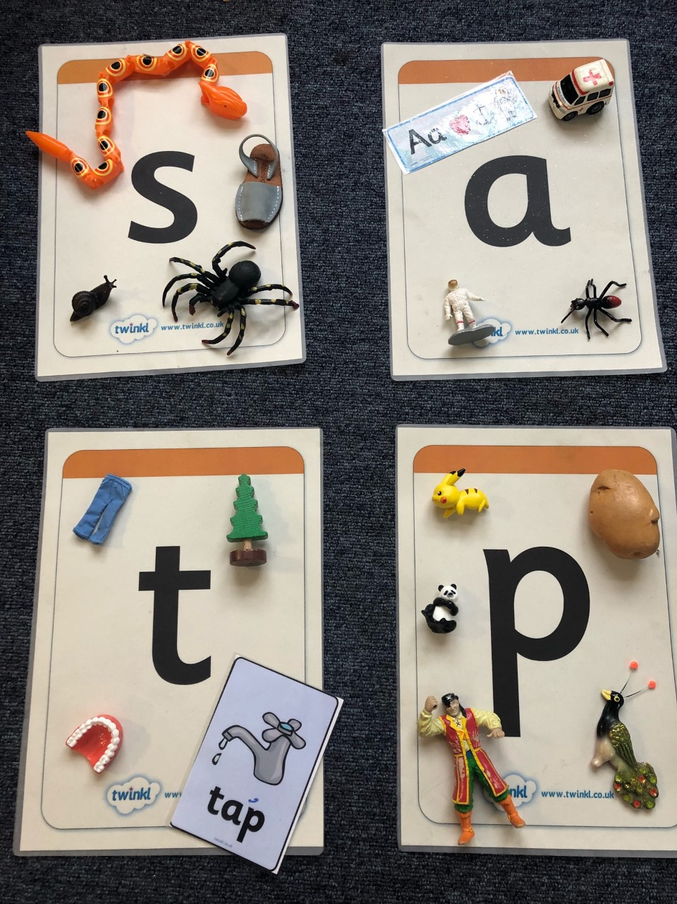

Slide 11
Year 1

Slide 12
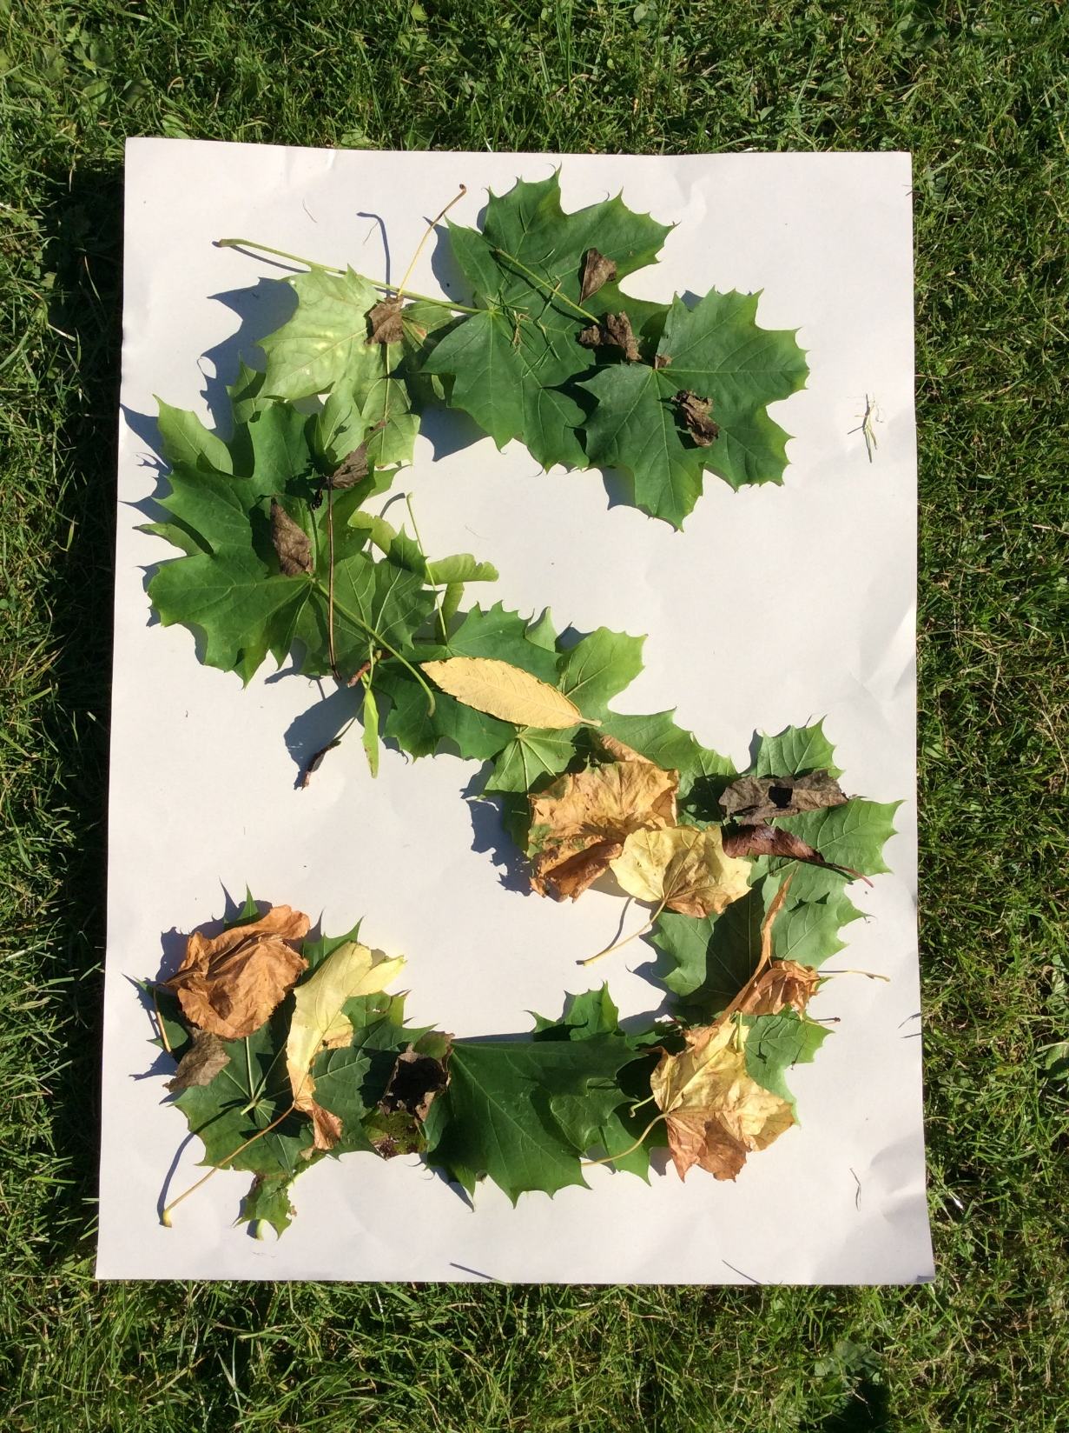

Slide 13
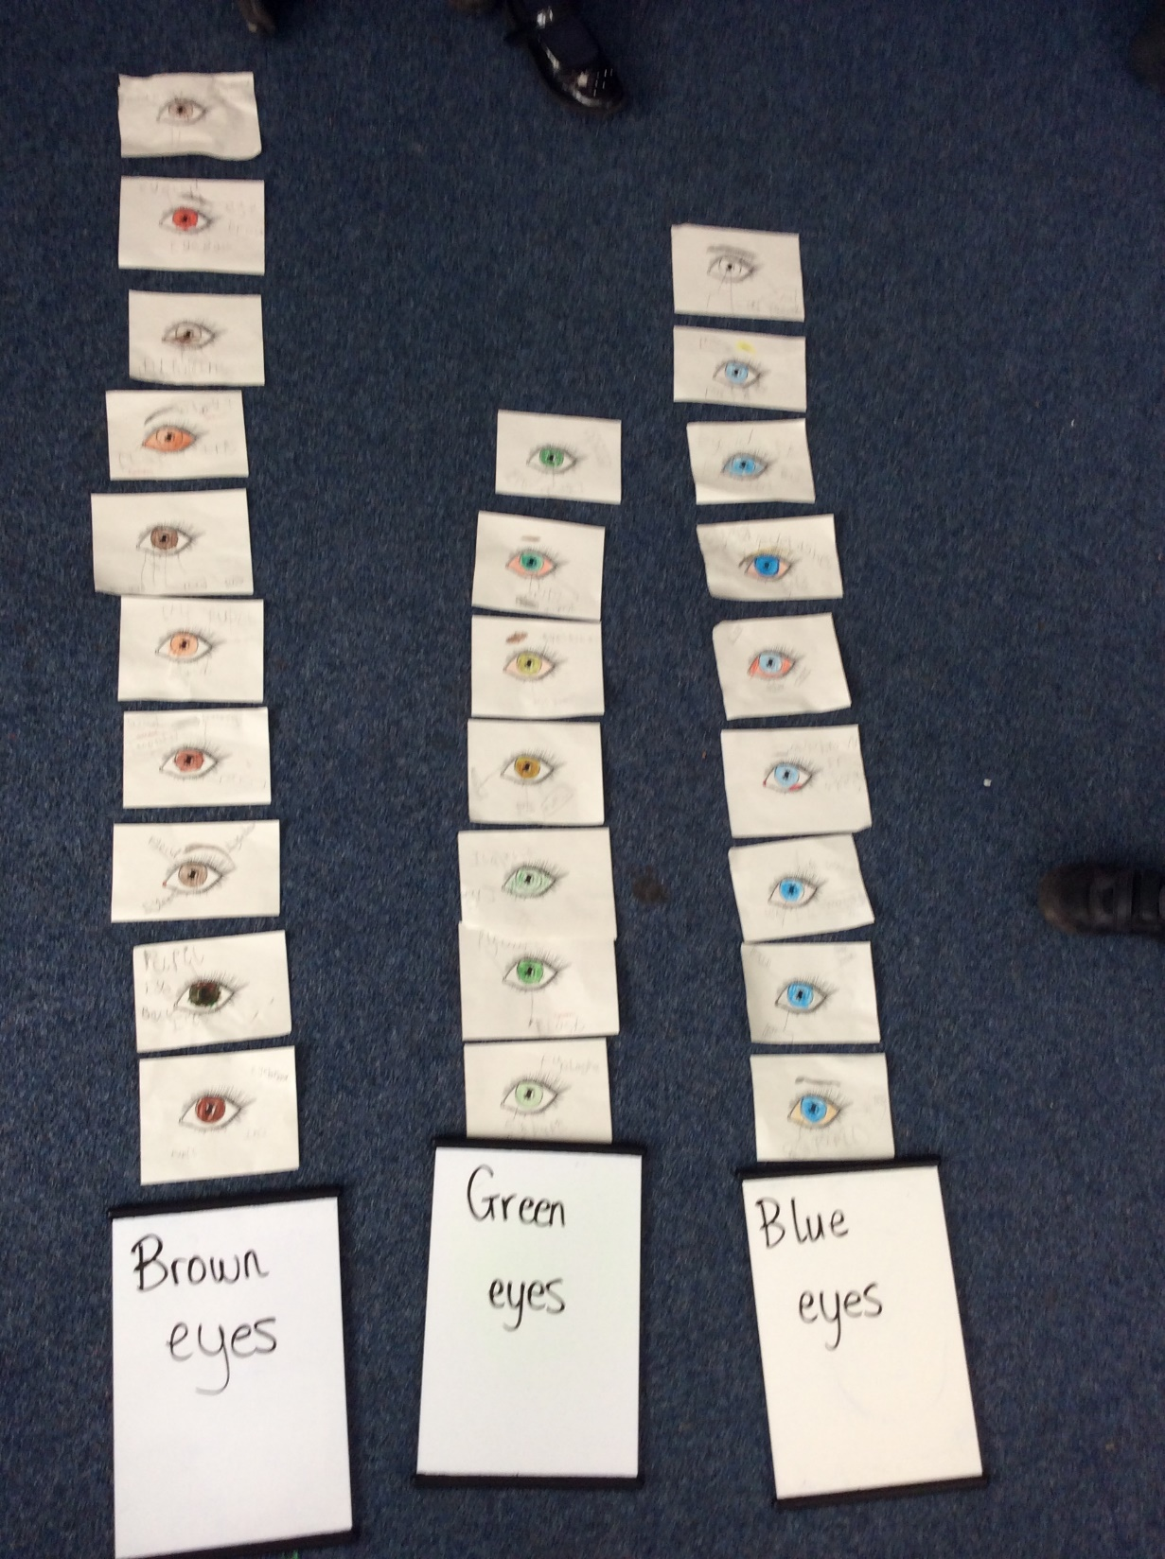

Slide 14
Year 2

Slide 15
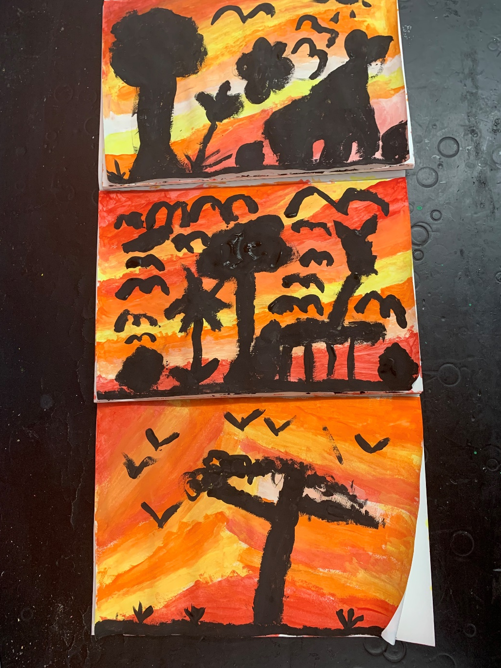

Slide 16
Year 3

Slide 17
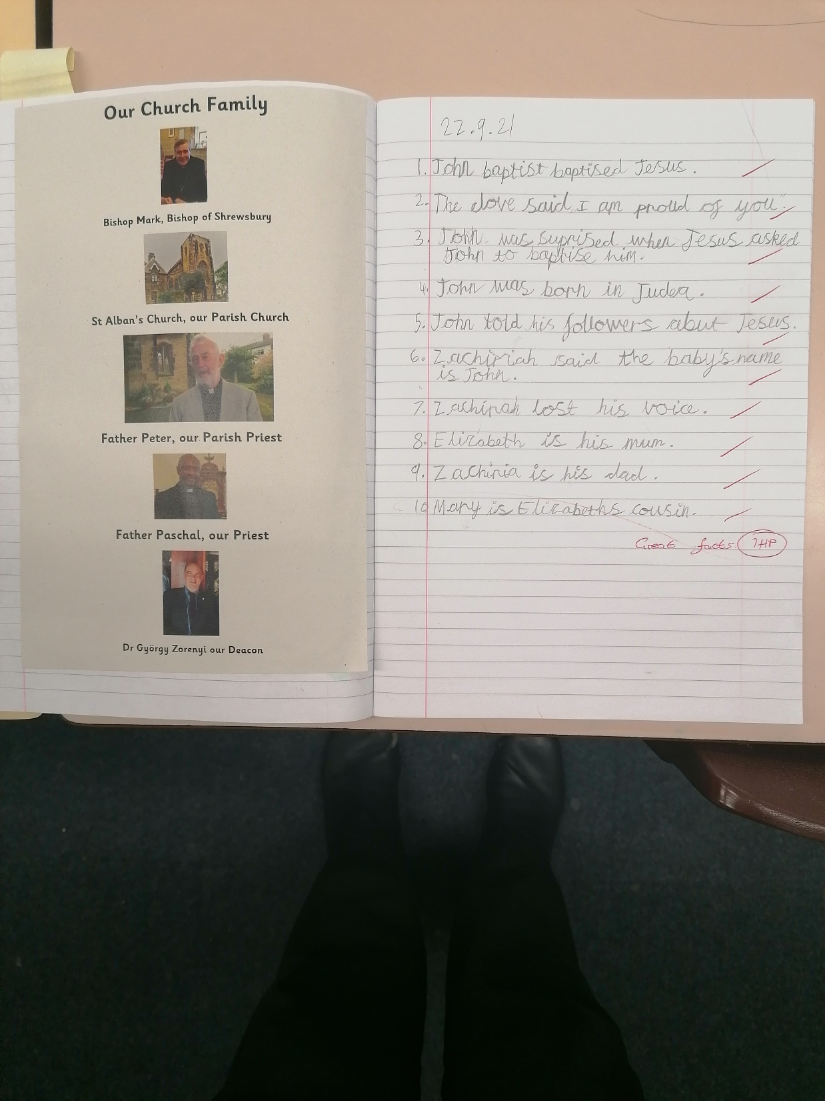

Slide 18
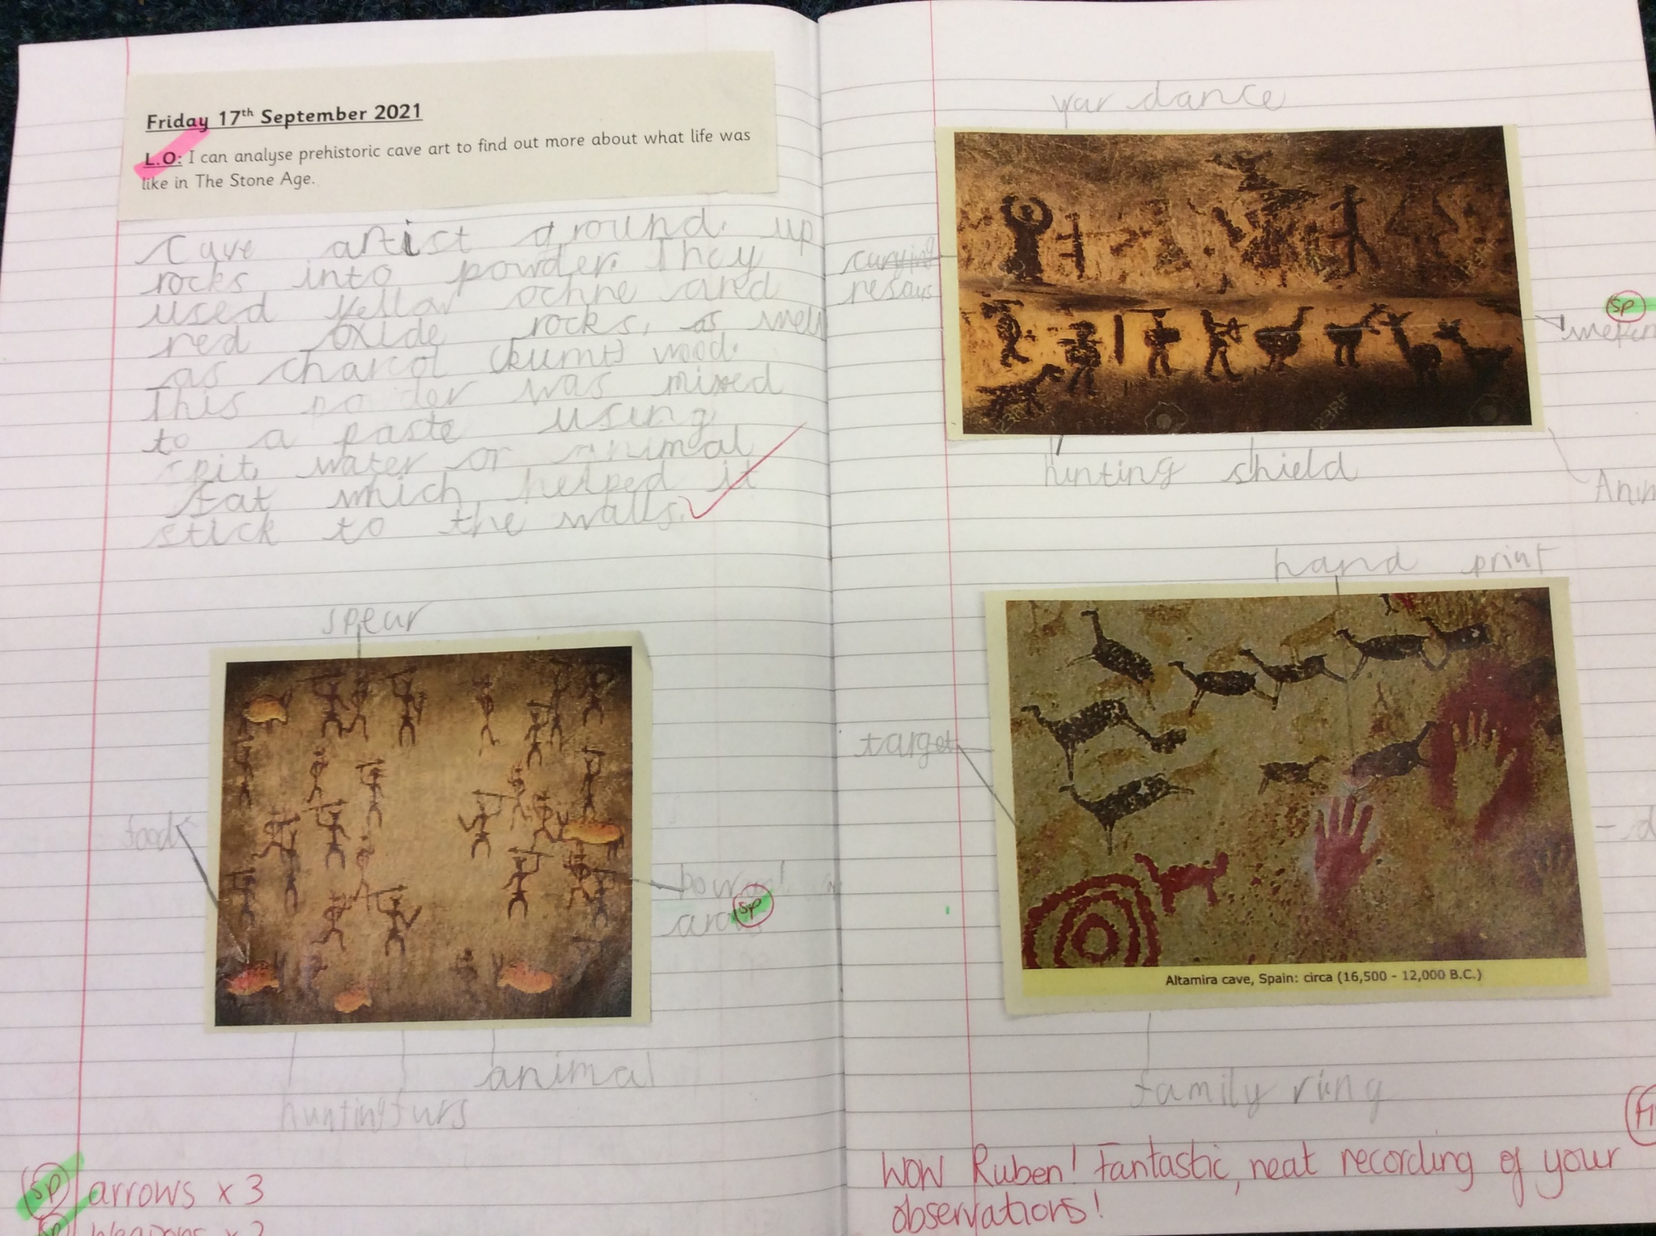

Slide 19
Year 4

Slide 20
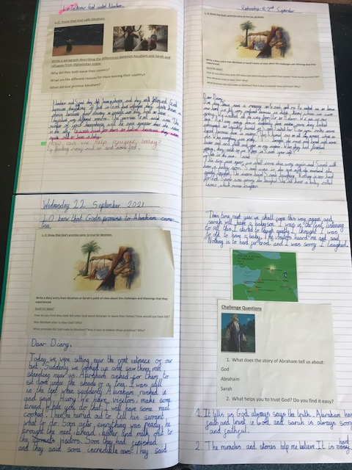

Slide 21
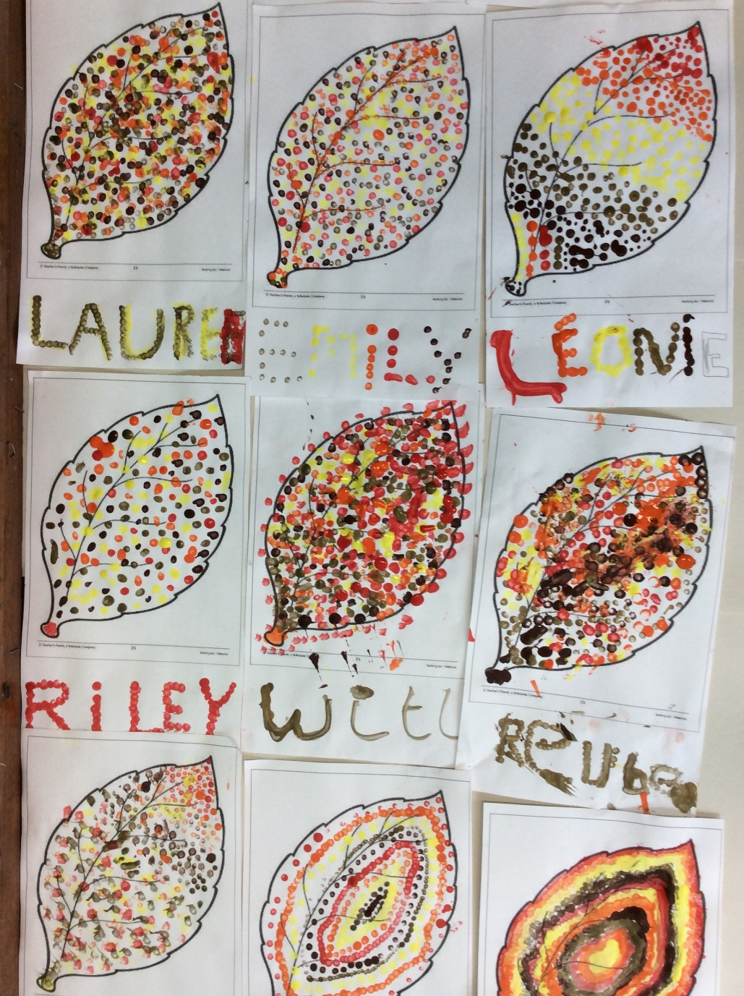

Slide 22
Year 5

Slide 23
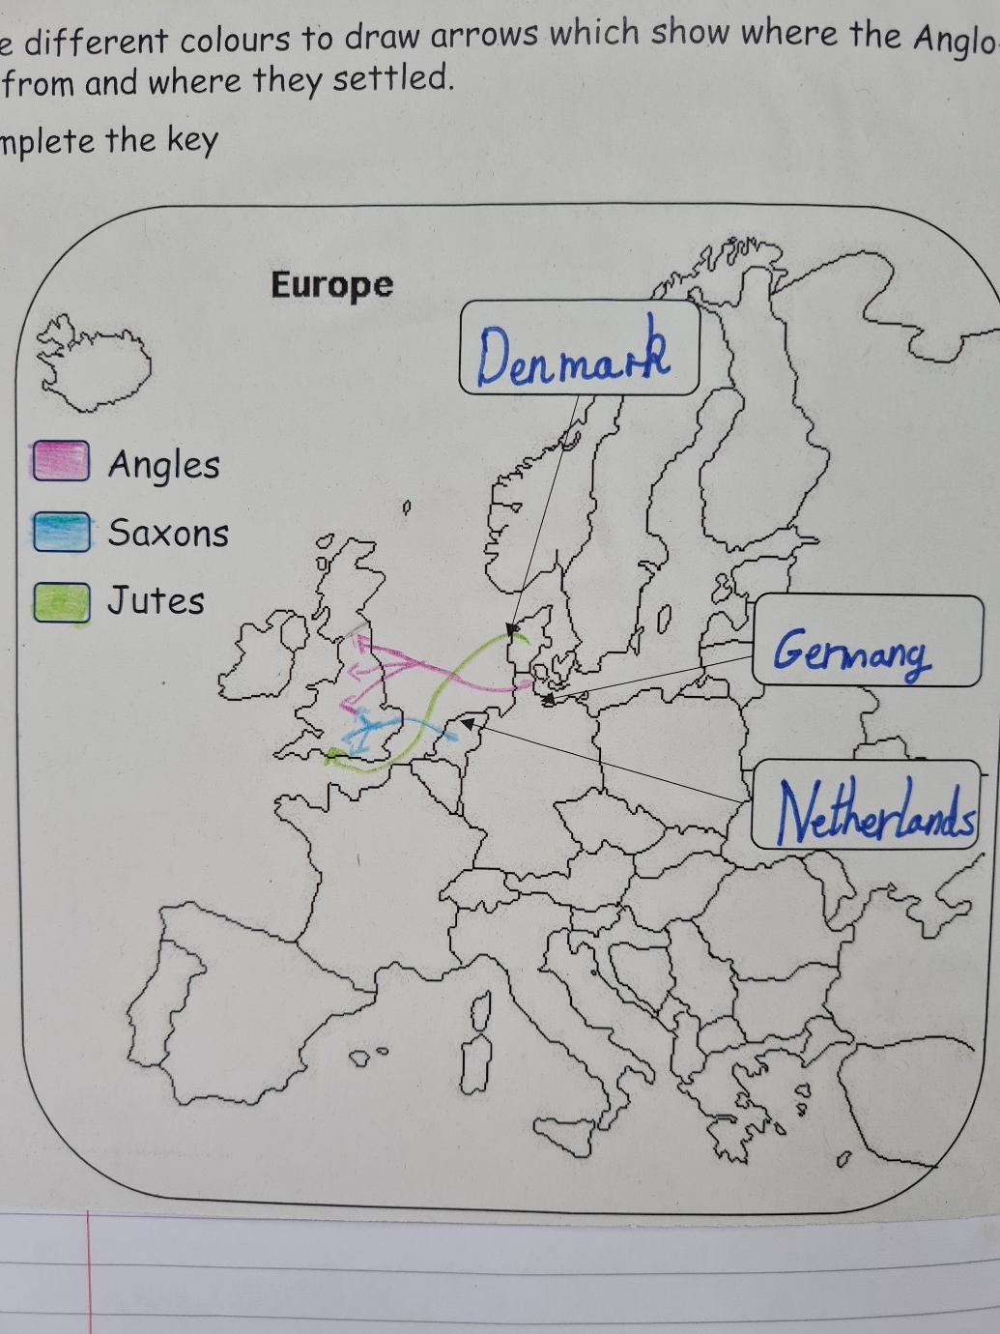

Slide 24
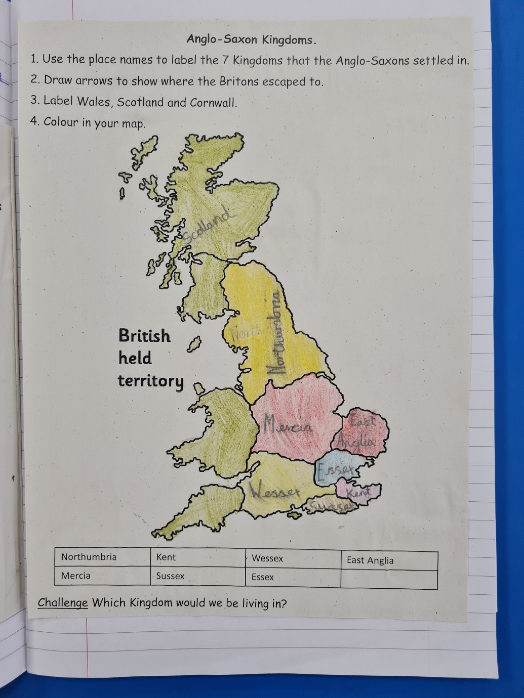

Slide 25
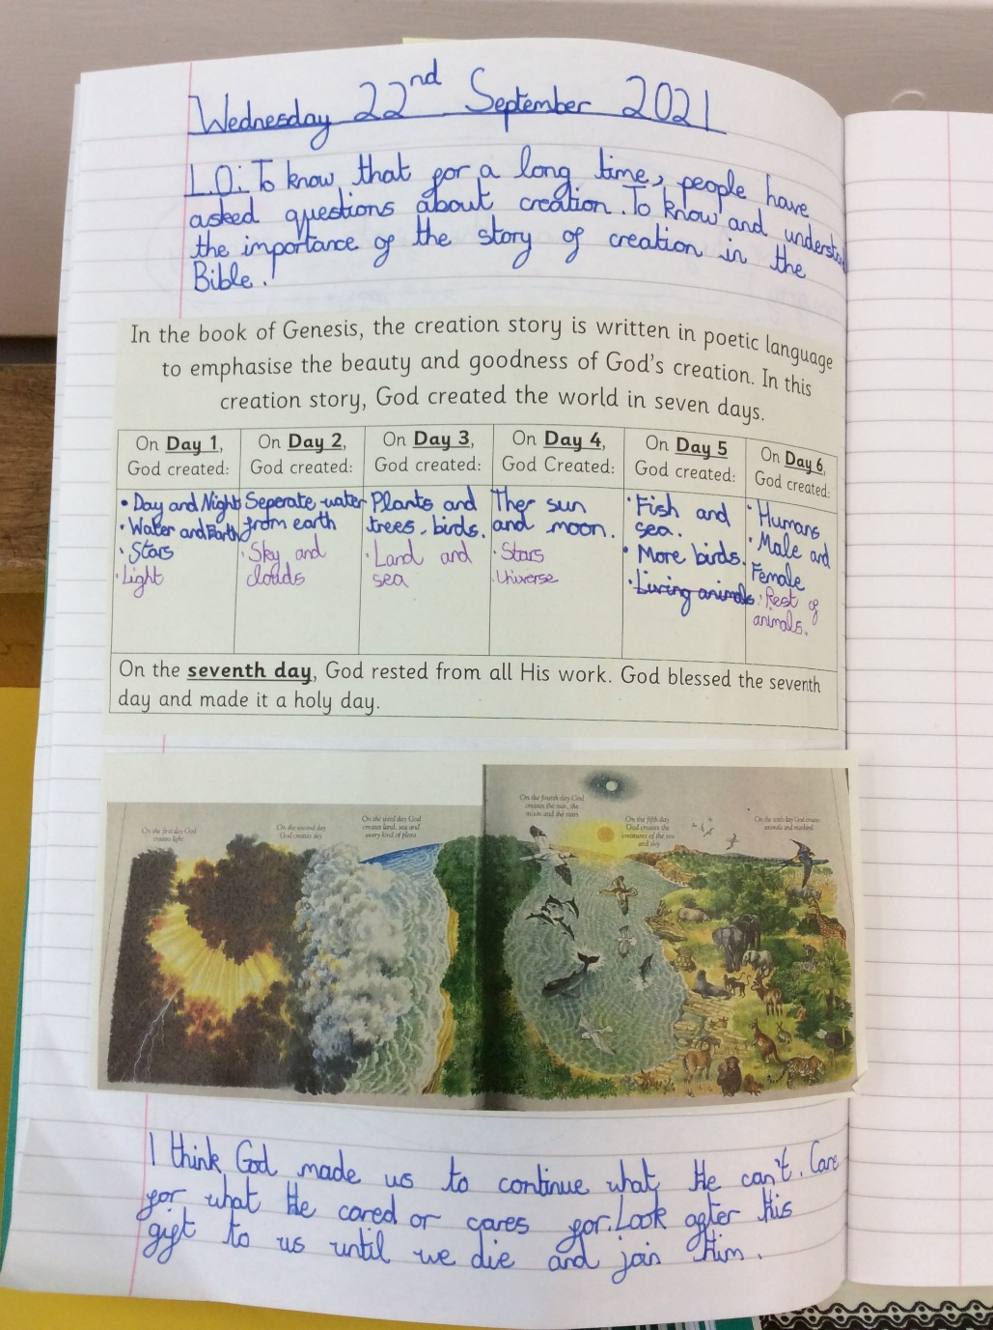

Slide 26
Year 6

Slide 27
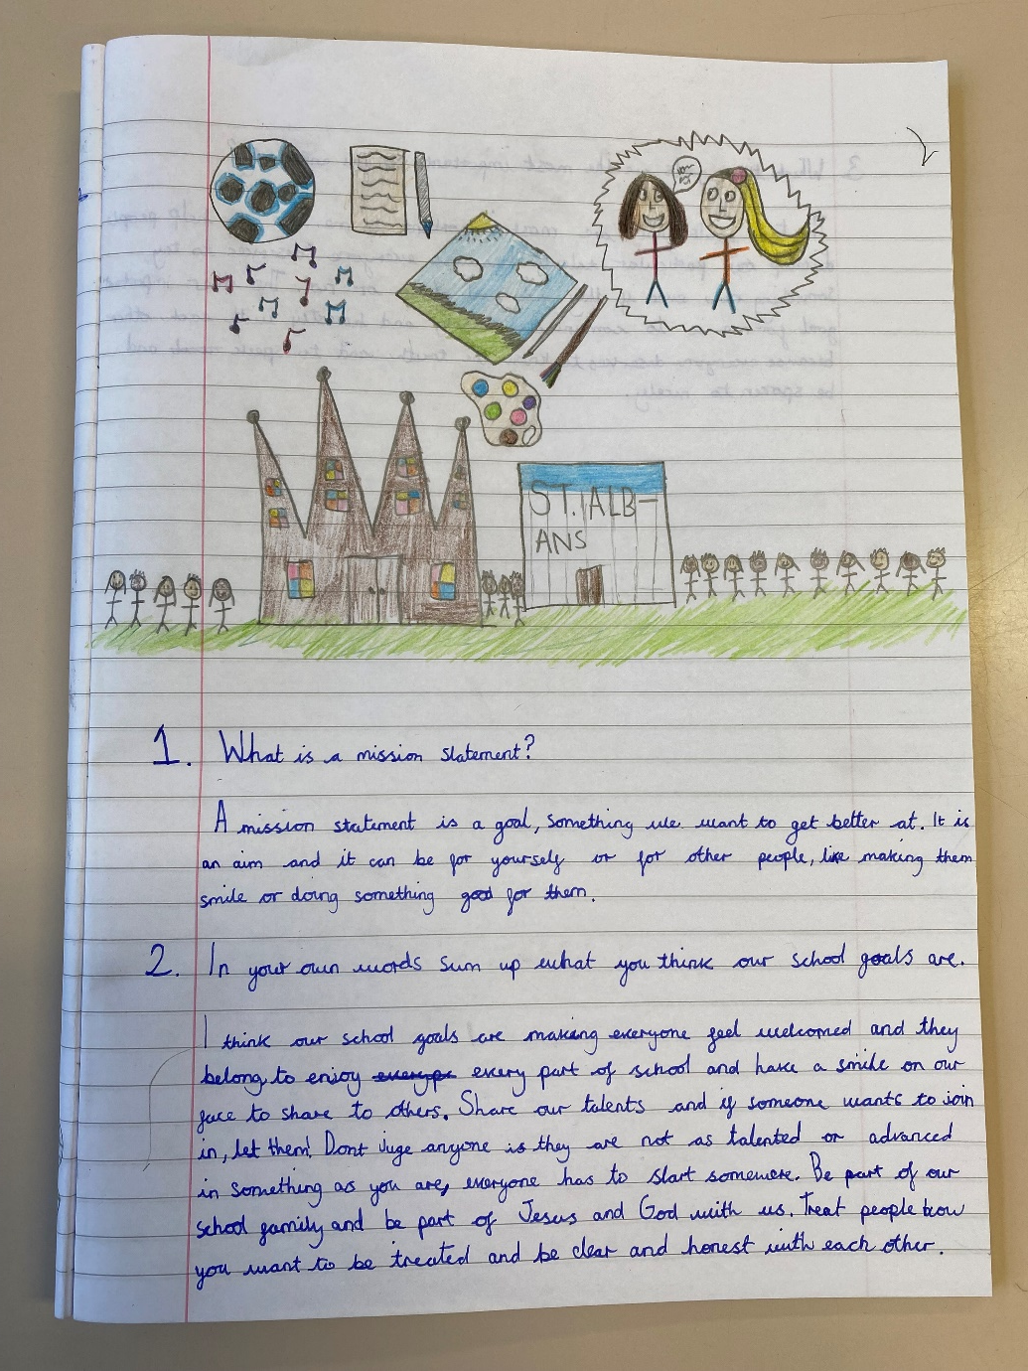

Slide 28
SPORTING SUPERSTARS!!

Slide 29
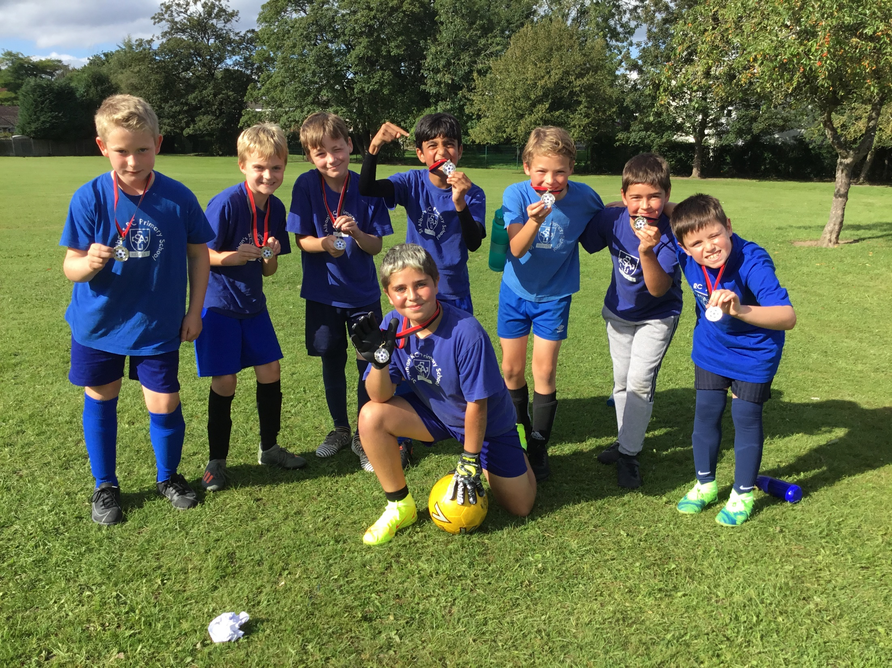

Slide 30
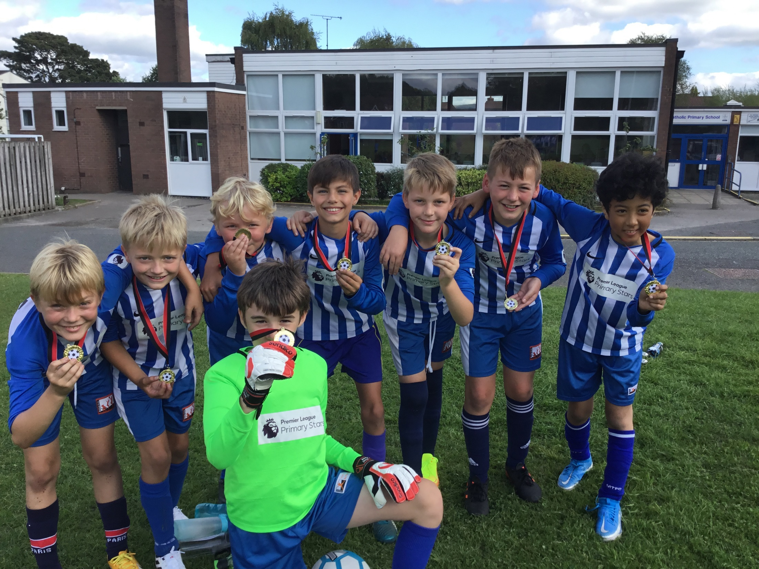

Slide 31


Slide 32
Congratulations to all of our stars of the week!

Slide 33


Slide 34


Slide 35
Jesus the Servant King

Slide 36
“There is nothing
small in the service of God.”
(St Francis de Sales)

Slide 37



St. Alban’s Mission Statement.
Love, learn, share and respect in the light of Jesus

Slide 38
St. Alban’s Mission Statement.
love

Slide 39
St. Alban’s Mission Statement.
learn

Slide 40
St. Alban’s Mission Statement.
share

Slide 41
St. Alban’s Mission Statement.
respect

Slide 42



Let us pray.
Dear Lord Jesus,
You led by example in serving others.
Please help us to serve those around us in any little way that we can as we try our best to love, learn, share and respect in your light.
Amen.

Slide 43
What little thing can we do to serve others this week?
Notes:
GO FORTH - MISSION

Slide 44
WOW!
WELL DONE EVERYONE!

