Slide 1


CELEBRATION ASSEMBLY
FRIDAY 17TH SEPTEMBER 2021

Slide 2

This is the day that the Lord has made!

Slide 3

Notes:
WORD

Slide 4
Hail Mary
Hail Mary, full of grace
The Lord is with thee.
Blessed art thou among women
And blessed is the fruit
Of thy womb, Jesus.
Holy Mary, mother of God,
Pray for us sinners now
And at the hour of our death.
Amen

Slide 5
Our Father
Our Father, Who art in Heaven,
Hallowed be Thy name.
Thy Kingdom come,
Thy will be done on earth as it is in Heaven.
Give us this day our daily bread
and forgive us our trespasses
as we forgive those who trespass against us
and lead us not into temptation
but deliver us from evil.
Amen

Slide 6
Dear Lord,
Please bless our school
As we try to
Love, learn,
Share and respect
In the light of Jesus.
St Alban, pray for us.
Amen

Slide 7
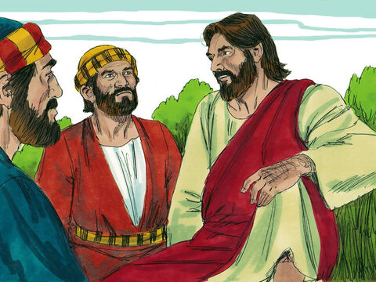
“Who do you say that I am?”

Slide 8

Reception

Slide 9
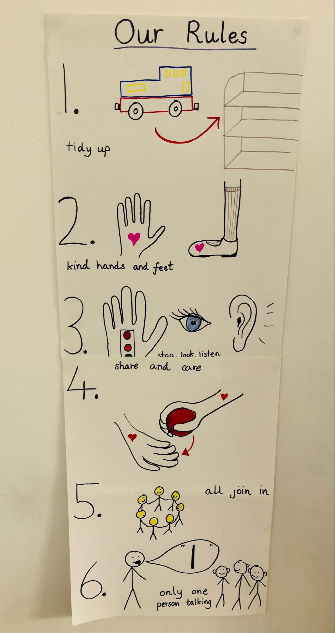

Slide 10
Year 1

Slide 11
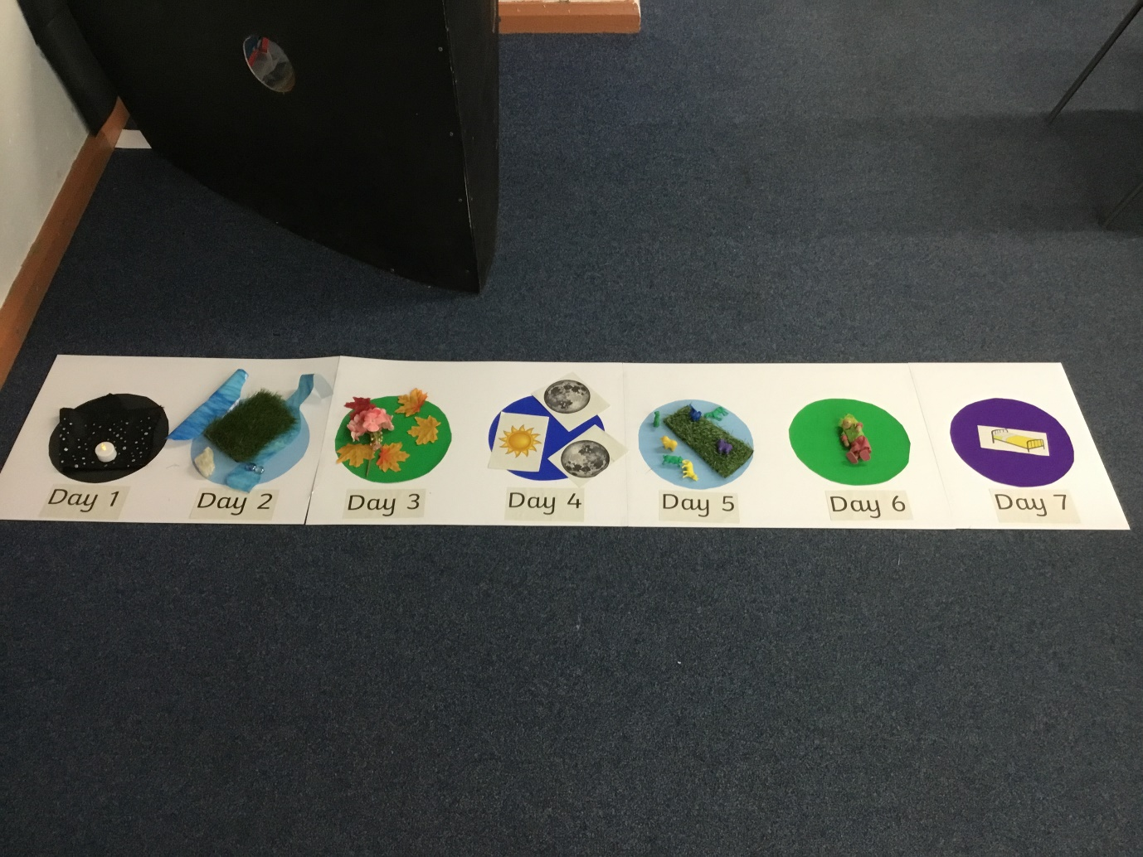

Slide 12
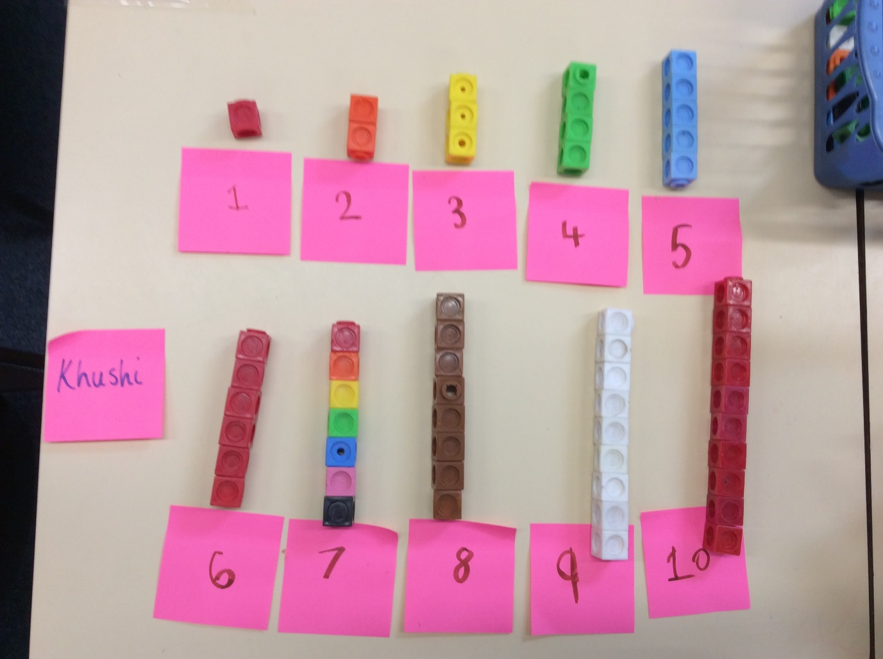

Slide 13
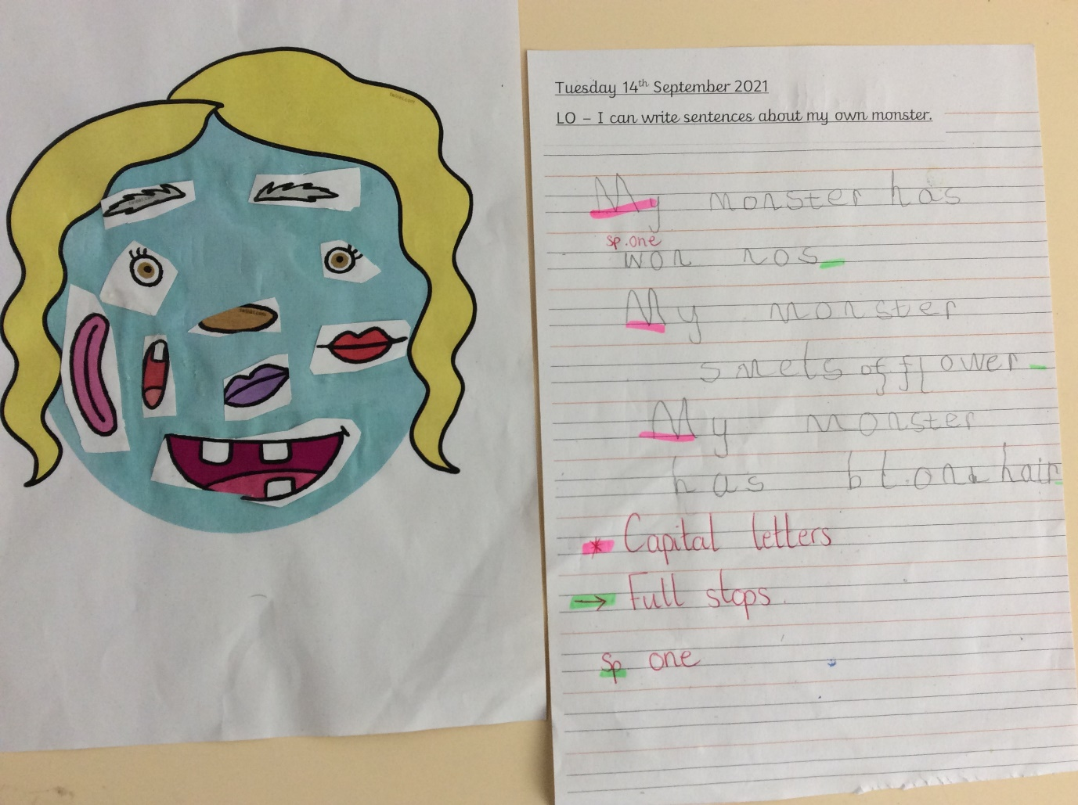

Slide 14
Year 2

Slide 15
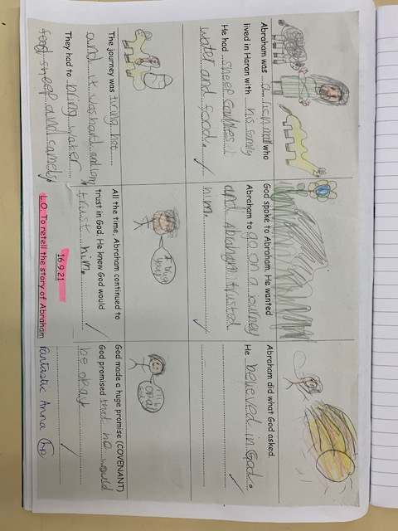

Slide 16
Year 3

Slide 17
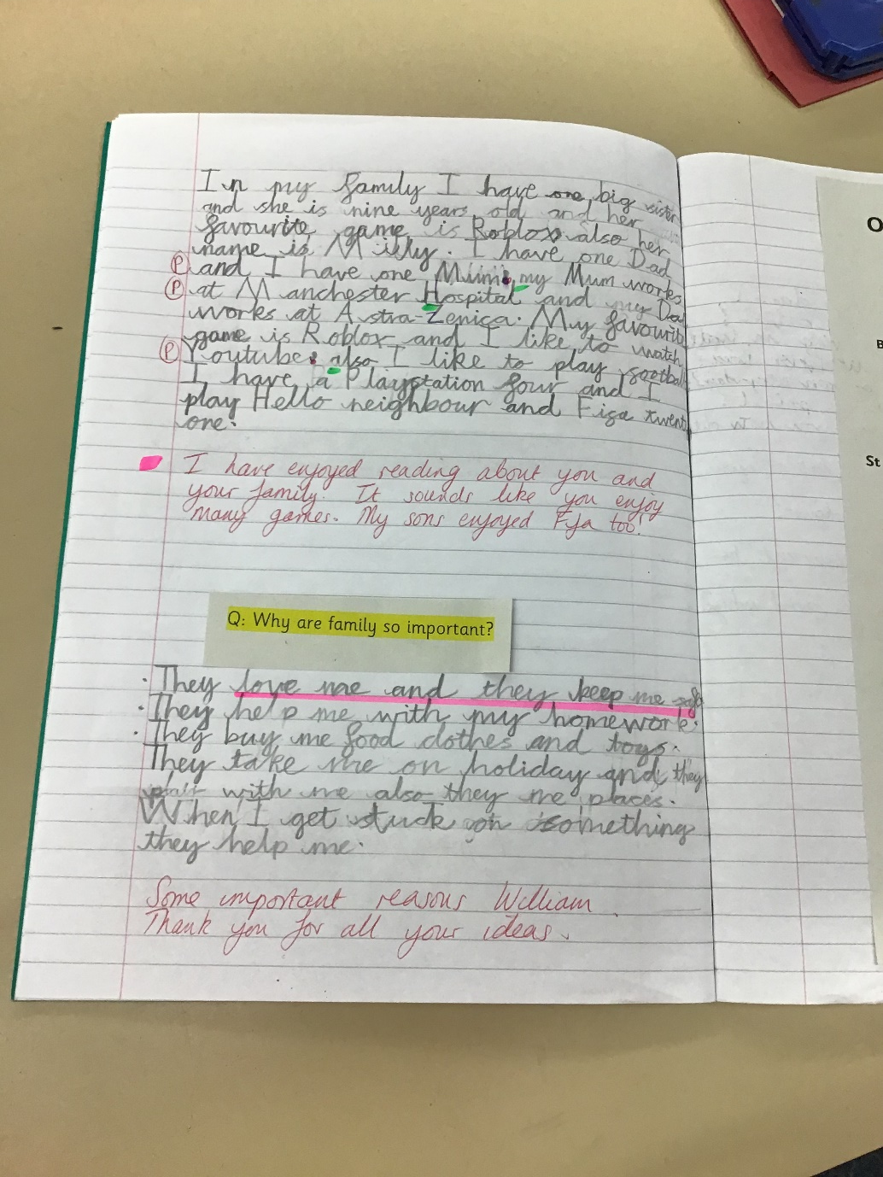

Slide 18
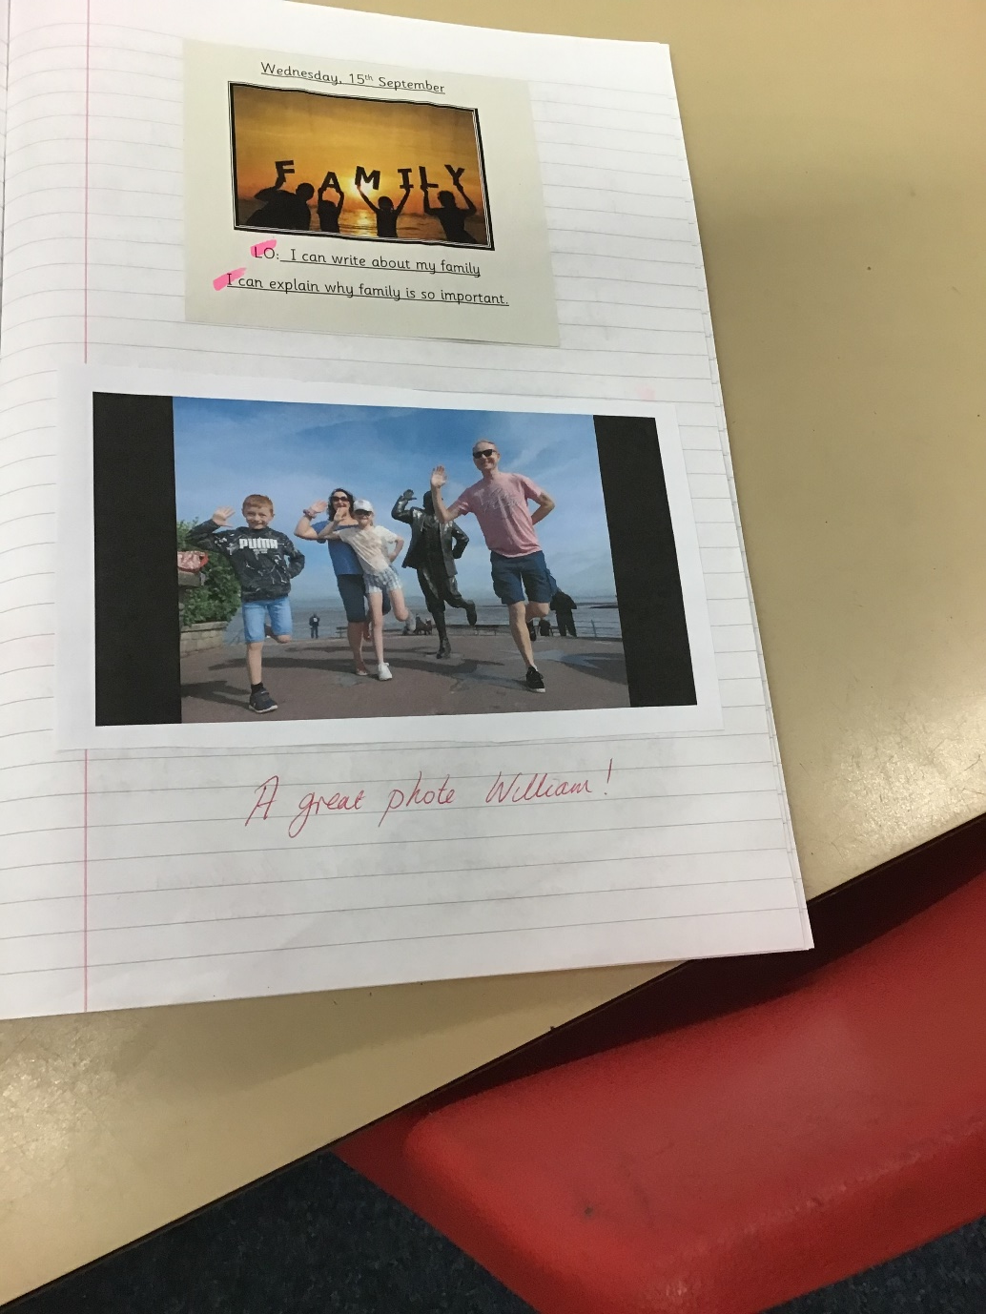

Slide 19
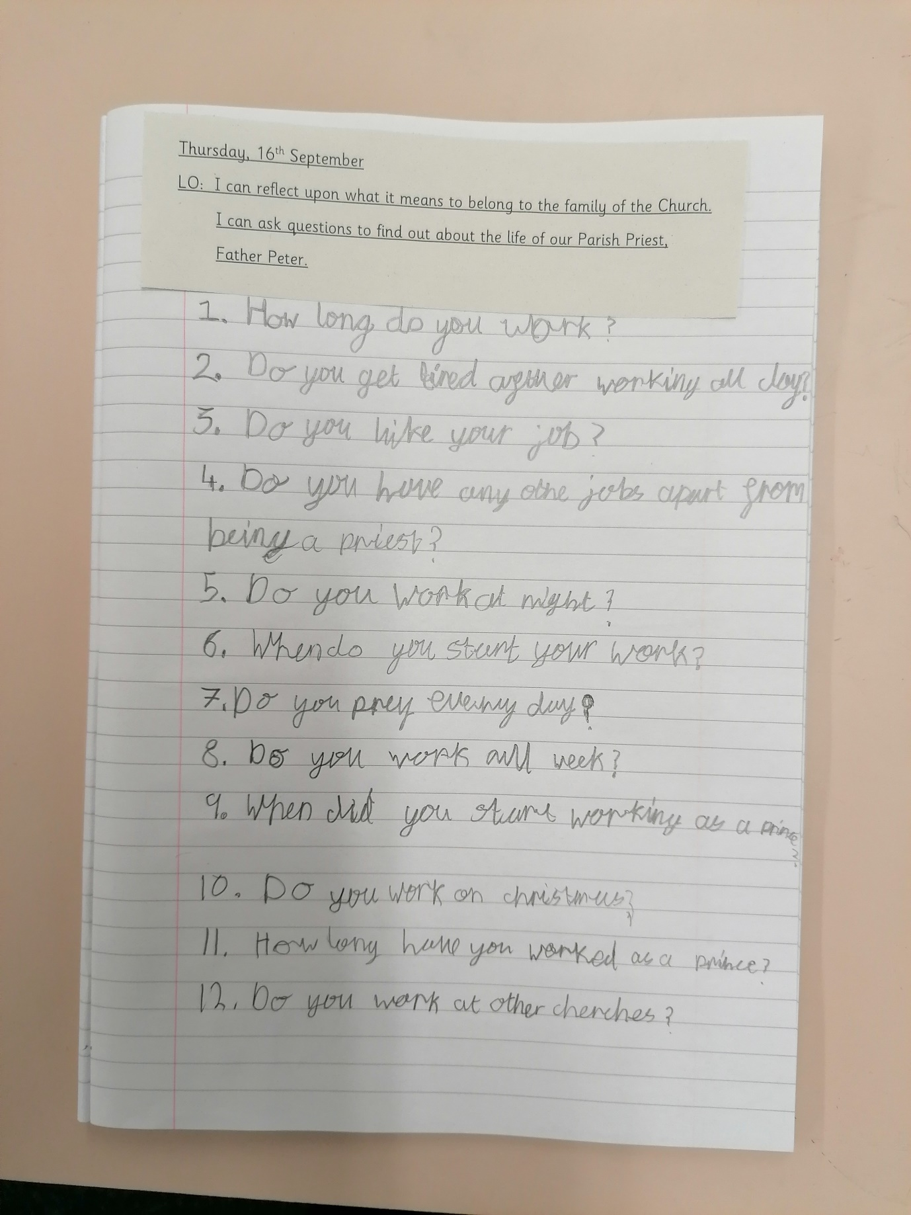

Slide 20
Year 4

Slide 21
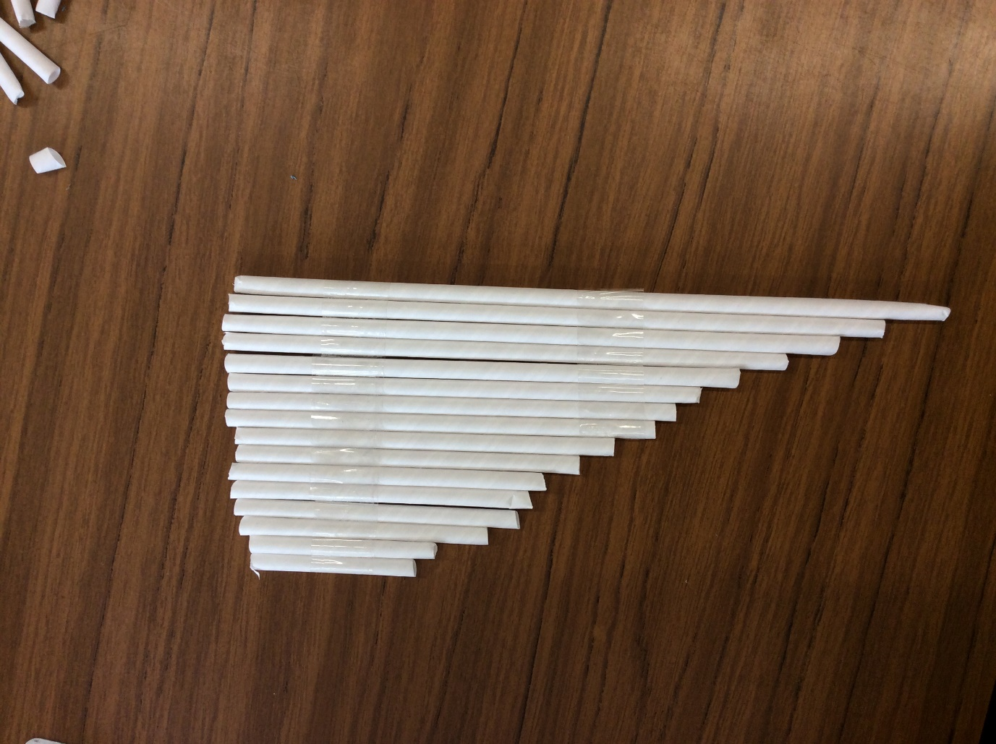

Slide 22
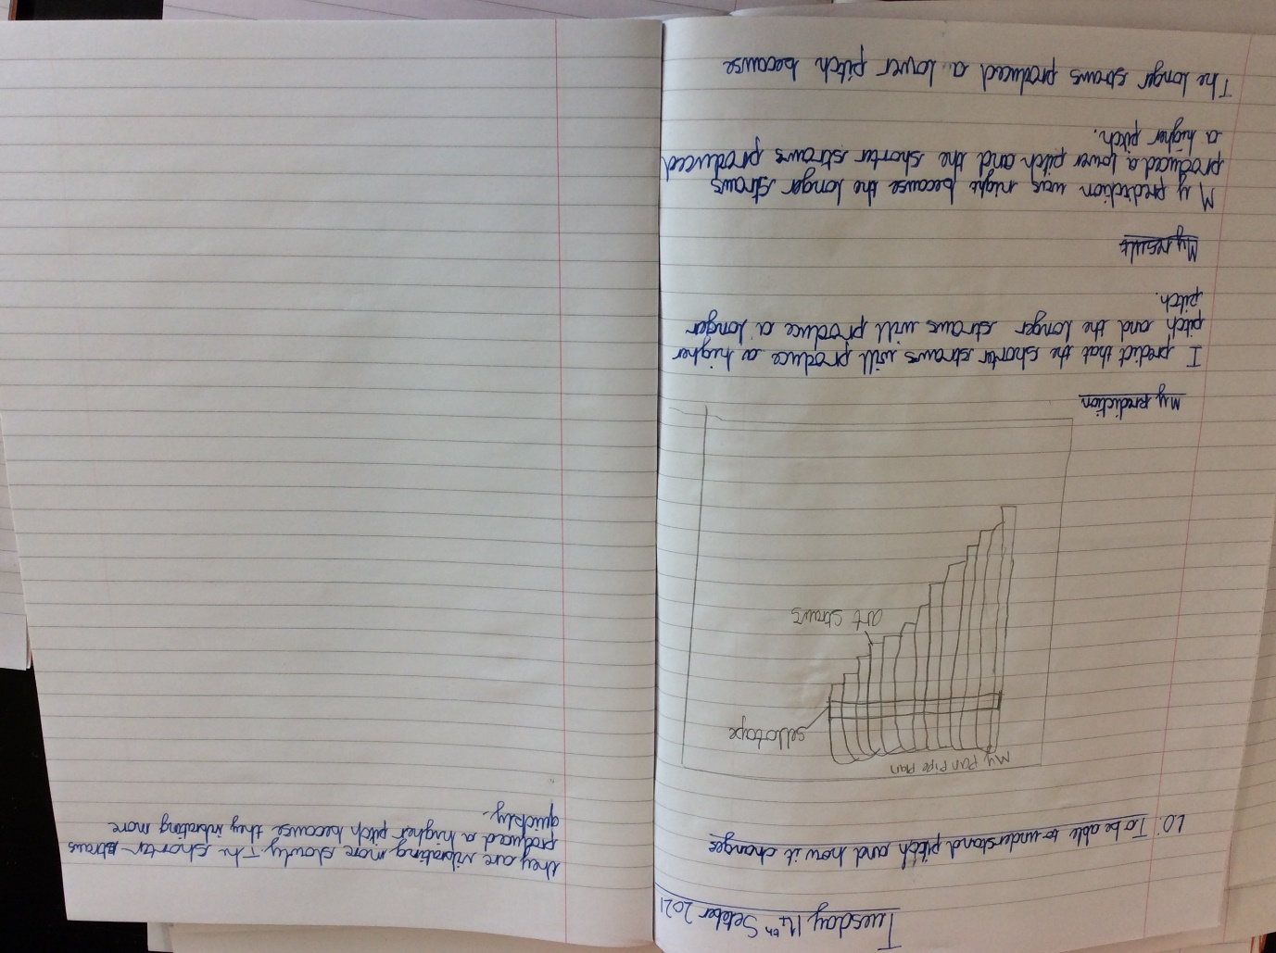

Slide 23
Year 5

Slide 24
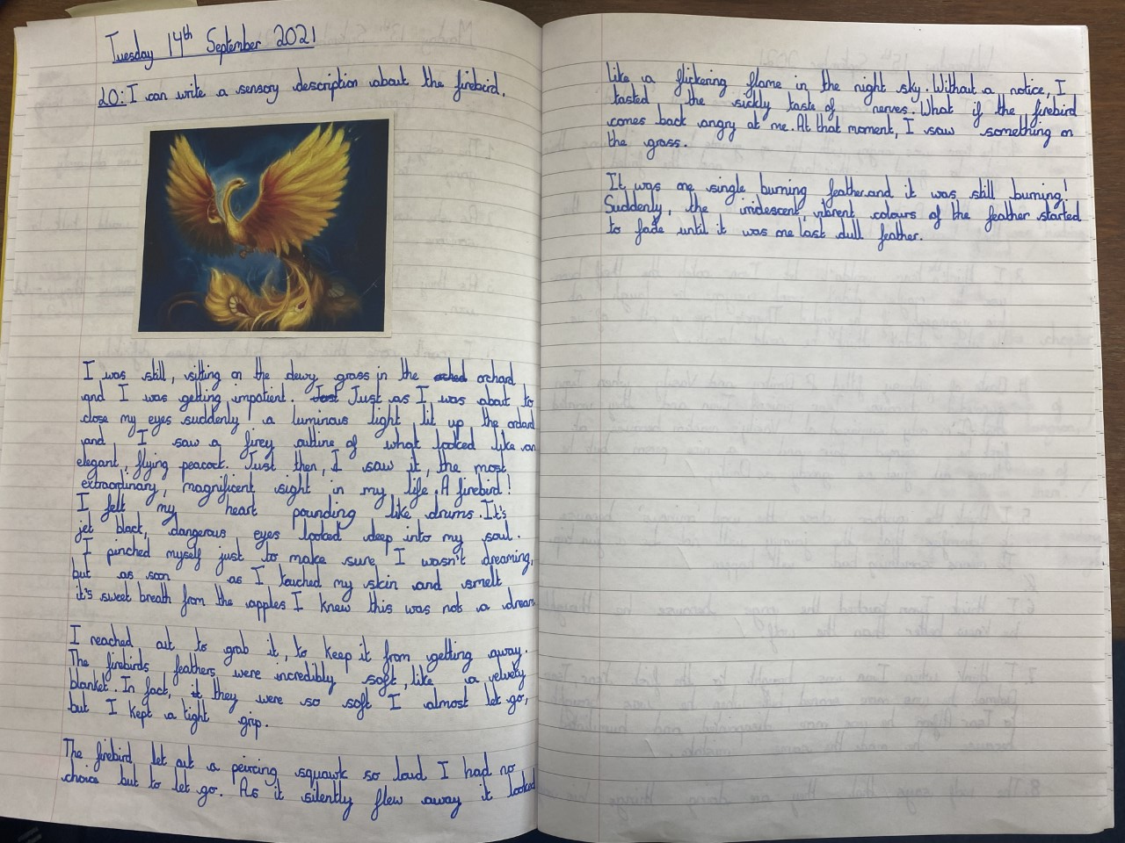

Slide 25
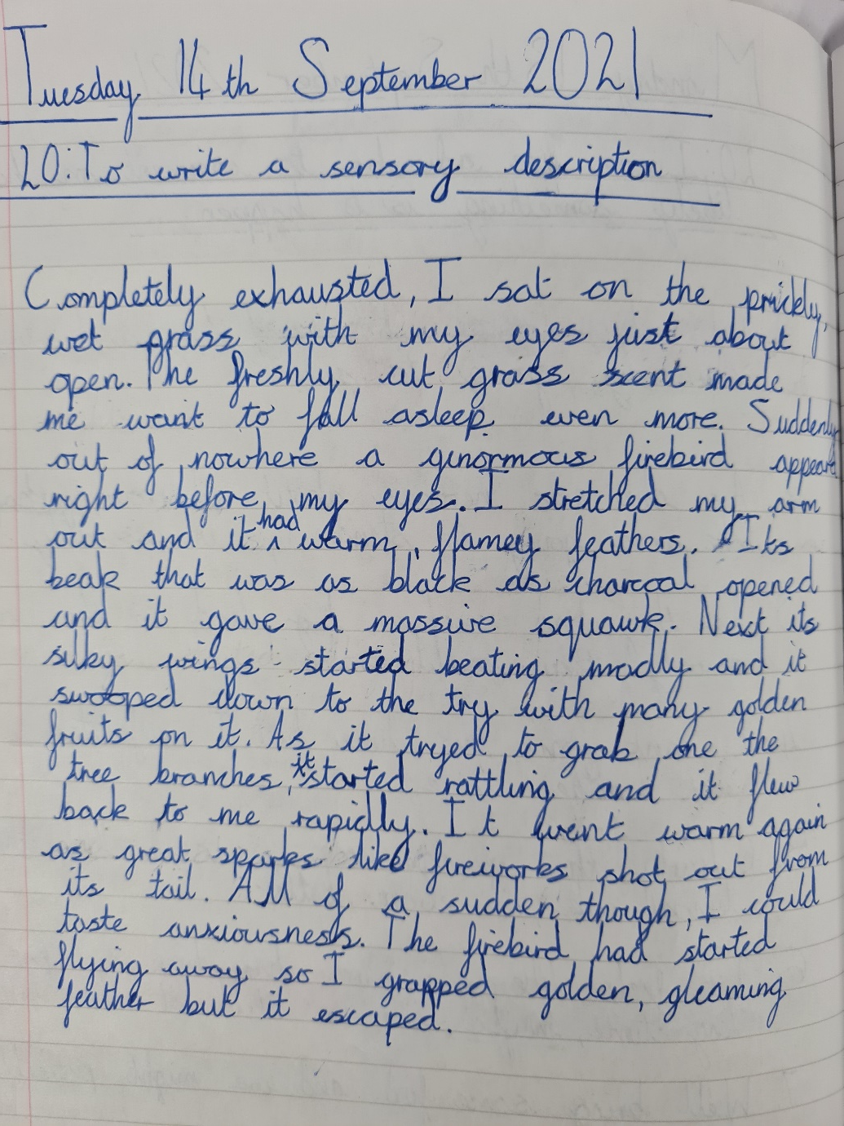

Slide 26
Year 6

Slide 27
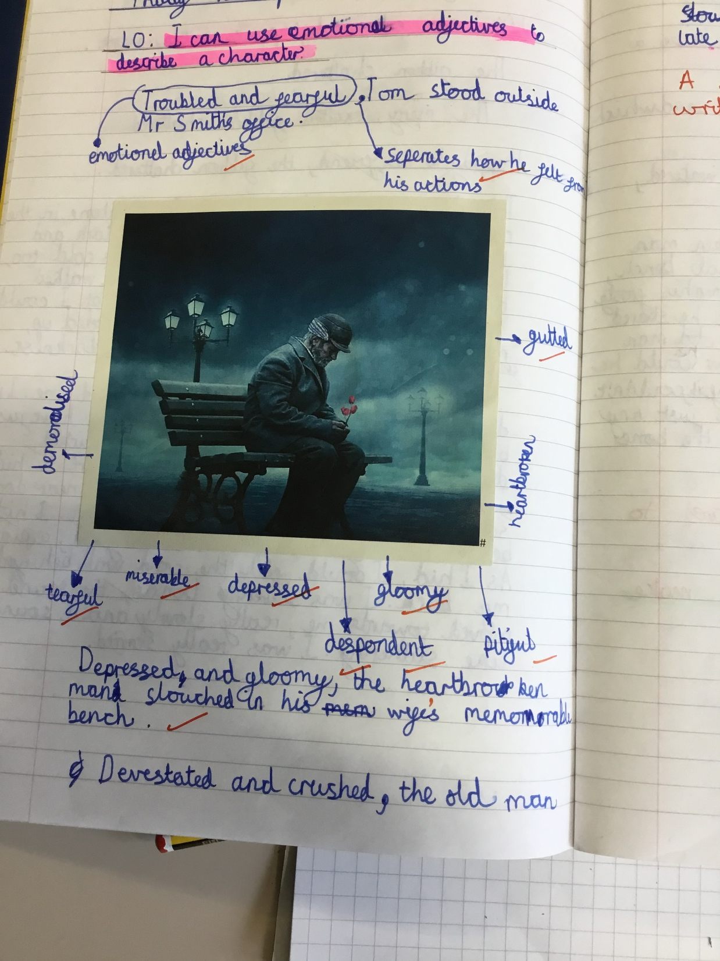

Slide 28
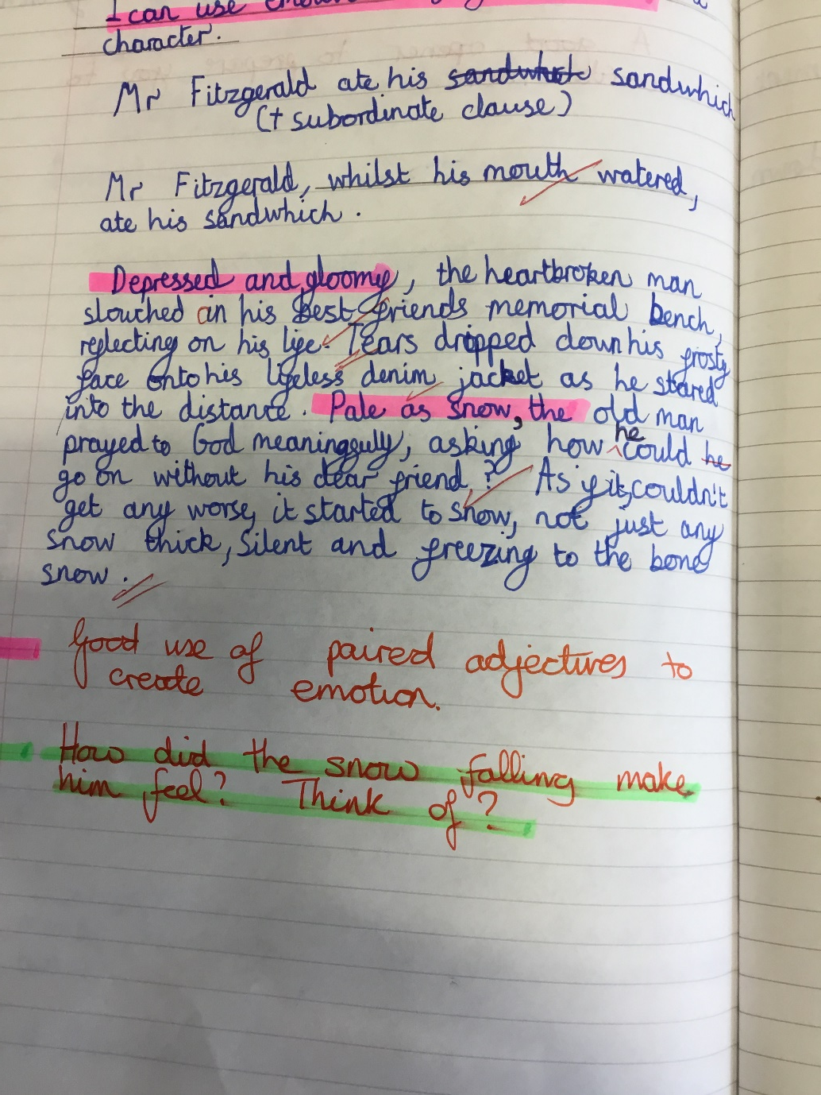

Slide 29
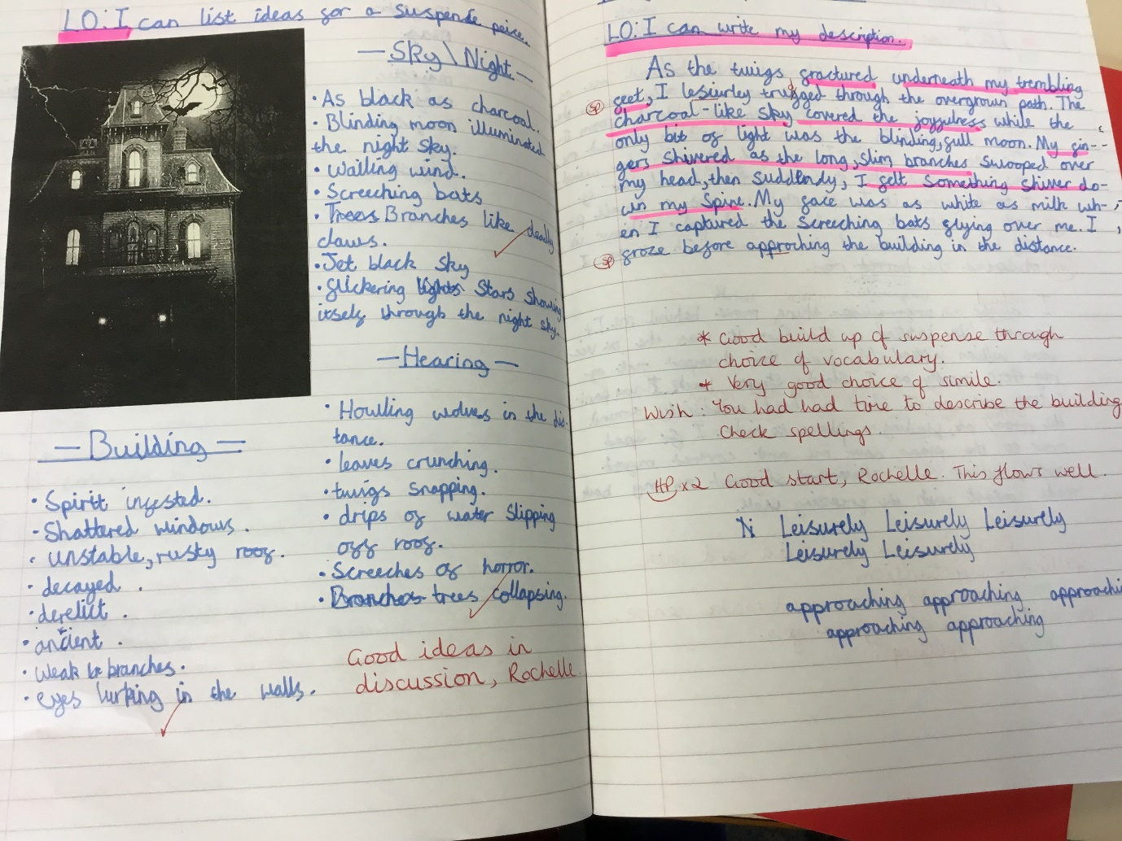

Slide 30


Slide 31
Congratulations to all of our stars of the week!

Slide 32


Slide 33


Slide 34
“Jesus loves us without limits.
He wants to help us, always.”
(Pope Francis)

Slide 35



St. Alban’s Mission Statement.
Love, learn, share and respect in the light of Jesus

Slide 36
St. Alban’s Mission Statement.
love

Slide 37
St. Alban’s Mission Statement.
learn

Slide 38
St. Alban’s Mission Statement.
share

Slide 39
St. Alban’s Mission Statement.
respect

Slide 40



Let us pray.
Dear Lord Jesus,
Please help us to understand and to know you,
To listen to your words and to follow your way.
Amen.

Slide 41
Let’s try to be more like Jesus and
“love without limits” this week!
Notes:
GO FORTH - MISSION

Slide 42
WOW!
WELL DONE EVERYONE!

