Slide 1


CELEBRATION ASSEMBLY
FRIDAY 10TH SEPTEMBER 2021

Slide 2

This is the day that the Lord has made!

Slide 3

Notes:
WORD

Slide 4
Hail Mary
Hail Mary, full of grace
The Lord is with thee.
Blessed art thou among women
And blessed is the fruit
Of thy womb, Jesus.
Holy Mary, mother of God,
Pray for us sinners now
And at the hour of our death.
Amen

Slide 5
Our Father
Our Father, Who art in Heaven,
Hallowed be Thy name.
Thy Kingdom come,
Thy will be done on earth as it is in Heaven.
Give us this day our daily bread
and forgive us our trespasses
as we forgive those who trespass against us
and lead us not into temptation
but deliver us from evil.
Amen

Slide 6
Dear Lord,
Please bless our school
As we try to
Love, learn,
Share and respect
In the light of Jesus.
St Alban, pray for us.
Amen

Slide 7
Jesus the healer

Slide 8
Jesus the healer

Slide 9

Reception

Slide 10
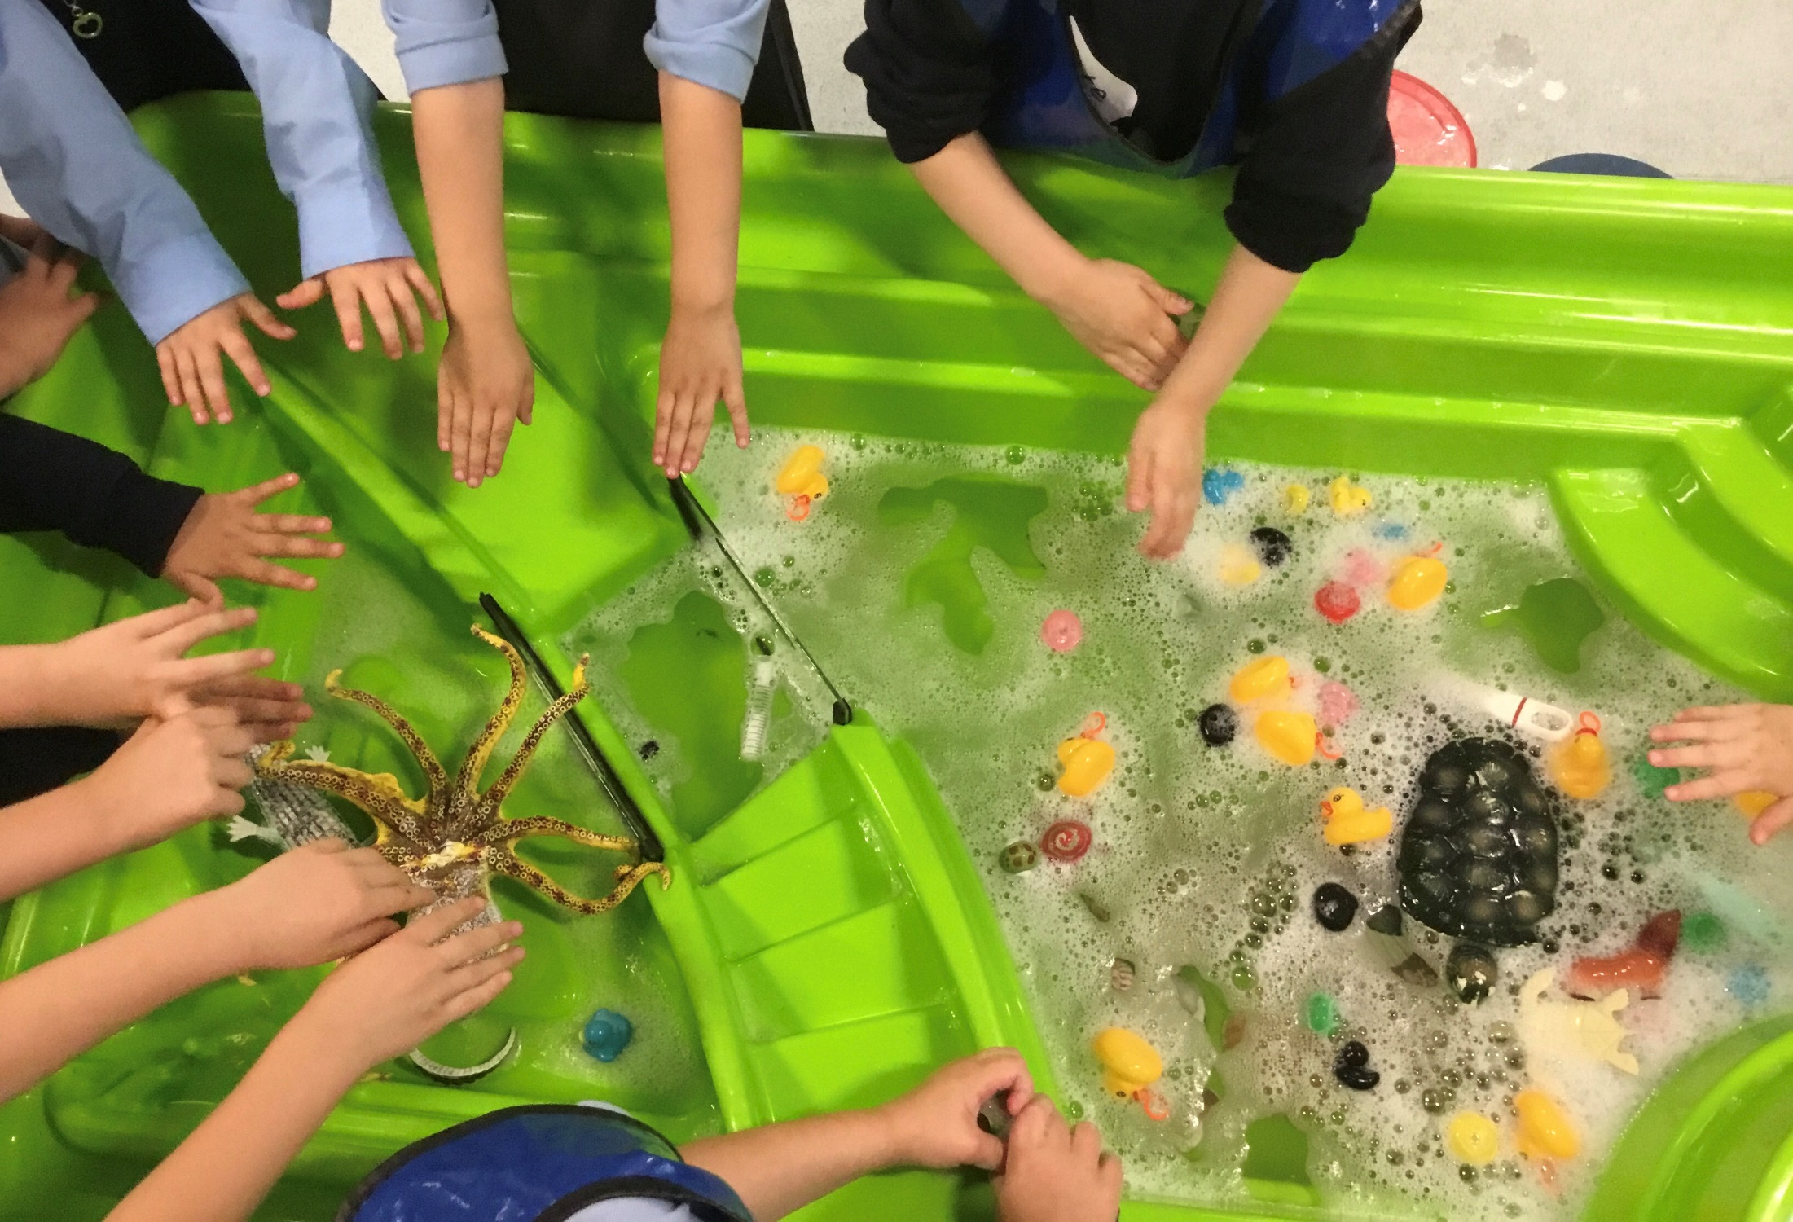

Slide 11
Year 1

Slide 12
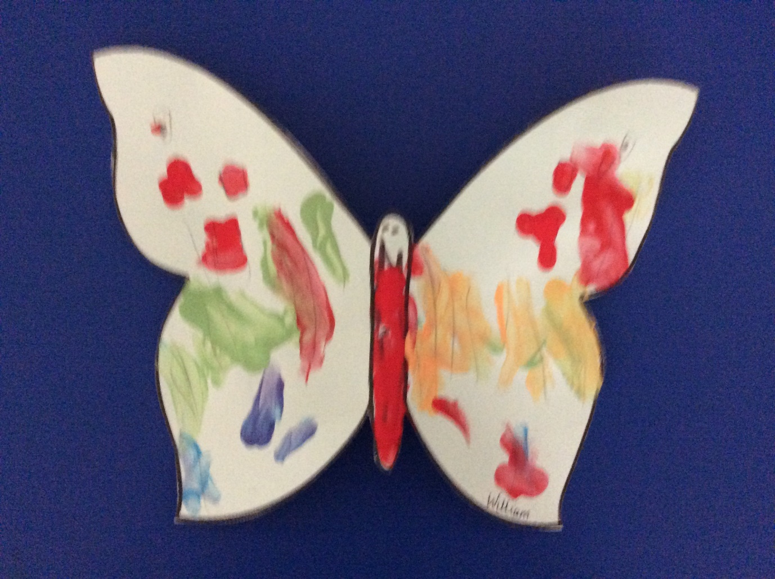

Slide 13
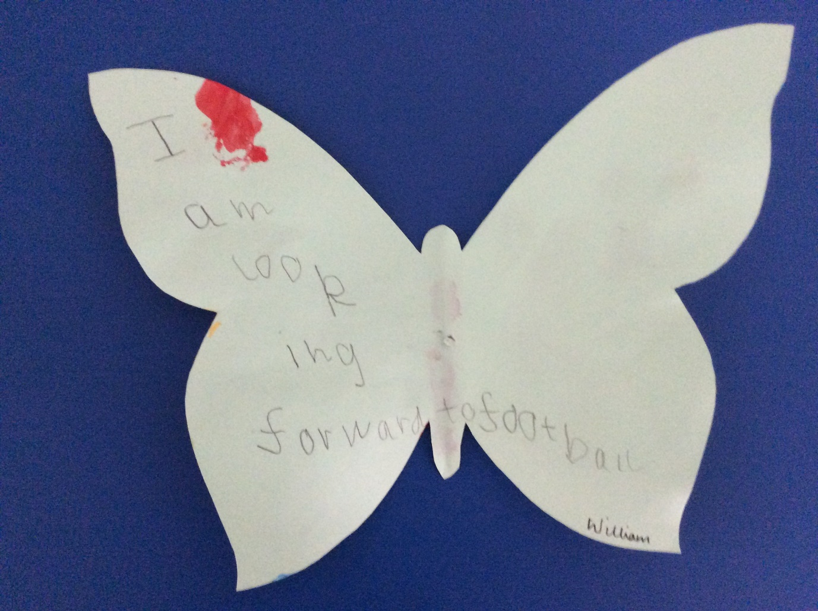

Slide 14
Year 2

Slide 15
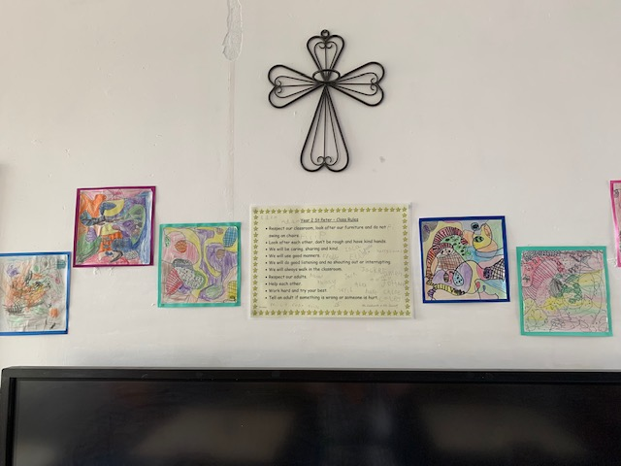

Slide 16
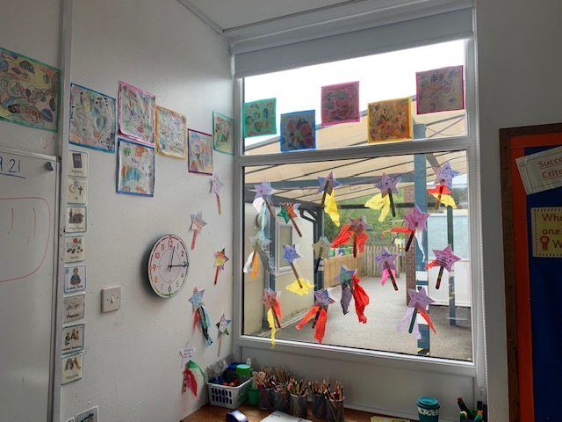

Slide 17
Year 3

Slide 18
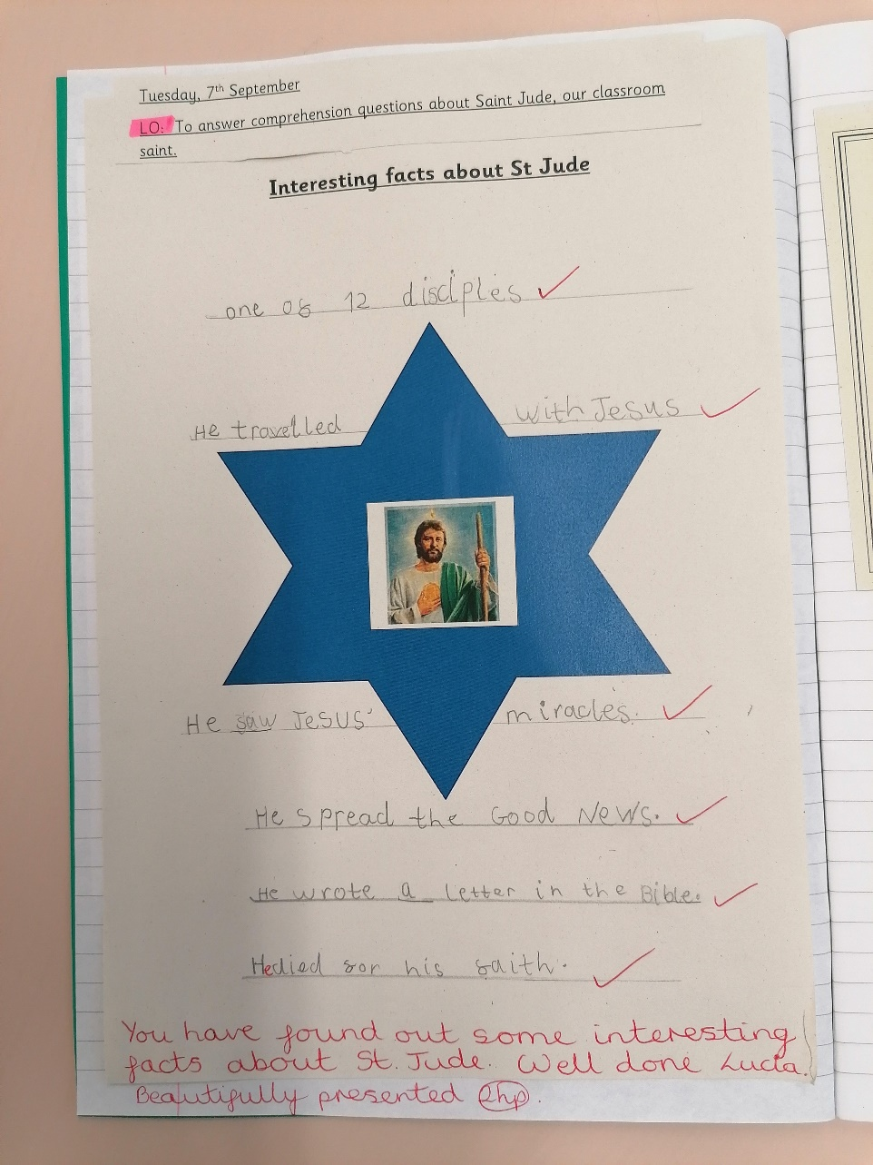

Slide 19
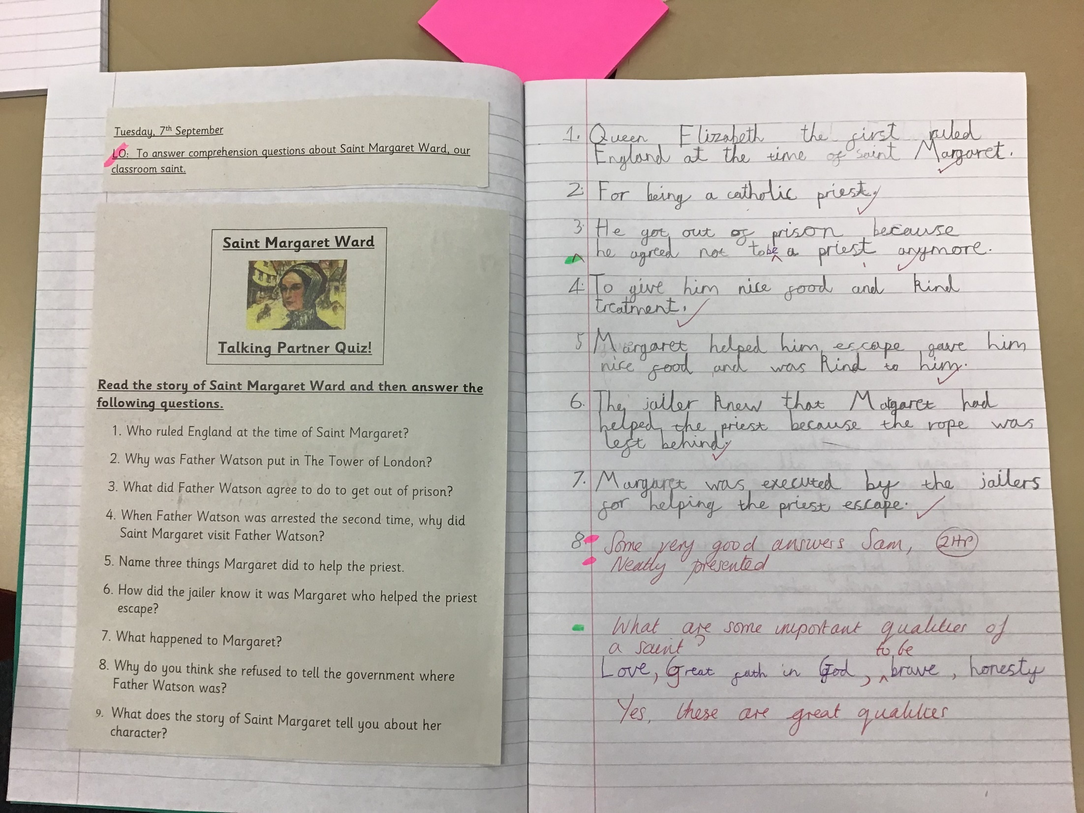

Slide 20
Year 4

Slide 21
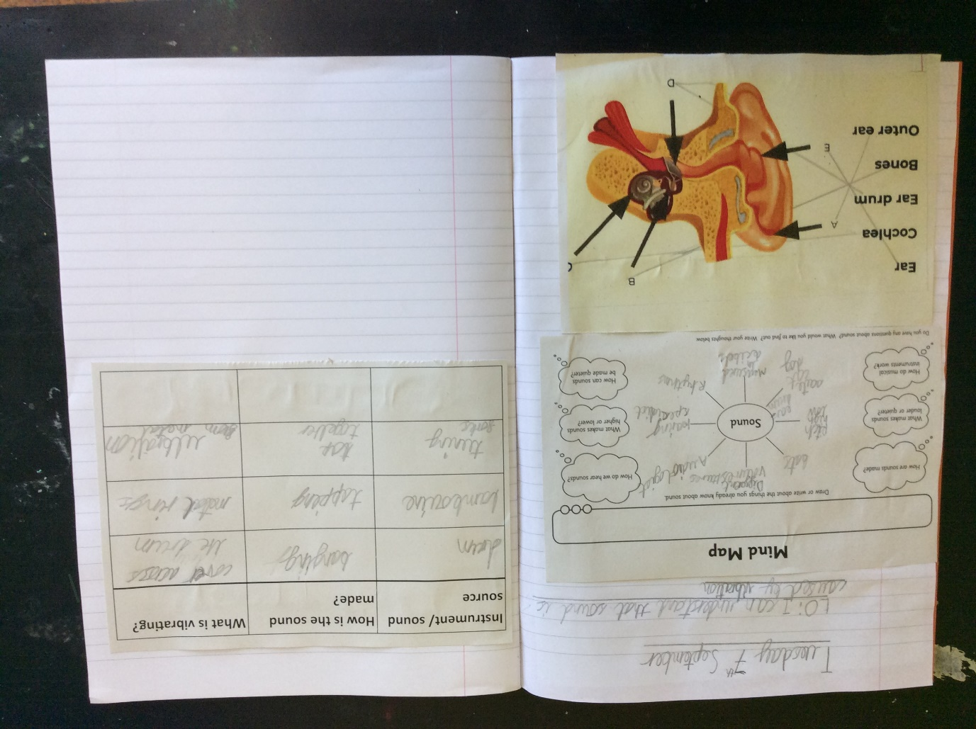

Slide 22
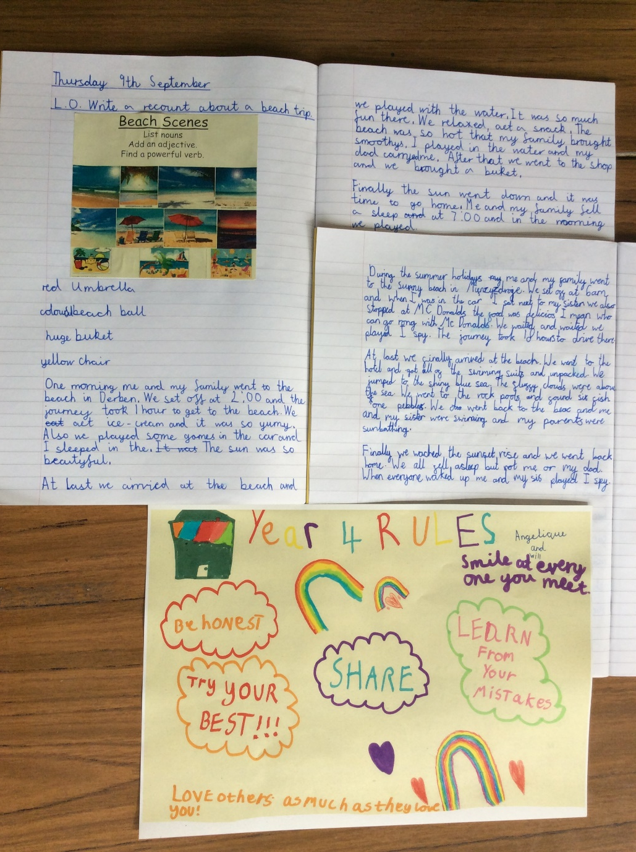

Slide 23
Year 5

Slide 24
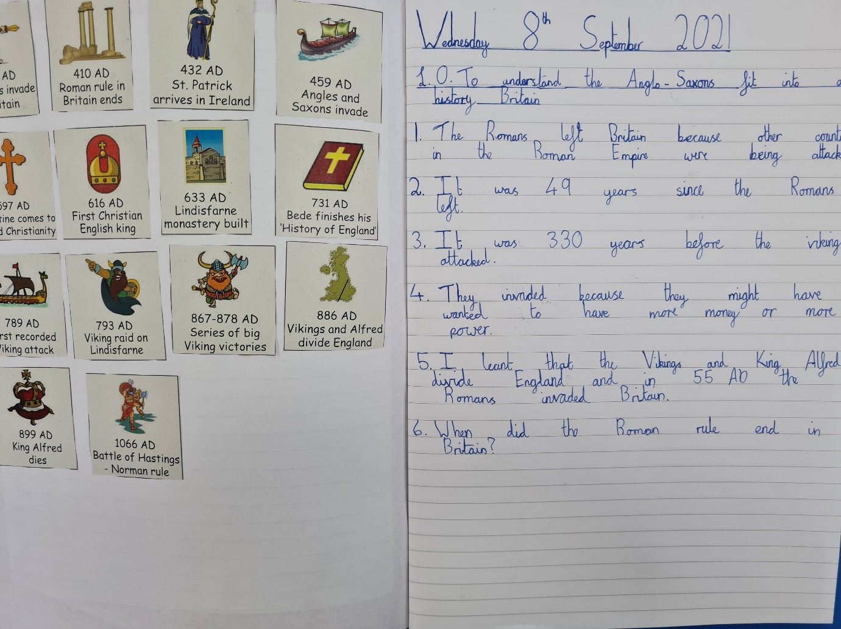

Slide 25
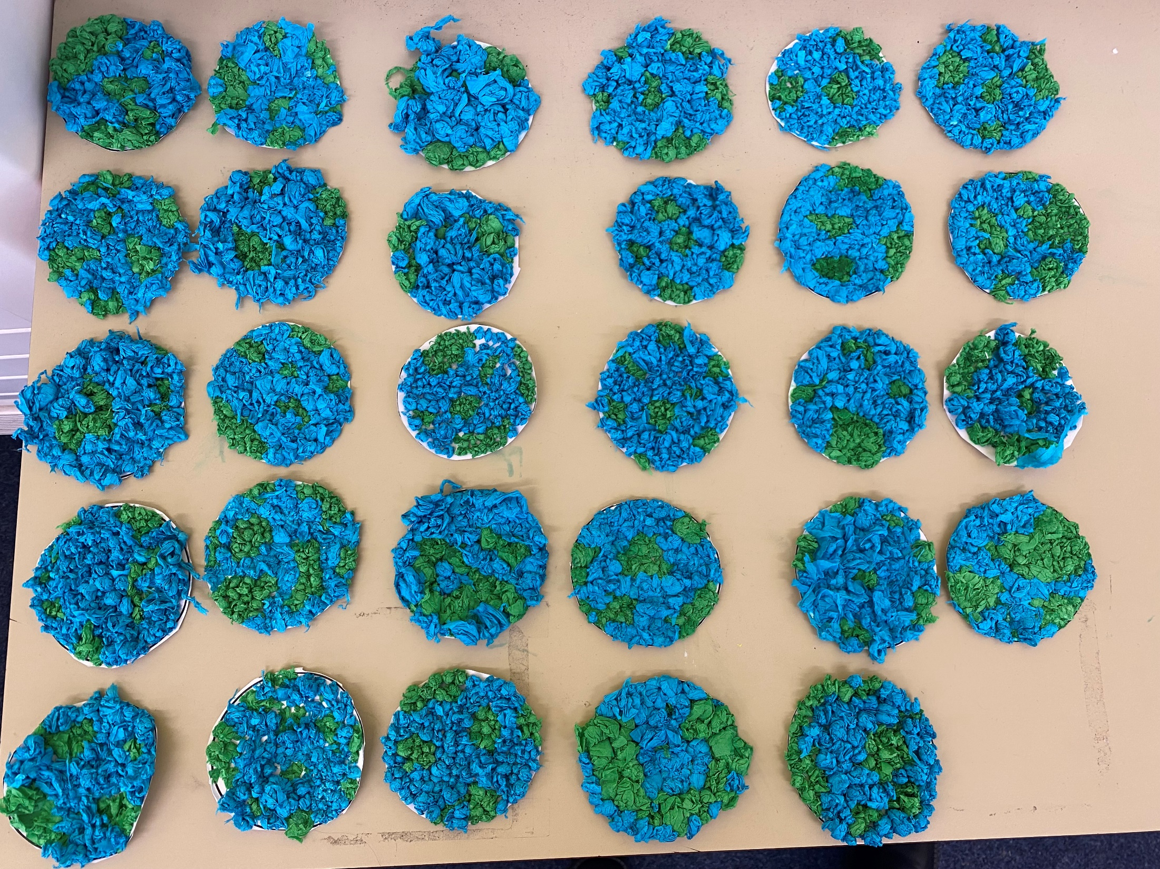

Slide 26
Year 6

Slide 27
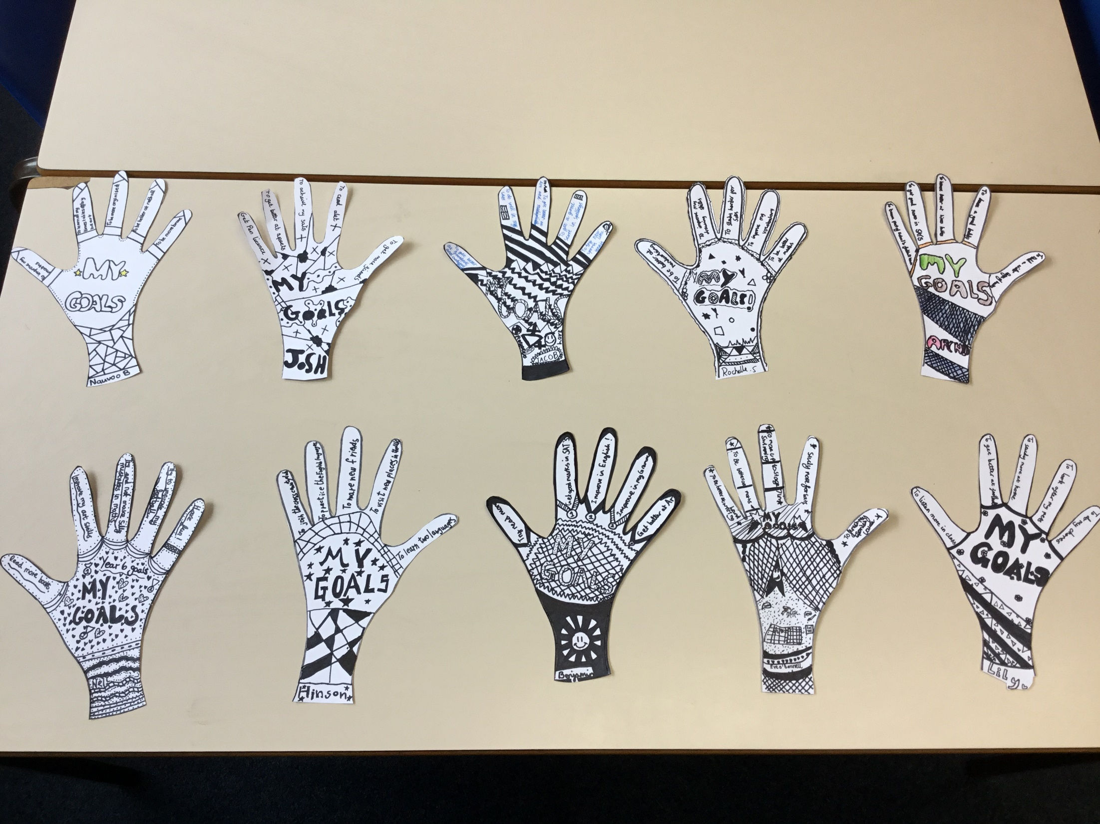

Slide 28


Slide 29
Congratulations to all of our stars of the week!

Slide 30


Slide 31


Slide 32
Jesus the healer

Slide 33



St. Alban’s Mission Statement.
Love, learn, share and respect in the light of Jesus

Slide 34
St. Alban’s Mission Statement.
love

Slide 35
St. Alban’s Mission Statement.
learn

Slide 36
St. Alban’s Mission Statement.
share

Slide 37
St. Alban’s Mission Statement.
respect

Slide 38




Let us pray.
Dear Blessed Lord,
As we reflect on our Mission Statement,
Help us to love, learn, share and respect
in the light of Jesus.
Amen.

Slide 39
How have we lived out our Mission Statement to
LOVE, LEARN, SHARE and RESPECT this week?
Notes:
GO FORTH - MISSION

Slide 40
WOW!
WELL DONE EVERYONE!

