Slide 1

E-safety ☺
Staying safe on the internet

Slide 2

Our 4 top tips
People you don’t know are strangers, they’re not always who they say they are.
Treat people as you would on the playground.
Keep your personal information private.
If you ever get a bad feeling always tell an adult.

Slide 3
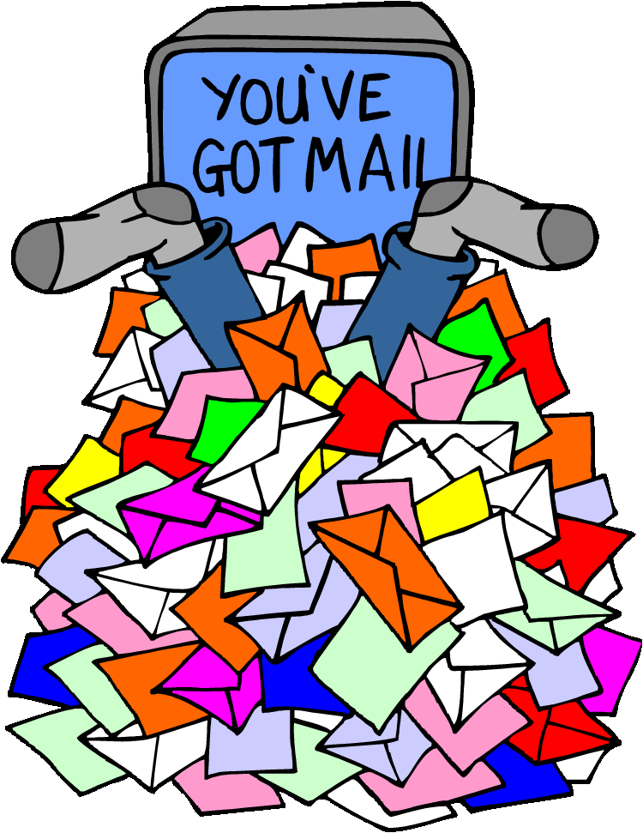
How to stay safe
Don’t open up e-mails from unknown people or strangers
Don’t enter competitions or contests online because most of them are fake or spam
Don’t download things from the internet without knowing that it’s not going to spread a virus throughout your computer or laptop

Slide 4

Passwords
The best passwords include numbers, random letters and symbols.
An example:
3lit3 399 (which translates to)
Elite egg

Slide 5
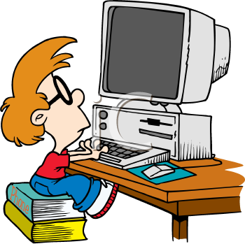
S M A R T
When you’re on the internet you should always remember SMART
Stay safe
Don’t Meet up with people
Don’t Accept random files or emails
Check if the website your using is Reliable
Tell someone you trust if something you don’t know pops up or you find a website that makes you uncomfortable

Slide 6

Hector
Hector is a clever dolphin that will appear on your screen if you click him. You click him when you see a website that you don’t like or is making you feel very uncomfortable. When you click Hector a screen will appear that will cover up the current website. After you click it, fetch a trustworthy adult to report the website.

Slide 7
Watch this video
https://youtu.be/eAIuYRla1nQ

Slide 8
Quiz! ☺
What are the three things that make the ultimate password?
Numbers, random letters and symbols.
What is the dolphin’s name?
Hector
Who do you tell when you have a bad feeling?
Your parents or anyone trustworthy.

Slide 9


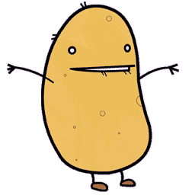

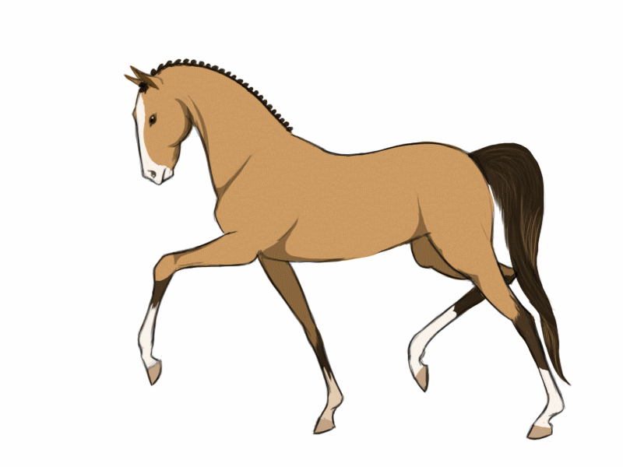
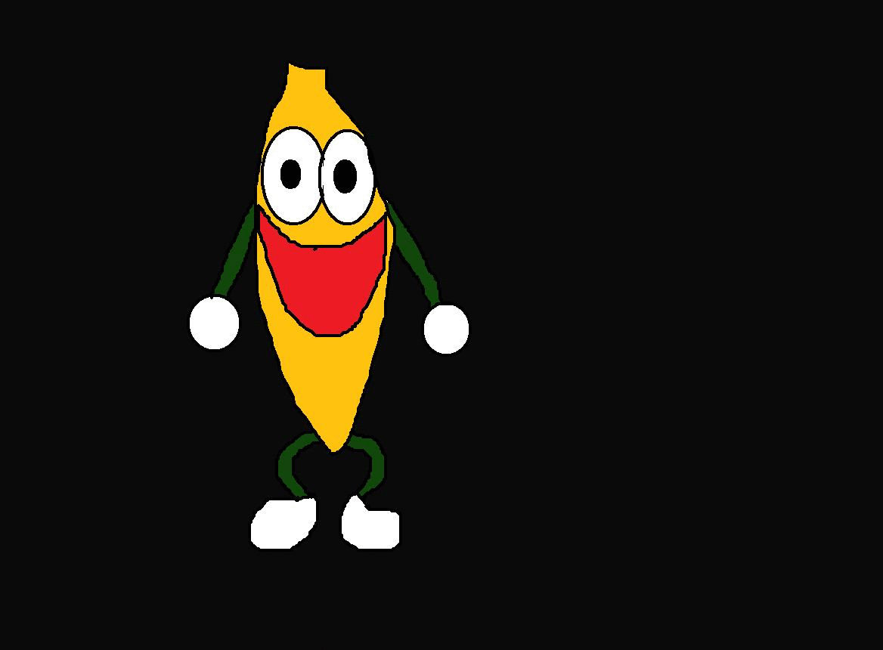
Thanks for watching! ☺

