Slide 1
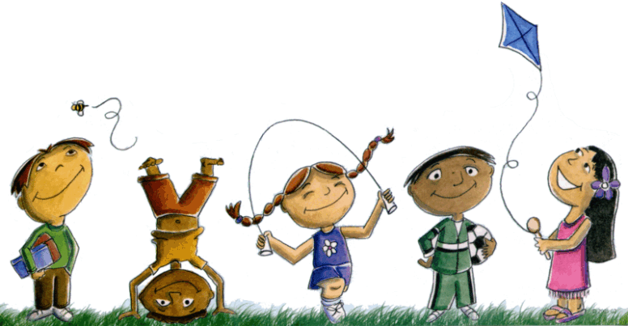
Let’s Celebrate!
Today is World Children’s Day.

Slide 2

Did you know that Children have rights?

Slide 3
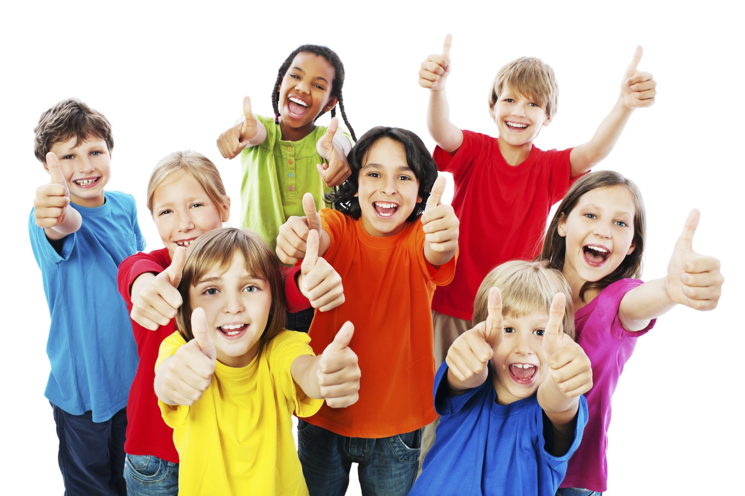
All of you have rights!!

Slide 4
United Nations Convention on the Rights of the Child.
In 1989 the Convention was agreed by governments across the world.
Almost every country has agreed to these rights.
There are 54 rights in the agreement.
Year 5 would like to share some of these rights with you.

Slide 5
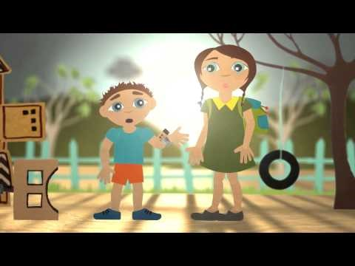
Ruby and Jack will tell you more about your rights.

Slide 6
Unfortunately throughout the world not all children have these rights.
Year 5 will give you some examples.

Slide 7
Governments, organisations, charities and individuals are working hard around the world to enable all children to have their rights.
Fundraising plays a big part in helping change things for the better but campaigning and raising awareness of difficulties are also vital ways of getting people around the world to understand and be able to support.

Slide 8
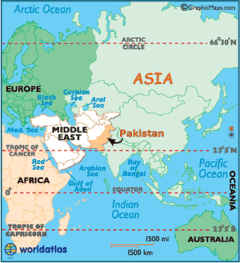
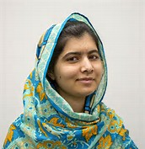
Malala is from Pakistan. She is a very brave, young girl who fights for girls to have the right to go to school, have equal opportunities, to be treated with dignity and live in peace.

Slide 9
So, let us celebrate today!
You are all getting your education today.
You are all getting your playtime today.
You are all getting food and clean water today.
You have a voice and are being listened too today.
You are with friends today.

Slide 10
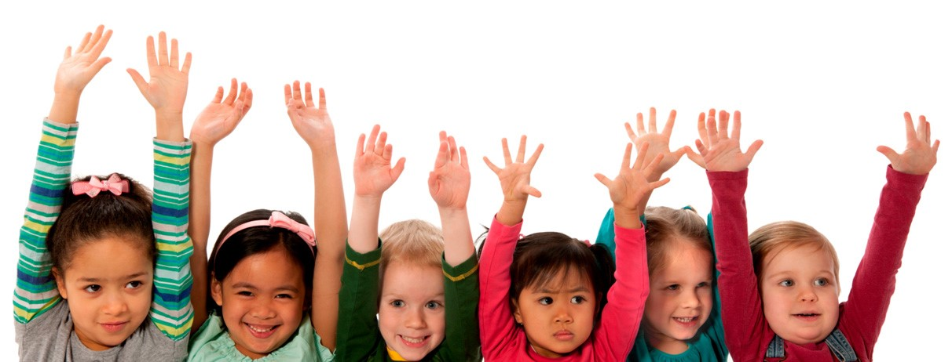
So each and every day
let’s celebrate the rights we have!
Put your hands up for Children’s Rights

Slide 11
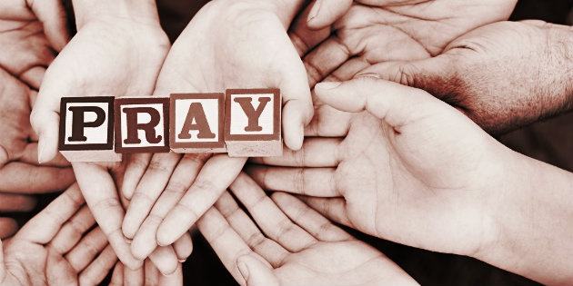
Please put your hands together and
Let us thank God

