Slide 1

New Beginnings…
Lets start off as we mean to go on!

Slide 2
Growth Mindset
Understand that we can improve ourselves and get better.
Notes:
Read the Star names and descriptions

Slide 3
REACH FOR THE STARS!
Commitment!
Hard Work!
Challenge!
Resilience!
Tenacity!

Slide 4
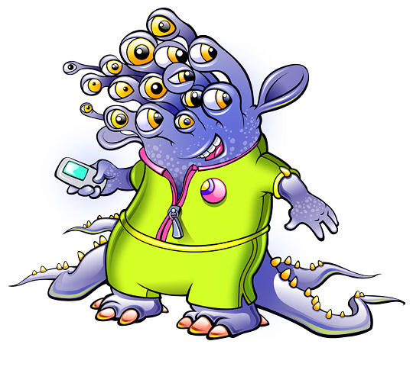

I’ll never be able
to fly the
space ship…
Not yet…
Let‘s keep trying,
you can learn
to do it!

Slide 5

DISCUSS…
What challenge will you set yourself for this NEW BEGINNING?
What will you concentrate on improving?
New Beginnings…
Let’s make this school year the best one yet!

Slide 6

DISCUSS…
What do you already have that will help?
What do you need to develop?
New Beginnings…
Let’s make this school year the best one yet!

Slide 7
CHALLENGE AND CELEBRATE…
In your class- think of a ways you will develop your GROWTH MIND SET…
Come back and celebrate how you have developed…
At the next SEAL assembly, present the ways you have developed your GROWTH MINDSET and made a positive NEW BEGINNING to our new school year…

Slide 8
DREAM IT…
BELIEVE IT…
ACHIEVE IT…
How will you make a change to ensure success?

