Slide 1

Going for Goals
SEAL CELEBRATION ASSEMBLY – FEBRUARY 2019

Slide 2
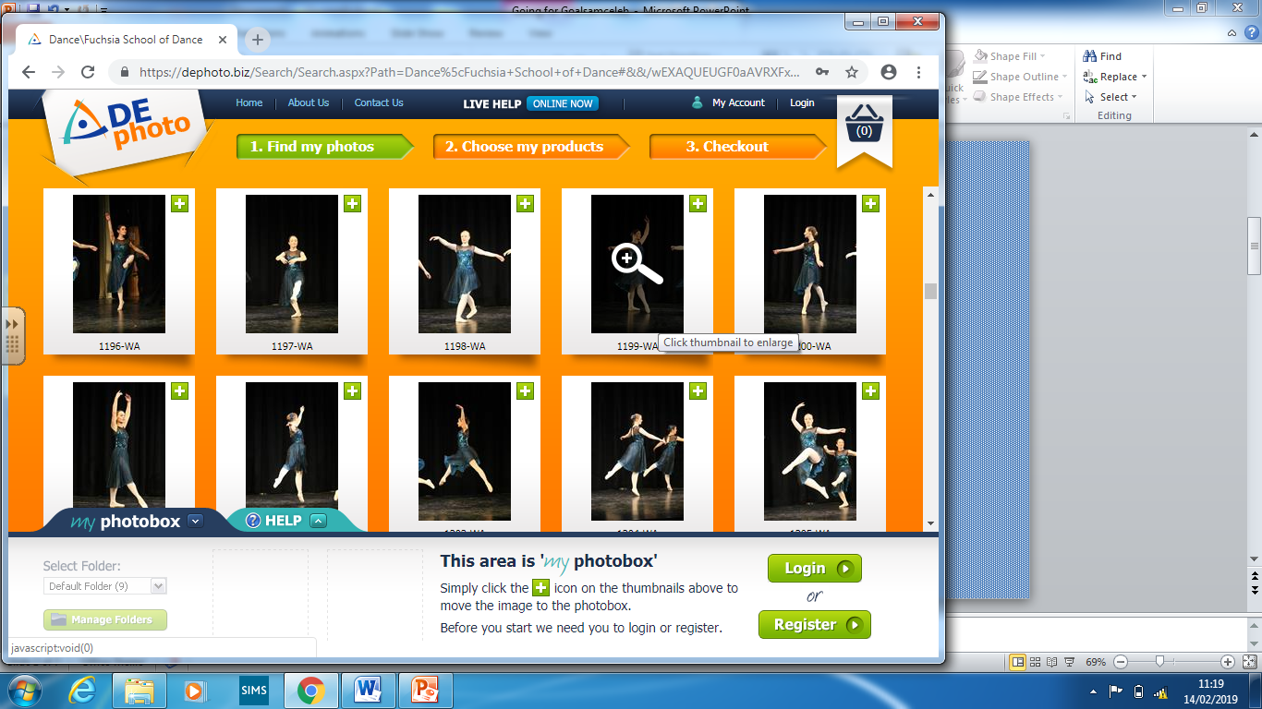
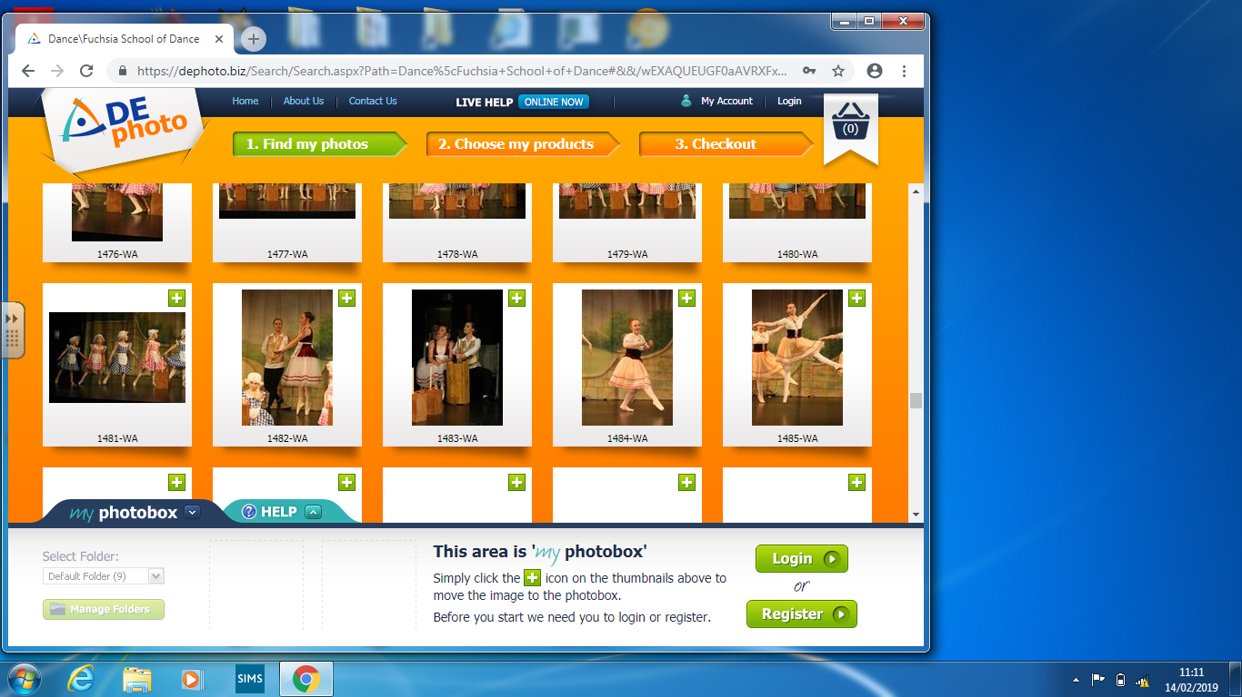
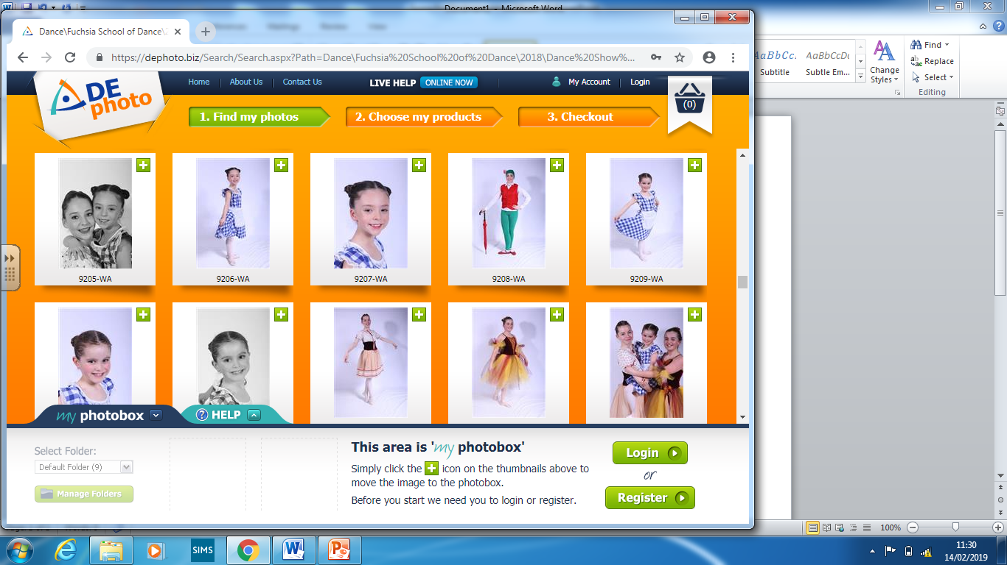
Ballet
Special Guest
Katrina Magee

Slide 3
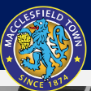
Football
Macc Town Rules!
Special Guest
Joshua

Slide 4
REACH FOR THE STARS!
Achieving my goal…
Commitment!
Hard Work!
Challenge!
Resilience!
Tenacity!
Notes:
know ourselves – We should celebrate our similarities and differences.
set ourselves realistic goals.
understand there may be obstacles– we can overcome these and still achieve our goal.
break goals down into smaller chunks or steps.
Understand the need for persistence to reach our goals – (we need to avoid distractions, overcome boredom, frustration, keep trying, come up with ways or seek help to overcome problems, know that when we fail we can try again and be successful)
make choices – break goals down and find solutions to help us achieve our goal

Slide 5
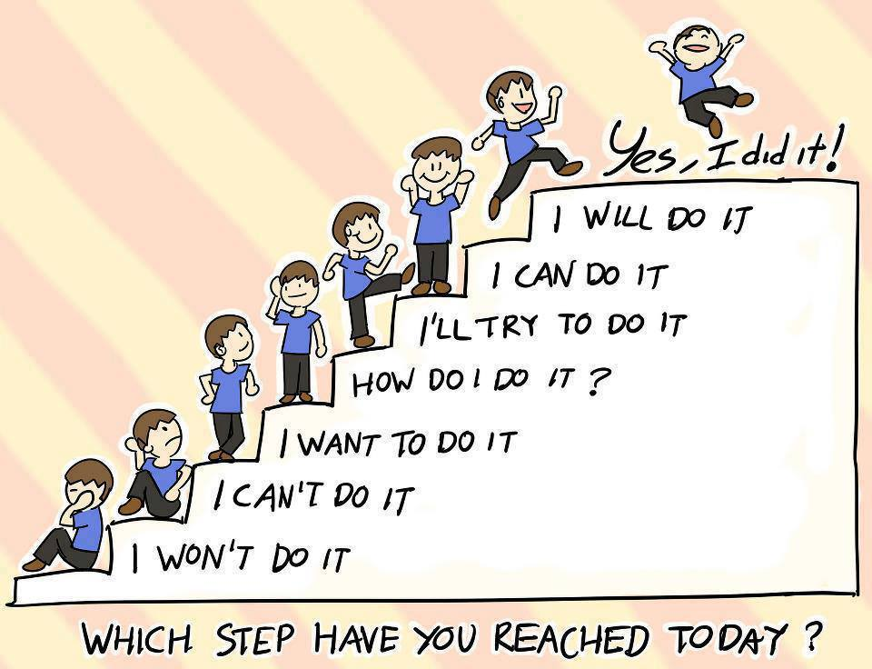


Slide 6
Reception Amara Armaan Thea Lucy
Year 1 Rishona Lily Reuben Imogen Max Maddison
Year 2 Louisa Oliver Noah Amelia Bo
Year 3 Charlie Auty Luke Ben Leila P Nell
Year 4 Evie B Leon Dylan
Year 5 Jaden C Ruby F Mia Charlotte W
Year 6 Surya Emily B Charlotte S Katie James K
SEAL CELEBRATION ASSEMBLY – FEBRUARY 2019

Slide 7
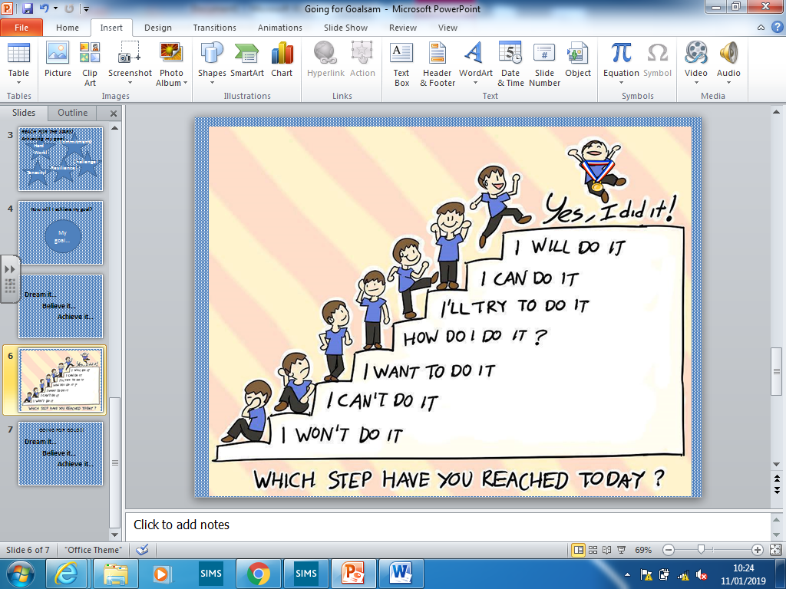
GOING FOR GOLD!!!
Dream it…
Believe it…
Achieve it…

