Slide 1


Slide 2

Notes:
WORD

Slide 3

Dear Lord,
Please bless our school
As we try to
Love, learn,
Share and respect
In the light of Jesus.
St Alban, pray for us.
Amen

Slide 4

The 1st Sunday of Advent, Year B

Slide 5
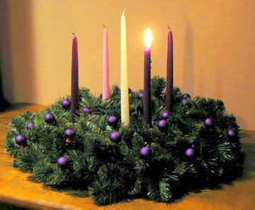
Advent
Advent begins four Sundays before Christmas Day and ends on Christmas Eve.
Traditional Advent wreaths have a candle to light on each Sunday of Advent.
This Sunday we light the first Advent candle, as a symbol of the hope we have in Jesus.

Slide 6
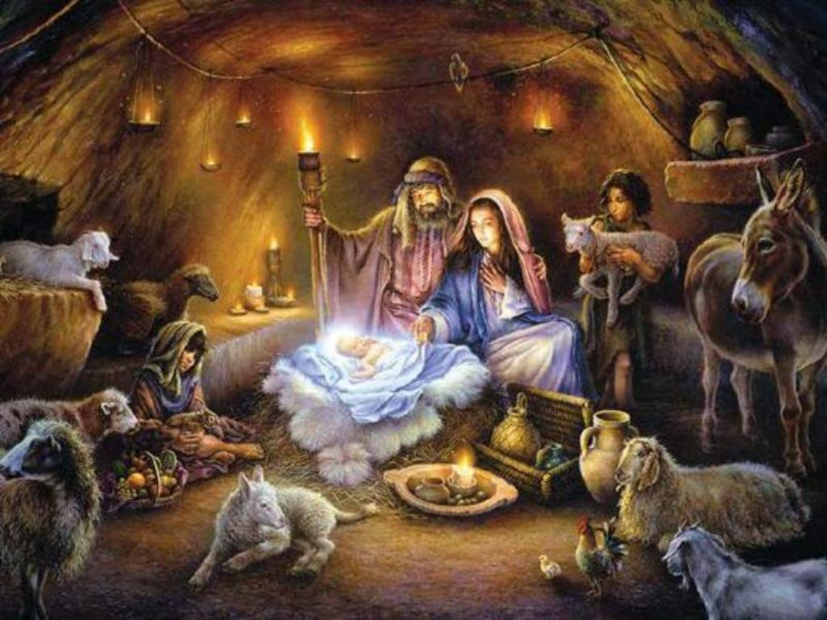
Advent
The word, “Advent” means important arrival.
What is the important arrival that we are getting ready for?

Slide 7

“Advent is a time to prepare our hearts to receive Jesus.” Pope Francis

Slide 8

Notes:
SYMBOLIC ACTION – FIRST AND LAST IN THE QUEUE

Slide 9
Mark 13:33-37
The Lord be with you.
And with your spirit
A reading from the Holy Gospel according to Mark.
Glory to you, O Lord.

Slide 10

Jesus said to his disciples, “Be on your guard, stay awake.

Slide 11
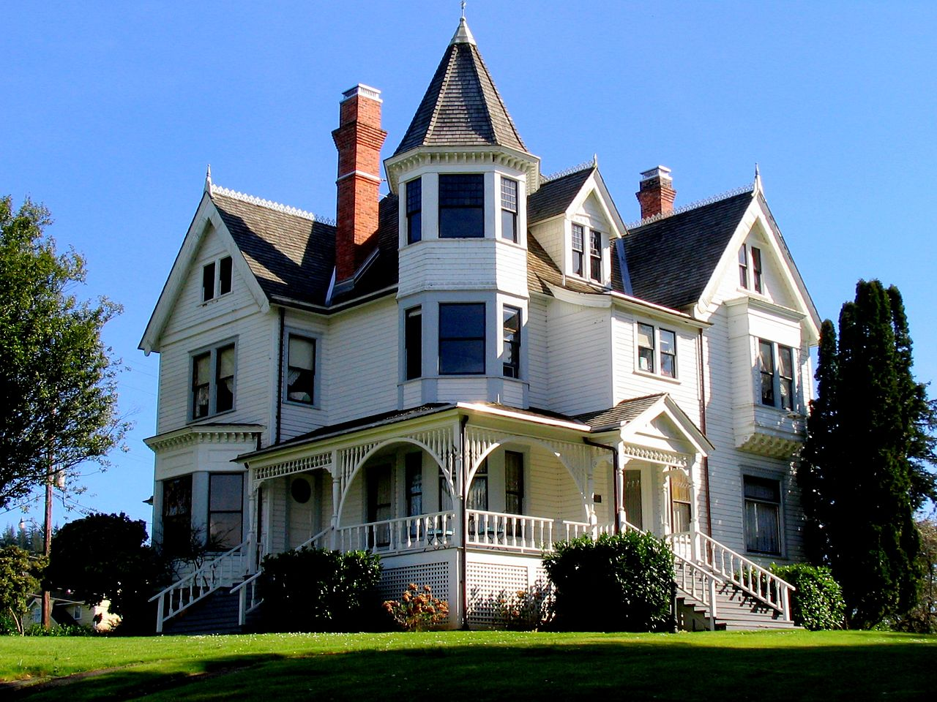
When a rich man travels abroad, he leaves his house and puts his servants in charge and orders the doorkeeper to keep a good watch.

Slide 12

So, always be ready - because you do not know when the Master of the house is coming; it may be evening or midnight, cockcrow or dawn.

Slide 13
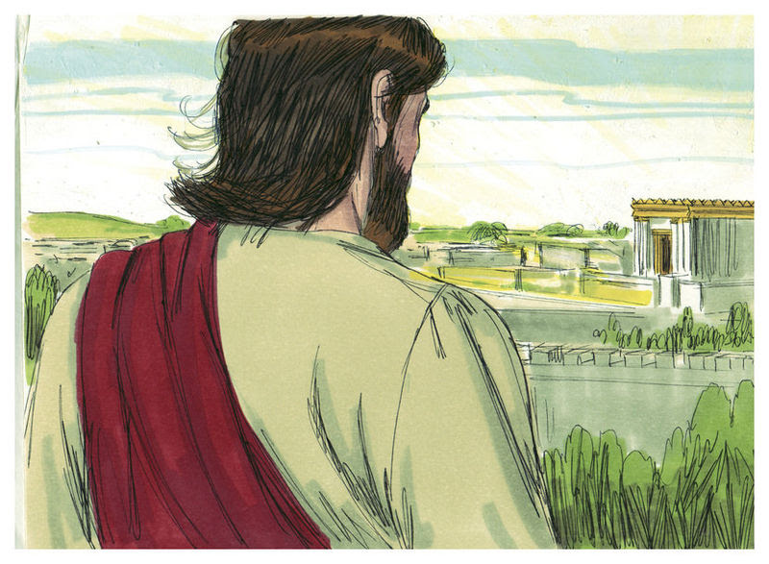
If he comes unexpectedly, he may find you unready for him. What I am saying to you now, I say to everyone: Stay awake – be ready!”

Slide 14
Mark 13:33-37
The Gospel of the Lord
Praise to you, Lord Jesus Christ.

Slide 15

How can we get ready during the season of Advent?
Pray together
Acts of kindness
Look out for people who may be sad or lonely
Use our talents well
Be a peacemaker
Share a smile!

Slide 16


Slide 17


Slide 18



Let us pray.
Dear Lord Jesus,
Help us to stay awake and to be aware of Your presence in the people that we meet in this Advent season.
Amen.

Slide 19
How can we keep our Advent promise this week?
Notes:
GO FORTH - MISSION

