Slide 1


Slide 2
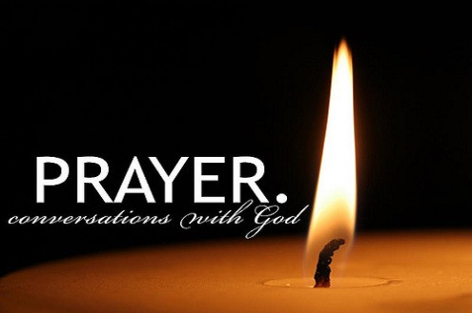
Notes:
WORD

Slide 3

Christ the King
Yesterday was the last Sunday in the Church’s year. This celebration is called the feast of Christ the King.

Slide 4
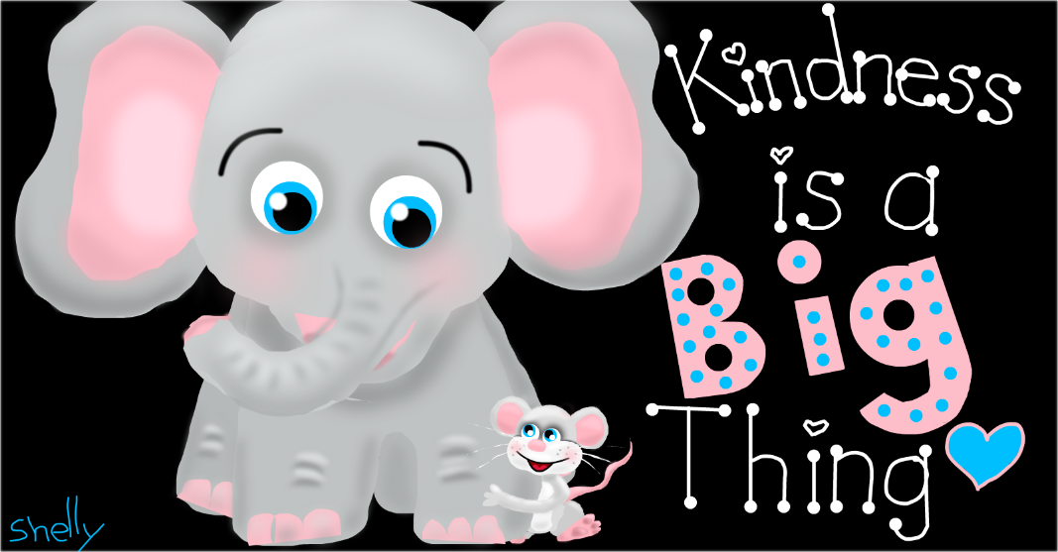
kindness
Sunday’s Gospel reminds us that Jesus is present in all people, especially in the sick, anyone in need, and also He is present in you and in me.
What we do for others, we do for Jesus – even small, everyday acts of kindness are most valuable in God’s eyes.

Slide 5

Acts of kindness
Has anyone been especially kind to you lately?
How did it make you feel?

Slide 6

Notes:
SYMBOLIC ACTION – FIRST AND LAST IN THE QUEUE

Slide 7
Matthew 25:31-46
The Lord be with you.
And with your spirit
A reading from the Holy Gospel according to Matthew.
Glory to you, O Lord.

Slide 8
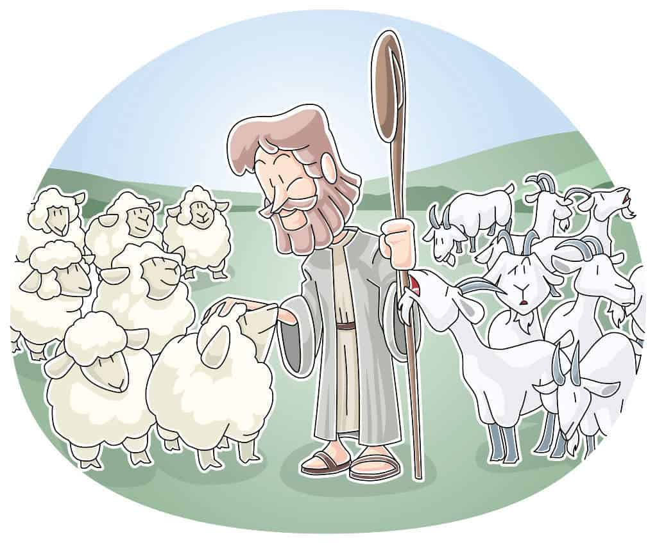
Jesus said to his disciples, “When the Son of Man comes at the end of time, all people will be gathered before him. He will separate them as a shepherd separates sheep from goats, and will place the sheep on his right hand and the goats on his left.

Slide 9
And he will say to those on his right, ‘Come, you who are blessed by my Father, inherit the Kingdom which has been prepared for you.

Slide 10
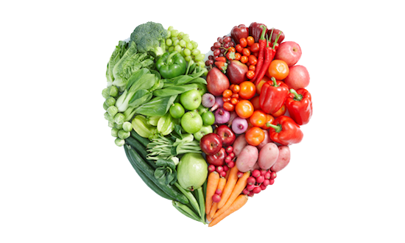
For I was hungry and you gave me food.

Slide 11

I was thirsty and you gave me drink.

Slide 12
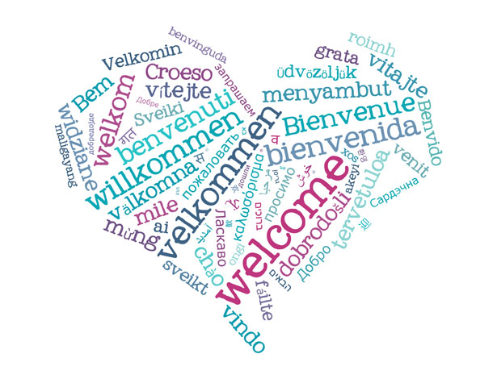
I was a stranger and you welcomed me.

Slide 13
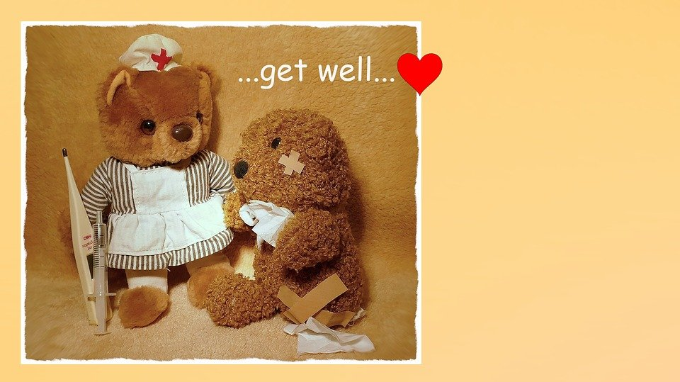
I was sick and you visited me.

Slide 14
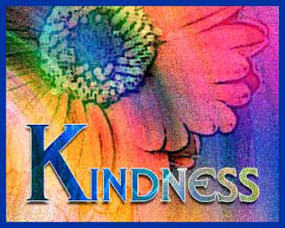
Whatever good you did for others in need, you did for me.

Slide 15
Matthew 25:31-46
The Gospel of the Lord
Praise to you, Lord Jesus Christ.

Slide 16
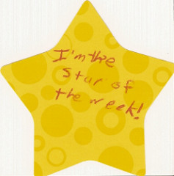

Slide 17
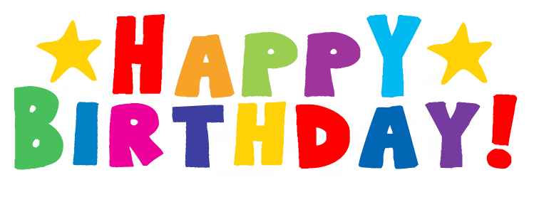

Slide 18
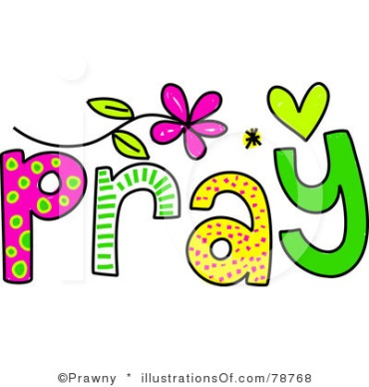


Let us pray.
Dear Lord,
Please help me to see You in everyone I meet, and be kind to all, especially to those that I sometimes find it difficult to love.
Amen.

Slide 19

How can we show kindness to others this week?
Notes:
GO FORTH - MISSION

