Slide 1


Slide 2
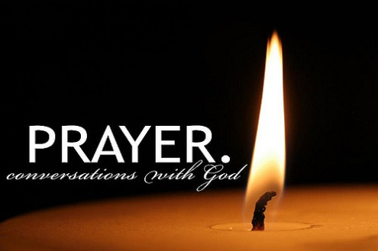
Notes:
WORD

Slide 3

Notes:
SYMBOLIC ACTION – FIRST AND LAST IN THE QUEUE

Slide 4
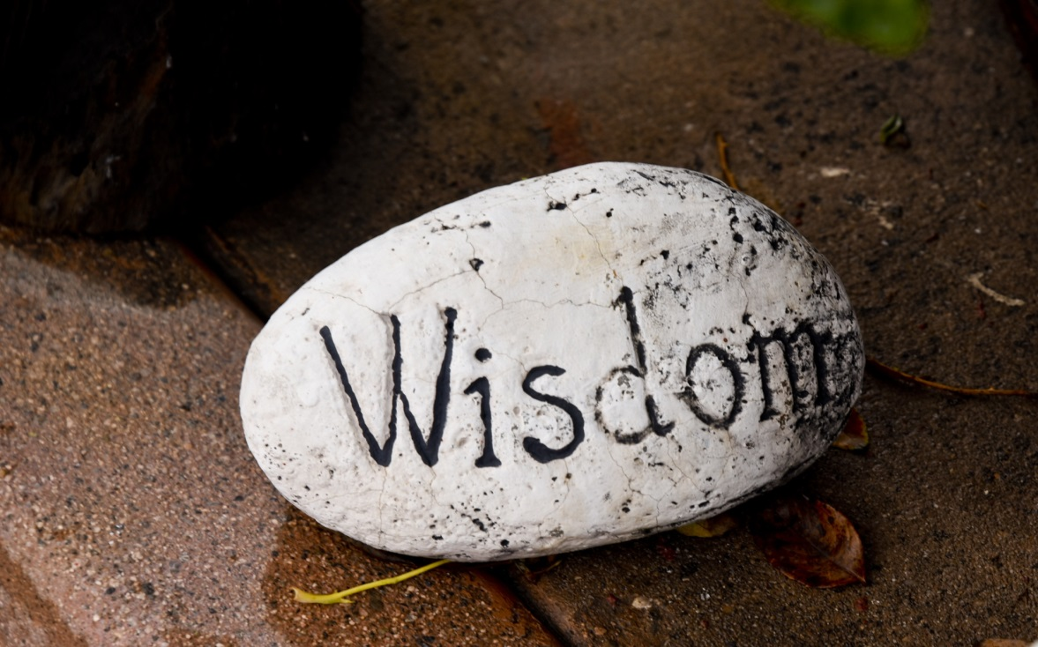
Wisdom
Wisdom is a gift from God which helps us to see things more clearly and make the right choices in life.

Slide 5
Matthew 25:1-13
The Lord be with you.
And with your spirit
A reading from the Holy Gospel according to Matthew.
Glory to you, O Lord.

Slide 6
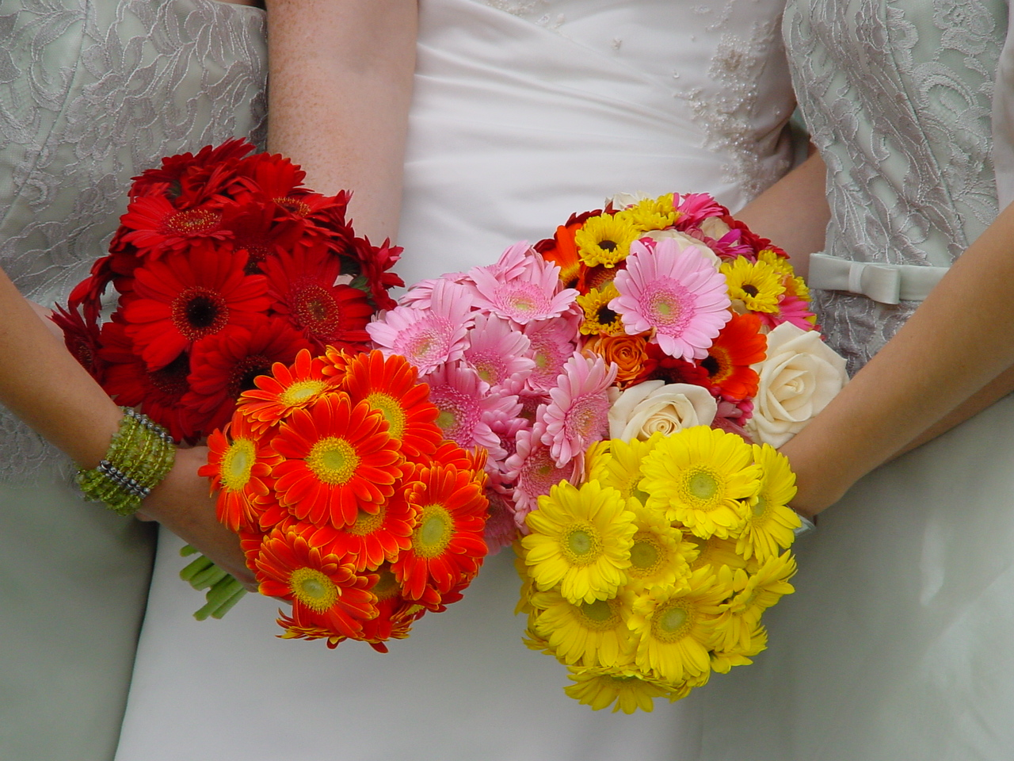
Wisdom
In this Sunday’s Gospel, the bridegroom represents Jesus and the wedding feast represents the Kingdom of Heaven.
Because of their wisdom, the five sensible bridesmaids prepared well for the wedding and experienced all the joys of the wedding feast, that is, the joys of the Kingdom of Heaven.

Slide 7

Wisdom
Wisdom is a real treasure, a virtue for us to nurture.
True wisdom is discovering what God wants us to do, then trying our best to do it.
It’s about using knowledge well – having good judgement.

Slide 8
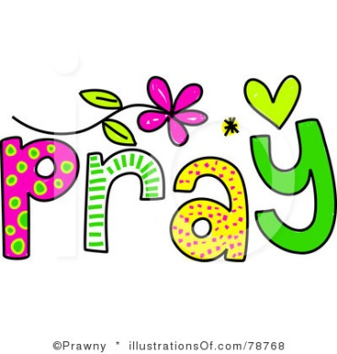


Let us pray.
Dear Lord Jesus,
Please help us to grow in wisdom, to be kind and loving, and so one day to share with you in all the joys of Heaven. Amen.
Amen.

Slide 9

Remembrance Day

Slide 10
Let us pray.
Dear Lord,
We remember those who stood for love and truth,
And thank you for the sacrifice they made for me and you.
Thank you that we can now enjoy peace and learn to love not fight,
Thank you that we can now sing and play, and not be scared or hide.
We pray for other countries where children live in fear,
And there is war and fighting and many are in tears.
Please help to make things better, and bring some peace to them.
Protect all those who try and help to make friends again.
Amen.

Slide 11

Challenge yourself to do 11 good deeds this week!
Notes:
GO FORTH - MISSION

