Slide 1


Slide 2
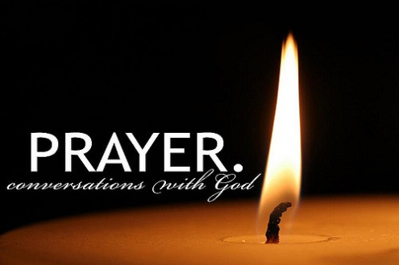
Notes:
WORD

Slide 3
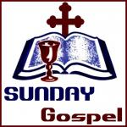
Notes:
SYMBOLIC ACTION – FIRST AND LAST IN THE QUEUE

Slide 4

The Beatitudes
“What does it mean to be “blessed”? To be
blessed means to be happy.” Pope Francis
In today’s Gospel, the blessings which promise happiness are called the BEATITUDES and they show us the path that will lead us closer to God.

Slide 5
Matthew 5:1-12
The Lord be with you.
And with your spirit
A reading from the Holy Gospel according to Matthew.
Glory to you, O Lord.

Slide 6
Matthew 5:1-12
The Gospel of the Lord
Praise to you, Lord Jesus Christ.

Slide 7
The Sermon on the Mount
The Sermon on the Mount is on of the Bible’s most well known passages and it has guided saints throughout the ages.
Yesterday was “The Feast of All Saints”.
What does the word, “saint” mean to you?
Were you named after a saint?
Who is the patron saint of our school?

Slide 8

The Feast of All Saints
Yesterday was “The Feast of All Saints”.
What does the word, “saint” mean to you?
Were you named after a saint?
Who is the patron saint of our school?

Slide 10
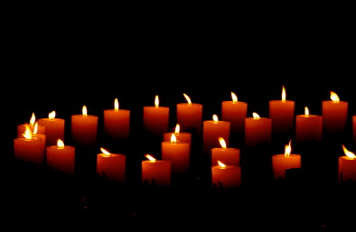
The Feast of All Souls
Yesterday was “The Feast of All Saints”.
Today is “The Feast of All Souls”.
We think especially today of all the people who have died and have gone to Heaven and we remember them in our prayers.

Slide 11
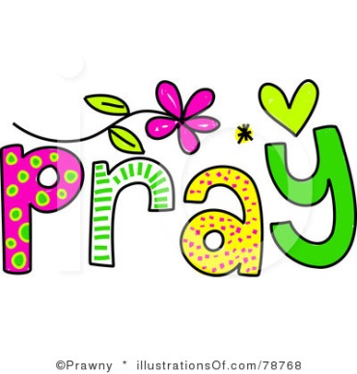


Let us pray.
Dear Lord,
We remember all the people who have died and have gone to Heaven.
Please keep them in your love and care.
Amen.

Slide 12

Try to find out a little bit more about your own patron saint.
How can you be a blessing to others this week?
Notes:
GO FORTH - MISSION

