Slide 1

Notes:
WORD

Slide 2

Notes:
SYMBOLIC ACTION – FIRST AND LAST IN THE QUEUE

Slide 3
Luke 16:19-31
The Lord be with you.
And with your spirit
A reading from the Holy Gospel according to Luke.
Glory to you, O Lord.

Slide 4
Luke 16:19-31
The Gospel of the Lord
Praise to you, Lord Jesus Christ.

Slide 5
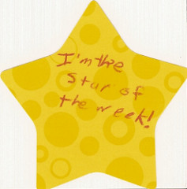

Slide 6


Slide 7



Let us pray.
Dear Lord,
Help me to be grateful for all of the wonderful blessings in my life. I pray that you remind me of just how lucky I am and that you never allow me to forget to show my thanks in prayer and by being kind to others.
Thank you Lord.
Amen.

Slide 8

As you leave today think about what you are going to do to show Jesus how grateful you are for everything that you have. Over the weekend make an extra special effort to do something kind for your family.
Notes:
GO FORTH - MISSION

