Slide 1
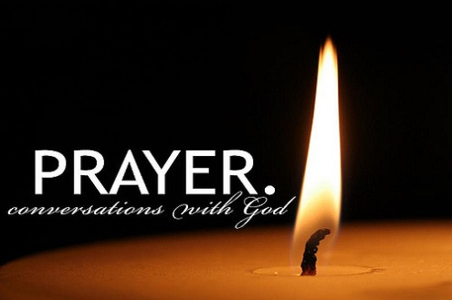
Notes:
WORD

Slide 2

thankfulness
Think about a time when you thanked someone.
Talk to your partner about it.

Slide 3

Notes:
SYMBOLIC ACTION – FIRST AND LAST IN THE QUEUE

Slide 4
Luke 17:11-19
The Lord be with you.
And with your spirit
A reading from the Holy Gospel according to Luke.
Glory to you, O Lord.

Slide 5
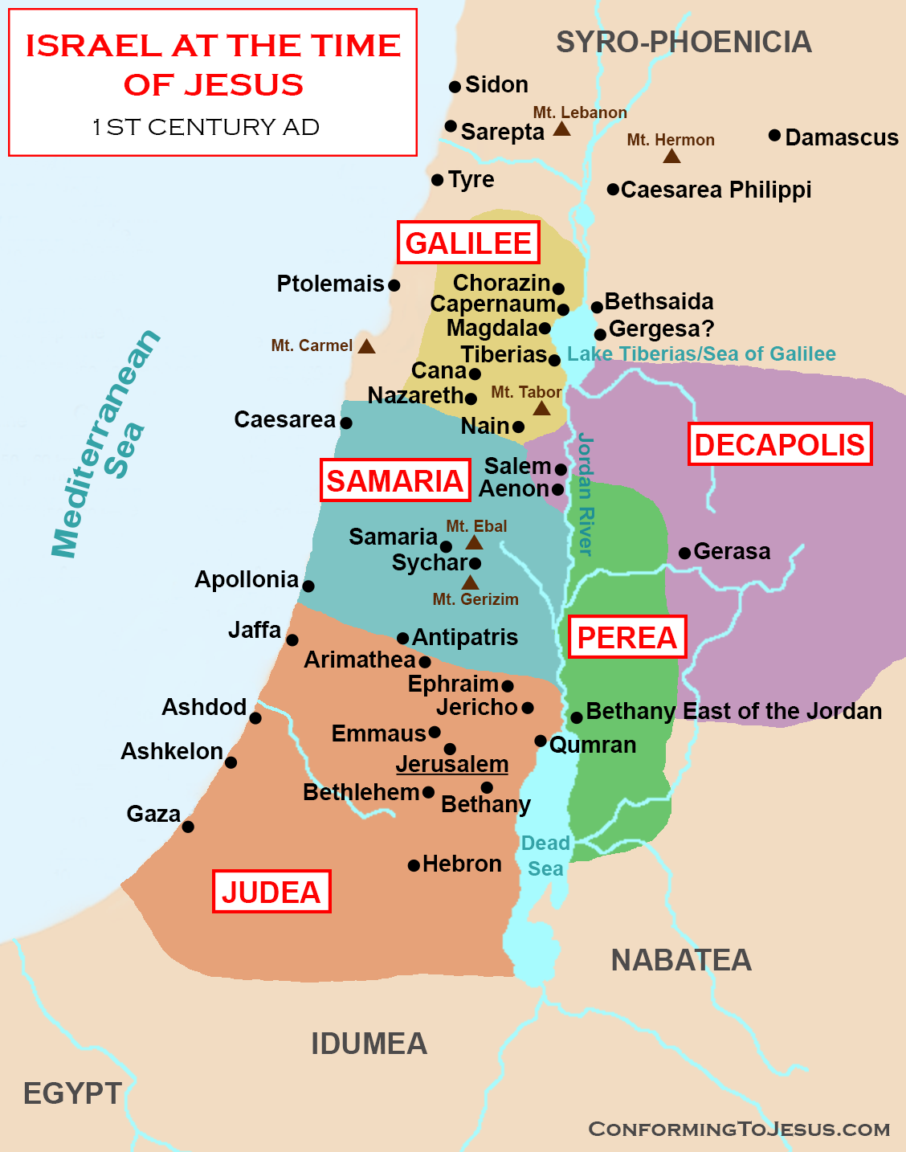
On the way to Jerusalem, Jesus travelled along the border between Samaria and Galilee.

Slide 6
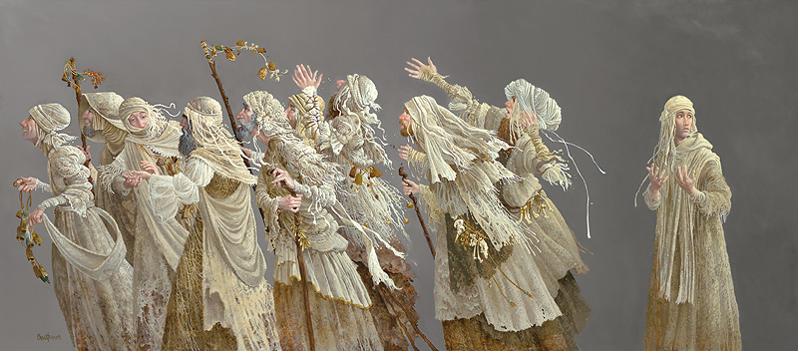
Finding himself cured, one of them turned back.
Notes:
TEN LEPERS
by James C. Christensen
Christensen was born in 1942 and raised in Culver City, California.
He specialises in fine art.
The "Ten Lepers" were a group of men cured of their disease through one of Christ's miracles. Their tattered wrappings suggest what was, until this moment, their illness. Of the ten, nine are too preoccupied celebrating their new lease on life to think of anything else, much yet thank him. The tenth, at this moment, grasps truly what has occurred. He is the only one that returns to acknowledge the Master.
This image provides an inspiring reminder to take a moment from our fast-paced world and reflect on what we have to be thankful for. And, just as importantly, to take the time to show this gratitude.

Slide 7





The man was a Samaritan.

Slide 8
Luke 17:11-19
The Gospel of the Lord
Praise to you, Lord Jesus Christ.

Slide 9
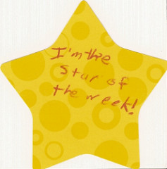

Slide 10


Slide 11
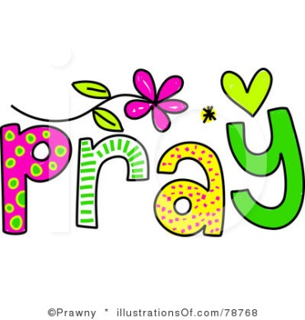


Let us pray.
Dear Lord,
As we reflect on the story of the ten lepers,
may we always remember to be thankful for Your blessings.
Amen.

Slide 12

How can we show our thanks to those around us, this week?
Notes:
GO FORTH - MISSION

