Slide 1

Notes:
WORD

Slide 2




prayer
Think about a time when you have prayed to ask God for something.
Talk to your partner about it.

Slide 3

Notes:
SYMBOLIC ACTION – FIRST AND LAST IN THE QUEUE

Slide 4
Luke 18:1-8
The Lord be with you.
And with your spirit
A reading from the Holy Gospel according to Luke.
Glory to you, O Lord.

Slide 5
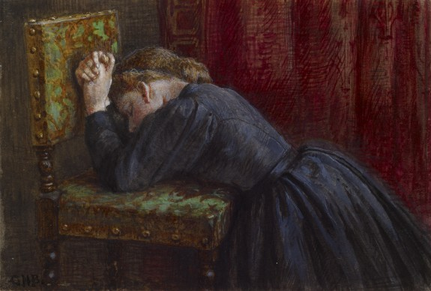
Woman Kneeling In Prayer
George Henry Boughton (1833-1905)

Slide 6



God, who is good, will help those who pray to Him every day.

Slide 7
Luke 18:1-8
The Gospel of the Lord
Praise to you, Lord Jesus Christ.

Slide 8


Slide 9


Slide 10



Let us pray.
Dear Lord,
We know that You will always listen to our prayers
and that You will always do what is best for us
and those we pray for.
Please keep our school, our friends and our families safe in Your love and care.
Amen.

Slide 11

Who will you pray for this week?
Notes:
GO FORTH - MISSION

