Slide 1

Notes:
WORD

Slide 2

Notes:
SYMBOLIC ACTION – FIRST AND LAST IN THE QUEUE

Slide 3
Luke 19:1-10
The Lord be with you.
And with your spirit
A reading from the Holy Gospel according to Luke.
Glory to you, O Lord.

Slide 4
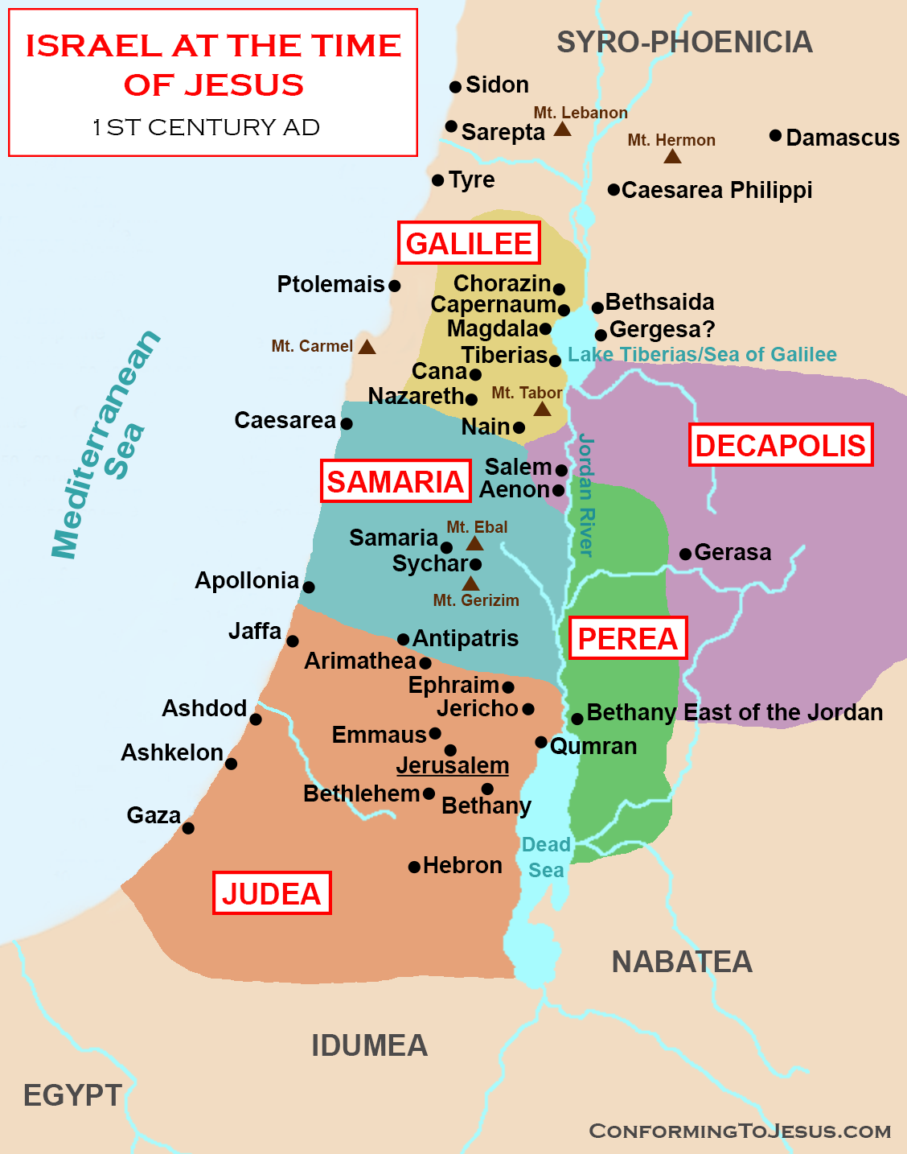
Jesus was going through Jericho, where a man called Zacchaeus lived.

Slide 5
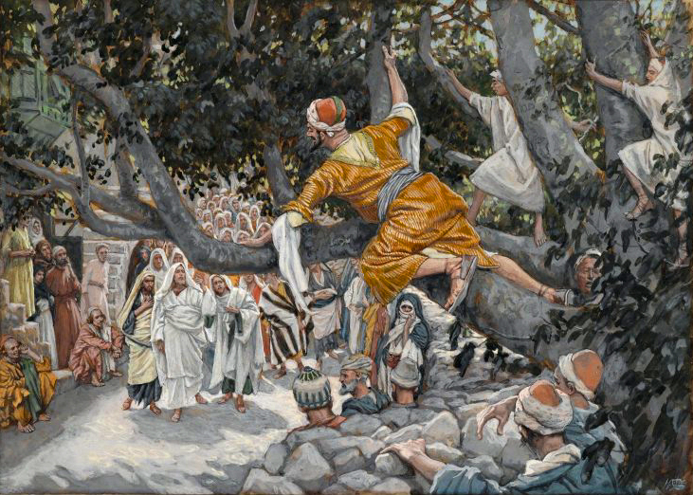
Zacchaeus
James Tissot (born in France)(1836–1902) : Zacchaeus in the Sycamore Awaiting the Passage of Jesus (between 1886 and 1894)

Slide 6
Luke 19:1-10
The Gospel of the Lord
Praise to you, Lord Jesus Christ.

Slide 7
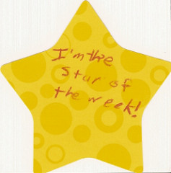

Slide 8


Slide 9



Let us pray.
Dear Lord Jesus,
We thank You for your generous love.
Please help us to welcome You always and to grow in generosity to You and to each other.
Amen.

Slide 10

How will you show your generosity to others this week?
Notes:
GO FORTH - MISSION

