Slide 1

Notes:
WORD

Slide 2

Notes:
SYMBOLIC ACTION – FIRST AND LAST IN THE QUEUE

Slide 3
Luke 21:5-19
The Lord be with you.
And with your spirit
A reading from the Holy Gospel according to Luke.
Glory to you, O Lord.

Slide 4
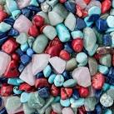
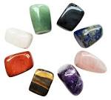

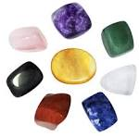
Some people were talking about the beautiful stones, which were used to build the temple and about the gifts that had been placed in it.

Slide 5

Jesus said, “Look around you. All this will come to an end and be forgotten but you won’t.
You and your goodness will be remembered and you will live forever.

Slide 6
Luke 21:5-19
The Gospel of the Lord
Praise to you, Lord Jesus Christ.

Slide 7
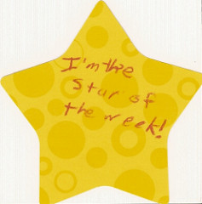

Slide 8


Slide 9



Let us pray.
Dear Lord Jesus,
Help us each day as we try to follow You.
Thank You for being our faithful friend.
Please help us to keep growing in faithfulness to You and to each other.
Amen.

Slide 10

How will you put some else’s needs before your own this week?
Notes:
GO FORTH - MISSION

