Slide 1

Notes:
WORD

Slide 2

Notes:
SYMBOLIC ACTION – FIRST AND LAST IN THE QUEUE

Slide 3
Luke 23:35-43
The Lord be with you.
And with your spirit
A reading from the Holy Gospel according to Luke.
Glory to you, O Lord.

Slide 4
Luke 23:35-43
The Gospel of the Lord
Praise to you, Lord Jesus Christ.

Slide 5
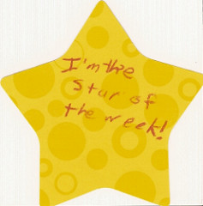

Slide 6


Slide 7



Let us pray.
Dear Lord Jesus,
Please help us to grow in the virtue of mercy.
Help us to be open to receiving your mercy and help us to show mercy to others.
Amen.

Slide 8

Merciful people do things out of their love and care for others and this helps to make this world a better place.
How will you make this world a better place this week?
Notes:
GO FORTH - MISSION

