Slide 1
Stay Awake (Laudate 72: 1, 2b, 3c)
Stay awake, be ready,
You do not know the hour when the Lord is coming.
Stay awake, be ready,
The Lord is coming soon!

Slide 2

Notes:
WORD

Slide 3

Notes:
SYMBOLIC ACTION – FIRST AND LAST IN THE QUEUE

Slide 4
Matthew 24:37-44
The Lord be with you.
And with your spirit
A reading from the Holy Gospel according to Matthew.
Glory to you, O Lord.

Slide 5
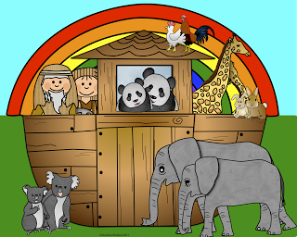

Slide 6
Stay Awake (Laudate 72: 1, 2b, 3c)
Stay awake, be ready,
You do not know the hour when the Lord is coming.
Stay awake, be ready,
The Lord is coming soon!

Slide 7


Slide 8
Stay Awake (Laudate 72: 1, 2b, 3c)
Stay awake, be ready,
You do not know the hour when the Lord is coming.
Stay awake, be ready,
The Lord is coming soon!

Slide 9
Matthew 24:37-44
The Gospel of the Lord
Praise to you, Lord Jesus Christ.

Slide 10


Slide 11


Slide 12



Let us pray.
Dear Lord Jesus,
Please help us to get ready during Advent to meet you with joy this Christmas and when You come again in Your glory.
Amen.

Slide 13
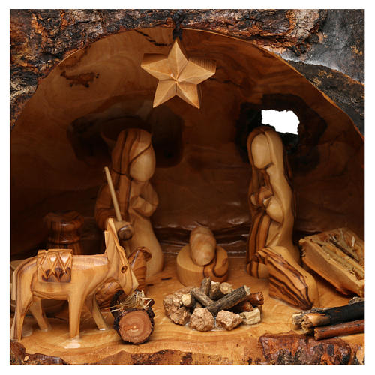

Advent helps us to get ready for Christmas. It is a time to make an extra effort to be more loving towards each other and to pray together.
This week, let’s all remember to say our prayers together at home and at school. We will all take turns in taking home a travelling crib!
Notes:
GO FORTH - MISSION

Slide 14
Stay Awake (Laudate 72: 1, 2b, 3c)
Stay awake, be ready,
You do not know the hour when the Lord is coming.
Stay awake, be ready,
The Lord is coming soon!

