Slide 1
Stay Awake (Laudate 72: 1, 2b, 3c)
Stay awake, be ready,
You do not know the hour when the Lord is coming.
Stay awake, be ready,
The Lord is coming soon!

Slide 2

Notes:
WORD

Slide 3

Notes:
SYMBOLIC ACTION – FIRST AND LAST IN THE QUEUE

Slide 4
Matthew 3:1-12
The Lord be with you.
And with your spirit
A reading from the Holy Gospel according to Matthew.
Glory to you, O Lord.

Slide 5
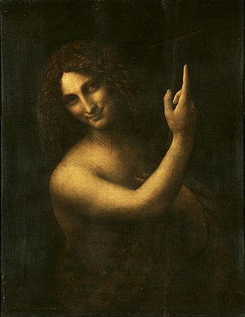
Saint John the Baptist (Leonardo da Vinci 1513-16 Louvre, Paris)

Slide 6
“Repent, change your ways; for the Kingdom of Heaven is close at hand.”

Slide 7
Stay Awake (Laudate 72: 1, 2b, 3c)
Stay awake, be ready,
You do not know the hour when the Lord is coming.
Stay awake, be ready,
The Lord is coming soon!

Slide 8
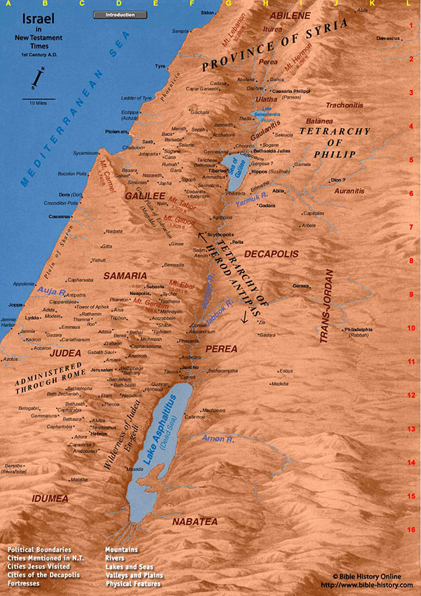

Slide 9
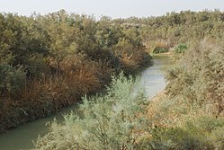
River Jordan

Slide 10
Matthew 3:1-12
The Gospel of the Lord
Praise to you, Lord Jesus Christ.

Slide 11


Slide 12


Slide 13



Let us pray.
Dear Lord Jesus,
Please help us to prepare our hearts this Advent and see if there are any ways that we could make a change for the better. Keep us close to You and help us to share Your love with everyone we meet.
Amen.

Slide 14
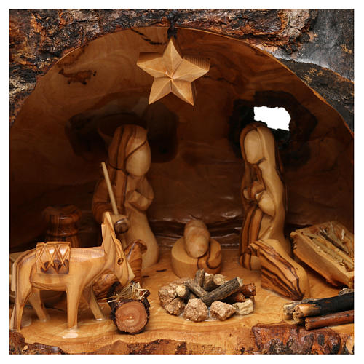

Advent helps us to get ready for Christmas. It is a time to make an extra effort to be more loving towards each other and to pray together.
This week, let’s continue to remember to say our prayers together at home and at school. We will all take turns in taking home a travelling crib!
Notes:
GO FORTH - MISSION

Slide 15
Stay Awake (Laudate 72: 1, 2b, 3c)
Stay awake, be ready,
You do not know the hour when the Lord is coming.
Stay awake, be ready,
The Lord is coming soon!

