Slide 1
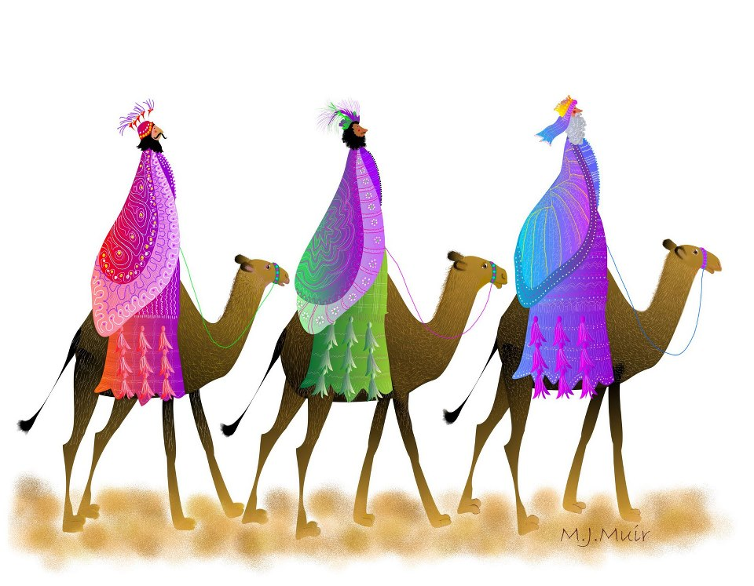

Slide 2
We three kings of orient are,
Bearing gifts we traverse afar
Field and fountain, moor and mountain,
Following yonder star.

Slide 3
Oh, star of wonder, star of night,
Star with royal beauty bright.
Westward leading, still proceeding,
Guide us with thy perfect light.

Slide 4

Notes:
WORD

Slide 5

Dear Lord,
Please bless our school
As we try to
Love, learn,
Share and respect
In the light of Jesus.
St Alban, pray for us.
Amen

Slide 6

Notes:
SYMBOLIC ACTION – FIRST AND LAST IN THE QUEUE

Slide 7
Matthew 2:1-12
The Lord be with you.
And with your spirit
A reading from the Holy Gospel according to Matthew.
Glory to you, O Lord.

Slide 8

We saw His star in the East and have come to worship Him.

Slide 9
Matthew 2:1-12
The Gospel of the Lord
Praise to you, Lord Jesus Christ.

Slide 10


Slide 11


Slide 12



Let us pray.
God of wonder,
Help us to have as much faith as the Wise Men
Who followed Your star to find Jesus.
Lead us down the right paths and
Help us to recognise Jesus in the people we meet
as we travel
through life.
Amen.

Slide 14
We three kings of orient are,
Bearing gifts we traverse afar
Field and fountain, moor and mountain,
Following yonder star.

Slide 15
Oh, star of wonder, star of night,
Star with royal beauty bright.
Westward leading, still proceeding,
Guide us with thy perfect light.

