Slide 1

Notes:
WORD

Slide 2

Dear Lord,
Please bless our school
As we try to
Love, learn,
Share and respect
In the light of Jesus.
St Alban, pray for us.
Amen

Slide 3

Notes:
SYMBOLIC ACTION – FIRST AND LAST IN THE QUEUE

Slide 4
Matthew 4:12-23
The Lord be with you.
And with your spirit
A reading from the Holy Gospel according to Matthew.
Glory to you, O Lord.

Slide 5
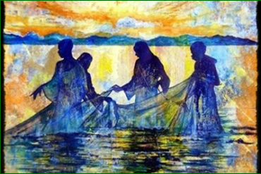

Slide 6
Matthew 4:12-23
The Gospel of the Lord
Praise to you, Lord Jesus Christ.

Slide 7
Follow me.

Slide 8


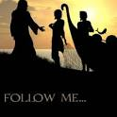



Let us pray.
Loving Father,
Help us to follow Jesus’ call to love as He loves
And to forgive as He forgives
So that the world will know that we are God’s children
Amen.

Slide 9


Slide 10


Slide 11
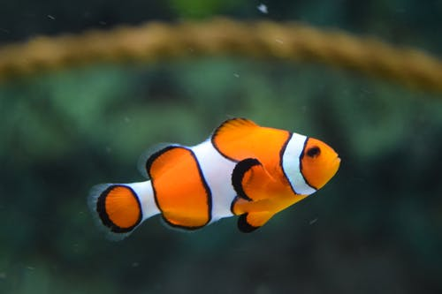
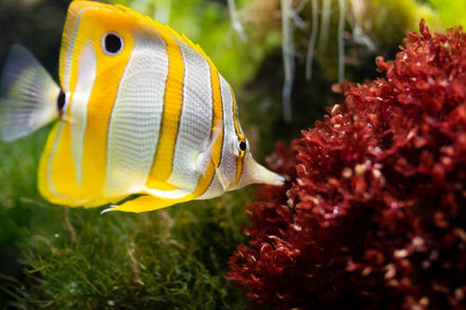
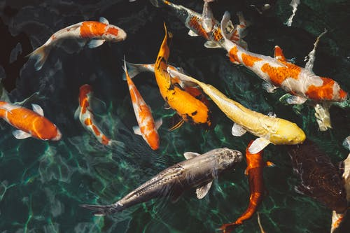
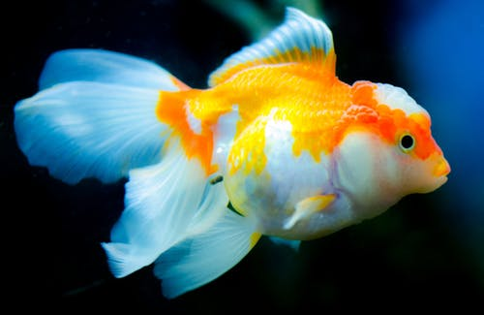

Slide 12
How can you show that you are following the example of Jesus, this weekend?
Notes:
GO FORTH - MISSION

Slide 13
Let us pray.
Loving Father,
Help us to follow Jesus’ call to love as He loves
And to forgive as He forgives
So that the world will know that we are God’s children
Amen.

