Slide 1
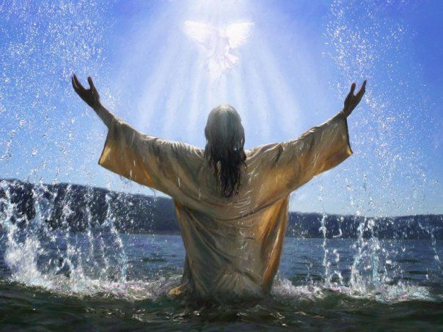

No sooner had Jesus come up out of the water than he saw the heavens torn apart and the Spirit, like a dove, descending on him.

Slide 2
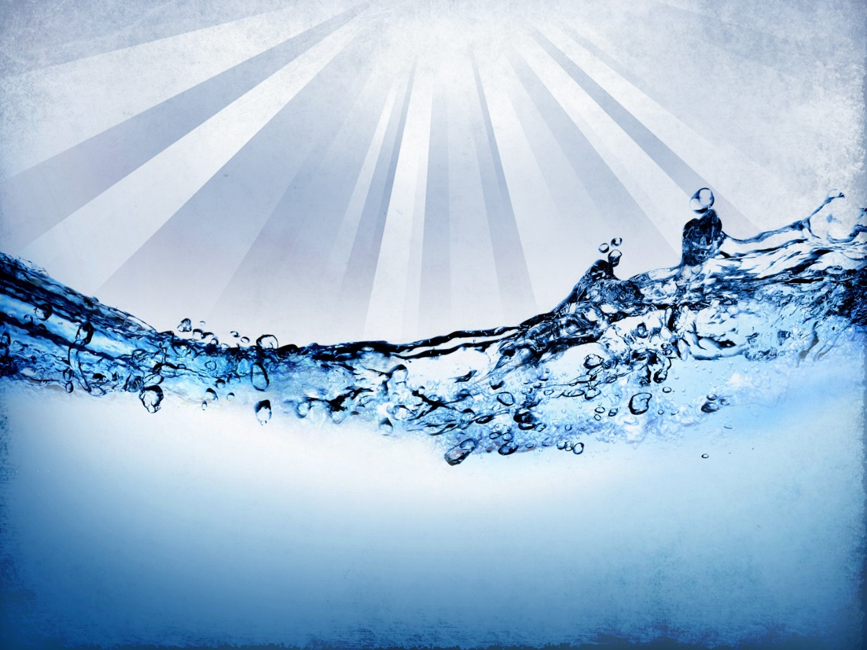
Then a voice from heaven said, “You are my son, the Beloved; my favour rests on you.”

Slide 3

Mark 1:7-11
The Gospel of the Lord
Praise to you, Lord Jesus Christ.

Slide 4
Baptism
In this Gospel reading, Jesus is baptised. He begins his mission to the world when the Holy Spirit comes down upon him - the same Spirit we receive through Baptism.
Baptism is a sacrament, which brings us closer to God.
When we are baptised, we receive the Holy Spirit, to help us to live like Jesus.

Slide 5
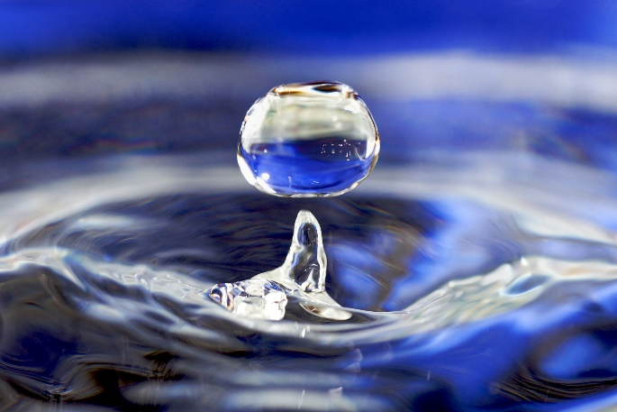
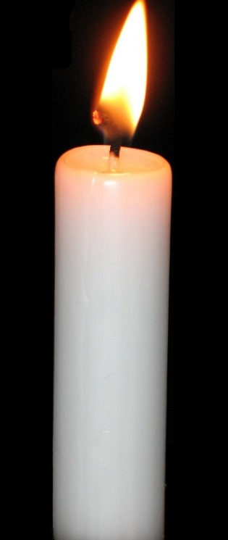

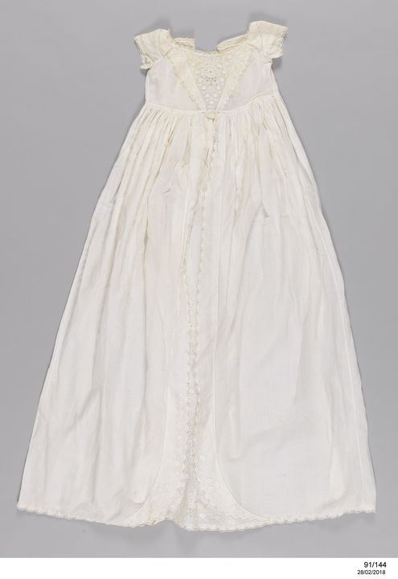
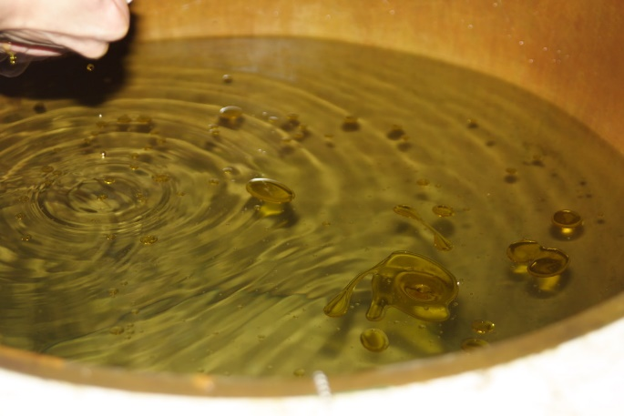

Slide 6



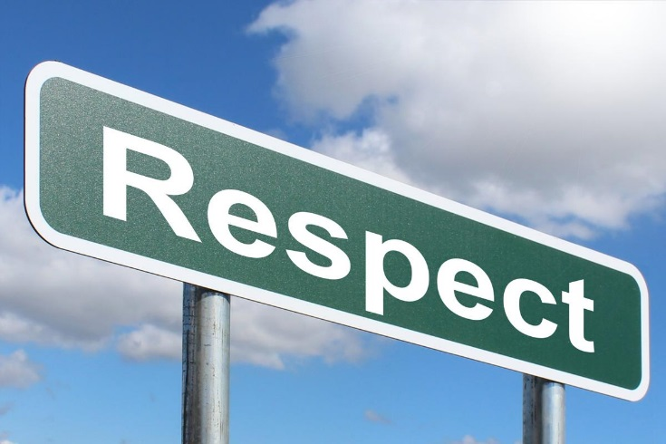

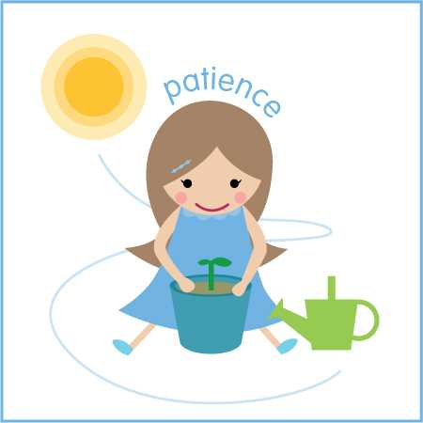
How can we live more like Jesus?

Slide 7


Slide 8
Reception - George & Jacob
Year 1 - Naomi & Mason
Year 2 - Fraser & William
Year 3 - George & Bethany
Year 4 - Erika & Kieron
Year 5 - Kai & Patrycja
Year 6 - Carter, Jack & Brianna

Slide 9


Slide 10

How can we try to live more like Jesus, this week?
Notes:
GO FORTH - MISSION

Slide 11



Dear Lord Jesus,
Thank you for the gift of Baptism.
Please help us to live like you and to spread God’s love throughout this new year.
Amen.

Slide 12
Thank you for taking part in our Good News Assembly!

