Slide 1


Good News Assembly 11.1.21
This is the day that the Lord has made!

Slide 2

Welcome, everyone!

Slide 3

Notes:
WORD

Slide 4
Hail Mary
Hail Mary, full of grace
The Lord is with thee.
Blessed art thou among women
And blessed is the fruit
Of thy womb, Jesus.
Holy Mary, mother of God,
Pray for us sinners now
And at the hour of our death.
Amen

Slide 5
Dear Lord,
Please bless our school
As we try to
Love, learn,
Share and respect
In the light of Jesus.
St Alban, pray for us.
Amen

Slide 6
The Feast of the Baptism of Our Lord
Yesterday, we celebrated the Feast of the Baptism of Our Lord.
In the Gospel reading, we hear the wonderful account of Jesus’ Baptism and we can reflect on the beautiful sacrament of Baptism.

Slide 7

Notes:
SYMBOLIC ACTION – FIRST AND LAST IN THE QUEUE

Slide 8
Mark 1:7-11
The Lord be with you.
And with your spirit
A reading from the Holy Gospel according to Mark.
Glory to you, O Lord.

Slide 9
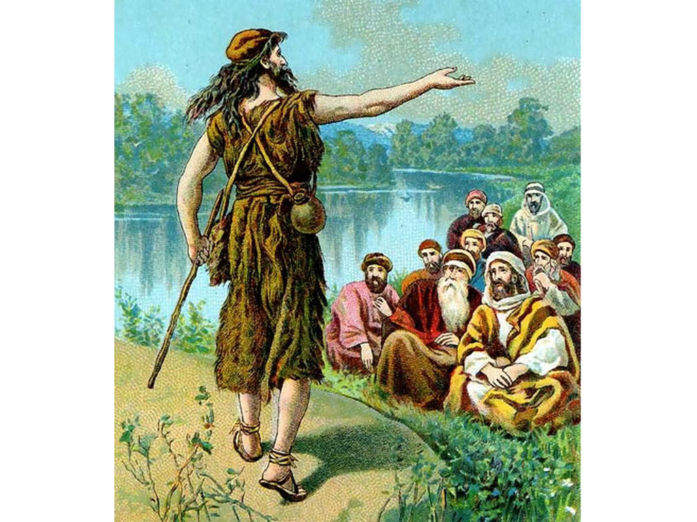
When John the Baptist was preaching, he said, “Someone is following me, someone who is more powerful than I am, and I am not fit to kneel down and undo the straps of his sandals.”

Slide 10

I have baptised you with water

Slide 11
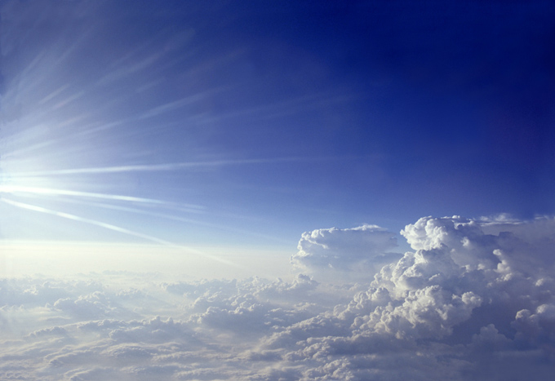
but he will baptise you with the Holy Spirit.

Slide 12
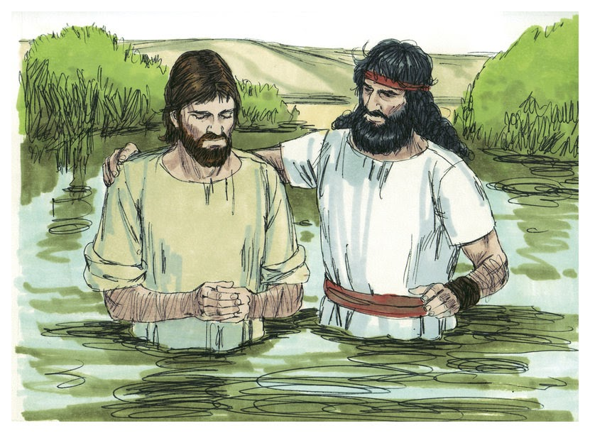
It was at this time that Jesus came from Nazareth in Galilee and was baptised by John in the River Jordan.

