Slide 1
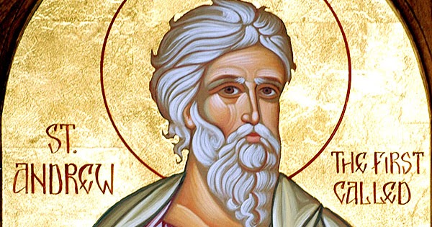

One of these two (who became followers of Jesus after hearing what John had said) was Andrew, the brother of Simon Peter.

Slide 2
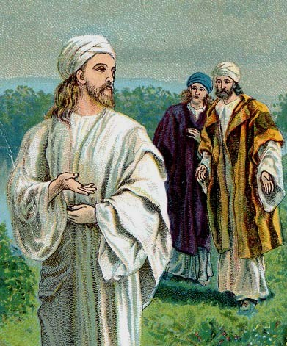
Early next morning, Andrew met his brother and said to him, “We have found the Messiah,” - which means the Christ - and he took Simon to Jesus.

Slide 3
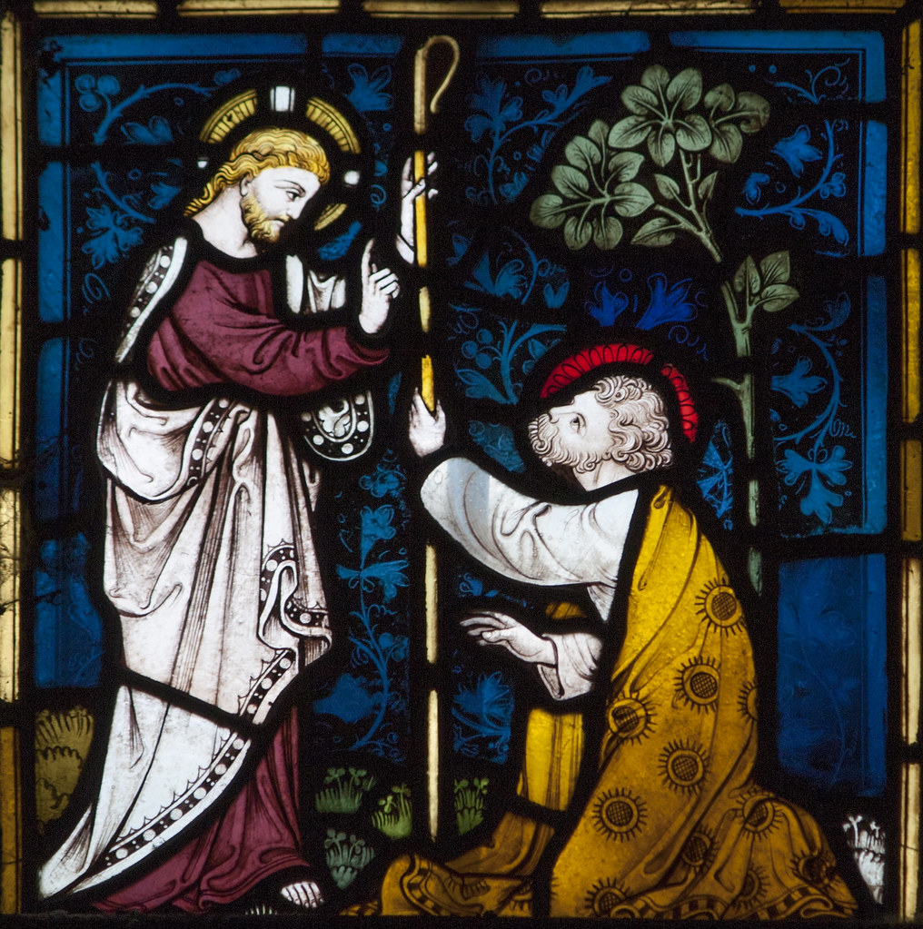
Jesus looked hard at him and said, “You are Simon son of John; you are to be called Cephas,” – meaning Rock.

Slide 4

John 1:35-42
The Gospel of the Lord
Praise to you, Lord Jesus Christ.

Slide 5
Cephas – Aramaic
Peter – Greek
Stone / Rock

Slide 6

“Yesterday is gone. Tomorrow has not yet come. We have only today. Let us begin.”
St Teresa of Calcutta

Slide 7


Slide 8
Reception - Olivia & Brooke
Year 1 - Flynn & Anna
Year 2 - Harry & Austin
Year 3 - Leonie & Maddison
Year 4 - Milly & Wojciech
Year 5 - Ben & Charlie
Year 6 - George & Phoebe

Slide 9


Slide 10

Is there anyone we need to make a new start with this week ?
Notes:
GO FORTH - MISSION

Slide 11



Dear Lord Jesus,
Please help me to be always ready to make a new start with you and with others as we start this new year.
Amen.

Slide 12
Thank you for taking part in our Good News Assembly!

