Slide 1


Good News Assembly 18.1.21
This is the day that the Lord has made!

Slide 2

Welcome, everyone!

Slide 3

Notes:
WORD

Slide 4
Hail Mary
Hail Mary, full of grace
The Lord is with thee.
Blessed art thou among women
And blessed is the fruit
Of thy womb, Jesus.
Holy Mary, mother of God,
Pray for us sinners now
And at the hour of our death.
Amen

Slide 5
Dear Lord,
Please bless our school
As we try to
Love, learn,
Share and respect
In the light of Jesus.
St Alban, pray for us.
Amen

Slide 6

new starts

Slide 7
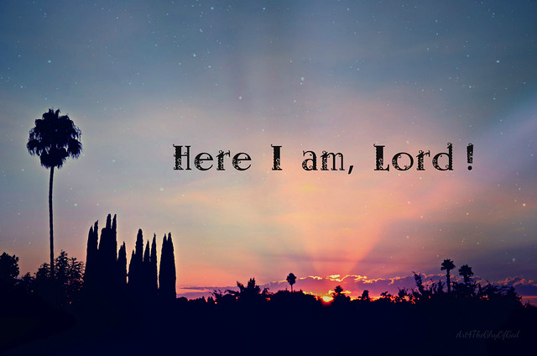
Samuel

Slide 8
new starts

Slide 9

Notes:
SYMBOLIC ACTION – FIRST AND LAST IN THE QUEUE

Slide 10
John 1:35-42
The Lord be with you.
And with your spirit
A reading from the Holy Gospel according to John.
Glory to you, O Lord.

Slide 11
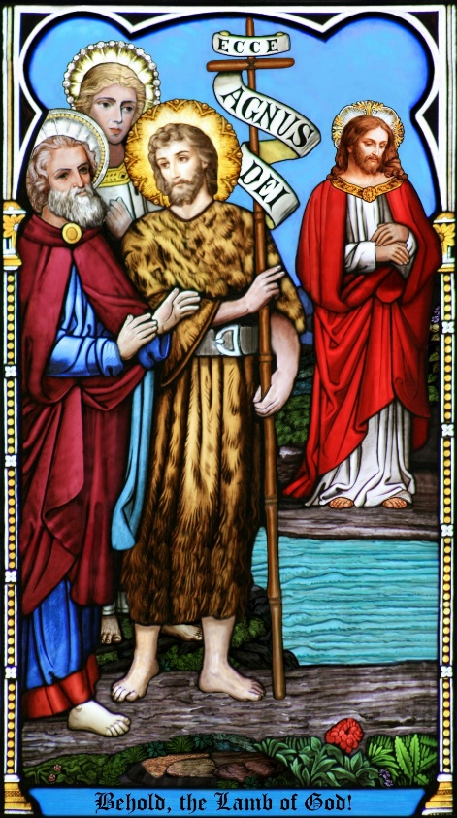
As John stood with two of his disciples, Jesus passed, and John stared hard at him and said, “Look, there is the lamb of God.” Hearing this, the two disciples followed Jesus.

Slide 12

Jesus turned round, saw them following and said, “What do you want?” They answered, “Rabbi,” – which means Teacher –“where do you live?” “Come and see,” he replied; so they went and saw where he lived, and stayed with him the rest of that day. It was about the tenth hour.

