Slide 1
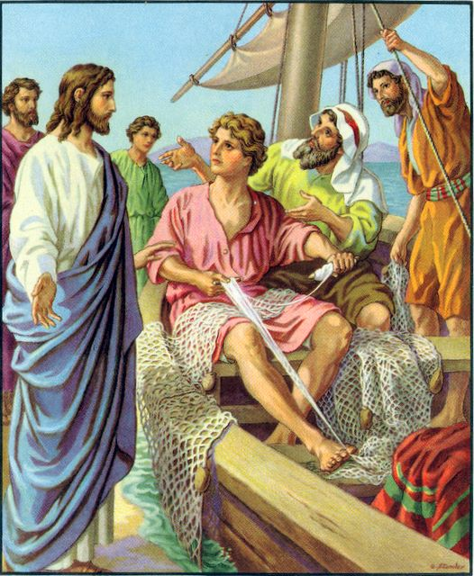

Going on a little further, he saw James, son of Zebedee, and his brother John; they too were in their boat, mending their nets.

Slide 2
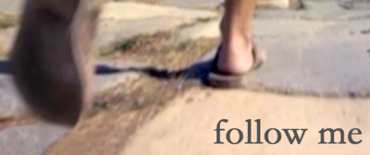
He called them at once and, leaving their father Zebedee in the boat with the men he employed, they went after him.

Slide 3

Mark 1:14-20
The Gospel of the Lord
Praise to you, Lord Jesus Christ.

Slide 4
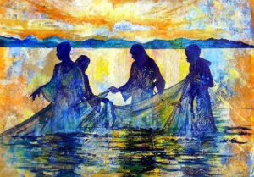
Fishers of Men

Slide 5
Follow me

Slide 6



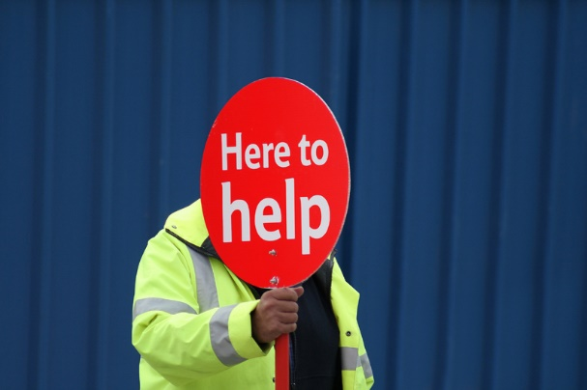




How can we follow in Jesus’ footsteps?

Slide 7


Slide 8
Reception - Adam & William
Year 1 - James & Iniya
Year 2 - Lucas & Edward
Year 3 - Farhan & Oscar
Year 4 - Srikrish & Jessie
Year 5 - Nadia & Lucy
Year 6 - Alanna & Klaudia

Slide 9


Slide 10

How can we follow Jesus more closely this week ?
Notes:
GO FORTH - MISSION

Slide 11



Dear Lord Jesus,
Please help me as I try to follow in your footsteps in what I say and do each day.
Amen.

Slide 13
Thank you for taking part in our Good News Assembly!

