Slide 1


Good News Assembly 25.1.21
This is the day that the Lord has made!

Slide 2

Welcome, everyone!

Slide 3

Notes:
WORD

Slide 4
Hail Mary
Hail Mary, full of grace
The Lord is with thee.
Blessed art thou among women
And blessed is the fruit
Of thy womb, Jesus.
Holy Mary, mother of God,
Pray for us sinners now
And at the hour of our death.
Amen

Slide 5
Dear Lord,
Please bless our school
As we try to
Love, learn,
Share and respect
In the light of Jesus.
St Alban, pray for us.
Amen

Slide 6
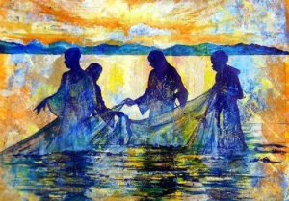

Slide 7
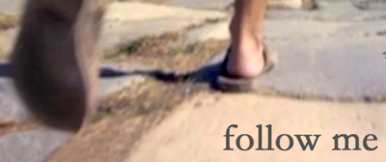
Follow me

Slide 8
Fishers of Men

Slide 9

Notes:
SYMBOLIC ACTION – FIRST AND LAST IN THE QUEUE

Slide 10
Mark 1:14-20
The Lord be with you.
And with your spirit
A reading from the Holy Gospel according to Mark.
Glory to you, O Lord.

Slide 11

After John had been arrested, Jesus went into Galilee. There he proclaimed the Good News from God. “The time has come,” he said, “and the kingdom of God is close at hand. Repent, and believe the Good News.”

Slide 12
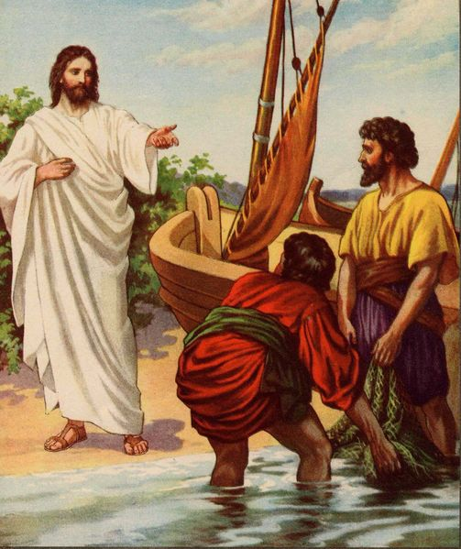
As he was walking along by the Sea of Galilee, he saw Simon and his brother Andrew casting a net in the lake - for they were fishermen.

Slide 13
And Jesus said to them, “Follow me and I will make you into fishers of men.” And at once they left their nets and followed him.

