Slide 1


Good News Assembly 1.2.21
This is the day that the Lord has made!

Slide 2

Welcome, everyone!

Slide 3

Notes:
WORD

Slide 4
Hail Mary
Hail Mary, full of grace
The Lord is with thee.
Blessed art thou among women
And blessed is the fruit
Of thy womb, Jesus.
Holy Mary, mother of God,
Pray for us sinners now
And at the hour of our death.
Amen

Slide 5
Dear Lord,
Please bless our school
As we try to
Love, learn,
Share and respect
In the light of Jesus.
St Alban, pray for us.
Amen

Slide 6




Jesus the teacher

Slide 7

Notes:
SYMBOLIC ACTION – FIRST AND LAST IN THE QUEUE

Slide 8
Mark 1:21-28
The Lord be with you.
And with your spirit
A reading from the Holy Gospel according to Mark.
Glory to you, O Lord.

Slide 9
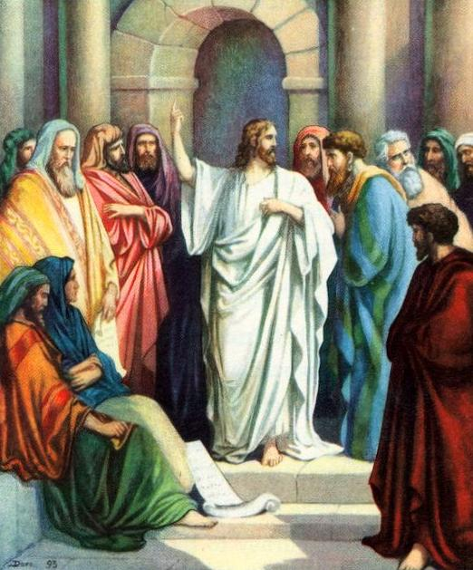
Jesus and his followers went as far as Capernaum, and as soon as the sabbath came, Jesus went to the synagogue and began to teach.

Slide 10
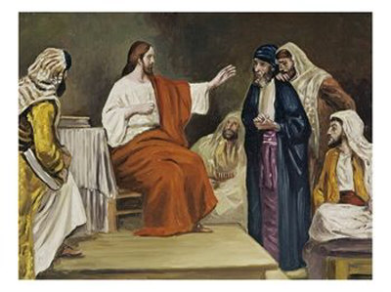
Jesus’ teaching made a deep impression on them because, unlike the scribes, he taught them with authority.

Slide 11
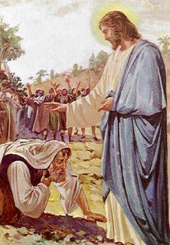
While he was teaching, Jesus was interrupted by a very sick man who started to shout wildly and whose body was trembling and shaking so Jesus paused and healed the sick man in full view of the people.

Slide 12
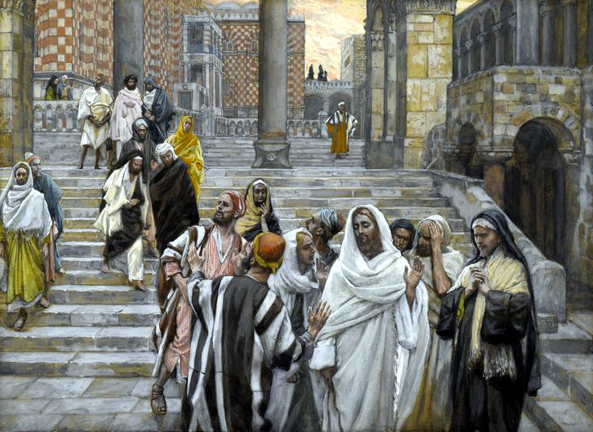
The people were so astonished that they started asking each other what it all meant. “Here is a teaching that is new,” they said, “and with authority behind it.”

Slide 13
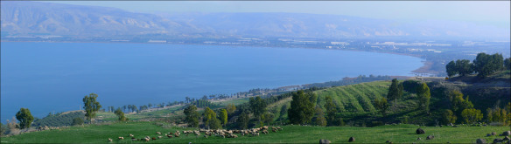
And his reputation rapidly spread everywhere, through all the surrounding Galilean countryside.

Slide 14
Mark 1:21-28
The Gospel of the Lord
Praise to you, Lord Jesus Christ.

Slide 15


Slide 16
Reception - Missy-Bluebell & Lily
Year 1 - Chloe & Noah
Year 2 - Louie & Evie
Year 3 - Eloisa & Oliwia
Year 4 - Bo & Jenna
Year 5 - Phoebe & Paul
Year 6 - Abi & Dylan

Slide 17


Slide 18

Jesus the teacher

Slide 19
How can we show kindness this week ?
Notes:
GO FORTH - MISSION

Slide 20



Dear Lord Jesus,
Please help us to always be kind to each other, as you have taught us.
Amen.

Slide 21
Thank you for taking part in our Good News Assembly!

