Slide 1


Good News Assembly 8.2.21
This is the day that the Lord has made!

Slide 2

Welcome, everyone!

Slide 3

Notes:
WORD

Slide 4
Hail Mary
Hail Mary, full of grace
The Lord is with thee.
Blessed art thou among women
And blessed is the fruit
Of thy womb, Jesus.
Holy Mary, mother of God,
Pray for us sinners now
And at the hour of our death.
Amen

Slide 5
Dear Lord,
Please bless our school
As we try to
Love, learn,
Share and respect
In the light of Jesus.
St Alban, pray for us.
Amen

Slide 6

5 minutes peace!

Slide 7



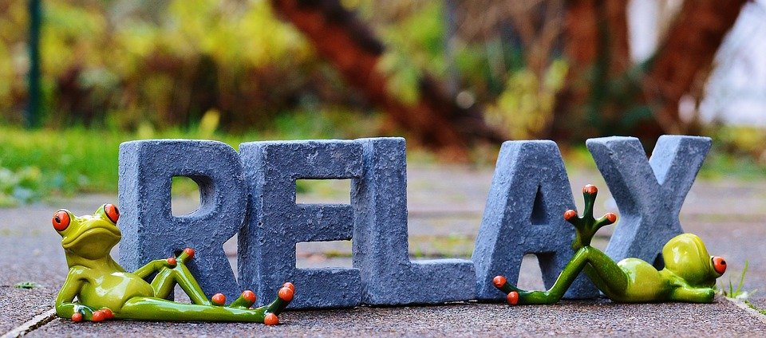
Why do we need peace and quiet?

Slide 8
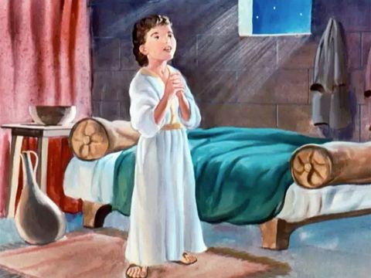
Can you remember what Samuel said?
“Speak Lord. Your servant is listening.”

Slide 9
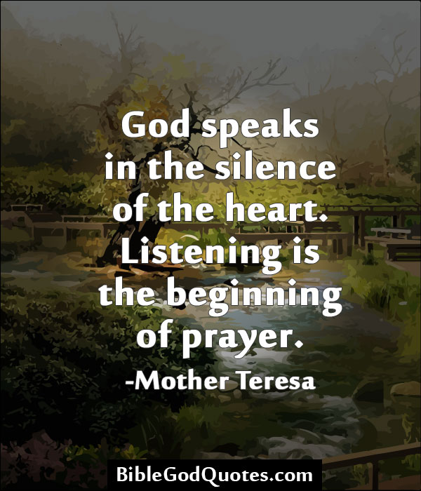
Why do we need peace and quiet?

Slide 10

Notes:
SYMBOLIC ACTION – FIRST AND LAST IN THE QUEUE

Slide 11
Mark 1:29-39
The Lord be with you.
And with your spirit
A reading from the Holy Gospel according to Mark.
Glory to you, O Lord.

Slide 12
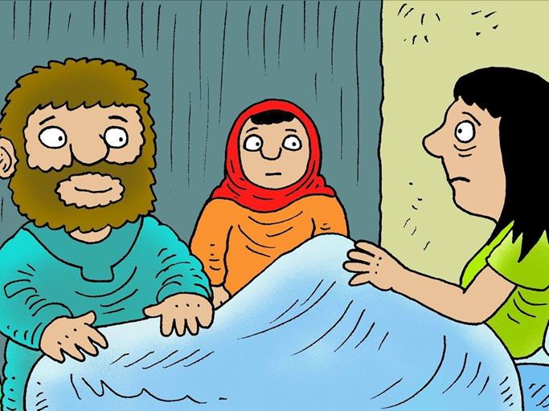
After teaching and praying in the synagogue, Jesus went to Simon and Andrew’s house. There, they found that Simon’s mother-in-law had gone to bed with fever.

